Slide 1
Random Forest CS4131 – Machine Learning
Faculty pic
Sudip Sanyal
Date: 14/11/2022

Slide 2
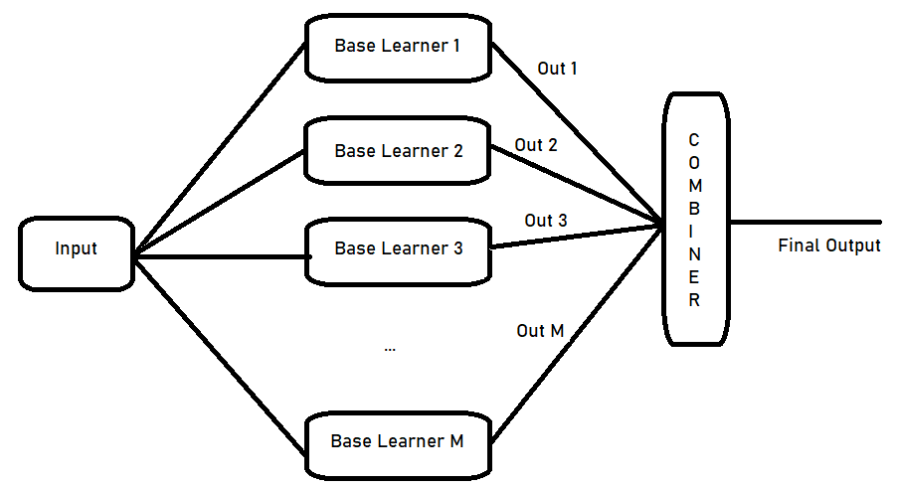
Recap: Schematic Diagram of Combining Learners

Slide 3
Recap: Bagging
Bootstrap Aggregation = Bagging
Prepare M different subsets of training set
Build M decision trees with these subsets
- Each tree is a different model
- Decision trees have high variance
The combiner takes M decisions and aggregates them
- Simple majority voting for classification
- Simple averaging for regression
Bagging reduced the variance error!
Bagging leads to parallel learners! Each learns independently of the others.

Slide 4
Recap: Boosting
Different models are generated sequentially
The first model makes some mistakes
The next model focuses on them and tries to remove them
There may be residual errors
Each subsequent model focuses on the errors of the previous model and tries to remove them
Thus, mistakes of previous models are learned by their successors
Exploits dependency between models
- gives higher weights to misclassified samples
Boosting reduces bias error

Slide 5
Random Forest – some key benefits
A very powerful ensemble method
Used frequently to win many Kaggle competitions
Can be used for classification and regression
Produces “importance of features” as a byproduct
Can be used to detect outliers
Can be used to detect novel samples

Slide 6
Wisdom of crowds
A large number of relatively uncorrelated models (trees) operating as a committee will outperform any of the individual constituent models
Example: Investments with low correlations (like stocks) form a portfolio - low variance error
Uncorrelated models give ensemble predictions -more accurate than individual predictions
Trees protect each other from their individual errors
- so long as they don’t all err in the same direction
- While some trees may be wrong, many other trees will be right

Slide 7
Random Forest – the basic idea
Random Forest is basically a bagging approach
Creates a forest of decision trees
In conventional bagging, randomization is w.r.t. training samples
In Random Forest randomization is w.r.t.
- training samples
- features used in individual decision trees
Leads to low variance errors and estimate of importance of individual features

Slide 8
Random Forest – the basic idea contd.
Basic steps of Random Forest:
For each tree in the Forest:
If the number of cases in the training set is N, sample N cases at random - but with replacement, from the original data. This is the training set for growing the tree.
If there are M features, a number m<<M is specified such that at each node, m variables are selected at random out of the M and the best split on these m is used to split the node.
The value of m (a hyperparameter) is held constant during the forest growing.
Each tree is grown to the largest extent possible. There is no pruning.

Slide 9
Forest error rates
The error rate of Random Forest depends on two factors
- The correlation between any two trees in the forest.
- Increasing the correlation increases the forest error rate.
- The strength of each individual tree in the forest.
- A tree with a low error rate is a strong classifier.
- Increasing the strength of the individual trees decreases the forest error rate.

Slide 10
Forest error rates contd.
Increasing the value of ‘m’
- increases correlation between trees
- i.e. increases the error rate
- increases strength of the individual trees
- i.e. decreases the error rate
Thus, it is critical to find an optimal value of ‘m’

Slide 11
Out-of-bag (OOB) samples
Recall that for building a tree
- Given N samples, we generate a training set of size N
- The training set is chosen at random, with replacement
Some samples will get repeated
Some others will not be used for building a tree
- May be used for building some other tree in the Forest
The samples that are not used for building a tree are called
Out-of-bag (OOB) samples
We have ~1/3rd samples as OOB for a particular tree

Slide 12
Using OOB samples for error estimates
All OOB samples of a tree are used as test samples for that tree
Thus, OOB samples give the error rates for specific trees
At the end of the run, take j to be the class that got most of the votes every time sample ‘n’ was oob
- i.e. majority voting as in normal bagging
oob error estimate = the proportion of times that j is not equal to the true class averaged over all samples
This has proven to be unbiased in many tests
No need to do cross validation

Slide 13
Estimating importance of features
Suppose we want to estimate the importance of j-th feature
For every tree in the forest
- test accuracy of tree using oob samples = A
- randomly permute values of j-th feature in oob set to get a new test set
- test the accuracy of this new set = B
- If B almost equal to A then what does it say about feature j?
- Subtract number of votes for correct class in the new test set from
number of votes for the correct class in original oob set
- The average of this number over all trees in the forest is the raw importance score for j-th feature

Slide 14
Proximity of samples
Given N samples, we can define a NxN proximity matrix, Prox
The matrix is symmetric, positive-definite
The Prox(i, j) is a measure of proximity of i-th and j-th sample
The process
For all sample pairs (i, j)
- Initialize Prox(i, j) = 0
- Test i-th and j-th sample on all trees in the forest
- If both samples exit through the same leaf node in a tree, increment Prox(i, j) by one
Divide Prox(i, j) by total number of trees

Slide 15
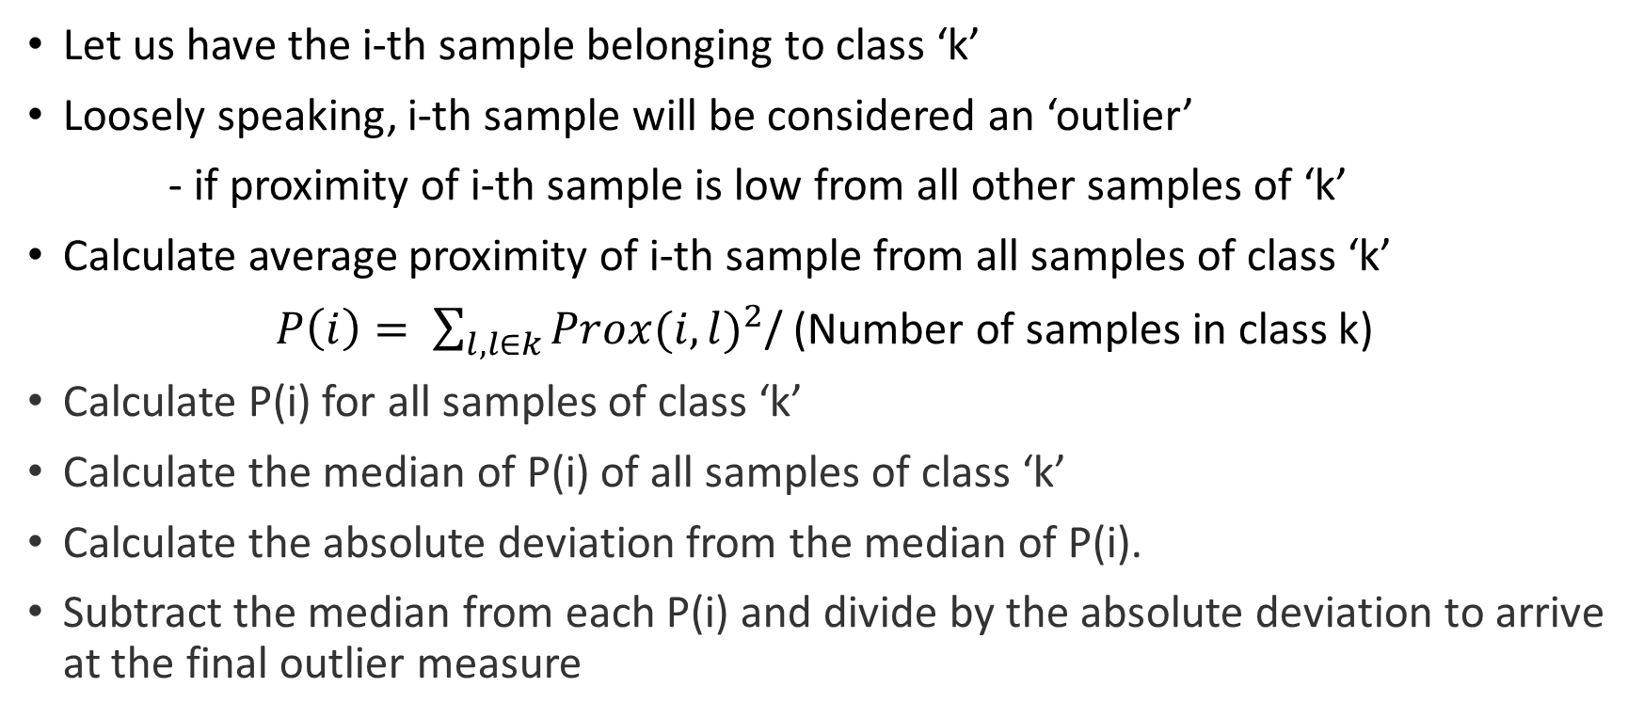
Outlier detection
Let us have the i-th sample belonging to class ‘k’
Loosely speaking, i-th sample will be considered an ‘outlier’
- if proximity of i-th sample is low from all other samples of ‘k’
Calculate average proximity of i-th sample from all samples of class ‘k’
$P\left(i\right)= \sum_{l, l∈k}{Prox(i,l)^{2}}$/ (Number of samples in class k)
Calculate P(i) for all samples of class ‘k’
Calculate the median of P(i) of all samples of class ‘k’
Calculate the absolute deviation from the median of P(i).
Subtract the median from each P(i) and divide by the absolute deviation to arrive at the final outlier measure

Slide 16
Novelty detection
A sample is “novel” if it does not fit with any class
Useful for continuous learning where new samples may belong to a new class
If a sample is an outlier of every class then it is a novelty
This is a powerful way of discovering new classes in streaming data

Slide 17
Keywords
<Supervised Learning>
<Ensemble Learning>
<Random Forest>
<Importance of features>
<Proximity of Samples>
<Outlier Detection>
<Novelty Detection>

Slide 18
Thank you

