Slide 1
Simulation of group behaviour during a protest
Authors: Nik Čadež, Pedro Macedo, Primož Mihelak, Luka Bajić
University of Ljubljana, Faculty of Computer and Information Science

Slide 2
Structure
Ideas and motivation
Overview of related work
Methods and crucial implementation details
Experiments and observations
Conclusions, ideas for future work

Slide 3
Objectives
Create believable crowd behaviour with multiple subgroups
Simulate the emergence of a leader during a protest
Give user the option to place police agents as barricades anywhere on the map
Related work:
Lemos, et. al. – Agent Based modeling of protests and violent confrontation (2014)
Itatani, Pelechano – Social Crowd Simulation (2024)
Clements, Fadai – Agent-based modelling of sports riots (2022)

Slide 4
Subgroups
Main division:
Active protesters
Bystanders
Leader
Additional indexing for the purposes of leader hierarchy
Static police agents added during runtime as obstacles for the other agents

Slide 5
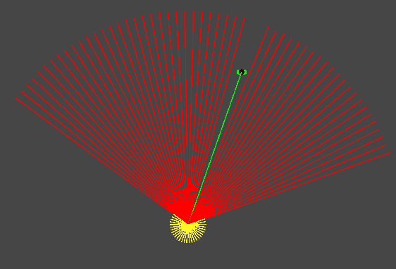
Vision
Divided into field of view and peripersonal space
Look around function for various purposes

Slide 6
Movement
Four main states:
Stationary
In-motion
Herd
disperse
End-Position-Seeking-Behaviour
Leader Following Behaviour
Other forces: Wall avoidance, collision avoidance

Slide 7
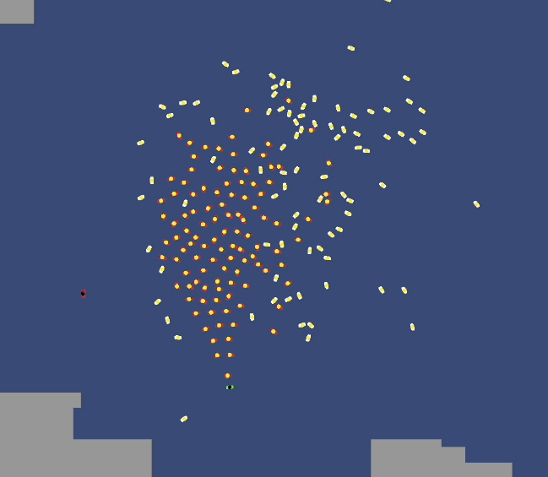
Leader following and hierarchy
Leader identification
Herd mentality for the purpose of following
Hierarchy of followers
Leader unidentification and eventual herd dispersal

Slide 8
Emotional contagion
Idea: simulate internal forces in humans
Two parameters: defection and recruitment + temporal component
Agents occasionally change state between protester and bystander
Change should depend on agent’s surroundings, but also have an element of randomness

Slide 9
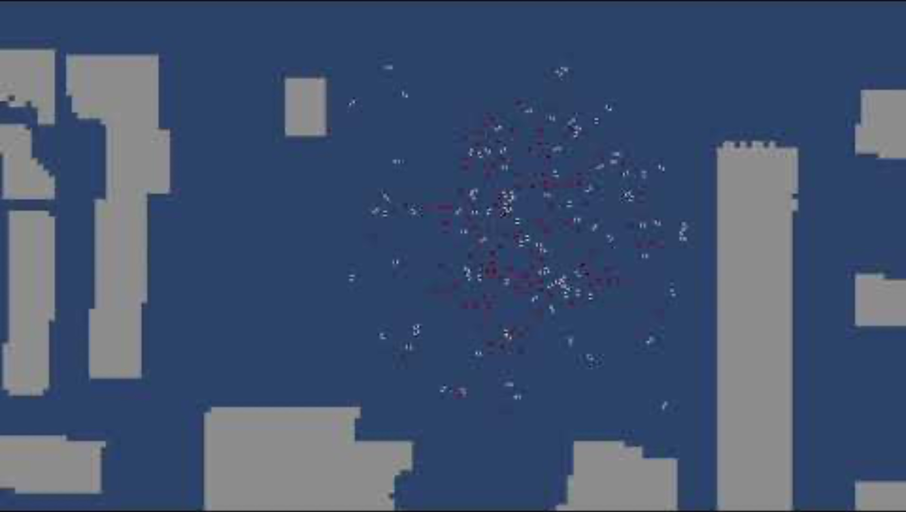
End-position-seeking-behaviour

Slide 10
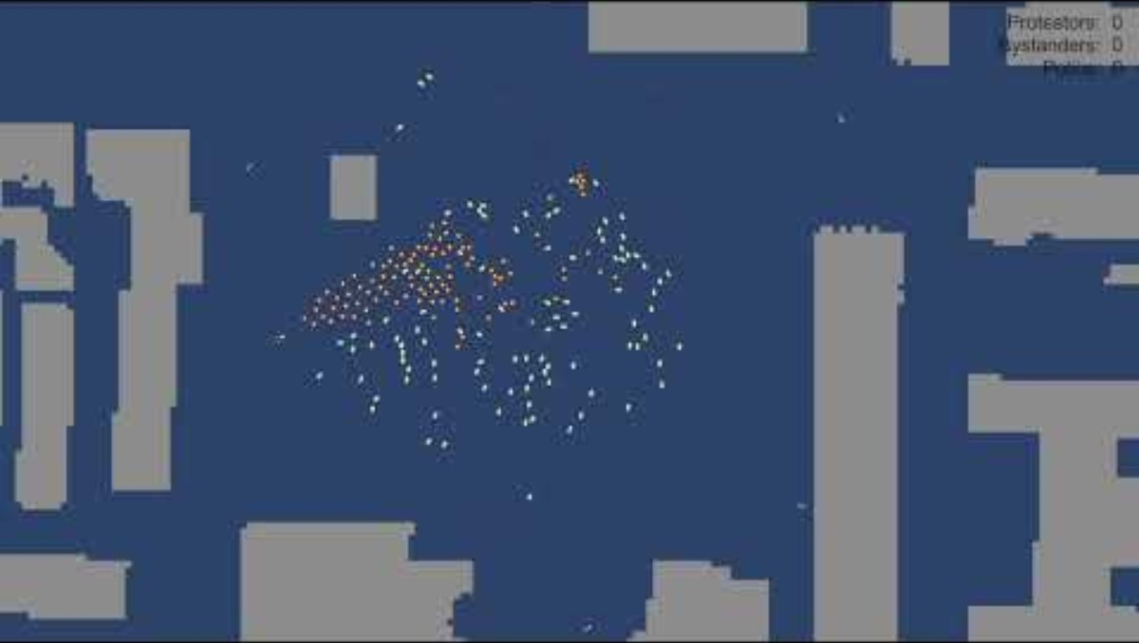
Leader identification

Slide 11
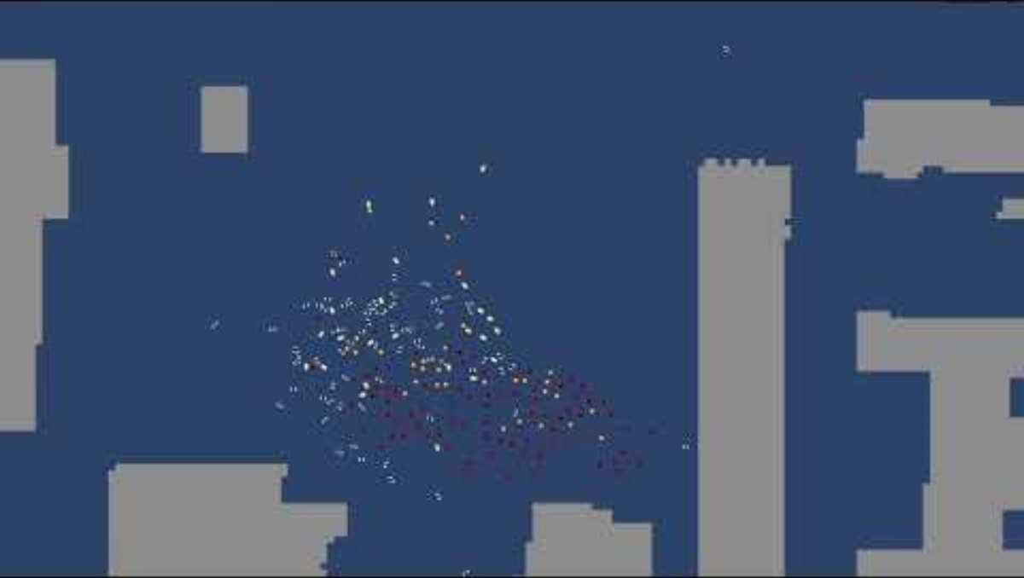
Protest conclusion

Slide 12
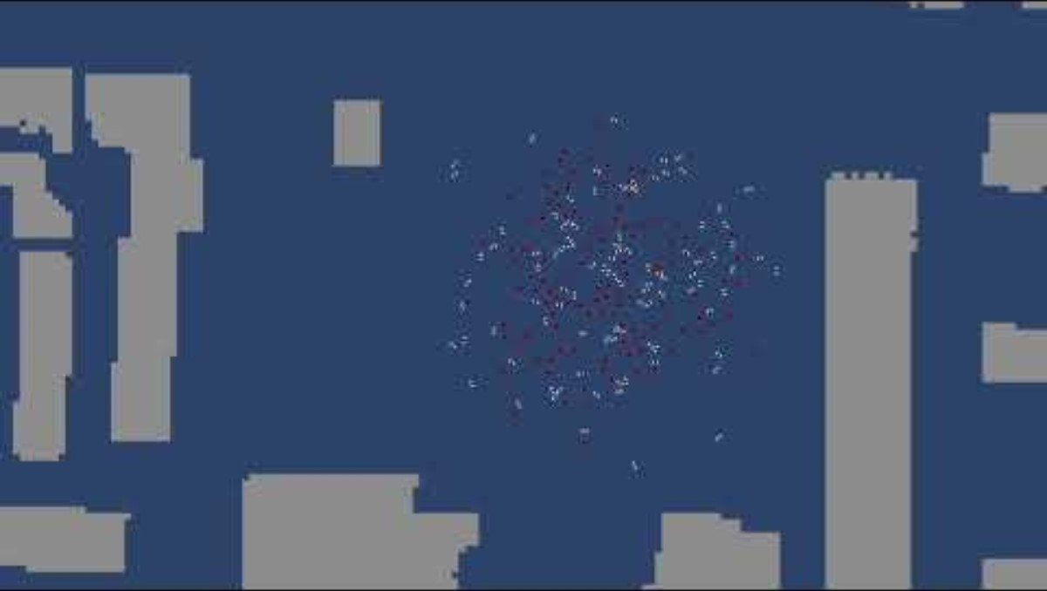
Protest simulation

Slide 13
Conclusions
Main goals were achieved
Unexpected behaviours emerged, but were successfully corrected
Future work:
Increase map accuracy (include parks, statues, etc.)
Train police agents to create optimal formations
Introduce uncertainty into vision
Using the GPU to speed up the simulation

Slide 14
Thank you for your attention

