Slide 1
Simulation of group behaviour during a protest
Authors: Nik Čadež, Pedro Macedo, Primož Mihelak, Luka Bajić
University of Ljubljana, Faculty of Computer and Information Science

Slide 2
Structure
Overview, related work
Methods
Experiments
Conclusions, ideas for future work

Slide 3
Objectives
Create believable human group behaviour
Give user the option to control leader and to place police agents as barricades anywhere on the map
Related work:
Lemos, et. al. – Agent Based modeling of protests and violent confrontation (2014)
Itatani, Pelechano – Social Crowd Simulation (2024)
Clements, Fadai – Agent-based modelling of sports riots (2022)

Slide 4
Methods
Basic flocking algorithm
Topological map
Social Crowd Simulation – steering dynamics (collision avoidance, wall repulsion, etc.)
Division of agents into subgroups, levels of aggression

Slide 5
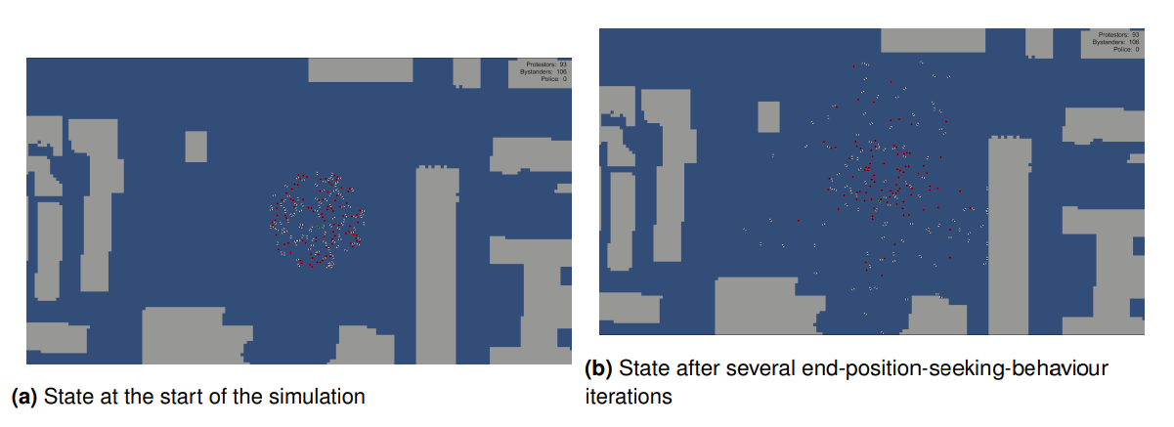
Results
End-position-seeking-behaviour

Slide 6
Results
Arbitrary movement for leader
…video

Slide 7
Results
User manually controls leader’s movement
…video

Slide 8
Results
Leader hierarchy

Slide 9
Conclusions
Model seems to approximate human behaviour reasonably well…
Future work:
Increase map accuracy (include parks, statues, etc.)
Train police agents to create optimal formations
Introduce uncertainty into vision

Slide 10
Thank you for your attention

