Slide 1
Chapter 1:
Business Process and Information System
Roshan Chitrakar, MBA
Associate Professor,
Nepal College of Information Technology

Slide 2
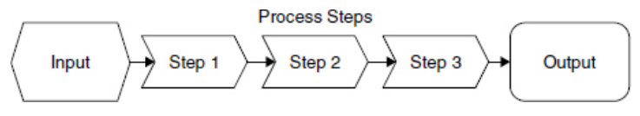
Organization Process
Organizations create and deliver value in the form of a product or service, which they offer to consumers or to other organizations.
A product or service is created trough a business process.
  Business Process is a sequence of tasks or activities that take a set of inputs and convert them into the desired output.

Slide 3
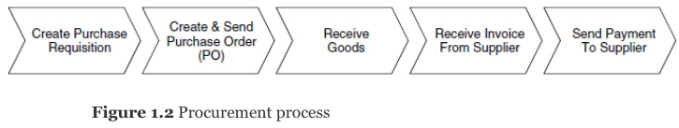
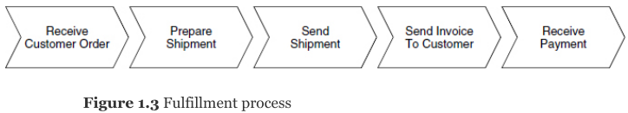
Business Process : Examples
In reality, business processes are complex, and they differ among companies and industries.
What about a Production Process ?

Slide 4
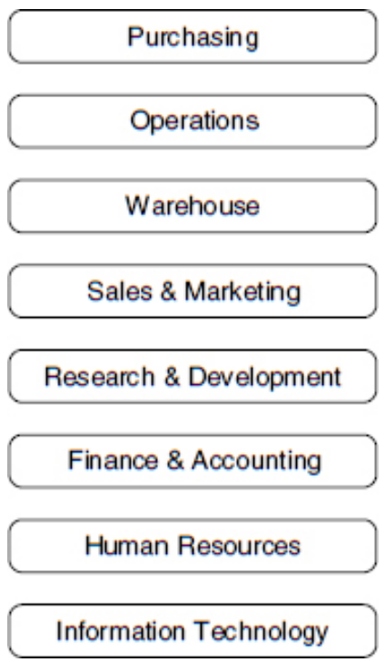
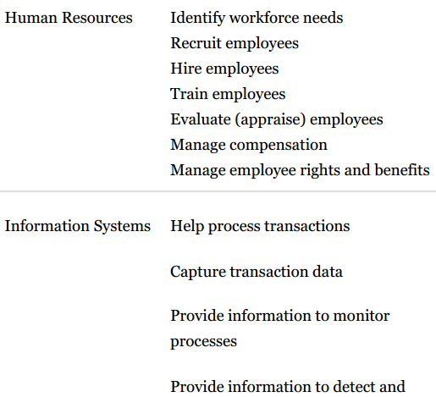
Functional Structure of an Org^{z}.
Organizations are divided into functions, or inter-related departments.
This structure involves the principles of division of labor and specialization.
Business processes are cross functional i.e. they rely on more than a functional group.
Functional structure includes rules and procedures to help manage organizations.

Slide 5
The Silo Effect
People in different functional areas perform their steps in isolation, without understanding what steps happen before and what next.
"By focusing narrowly on specific tasks, they lose sight of the big picture of the larger process" is referred to as the Silo Effect.
Key Point : The silo nature of the functional organizational structure and the cross-functional nature of processes are at odds with each other.
Challenge : To effectively coordinate the activities among the different functions or departments.
Solution : To exchange information efficiently and effectively.

Slide 6

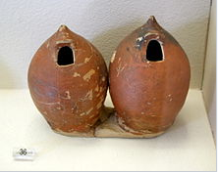
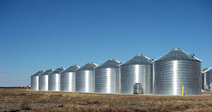
Pictures of Silos
Ancient Greek vases shaped as silos
Steel grain silos
8' diameter by 150 feet silo bag silo

Slide 7
Delays in Execution
Caused by the time it takes to exchange information among different parts of the process.
Two types of delays: -
  Lead time delay
    (e.g., how far in advance a company must plan to obtain raw materials from its suppliers)
  Cycle time delay
    (e.g., the amount of time needed to produce a product or process a customer order)
Manual process further increases delay

Slide 8
more reasons for Poor Co-ordination
Excess Inventory
  {Read the Case : Cisco Systems}
Lack of Visibility Across Processes
  {Read the Case : Nike}
To overcome these problems, organizations must break out of silos and focus on processes.
Need to substitute a process view for the traditional functional view.
  {Read the Case : Dell}

Slide 9
Global Business Environment
The big picture of modern business environment contains
  Global competition
  Information revolution
  knowledge worker
They have major impacts on the global business and will continue to have in foreseeable future

Slide 10
Global Competition
More often,
  the product is designed in one country,
  the parts to make the product are produced in several countries,
  the product is assembled in another country, and
  service and support for the product are provided by people in yet another country.
organizations have relocated parts of their operations to places outside their home countries to take advantage of unique business efficiencies e.g.
  companies have moved manufacturing to places where labor is less expensive,
  they have transferred research and development to locations that offer an abundant supply of highly educated scientists and engineers
Increased global competition puts pressure on companies to be more efficient and productive

Slide 11
Information Revolution
Organizations should develop strategies to integrate their operations, which can be distributed across many different geographic locations.
  Hence, Information Revolution is required.
Information Revolution is "increased use of information and communication technology to create, deliver, and use information."
ICT helps organizations to globalize their operations by enabling them to coordinate business processes that are performed around the world.

Slide 12
Knowledge Workers
Use ICT to create, acquire, process, synthesize, disseminate, analyze, and use information to be more productive.
Perform work that often requires both
  structured information (well defined, and its source is known) and
  unstructured information (not well defined or not readily available)
Knowledge work is typically non-routine in that it is not repeated throughout the course of the workday or workweek. (note: task workers perform routine works)
knowledge workers must have a thorough understanding of the business processes that occur across different areas of the company.
Knowledge workers are employed in all parts of an organization.
Point to Ponder : You will be a knowledge worker at some point in your career.
  you must develop the skills to find and use the information you need rather than rely on others to find it for you

Slide 13
Knowledge Workers : Attributes
Strategic Thinking
  ability to see the big picture and understand how your organization works as a whole.
Information Literacy
  ability to determine what information is needed, where to find it, and how to use it.
Communication and Collaboration
  ability to function as an effective part of a project team where you understand your role as well as the roles of others.

Slide 14
Importance of Information Systems
Business processes span multiple departments across companies—and across multiple countries.
These processes cannot be managed manually; ICT is an essential part of the process view of organizations.
A class of ICT, known as enterprise systems (ES) or enterprise resource planning (ERP) systems, is essential to managing business processes.
SAP introduced the first integrated enterprise systems.

Slide 15
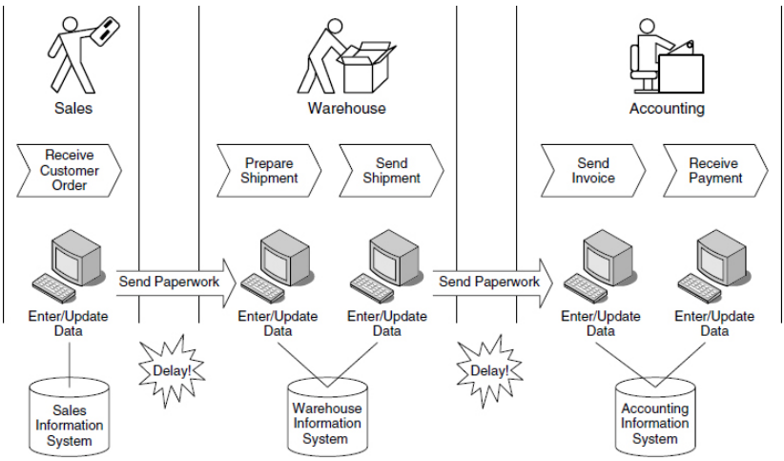
Functional Information Systems
Most information systems focus on functions rather than processes and are not well integrated i.e. they do not share data and information with one another.
Systems in organizations have evolved over the years in isolation i.e. exchanging information among them is either difficult or exchanged manually.

Slide 16
Bibliography
Jeffery & R. Simha, Essentials of Business Process and Information Systems

