Slide 1
Chapter 2:
Enterprise Systems (ES)
Roshan Chitrakar, MBA
Associate Professor,
Nepal College of Information Technology

Slide 2
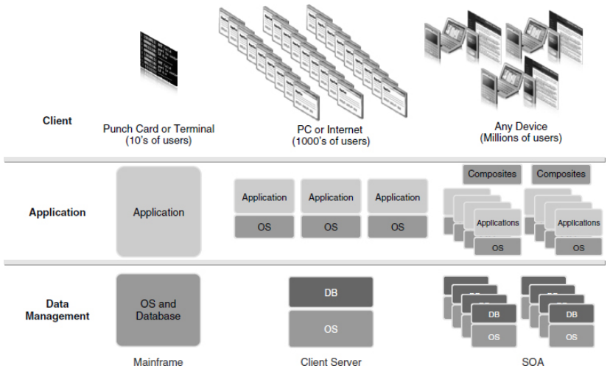
Evolution of Enterprise Systems
Enterprise systems have evolved from stand-alone systems to distributed systems.
ES include hardware, software, and a database.
Stages of ES evolution:-
Stand-Alone Mainframe Systems
Client-Server Architecture
Service-Oriented Architecture

Slide 3
Stage 1: Mainframe Systems
In the early days of ES, hardware typically consisted of large, expensive mainframe computers.
Software includes specialized operating system software, custom applications that provide capabilities needed to complete specific tasks etc.
Early databases were extremely complex and difficult to manage.
They had to use a terminal that was physically connected to the mainframe to input commands to the system using punch cards.
Drawbacks of the mainframe architecture are its limited scalability, unable to be easily used by other companies etc.
The early ES has packaged applications instead of proprietary applications, the concept being pioneered by SAP in 1972,

Slide 4
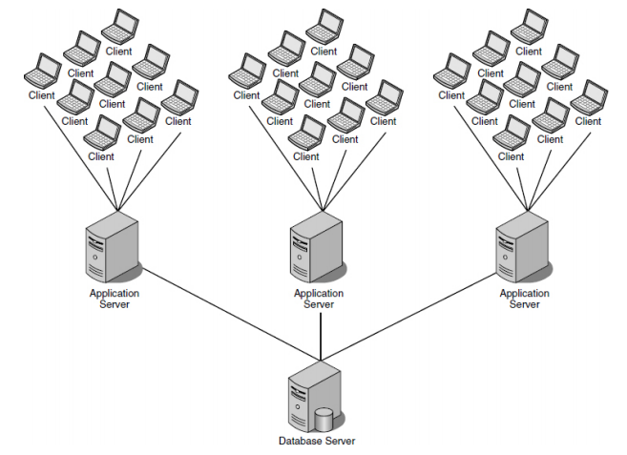
Stage 2: Client-Server Architecture
Three components or layers are called the presentation layer, application layer, and data layer .
The shift to the three-tier client server dramatically reduced the costs of acquiring, implementing, and using an ES while significantly increasing the scalability of the systems.

Slide 5
Stage 3: Service-Oriented Architecture
Web-enabled their three-tier applications so that users could access the systems through a Web browser.
By using Web services, companies could now integrate several client-server applications and create an enterprise mashup , or composite applications.
Companies such as SAP have invested billions of dollars to service-enable their core ES so that these systems can be exposed and connected to an infinite number of composite applications and third-party ES.

Slide 6
Types Of Enterprise Systems
Enterprise resource planning (ERP) systems
Best-of-breed applications
Niche applications

Slide 7
Types Of Data In Es
Transaction Data
Master Data
Organizational Data

Slide 8
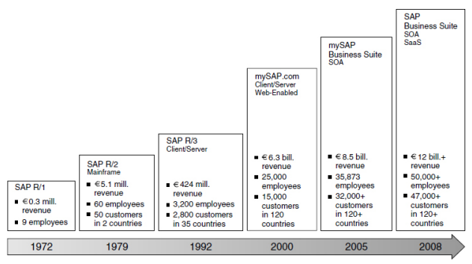
SAP OVERVIEW

Slide 9
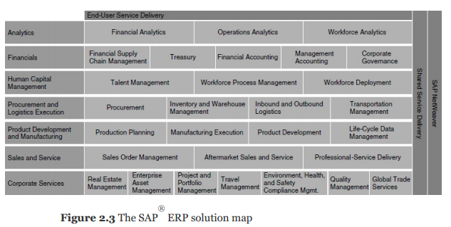
SAP ERP

Slide 10
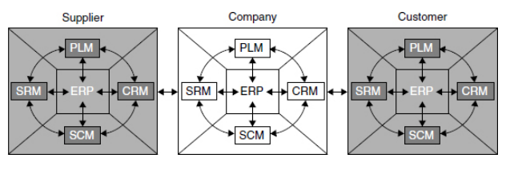
SAP Application Suite

Slide 11
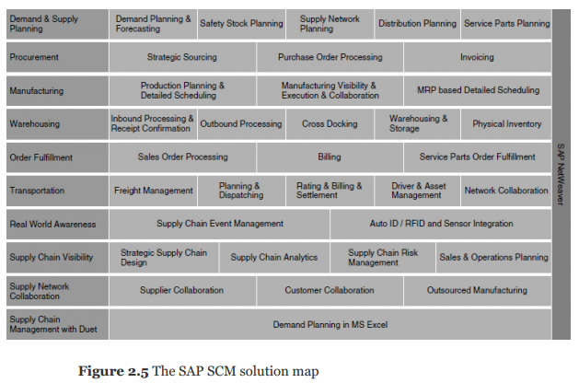
SAP SCM

Slide 12
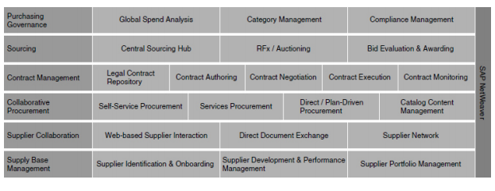
SAP SRM

Slide 13
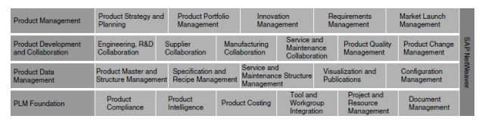
SAP PLM

Slide 14
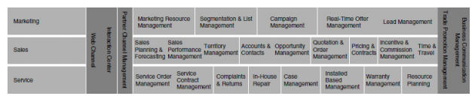
SAP CRM

Slide 15
Bibliography
Jeffery & R. Simha, Essentials of Business Process and Information Systems

