Slide 1
Chapter 3: IT and Strategy
Roshan Chitrakar, MBA
Associate Professor,
Nepal College of Information Technology

Slide 2
Introduction
In Greek, “strategos” means “general in the army”.
Strategy is the plan to gain advantage over the enemy in war. It could involve losing some of the battles, but the ultimate objective is to win the war.
Strategy in business means
  to create new opportunities,
  To position the product, and
  To beat competition
IT is nowadays used as a strategic tool as well as a strategic partner of an organization.
Effective use of information, knowledge building, and the use of all IT resources are some of the major aspects of IT strategy.

Slide 3
Strategy : Definition
A plan, which when put into action, drives business, manages knowledge, and various initiatives in an organization. It positions products and leads you to success.
The science and art of effective use of all possible forces of a nation or entity to execute approved plans optimally or as effectively as possible during different social and political situations including peace or war.
The science and art of military command as applied to the overall planning and conduct of large-scale combat operations.

Slide 4
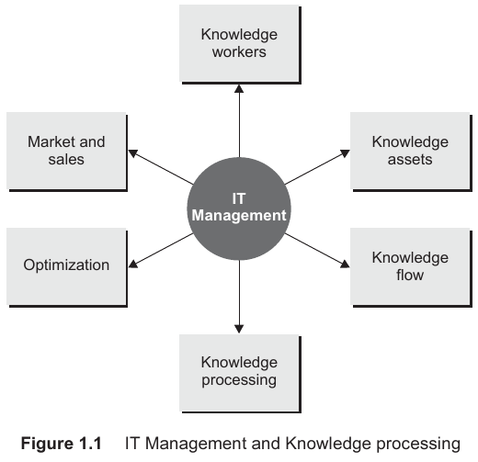
IT Management and IT Strategy
IT management and IT strategies sit at the centre of many activities
IT facilitates knowledge management and transaction across the organization viz.:-
  Knowledge workers and related transactions
  Market and sales
  Overall optimization of processes
  Gathering, building, and processing the available knowledge
  Building knowledge assets IT
  Optimization of overall knowledge flow

Slide 5
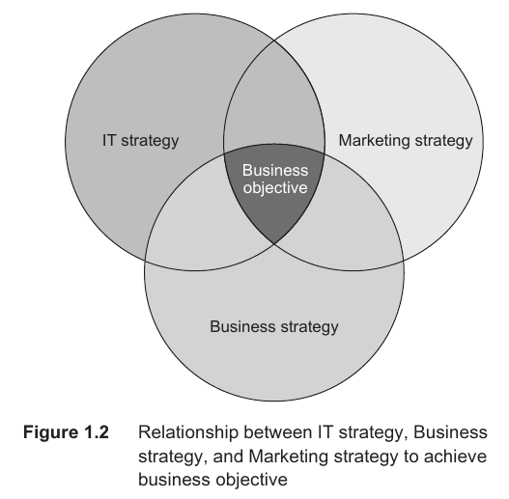
Business and Strategy
Achieving sustainable success requires
  proper strategy,
  proper technology, and,
  a strategic balance between the technology and business.
A strategy needs to be dynamic and agile.
Quinn (1992) says that an effective business strategy should have: -
  A clear and decisive statement of the primary goals or objectives to be achieved;
  An analysis of the main policies guiding or limiting the companys actions; and
  A description of the major programmes that will be used to accomplish the goals within the limits.
The overall business strategy is made up of different strategies:
  Marketing strategy,
  Competitive strategy,
  Knowledge management strategy, and
  Technology strategy.

Slide 6
Information Technology Strategy
Definition:
  The science or art of effective use of information and allied technologies, and IT resources of the organization to execute strategic plans optimally or as effectively as possible to achieve business objectives.
IT strategy is about rethinking of information technology, the allied technology, and existing information technology resources to achieve the ultimate business objective.
Driving forces of IT strategies are: -
  Company : Business is about the company and its resources and their optimal use to achieve the business goals,
  Customer : Customers are the most important part of the business, and
  Competition : Business is about building a sustainable competitive advantage over rivals.

Slide 7
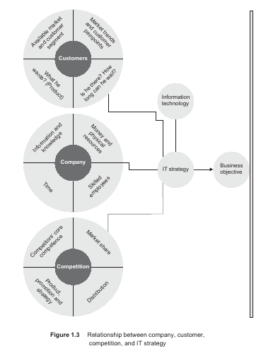
Customer and Related Parameters
Available customer segment
His needs
Customer pain points

Slide 8
Company and Related Parameters
The knowledge base of the company
Resources and their skills
Money and time

Slide 9
Competition and Related Parameters
Core competitors
Promotion strategies
Market share
Now the IT strategy can be termed as
the effective use of IT and resources to help an organization fight competition, satisfy customer needs in the interest of the company, and position IT to achieve the business objectives.

Slide 10
Strategies and Success
Challenges to build a right IT Strategy
  High expectation from IT
  IT brings technological changes in organizations
  Ongoing changes
  IT managers often are too specialized and poor in leadership
  Difficult to alight IT with business objectives
  Difficult to measure RoI (Return on Investment) in case of IT

Slide 11
Strategies and Success (contd.)
Reasons of IT strategy failure
  Misaligned with business objectives
  Inappropriate
  Not dynamic
  Too common
  Based on wrong figures
  Unable to learn
  Improper application / bad implementation
  Delayed
  Environment ignorant
  Complicated
Generic successful strategies may be categorized under 3 main heads: -
  Gain leadership
  Differentiate
  Gain focus

Slide 12
Strategies and Success (contd.)
Factors influencing IT Strategy
  Customer needs
  IT infrastructure
  Business Impact
  ROI on IT investment
  Internal and external factors
  Technological innovation and capabilities

Slide 13
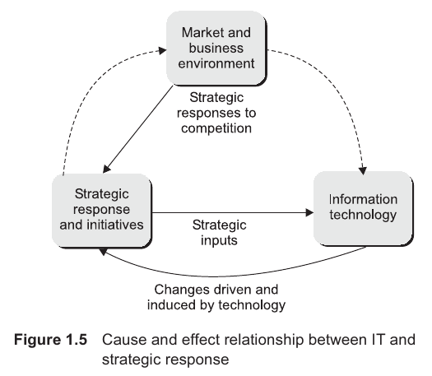
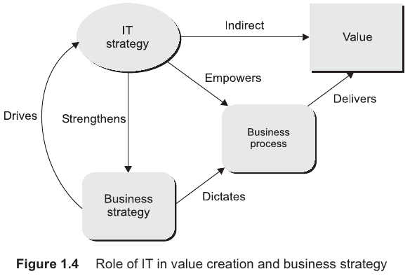
Strategies and Success (contd.)
Relationship between IT and business:-

Slide 14
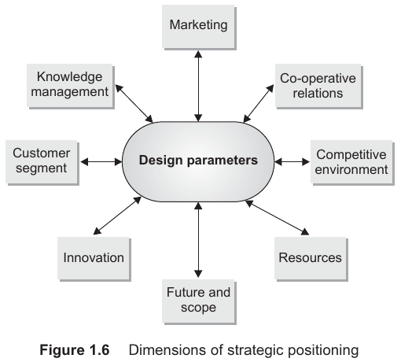
Strategy Design Parameters
Marketing
Knowledge management
Customer segment
Future and scope
Resources
Competitive environment
Co-operative relations
Innovation

Slide 15
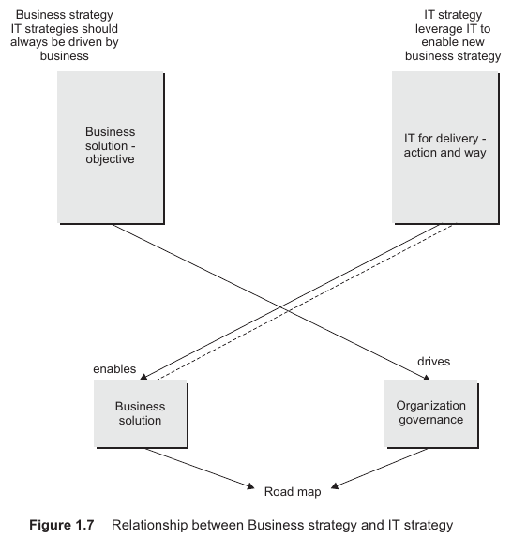
Strategy Design Parameters (contd.)
Besides enabling business strategy, IT strategy leverages IT to enrich new business strategies and helps drive the business by empowering it to achieve the business objectives.

Slide 16
Strategic Positioning
IT is positioned as the information backbone and decision-making tool of many institutions/organizations.
In 1988, Charles Wiseman added to the general framework the following five thrust areas:
  Differentiation
  Cost
  Innovation
  Growth
  Alliances
IT allows better positioning of products and organizations, by providing organizations the knowledge required for such positioning.
Advanced technology shapes the products and services of the future by allowing information management and correcting positioning errors.

Slide 17
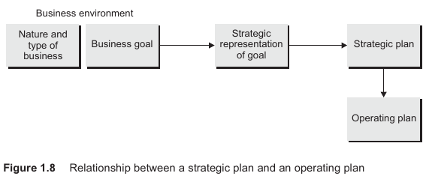
Strategic vs. Operating Plan
The nature and type of business and business goals together help in describing the strategic representation of the goals.
Strategic representation of goals is exemplified by various parameters e.g. : -
  Strategic positioning
  Strategic actions for the goal
  Strategic initiatives
  Goals from the perspective of strategic actions

Slide 18
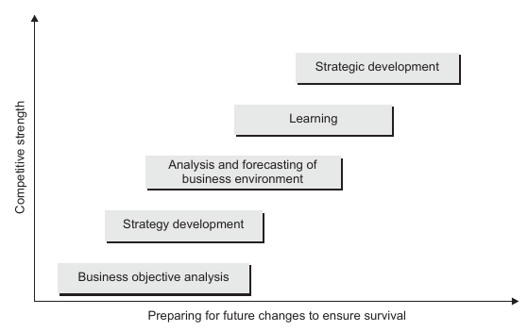
Evolution of Strategy
The process of evolution of a strategy includes:
  Development of basic strategy
  Deciding strategic sequence
  Analysis and deployment of different strategic initiatives
  Study of the environment and forces in the market
  Study of the impact of strategic actions
  Learning based on the impact of strategic actions
  Re-tuning and finalizing the strategic sequence
  Re-deciding the strategic sequence
Fig. 1.9: Strategic Evolution on a Timescale

Slide 19
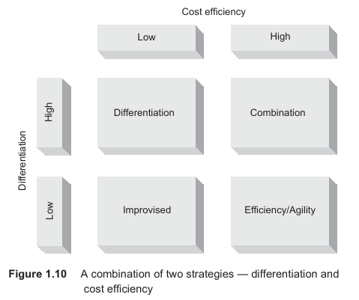
Basis of Successful Strategies
Vision
Re-inventing the business, market, and organization
Looking at the big picture
Reality
Core competencies
Charismatic leadership
Shared vision, shared values, and shared processes
Attention to details
Mapping between organizational strengths and market opportunities
A strategy can be a combination of two strategies e.g. differentiation + cost efficiency.

Slide 20
Strategy Development
There is a need for enabling conditions to develop strategies.
Skills and willingness balanced with tasks result in commitment and insights that provide those conditions.
  Skill and insight leads to the ability to adapt and spread new concepts,
  Willingness and insight leads to the inclination and desire to spread these concepts.
  Skill and commitment leads to the development of policies,
  Willingness and commitment leads to the willingness for innovation.
The most important aspect of this development is keeping it as simple as possible.

Slide 21
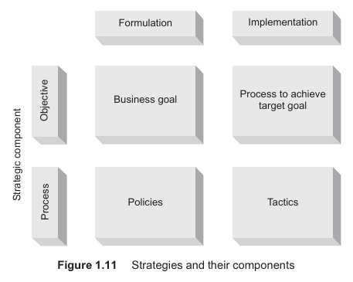
Strategic Sequence
The overall strategy of a company may consist of a number of strategic moves.
The strategic sequence deals with a set of strategic moves that follows a particular order.
IT makes required information available for strategic decision-making.
Once the overall business and IT strategy is formulated, there is a need to define strategic sequence and tactics associated with each state.
Deciding the strategic sequence and prioritizing various moves are an important part of strategy formulation.

Slide 22
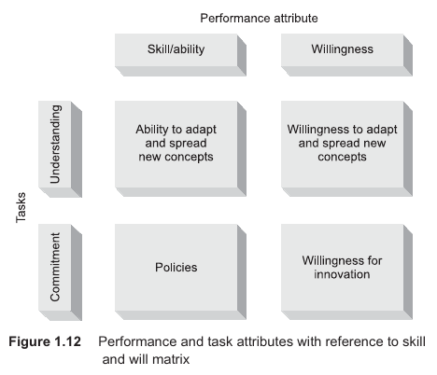
Development of a Strategy
There are soft aspects for enabling conditions to develop any strategy.
Strategy without alignment and willingness will not be effective.
There is a need to balance willingness and ability, and insight and commitment.
Employees at various altitudes and at various strategic positions in the organization should be made to understand and sign for the strategy.

Slide 23
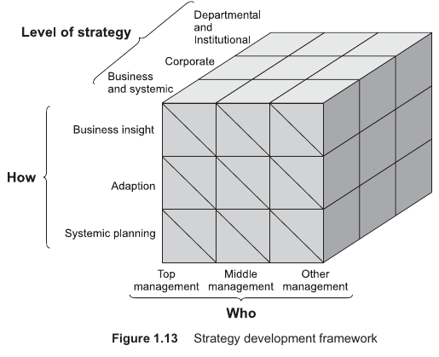
Strategic Development Framework
A strategy development framework has three axes:
  Who
  How
  Level of strategy
Strategy is a three-legged stool and is the act of balancing innovation, positioning, and competition with business objectives sitting at the top.
It can further be extended to IT strategy development framework.

Slide 24
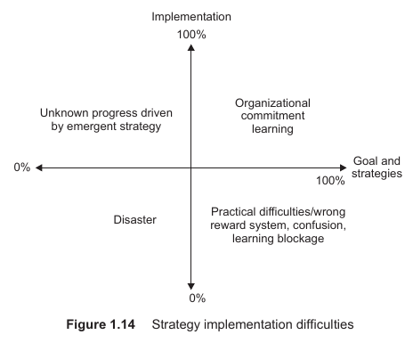
Strategy Implementation: Difficulties
Agreement of all employees
Disaster
Changes in business environment
Wrong reward systems
Confusion between management and strategy
Learning blockage

Slide 25
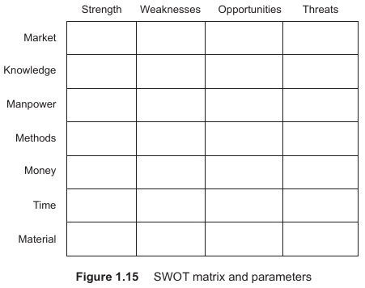
SWOT Analysis
In SWOT analysis of a strategy, one of the factors can be information technology and there could be listing of strength, weakness, opportunity, and threats with reference to business strategy.
But IT also drives various categories such as material, methods, and manpower.
Further, there are knowledge management aspects of business that help in overcoming these obstacles.

Slide 26
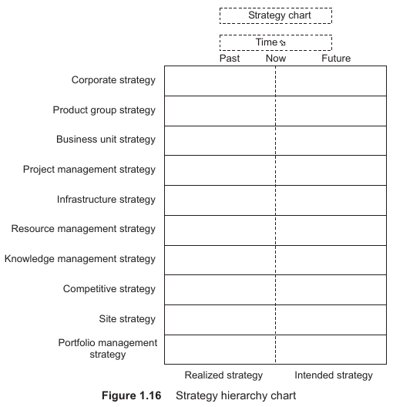
Strategy Hierarchy
Corporate strategy
Product group strategy
Site strategy
Business unit strategy
Manufacturing/Development/Project management strategies
Implementation technology infrastructure strategy
Resource management strategy
Knowledge management strategy
Competitive strategy
Portfolio management strategy

Slide 27
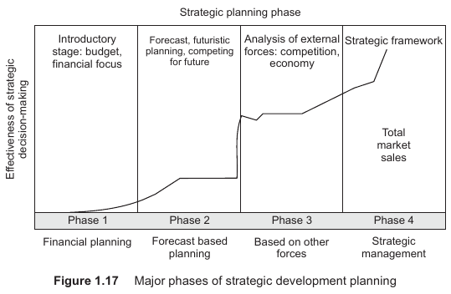
Strategic Planning and IT
Phases in strategic development planning
  1. Financial and resource-based planning
  2. Forecast-based planning
  3. Externally-oriented planning
  4. Strategic management

Slide 28
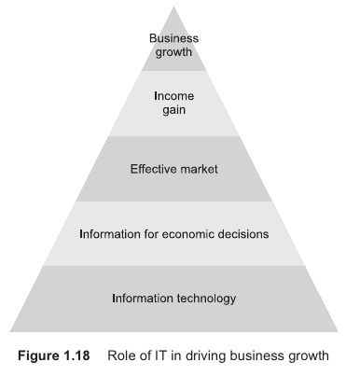
Types of IT Strategies
Three categories
  Based on types of companies
  Based on Business objectives
  Based on types of business
A few types of IT strategies are : -
  IT marketing strategy
  IT competitive strategy
  IT project strategy
  IT product strategy
  IT infrastructure strategy

Slide 29
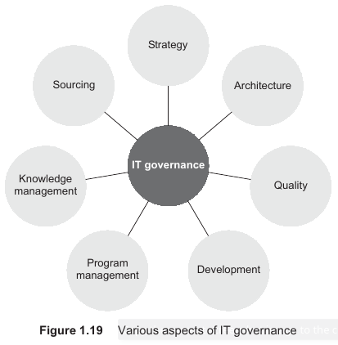
Types of IT Strategies (contd.)
IT strategy drives IT governance, which in turn drives programme management, development, quality, architecture, and sourcing.
IT strategy makes the organization capable of prospering in a changing environment.

Slide 30
Context and Strategy
Business context drives an IT strategy.
In case the business is dynamic, it could lead to different sorts of issues.
It acts as a major correcting factor in a business context.
In case of a change in business context a need may arise to change or re-orient the IT strategy.
Reality, survival, and perception are some of the important components of this strategy.

Slide 31
IT Strategy in Dynamic Business
Knowledge is at the centre of all evolving organizations.
IT strategy enables proper knowledge management in a business and helps business to succeed in such dynamic and evolving situations.
Strategy is about learning, de-learning, and re-learning, to acquire or hold a winning position.
The changing business environment will change external factors, even if the business objectives remain the same.
IT strategy in such context is to “retain simplicity”, abrupt changes are not recommended.

Slide 32
Compiled from
Parag Kulkarni & Pradip K Chande, IT Strategy for Business

