Slide 1
Chapter 4: Managing IT
Roshan Chitrakar, MBA
Associate Professor,
Nepal College of Information Technology

Slide 2
Introduction
IT is transforming from a technology provider to a strategic partner. So, IT management has three facets: -
  (1) Technology,
  (2) Business, and
  (3) Management
IT Management includes: -
  IT risk management,
  IT resource management,
  IT personnel management,
  Measurement of IT,
  Impact Analysis,
  System management,
  Process and Transaction management,
  Technology management etc.

Slide 3
Role of IT Management
Selection of Technology
Financial Management
IT- related resource management
Positioning of IT
Managing IT issues
Knowledge management related to IT
Developing IT
IT-related innovation
Adapting new technologies
Getting maximum benefits out of IT

Slide 4
Stages of IT Life-Cycle
Identification of need for IT and related technologies
Technology selection
Adapting IT
Building and implementing IT
Innovations for future and maximizing benefits
Growth and maturity of IT
Use and maximization of IT
IT integration
Understanding limitations of existing IT and technologies in the next context
Transition to new technology

Slide 5
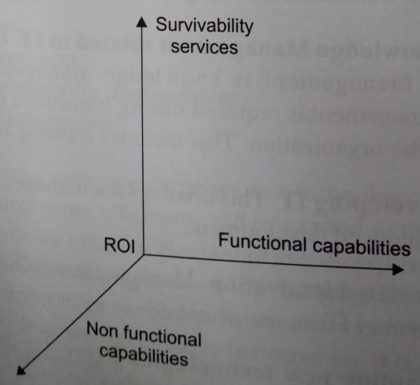
Technology Evaluation Parameters
Stand-alone technology assessment
Suitability assessment
Compatibility study
Survivability study
Return on Investment (RoI)
Growth and futuristic issues

Slide 6
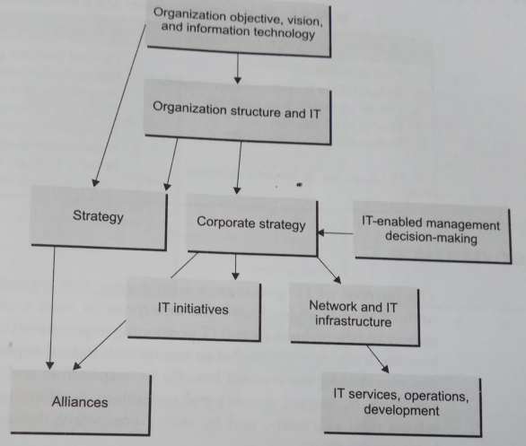
IT Management Framework
Factored into: -
  Corporate strategy
  IT-enabled decision making
  IT and organizational structure
  IT initiatives
  IT infrastructure
  IT services
  Alliances

Slide 7
IT : a Service Provider vs. a Strategic Partner
IT as a Service Provider
Used for efficiency
Budget driven by external requirements
Can be separated from business
Treated as an expense
Technical experts manage IT
No role in business decisions
IT as a Strategic Partner
Used for business growth
Driven by business strategy
Integral part of the business
Treated as an investment
Business managers with technical knowledge manage IT
Has a role in business decisions

Slide 8
IT Governance
IT governance ensures that IT performance is aligned with the enterprise in such a way that it can understand the technology and IT positioning requirements to obtain maximum benefits.
It also ascertain that an enterprise is taking benefits
  By appropriate use of resources
  By correct technology positioning
  By managing IT related risks
  By taking competent decisions to achieve business objectives.

Slide 9
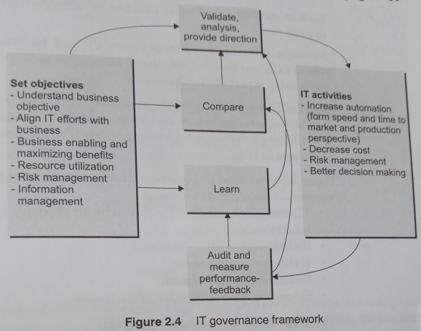
Framework of IT Governance
The “learn” and “compare” functions act as prime moves, which can be identified along : -
  Dealing with present scenario
  Futuristic arrangements
  Auditing
  Setting and analyzing objectives
IT governance includes: -
  Overview and direction of IT
  Built-in strategic road map
  Strategic interrelationship between IT and business
  Roles of IT for fulfilling strategic objectives

Slide 10
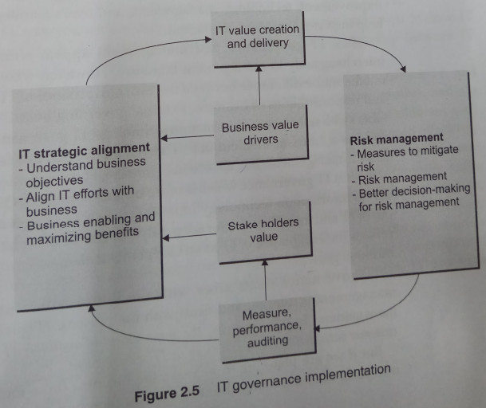
IT Governance Implementation
IT delivers value through: -
  IT strategic alignment
  Risk management
  Technology management
  Performance improvement
  Enhancing the overall value of the business

Slide 11
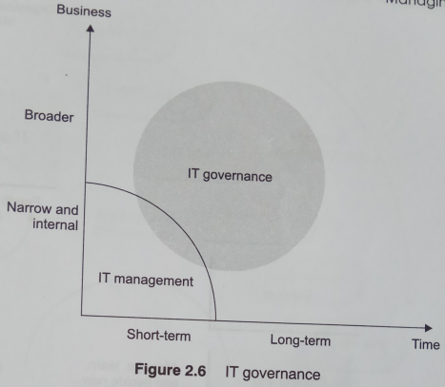
IT Gov. overlaps IT Mgmt.
The roles of IT governance and IT management are somewhat overlapping.
IT governance is more external and has futuristic element in it, whereas IT management is more internal and business oriented.
IT governance sits very close to business objectives and needs to drive IT based on these objectives.

Slide 12
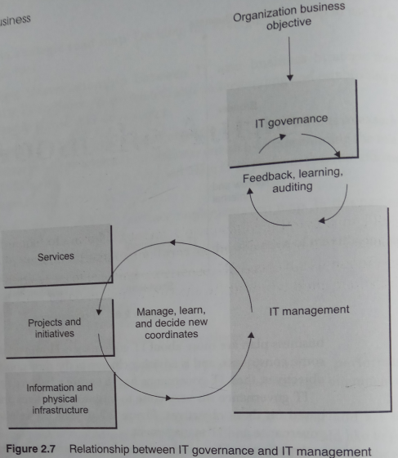
Rel^{n} bet^{n} IT Gov. and IT Mgmt.
Effective IT governance results from understanding business, IT and their relationships.
IT governance keeps IT and business together to improve performance of the business processes, projects, IT itself and infrastructure, along with resources withing the organization.

Slide 13
IT Governance and Strategy
IT government strategy should be established with the backing of the top management, which
  Clarifies who owns the IT resources
  With whom rests the ultimate responsibility
The proper IT governance strategy ensures that the senior management retains control and responsibility for the IT operations of the organization.
IT governance deals with overall control, communication and execution.
Technical architecture needs to be designed taking into account the soft and hard aspects.
Technical architects / experts must be involved in the development of business strategy; they may involve in the system development process and also in various technology and product decisions.

Slide 14
Roles of IT Governance
In many cases, it was found that there was a gap between what IT was supposed to do and what it was doing.
Roles of IT are, but not limited to, the following: -
  Monitoring and measurement of IT
  Process improvement
  Change Management
  Planning IT
  Opportunities and expansion
  Selection of project, sub-projects, and options
  Issue identification and prioritization for action
  Measurement
  Project scope planning and expansion
  Learning

Slide 15
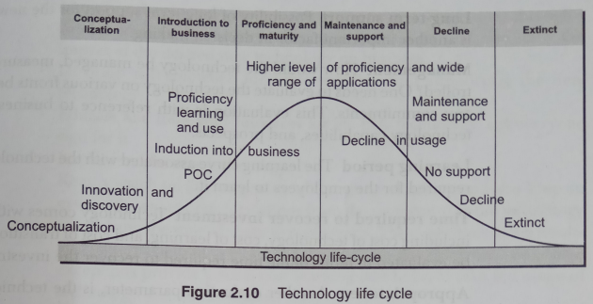
Technology Management Process
A technology life cycle includes the following: -
  Conceptualization
  Innovation and Discovery
  Proof of Concept
  Proficiency and Maturity
  Maintenance and Support
  Technology decline
  Extinct

Slide 16
Steps in Technology Management
There is a need for careful assessment of the requirements before going in for a new technology.
  Know the gap between the technology you have and that you would like to have.
  Identify the technology that meets your requirements.
  Develop a framework for implementing and supporting the new technology
  Educate and train your resources
  Implement the new technology
  Keep a watch on the integration of the new technology.

Slide 17
Evaluating New Technology
Some of the aspects that are considered before deciding on the suitable technology: -
  Value and benefits
  Stability and consistent value creation
  Interfaces and adaptability
  Long-term support
  Management
  Learning period
  Time required to recover investment
  Appropriateness
  Position among the available options
  Integration efforts
  Technical fitness

Slide 18
Assessment of Existing Technology
The following parameters are considered for assessment of the existing technology: -
  Issues
  Need of new technology
  Gaps
  Business-based analysis
  Need of replacement
  Impact

Slide 19
Identification and Selection of New Technology
Technology selection is based on the following: -
  Business requirements
  Present technology limitations
  Business compatibility
  Technology future
  Technical compliance

Slide 20
Strategic Aspects of IT
Following are the strategic aspects of IT: -
  IT for positioning the product
  IT as a strategic tool for development
  IT as a business enabler
  IT for differentiation
  IT for penetration
  IT for quality
  IT for cost-effectiveness
  IT positioning within and outside the company
  IT to manage knowledge
  IT strategy to balance IT and business objectives
Positioning the company for change includes
  Understanding of the need for a change
  Identifying the technology for the future
  Arrange company resources for the change
  Building technical capabilities
The preparedness for such a transformation includes
  Making the organization ready for change
  Keeping track of the after-effects
  Understanding and adapting to change

Slide 21
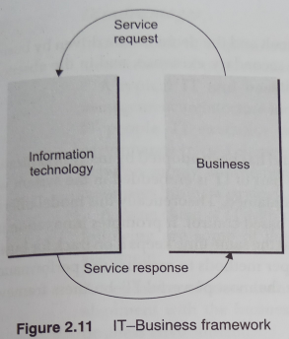
IT and Business alignment
Three frameworks are dealt here: -
  IT-Business (Isolated) framework
  Embedded framework
  Hybrid framework
IT business alignment is influenced by : -
  Acceptance of new technology
  Learning new technology
  Creation of visibility
  Execution
  Optimization
  Learning from experience and outcomes

Slide 22
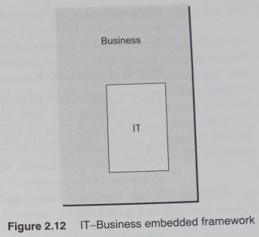
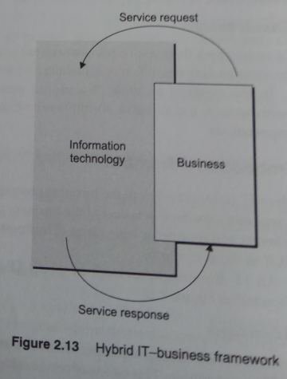
IT and Business alignment (contd.)

Slide 23
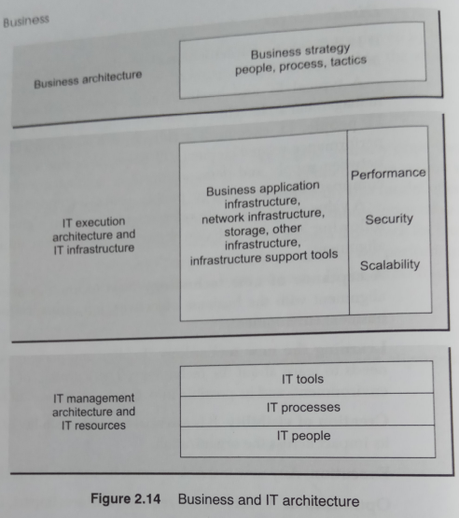
IT-Business Architecture
IT-Business architecture has three parts: -
  Business architecture
    comprises business strategy, people, processes and other business inputs.
  IT execution architecture
    has various IT infrastructure and performance-related elements.
  IT management architecture
    includes management of IT tools, IT processes and IT people

Slide 24
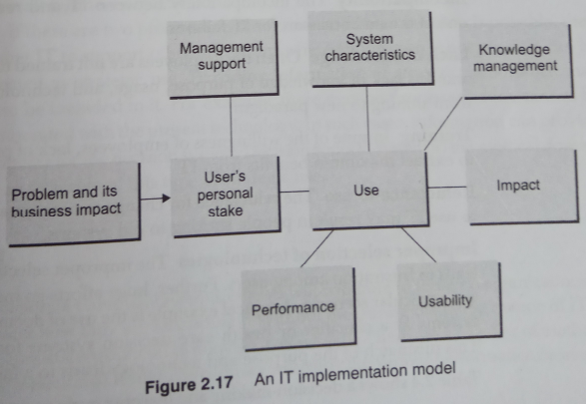
Implementing IT
The success of implementation is determined by: -
  Cost effectiveness
  Cost-benefit study
  Technical compliance for a particular function
  User satisfaction
  Performance
  Impact of the system
  Accomplishment of the objectives

Slide 25
IT Design
IT design has roles at every stage of IT management – from the introduction of IT to enhancement and usage during various stages.
Initial work on design, analysis, and prototyping form the basis for deciding which of the outlined visions for future IT implementation and usage best meets the business goals and user needs for IT support in their work.
IT design project may be impeded by: -
  Hight complexity
  Changing requirements
  Conflicts of interest
  High situation dependence

Slide 26
Exploiting IT Capabilities
In many cases, IT is under-utilized or the organization fails to exploit IT capabilities due to the following reasons: -
  Incompatibility
  Lack of knowledge
  Training
  Reluctance to use
  Improper selection of technologies
Using IT in a Strategic manner
  IT should be positioned within the organization, in such a manner that maximum benefit could be derived from it, without having any negative impact on other processes.

Slide 27
Measuring IT
There are a number of methods for measuring IT, Balance Score Card (BSC) is one of them.
The main indicators of IT performane are: -
  Impact of IT in various areas
  Return of investment (RoI)
  Initiatives, and return on them in future
Some of the benefits of IT measurements are: -
  Process improvement
  Speed of delivery
  Availability of information

Slide 28
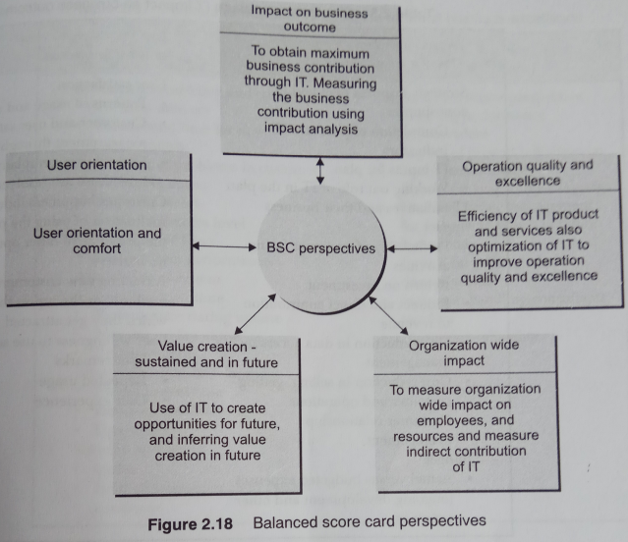
Balance Score Card (BSC)
Different perspectives of BSC are: -
  Corporate contribution
  Customer orientation
  Operational excellence
  Future orientation

Slide 29
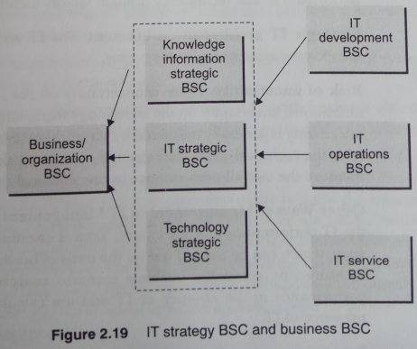
IT-BSC
IT-BSC is used for measuring business contribution and the positioning of IT and IT perspectives.
The relationship between IT and business can be more explicitly expressed through a cascade of BSCs.
IT-BSC is a fusion of IT and business measurement models, where IT department BSD and IT operational BSC are defined as enablers.

Slide 30
Compiled from
Parag Kulkarni & Pradip K Chande, IT Strategy for Business

