Slide 1
Chapter 5: e-Strategy
Roshan Chitrakar, MBA
Associate Professor,
Nepal College of Information Technology

Slide 2
Introduction
E-Strategy is the strategy use of electronic capabilities to achieve business objectives.
It refers to the delivery of powerful combination of stratefy, issue advocacy, and cutting -edge web-technology services (including all services that can come under umbrella of ‘e’) to empower, activate, educate and mobilize support business strategy, marketing strategy, IT and infrastructure strategy and resources of a business to achieve business objectives.

Slide 3
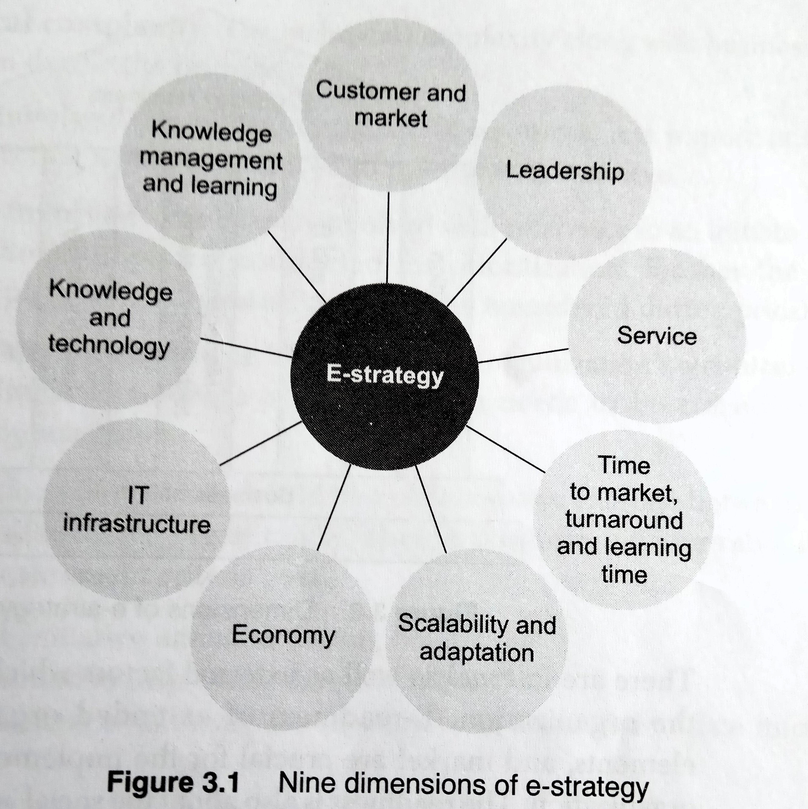
Nine Dimensions of e-strategy
IT infrastructure
Knowledge and technology
Knowledge management and learning
Customer and market
Leadership
Service
Time to market / turnaround time / learning time
Scalability and adaptation
Economy

Slide 4
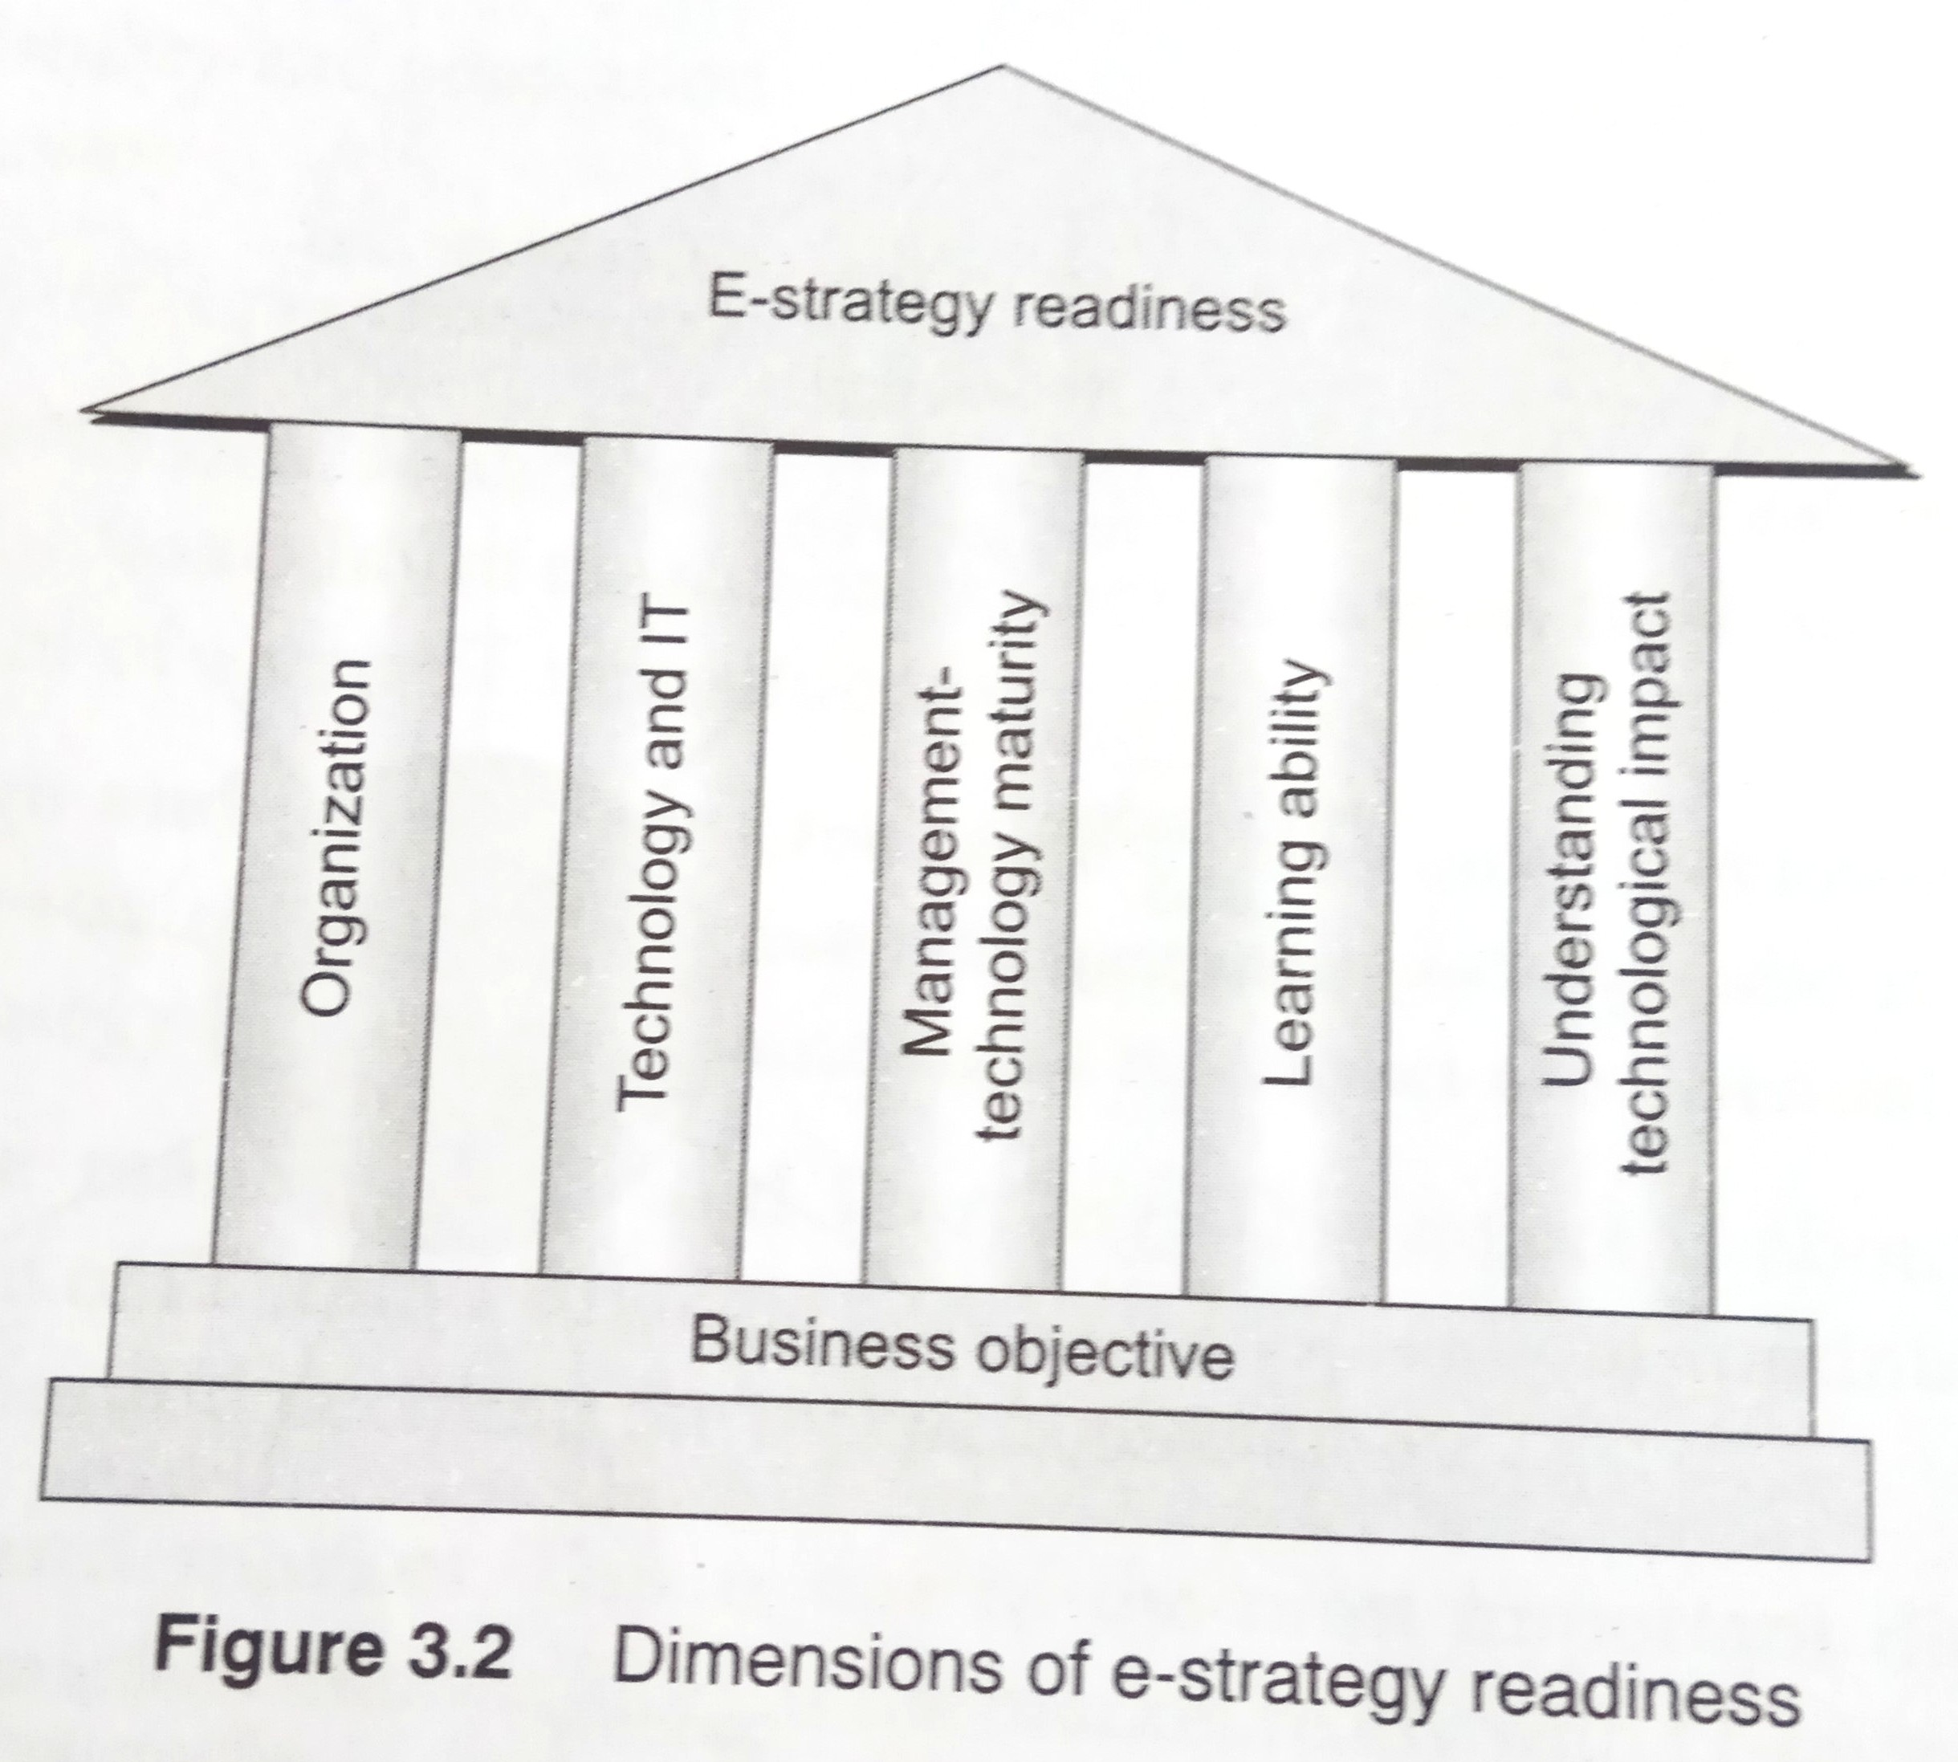
Readiness for Implementation
To implement and e-strategy, an organization should be ready and equipped for its realization
An organization that is ready for e-strategy realization should have net readiness and strategic alignment with business.
The readiness is also about the social acceptance of the technology.
The e-business strategy is a subset of the overall business strategy of an organization.
The organization’s readiness and market will help it to prioritize the objectives of initiatives and this prioritization will drive its e-strategy.

Slide 5
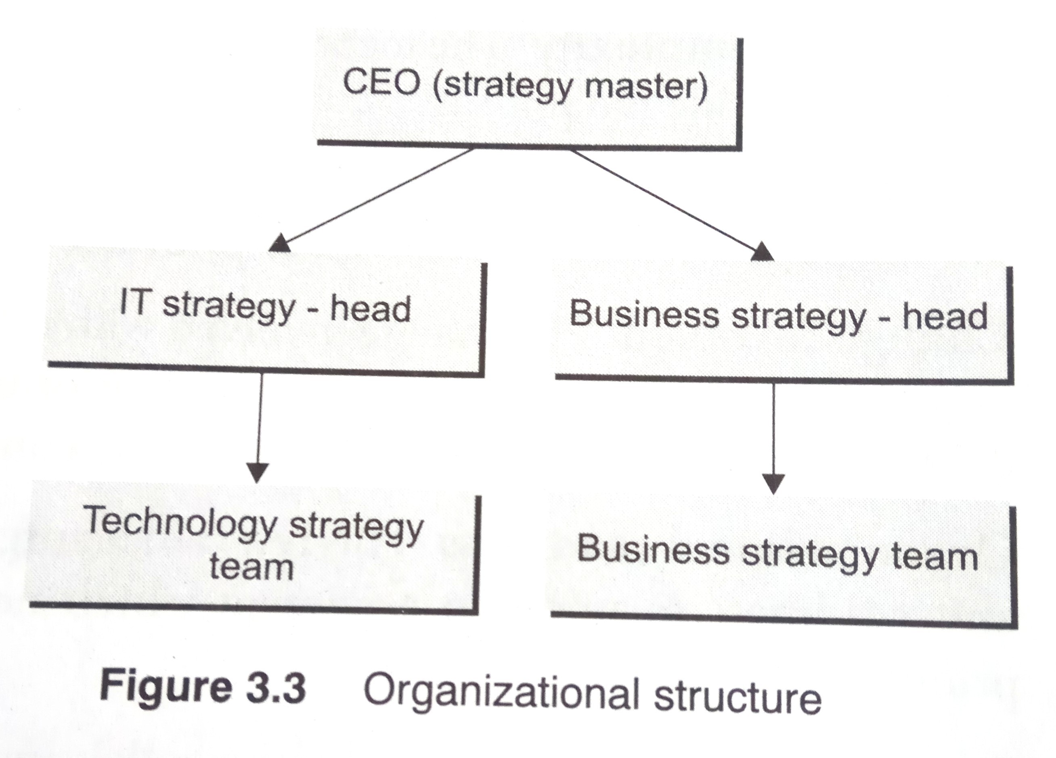
Governance Structure for e-strategy implementation
Any e-business initiative involves representation from both the business and the IT team, who work in close co-ordination to reach the overall e-strategic plan or goals.
There is a need for a clear governance structure that is able to look across the different initiatives, monitor their health, resolve conflicts, and provide the requisite funding and resources.

Slide 6
E-Business and E-Strategy
E-Strategy cannot be discussed in isolation, nor can e-business be talked about in the same breadth as e-strategy.
Analysis of strengths and opportunities of e-strategy against that of e-business is essential.
Strengths
  Target group is reached; low investments within traditional sector; reputation of traditional brands; e-commerce shops are expandable; e-commerce prices respond according to the demand; e-commerce lowers the cost of stocks and personnel; e-commerce is available 24 hours a day; e-commerce personnel are highly educated.
Opportunities
  Use of ‘gimmicks’ for promotional activities online; e-commerce partnerships with wholesale trade companies; starting e-commerce application with familiar retailer; operated in a niche market; integrate e-commerce applications with the back office; Selling known brands using e-commerce has an advantage over unknown brands; sell a complete range of products by using partnerships; Price can be selling strategy because an e-retailer has lower costs;

Slide 7
Developing e-Strategy
Keys to successful development of an e-commerce strategy: -
  Support from senior executives
  Develop strategy prior to web presence
  Focus on technology, branding, marketing and service
  Match IT infrastructure to strategic objectives
  Identify and use of knowledge in the organization
  Add value for customer
With e-strategy, it is possible to transform a traditional fixed-asset company into a nimble Internet company.

Slide 8
E-business Models
A business model is a set of business processes through planned activities to achieve business objectives.
Business models and their objectives have different strategic decision making aspects.
Components of business models are: -
  Value proposition
  Revenue Model / Cash flow
  Market forces and available opportunities
  Competition
  Positioning of Product
  Market Strategy
  Technology and IT Strategy
  Organization structure and development
  Management team
  Knowledge management

Slide 9
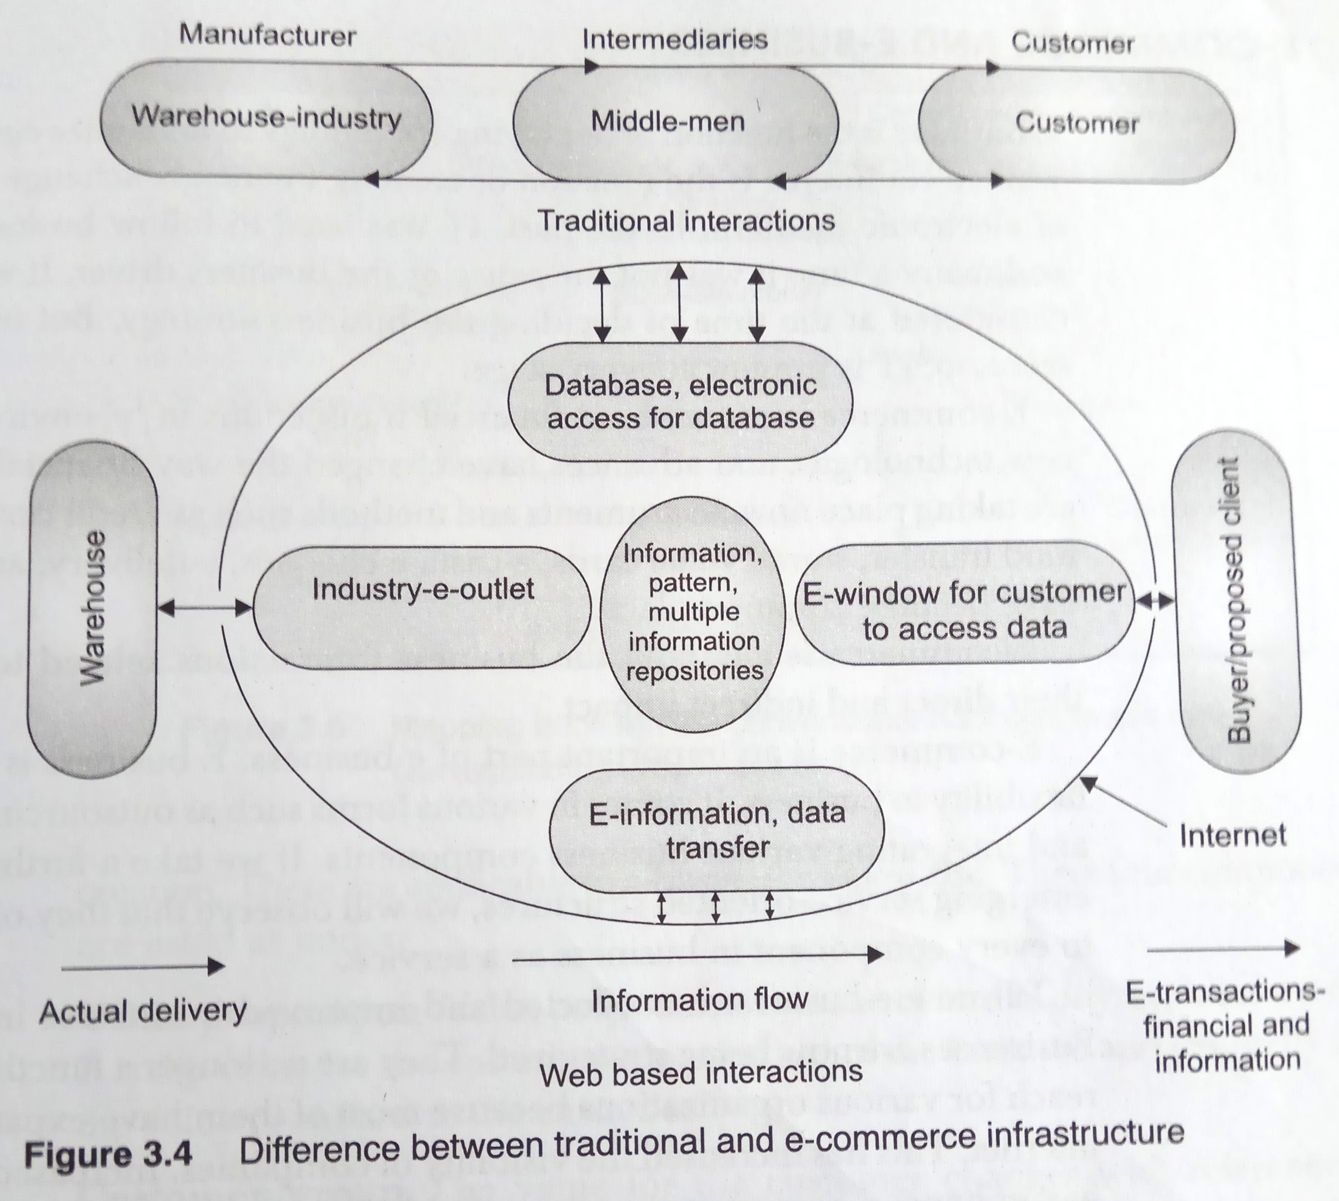
E-business Models (contd.)
Amazon and Dell from e-business models:
  They are approaching the whole business in different manner.
  Their value proposition and revenue models are completely different from those of their traditional business counterparts.
E-transactions and e-commerce have become a common place over the past few years.
The flow of information and data has replaced the intermediaries while electronic monetary transactions have replaced actual financial transactions
The strategy of distributors, suppliers, and physical penetration has been replaced by e-strategy of electronic transactions and positioning of the technology.
The complexity of the overall models has increased along with the evolution but it has resulted in improved usability.

Slide 10
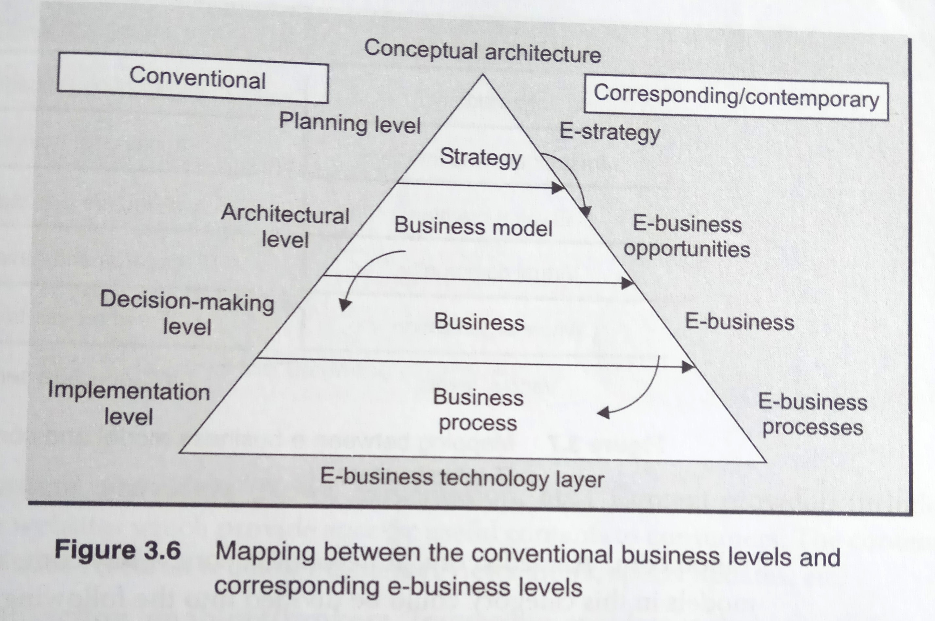
e-Commerce and e-Business
E-business is the function of deploying technology to maximize customer value while e-commerce is the function of creating financial exchange with the use of electronic medium.
E-commerce is an important part of e-business.
e-business offers flexibility to business. It comes in various forms such as outsourcing, off shoring and integrating various business components
Businesses nowadays are being strategized. They are no longer a function of physical reach for various organizations because most of them have expanded through the Internet. This has increased the visibility of companies also.
Businesses have changed the way they communicate externally and internally.
An e-business system enables marketing, buying, selling, delivering, servicing, and payment of products, services, and information primarily across non-priority networks, in order to link enterprise with its current and target customers, agents, suppliers, and business partners.

Slide 11
E-business models
E-business components that are applicable to e-business models also are: -
  Value proposition
  Customer group
  The way value will be created
  Money
Some of the popular e-business models are: -
  B2C
  B2B
  Others are P2P, C2C etc.

Slide 12
B2C (Business to Consumer)
B2C could be divided into: -
  Different portals
  Sale of goods electronically (e-tailors)
  Content providers
  Transaction enablers/brokers
  E-auctions
  Service providers
  Community information providers
  Hybrid models

Slide 13
B2B (Business to Business)
These are the models in which businesses focus on buying/selling to other businesses.
The companies which help to bring buyers and sellers together, distribute products to other businesses, and which act as a service provider for other businesses.
Other models are: -
  C2C (Consumer to Consumer)
    Transactions take place without the presence of any middlemen.
  P2P (Peer to Peer)
    It is about the connectivity between peers for business

Slide 14
Making e-strategy work
To make e-strategy work, an organization has to deal with the changes in technology, educate its employees and customers, and decide and plan its actions in the light of the changes.
The two major phases are: -
  Pre-implementation
    The management of the organization needs to make it ready for the changes
  Post-implementation
    The management has to understand the after effects of implementation and changes, and deals with them accordingly.

Slide 15
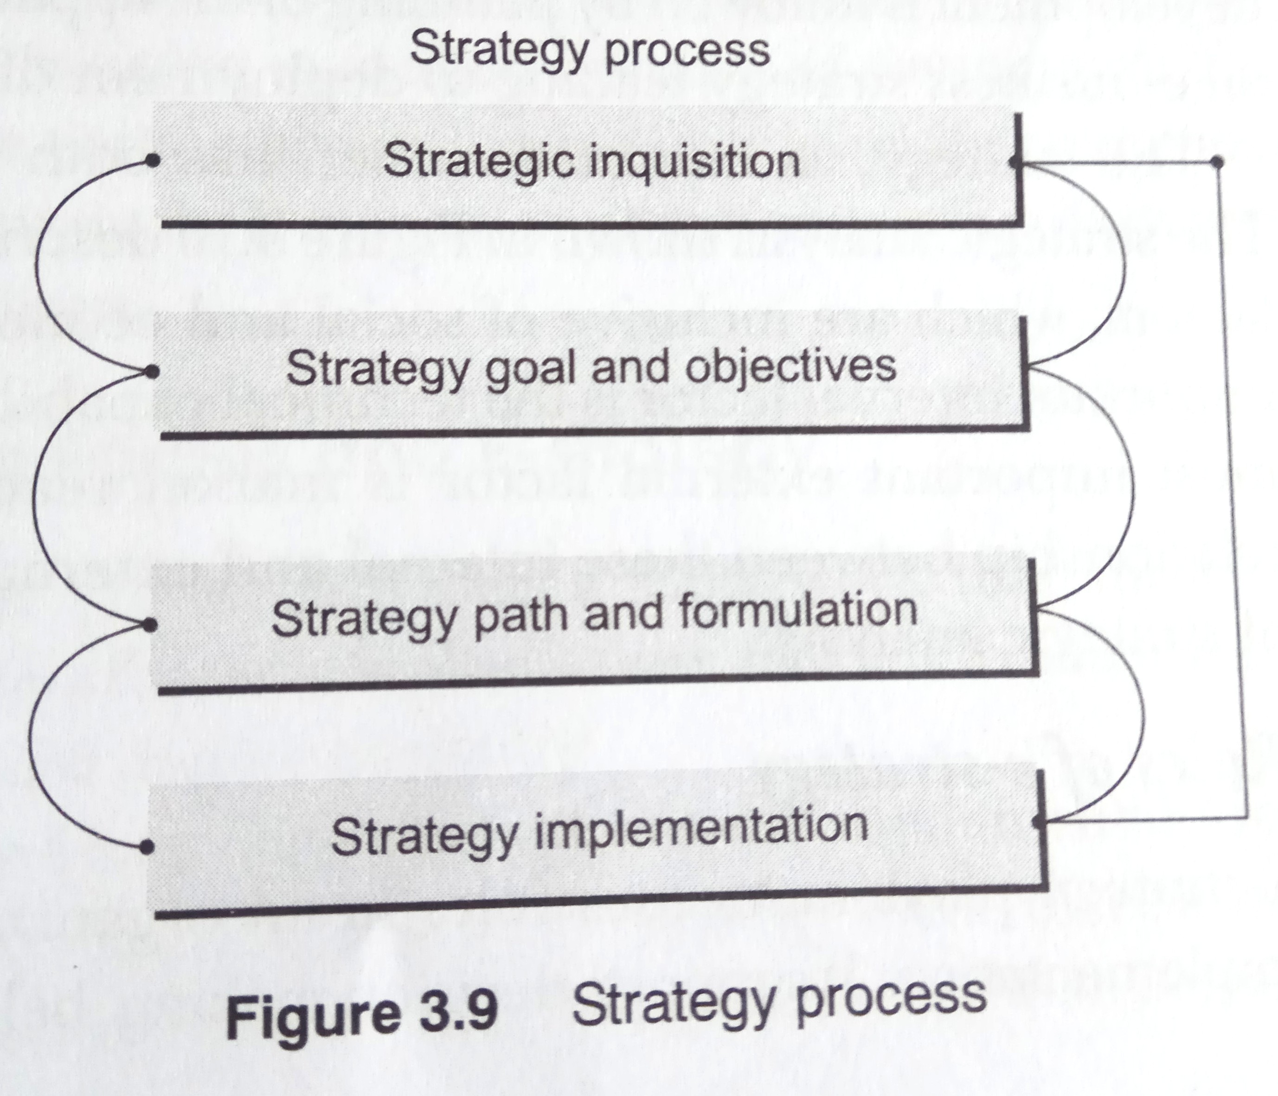
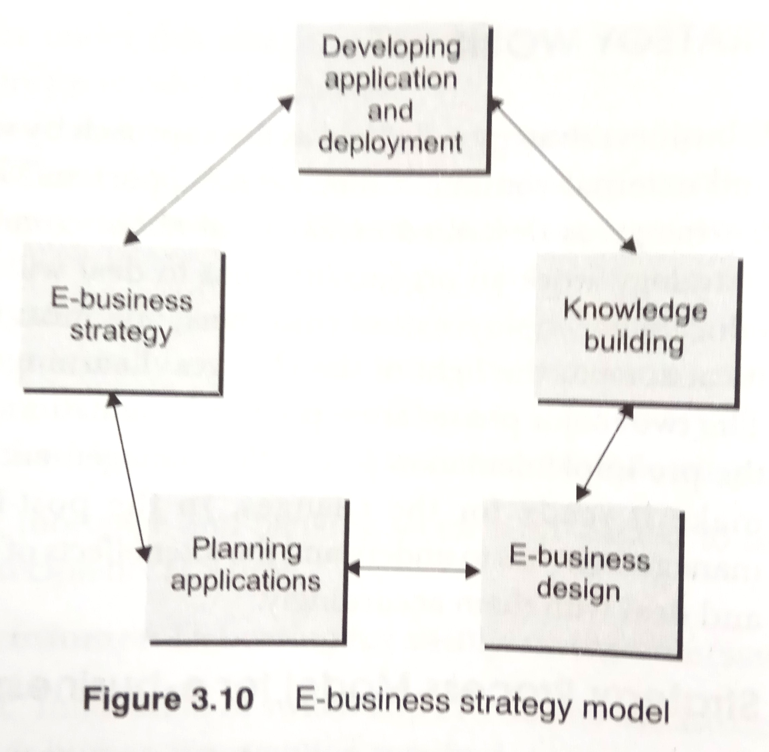
Strategy Process Model

Slide 16
Porter’s Five Forces and e-Strategy
Michael Porter provided a framework that shows that an industry is influenced by five forces, namely: -
  Supplier power
  Barriers to entry
  Threat of substitutes
  Buyer power
  Degree of rivalry
Five Forces model also describes the fundamental forces to formulate business strategy. In order to make e-strategy work, there is a need for iterative strategy model.

Slide 17
Five Forces: Impacts & Solutions
Force 1 : Bargaining power of buyer
e-Impact | e-Strategy to make business work
Increased due to choices Increased because of increase in customer knowledge and transparency Increased because of availability of different channels Increased because of availability of different sources | Quality beyond technology Service with apt technology ‘e’ for extra
Force 2 : Bargaining power of supplier
e-Impact | e-Strategy to make business work
Reduced due to choices Commoditization of e-procurement and e-market places More price-driven | Limit commoditazation by new measurement Let business drive commerce Value for money

Slide 18
Five Forces: Impacts & Solutions (contd.)
Force 3 : Threat of substitute products and services
e-Impact | e-Strategy to make business work
New products being introduced because of the availability of knowledge and market place from different resources Monitoring such entries has become easier Faster production of services | Proper tracking with technology Strategy to build barriers Innovation with ‘e’
Force 2 : Barriers to entry
e-Impact | e-Strategy to make business work
Reduced for service organizations and retailers who need mobile sales force Monitoring new entrance has become easier Easy for followers due to internet | Build barriers with innovation and new techniques Optimal use Barriers with service

Slide 19
Five Forces: Impacts & Solutions (contd.)
Force 5 : Rivalry among existing competitors
e-Impact | e-Strategy to make business work
More intense because of shorter product life cycles Commoditizations | Capturing complete value chain E-strategy to target niche market Knowledge-enabled business
To make an e-strategy work, organization should be ready for ‘e’.
This readiness not only involves technological readiness but is also involves psychological readiness.
This readiness pertains to the effective usage of ‘e’ and further effectiveness of e-strategy.
There is a need for e-awareness, and a need for market to accept.
There is also need to derive competitive advantage and a proper way to measure RoI.

Slide 20
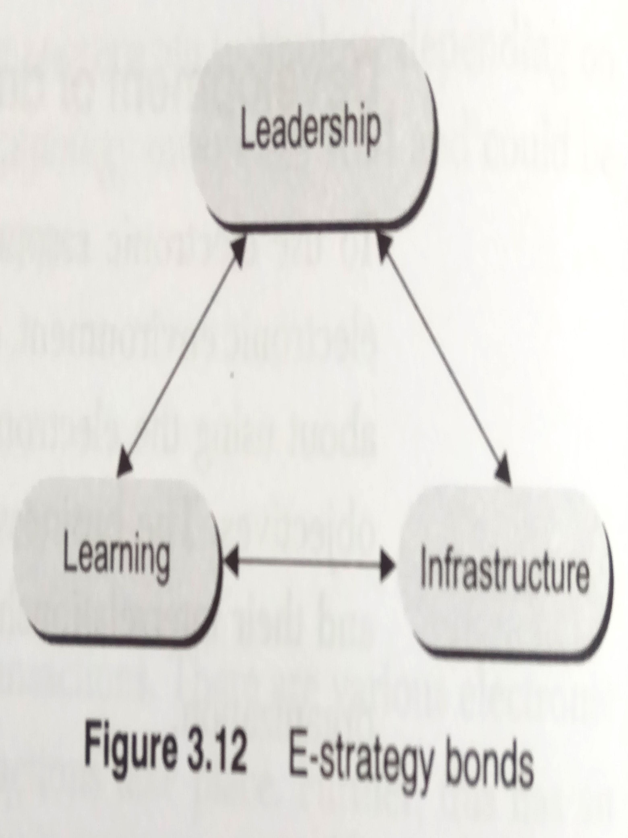
Bonds of e-commerce strategy
The strength of e-commerce strategy depends upon addressing the three functional issues: -
  Leadership
  Infrastructure
  Organizational learning
Bond-1: Leadership
  Executives have to expand their vision for their organization and develop creative strategies.
  Leaders should
    Keep an open mind
    Not isolate themselves from new and experimental technologies
    Encourage new research work
    Be ready to make the necessary change

Slide 21
Bonds of e-commerce strategy (contd.)
Bond-2: Infrastructure
  Put in place the requisite infrastructure at several levels.
  The focus should be paid on determining the impact that future technologies will have on the market and the organization.
  Ensure that the organization has the capability to adapt to the changes in the technologies and market.
  The execution occurs at the physical level in hardware and software with telecommunication infrastructure.
Bond-3: Organizational learning
  E-commerce solution depends upon its ability to leverage and deploy organization learning
  Organization learning is linked to leadership competencies.
  Learning occurs in formulating and creating a brand, technology, market and service leadership positions.
  Leaders with learning culture facilitate new concepts and technologies.
  Successful organizations always internalize learning by developing an understanding of their processes and functions, which is important for company’s long term survival

Slide 22
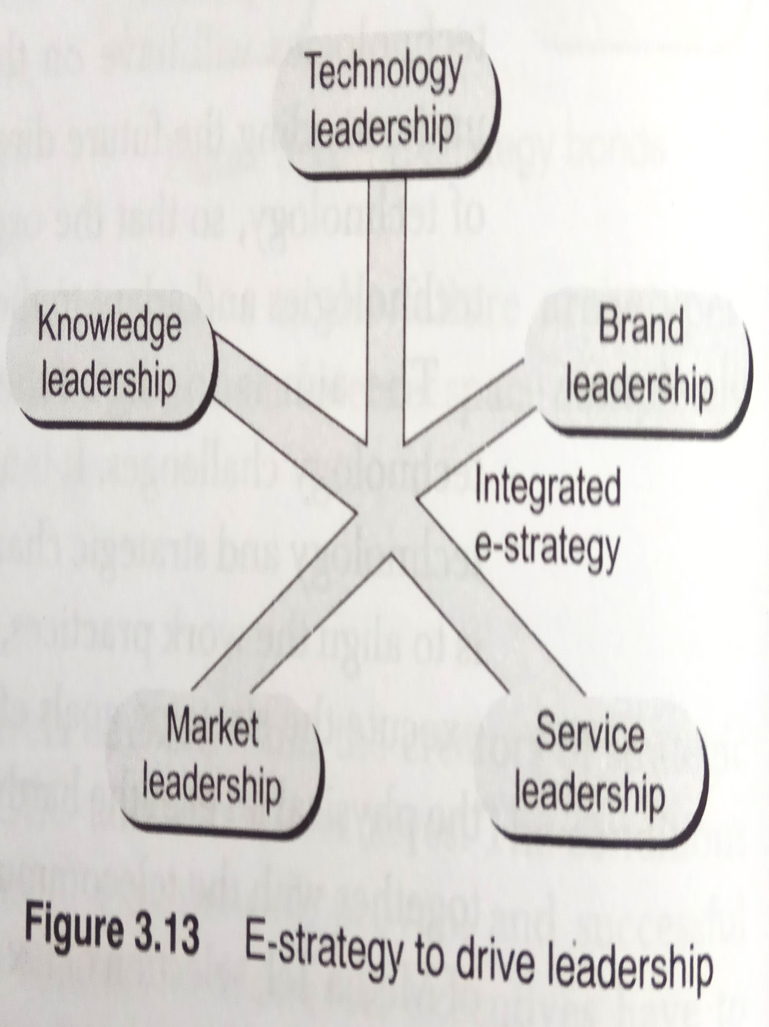
Five Pronged e-Strategic Directions
Technology leadership
Brand leadership
Service leadership
Market leadership
Knowledge leadership

Slide 23
E-Strategy Barriers
Weaknesses
  Traditional workers are not aware of new technologies
  The e-commerce target group is difficult to reach; other channels are required along with internet.
  Most of the e-commerce companies sell using only the email; back office is usually not integrated in the e-commerce applications.
  The e-commerce logistical costs can be high.
  The current e-commerce investment climate is not very positive.
Threats
  Many websites offer the same products.
  The logistics of the business processes are often a bottleneck.
  Different prices for different customers or different prices on different days.
  The delivery time, terms of delivery, and the after-sales service have to be efficient. ( A customer is unlikely to return to the system in case of a negative experiences.)

Slide 24
Best Practices
Some of the best practices for implementing e-strategy : -
  Understanding and implementing the electronic integration needs for new customer facing systems.
  Analyzing and identifying the strategic route for transition from old or legacy system to new or next generation information systems.

Slide 25
Compiled from
Parag Kulkarni & Pradip K Chande, IT Strategy for Business

