Slide 1
Chapter 6: IT Strategy for Knowledge Management
Roshan Chitrakar, MBA
Associate Professor,
Nepal College of Information Technology

Slide 2
Knowledge Management (KM) : Introduction
Knowledge is the force which decides direction of overall knowledge and business strategies. Managing this force, directing it, using it optimally etc. are some of the functions of Knowledge management.
KM is often confused with Information Management and Data Management.
Knowledge within an organization may be:- tacit, explicit or semi-tacit.
Knowledge has a time axis – yesterday’s knowledge may be today’s information.
Making knowledge available at the right time to the right person is the key aspect of Knowledge Management.
Knowledge workers in an organization hold most of the tacit knowledge, which may be lost in cases of attrition and inter-departmental transfers.

Slide 3
KM and IT Strategies
One important aspect of KM is to build and use knowledge within and outside the organization optimally, whereas IT enables knowledge codification, knowledge storage, and knowledge reuse.
IT makes it possible to represent, map and position knowledge within and across an organization.
IT strategy for KM is not about developing new IT applications but about strategic visioning in IT that can build a strong KM strategy.
KM consists of facets like: - technology, culture, management, knowledge workers, prioritization, auditing, and measurement.
Information system architecture is one of the most important edifices of KM. IT strategies enable KM strategies and vice-versa.

Slide 4
Components of KM Platform
Document management
Various automation processes
Intelligent business flow
Work flow
Decision Support System
Data warehouses
Intranet
Communication platforms
Knowledge and process building tools and packages
Data capturing and pattern analysis tools
Collaboration tools

Slide 5
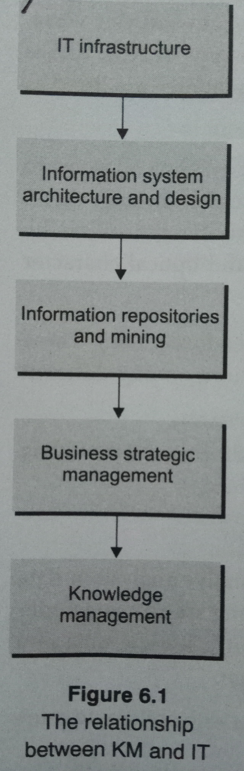
IT Strategy and KM Road-map
The knowledge forces in the organization are divided into
  Internal knowledge forces
  External knowledge forces
  Internal – External knowledge forces
IT resources (e.g. Internet, AI, DSS, Intranet, Email, Communication systems, BBS, BI systems etc.) support KM. Using these resources and systems strategically along with embedding the in IT strategy is necessary in KM.

Slide 6
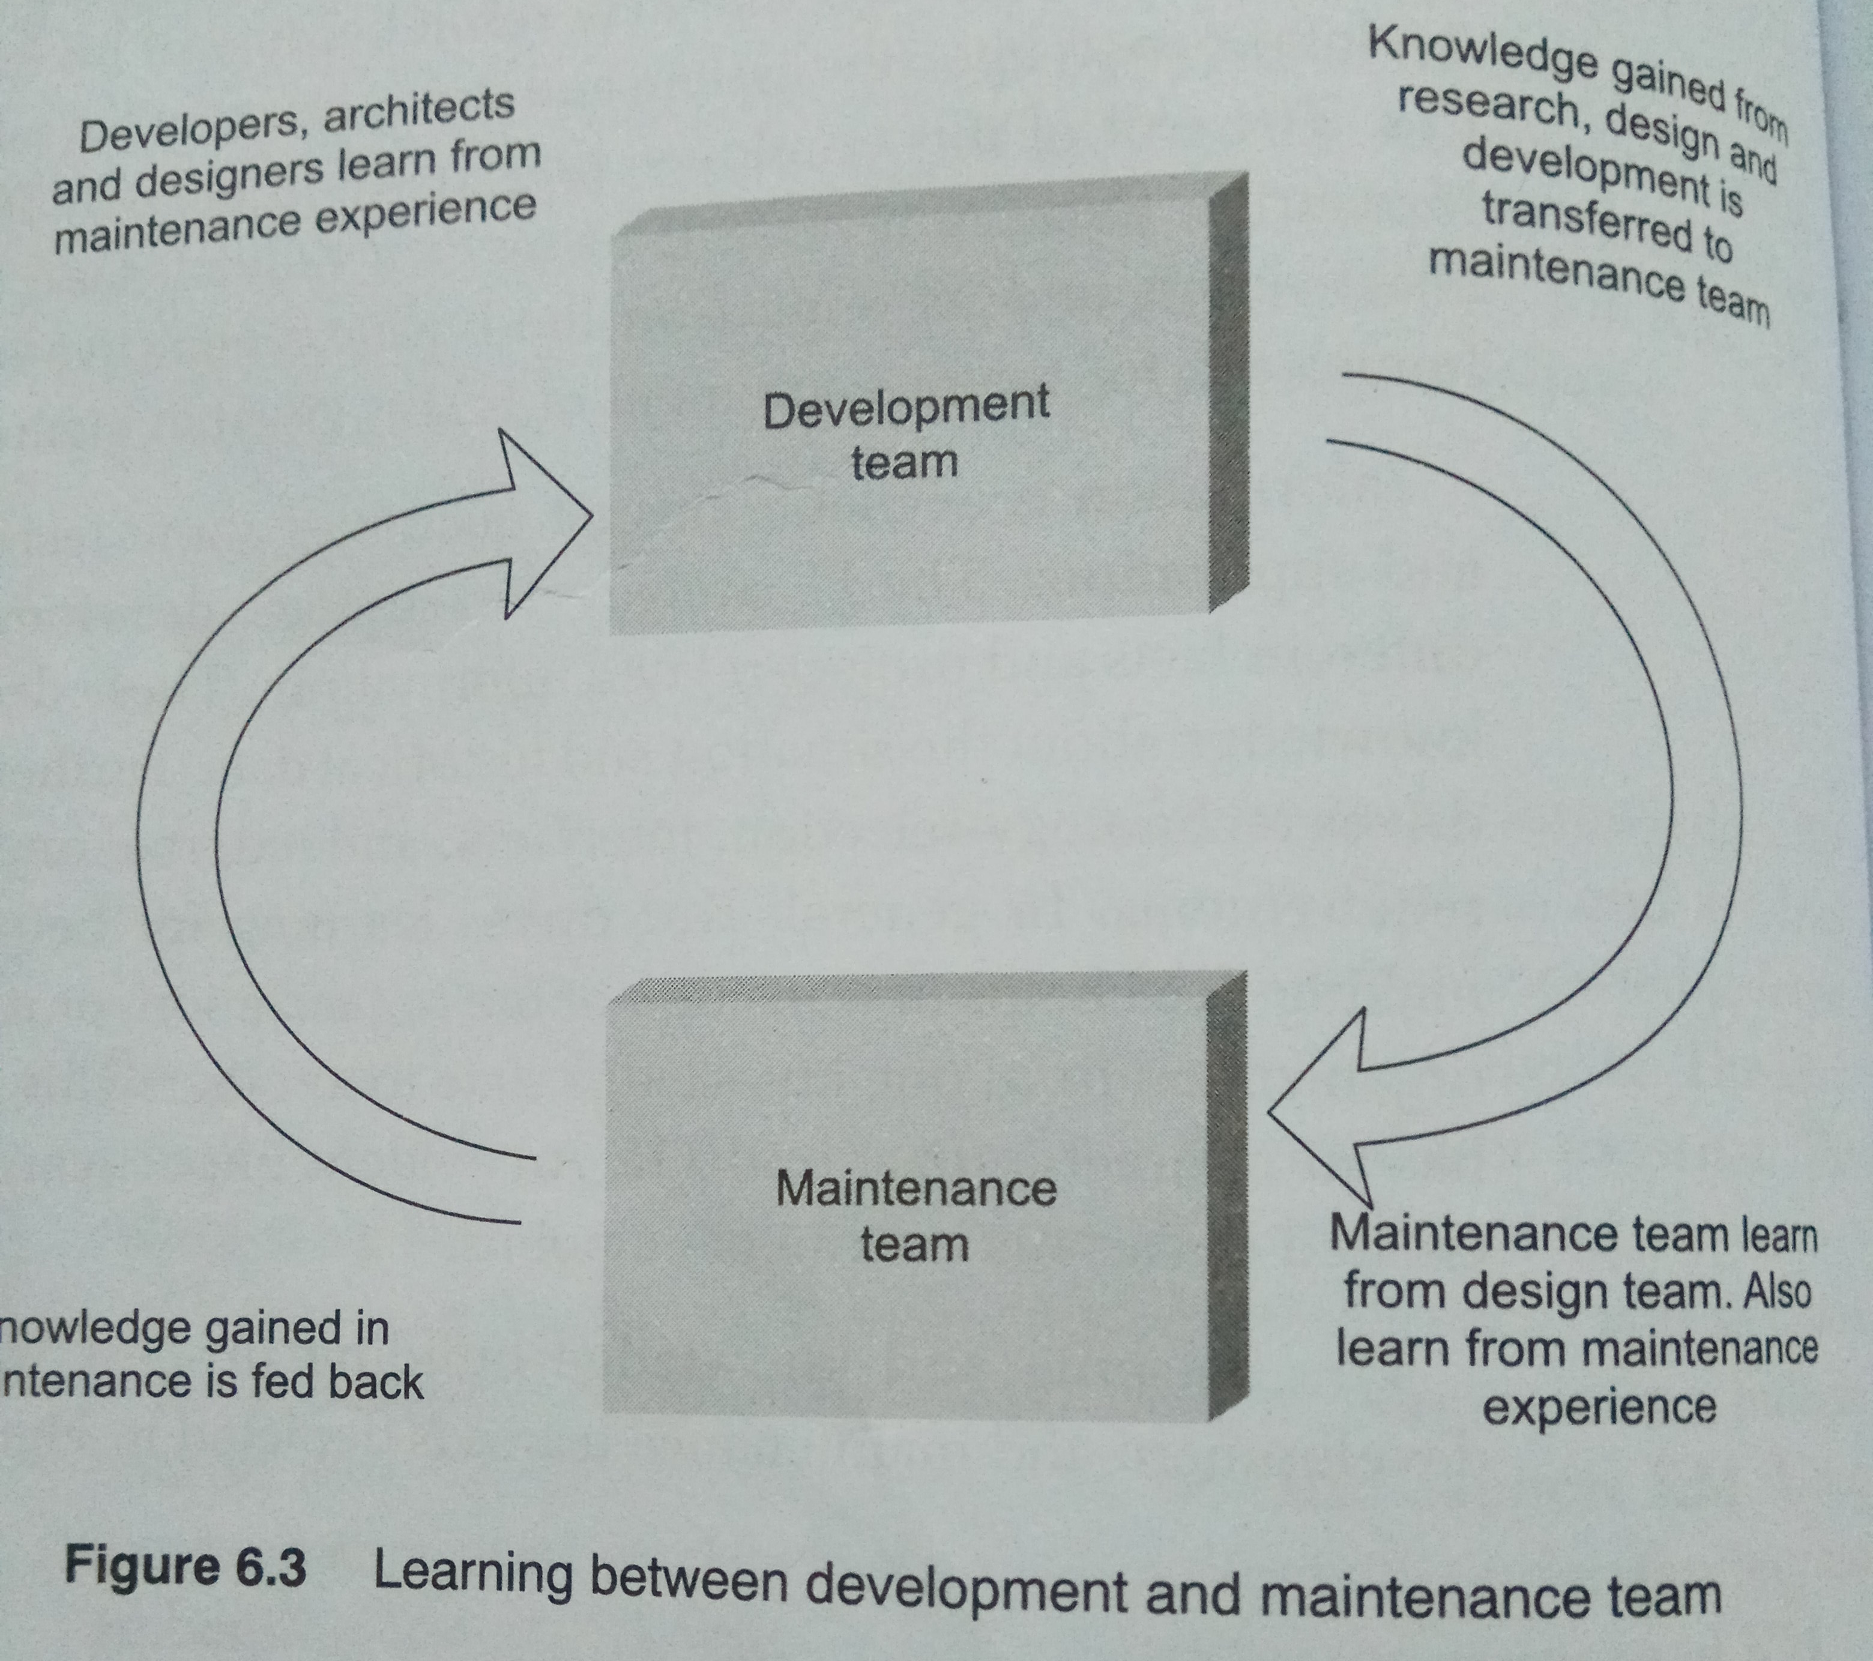
Role of KM in IT Strategy
KM enables effective strategy design and implementation which can help an organization succeed.
IT strategies for KM are driven by requirements of knowledge flow and minimizing the knowledge loss.
Knowledge loss can be evident or non-evident. Evident loss is seen directly and has direct impact on business, whereas measuring a non-evident loss is difficult.
IT strategy and strategic decisions are driven by knowledge about the situation and historical data. Moreover, KM drives learning for better strategic decision-making.
KM heps in transition of an organization from one knowledge state to another.

Slide 7
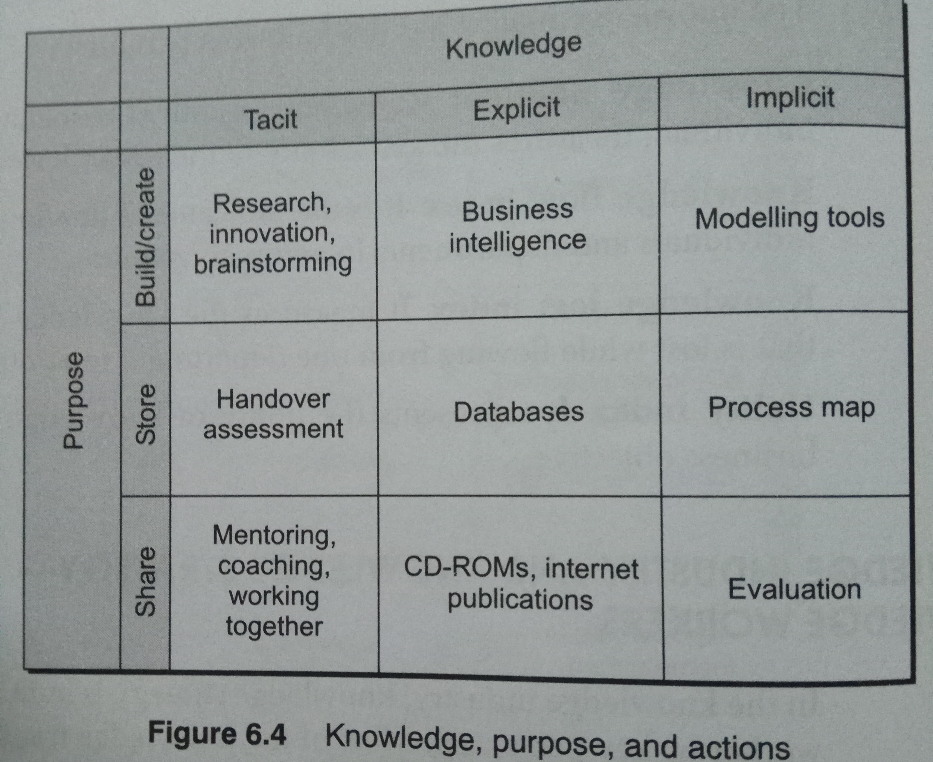
Knowledge Industry and Knowledge Strategy
In a knowledge industry, knowledge strategy is built around knowledge workers.
Tacit, implicit and explicit knowledge need to be transformed, built and stored.
IT enables all knowledge transactions and KM activities.
Knowledge economy is based on knowledge advantage that is on what you know (not what you make).
  The more exclusive and extensive the knowledge, the greater is the price they command.
  The more knowledge the work is, the greater is the value of the knowledge.
A company must exercise knowledge building exercises for the following decisions:-
  (1) Startup product;
  (2) Continuing service or product;
  (3) Complementing existing products;
  (4) Different services for product.

Slide 8
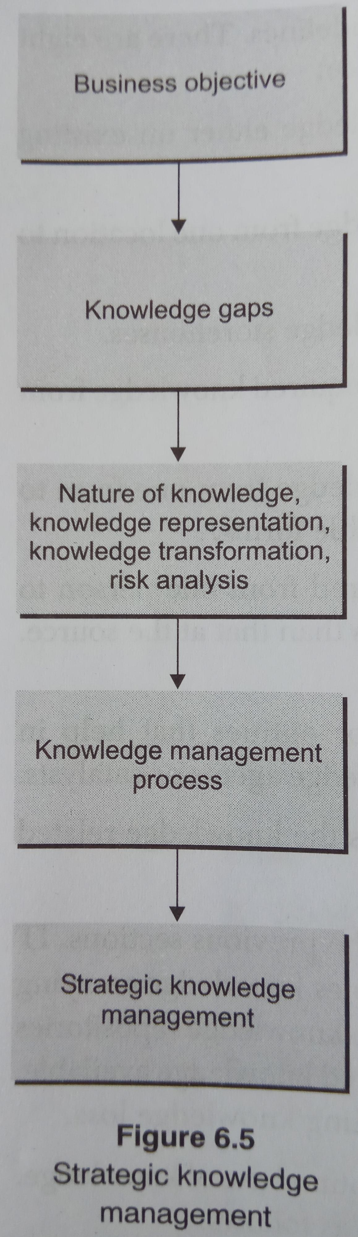
Strategic Knowledge Management
KM strategies, though based on the same guidelines, differ from one knowledge industry to another.
Aspects (components) of Knowledge space: -
  Knowledge creators
  Knowledge carriers
  Knowledge repositories
  Knowledge mining
  Knowledge transformers
  Knowledge loss
  Knowledge agents / catalysts
  Knowledge driver
Objectives of KM Strategy: -
  Positioning knowledge strategically
  Using knowledge optimally
  Transforming knowledge with minimum loss
  Motivating knowledge workers
  Tapping knowledge across organization
  Aligning knowledge force with business objectives
  Allowing organization to use knowledge as a strategic tool

Slide 9
Knowledge Transformation
Includes: -
  Knowledge creation
  Knowledge acquisition
  Raising awareness
  Knowledge transformation
  Knowledge mapping
  Knowledge application
  Problem solving
  Learning and knowledge creation
Knowledge in an organization can be divided into four types, based on levels.
  Elementary knowledge
  Core knowledge
  Advanced knowledge
  Innovative knowledge
Based on application, knowledge may be divided into: -
  Administrative knowledge
  Declarative knowledge
  Procedural knowledge
  Analytical knowledge
  Transaction knowledge
  Derived knowledge

Slide 10
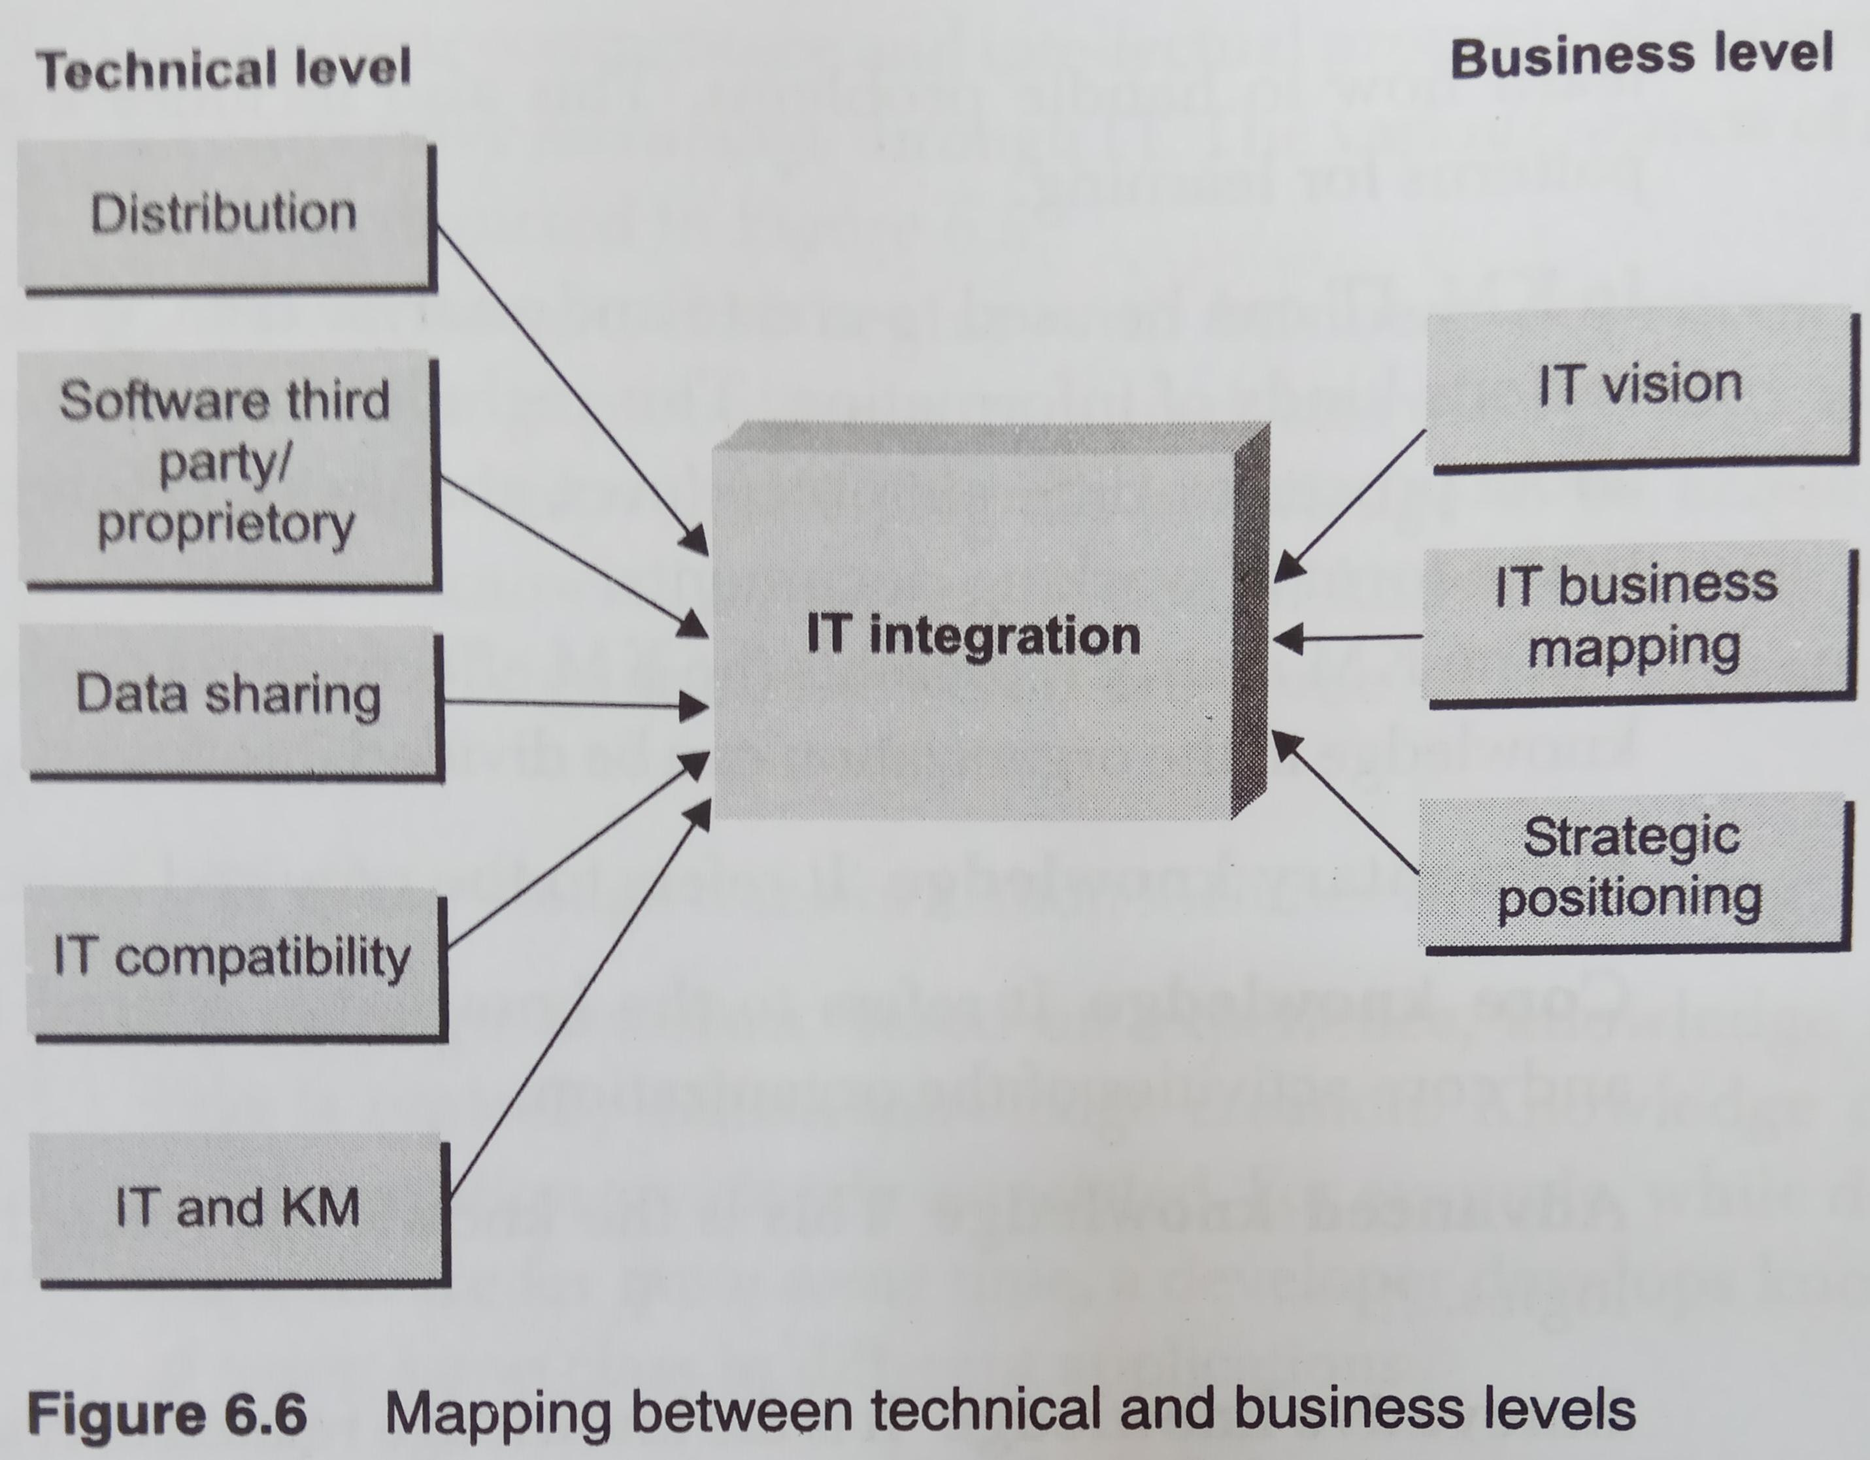
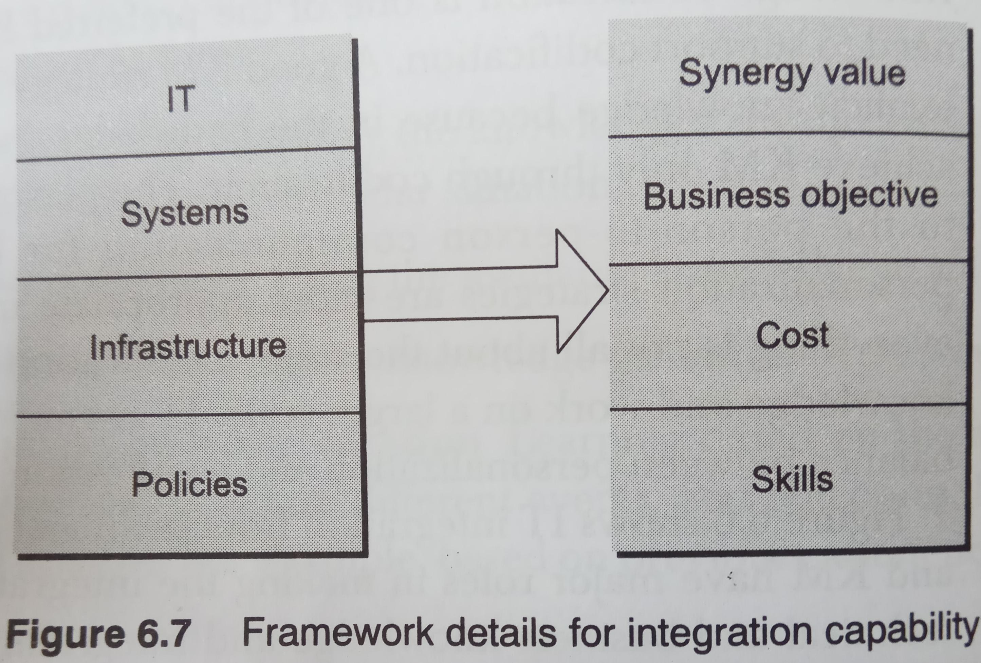
KM and IT for Integration
KM and IT have major roles in making the integration happen
Managing technical and business knowledge and integrating them to achieve business objectives is possible through effective KM.
Data sharing, IT business mapping, IT compatibility, and distribution are enabled with IT strategies for KM.

Slide 11
Compiled from
Parag Kulkarni & Pradip K Chande, IT Strategy for Business

