Slide 1
Chapter 7: IT Strategy for IT Companies
Roshan Chitrakar, MBA
Associate Professor,
Nepal College of Information Technology

Slide 2
Introduction
IT companies are companies that have IT as a part of their business objectives.
Strategies in IT and non-IT companies are different and the difference lies in the way IT is positioned.
IT companies are categorized into: -
  Project companies : produce products based on information technology.
  Product companies : undertake projects based on customer requirements.
  IT consulting companies
  IT service companies
Different types of IT companies
  Have different business outcomes and life cycles,
  Approach business in different ways,
  Need different business strategies, and so on.
IT is the mean, source, tool and outcome of an IT company, where it also acts as a driver, objective and strategic weapon too.

Slide 3
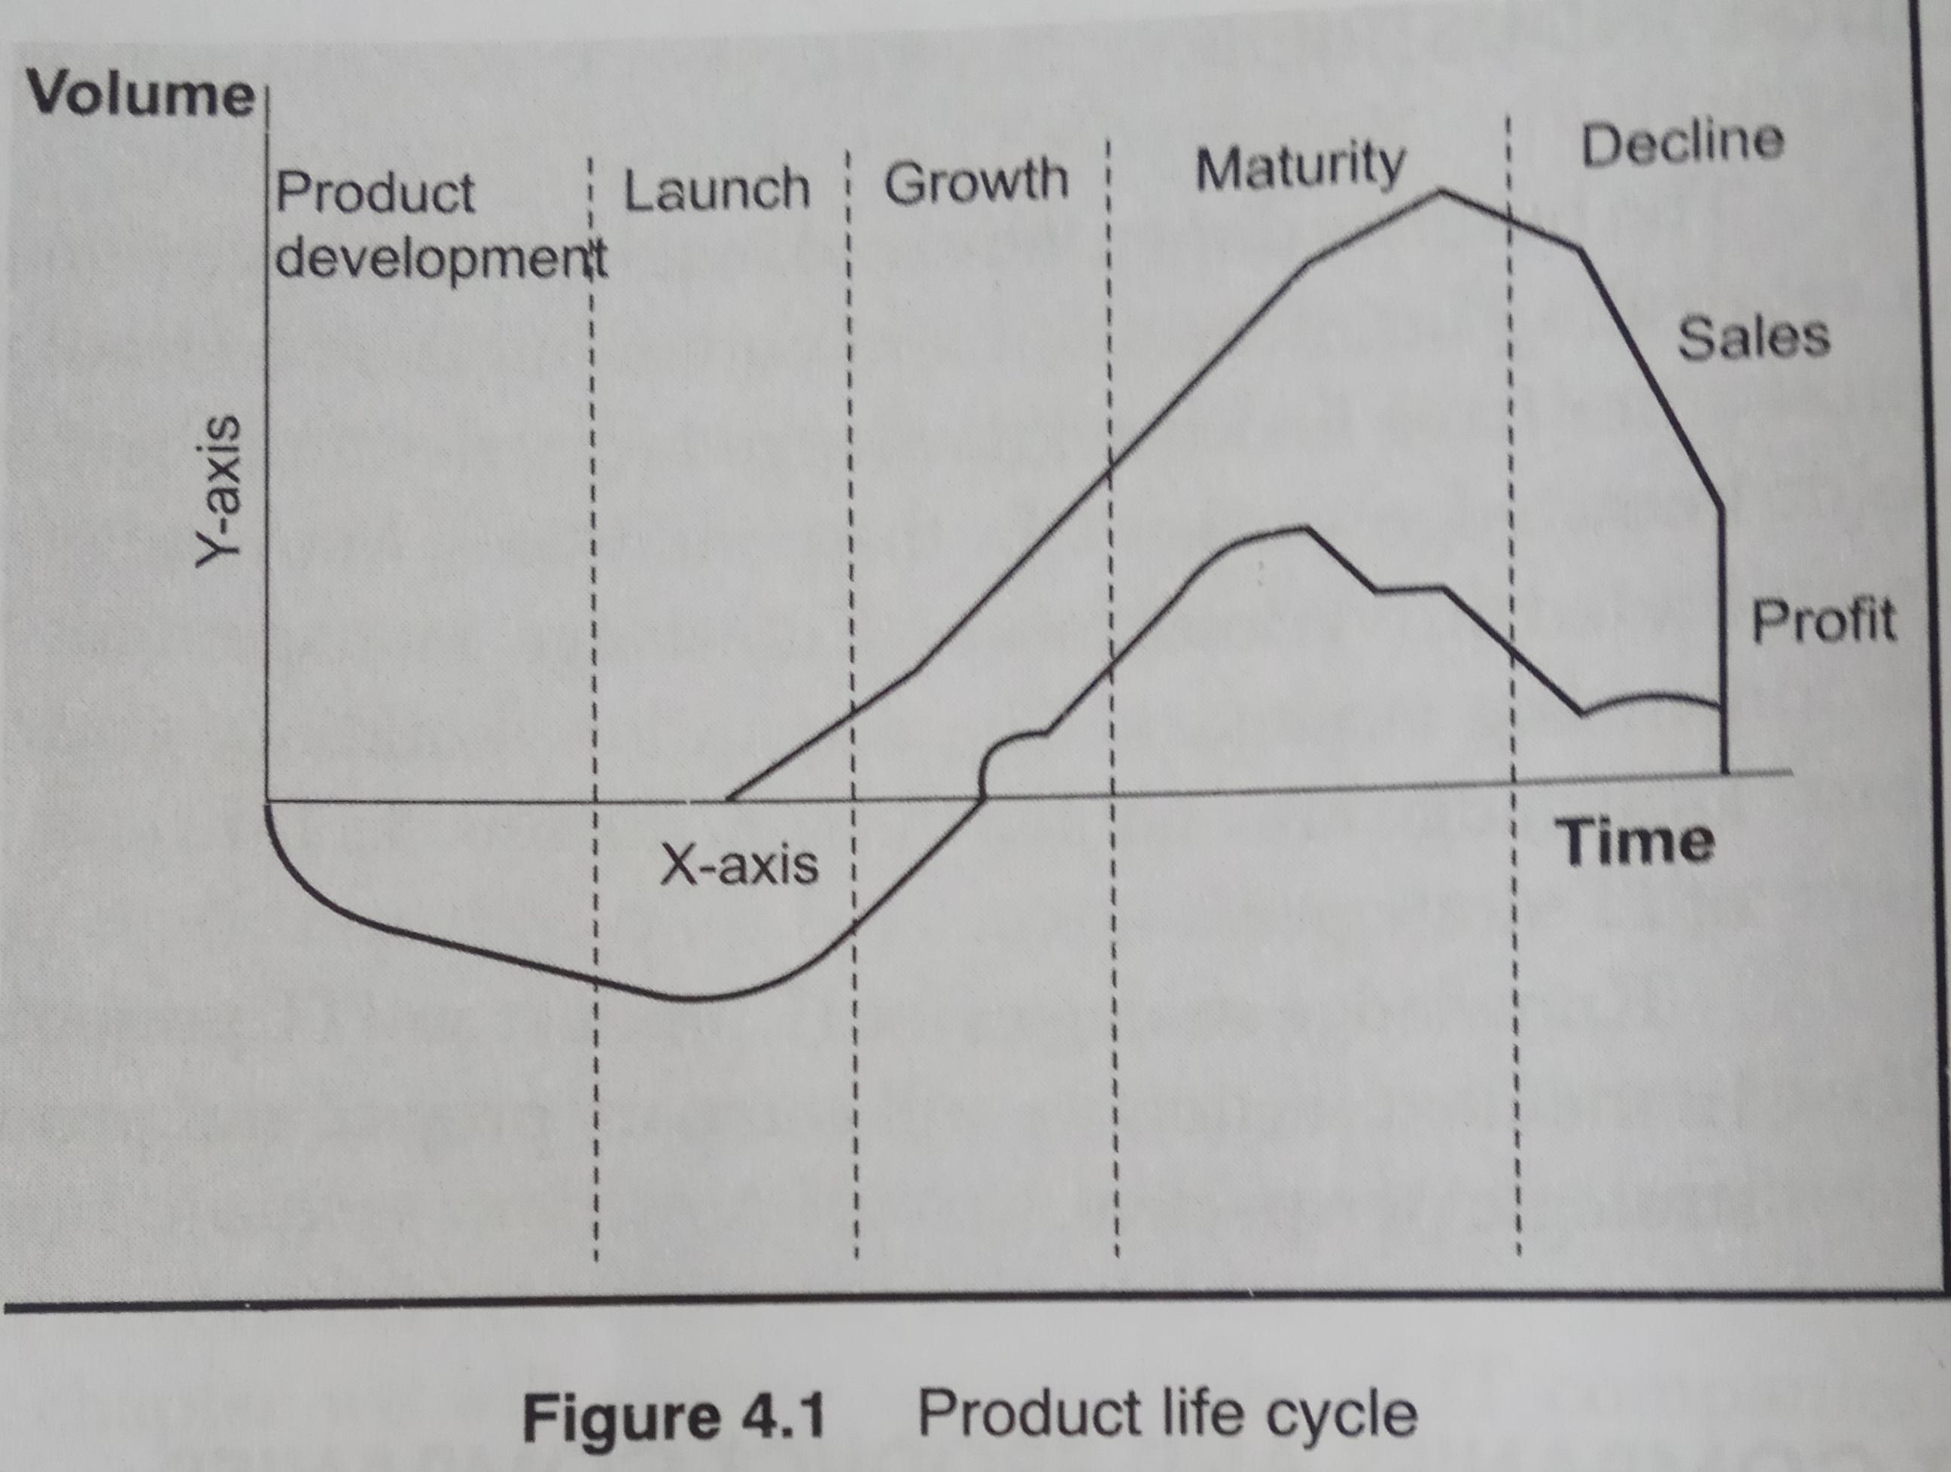
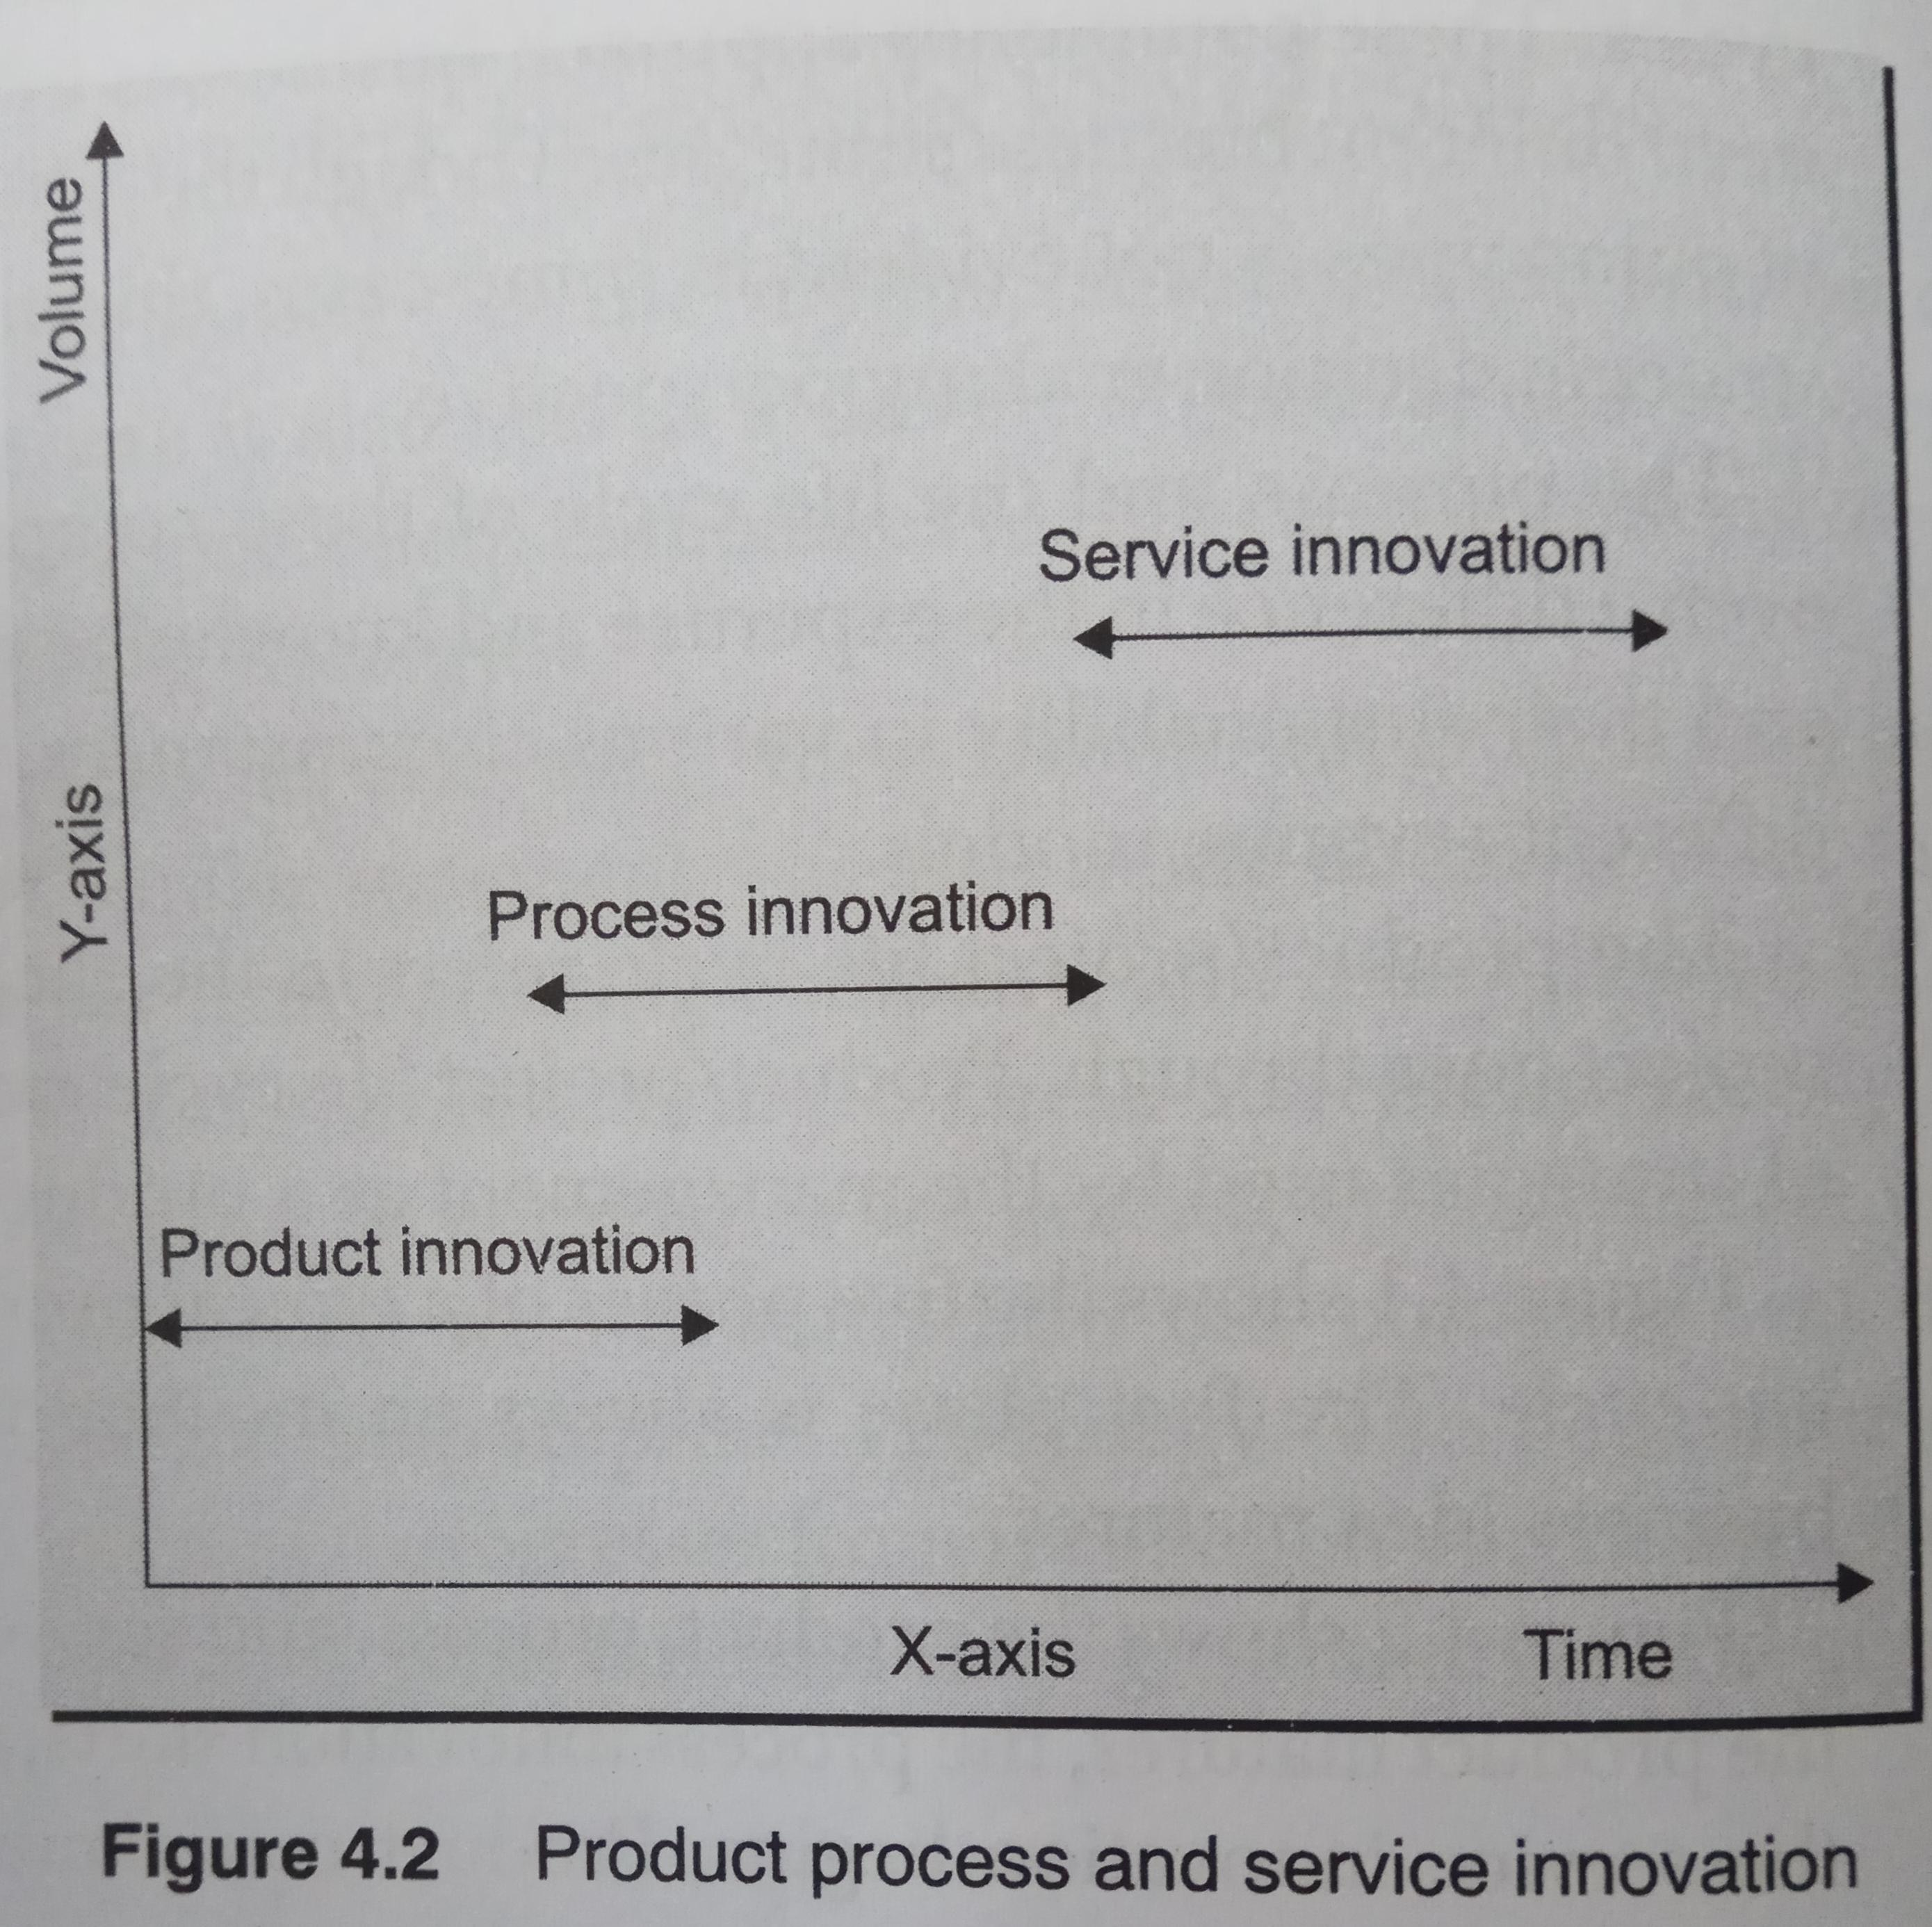
IT Product Company
Among the 5 phases of product cycle, the first phase is always an incubation period during the business idea matures.
When product matures, process innovation starts, and when process matures, service innovation begins.
Company starts making more profit from service than from marketing.

Slide 4
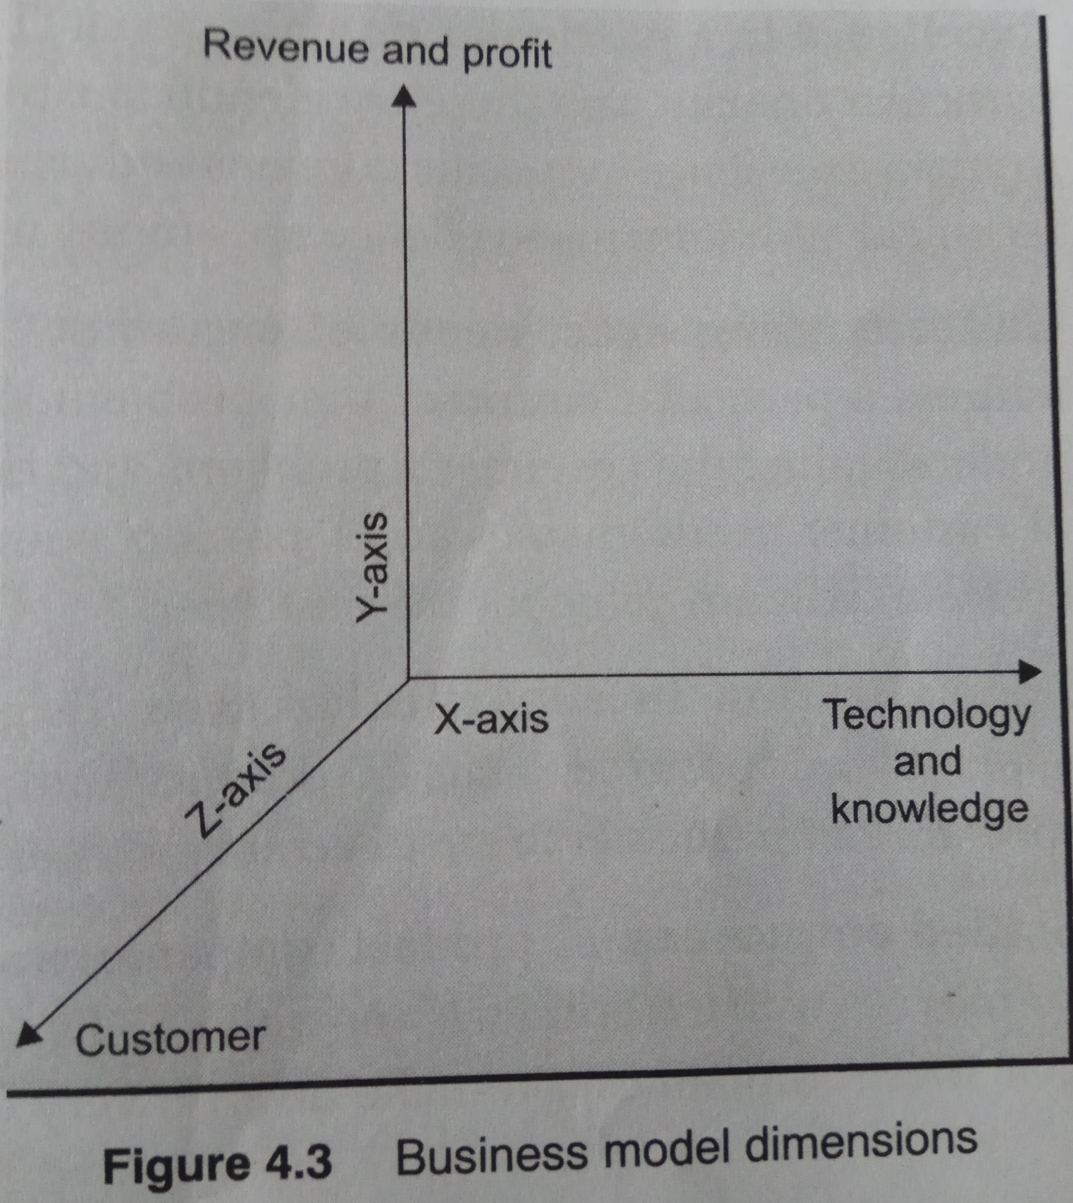
Product Company : Business Dimensions
The Business model dimensions are: -
  Customer,
  Technology & Knowledge,
  Revenue & Profit
3 main drivers are: -
  Customer
  Delivery model
  Revenue model
IT strategy impacts the customer dimension by the way a product is positioned, technology interface provided etc.
IT also drives revenue, availability of information and knowledge.

Slide 5
Product Company : Characteristics
Incubation
Innovation
Uncertainty
Different phases
Product culture
Excellence in a domain
Understanding exact need of customer
Specialization in a particular area
Skilled employees

Slide 6
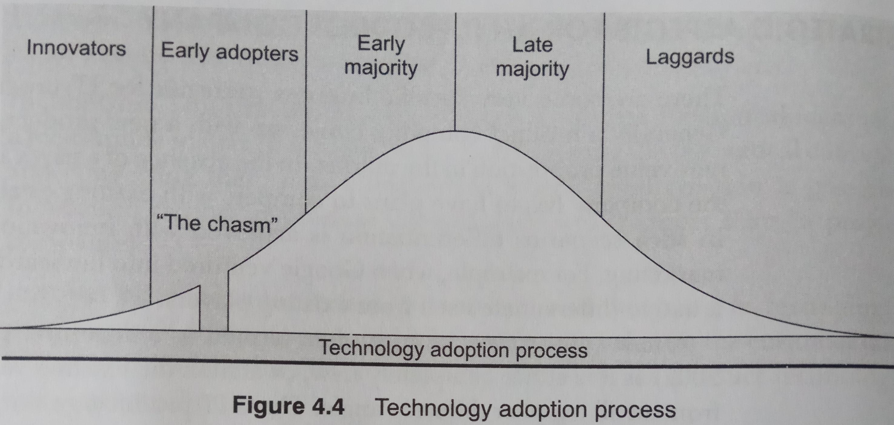
Product Company : Strategic Aspects
Propose a new product in market differently with innovation, quality and marketing.
According to Moore (2002) a new value proposition is disruptive as it is either entirely a new product or attacks as already existing value proposition.
A new IT product has to go through technology adoption life cycles and these phase come across numerous chasms.
To overcome such hurdles, company need a good marketing strategy and technological maturity.

Slide 7
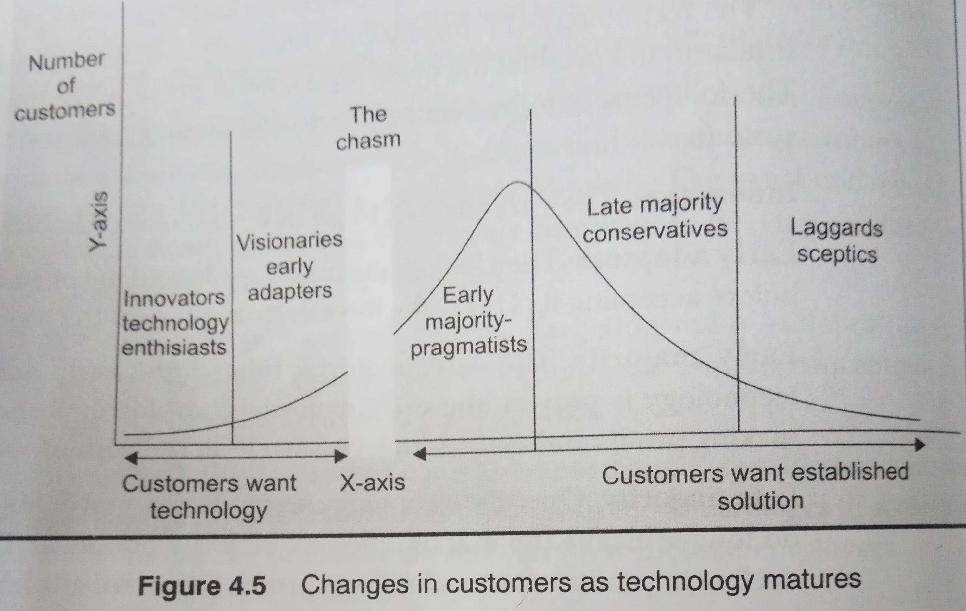
Product Company : Strategic Aspects (contd.)
Initial customers are innovators and enthusiasts are ready to accept new technology
Visionary customers understand merits of technology and want to take the lead.
Pragmatic and practical customers want the products proven by the market; they wish to ensure that there is not risk involved.
Conservative customers are ones with very low risk profiles.
Laggard sceptic people act after re-assuring themselves about the technology.

Slide 8
Project Company Characteristics
Incubation: short time
Innovation : Process-oriented
Uncertainty: Less amount
Different phases : Short period
Process culture
Excellence in a domain : less
Understanding need of customer : less exact
Specialization in a particular area : not mandatory
Big team of semi-skilled employees

Slide 9
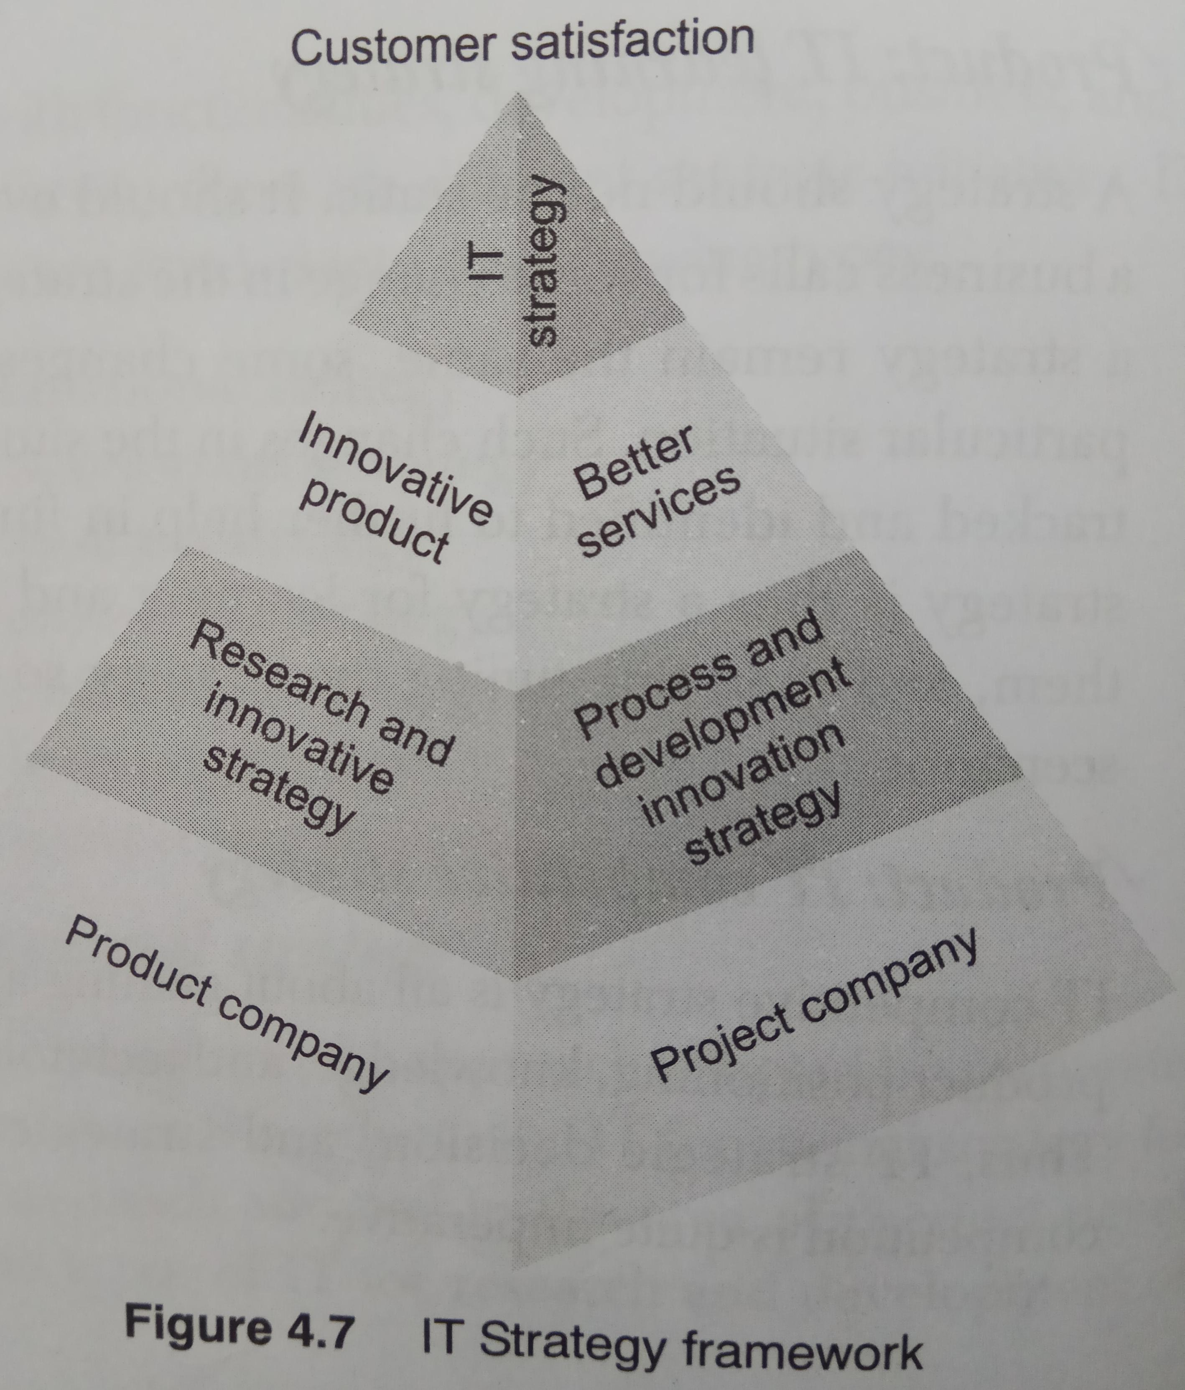
IT Strategies for Product Company
IT functional strategy
IT development strategy
IT business strategy
IT knowledge strategy
IT distribution strategy
IT learning strategy
IT competitive strategy

Slide 10
IT Strategy Development
Stage 1: Defining
Stage 2: Planning
Stage 3: Measurement
Stage 4: Learning
Stage 5: Execution
Once IT strategy is developed, it is involved in various steps like: -
  Product planning step
  Product development step
  Identifying internal and external interfaces

Slide 11
IT Strategy Drivers
What the customer wants?
Service orientation
Technical positioning of the product
Risks
Flexibility and adjustment in dynamic environment
Innovation
Sustainability
Quality
Technology appropriateness
Knowledge management requirements

Slide 12
Start-up Company
Innovation is at the heart of the Start-up companies
Factors that drives innovation are: -
  Disruptive technology, innovation, risk (diversified approach)
  Pace of execution, speed response to rapid change, and adaptation to the new environment
  Agility and flexibility
  Knowing the customer requirements and inventing the new product or interfaces with them.
  Understanding and properly valuing the innovation

Slide 13
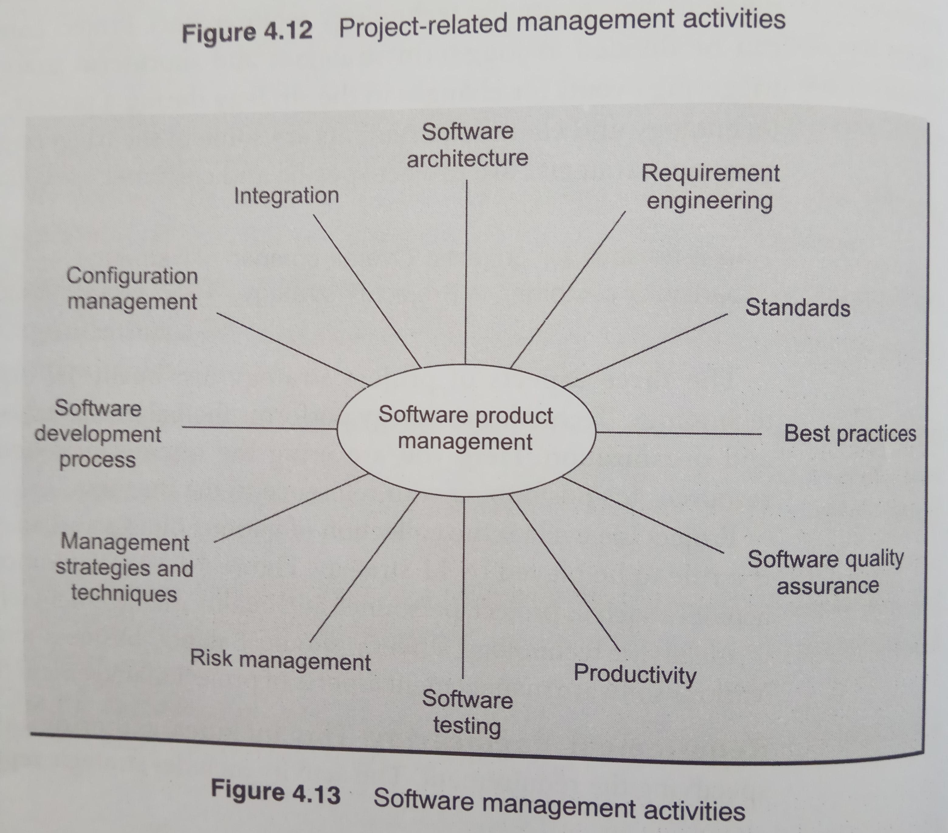
Project Life Cycle and Strategies
Project life cycle and revenue models of projects are different from product life cycle.
IT products start generating revenues much earlier than IT projects.
Growth of product companies are faster than product companies.
The customer behaviour and technology requirements are also different.
Project company strategies can be divided into
  Short term strategies
  Long term strategies
Project company strategies are
  Customer specific
  Project specific
Project life cycle is collection of various phases and strategy plays a role in each phase.

Slide 14
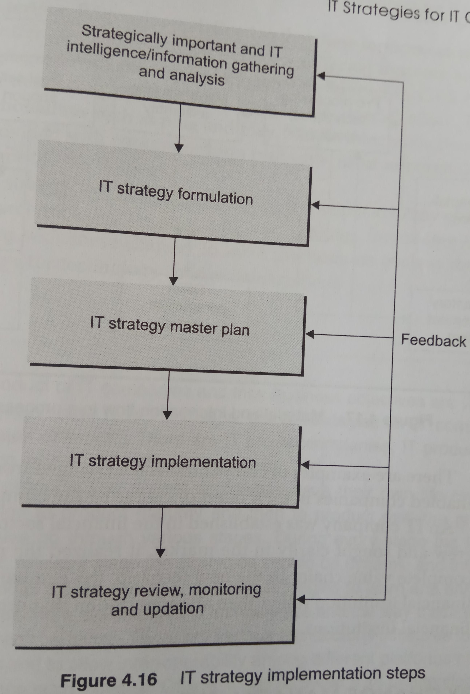
IT Strategy Implementation
Formulation
Strategy master plan
Implementation of a plan
IT strategy review and updating

Slide 15
Compiled from
Parag Kulkarni & Pradip K Chande, IT Strategy for Business

