Slide 1
Chapter 8: IT Strategy Implementation
Roshan Chitrakar, MBA
Associate Professor,
Nepal College of Information Technology

Slide 2
Introduction
IT strategy implementation refers to: -
  Outlining of strategic plans
  Working on initiatives
  Executing
IT strategy implementation takes an organization through different changes and transitions.
IT strategy implementation has four major aspects: -
  Leadership
  Technology
  Infrastructure
  Market
IT strategy implementation begins with
  Planning, and is followed by
  Development of IT strategic plan
  Identifying different activities and milestones in the process of implementation
  Prioritization of activities
  Executing the activities step-by-step.

Slide 3
Development of IT Strategic Plan
Two types of IT Strategic plans: -
  Short term plan
  Long term plan
Development of IT strategic plan requires to know
  What is an IT Strategic plan?
  Why do we need ?
  How do we execute? (steps needed)

Slide 4
Steps in developing IT strategy plan
Analyze business plan
Understand business objectives
Analyze IT-centered business
Know gap between IT requirements and IT capabilities
Prepare the first version of IT strategic plan

Slide 5
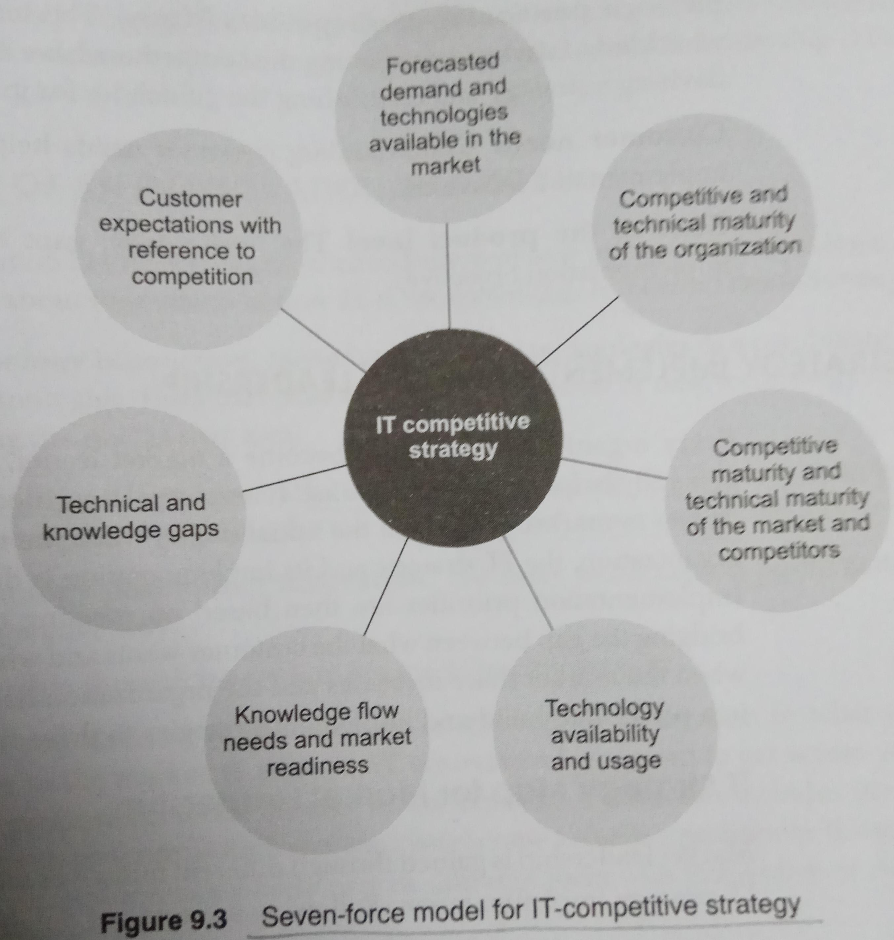
Gain Competitive Advantage
The implementation of IT strategy needs to focus on building competitive advantage.
One simple way is to create an entry barrier so as not to allow a competitor to enter the business. Many organizations use brand as an entry barrier.
Another way is to manage information flow (knowledge !?) about competition as well as individual competitors.

Slide 6
IT Strategy Implementation and Leadership
The leadership role generally helps to drive the market. i.e. transition from being market driven to market driving.
Some of the initiatives of the leadership are : -
  Leadership through Innovation
  Leadership through Pricing
  Leadership through Quality
  Leadership through Technology
  Leadership through Leadership

Slide 7
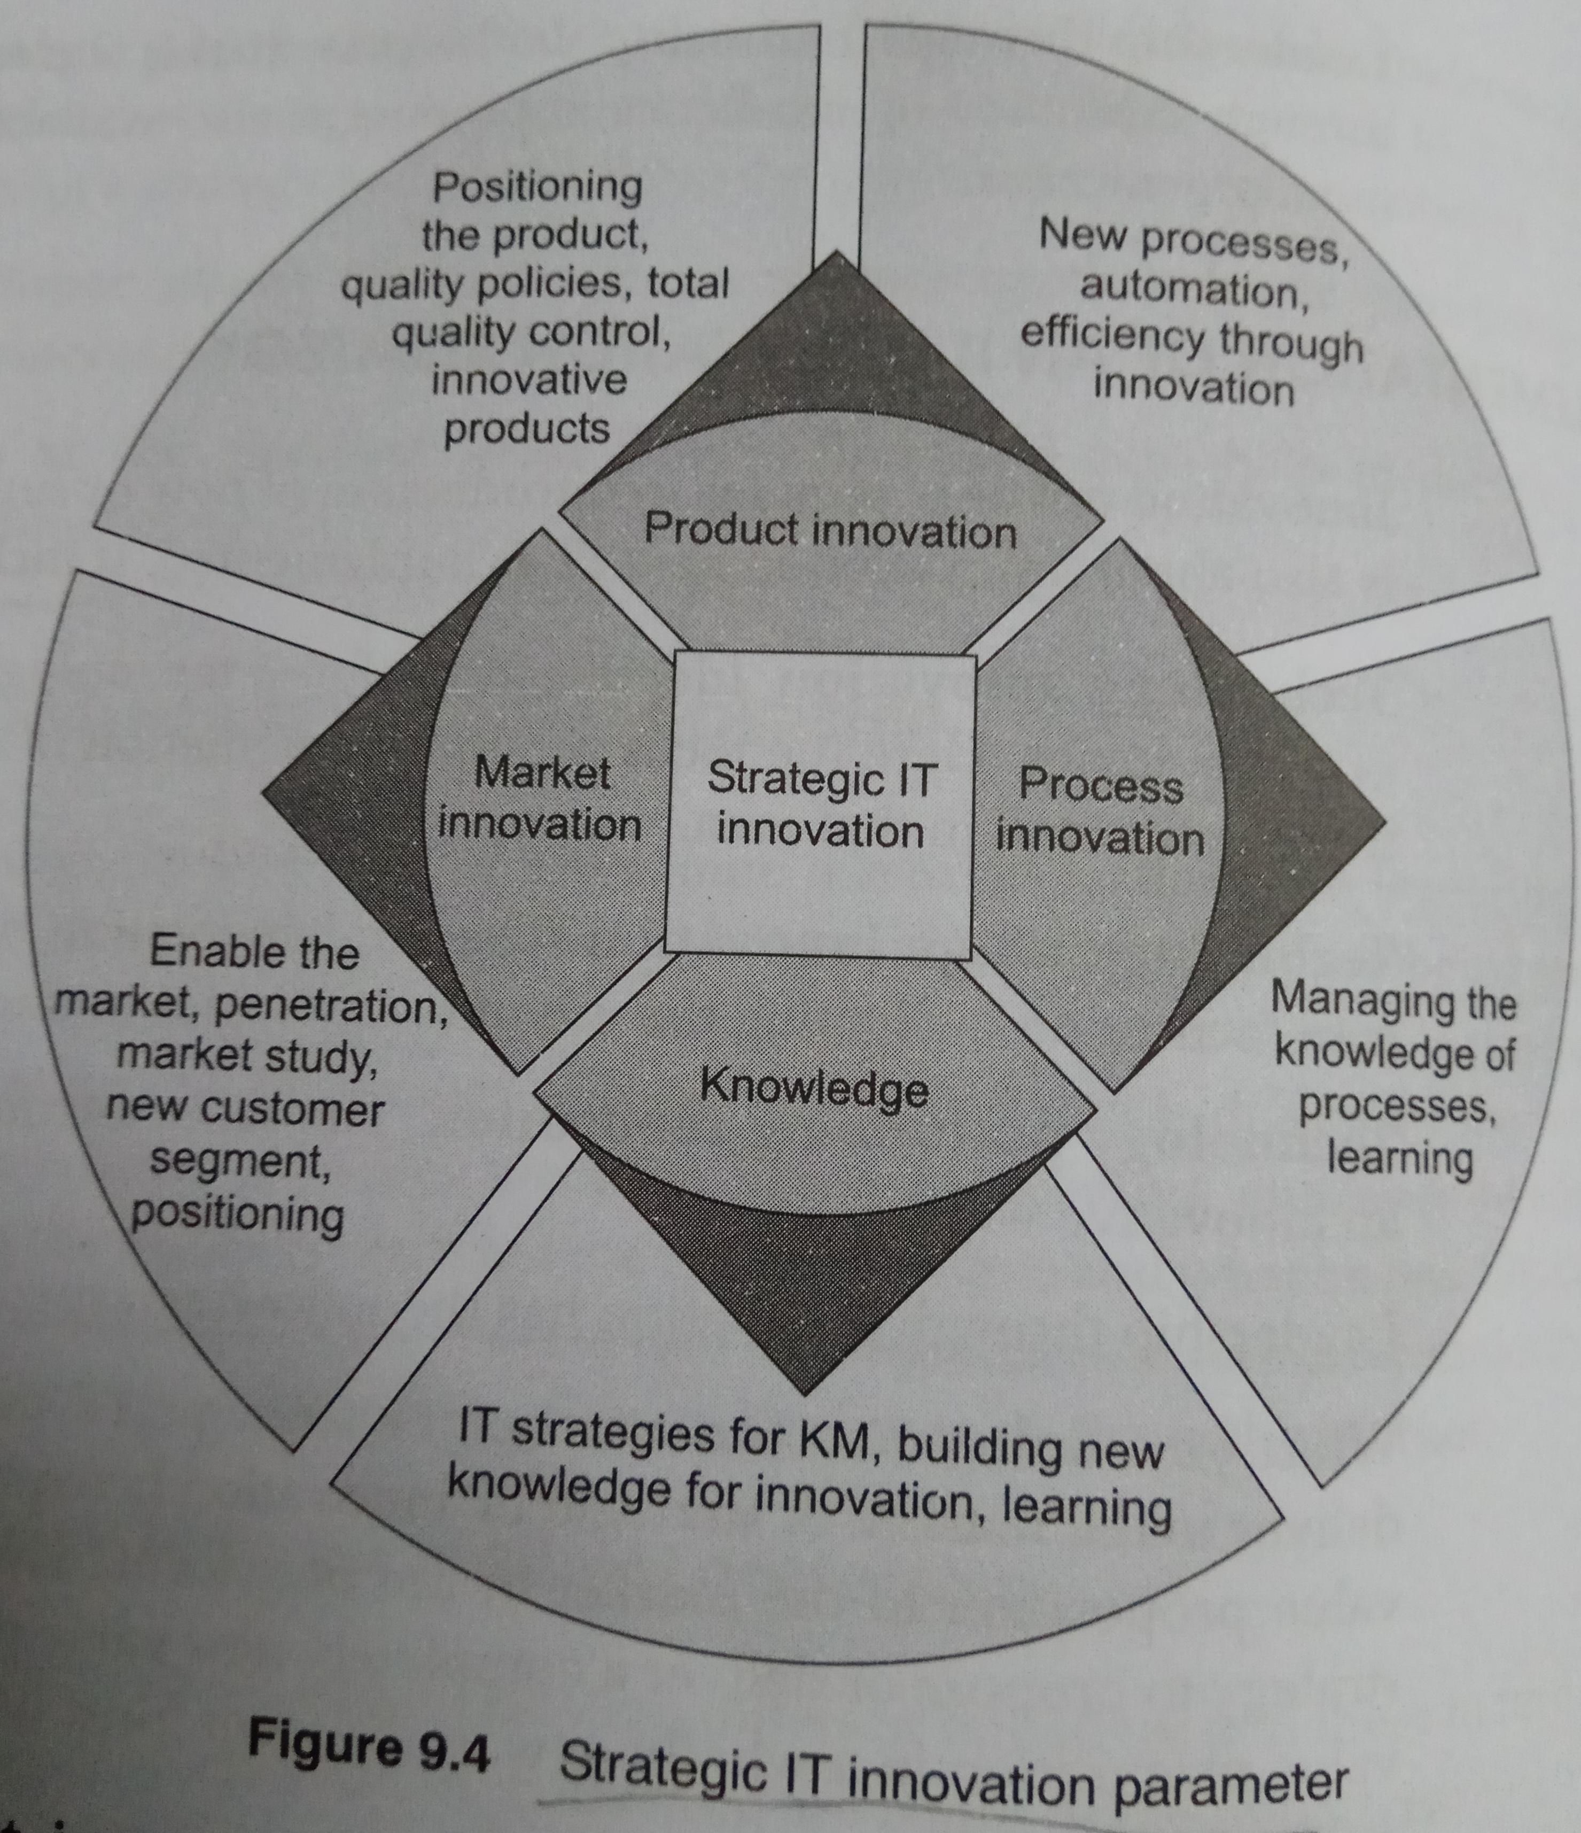
Strategic IT Innovation
Includes: -
  Technology innovation
  Technology usage innovation
  Technology positioning innovation
Leadership through innovation has: -
  What you deliver to the market
  How you deliver to the market
  How you position the product
Strategic innovation parameters Include: -
  Market innovation
  Process innovation
  Product innovation
  Knowledge

Slide 8
IT Strategy for Specialization
Sometimes, differentiation is achieved by moving away from specialization.
Specialization can help achieve differentiation.
Differentiation can be related to anything that satisfies and offers better service to a customer as compared to competitors.
Specialization is something more about core competence.
Specialization
  Identify the specialized area
  Market study and business impact
  IT for developing the product
  IT for specialized customer segment

Slide 9
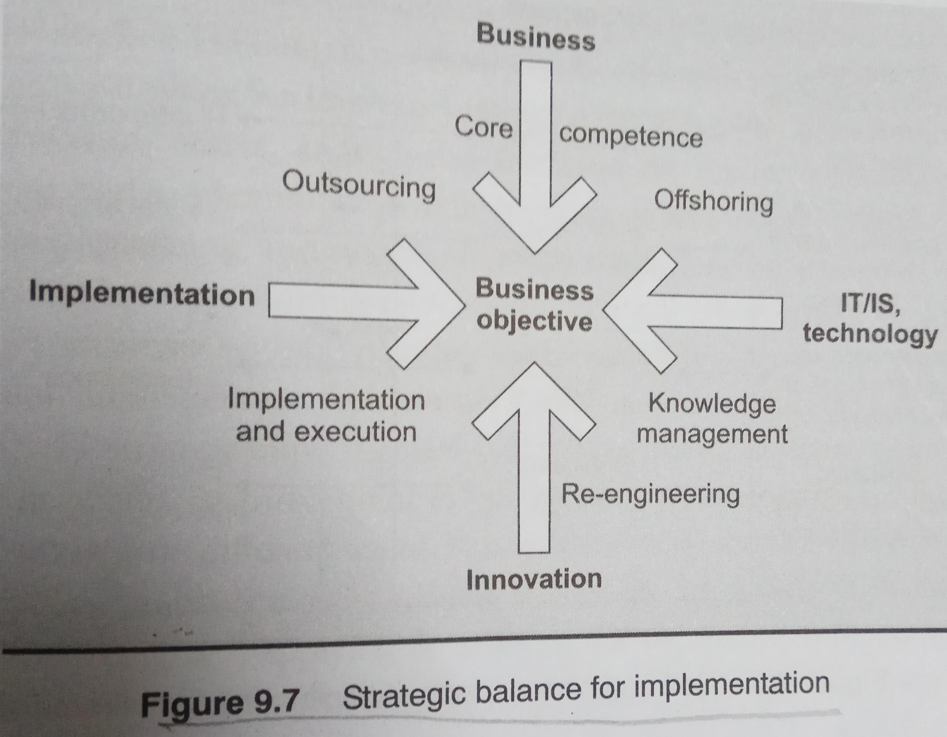
Strategic Balance for Implementation
Organization needs balance between execution and implementation
A balance act needs to be performed between innovation and business.
Also needed are balance between external and internal factors, market and organization, business and technical initiatives.
There has to be a straight balance between numerous initiatives and between the implementer and the leader.

Slide 10
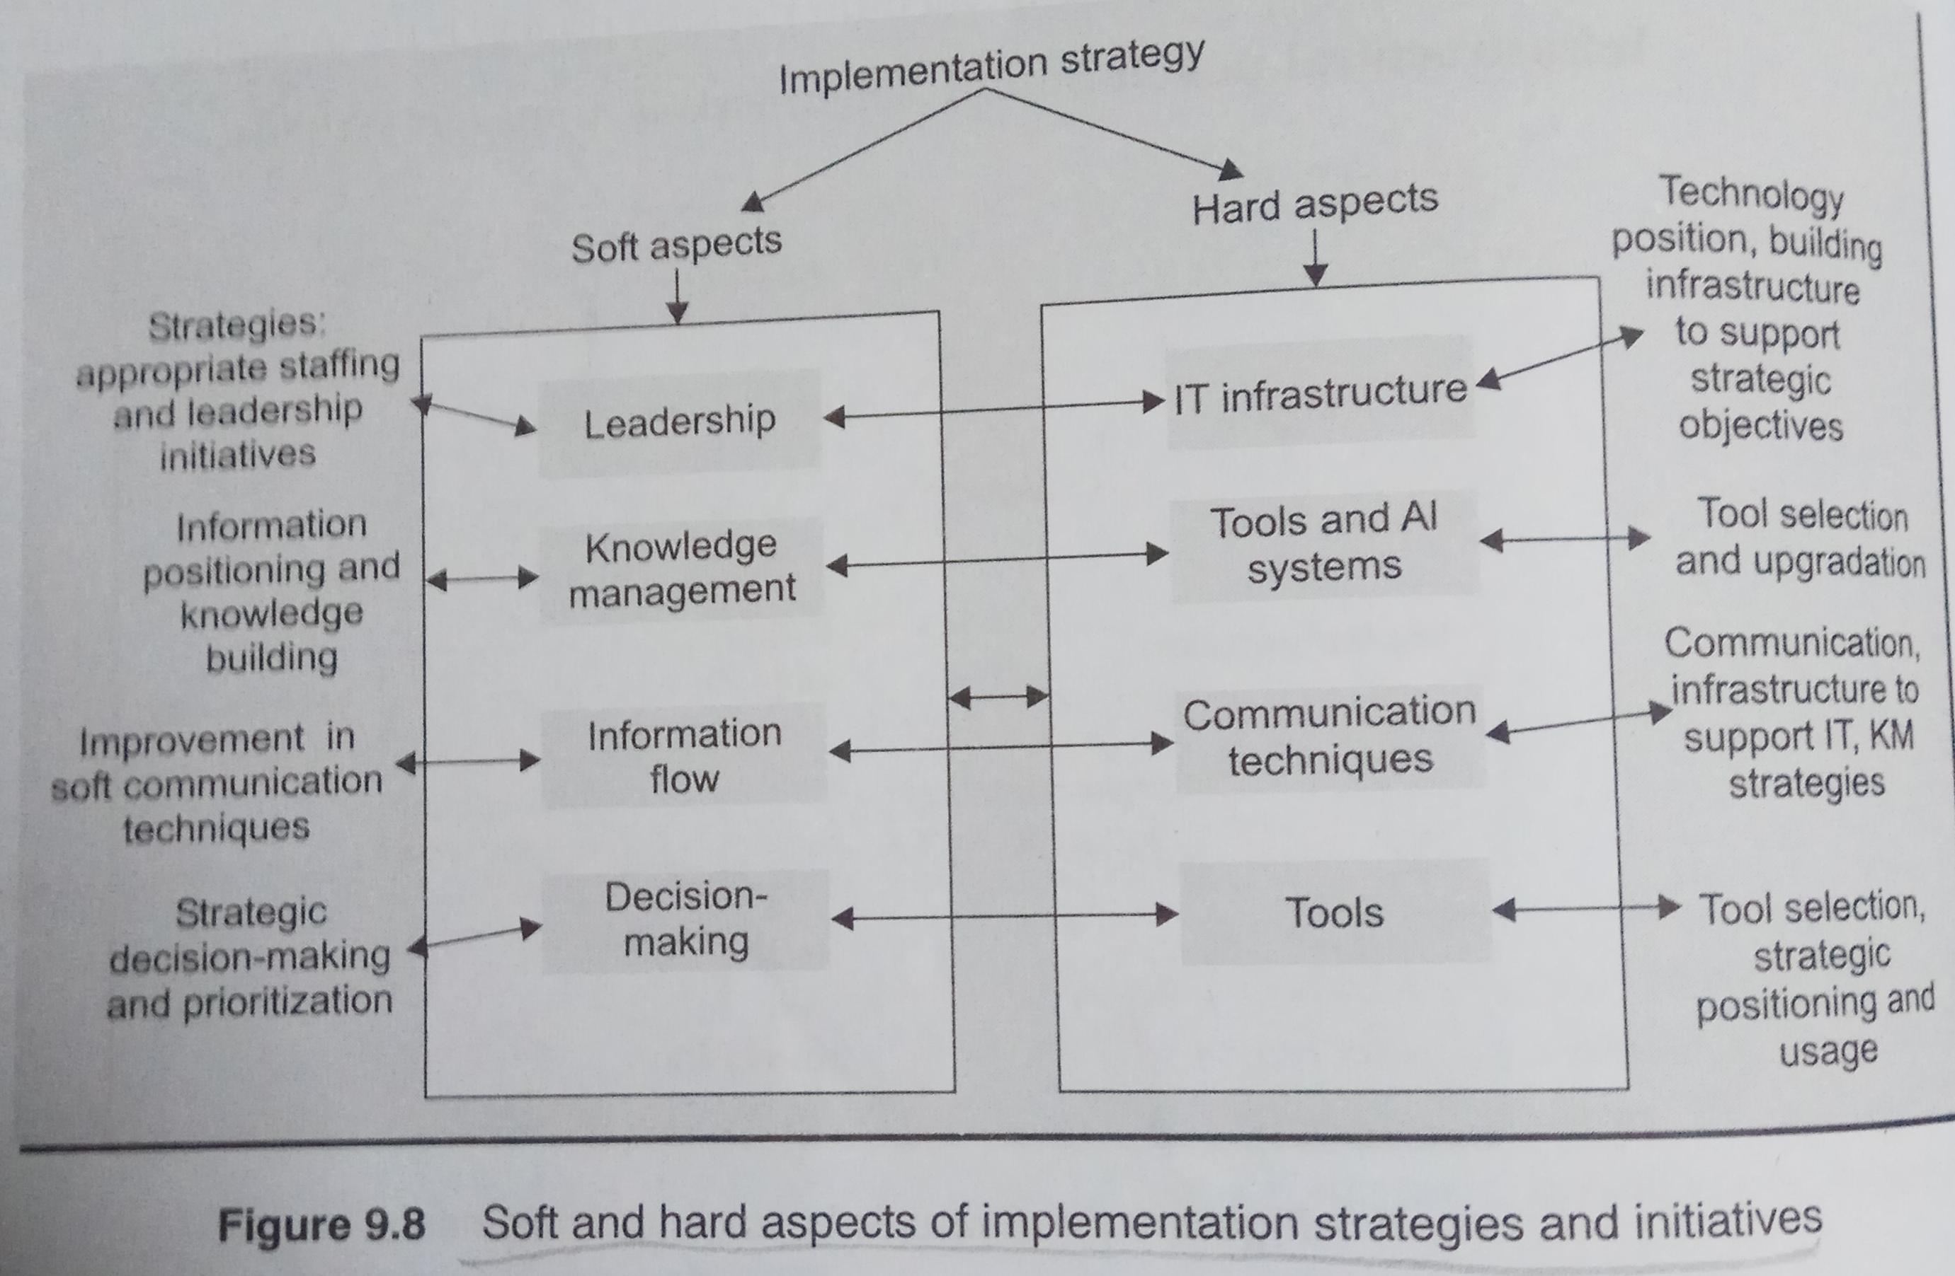
Soft and Hard aspects of implementation
Soft aspects are related to people and processes
Hard aspects have more to do with technology and infrastructure.

Slide 11
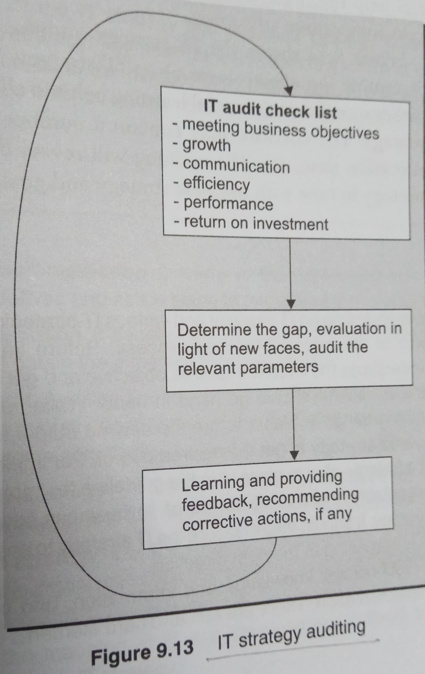
IT strategy Audit
There is need to audit IT strategy, its implementation, and execution process.
Audit helps the understanding the flaws in the IT strategy and its implementation; also helps in improving its process.
Organization needs to consider the alignment of IT and business strategy; consistency in implementation, and efficient information flow and analysis.
IT strategy audit includes information system audit and study of the impact of initiatives.
It analyses change management besides scrutinizing the dynamic nature of the strategy.
An IT strategy audit is the auditing of strategic initiatives to verify whether they can help the organization to achieve the business objectives and ultimately gain competitive advantages.

Slide 12
Compiled from
Parag Kulkarni & Pradip K Chande, IT Strategy for Business

