Slide 1
Chapter 9: Global IT Strategy
Roshan Chitrakar, MBA
Associate Professor,
Nepal College of Information Technology

Slide 2
Introduction
Global IT strategy is mainly driven by business strategy with global focus.
Globalization of business has gained pace and IT has enabled various products to reach distant corners of the world.
There is a need to manage technology differently because of the spread and large variations it has experienced during globalization.
With the advent of globalization, both threats and opportunists increased for every company in the world.
Some barriers of competition which were very effective a few years ago have fallen out with the advent of globalization and new market dynamics.
Globalization, coupled with distributed computing, has increased the opportunities and competition manifold.
Globalization perceives the world as one big market place (boundary-less world).

Slide 3
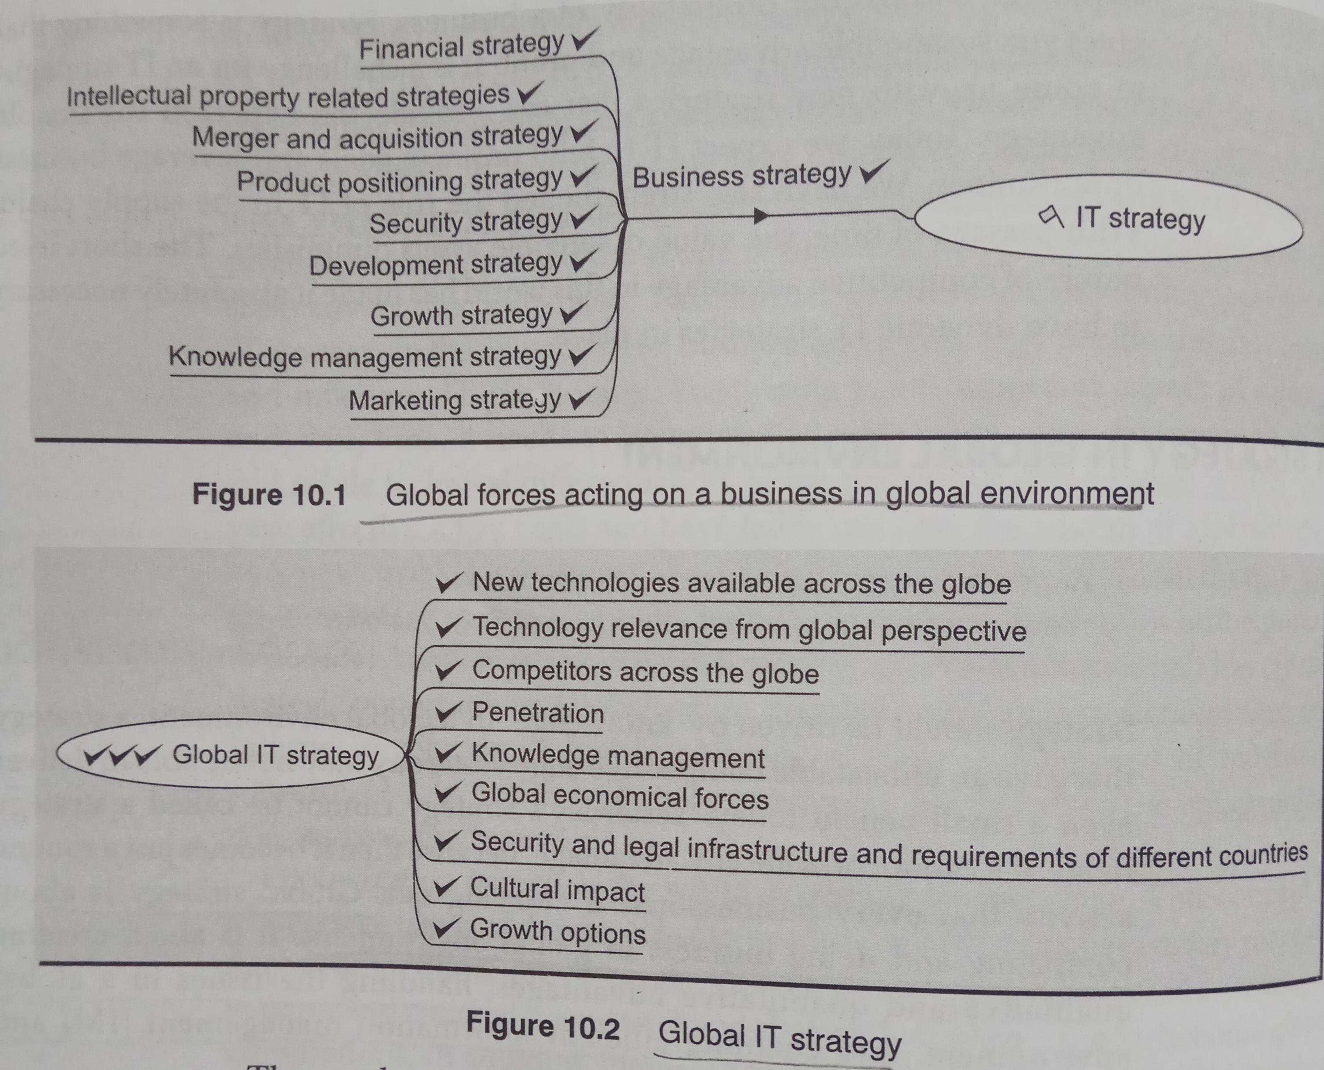
IT Strategy in Global Environment
Global strategy is about competing and doing business in global environment.
It is about creating qualitative and quantitative advantages, handling issues in a global environment, and enabling efficient information management (IM) and decision making in the global scenario.
Global scenario has changed the dimension of competition, the need of penetration, the quality measures, and has made it necessary for organizations to keep themselves abreast with new technology.

Slide 4
Global Product Life Cycle
Different strategies are taken at different phases of global product life cycle.
Phases: -
  Global IT Entry
    Environment analysis is the most important strategy at the Entry phase. Trends of social, economical, technological, legal and political nature etc should be considered . The IT strategy at this phase can handle overall global positioning and decide when to enter, where to enter, and how to enter.
  Global IT Investment
    At this phase, the investment strategy is taken. There is always a need to strike a balance between IT innovation and investment in meeting the immediate business goals.
  Global IT Expansion
    At this phase, strategy about expansion on the technology front, business offering front, and on the overall business horizon etc. are considered. Also taken into account are distributed infrastructure and effective use of centralized information storage in order to enable decision making.
  Global IT Penetration
    The market penetration strategy is taken at this phase of the global product life cycle. The desired market segment can be achieved through IT strategy The IT strategy should be able to decide the use of technological innovation to penetrate the market and further build on the existing customer base.
  Global IT Termination
    The ‘information and support tool’ for terminating a product from a global market is required and IT strategy helps provide such tools. So, a strategy need to be designed for graceful exit or a part of the product, version of the product, or the overall business.

Slide 5
Technological Environment and Global IT Strategy
IT aspects of global strategy include: -
  Producing / developing a product
  Standardization / configuration of product / system
  Global availability of product / system / service
  Servicing / supporting product / system globally
  Enhancement to product / system w.r.t. global context
  Global positioning of product / system
  Global Knowledge economy

Slide 6
Global Strategic Management
Global Strategic management is built around general issues of products which have a global visibility.
Here are some common technology strategies for global environment: -
  Local Strategies
  Global Strategies
  Glocal (Customized) Strategies
  Global KM
    Managing the knowledge to obtain global competitive advantage
  Global strategic positioning of technology
    Positioning the product and the company globally to get strategic advantage over competitors.

Slide 7
Global Distribution Channel
There are two aspects of being global:-
  One, you have customers across the globe but do not have a presence everywhere.
  Two, even though you have a presence in many places across the world, you are serving customers in a particular continent or country.
The basic difference between local and global strategies, in relation to the distribution channels, lie in the following factors: -
  Spread of market
  Difference in culture
  Intense competition
  Unknown variables
  Compatibility issues

Slide 8
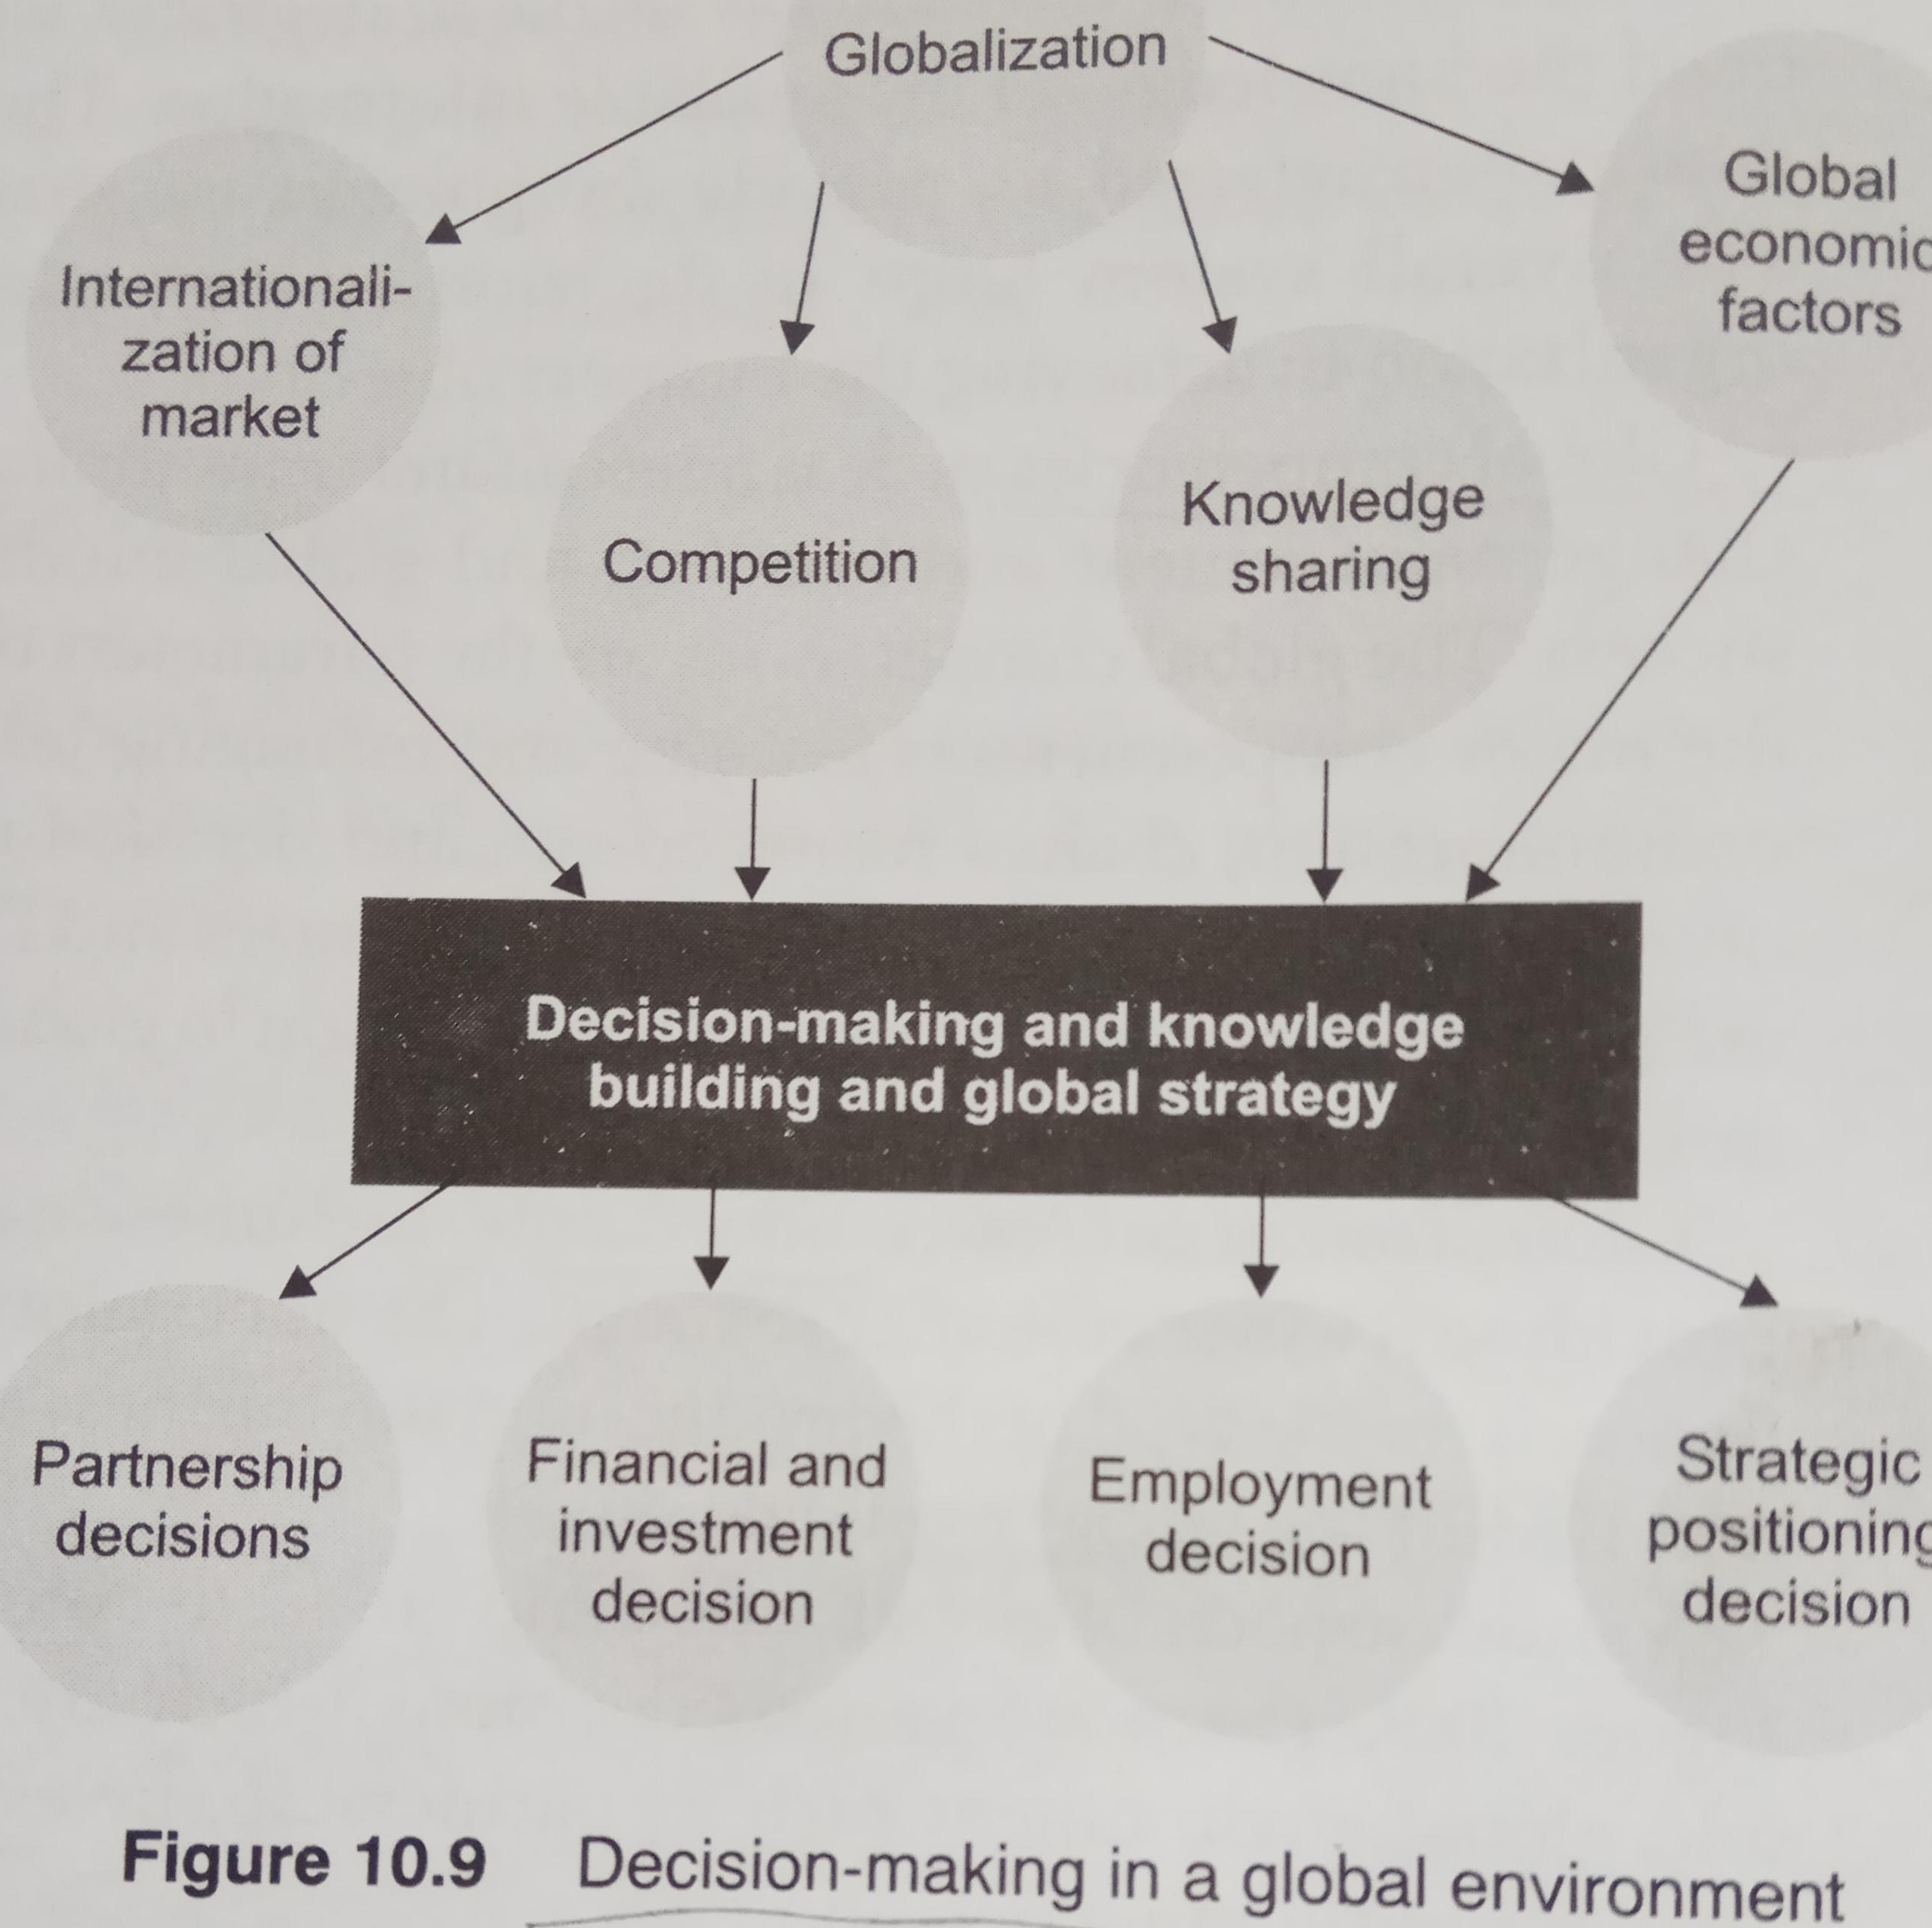
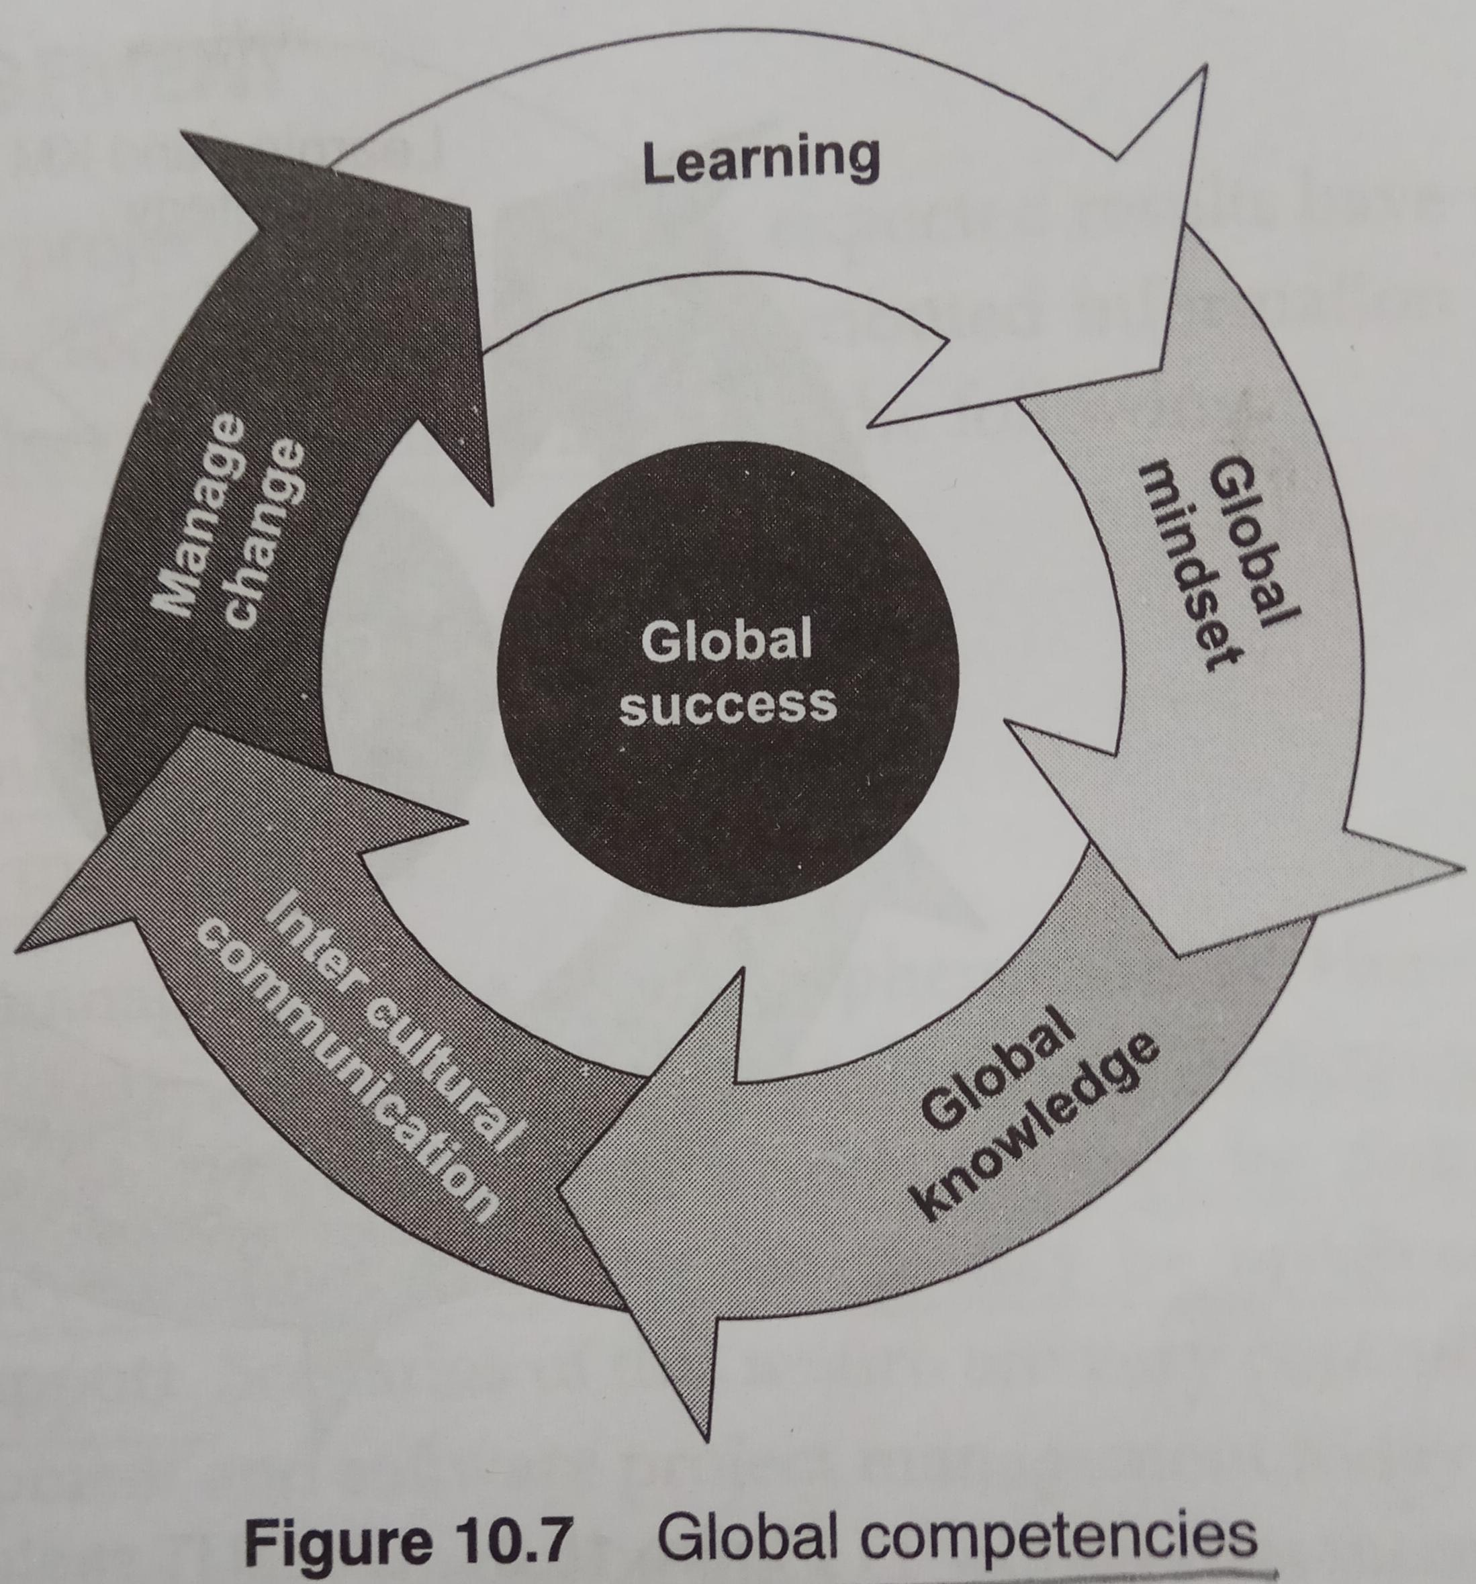
Global IT Strategic Issues
Information Acquisition
  It is important to make the acquired information available strategically when required to desired locations, and build the knowledge on the those information.
Global Competencies
  Intercultural communication, global knowledge, change management and learning, and global mindset contribute to global success.
Uncertainty
  Globalization increases uncertainty in some cases; and also reduces it by providing a wider customer segment.
Global Decision-making
  There are various decisions which are based on global strategy and global environment such as partnership, investment, employment and strategic positioning decision.

Slide 9
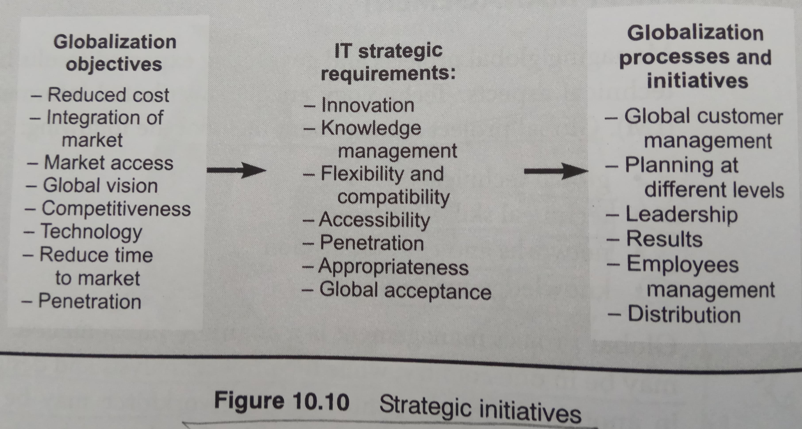
Global Project Management
Includes: -
  Global technical forces
  Technical skill distribution
  Networks and communication
  Knowledge management
Different activities of Project management phases may be done in different countries.
  e.g. the customer may be in one country while project analysis and designing may be done in another country.
Project strategies are built around project business objectives.
Global project managers make use of resources and opportunities available across the globe. They make use of different locations, people, and global knowledge.

Slide 10
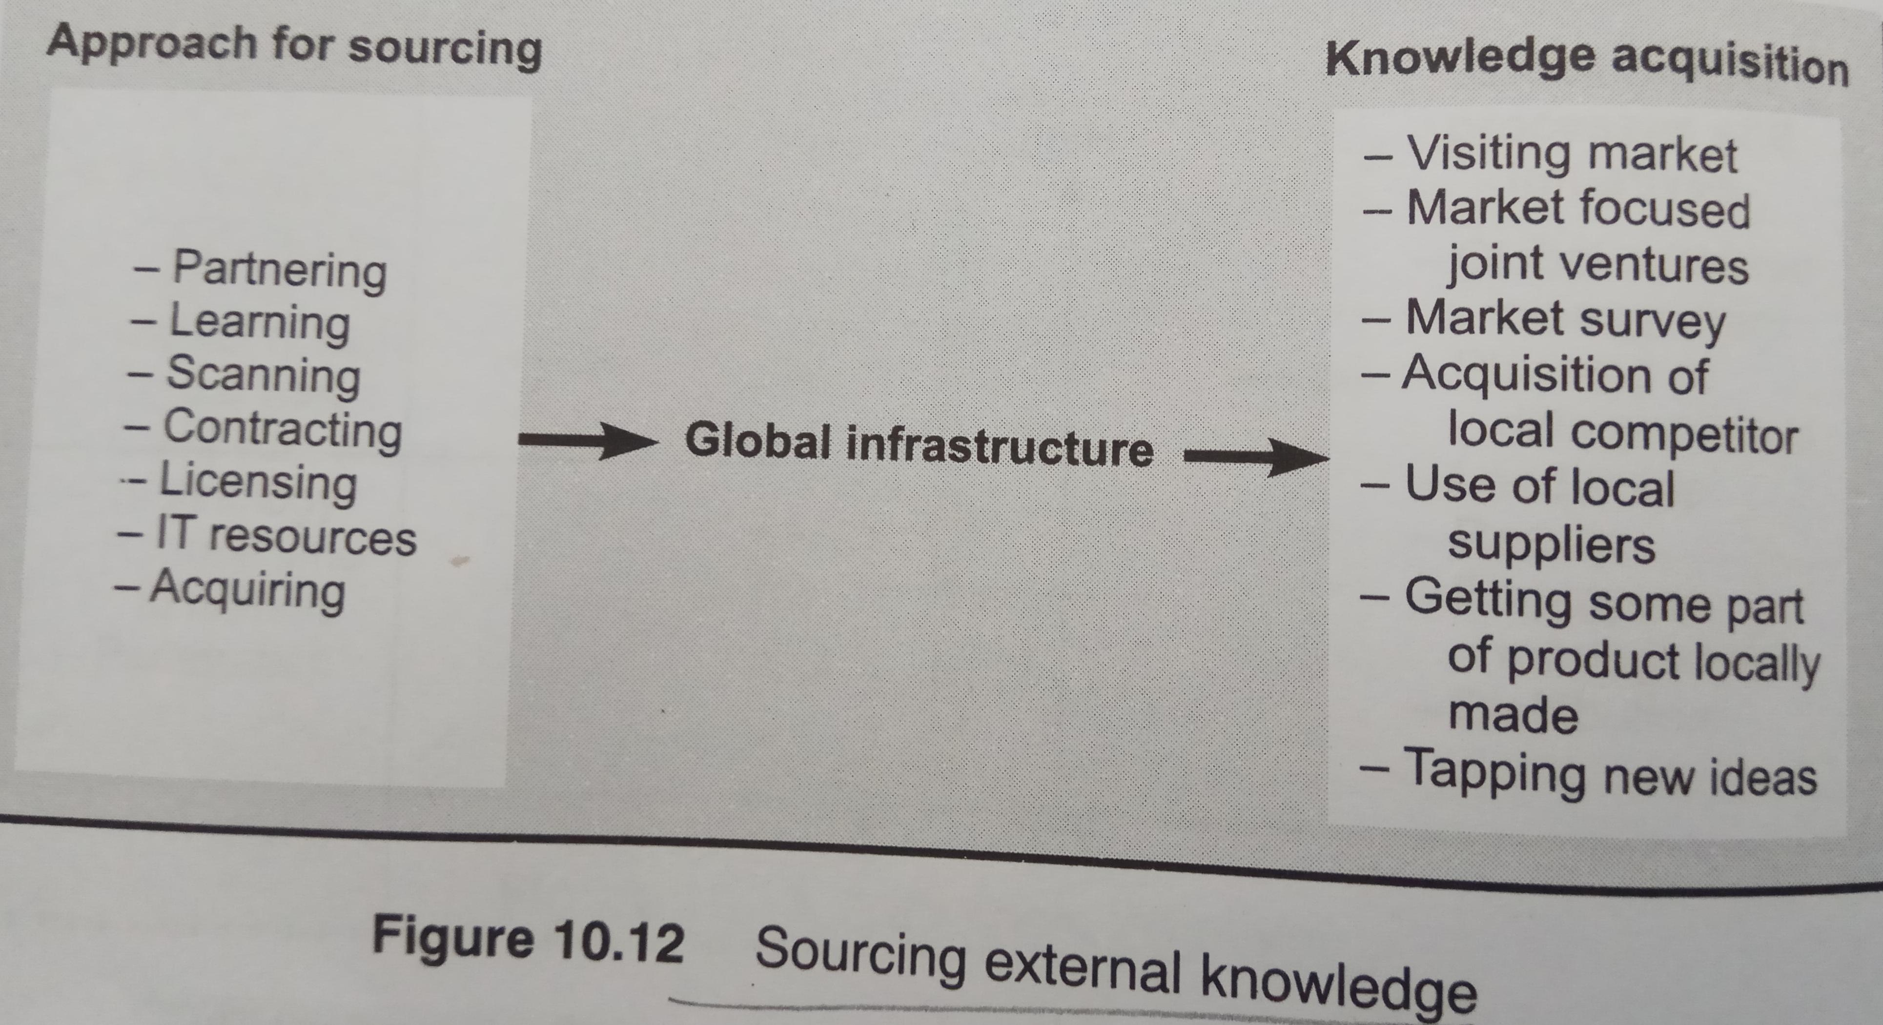
Global Innovation and Knowledge Management
Knowledge and skills have become the engine for economic growth.
Global IT strategy and global KM go hand in hand. The global IT strategy enables organizations to successfully manage global knowledge.
Global strategy goes through different phases and as then number of unknowns increase, so do the learning and tuning at every stage.

Slide 11
Convergence Model of IT in a Global Organization
Overall convergence is required in a global organization because of variations in cultures, technologies, geographies, and requirements.
Technical, Infrastructural, people-centric factors (soft and hard aspects) should be taken into account to build a successful global organization.
This convergence model has various components such as
  Organizational structure and
  Internal and external business processes
  People, processes, knowledge, and skills
  Information system components, communication methods.
IT strategies for globalization need to ensure a smooth convergence.

Slide 12
Compiled from
Parag Kulkarni & Pradip K Chande, IT Strategy for Business

