Slide 1

LUO HERITAGE / SELF-STUDY SLIDES
LANGUAGE • CULTURE • LIVING MEMORY
Uploaders
Prepare accurate drafts and send them for review
You will be able to add the right material, record permission and follow its review status.
READ • TRY • CHECK
25 October 2026 | Edition 1.0
Notes:
Self-study guide. Screenshots show actual interface components rendered with clearly labelled sample data, not a production acceptance demonstration. No real account or cultural record was changed to make these slides.

Slide 2
SELF-STUDY / UPLOADERS
Start here: learn at your own pace
1
Read a slide, try its action, then check the result. Tap means click. Gold circles mark important
controls in the screenshots.
2
Use your own account. Your organisation supplies the correct website address and any staff
access.
3
Screenshots show the current interface with practice details. Actual names, content and
menus may differ.
Read the step
→
Try it yourself
→
Check the result
If your menu looks different, first check My access. Do not ask someone to lend you their account.
CHECK: You will be able to add the right material, record permission and follow its review status.
LUO HERITAGE / UPLOADERS
Contents
02 / 21
Notes:
Start here: learn at your own pace
1. Read a slide, try its action, then check the result. Tap means click. Gold circles mark important controls in the screenshots.
2. Use your own account. Your organisation supplies the correct website address and any staff access.
3. Screenshots show the current interface with practice details. Actual names, content and menus may differ.
Expected result: You will be able to add the right material, record permission and follow its review status.
Important: If your menu looks different, first check My access. Do not ask someone to lend you their account.

Slide 3
SELF-STUDY / UPLOADERS
What this guide covers
1
Confirm your assigned language and find Upload Content.
2
Prepare text, attachments, source details and private drafts.
3
Submit once and follow any requested corrections.
CHECK: Use the slide numbers to return to a task. The PDF has page bookmarks; PowerPoint has a contents view.
LUO HERITAGE / UPLOADERS
Contents
03 / 21
Notes:
What this guide covers
1. Confirm your assigned language and find Upload Content.
2. Prepare text, attachments, source details and private drafts.
3. Submit once and follow any requested corrections.
Expected result: Use the slide numbers to return to a task. The PDF has page bookmarks; PowerPoint has a contents view.

Slide 4

SELF-STUDY / UPLOADERS
Sign in to your own account
1
Open the Luo Heritage address supplied by your organisation.
Choose Sign in or Log in.
2
Enter your email and password, then choose Log in. Check your
spelling if it fails.
3
Community members may also use Google. Staff should use the
account supplied by their administrator.
Never share your password. Use only an address you trust.
CURRENT INTERFACE • PRACTICE DETAILS
CHECK: Your account or dashboard opens.
LUO HERITAGE / UPLOADERS
Contents
04 / 21
Notes:
Sign in to your own account
1. Open the Luo Heritage address supplied by your organisation. Choose Sign in or Log in.
2. Enter your email and password, then choose Log in. Check your spelling if it fails.
3. Community members may also use Google. Staff should use the account supplied by their administrator.
Expected result: Your account or dashboard opens.
Important: Never share your password. Use only an address you trust.
Screenshot: current application interface rendered with sample details. No live action is demonstrated.

Slide 5

SELF-STUDY / UPLOADERS
Forgot your password?
1
On the sign-in screen, choose Forgotten
password? Select Reset password.
2
Enter your account email. Choose Send
email, then check your inbox and spam
folder.
3
Open the newest reset link within 30
minutes. A link can be used only once.
If no email arrives, contact the person who manages your account. Do
not keep requesting links.
CURRENT INTERFACE • PRACTICE DETAILS
CHECK: An account email arrives if the address is eligible and the email service is available.
LUO HERITAGE / UPLOADERS
Contents
05 / 21
Notes:
Forgot your password?
1. On the sign-in screen, choose Forgotten password? Select Reset password.
2. Enter your account email. Choose Send email, then check your inbox and spam folder.
3. Open the newest reset link within 30 minutes. A link can be used only once.
Expected result: An account email arrives if the address is eligible and the email service is available.
Important: If no email arrives, contact the person who manages your account. Do not keep requesting links.
Screenshot: current application interface rendered with sample details. No live action is demonstrated.

Slide 6

SELF-STUDY / UPLOADERS
Choose a new password
1
Open the password reset link from your
own inbox.
2
Enter a new password of at least 12
characters. A short phrase with several
words is easier to remember.
3
Choose Confirm. Return to sign in and use
the new password on each device.
Do not forward the reset link. If it has expired, request a new one.
CURRENT INTERFACE • PRACTICE DETAILS
CHECK: The password changes and old sign-ins are ended.
LUO HERITAGE / UPLOADERS
Contents
06 / 21
Notes:
Choose a new password
1. Open the password reset link from your own inbox.
2. Enter a new password of at least 12 characters. A short phrase with several words is easier to remember.
3. Choose Confirm. Return to sign in and use the new password on each device.
Expected result: The password changes and old sign-ins are ended.
Important: Do not forward the reset link. If it has expired, request a new one.
Screenshot: current application interface rendered with sample details. No live action is demonstrated.

Slide 7
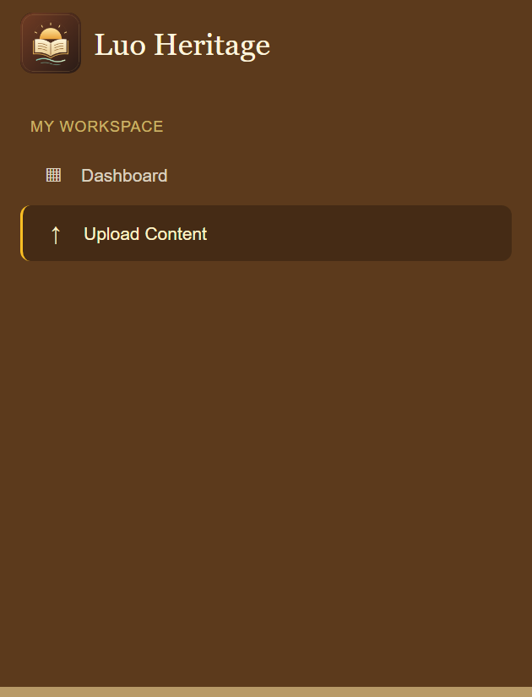
SELF-STUDY / UPLOADERS
Open your uploading workspace
1
Sign in using the account supplied to you. Open the admin
dashboard.
2
Choose Upload Content. Work only in the language assigned to
you.
3
If no collection can be created, check your assigned language
with the administrator.
Uploaders normally see Dashboard and Upload Content. Other duties require a separate assignment.
CURRENT INTERFACE • PRACTICE DETAILS
CHECK: Your content list opens for the languages you are allowed to upload.
LUO HERITAGE / UPLOADERS
Contents
07 / 21
Notes:
Open your uploading workspace
1. Sign in using the account supplied to you. Open the admin dashboard.
2. Choose Upload Content. Work only in the language assigned to you.
3. If no collection can be created, check your assigned language with the administrator.
Expected result: Your content list opens for the languages you are allowed to upload.
Important: Uploaders normally see Dashboard and Upload Content. Other duties require a separate assignment.
Screenshot: current application interface rendered with sample details. No live action is demonstrated.

Slide 8
SELF-STUDY / UPLOADERS
How a contribution reaches readers
1
The uploader or contributor prepares a draft and submits it.
2
A cultural reviewer checks accuracy. An editor makes requested corrections and returns the
item for review.
3
A publisher checks the final item and permission. Only an approved public release becomes
visible to readers.
Prepare draft
→
Cultural review
→
Publisher check
→
Public release
Different people should perform the independent checks. Do not approve your own work.
CHECK: An item may return for changes. Drafts and private approvals are not public publication.
LUO HERITAGE / UPLOADERS
Contents
08 / 21
Notes:
How a contribution reaches readers
1. The uploader or contributor prepares a draft and submits it.
2. A cultural reviewer checks accuracy. An editor makes requested corrections and returns the item for review.
3. A publisher checks the final item and permission. Only an approved public release becomes visible to readers.
Expected result: An item may return for changes. Drafts and private approvals are not public publication.
Important: Different people should perform the independent checks. Do not approve your own work.

Slide 9
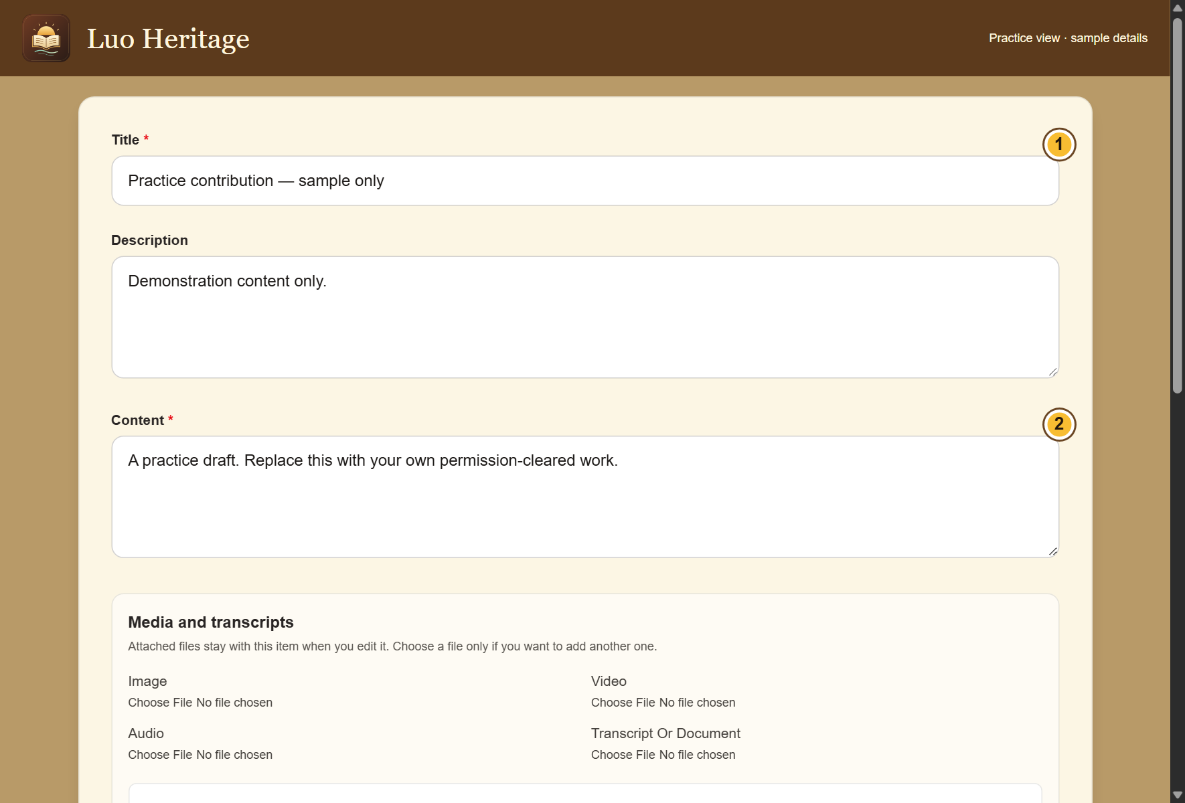
SELF-STUDY / UPLOADERS
Prepare before you upload
1
Check the collection, language, title and file
names before starting.
2
Confirm who supplied the material and
what permission was given. Keep evidence
through the organisation’s approved
process.
3
Use a draft when a meaning, translation or
permission is uncertain. Do not guess.
CURRENT INTERFACE • PRACTICE DETAILS
CHECK: You have the information needed for a useful draft.
LUO HERITAGE / UPLOADERS
Contents
09 / 21
Notes:
Prepare before you upload
1. Check the collection, language, title and file names before starting.
2. Confirm who supplied the material and what permission was given. Keep evidence through the organisation’s approved process.
3. Use a draft when a meaning, translation or permission is uncertain. Do not guess.
Expected result: You have the information needed for a useful draft.
Screenshot: current application interface rendered with sample details. No live action is demonstrated.

Slide 10
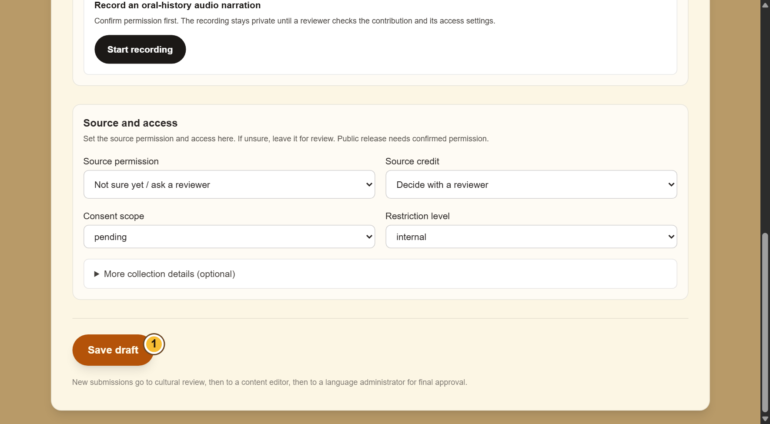
SELF-STUDY / UPLOADERS
Enter the contribution details
1
Open the appropriate new-content form
from Upload Content.
2
Enter the title and all required collection
fields. Read the text again for missing
words.
3
Add a clear description and choose Save
draft. An admin upload is a draft until
submitted for review.
Admin forms use Save draft or Save changes. Community forms use
Save private draft and Submit for reviewer.
CURRENT INTERFACE • PRACTICE DETAILS
CHECK: The online draft appears in your content list.
LUO HERITAGE / UPLOADERS
Contents
10 / 21
Notes:
Enter the contribution details
1. Open the appropriate new-content form from Upload Content.
2. Enter the title and all required collection fields. Read the text again for missing words.
3. Add a clear description and choose Save draft. An admin upload is a draft until submitted for review.
Expected result: The online draft appears in your content list.
Important: Admin forms use Save draft or Save changes. Community forms use Save private draft and Submit for reviewer.
Screenshot: current application interface rendered with sample details. No live action is demonstrated.

Slide 11
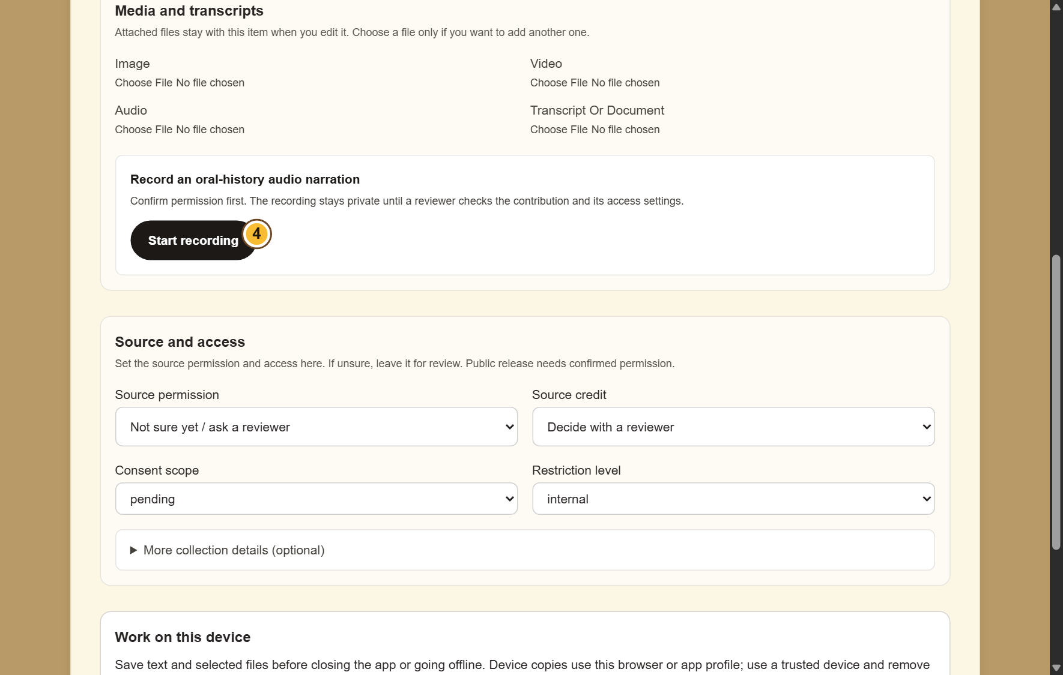
SELF-STUDY / UPLOADERS
Add pictures, audio or documents
1
Find Media and transcripts. Choose a file
under the matching type.
2
For an oral history, confirm permission
before choosing Start recording. Stop when
finished.
3
Check that the correct files are selected.
Keep the app open while an upload is in
progress.
If microphone access is refused, allow it in your device settings or attach
an existing recording.
CURRENT INTERFACE • PRACTICE DETAILS
CHECK: The selected files stay with the contribution when it is saved successfully.
LUO HERITAGE / UPLOADERS
Contents
11 / 21
Notes:
Add pictures, audio or documents
1. Find Media and transcripts. Choose a file under the matching type.
2. For an oral history, confirm permission before choosing Start recording. Stop when finished.
3. Check that the correct files are selected. Keep the app open while an upload is in progress.
Expected result: The selected files stay with the contribution when it is saved successfully.
Important: If microphone access is refused, allow it in your device settings or attach an existing recording.
Screenshot: current application interface rendered with sample details. No live action is demonstrated.

Slide 12

SELF-STUDY / UPLOADERS
Check permission before sharing
1
Under Source and access, choose Source
permission. If unsure, leave Not sure yet /
ask a reviewer.
2
Choose how to credit the source. Use a
person’s name only when they agree.
3
Keep restricted, sacred or research-only
material private. Ask a reviewer before
changing access.
Permission to collect material is not automatically permission to publish it.
CURRENT INTERFACE • PRACTICE DETAILS
CHECK: The draft records who may use the material and how the source should be credited.
LUO HERITAGE / UPLOADERS
Contents
12 / 21
Notes:
Check permission before sharing
1. Under Source and access, choose Source permission. If unsure, leave Not sure yet / ask a reviewer.
2. Choose how to credit the source. Use a person’s name only when they agree.
3. Keep restricted, sacred or research-only material private. Ask a reviewer before changing access.
Expected result: The draft records who may use the material and how the source should be credited.
Important: Permission to collect material is not automatically permission to publish it.
Screenshot: current application interface rendered with sample details. No live action is demonstrated.

Slide 13
SELF-STUDY / UPLOADERS
What the permission labels mean
1
Source permission: has the source agreed
to the proposed use? Choose Not sure yet
when you do not know.
2
Consent scope: what use was agreed?
Public excerpt means an approved public
part; research only and teaching have
different limits.
3
Restriction level: who may see it? Internal
and restricted are not public. Sacred
material needs the collection owner’s
special care.
If the permission record is unclear, keep the item private and ask the
responsible reviewer.
CURRENT INTERFACE • PRACTICE DETAILS
CHECK: You understand the labels before you change them.
LUO HERITAGE / UPLOADERS
Contents
13 / 21
Notes:
What the permission labels mean
1. Source permission: has the source agreed to the proposed use? Choose Not sure yet when you do not know.
2. Consent scope: what use was agreed? Public excerpt means an approved public part; research only and teaching have different limits.
3. Restriction level: who may see it? Internal and restricted are not public. Sacred material needs the collection owner’s special care.
Expected result: You understand the labels before you change them.
Important: If the permission record is unclear, keep the item private and ask the responsible reviewer.
Screenshot: current application interface rendered with sample details. No live action is demonstrated.

Slide 14
SELF-STUDY / UPLOADERS
Add collection details when required
1
Open the extra source or collection details
section.
2
Record the known collection date, source
reference, location and collector. Leave
unknown details for review.
3
Do not put personal phone numbers,
sacred site coordinates or private
participant details in a public description.
CURRENT INTERFACE • PRACTICE DETAILS
CHECK: Reviewers can understand where the material came from without exposing private details.
LUO HERITAGE / UPLOADERS
Contents
14 / 21
Notes:
Add collection details when required
1. Open the extra source or collection details section.
2. Record the known collection date, source reference, location and collector. Leave unknown details for review.
3. Do not put personal phone numbers, sacred site coordinates or private participant details in a public description.
Expected result: Reviewers can understand where the material came from without exposing private details.
Screenshot: current application interface rendered with sample details. No live action is demonstrated.

Slide 15
SELF-STUDY / UPLOADERS
Know where your draft is saved
1
In Upload Content, Save draft or Save
changes saves the item online. Wait for
confirmation and check the list.
2
The community Contribute & submissions
form also offers device copies. That is a
separate route from the admin upload form.
3
A device copy is never submitted
automatically. To send an admin draft, use
Send to cultural review in the online list.
Keep the original file until the online item and its attachments have been
checked.
CURRENT INTERFACE • PRACTICE DETAILS
CHECK: You know which copy is saved and which action sends it for review.
LUO HERITAGE / UPLOADERS
Contents
15 / 21
Notes:
Know where your draft is saved
1. In Upload Content, Save draft or Save changes saves the item online. Wait for confirmation and check the list.
2. The community Contribute & submissions form also offers device copies. That is a separate route from the admin upload form.
3. A device copy is never submitted automatically. To send an admin draft, use Send to cultural review in the online list.
Expected result: You know which copy is saved and which action sends it for review.
Important: Keep the original file until the online item and its attachments have been checked.
Screenshot: current application interface rendered with sample details. No live action is demonstrated.

Slide 16
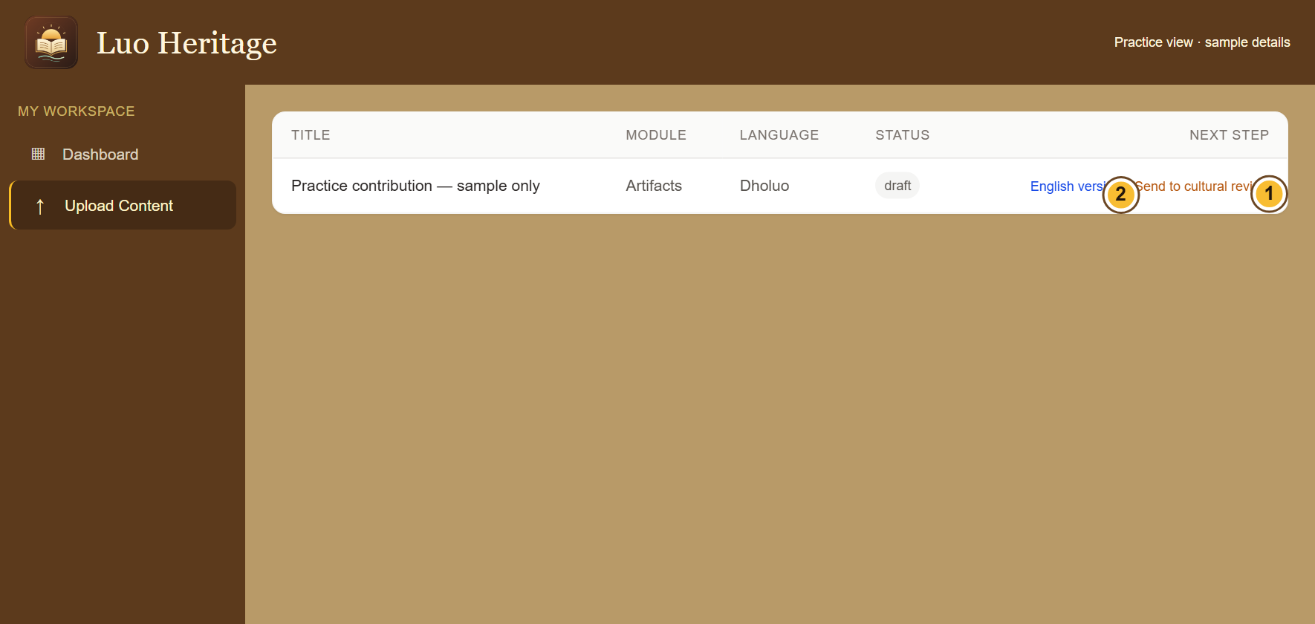
SELF-STUDY / UPLOADERS
Send the online draft for cultural review
1
Return to Upload Content and find the
saved draft.
2
Choose Send to cultural review beside the
intended item. Send it only once.
3
Refresh the list and check its status. You
cannot publish an item using only the
uploader role.
The English version link opens a separate translation. Complete it where
required before review.
CURRENT INTERFACE • PRACTICE DETAILS
CHECK: The draft is marked as submitted or under review.
LUO HERITAGE / UPLOADERS
Contents
16 / 21
Notes:
Send the online draft for cultural review
1. Return to Upload Content and find the saved draft.
2. Choose Send to cultural review beside the intended item. Send it only once.
3. Refresh the list and check its status. You cannot publish an item using only the uploader role.
Expected result: The draft is marked as submitted or under review.
Important: The English version link opens a separate translation. Complete it where required before review.
Screenshot: current application interface rendered with sample details. No live action is demonstrated.

Slide 17
SELF-STUDY / UPLOADERS
Respond to a correction request
1
Find the returned item and read the
reviewer’s notes.
2
Open the editable draft, make only the
necessary corrections and save.
3
Submit the corrected item again or follow
the editor’s handover. Tell the reviewer
what changed.
Editors use Editor Queue. Uploaders use the editable items available in
Upload Content.
CURRENT INTERFACE • PRACTICE DETAILS
CHECK: The corrected version is ready for another independent check.
LUO HERITAGE / UPLOADERS
Contents
17 / 21
Notes:
Respond to a correction request
1. Find the returned item and read the reviewer’s notes.
2. Open the editable draft, make only the necessary corrections and save.
3. Submit the corrected item again or follow the editor’s handover. Tell the reviewer what changed.
Expected result: The corrected version is ready for another independent check.
Important: Editors use Editor Queue. Uploaders use the editable items available in Upload Content.
Screenshot: current application interface rendered with sample details. No live action is demonstrated.

Slide 18
SELF-STUDY / UPLOADERS
Check files before you finish
1
Reopen the saved item and inspect every
attached file.
2
If an upload failed, reconnect and check
whether the text or file was already saved
before retrying.
3
Keep your original source file until the
organisation confirms it is safely stored.
CURRENT INTERFACE • PRACTICE DETAILS
CHECK: The item has the intended files and no accidental duplicate uploads.
LUO HERITAGE / UPLOADERS
Contents
18 / 21
Notes:
Check files before you finish
1. Reopen the saved item and inspect every attached file.
2. If an upload failed, reconnect and check whether the text or file was already saved before retrying.
3. Keep your original source file until the organisation confirms it is safely stored.
Expected result: The item has the intended files and no accidental duplicate uploads.
Screenshot: current application interface rendered with sample details. No live action is demonstrated.

Slide 19

SELF-STUDY / UPLOADERS
Protect your account and other people
1
Use your own account. Sign out on a
shared computer or phone.
2
Do not copy private interviews, class
results or account lists into public chats or
messages.
3
If a screen shows information you should
not see, stop and tell the account
administrator.
Send support the screen name and error message, never your password
or a reset link.
CURRENT INTERFACE • PRACTICE DETAILS
CHECK: Your work remains linked to the right person and private information stays protected.
LUO HERITAGE / UPLOADERS
Contents
19 / 21
Notes:
Protect your account and other people
1. Use your own account. Sign out on a shared computer or phone.
2. Do not copy private interviews, class results or account lists into public chats or messages.
3. If a screen shows information you should not see, stop and tell the account administrator.
Expected result: Your work remains linked to the right person and private information stays protected.
Important: Send support the screen name and error message, never your password or a reset link.
Screenshot: current application interface rendered with sample details. No live action is demonstrated.

Slide 20
SELF-STUDY / UPLOADERS
When something does not work
1
Check your internet connection. Read the message on screen
before trying again.
2
If your sign-in has expired, sign in again. If a button is missing,
ask which role and language you have.
3
If it still fails, note the time, screen, button and exact message.
Send these to your account administrator.
Before repeating an upload or submission, check whether the first attempt was already saved.
CURRENT INTERFACE • PRACTICE DETAILS
CHECK: You can explain the problem clearly without exposing private information.
LUO HERITAGE / UPLOADERS
Contents
20 / 21
Notes:
When something does not work
1. Check your internet connection. Read the message on screen before trying again.
2. If your sign-in has expired, sign in again. If a button is missing, ask which role and language you have.
3. If it still fails, note the time, screen, button and exact message. Send these to your account administrator.
Expected result: You can explain the problem clearly without exposing private information.
Important: Before repeating an upload or submission, check whether the first attempt was already saved.
Screenshot: current application interface rendered with sample details. No live action is demonstrated.

Slide 21
SELF-STUDY / UPLOADERS
Try it yourself: your readiness check
1
Locate your assigned collection and create a private practice draft.
2
Explain the permission setting you would choose when permission is uncertain.
3
Show where you would submit the draft, and explain why you cannot publish it yourself.
Try
→
Check
→
Ask if unsure
Use only approved practice material. Do not publish, delete accounts or change live settings just to practise.
CHECK: You are ready for routine work when you can complete these steps without help.
LUO HERITAGE / UPLOADERS
Contents
21 / 21
Notes:
Try it yourself: your readiness check
1. Locate your assigned collection and create a private practice draft.
2. Explain the permission setting you would choose when permission is uncertain.
3. Show where you would submit the draft, and explain why you cannot publish it yourself.
Expected result: You are ready for routine work when you can complete these steps without help.
Important: Use only approved practice material. Do not publish, delete accounts or change live settings just to practise.

