Slide 1

LUO HERITAGE / SELF-STUDY SLIDES
LANGUAGE • CULTURE • LIVING MEMORY
Cultural reviewers
Check accuracy, meaning and respectful use
You will be able to make a clear, independent cultural review decision.
READ • TRY • CHECK
25 October 2026 | Edition 1.0
Notes:
Self-study guide. Screenshots show actual interface components rendered with clearly labelled sample data, not a production acceptance demonstration. No real account or cultural record was changed to make these slides.

Slide 2
SELF-STUDY / CULTURAL REVIEWERS
Start here: learn at your own pace
1
Read a slide, try its action, then check the result. Tap means click. Gold circles mark important
controls in the screenshots.
2
Use your own account. Your organisation supplies the correct website address and any staff
access.
3
Screenshots show the current interface with practice details. Actual names, content and
menus may differ.
Read the step
→
Try it yourself
→
Check the result
If your menu looks different, first check My access. Do not ask someone to lend you their account.
CHECK: You will be able to make a clear, independent cultural review decision.
LUO HERITAGE / CULTURAL REVIEWERS
Contents
02 / 19
Notes:
Start here: learn at your own pace
1. Read a slide, try its action, then check the result. Tap means click. Gold circles mark important controls in the screenshots.
2. Use your own account. Your organisation supplies the correct website address and any staff access.
3. Screenshots show the current interface with practice details. Actual names, content and menus may differ.
Expected result: You will be able to make a clear, independent cultural review decision.
Important: If your menu looks different, first check My access. Do not ask someone to lend you their account.

Slide 3
SELF-STUDY / CULTURAL REVIEWERS
What this guide covers
1
Open Cultural Review and examine the item and its source.
2
Approve accurate material or request clear changes.
3
Use independent voting for a proposed cultural rejection.
CHECK: Use the slide numbers to return to a task. The PDF has page bookmarks; PowerPoint has a contents view.
LUO HERITAGE / CULTURAL REVIEWERS
Contents
03 / 19
Notes:
What this guide covers
1. Open Cultural Review and examine the item and its source.
2. Approve accurate material or request clear changes.
3. Use independent voting for a proposed cultural rejection.
Expected result: Use the slide numbers to return to a task. The PDF has page bookmarks; PowerPoint has a contents view.

Slide 4

SELF-STUDY / CULTURAL REVIEWERS
Sign in to your own account
1
Open the Luo Heritage address supplied by your organisation.
Choose Sign in or Log in.
2
Enter your email and password, then choose Log in. Check your
spelling if it fails.
3
Community members may also use Google. Staff should use the
account supplied by their administrator.
Never share your password. Use only an address you trust.
CURRENT INTERFACE • PRACTICE DETAILS
CHECK: Your account or dashboard opens.
LUO HERITAGE / CULTURAL REVIEWERS
Contents
04 / 19
Notes:
Sign in to your own account
1. Open the Luo Heritage address supplied by your organisation. Choose Sign in or Log in.
2. Enter your email and password, then choose Log in. Check your spelling if it fails.
3. Community members may also use Google. Staff should use the account supplied by their administrator.
Expected result: Your account or dashboard opens.
Important: Never share your password. Use only an address you trust.
Screenshot: current application interface rendered with sample details. No live action is demonstrated.

Slide 5

SELF-STUDY / CULTURAL REVIEWERS
Forgot your password?
1
On the sign-in screen, choose Forgotten
password? Select Reset password.
2
Enter your account email. Choose Send
email, then check your inbox and spam
folder.
3
Open the newest reset link within 30
minutes. A link can be used only once.
If no email arrives, contact the person who manages your account. Do
not keep requesting links.
CURRENT INTERFACE • PRACTICE DETAILS
CHECK: An account email arrives if the address is eligible and the email service is available.
LUO HERITAGE / CULTURAL REVIEWERS
Contents
05 / 19
Notes:
Forgot your password?
1. On the sign-in screen, choose Forgotten password? Select Reset password.
2. Enter your account email. Choose Send email, then check your inbox and spam folder.
3. Open the newest reset link within 30 minutes. A link can be used only once.
Expected result: An account email arrives if the address is eligible and the email service is available.
Important: If no email arrives, contact the person who manages your account. Do not keep requesting links.
Screenshot: current application interface rendered with sample details. No live action is demonstrated.

Slide 6

SELF-STUDY / CULTURAL REVIEWERS
Choose a new password
1
Open the password reset link from your
own inbox.
2
Enter a new password of at least 12
characters. A short phrase with several
words is easier to remember.
3
Choose Confirm. Return to sign in and use
the new password on each device.
Do not forward the reset link. If it has expired, request a new one.
CURRENT INTERFACE • PRACTICE DETAILS
CHECK: The password changes and old sign-ins are ended.
LUO HERITAGE / CULTURAL REVIEWERS
Contents
06 / 19
Notes:
Choose a new password
1. Open the password reset link from your own inbox.
2. Enter a new password of at least 12 characters. A short phrase with several words is easier to remember.
3. Choose Confirm. Return to sign in and use the new password on each device.
Expected result: The password changes and old sign-ins are ended.
Important: Do not forward the reset link. If it has expired, request a new one.
Screenshot: current application interface rendered with sample details. No live action is demonstrated.

Slide 7
SELF-STUDY / CULTURAL REVIEWERS
How a contribution reaches readers
1
The uploader or contributor prepares a draft and submits it.
2
A cultural reviewer checks accuracy. An editor makes requested corrections and returns the
item for review.
3
A publisher checks the final item and permission. Only an approved public release becomes
visible to readers.
Prepare draft
→
Cultural review
→
Publisher check
→
Public release
Different people should perform the independent checks. Do not approve your own work.
CHECK: An item may return for changes. Drafts and private approvals are not public publication.
LUO HERITAGE / CULTURAL REVIEWERS
Contents
07 / 19
Notes:
How a contribution reaches readers
1. The uploader or contributor prepares a draft and submits it.
2. A cultural reviewer checks accuracy. An editor makes requested corrections and returns the item for review.
3. A publisher checks the final item and permission. Only an approved public release becomes visible to readers.
Expected result: An item may return for changes. Drafts and private approvals are not public publication.
Important: Different people should perform the independent checks. Do not approve your own work.

Slide 8
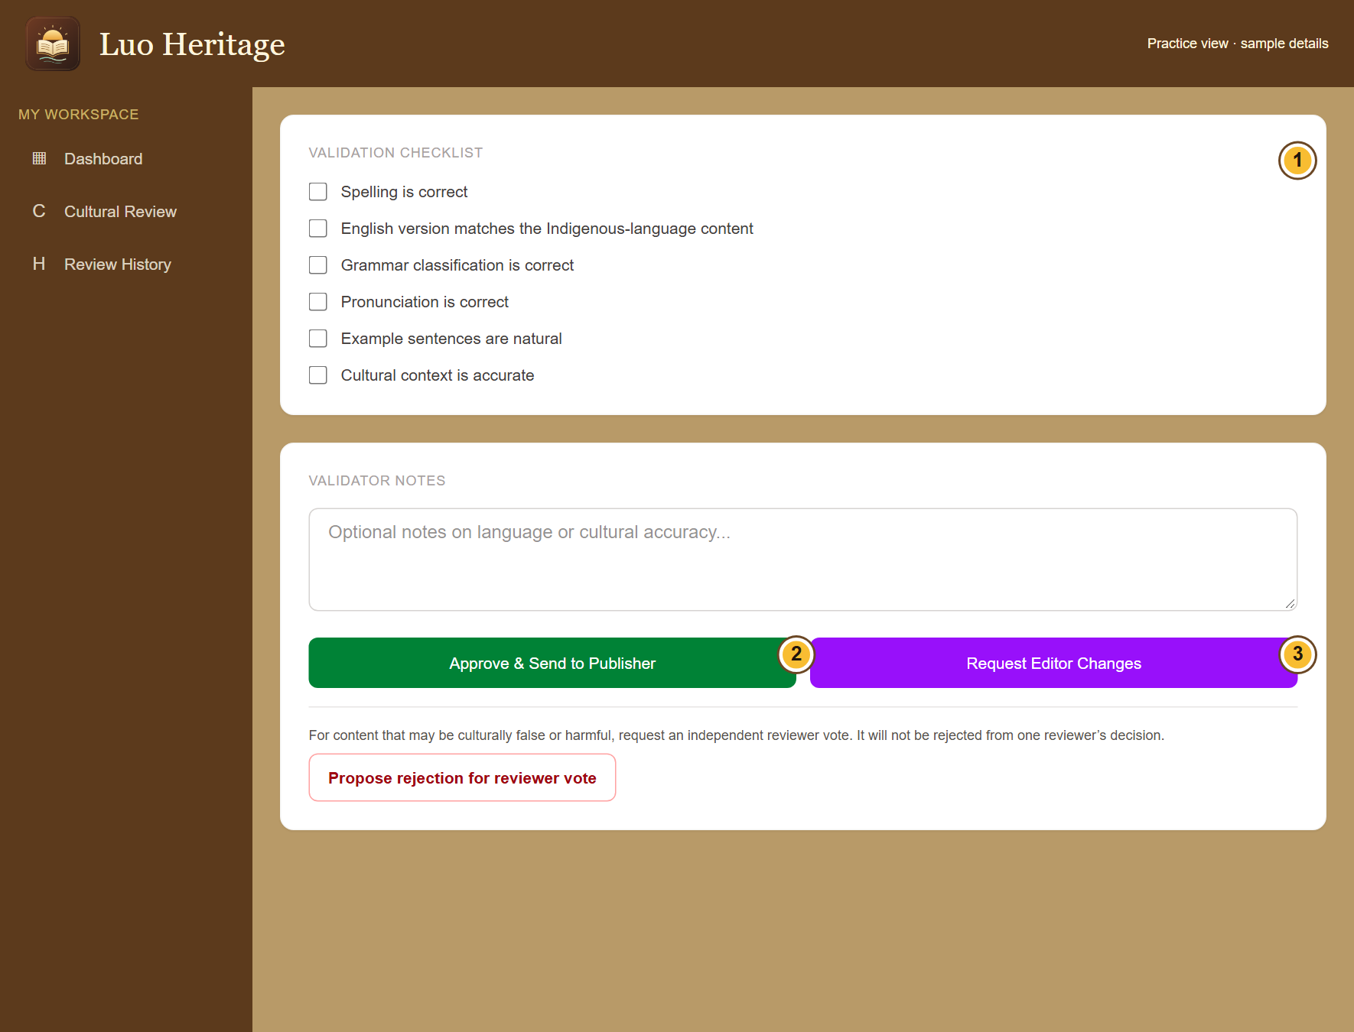
SELF-STUDY / CULTURAL REVIEWERS
Open the right review item
1
Choose Cultural Review in your staff menu.
2
Open a submitted item in your assigned
language. Check that you did not prepare
the material yourself.
3
Read its source, access settings, full text
and attached media before deciding.
An item can change while another reviewer works on it. Refresh if the
system asks you to.
CURRENT INTERFACE • PRACTICE DETAILS
CHECK: You are reviewing the current version of the intended item.
LUO HERITAGE / CULTURAL REVIEWERS
Contents
08 / 19
Notes:
Open the right review item
1. Choose Cultural Review in your staff menu.
2. Open a submitted item in your assigned language. Check that you did not prepare the material yourself.
3. Read its source, access settings, full text and attached media before deciding.
Expected result: You are reviewing the current version of the intended item.
Important: An item can change while another reviewer works on it. Refresh if the system asks you to.
Screenshot: current application interface rendered with sample details. No live action is demonstrated.

Slide 9
SELF-STUDY / CULTURAL REVIEWERS
Complete the cultural checks
1
Open Cultural Review and choose the
item. Read its text, source details and
attached files.
2
Check spelling, translation, grammar,
pronunciation, examples and cultural
context. Tick only what you have checked.
3
Add useful notes. If the item is correct,
choose Approve & Send to Publisher.
If you cannot check a recording or meaning, ask for help rather than
ticking the box.
CURRENT INTERFACE • PRACTICE DETAILS
CHECK: The item moves to the publisher queue after a successful cultural review.
LUO HERITAGE / CULTURAL REVIEWERS
Contents
09 / 19
Notes:
Complete the cultural checks
1. Open Cultural Review and choose the item. Read its text, source details and attached files.
2. Check spelling, translation, grammar, pronunciation, examples and cultural context. Tick only what you have checked.
3. Add useful notes. If the item is correct, choose Approve & Send to Publisher.
Expected result: The item moves to the publisher queue after a successful cultural review.
Important: If you cannot check a recording or meaning, ask for help rather than ticking the box.
Screenshot: current application interface rendered with sample details. No live action is demonstrated.

Slide 10

SELF-STUDY / CULTURAL REVIEWERS
Check permission before sharing
1
Under Source and access, choose Source
permission. If unsure, leave Not sure yet /
ask a reviewer.
2
Choose how to credit the source. Use a
person’s name only when they agree.
3
Keep restricted, sacred or research-only
material private. Ask a reviewer before
changing access.
Permission to collect material is not automatically permission to publish it.
CURRENT INTERFACE • PRACTICE DETAILS
CHECK: The draft records who may use the material and how the source should be credited.
LUO HERITAGE / CULTURAL REVIEWERS
Contents
10 / 19
Notes:
Check permission before sharing
1. Under Source and access, choose Source permission. If unsure, leave Not sure yet / ask a reviewer.
2. Choose how to credit the source. Use a person’s name only when they agree.
3. Keep restricted, sacred or research-only material private. Ask a reviewer before changing access.
Expected result: The draft records who may use the material and how the source should be credited.
Important: Permission to collect material is not automatically permission to publish it.
Screenshot: current application interface rendered with sample details. No live action is demonstrated.

Slide 11
SELF-STUDY / CULTURAL REVIEWERS
What the permission labels mean
1
Source permission: has the source agreed
to the proposed use? Choose Not sure yet
when you do not know.
2
Consent scope: what use was agreed?
Public excerpt means an approved public
part; research only and teaching have
different limits.
3
Restriction level: who may see it? Internal
and restricted are not public. Sacred
material needs the collection owner’s
special care.
If the permission record is unclear, keep the item private and ask the
responsible reviewer.
CURRENT INTERFACE • PRACTICE DETAILS
CHECK: You understand the labels before you change them.
LUO HERITAGE / CULTURAL REVIEWERS
Contents
11 / 19
Notes:
What the permission labels mean
1. Source permission: has the source agreed to the proposed use? Choose Not sure yet when you do not know.
2. Consent scope: what use was agreed? Public excerpt means an approved public part; research only and teaching have different limits.
3. Restriction level: who may see it? Internal and restricted are not public. Sacred material needs the collection owner’s special care.
Expected result: You understand the labels before you change them.
Important: If the permission record is unclear, keep the item private and ask the responsible reviewer.
Screenshot: current application interface rendered with sample details. No live action is demonstrated.

Slide 12
SELF-STUDY / CULTURAL REVIEWERS
Request an editor’s correction
1
Describe the problem in the notes: say
where it is, why it matters and what needs
checking.
2
Choose Request Editor Changes when a
correction is needed.
3
The editor fixes the draft and sends it back
to cultural review. Check the corrected
version again.
Write useful comments such as “Check the meaning in paragraph two,”
rather than “Wrong.”
CURRENT INTERFACE • PRACTICE DETAILS
CHECK: The editor receives a clear change request; the item is not published.
LUO HERITAGE / CULTURAL REVIEWERS
Contents
12 / 19
Notes:
Request an editor’s correction
1. Describe the problem in the notes: say where it is, why it matters and what needs checking.
2. Choose Request Editor Changes when a correction is needed.
3. The editor fixes the draft and sends it back to cultural review. Check the corrected version again.
Expected result: The editor receives a clear change request; the item is not published.
Important: Write useful comments such as “Check the meaning in paragraph two,” rather than “Wrong.”
Screenshot: current application interface rendered with sample details. No live action is demonstrated.

Slide 13
SELF-STUDY / CULTURAL REVIEWERS
Raise a serious cultural concern
1
If material may be culturally false or
harmful, explain your concern in the notes.
2
Choose Propose rejection for reviewer
vote. This asks other assigned reviewers to
check it.
3
Do not treat your proposal as a completed
rejection. Wait for the required independent
votes.
For a serious privacy problem, also contact the responsible administrator
promptly.
CURRENT INTERFACE • PRACTICE DETAILS
CHECK: The concern goes to an independent review vote.
LUO HERITAGE / CULTURAL REVIEWERS
Contents
13 / 19
Notes:
Raise a serious cultural concern
1. If material may be culturally false or harmful, explain your concern in the notes.
2. Choose Propose rejection for reviewer vote. This asks other assigned reviewers to check it.
3. Do not treat your proposal as a completed rejection. Wait for the required independent votes.
Expected result: The concern goes to an independent review vote.
Important: For a serious privacy problem, also contact the responsible administrator promptly.
Screenshot: current application interface rendered with sample details. No live action is demonstrated.

Slide 14
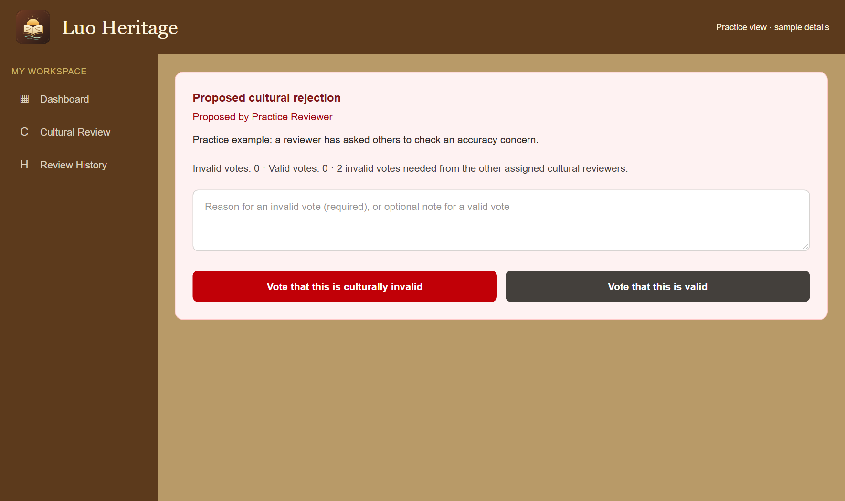
SELF-STUDY / CULTURAL REVIEWERS
Vote on another reviewer’s proposal
1
Open the proposed cultural rejection. Read
the reason and the original source.
2
If you are eligible, choose whether the item
is culturally valid or invalid. Give a clear
reason for an invalid vote.
3
Check the confirmation and vote count.
You cannot vote on your own proposal or
vote twice.
CURRENT INTERFACE • PRACTICE DETAILS
CHECK: Your independent vote is recorded. The system applies the required threshold.
LUO HERITAGE / CULTURAL REVIEWERS
Contents
14 / 19
Notes:
Vote on another reviewer’s proposal
1. Open the proposed cultural rejection. Read the reason and the original source.
2. If you are eligible, choose whether the item is culturally valid or invalid. Give a clear reason for an invalid vote.
3. Check the confirmation and vote count. You cannot vote on your own proposal or vote twice.
Expected result: Your independent vote is recorded. The system applies the required threshold.
Screenshot: current application interface rendered with sample details. No live action is demonstrated.

Slide 15
SELF-STUDY / CULTURAL REVIEWERS
Keep a useful review history
1
Open Review History to find your recorded
actions.
2
Use the item’s title and review notes when
explaining a decision to an editor or
coordinator.
3
If an error is found later, report it with the
item reference rather than editing history or
concealing the earlier decision.
CURRENT INTERFACE • PRACTICE DETAILS
CHECK: Other staff can understand how the decision was reached.
LUO HERITAGE / CULTURAL REVIEWERS
Contents
15 / 19
Notes:
Keep a useful review history
1. Open Review History to find your recorded actions.
2. Use the item’s title and review notes when explaining a decision to an editor or coordinator.
3. If an error is found later, report it with the item reference rather than editing history or concealing the earlier decision.
Expected result: Other staff can understand how the decision was reached.
Screenshot: current application interface rendered with sample details. No live action is demonstrated.

Slide 16
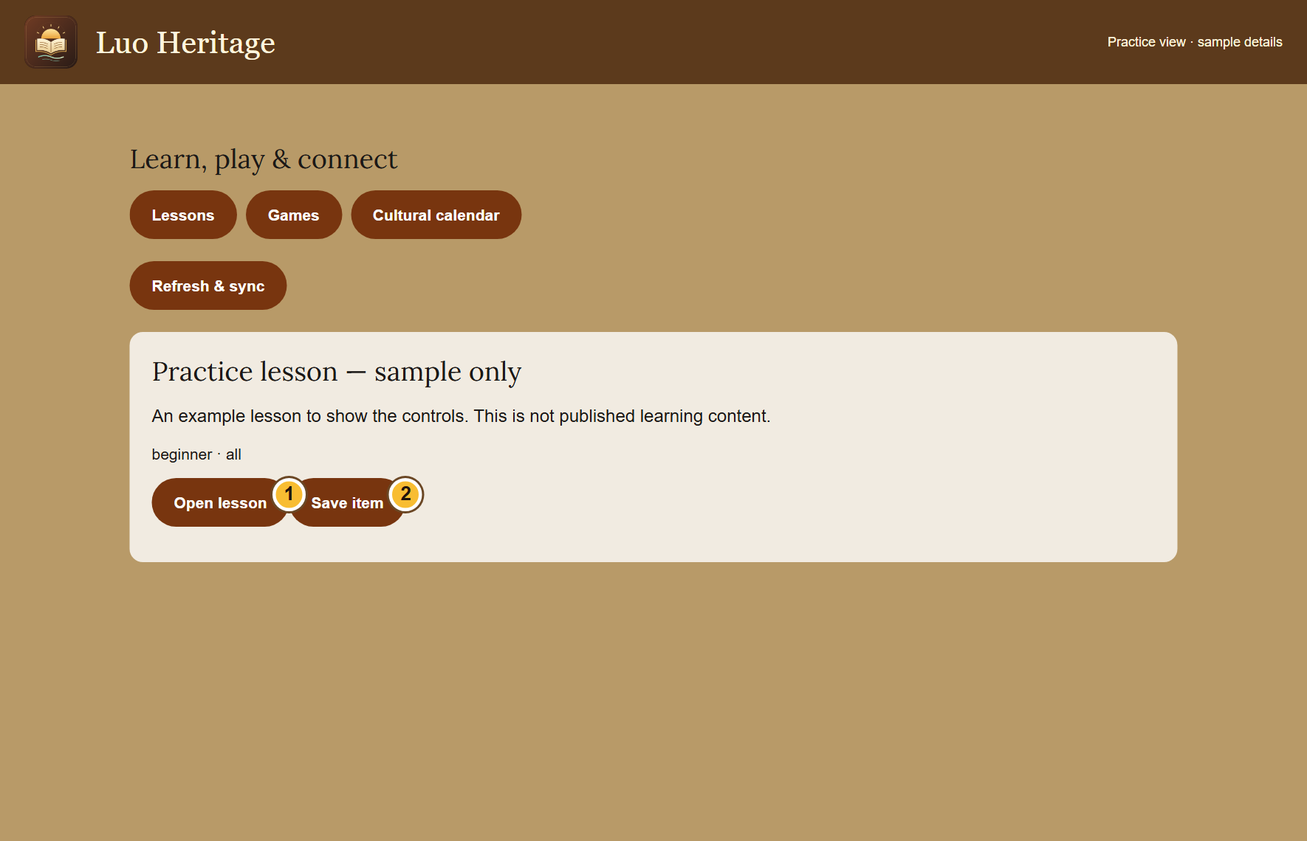
SELF-STUDY / CULTURAL REVIEWERS
Review learning material with the same care
1
Open Lessons, games & calendar if your
role offers the content workspace.
2
Read a submitted lesson, its questions,
answers, source and audience. Use the
review action only if independently
assigned.
3
A course review is separate from reviewing
its individual lessons. Ask the coordinator if
the action is not available.
A role that can review material does not automatically let its author
approve their own work.
CURRENT INTERFACE • PRACTICE DETAILS
CHECK: Learning material receives the appropriate independent checks.
LUO HERITAGE / CULTURAL REVIEWERS
Contents
16 / 19
Notes:
Review learning material with the same care
1. Open Lessons, games & calendar if your role offers the content workspace.
2. Read a submitted lesson, its questions, answers, source and audience. Use the review action only if independently assigned.
3. A course review is separate from reviewing its individual lessons. Ask the coordinator if the action is not available.
Expected result: Learning material receives the appropriate independent checks.
Important: A role that can review material does not automatically let its author approve their own work.
Screenshot: current application interface rendered with sample details. No live action is demonstrated.

Slide 17

SELF-STUDY / CULTURAL REVIEWERS
Protect your account and other people
1
Use your own account. Sign out on a
shared computer or phone.
2
Do not copy private interviews, class
results or account lists into public chats or
messages.
3
If a screen shows information you should
not see, stop and tell the account
administrator.
Send support the screen name and error message, never your password
or a reset link.
CURRENT INTERFACE • PRACTICE DETAILS
CHECK: Your work remains linked to the right person and private information stays protected.
LUO HERITAGE / CULTURAL REVIEWERS
Contents
17 / 19
Notes:
Protect your account and other people
1. Use your own account. Sign out on a shared computer or phone.
2. Do not copy private interviews, class results or account lists into public chats or messages.
3. If a screen shows information you should not see, stop and tell the account administrator.
Expected result: Your work remains linked to the right person and private information stays protected.
Important: Send support the screen name and error message, never your password or a reset link.
Screenshot: current application interface rendered with sample details. No live action is demonstrated.

Slide 18
SELF-STUDY / CULTURAL REVIEWERS
When something does not work
1
Check your internet connection. Read the message on screen
before trying again.
2
If your sign-in has expired, sign in again. If a button is missing,
ask which role and language you have.
3
If it still fails, note the time, screen, button and exact message.
Send these to your account administrator.
Before repeating an upload or submission, check whether the first attempt was already saved.
CURRENT INTERFACE • PRACTICE DETAILS
CHECK: You can explain the problem clearly without exposing private information.
LUO HERITAGE / CULTURAL REVIEWERS
Contents
18 / 19
Notes:
When something does not work
1. Check your internet connection. Read the message on screen before trying again.
2. If your sign-in has expired, sign in again. If a button is missing, ask which role and language you have.
3. If it still fails, note the time, screen, button and exact message. Send these to your account administrator.
Expected result: You can explain the problem clearly without exposing private information.
Important: Before repeating an upload or submission, check whether the first attempt was already saved.
Screenshot: current application interface rendered with sample details. No live action is demonstrated.

Slide 19
SELF-STUDY / CULTURAL REVIEWERS
Try it yourself: your readiness check
1
Explain one checklist item using an approved practice contribution.
2
Describe how to request an editor change and how the item returns to you.
3
Explain why a proposed rejection needs independent votes.
Try
→
Check
→
Ask if unsure
Use only approved practice material. Do not publish, delete accounts or change live settings just to practise.
CHECK: You are ready for routine work when you can complete these steps without help.
LUO HERITAGE / CULTURAL REVIEWERS
Contents
19 / 19
Notes:
Try it yourself: your readiness check
1. Explain one checklist item using an approved practice contribution.
2. Describe how to request an editor change and how the item returns to you.
3. Explain why a proposed rejection needs independent votes.
Expected result: You are ready for routine work when you can complete these steps without help.
Important: Use only approved practice material. Do not publish, delete accounts or change live settings just to practise.

