Slide 1

LUO HERITAGE / SELF-STUDY SLIDES
LANGUAGE • CULTURE • LIVING MEMORY
Language administrators
Coordinate people and content for your language
You will be able to manage your language’s work while keeping staff duties clear.
READ • TRY • CHECK
25 October 2026 | Edition 1.0
Notes:
Self-study guide. Screenshots show actual interface components rendered with clearly labelled sample data, not a production acceptance demonstration. No real account or cultural record was changed to make these slides.

Slide 2
SELF-STUDY / LANGUAGE ADMINISTRATORS
Start here: learn at your own pace
1
Read a slide, try its action, then check the result. Tap means click. Gold circles mark important
controls in the screenshots.
2
Use your own account. Your organisation supplies the correct website address and any staff
access.
3
Screenshots show the current interface with practice details. Actual names, content and
menus may differ.
Read the step
→
Try it yourself
→
Check the result
If your menu looks different, first check My access. Do not ask someone to lend you their account.
CHECK: You will be able to manage your language’s work while keeping staff duties clear.
LUO HERITAGE / LANGUAGE ADMINISTRATORS
Contents
02 / 21
Notes:
Start here: learn at your own pace
1. Read a slide, try its action, then check the result. Tap means click. Gold circles mark important controls in the screenshots.
2. Use your own account. Your organisation supplies the correct website address and any staff access.
3. Screenshots show the current interface with practice details. Actual names, content and menus may differ.
Expected result: You will be able to manage your language’s work while keeping staff duties clear.
Important: If your menu looks different, first check My access. Do not ask someone to lend you their account.

Slide 3
SELF-STUDY / LANGUAGE ADMINISTRATORS
What this guide covers
1
Understand your language’s menu, people and content.
2
Coordinate uploads, cultural review, editing and publication.
3
Check teaching access, translations, activity and problems.
CHECK: Use the slide numbers to return to a task. The PDF has page bookmarks; PowerPoint has a contents view.
LUO HERITAGE / LANGUAGE ADMINISTRATORS
Contents
03 / 21
Notes:
What this guide covers
1. Understand your language’s menu, people and content.
2. Coordinate uploads, cultural review, editing and publication.
3. Check teaching access, translations, activity and problems.
Expected result: Use the slide numbers to return to a task. The PDF has page bookmarks; PowerPoint has a contents view.

Slide 4

SELF-STUDY / LANGUAGE ADMINISTRATORS
Sign in to your own account
1
Open the Luo Heritage address supplied by your organisation.
Choose Sign in or Log in.
2
Enter your email and password, then choose Log in. Check your
spelling if it fails.
3
Community members may also use Google. Staff should use the
account supplied by their administrator.
Never share your password. Use only an address you trust.
CURRENT INTERFACE • PRACTICE DETAILS
CHECK: Your account or dashboard opens.
LUO HERITAGE / LANGUAGE ADMINISTRATORS
Contents
04 / 21
Notes:
Sign in to your own account
1. Open the Luo Heritage address supplied by your organisation. Choose Sign in or Log in.
2. Enter your email and password, then choose Log in. Check your spelling if it fails.
3. Community members may also use Google. Staff should use the account supplied by their administrator.
Expected result: Your account or dashboard opens.
Important: Never share your password. Use only an address you trust.
Screenshot: current application interface rendered with sample details. No live action is demonstrated.

Slide 5

SELF-STUDY / LANGUAGE ADMINISTRATORS
Forgot your password?
1
On the sign-in screen, choose Forgotten
password? Select Reset password.
2
Enter your account email. Choose Send
email, then check your inbox and spam
folder.
3
Open the newest reset link within 30
minutes. A link can be used only once.
If no email arrives, contact the person who manages your account. Do
not keep requesting links.
CURRENT INTERFACE • PRACTICE DETAILS
CHECK: An account email arrives if the address is eligible and the email service is available.
LUO HERITAGE / LANGUAGE ADMINISTRATORS
Contents
05 / 21
Notes:
Forgot your password?
1. On the sign-in screen, choose Forgotten password? Select Reset password.
2. Enter your account email. Choose Send email, then check your inbox and spam folder.
3. Open the newest reset link within 30 minutes. A link can be used only once.
Expected result: An account email arrives if the address is eligible and the email service is available.
Important: If no email arrives, contact the person who manages your account. Do not keep requesting links.
Screenshot: current application interface rendered with sample details. No live action is demonstrated.

Slide 6

SELF-STUDY / LANGUAGE ADMINISTRATORS
Choose a new password
1
Open the password reset link from your
own inbox.
2
Enter a new password of at least 12
characters. A short phrase with several
words is easier to remember.
3
Choose Confirm. Return to sign in and use
the new password on each device.
Do not forward the reset link. If it has expired, request a new one.
CURRENT INTERFACE • PRACTICE DETAILS
CHECK: The password changes and old sign-ins are ended.
LUO HERITAGE / LANGUAGE ADMINISTRATORS
Contents
06 / 21
Notes:
Choose a new password
1. Open the password reset link from your own inbox.
2. Enter a new password of at least 12 characters. A short phrase with several words is easier to remember.
3. Choose Confirm. Return to sign in and use the new password on each device.
Expected result: The password changes and old sign-ins are ended.
Important: Do not forward the reset link. If it has expired, request a new one.
Screenshot: current application interface rendered with sample details. No live action is demonstrated.

Slide 7
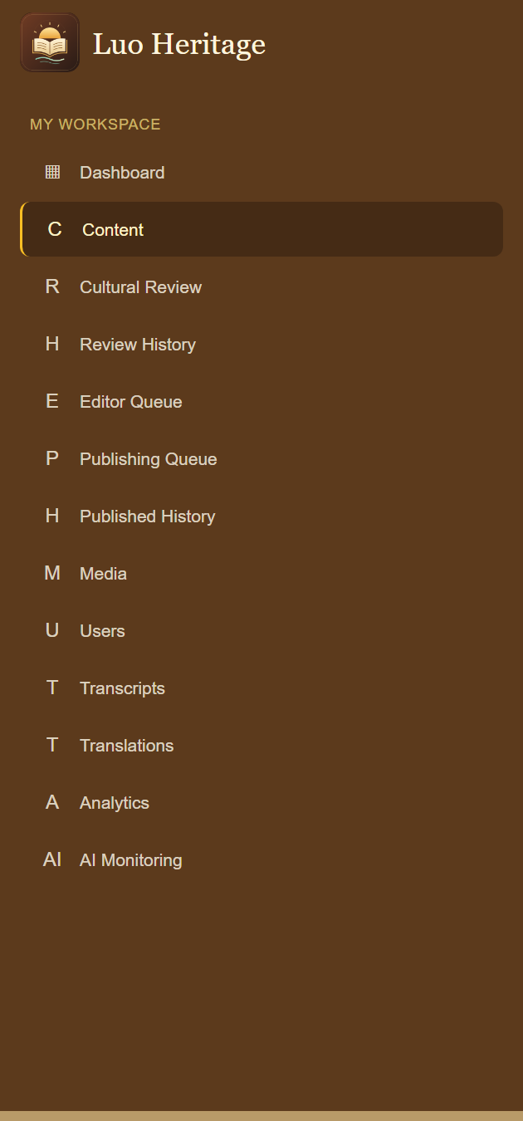
SELF-STUDY / LANGUAGE ADMINISTRATORS
Read your language workspace
1
Open the admin dashboard and confirm the selected language.
2
Use Content, Cultural Review, Editor Queue and Publishing
Queue to find work at each stage.
3
Use Media, Users and Transcripts only for the material and
people in your permitted scope.
CURRENT INTERFACE • PRACTICE DETAILS
CHECK: You can direct a question to the right screen and staff member.
LUO HERITAGE / LANGUAGE ADMINISTRATORS
Contents
07 / 21
Notes:
Read your language workspace
1. Open the admin dashboard and confirm the selected language.
2. Use Content, Cultural Review, Editor Queue and Publishing Queue to find work at each stage.
3. Use Media, Users and Transcripts only for the material and people in your permitted scope.
Expected result: You can direct a question to the right screen and staff member.
Screenshot: current application interface rendered with sample details. No live action is demonstrated.

Slide 8
SELF-STUDY / LANGUAGE ADMINISTRATORS
How a contribution reaches readers
1
The uploader or contributor prepares a draft and submits it.
2
A cultural reviewer checks accuracy. An editor makes requested corrections and returns the
item for review.
3
A publisher checks the final item and permission. Only an approved public release becomes
visible to readers.
Prepare draft
→
Cultural review
→
Publisher check
→
Public release
Different people should perform the independent checks. Do not approve your own work.
CHECK: An item may return for changes. Drafts and private approvals are not public publication.
LUO HERITAGE / LANGUAGE ADMINISTRATORS
Contents
08 / 21
Notes:
How a contribution reaches readers
1. The uploader or contributor prepares a draft and submits it.
2. A cultural reviewer checks accuracy. An editor makes requested corrections and returns the item for review.
3. A publisher checks the final item and permission. Only an approved public release becomes visible to readers.
Expected result: An item may return for changes. Drafts and private approvals are not public publication.
Important: Different people should perform the independent checks. Do not approve your own work.

Slide 9
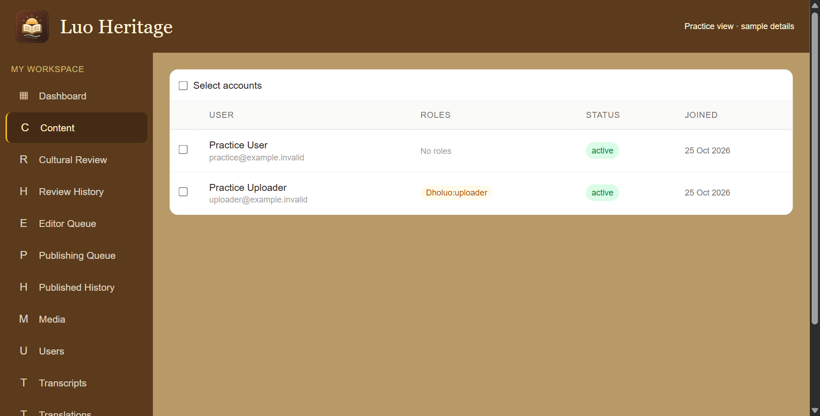
SELF-STUDY / LANGUAGE ADMINISTRATORS
Help users without changing the wrong account
1
Open Users. Find the person by their own
name and email.
2
Open their details and check their
language and current access before
changing anything.
3
Use only the changes allowed by your role.
Read every confirmation before
suspending or activating accounts.
Do not select every account to solve a problem affecting one person.
CURRENT INTERFACE • PRACTICE DETAILS
CHECK: The intended account has the correct status and access.
LUO HERITAGE / LANGUAGE ADMINISTRATORS
Contents
09 / 21
Notes:
Help users without changing the wrong account
1. Open Users. Find the person by their own name and email.
2. Open their details and check their language and current access before changing anything.
3. Use only the changes allowed by your role. Read every confirmation before suspending or activating accounts.
Expected result: The intended account has the correct status and access.
Important: Do not select every account to solve a problem affecting one person.
Screenshot: current application interface rendered with sample details. No live action is demonstrated.

Slide 10
SELF-STUDY / LANGUAGE ADMINISTRATORS
Give a person only the access they need
1
Open the person’s account details and
verify their email.
2
Use the role controls available to you for
your language. If staff creation is not
offered, ask a Super Admin.
3
Confirm the assignment in the person’s
access list and ask them to sign in again if
the menu has not refreshed.
Language access does not allow you to grant Super Admin ownership.
CURRENT INTERFACE • PRACTICE DETAILS
CHECK: The right person can do their assigned task in the intended language.
LUO HERITAGE / LANGUAGE ADMINISTRATORS
Contents
10 / 21
Notes:
Give a person only the access they need
1. Open the person’s account details and verify their email.
2. Use the role controls available to you for your language. If staff creation is not offered, ask a Super Admin.
3. Confirm the assignment in the person’s access list and ask them to sign in again if the menu has not refreshed.
Expected result: The right person can do their assigned task in the intended language.
Important: Language access does not allow you to grant Super Admin ownership.
Screenshot: current application interface rendered with sample details. No live action is demonstrated.

Slide 11
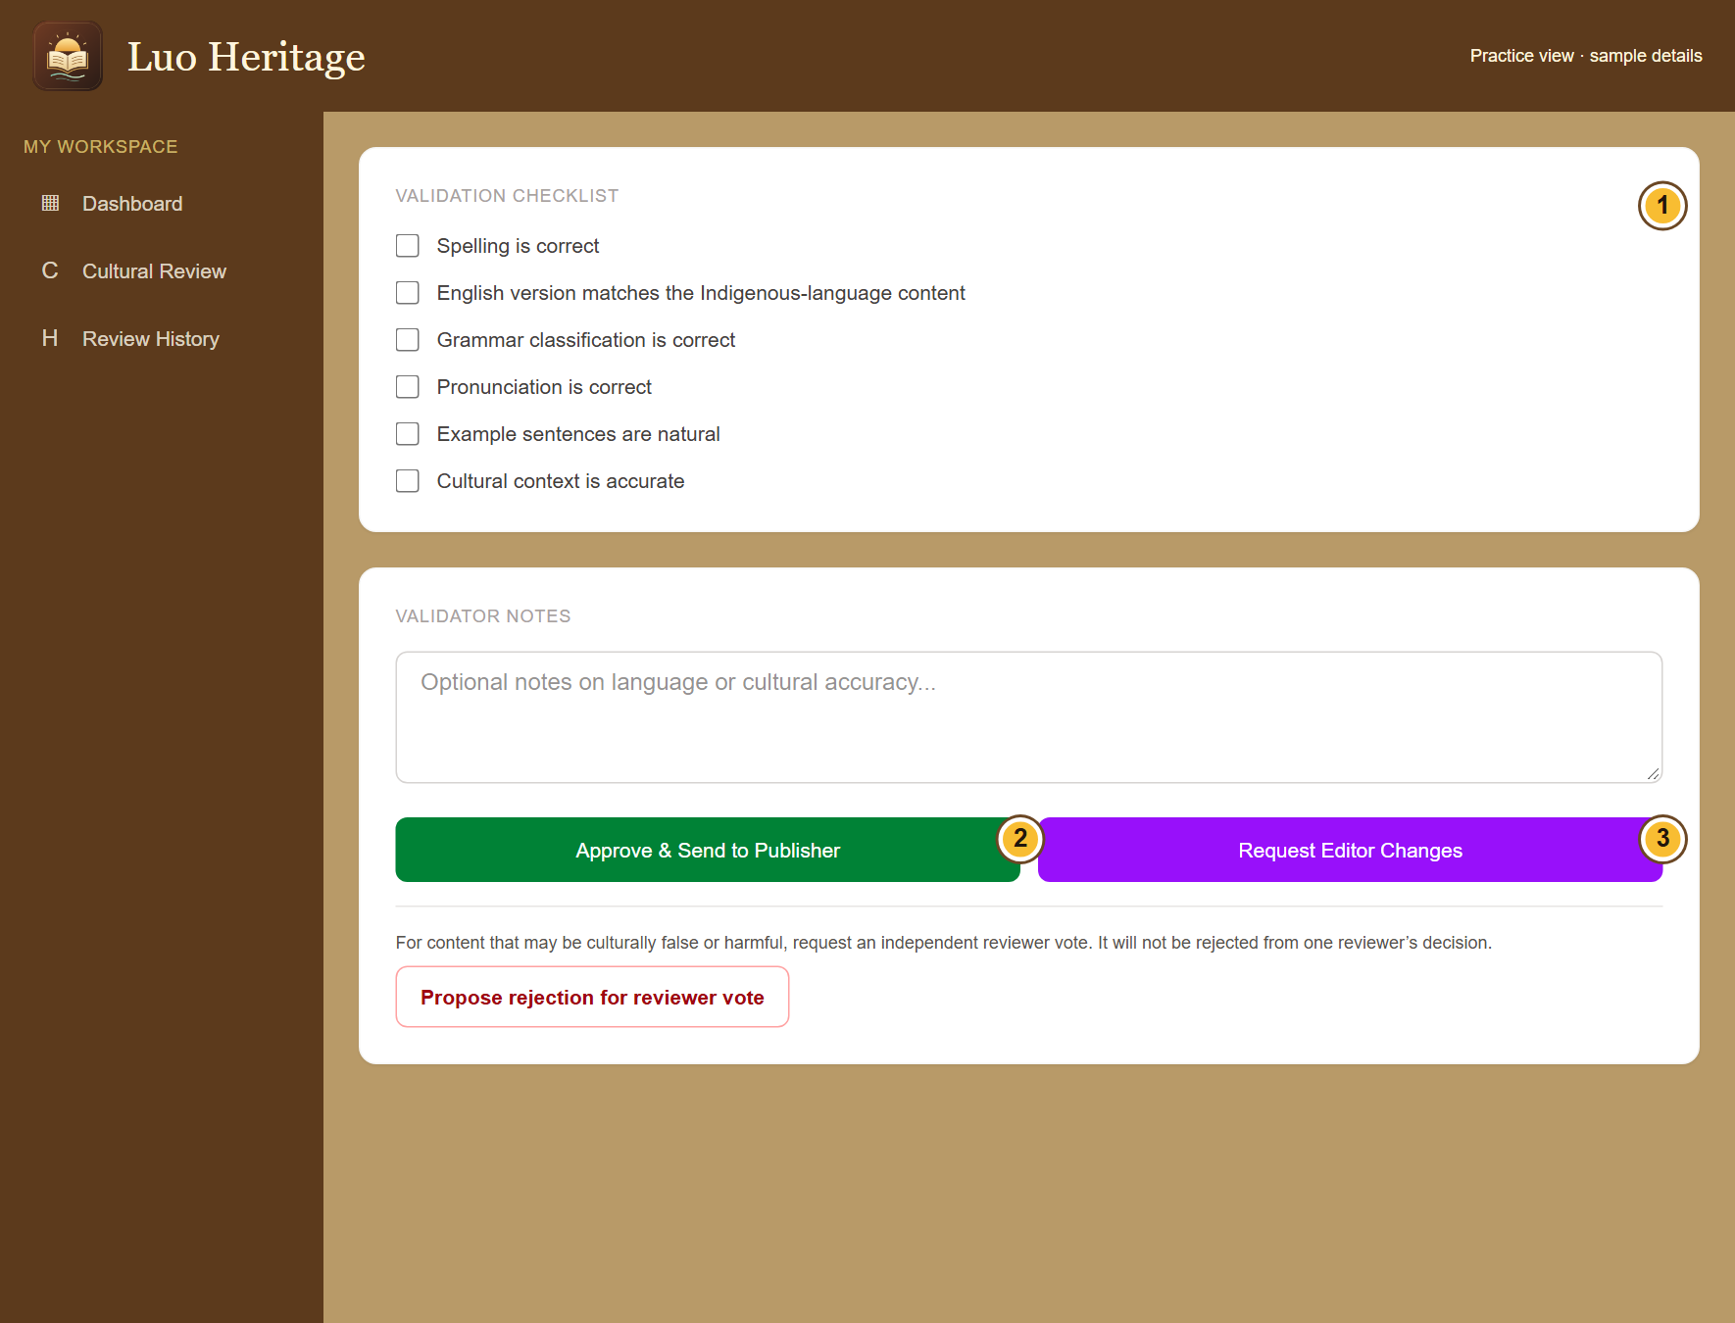
SELF-STUDY / LANGUAGE ADMINISTRATORS
Coordinate a review without skipping stages
1
Check the oldest waiting items and who is
assigned to each stage.
2
Ask the uploader to complete missing
source details, the reviewer to check
accuracy, or the editor to make requested
changes.
3
Keep independent review: broad access
does not make it appropriate to approve
your own submission.
CURRENT INTERFACE • PRACTICE DETAILS
CHECK: Work moves through the intended people and checks.
LUO HERITAGE / LANGUAGE ADMINISTRATORS
Contents
11 / 21
Notes:
Coordinate a review without skipping stages
1. Check the oldest waiting items and who is assigned to each stage.
2. Ask the uploader to complete missing source details, the reviewer to check accuracy, or the editor to make requested changes.
3. Keep independent review: broad access does not make it appropriate to approve your own submission.
Expected result: Work moves through the intended people and checks.
Screenshot: current application interface rendered with sample details. No live action is demonstrated.

Slide 12
SELF-STUDY / LANGUAGE ADMINISTRATORS
Complete the cultural checks
1
Open Cultural Review and choose the
item. Read its text, source details and
attached files.
2
Check spelling, translation, grammar,
pronunciation, examples and cultural
context. Tick only what you have checked.
3
Add useful notes. If the item is correct,
choose Approve & Send to Publisher.
If you cannot check a recording or meaning, ask for help rather than
ticking the box.
CURRENT INTERFACE • PRACTICE DETAILS
CHECK: The item moves to the publisher queue after a successful cultural review.
LUO HERITAGE / LANGUAGE ADMINISTRATORS
Contents
12 / 21
Notes:
Complete the cultural checks
1. Open Cultural Review and choose the item. Read its text, source details and attached files.
2. Check spelling, translation, grammar, pronunciation, examples and cultural context. Tick only what you have checked.
3. Add useful notes. If the item is correct, choose Approve & Send to Publisher.
Expected result: The item moves to the publisher queue after a successful cultural review.
Important: If you cannot check a recording or meaning, ask for help rather than ticking the box.
Screenshot: current application interface rendered with sample details. No live action is demonstrated.

Slide 13
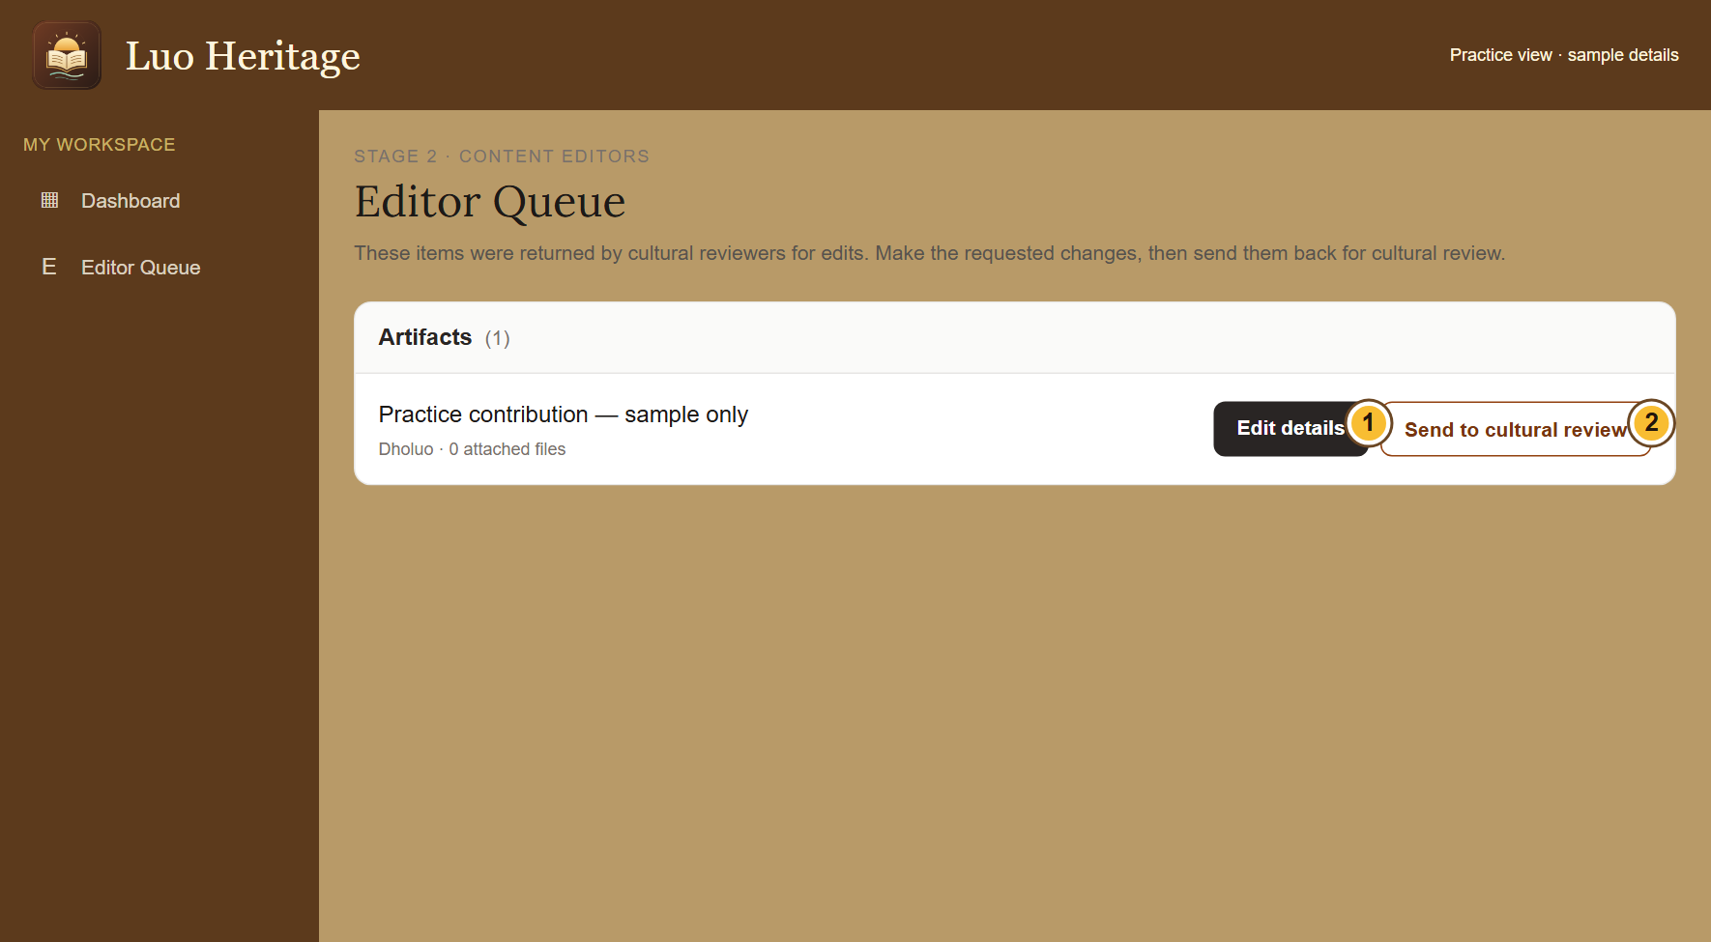
SELF-STUDY / LANGUAGE ADMINISTRATORS
Correct an item returned by a reviewer
1
Open Editor Queue. Find the item and
choose Edit details.
2
Read the requested changes. Correct the
text or files, then save your changes.
3
Return to the queue and choose Send to
cultural review. The reviewer must check
the corrected version.
Saving an edit does not publish it. Keep the source’s meaning and credit.
CURRENT INTERFACE • PRACTICE DETAILS
CHECK: The corrected item returns to cultural review.
LUO HERITAGE / LANGUAGE ADMINISTRATORS
Contents
13 / 21
Notes:
Correct an item returned by a reviewer
1. Open Editor Queue. Find the item and choose Edit details.
2. Read the requested changes. Correct the text or files, then save your changes.
3. Return to the queue and choose Send to cultural review. The reviewer must check the corrected version.
Expected result: The corrected item returns to cultural review.
Important: Saving an edit does not publish it. Keep the source’s meaning and credit.
Screenshot: current application interface rendered with sample details. No live action is demonstrated.

Slide 14
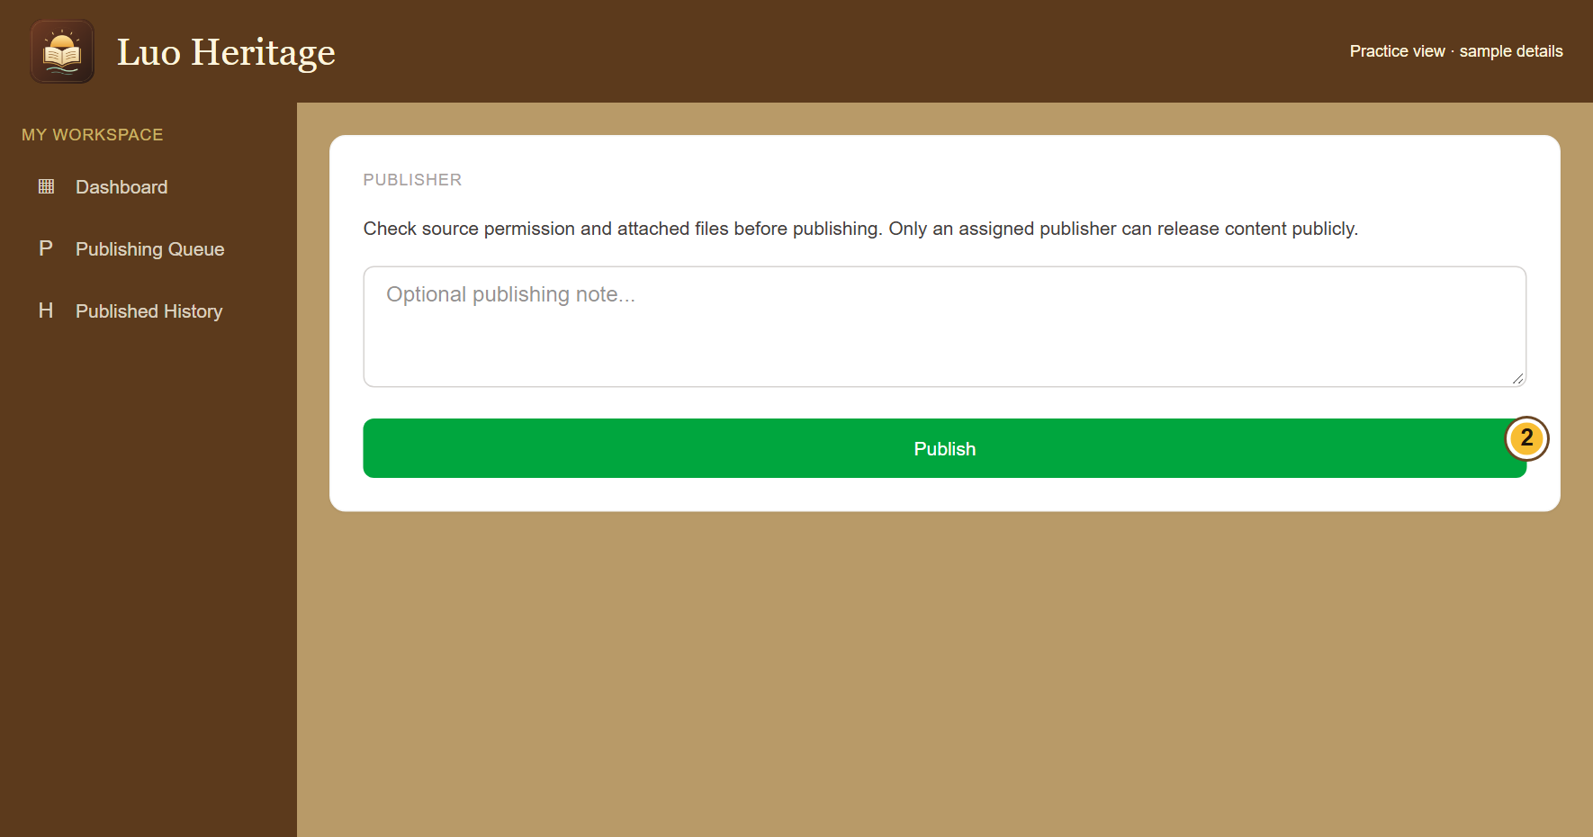
SELF-STUDY / LANGUAGE ADMINISTRATORS
Check carefully before choosing Publish
1
Open Publishing Queue and read the
culturally reviewed item.
2
Check the text, attached files, source
permission and public access settings. Add
a note if needed.
3
Choose Publish only when the item is
ready. Read the confirmation: an internal
approval can remain private.
A Publish button is not permission to release sacred, restricted or
research-only material.
CURRENT INTERFACE • PRACTICE DETAILS
CHECK: Eligible public material becomes available to readers; internal material remains protected.
LUO HERITAGE / LANGUAGE ADMINISTRATORS
Contents
14 / 21
Notes:
Check carefully before choosing Publish
1. Open Publishing Queue and read the culturally reviewed item.
2. Check the text, attached files, source permission and public access settings. Add a note if needed.
3. Choose Publish only when the item is ready. Read the confirmation: an internal approval can remain private.
Expected result: Eligible public material becomes available to readers; internal material remains protected.
Important: A Publish button is not permission to release sacred, restricted or research-only material.
Screenshot: current application interface rendered with sample details. No live action is demonstrated.

Slide 15
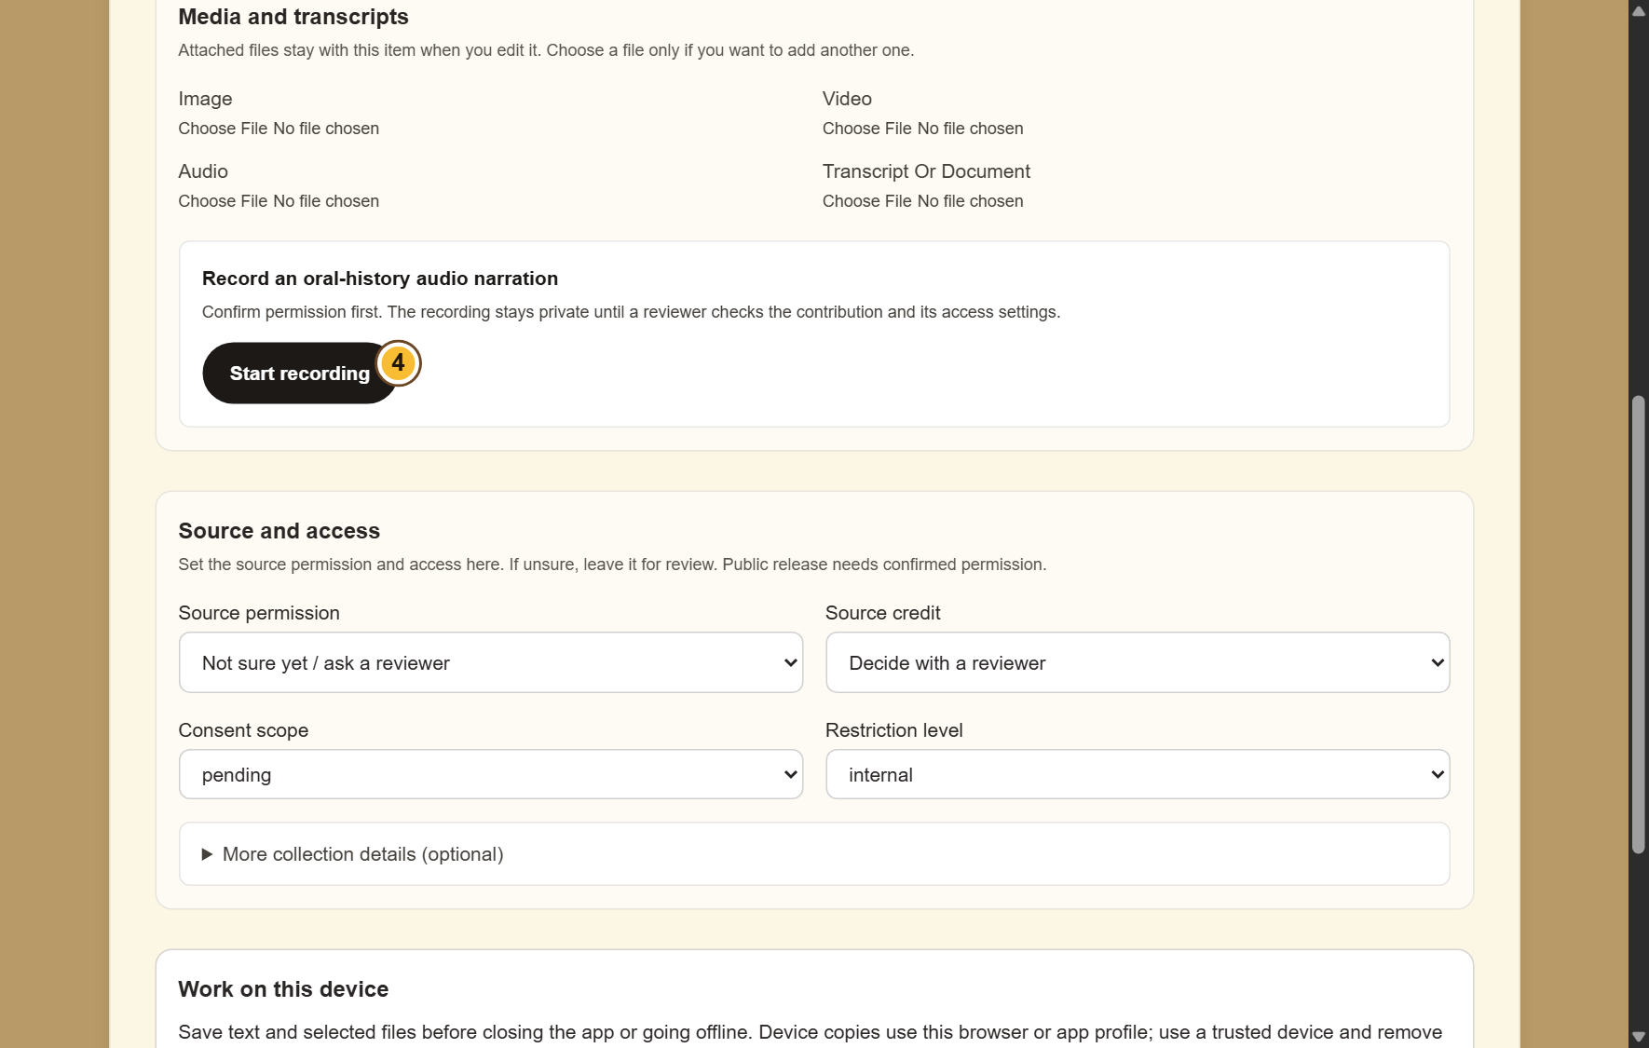
SELF-STUDY / LANGUAGE ADMINISTRATORS
Check media and translation quality
1
Open Media and the relevant content item.
Check files, labels and access settings.
2
Use Translations to review the language
labels and available translations. Missing
text needs a checked translation.
3
Ask the responsible content editor or
reviewer to correct inaccurate material.
CURRENT INTERFACE • PRACTICE DETAILS
CHECK: The collection is usable in the intended language without misleading labels.
LUO HERITAGE / LANGUAGE ADMINISTRATORS
Contents
15 / 21
Notes:
Check media and translation quality
1. Open Media and the relevant content item. Check files, labels and access settings.
2. Use Translations to review the language labels and available translations. Missing text needs a checked translation.
3. Ask the responsible content editor or reviewer to correct inaccurate material.
Expected result: The collection is usable in the intended language without misleading labels.
Screenshot: current application interface rendered with sample details. No live action is demonstrated.

Slide 16
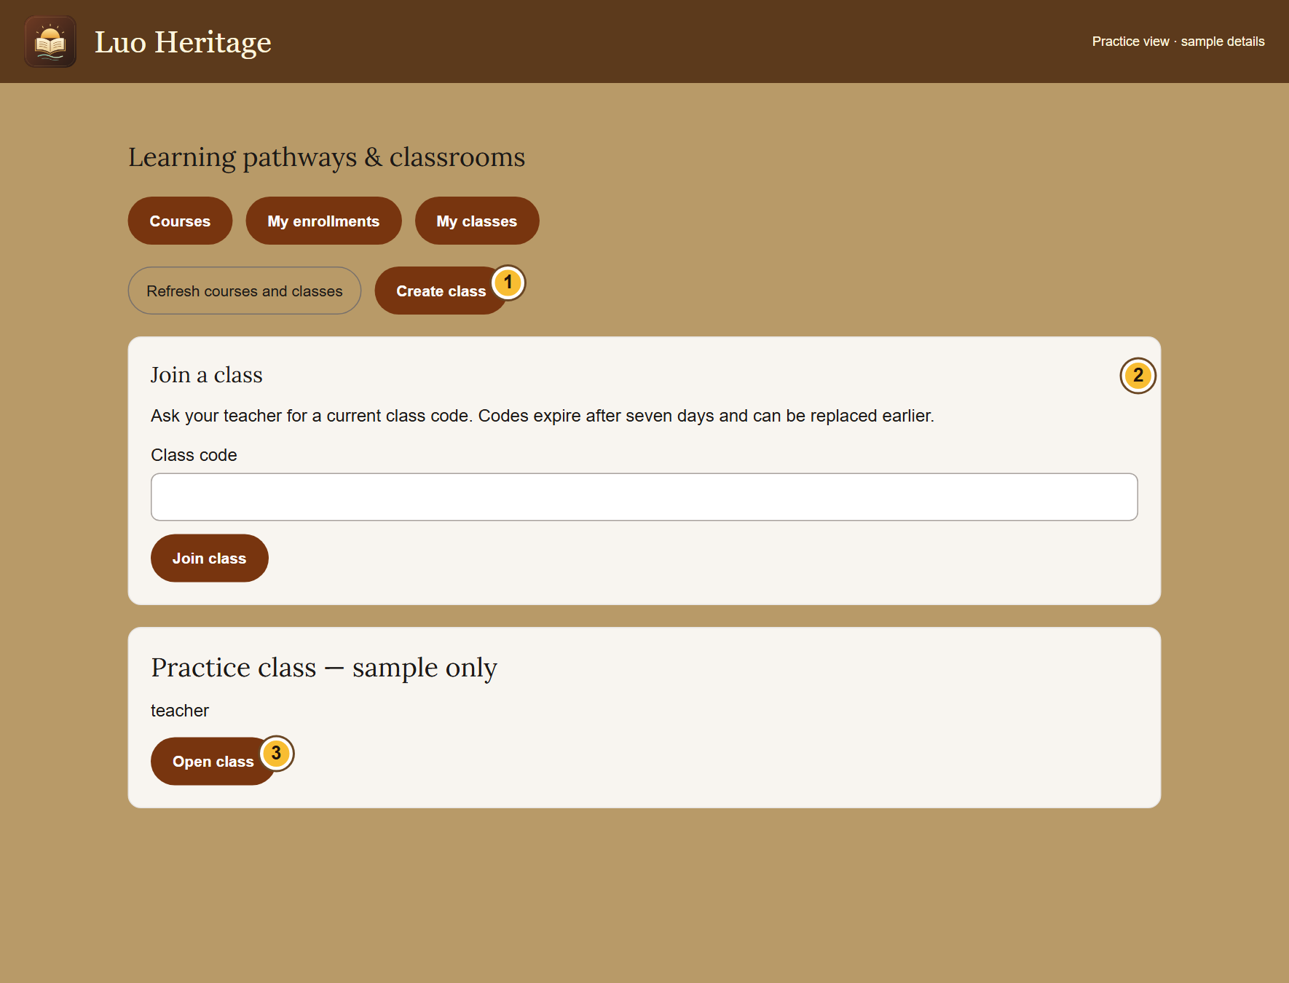
SELF-STUDY / LANGUAGE ADMINISTRATORS
Handle teaching access and learning content
1
Confirm that a teacher has been given
actual teaching access; an interest on their
profile is not enough.
2
Check that lessons and courses are
published only after independent review.
3
Ask teachers to handle class membership,
assignments and gradebooks within their
classes.
CURRENT INTERFACE • PRACTICE DETAILS
CHECK: Teachers can use the right classes and learners can open approved lessons.
LUO HERITAGE / LANGUAGE ADMINISTRATORS
Contents
16 / 21
Notes:
Handle teaching access and learning content
1. Confirm that a teacher has been given actual teaching access; an interest on their profile is not enough.
2. Check that lessons and courses are published only after independent review.
3. Ask teachers to handle class membership, assignments and gradebooks within their classes.
Expected result: Teachers can use the right classes and learners can open approved lessons.
Screenshot: current application interface rendered with sample details. No live action is demonstrated.

Slide 17
SELF-STUDY / LANGUAGE ADMINISTRATORS
Read activity and AI reports carefully
1
Open Analytics for the activity recorded by the system.
2
Use AI Monitoring to review recorded questions, feedback and
concerns within your allowed access.
3
Treat low counts as a reason to investigate usage, not as proof
of a technical fault. Escalate private-data or accuracy concerns.
CURRENT INTERFACE • PRACTICE DETAILS
CHECK: You can explain recorded activity without inventing missing results.
LUO HERITAGE / LANGUAGE ADMINISTRATORS
Contents
17 / 21
Notes:
Read activity and AI reports carefully
1. Open Analytics for the activity recorded by the system.
2. Use AI Monitoring to review recorded questions, feedback and concerns within your allowed access.
3. Treat low counts as a reason to investigate usage, not as proof of a technical fault. Escalate private-data or accuracy concerns.
Expected result: You can explain recorded activity without inventing missing results.
Screenshot: current application interface rendered with sample details. No live action is demonstrated.

Slide 18

SELF-STUDY / LANGUAGE ADMINISTRATORS
Handle a permission or privacy complaint
1
Note the affected item and what the person
says is wrong. Avoid copying the private
content into your report.
2
Notify the responsible institutional owner
and arrange the permitted restriction or
withdrawal action.
3
Check that the final public view matches
the decision and retain the review record.
Do not resolve a complaint by silently removing source evidence or
review history.
CURRENT INTERFACE • PRACTICE DETAILS
CHECK: A concern has an owner and a documented response.
LUO HERITAGE / LANGUAGE ADMINISTRATORS
Contents
18 / 21
Notes:
Handle a permission or privacy complaint
1. Note the affected item and what the person says is wrong. Avoid copying the private content into your report.
2. Notify the responsible institutional owner and arrange the permitted restriction or withdrawal action.
3. Check that the final public view matches the decision and retain the review record.
Expected result: A concern has an owner and a documented response.
Important: Do not resolve a complaint by silently removing source evidence or review history.
Screenshot: current application interface rendered with sample details. No live action is demonstrated.

Slide 19

SELF-STUDY / LANGUAGE ADMINISTRATORS
Protect your account and other people
1
Use your own account. Sign out on a
shared computer or phone.
2
Do not copy private interviews, class
results or account lists into public chats or
messages.
3
If a screen shows information you should
not see, stop and tell the account
administrator.
Send support the screen name and error message, never your password
or a reset link.
CURRENT INTERFACE • PRACTICE DETAILS
CHECK: Your work remains linked to the right person and private information stays protected.
LUO HERITAGE / LANGUAGE ADMINISTRATORS
Contents
19 / 21
Notes:
Protect your account and other people
1. Use your own account. Sign out on a shared computer or phone.
2. Do not copy private interviews, class results or account lists into public chats or messages.
3. If a screen shows information you should not see, stop and tell the account administrator.
Expected result: Your work remains linked to the right person and private information stays protected.
Important: Send support the screen name and error message, never your password or a reset link.
Screenshot: current application interface rendered with sample details. No live action is demonstrated.

Slide 20
SELF-STUDY / LANGUAGE ADMINISTRATORS
When something does not work
1
Check your internet connection. Read the message on screen
before trying again.
2
If your sign-in has expired, sign in again. If a button is missing,
ask which role and language you have.
3
If it still fails, note the time, screen, button and exact message.
Send these to your account administrator.
Before repeating an upload or submission, check whether the first attempt was already saved.
CURRENT INTERFACE • PRACTICE DETAILS
CHECK: You can explain the problem clearly without exposing private information.
LUO HERITAGE / LANGUAGE ADMINISTRATORS
Contents
20 / 21
Notes:
When something does not work
1. Check your internet connection. Read the message on screen before trying again.
2. If your sign-in has expired, sign in again. If a button is missing, ask which role and language you have.
3. If it still fails, note the time, screen, button and exact message. Send these to your account administrator.
Expected result: You can explain the problem clearly without exposing private information.
Important: Before repeating an upload or submission, check whether the first attempt was already saved.
Screenshot: current application interface rendered with sample details. No live action is demonstrated.

Slide 21
SELF-STUDY / LANGUAGE ADMINISTRATORS
Try it yourself: your readiness check
1
Name the person responsible for each stage of a contribution.
2
Check a practice account’s language and duties without granting extra power.
3
Explain how you would handle a missing teacher button or a privacy complaint.
Try
→
Check
→
Ask if unsure
Use only approved practice material. Do not publish, delete accounts or change live settings just to practise.
CHECK: You are ready for routine work when you can complete these steps without help.
LUO HERITAGE / LANGUAGE ADMINISTRATORS
Contents
21 / 21
Notes:
Try it yourself: your readiness check
1. Name the person responsible for each stage of a contribution.
2. Check a practice account’s language and duties without granting extra power.
3. Explain how you would handle a missing teacher button or a privacy complaint.
Expected result: You are ready for routine work when you can complete these steps without help.
Important: Use only approved practice material. Do not publish, delete accounts or change live settings just to practise.

