Slide 1

LUO HERITAGE / SELF-STUDY SLIDES
LANGUAGE • CULTURE • LIVING MEMORY
Super Admins
Oversee assigned languages and support staff
You will be able to coordinate access and monitor work without confusing oversight with
editorial permission.
READ • TRY • CHECK
25 October 2026 | Edition 1.0
Notes:
Self-study guide. Screenshots show actual interface components rendered with clearly labelled sample data, not a production acceptance demonstration. No real account or cultural record was changed to make these slides.

Slide 2
SELF-STUDY / SUPER ADMINS
Start here: learn at your own pace
1
Read a slide, try its action, then check the result. Tap means click. Gold circles mark important
controls in the screenshots.
2
Use your own account. Your organisation supplies the correct website address and any staff
access.
3
Screenshots show the current interface with practice details. Actual names, content and
menus may differ.
Read the step
→
Try it yourself
→
Check the result
If your menu looks different, first check My access. Do not ask someone to lend you their account.
CHECK: You will be able to coordinate access and monitor work without confusing oversight with editorial permission.
LUO HERITAGE / SUPER ADMINS
Contents
02 / 19
Notes:
Start here: learn at your own pace
1. Read a slide, try its action, then check the result. Tap means click. Gold circles mark important controls in the screenshots.
2. Use your own account. Your organisation supplies the correct website address and any staff access.
3. Screenshots show the current interface with practice details. Actual names, content and menus may differ.
Expected result: You will be able to coordinate access and monitor work without confusing oversight with editorial permission.
Important: If your menu looks different, first check My access. Do not ask someone to lend you their account.

Slide 3
SELF-STUDY / SUPER ADMINS
What this guide covers
1
Understand what your wider menu allows and what remains restricted.
2
Manage staff for your assigned languages and help users.
3
Monitor content, activity and system settings responsibly.
CHECK: Use the slide numbers to return to a task. The PDF has page bookmarks; PowerPoint has a contents view.
LUO HERITAGE / SUPER ADMINS
Contents
03 / 19
Notes:
What this guide covers
1. Understand what your wider menu allows and what remains restricted.
2. Manage staff for your assigned languages and help users.
3. Monitor content, activity and system settings responsibly.
Expected result: Use the slide numbers to return to a task. The PDF has page bookmarks; PowerPoint has a contents view.

Slide 4

SELF-STUDY / SUPER ADMINS
Sign in to your own account
1
Open the Luo Heritage address supplied by your organisation.
Choose Sign in or Log in.
2
Enter your email and password, then choose Log in. Check your
spelling if it fails.
3
Community members may also use Google. Staff should use the
account supplied by their administrator.
Never share your password. Use only an address you trust.
CURRENT INTERFACE • PRACTICE DETAILS
CHECK: Your account or dashboard opens.
LUO HERITAGE / SUPER ADMINS
Contents
04 / 19
Notes:
Sign in to your own account
1. Open the Luo Heritage address supplied by your organisation. Choose Sign in or Log in.
2. Enter your email and password, then choose Log in. Check your spelling if it fails.
3. Community members may also use Google. Staff should use the account supplied by their administrator.
Expected result: Your account or dashboard opens.
Important: Never share your password. Use only an address you trust.
Screenshot: current application interface rendered with sample details. No live action is demonstrated.

Slide 5

SELF-STUDY / SUPER ADMINS
Forgot your password?
1
On the sign-in screen, choose Forgotten
password? Select Reset password.
2
Enter your account email. Choose Send
email, then check your inbox and spam
folder.
3
Open the newest reset link within 30
minutes. A link can be used only once.
If no email arrives, contact the person who manages your account. Do
not keep requesting links.
CURRENT INTERFACE • PRACTICE DETAILS
CHECK: An account email arrives if the address is eligible and the email service is available.
LUO HERITAGE / SUPER ADMINS
Contents
05 / 19
Notes:
Forgot your password?
1. On the sign-in screen, choose Forgotten password? Select Reset password.
2. Enter your account email. Choose Send email, then check your inbox and spam folder.
3. Open the newest reset link within 30 minutes. A link can be used only once.
Expected result: An account email arrives if the address is eligible and the email service is available.
Important: If no email arrives, contact the person who manages your account. Do not keep requesting links.
Screenshot: current application interface rendered with sample details. No live action is demonstrated.

Slide 6

SELF-STUDY / SUPER ADMINS
Choose a new password
1
Open the password reset link from your
own inbox.
2
Enter a new password of at least 12
characters. A short phrase with several
words is easier to remember.
3
Choose Confirm. Return to sign in and use
the new password on each device.
Do not forward the reset link. If it has expired, request a new one.
CURRENT INTERFACE • PRACTICE DETAILS
CHECK: The password changes and old sign-ins are ended.
LUO HERITAGE / SUPER ADMINS
Contents
06 / 19
Notes:
Choose a new password
1. Open the password reset link from your own inbox.
2. Enter a new password of at least 12 characters. A short phrase with several words is easier to remember.
3. Choose Confirm. Return to sign in and use the new password on each device.
Expected result: The password changes and old sign-ins are ended.
Important: Do not forward the reset link. If it has expired, request a new one.
Screenshot: current application interface rendered with sample details. No live action is demonstrated.

Slide 7
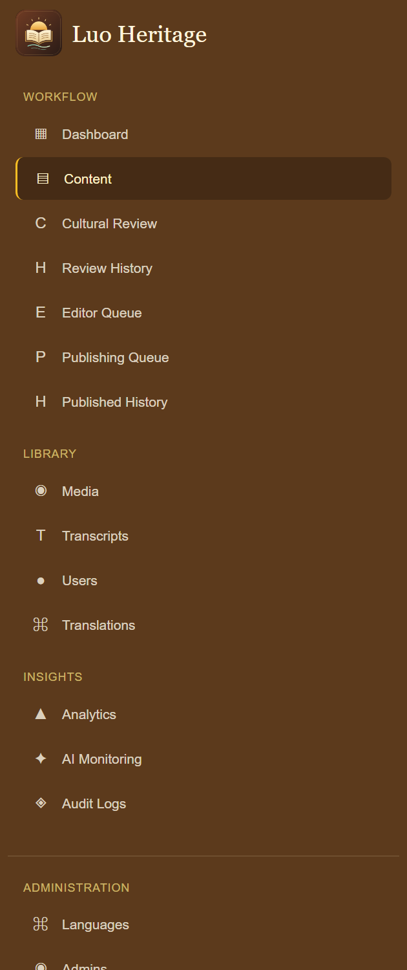
SELF-STUDY / SUPER ADMINS
Understand your wider menu
1
Use Workflow and Library to inspect content, people and
collections.
2
Use Insights to see Analytics, AI Monitoring and Audit Logs.
3
Administration contains Languages, Admins, Backup and
System. Visibility does not mean every action is allowed.
CURRENT INTERFACE • PRACTICE DETAILS
CHECK: You can find the right area without assuming that every visible button is yours to use.
LUO HERITAGE / SUPER ADMINS
Contents
07 / 19
Notes:
Understand your wider menu
1. Use Workflow and Library to inspect content, people and collections.
2. Use Insights to see Analytics, AI Monitoring and Audit Logs.
3. Administration contains Languages, Admins, Backup and System. Visibility does not mean every action is allowed.
Expected result: You can find the right area without assuming that every visible button is yours to use.
Screenshot: current application interface rendered with sample details. No live action is demonstrated.

Slide 8
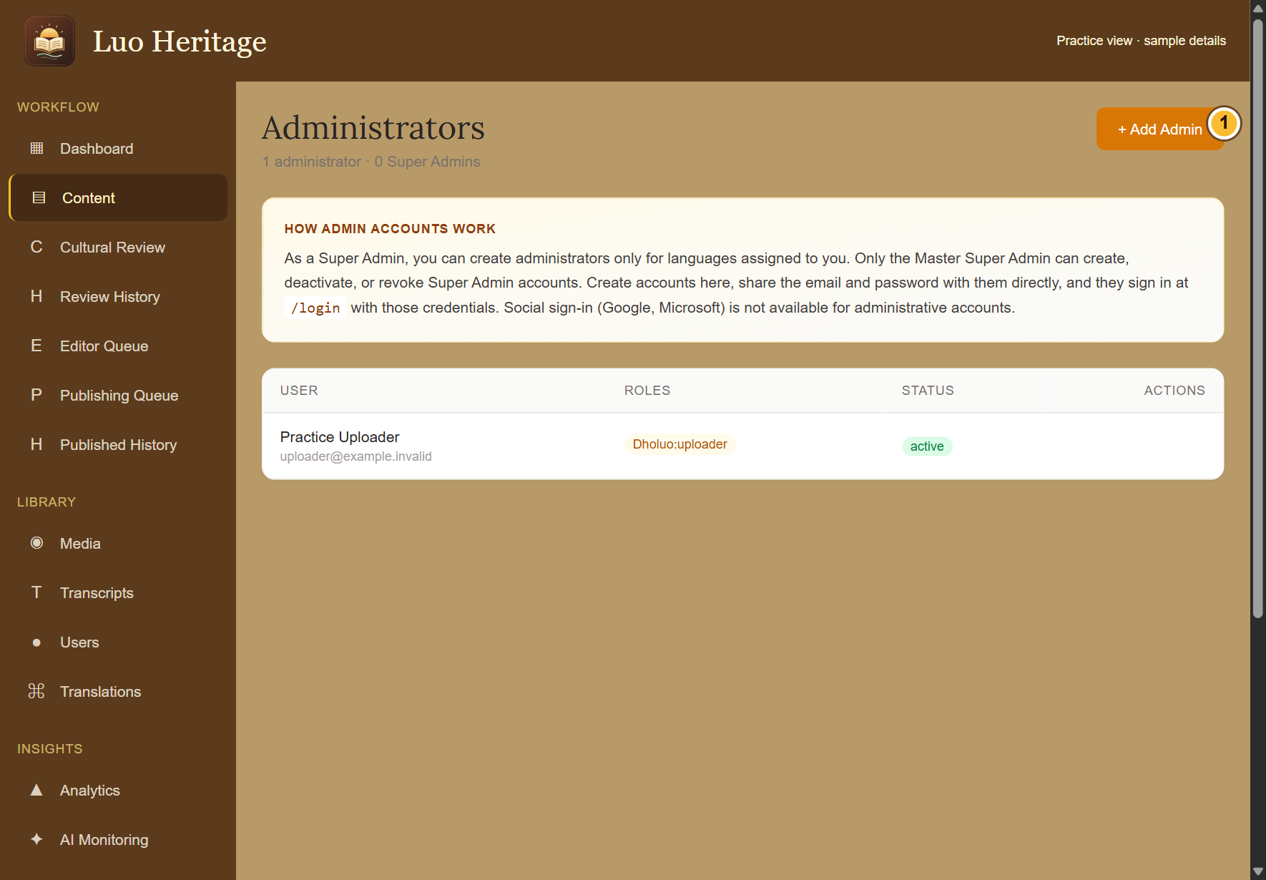
SELF-STUDY / SUPER ADMINS
Know the limits of Super Admin access
1
You oversee the languages assigned to
you and may create permitted staff within
that scope.
2
Editing, cultural review, uploading and
publishing still require their assigned
language duties.
3
Only the Master Super Admin can create or
remove Super Admin authority. Database
backups are also reserved for that owner.
CURRENT INTERFACE • PRACTICE DETAILS
CHECK: You know when to act and when to refer the request to the Master Super Admin.
LUO HERITAGE / SUPER ADMINS
Contents
08 / 19
Notes:
Know the limits of Super Admin access
1. You oversee the languages assigned to you and may create permitted staff within that scope.
2. Editing, cultural review, uploading and publishing still require their assigned language duties.
3. Only the Master Super Admin can create or remove Super Admin authority. Database backups are also reserved for that owner.
Expected result: You know when to act and when to refer the request to the Master Super Admin.
Screenshot: current application interface rendered with sample details. No live action is demonstrated.

Slide 9
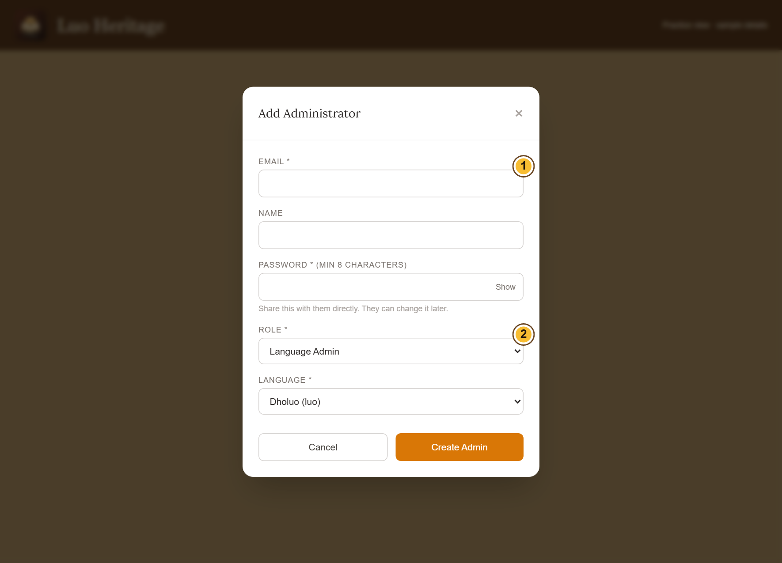
SELF-STUDY / SUPER ADMINS
Create a staff account for the right person
1
Open Admins, then choose + Add Admin.
Confirm the person’s email and name.
2
Choose only the role and language the
person needs. Set a strong temporary
password.
3
Save the account. Share access details
privately with that person and ask them to
set their own password.
Only the Master Super Admin can create or remove Super Admin
authority.
CURRENT INTERFACE • PRACTICE DETAILS
CHECK: The staff member appears in Administrators with the intended role and language.
LUO HERITAGE / SUPER ADMINS
Contents
09 / 19
Notes:
Create a staff account for the right person
1. Open Admins, then choose + Add Admin. Confirm the person’s email and name.
2. Choose only the role and language the person needs. Set a strong temporary password.
3. Save the account. Share access details privately with that person and ask them to set their own password.
Expected result: The staff member appears in Administrators with the intended role and language.
Important: Only the Master Super Admin can create or remove Super Admin authority.
Screenshot: current application interface rendered with sample details. No live action is demonstrated.

Slide 10
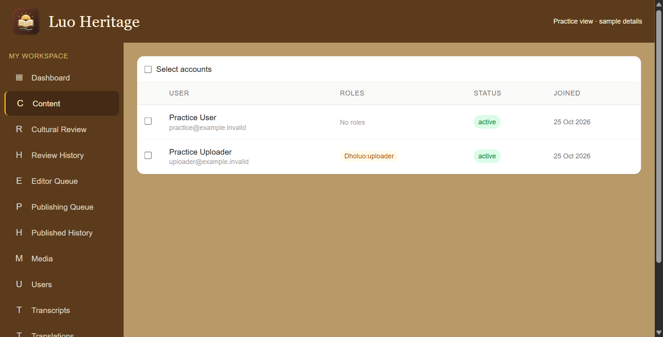
SELF-STUDY / SUPER ADMINS
Help users without changing the wrong account
1
Open Users. Find the person by their own
name and email.
2
Open their details and check their
language and current access before
changing anything.
3
Use only the changes allowed by your role.
Read every confirmation before
suspending or activating accounts.
Do not select every account to solve a problem affecting one person.
CURRENT INTERFACE • PRACTICE DETAILS
CHECK: The intended account has the correct status and access.
LUO HERITAGE / SUPER ADMINS
Contents
10 / 19
Notes:
Help users without changing the wrong account
1. Open Users. Find the person by their own name and email.
2. Open their details and check their language and current access before changing anything.
3. Use only the changes allowed by your role. Read every confirmation before suspending or activating accounts.
Expected result: The intended account has the correct status and access.
Important: Do not select every account to solve a problem affecting one person.
Screenshot: current application interface rendered with sample details. No live action is demonstrated.

Slide 11
SELF-STUDY / SUPER ADMINS
How a contribution reaches readers
1
The uploader or contributor prepares a draft and submits it.
2
A cultural reviewer checks accuracy. An editor makes requested corrections and returns the
item for review.
3
A publisher checks the final item and permission. Only an approved public release becomes
visible to readers.
Prepare draft
→
Cultural review
→
Publisher check
→
Public release
Different people should perform the independent checks. Do not approve your own work.
CHECK: An item may return for changes. Drafts and private approvals are not public publication.
LUO HERITAGE / SUPER ADMINS
Contents
11 / 19
Notes:
How a contribution reaches readers
1. The uploader or contributor prepares a draft and submits it.
2. A cultural reviewer checks accuracy. An editor makes requested corrections and returns the item for review.
3. A publisher checks the final item and permission. Only an approved public release becomes visible to readers.
Expected result: An item may return for changes. Drafts and private approvals are not public publication.
Important: Different people should perform the independent checks. Do not approve your own work.

Slide 12
SELF-STUDY / SUPER ADMINS
Check staff assignments regularly
1
Open Admins and verify each person’s
email, status, language and duty.
2
If a person changes duties, update access
through the permitted controls; do not
share another account.
3
Read every revoke or deactivate
confirmation. Revoking staff duties is
different from deleting the person’s
account.
CURRENT INTERFACE • PRACTICE DETAILS
CHECK: Staff have the access needed for current work and no unnecessary authority.
LUO HERITAGE / SUPER ADMINS
Contents
12 / 19
Notes:
Check staff assignments regularly
1. Open Admins and verify each person’s email, status, language and duty.
2. If a person changes duties, update access through the permitted controls; do not share another account.
3. Read every revoke or deactivate confirmation. Revoking staff duties is different from deleting the person’s account.
Expected result: Staff have the access needed for current work and no unnecessary authority.
Screenshot: current application interface rendered with sample details. No live action is demonstrated.

Slide 13
SELF-STUDY / SUPER ADMINS
Help a user regain access
1
Confirm which email and language they
should be using. Do not ask for their
password.
2
Guide them to Forgotten password? and
the newest email link. Check whether the
account is active.
3
If password emails are not being delivered,
ask the authorised system owner to check
Email settings and the test result.
CURRENT INTERFACE • PRACTICE DETAILS
CHECK: The user receives the right recovery instructions without exposing their credentials.
LUO HERITAGE / SUPER ADMINS
Contents
13 / 19
Notes:
Help a user regain access
1. Confirm which email and language they should be using. Do not ask for their password.
2. Guide them to Forgotten password? and the newest email link. Check whether the account is active.
3. If password emails are not being delivered, ask the authorised system owner to check Email settings and the test result.
Expected result: The user receives the right recovery instructions without exposing their credentials.
Screenshot: current application interface rendered with sample details. No live action is demonstrated.

Slide 14
SELF-STUDY / SUPER ADMINS
Review activity and recorded decisions
1
Use Analytics and AI Monitoring to inspect recorded activity and
feedback.
2
Use Audit Logs to see who changed a record or setting and
when.
3
Investigate unexpected changes with the responsible staff
member. Do not alter evidence to hide a mistake.
CURRENT INTERFACE • PRACTICE DETAILS
CHECK: You can follow a concern to the relevant person and recorded action.
LUO HERITAGE / SUPER ADMINS
Contents
14 / 19
Notes:
Review activity and recorded decisions
1. Use Analytics and AI Monitoring to inspect recorded activity and feedback.
2. Use Audit Logs to see who changed a record or setting and when.
3. Investigate unexpected changes with the responsible staff member. Do not alter evidence to hide a mistake.
Expected result: You can follow a concern to the relevant person and recorded action.
Screenshot: current application interface rendered with sample details. No live action is demonstrated.

Slide 15
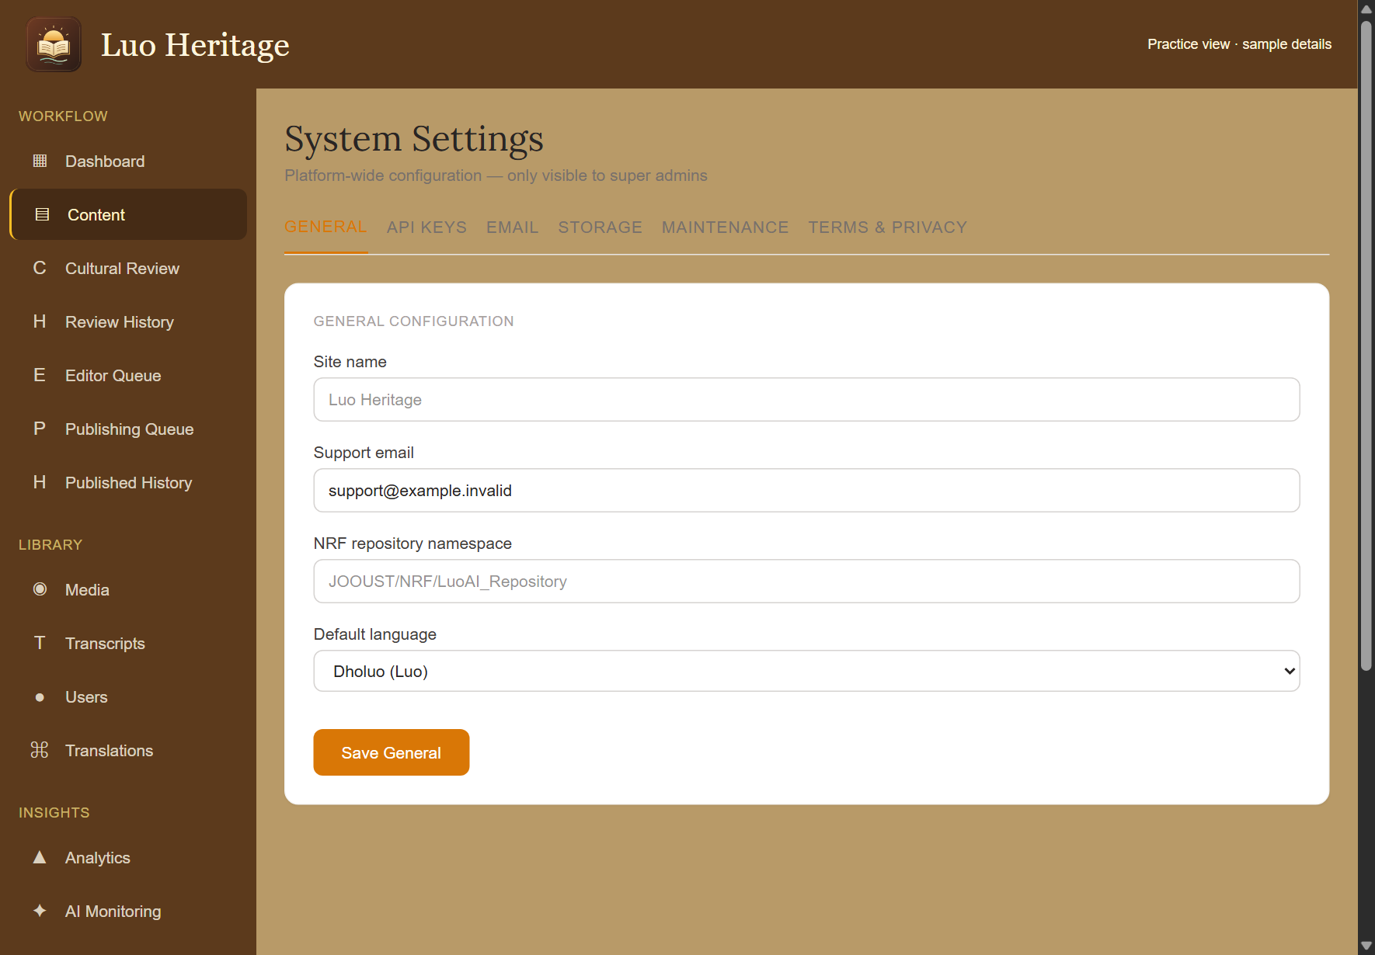
SELF-STUDY / SUPER ADMINS
Use System settings carefully
1
Open System and read the selected tab
before changing anything.
2
Change only a setting you understand and
are authorised to manage. Save the
intended group of settings.
3
Check the result afterwards. For service
keys, backup, legal ownership or an
unavailable control, contact the Master
Super Admin.
Do not include secret service keys in screenshots, slides, email or
support messages.
CURRENT INTERFACE • PRACTICE DETAILS
CHECK: A deliberate saved change has the intended effect.
LUO HERITAGE / SUPER ADMINS
Contents
15 / 19
Notes:
Use System settings carefully
1. Open System and read the selected tab before changing anything.
2. Change only a setting you understand and are authorised to manage. Save the intended group of settings.
3. Check the result afterwards. For service keys, backup, legal ownership or an unavailable control, contact the Master Super Admin.
Expected result: A deliberate saved change has the intended effect.
Important: Do not include secret service keys in screenshots, slides, email or support messages.
Screenshot: current application interface rendered with sample details. No live action is demonstrated.

Slide 16
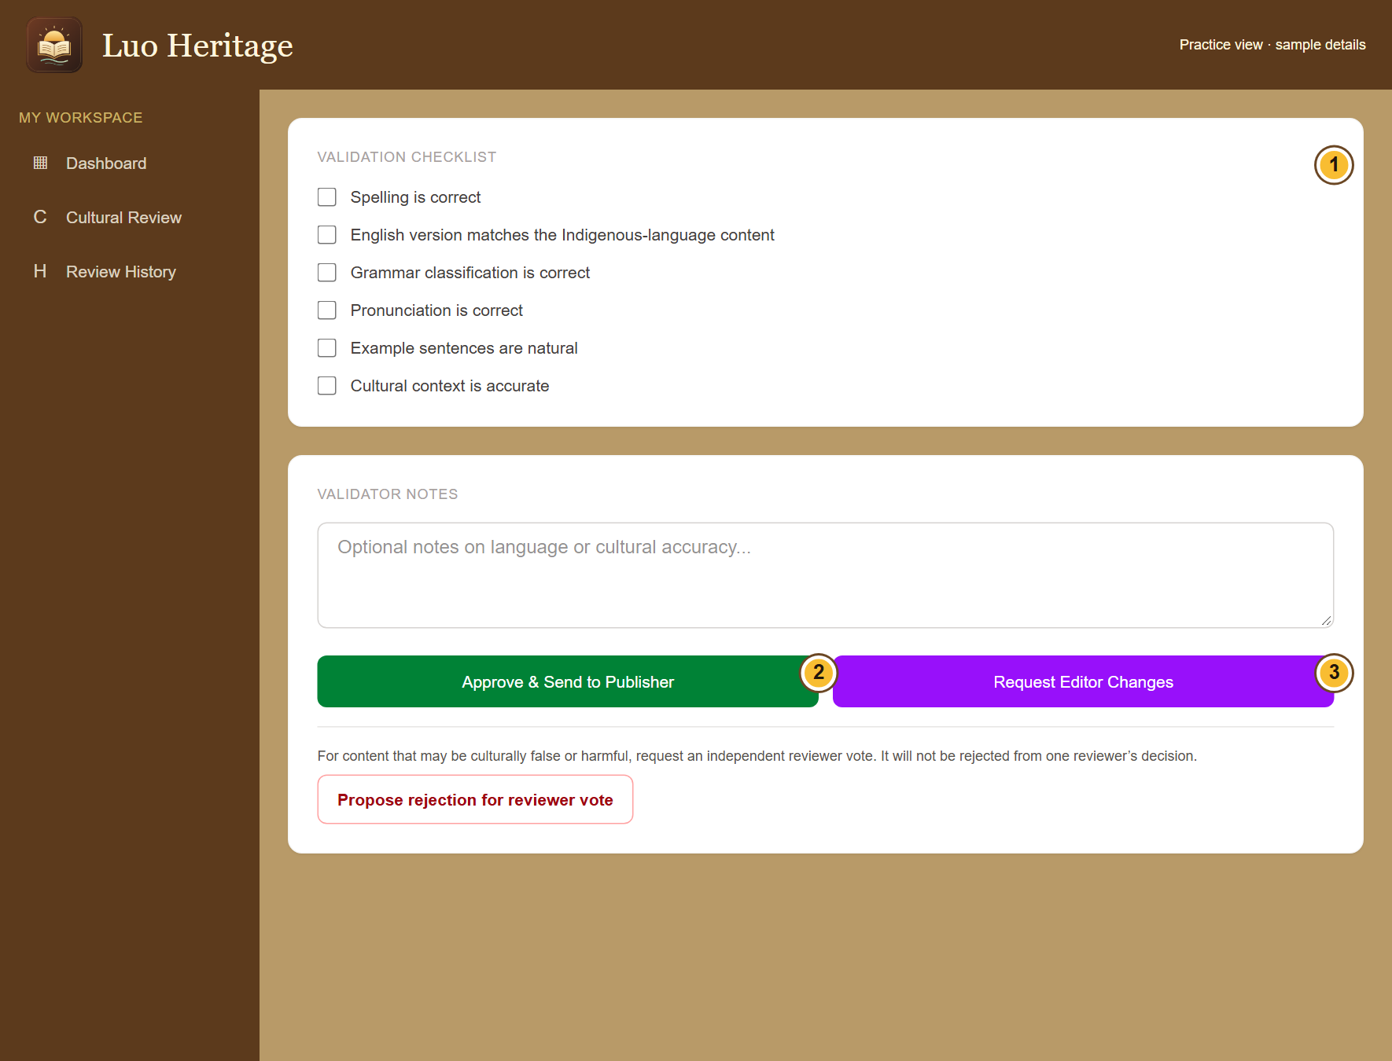
SELF-STUDY / SUPER ADMINS
Coordinate content and learning concerns
1
Route incomplete uploads to uploaders,
corrections to editors and cultural concerns
to reviewers.
2
Ask the assigned publisher to check
release readiness. Do not bypass the
independent checks.
3
For class work, involve the teacher. Keep
learner results and research material
private.
CURRENT INTERFACE • PRACTICE DETAILS
CHECK: The right person handles the issue without excessive access.
LUO HERITAGE / SUPER ADMINS
Contents
16 / 19
Notes:
Coordinate content and learning concerns
1. Route incomplete uploads to uploaders, corrections to editors and cultural concerns to reviewers.
2. Ask the assigned publisher to check release readiness. Do not bypass the independent checks.
3. For class work, involve the teacher. Keep learner results and research material private.
Expected result: The right person handles the issue without excessive access.
Screenshot: current application interface rendered with sample details. No live action is demonstrated.

Slide 17

SELF-STUDY / SUPER ADMINS
Protect your account and other people
1
Use your own account. Sign out on a
shared computer or phone.
2
Do not copy private interviews, class
results or account lists into public chats or
messages.
3
If a screen shows information you should
not see, stop and tell the account
administrator.
Send support the screen name and error message, never your password
or a reset link.
CURRENT INTERFACE • PRACTICE DETAILS
CHECK: Your work remains linked to the right person and private information stays protected.
LUO HERITAGE / SUPER ADMINS
Contents
17 / 19
Notes:
Protect your account and other people
1. Use your own account. Sign out on a shared computer or phone.
2. Do not copy private interviews, class results or account lists into public chats or messages.
3. If a screen shows information you should not see, stop and tell the account administrator.
Expected result: Your work remains linked to the right person and private information stays protected.
Important: Send support the screen name and error message, never your password or a reset link.
Screenshot: current application interface rendered with sample details. No live action is demonstrated.

Slide 18
SELF-STUDY / SUPER ADMINS
When something does not work
1
Check your internet connection. Read the message on screen
before trying again.
2
If your sign-in has expired, sign in again. If a button is missing,
ask which role and language you have.
3
If it still fails, note the time, screen, button and exact message.
Send these to your account administrator.
Before repeating an upload or submission, check whether the first attempt was already saved.
CURRENT INTERFACE • PRACTICE DETAILS
CHECK: You can explain the problem clearly without exposing private information.
LUO HERITAGE / SUPER ADMINS
Contents
18 / 19
Notes:
When something does not work
1. Check your internet connection. Read the message on screen before trying again.
2. If your sign-in has expired, sign in again. If a button is missing, ask which role and language you have.
3. If it still fails, note the time, screen, button and exact message. Send these to your account administrator.
Expected result: You can explain the problem clearly without exposing private information.
Important: Before repeating an upload or submission, check whether the first attempt was already saved.
Screenshot: current application interface rendered with sample details. No live action is demonstrated.

Slide 19
SELF-STUDY / SUPER ADMINS
Try it yourself: your readiness check
1
Explain the difference between a Super Admin and the Master Super Admin.
2
Create no live accounts during practice; instead identify the correct role and language in the
form.
3
Find the recovery, monitoring and escalation paths for a reported problem.
Try
→
Check
→
Ask if unsure
Use only approved practice material. Do not publish, delete accounts or change live settings just to practise.
CHECK: You are ready for routine work when you can complete these steps without help.
LUO HERITAGE / SUPER ADMINS
Contents
19 / 19
Notes:
Try it yourself: your readiness check
1. Explain the difference between a Super Admin and the Master Super Admin.
2. Create no live accounts during practice; instead identify the correct role and language in the form.
3. Find the recovery, monitoring and escalation paths for a reported problem.
Expected result: You are ready for routine work when you can complete these steps without help.
Important: Use only approved practice material. Do not publish, delete accounts or change live settings just to practise.

