Slide 1

LUO HERITAGE / SELF-STUDY SLIDES
LANGUAGE • CULTURE • LIVING MEMORY
Researchers and institutional readers
Find usable sources and respect collection permissions
You will be able to distinguish public reading from authorised research access and request
help safely.
READ • TRY • CHECK
25 October 2026 | Edition 1.0
Notes:
Self-study guide. Screenshots show actual interface components rendered with clearly labelled sample data, not a production acceptance demonstration. No real account or cultural record was changed to make these slides.

Slide 2
SELF-STUDY / RESEARCHERS AND INSTITUTIONAL READERS
Start here: learn at your own pace
1
Read a slide, try its action, then check the result. Tap means click. Gold circles mark important
controls in the screenshots.
2
Use your own account. Your organisation supplies the correct website address and any staff
access.
3
Screenshots show the current interface with practice details. Actual names, content and
menus may differ.
Read the step
→
Try it yourself
→
Check the result
If your menu looks different, first check My access. Do not ask someone to lend you their account.
CHECK: You will be able to distinguish public reading from authorised research access and request help safely.
LUO HERITAGE / RESEARCHERS AND INSTITUTIONAL READERS
Contents
02 / 21
Notes:
Start here: learn at your own pace
1. Read a slide, try its action, then check the result. Tap means click. Gold circles mark important controls in the screenshots.
2. Use your own account. Your organisation supplies the correct website address and any staff access.
3. Screenshots show the current interface with practice details. Actual names, content and menus may differ.
Expected result: You will be able to distinguish public reading from authorised research access and request help safely.
Important: If your menu looks different, first check My access. Do not ask someone to lend you their account.

Slide 3
SELF-STUDY / RESEARCHERS AND INSTITUTIONAL READERS
What this guide covers
1
Use public collections and sources responsibly.
2
Understand what the researcher interest does and does not allow.
3
Read internal transcripts only when separately authorised.
CHECK: Use the slide numbers to return to a task. The PDF has page bookmarks; PowerPoint has a contents view.
LUO HERITAGE / RESEARCHERS AND INSTITUTIONAL READERS
Contents
03 / 21
Notes:
What this guide covers
1. Use public collections and sources responsibly.
2. Understand what the researcher interest does and does not allow.
3. Read internal transcripts only when separately authorised.
Expected result: Use the slide numbers to return to a task. The PDF has page bookmarks; PowerPoint has a contents view.

Slide 4

SELF-STUDY / RESEARCHERS AND INSTITUTIONAL READERS
Sign in to your own account
1
Open the Luo Heritage address supplied by your organisation.
Choose Sign in or Log in.
2
Enter your email and password, then choose Log in. Check your
spelling if it fails.
3
Community members may also use Google. Staff should use the
account supplied by their administrator.
Never share your password. Use only an address you trust.
CURRENT INTERFACE • PRACTICE DETAILS
CHECK: Your account or dashboard opens.
LUO HERITAGE / RESEARCHERS AND INSTITUTIONAL READERS
Contents
04 / 21
Notes:
Sign in to your own account
1. Open the Luo Heritage address supplied by your organisation. Choose Sign in or Log in.
2. Enter your email and password, then choose Log in. Check your spelling if it fails.
3. Community members may also use Google. Staff should use the account supplied by their administrator.
Expected result: Your account or dashboard opens.
Important: Never share your password. Use only an address you trust.
Screenshot: current application interface rendered with sample details. No live action is demonstrated.

Slide 5

SELF-STUDY / RESEARCHERS AND INSTITUTIONAL READERS
Forgot your password?
1
On the sign-in screen, choose Forgotten
password? Select Reset password.
2
Enter your account email. Choose Send
email, then check your inbox and spam
folder.
3
Open the newest reset link within 30
minutes. A link can be used only once.
If no email arrives, contact the person who manages your account. Do
not keep requesting links.
CURRENT INTERFACE • PRACTICE DETAILS
CHECK: An account email arrives if the address is eligible and the email service is available.
LUO HERITAGE / RESEARCHERS AND INSTITUTIONAL READERS
Contents
05 / 21
Notes:
Forgot your password?
1. On the sign-in screen, choose Forgotten password? Select Reset password.
2. Enter your account email. Choose Send email, then check your inbox and spam folder.
3. Open the newest reset link within 30 minutes. A link can be used only once.
Expected result: An account email arrives if the address is eligible and the email service is available.
Important: If no email arrives, contact the person who manages your account. Do not keep requesting links.
Screenshot: current application interface rendered with sample details. No live action is demonstrated.

Slide 6

SELF-STUDY / RESEARCHERS AND INSTITUTIONAL READERS
Choose a new password
1
Open the password reset link from your
own inbox.
2
Enter a new password of at least 12
characters. A short phrase with several
words is easier to remember.
3
Choose Confirm. Return to sign in and use
the new password on each device.
Do not forward the reset link. If it has expired, request a new one.
CURRENT INTERFACE • PRACTICE DETAILS
CHECK: The password changes and old sign-ins are ended.
LUO HERITAGE / RESEARCHERS AND INSTITUTIONAL READERS
Contents
06 / 21
Notes:
Choose a new password
1. Open the password reset link from your own inbox.
2. Enter a new password of at least 12 characters. A short phrase with several words is easier to remember.
3. Choose Confirm. Return to sign in and use the new password on each device.
Expected result: The password changes and old sign-ins are ended.
Important: Do not forward the reset link. If it has expired, request a new one.
Screenshot: current application interface rendered with sample details. No live action is demonstrated.

Slide 7

SELF-STUDY / RESEARCHERS AND INSTITUTIONAL READERS
Understand your access before you begin
1
A researcher interest describes your
purpose. It does not unlock private
interviews or staff screens.
2
Start with the public library and approved
sources available to ordinary accounts.
3
For internal research material, contact the
person responsible for the collection. Use
only the access they formally assign.
This guide does not promise a self-service private-dataset download
portal.
CURRENT INTERFACE • PRACTICE DETAILS
CHECK: You know which material you may use without borrowing another person’s account.
LUO HERITAGE / RESEARCHERS AND INSTITUTIONAL READERS
Contents
07 / 21
Notes:
Understand your access before you begin
1. A researcher interest describes your purpose. It does not unlock private interviews or staff screens.
2. Start with the public library and approved sources available to ordinary accounts.
3. For internal research material, contact the person responsible for the collection. Use only the access they formally assign.
Expected result: You know which material you may use without borrowing another person’s account.
Important: This guide does not promise a self-service private-dataset download portal.
Screenshot: current application interface rendered with sample details. No live action is demonstrated.

Slide 8
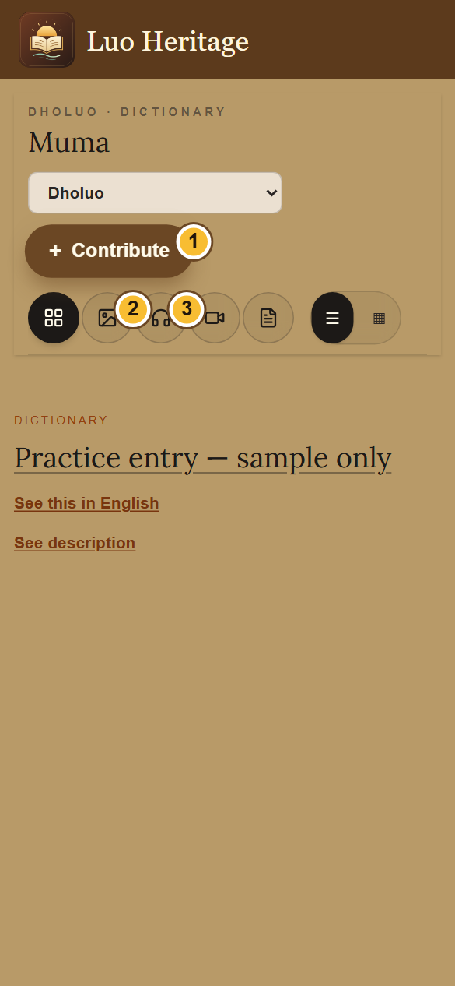
SELF-STUDY / RESEARCHERS AND INSTITUTIONAL READERS
Use the library on a phone
1
Open a collection, such as Muma (Dictionary), from the menu.
2
Use the picture, headphones, video or page icon to choose a
type of content. The four-square icon shows all types.
3
Choose the list or grid button to change the view. Scroll the
entries below the controls.
An empty result can mean there are no published entries of that type. Try All.
CURRENT INTERFACE • PRACTICE DETAILS
CHECK: The collection shows entries matching your chosen filter.
LUO HERITAGE / RESEARCHERS AND INSTITUTIONAL READERS
Contents
08 / 21
Notes:
Use the library on a phone
1. Open a collection, such as Muma (Dictionary), from the menu.
2. Use the picture, headphones, video or page icon to choose a type of content. The four-square icon shows all types.
3. Choose the list or grid button to change the view. Scroll the entries below the controls.
Expected result: The collection shows entries matching your chosen filter.
Important: An empty result can mean there are no published entries of that type. Try All.
Screenshot: current application interface rendered with sample details. No live action is demonstrated.

Slide 9
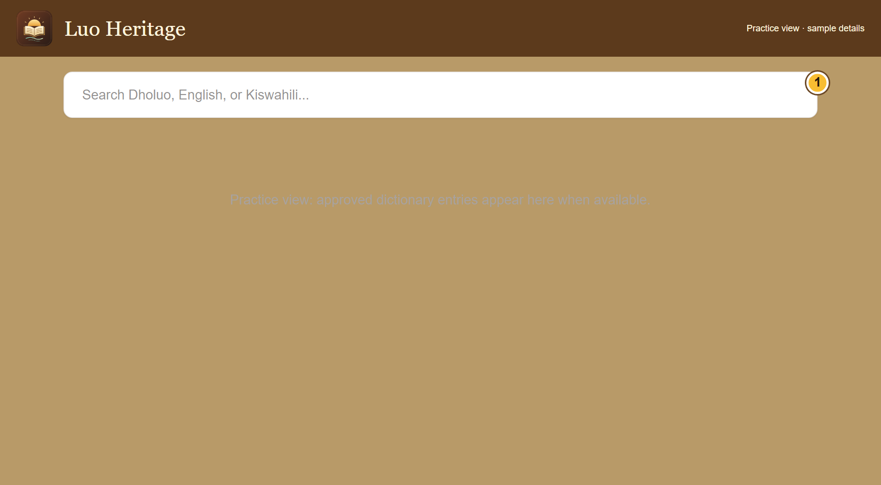
SELF-STUDY / RESEARCHERS AND INSTITUTIONAL READERS
Find a word in the public dictionary
1
On the public website, open the dictionary
page and find its search box.
2
Enter a Dholuo word or an English or
Kiswahili meaning. Wait for the results,
then read the relevant entry.
3
If there is no result, check spelling or try
another word. A missing published entry is
not proof that the word does not exist.
The shared app’s Muma screen uses collection filters; it may not show
this website search box.
CURRENT INTERFACE • PRACTICE DETAILS
CHECK: You can use the dictionary search where it is offered.
LUO HERITAGE / RESEARCHERS AND INSTITUTIONAL READERS
Contents
09 / 21
Notes:
Find a word in the public dictionary
1. On the public website, open the dictionary page and find its search box.
2. Enter a Dholuo word or an English or Kiswahili meaning. Wait for the results, then read the relevant entry.
3. If there is no result, check spelling or try another word. A missing published entry is not proof that the word does not exist.
Expected result: You can use the dictionary search where it is offered.
Important: The shared app’s Muma screen uses collection filters; it may not show this website search box.
Screenshot: current application interface rendered with sample details. No live action is demonstrated.

Slide 10
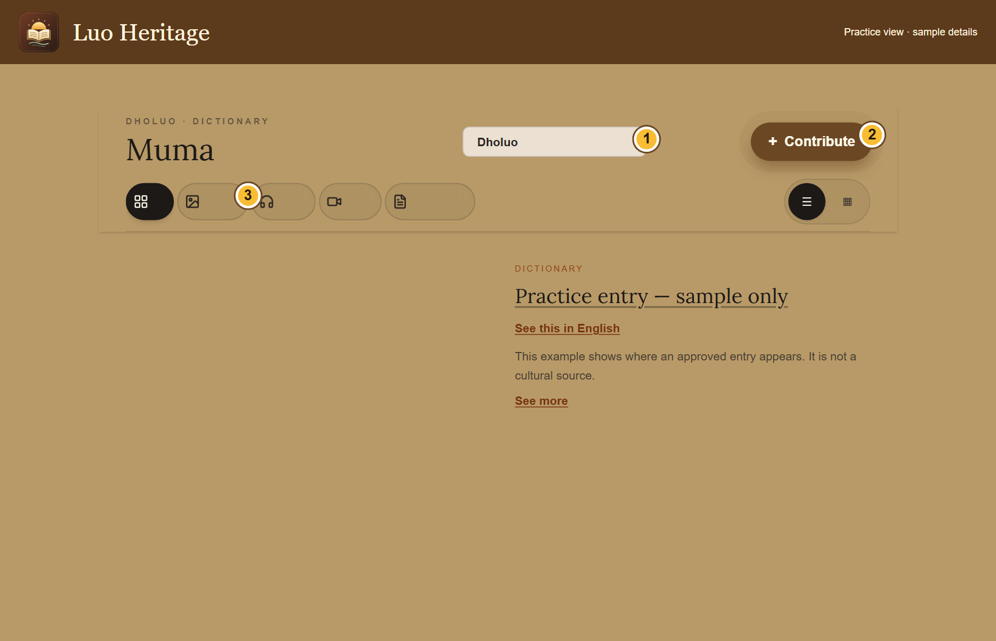
SELF-STUDY / RESEARCHERS AND INSTITUTIONAL READERS
Use a source, not only an AI answer
1
Open the approved entry and read its
description, language and source credit.
2
For an AI answer, open the cited platform
entries and compare the answer with them.
3
Record the source title and permitted
reference details for your research notes.
Follow the organisation’s citation and reuse
rules.
CURRENT INTERFACE • PRACTICE DETAILS
CHECK: Your notes refer to actual approved material rather than an uncited generated answer.
LUO HERITAGE / RESEARCHERS AND INSTITUTIONAL READERS
Contents
10 / 21
Notes:
Use a source, not only an AI answer
1. Open the approved entry and read its description, language and source credit.
2. For an AI answer, open the cited platform entries and compare the answer with them.
3. Record the source title and permitted reference details for your research notes. Follow the organisation’s citation and reuse rules.
Expected result: Your notes refer to actual approved material rather than an uncited generated answer.
Screenshot: current application interface rendered with sample details. No live action is demonstrated.

Slide 11
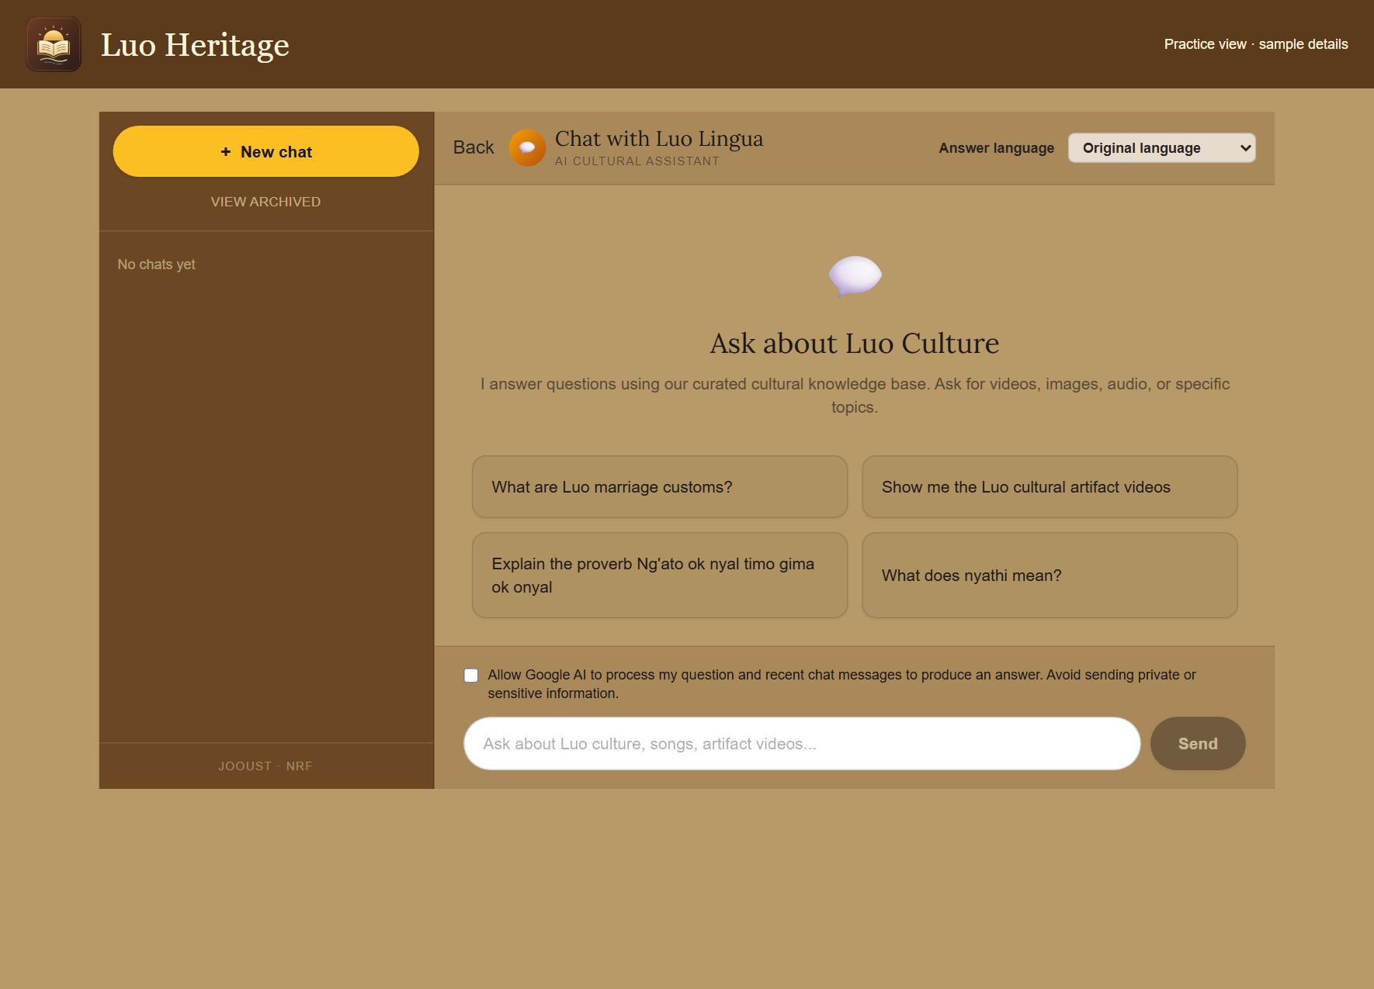
SELF-STUDY / RESEARCHERS AND INSTITUTIONAL READERS
Ask the AI chatbot a clear question
1
Open Chat or Chatbot. Choose your
answer language and read the processing
permission notice.
2
If you agree, allow AI processing. Ask one
clear question and wait for the response.
3
Open any sources provided. Ask a
follow-up question if you need a simpler
explanation.
AI can make mistakes. Do not enter private interviews, passwords or
learners’ personal information.
CURRENT INTERFACE • PRACTICE DETAILS
CHECK: You can read an answer and inspect any linked sources.
LUO HERITAGE / RESEARCHERS AND INSTITUTIONAL READERS
Contents
11 / 21
Notes:
Ask the AI chatbot a clear question
1. Open Chat or Chatbot. Choose your answer language and read the processing permission notice.
2. If you agree, allow AI processing. Ask one clear question and wait for the response.
3. Open any sources provided. Ask a follow-up question if you need a simpler explanation.
Expected result: You can read an answer and inspect any linked sources.
Important: AI can make mistakes. Do not enter private interviews, passwords or learners’ personal information.
Screenshot: current application interface rendered with sample details. No live action is demonstrated.

Slide 12
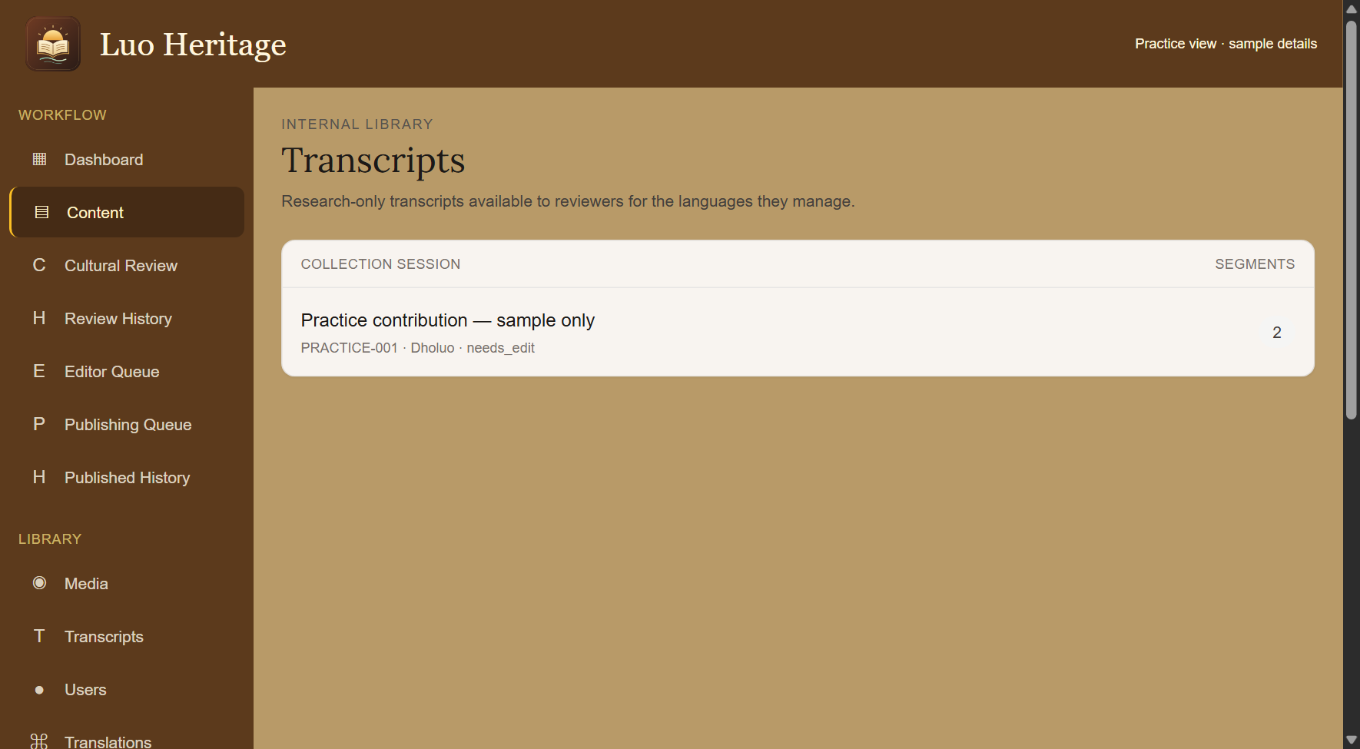
SELF-STUDY / RESEARCHERS AND INSTITUTIONAL READERS
Request private research access properly
1
Describe your research purpose, the
collection needed and who will use it.
2
Ask the person responsible for the
collection what permission, consent and
access conditions apply.
3
Wait for approval. Do not treat a visible
title, an imported file or a colleague’s copy
as permission to reuse it.
Research-only, teaching and public sharing are different permissions.
CURRENT INTERFACE • PRACTICE DETAILS
CHECK: The access request can be considered by the responsible person.
LUO HERITAGE / RESEARCHERS AND INSTITUTIONAL READERS
Contents
12 / 21
Notes:
Request private research access properly
1. Describe your research purpose, the collection needed and who will use it.
2. Ask the person responsible for the collection what permission, consent and access conditions apply.
3. Wait for approval. Do not treat a visible title, an imported file or a colleague’s copy as permission to reuse it.
Expected result: The access request can be considered by the responsible person.
Important: Research-only, teaching and public sharing are different permissions.
Screenshot: current application interface rendered with sample details. No live action is demonstrated.

Slide 13
SELF-STUDY / RESEARCHERS AND INSTITUTIONAL READERS
For authorised reviewers: open transcripts
1
This step applies only if you have
separately been assigned a role that can
read the internal transcript library.
2
Open Transcripts from the staff menu.
Choose the permitted session in your
assigned language.
3
Check the session reference and read only
the material allowed by your approval.
If Transcripts is missing or access is refused, ask the custodian. Do not
try another user’s login.
CURRENT INTERFACE • PRACTICE DETAILS
CHECK: An authorised reader reaches the correct internal session.
LUO HERITAGE / RESEARCHERS AND INSTITUTIONAL READERS
Contents
13 / 21
Notes:
For authorised reviewers: open transcripts
1. This step applies only if you have separately been assigned a role that can read the internal transcript library.
2. Open Transcripts from the staff menu. Choose the permitted session in your assigned language.
3. Check the session reference and read only the material allowed by your approval.
Expected result: An authorised reader reaches the correct internal session.
Important: If Transcripts is missing or access is refused, ask the custodian. Do not try another user’s login.
Screenshot: current application interface rendered with sample details. No live action is demonstrated.

Slide 14
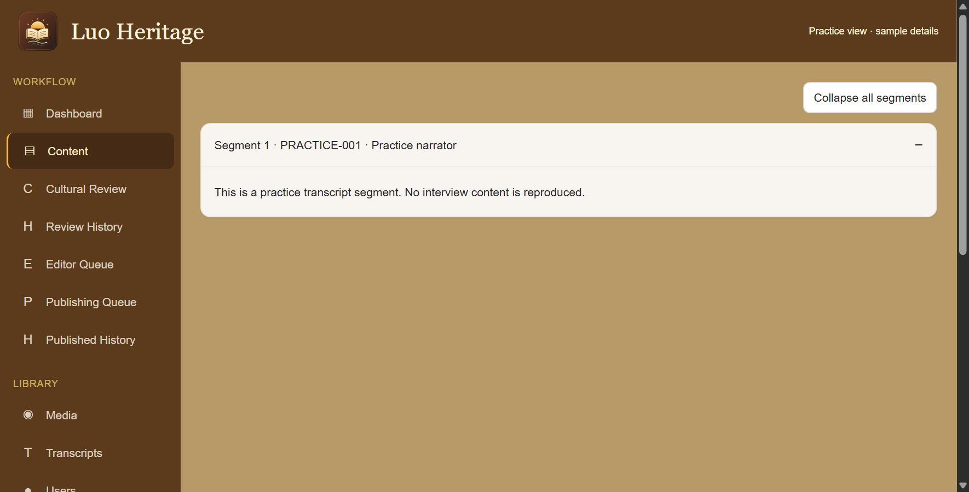
SELF-STUDY / RESEARCHERS AND INSTITUTIONAL READERS
Read transcript sections carefully
1
Open the permitted session and choose a
segment, or Expand all segments.
2
Keep the source reference with your notes.
An AI summary is not a replacement for the
original text.
3
Do not translate, publish, export or submit
internal text to an external AI service
without the required permission.
CURRENT INTERFACE • PRACTICE DETAILS
CHECK: Your work retains its connection to the permitted original source.
LUO HERITAGE / RESEARCHERS AND INSTITUTIONAL READERS
Contents
14 / 21
Notes:
Read transcript sections carefully
1. Open the permitted session and choose a segment, or Expand all segments.
2. Keep the source reference with your notes. An AI summary is not a replacement for the original text.
3. Do not translate, publish, export or submit internal text to an external AI service without the required permission.
Expected result: Your work retains its connection to the permitted original source.
Screenshot: current application interface rendered with sample details. No live action is demonstrated.

Slide 15

SELF-STUDY / RESEARCHERS AND INSTITUTIONAL READERS
Check permission before sharing
1
Under Source and access, choose Source
permission. If unsure, leave Not sure yet /
ask a reviewer.
2
Choose how to credit the source. Use a
person’s name only when they agree.
3
Keep restricted, sacred or research-only
material private. Ask a reviewer before
changing access.
Permission to collect material is not automatically permission to publish it.
CURRENT INTERFACE • PRACTICE DETAILS
CHECK: The draft records who may use the material and how the source should be credited.
LUO HERITAGE / RESEARCHERS AND INSTITUTIONAL READERS
Contents
15 / 21
Notes:
Check permission before sharing
1. Under Source and access, choose Source permission. If unsure, leave Not sure yet / ask a reviewer.
2. Choose how to credit the source. Use a person’s name only when they agree.
3. Keep restricted, sacred or research-only material private. Ask a reviewer before changing access.
Expected result: The draft records who may use the material and how the source should be credited.
Important: Permission to collect material is not automatically permission to publish it.
Screenshot: current application interface rendered with sample details. No live action is demonstrated.

Slide 16
SELF-STUDY / RESEARCHERS AND INSTITUTIONAL READERS
What the permission labels mean
1
Source permission: has the source agreed
to the proposed use? Choose Not sure yet
when you do not know.
2
Consent scope: what use was agreed?
Public excerpt means an approved public
part; research only and teaching have
different limits.
3
Restriction level: who may see it? Internal
and restricted are not public. Sacred
material needs the collection owner’s
special care.
If the permission record is unclear, keep the item private and ask the
responsible reviewer.
CURRENT INTERFACE • PRACTICE DETAILS
CHECK: You understand the labels before you change them.
LUO HERITAGE / RESEARCHERS AND INSTITUTIONAL READERS
Contents
16 / 21
Notes:
What the permission labels mean
1. Source permission: has the source agreed to the proposed use? Choose Not sure yet when you do not know.
2. Consent scope: what use was agreed? Public excerpt means an approved public part; research only and teaching have different limits.
3. Restriction level: who may see it? Internal and restricted are not public. Sacred material needs the collection owner’s special care.
Expected result: You understand the labels before you change them.
Important: If the permission record is unclear, keep the item private and ask the responsible reviewer.
Screenshot: current application interface rendered with sample details. No live action is demonstrated.

Slide 17
SELF-STUDY / RESEARCHERS AND INSTITUTIONAL READERS
Request an export rather than assuming permission
1
Tell the collection owner exactly which
records and fields are needed and why.
2
Ask for the approved export and any
citation, storage, sharing or deletion
conditions.
3
Check the files and permission record
together. Keep participant identities and
sensitive locations protected.
An administrator’s technical ability to export is not the same as
permission for your study.
CURRENT INTERFACE • PRACTICE DETAILS
CHECK: Any research copy has a documented purpose and agreed conditions.
LUO HERITAGE / RESEARCHERS AND INSTITUTIONAL READERS
Contents
17 / 21
Notes:
Request an export rather than assuming permission
1. Tell the collection owner exactly which records and fields are needed and why.
2. Ask for the approved export and any citation, storage, sharing or deletion conditions.
3. Check the files and permission record together. Keep participant identities and sensitive locations protected.
Expected result: Any research copy has a documented purpose and agreed conditions.
Important: An administrator’s technical ability to export is not the same as permission for your study.
Screenshot: current application interface rendered with sample details. No live action is demonstrated.

Slide 18
SELF-STUDY / RESEARCHERS AND INSTITUTIONAL READERS
Report a source or consent concern
1
Note the item title and reference, and
describe the concern without copying
restricted text.
2
Contact the person responsible for the
collection or the administrator who granted
your access.
3
Pause any disputed reuse until the
responsible person confirms what is
permitted.
CURRENT INTERFACE • PRACTICE DETAILS
CHECK: The rights concern is handled without spreading the disputed material.
LUO HERITAGE / RESEARCHERS AND INSTITUTIONAL READERS
Contents
18 / 21
Notes:
Report a source or consent concern
1. Note the item title and reference, and describe the concern without copying restricted text.
2. Contact the person responsible for the collection or the administrator who granted your access.
3. Pause any disputed reuse until the responsible person confirms what is permitted.
Expected result: The rights concern is handled without spreading the disputed material.
Screenshot: current application interface rendered with sample details. No live action is demonstrated.

Slide 19
SELF-STUDY / RESEARCHERS AND INSTITUTIONAL READERS
Protect your account and other people
1
Use your own account. Sign out on a
shared computer or phone.
2
Do not copy private interviews, class
results or account lists into public chats or
messages.
3
If a screen shows information you should
not see, stop and tell the account
administrator.
Send support the screen name and error message, never your password
or a reset link.
CURRENT INTERFACE • PRACTICE DETAILS
CHECK: Your work remains linked to the right person and private information stays protected.
LUO HERITAGE / RESEARCHERS AND INSTITUTIONAL READERS
Contents
19 / 21
Notes:
Protect your account and other people
1. Use your own account. Sign out on a shared computer or phone.
2. Do not copy private interviews, class results or account lists into public chats or messages.
3. If a screen shows information you should not see, stop and tell the account administrator.
Expected result: Your work remains linked to the right person and private information stays protected.
Important: Send support the screen name and error message, never your password or a reset link.
Screenshot: current application interface rendered with sample details. No live action is demonstrated.

Slide 20
SELF-STUDY / RESEARCHERS AND INSTITUTIONAL READERS
When something does not work
1
Check your internet connection. Read the message on screen
before trying again.
2
If your sign-in has expired, sign in again. If a button is missing,
ask which role and language you have.
3
If it still fails, note the time, screen, button and exact message.
Send these to your account administrator.
Before repeating an upload or submission, check whether the first attempt was already saved.
CURRENT INTERFACE • PRACTICE DETAILS
CHECK: You can explain the problem clearly without exposing private information.
LUO HERITAGE / RESEARCHERS AND INSTITUTIONAL READERS
Contents
20 / 21
Notes:
When something does not work
1. Check your internet connection. Read the message on screen before trying again.
2. If your sign-in has expired, sign in again. If a button is missing, ask which role and language you have.
3. If it still fails, note the time, screen, button and exact message. Send these to your account administrator.
Expected result: You can explain the problem clearly without exposing private information.
Important: Before repeating an upload or submission, check whether the first attempt was already saved.
Screenshot: current application interface rendered with sample details. No live action is demonstrated.

Slide 21
SELF-STUDY / RESEARCHERS AND INSTITUTIONAL READERS
Try it yourself: your readiness check
1
Find a public source and explain how you would cite it.
2
Explain why the researcher interest does not grant internal access.
3
Describe how you would request a transcript or dataset export and check its reuse conditions.
Try
→
Check
→
Ask if unsure
Use only approved practice material. Do not publish, delete accounts or change live settings just to practise.
CHECK: You are ready for routine work when you can complete these steps without help.
LUO HERITAGE / RESEARCHERS AND INSTITUTIONAL READERS
Contents
21 / 21
Notes:
Try it yourself: your readiness check
1. Find a public source and explain how you would cite it.
2. Explain why the researcher interest does not grant internal access.
3. Describe how you would request a transcript or dataset export and check its reuse conditions.
Expected result: You are ready for routine work when you can complete these steps without help.
Important: Use only approved practice material. Do not publish, delete accounts or change live settings just to practise.

