Slide 1

LUO HERITAGE
LANGUAGE • CULTURE • LIVING MEMORY
Complete user training
One presentation for every user role
Start with the common steps. Then go to your role.
Read the action, try it, and check the result.
SCREENSHOTS • CLEAR STEPS • ROLE SECTIONS
26 October 2026 | Combined edition
Notes:
One self-contained presentation. Screenshots use labelled practice details from actual application components; they are not live-account acceptance evidence.

Slide 2
SELF-STUDY / START HERE
How to use this one presentation
1
This file contains all user roles. You do not need another guide, a ZIP file or a folder of
screenshots to read it.
2
Read the common steps first. Then use Contents to open the section for the work you have
actually been assigned.
3
The screenshots use practice details. Your own names, records and menus may look
different. Use approved practice material when trying a task.
Read one step
→
Try it yourself
→
Check the result
Never publish, remove accounts or change live settings just to practise.
CHECK: Use the PDF for easy reading on a phone or computer. The PowerPoint contains the same slides.
LUO HERITAGE / START HERE
Contents
02 / 138
Notes:
How to use this one presentation
1. This file contains all user roles. You do not need another guide, a ZIP file or a folder of screenshots to read it.
2. Read the common steps first. Then use Contents to open the section for the work you have actually been assigned.
3. The screenshots use practice details. Your own names, records and menus may look different. Use approved practice material when trying a task.
Expected result: Use the PDF for easy reading on a phone or computer. The PowerPoint contains the same slides.
Important: Never publish, remove accounts or change live settings just to practise.

Slide 3
ONE PRESENTATION / ALL USER ROLES
Choose your section
Select a box, or go to the slide number shown.
Common steps — everyone
4
Community members
20
Students and learners
33
Teachers and lecturers
38
Uploaders
49
Cultural reviewers
60
Content editors
70
Publishers
79
Language administrators
88
Super Admins
101
Master Super Admin
112
Researchers and institutional readers
127
Missing a button? Ask your administrator to check your assigned role and language.
LUO HERITAGE / CONTENTS
Contents
03 / 138
Notes:
All buttons link within this presentation. No separate files are needed. Slide numbers also work when a viewer does not support clickable contents.

Slide 4

SELF-STUDY / COMMON STEPS
Sign in to your own account
1
Open the Luo Heritage address supplied by your organisation.
Choose Sign in or Log in.
2
Enter your email and password, then choose Log in. Check your
spelling if it fails.
3
Community members may also use Google. Staff should use the
account supplied by their administrator.
Never share your password. Use only an address you trust.
CURRENT INTERFACE • PRACTICE DETAILS
CHECK: Your account or dashboard opens.
LUO HERITAGE / COMMON STEPS
Contents
04 / 138
Notes:
Sign in to your own account
1. Open the Luo Heritage address supplied by your organisation. Choose Sign in or Log in.
2. Enter your email and password, then choose Log in. Check your spelling if it fails.
3. Community members may also use Google. Staff should use the account supplied by their administrator.
Expected result: Your account or dashboard opens.
Important: Never share your password. Use only an address you trust.
Screenshot: current application interface rendered with sample details. No live action is demonstrated.

Slide 5

SELF-STUDY / COMMON STEPS
Forgot your password?
1
On the sign-in screen, choose Forgotten
password? Select Reset password.
2
Enter your account email. Choose Send
email, then check your inbox and spam
folder.
3
Open the newest reset link within 30
minutes. A link can be used only once.
If no email arrives, contact the person who manages your account. Do
not keep requesting links.
CURRENT INTERFACE • PRACTICE DETAILS
CHECK: An account email arrives if the address is eligible and the email service is available.
LUO HERITAGE / COMMON STEPS
Contents
05 / 138
Notes:
Forgot your password?
1. On the sign-in screen, choose Forgotten password? Select Reset password.
2. Enter your account email. Choose Send email, then check your inbox and spam folder.
3. Open the newest reset link within 30 minutes. A link can be used only once.
Expected result: An account email arrives if the address is eligible and the email service is available.
Important: If no email arrives, contact the person who manages your account. Do not keep requesting links.
Screenshot: current application interface rendered with sample details. No live action is demonstrated.

Slide 6

SELF-STUDY / COMMON STEPS
Choose a new password
1
Open the password reset link from your
own inbox.
2
Enter a new password of at least 12
characters. A short phrase with several
words is easier to remember.
3
Choose Confirm. Return to sign in and use
the new password on each device.
Do not forward the reset link. If it has expired, request a new one.
CURRENT INTERFACE • PRACTICE DETAILS
CHECK: The password changes and old sign-ins are ended.
LUO HERITAGE / COMMON STEPS
Contents
06 / 138
Notes:
Choose a new password
1. Open the password reset link from your own inbox.
2. Enter a new password of at least 12 characters. A short phrase with several words is easier to remember.
3. Choose Confirm. Return to sign in and use the new password on each device.
Expected result: The password changes and old sign-ins are ended.
Important: Do not forward the reset link. If it has expired, request a new one.
Screenshot: current application interface rendered with sample details. No live action is demonstrated.

Slide 7
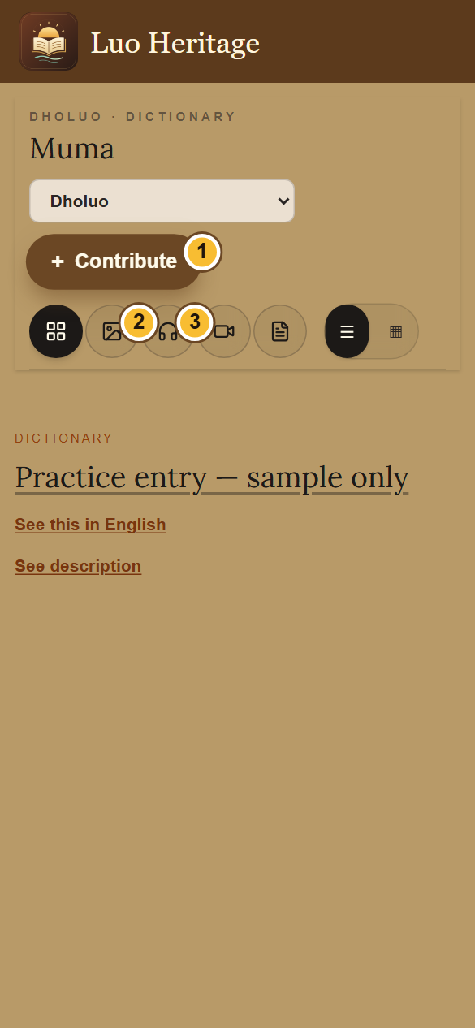
SELF-STUDY / COMMON STEPS
Use the library on a phone
1
Open a collection, such as Muma (Dictionary), from the menu.
2
Use the picture, headphones, video or page icon to choose a
type of content. The four-square icon shows all types.
3
Choose the list or grid button to change the view. Scroll the
entries below the controls.
An empty result can mean there are no published entries of that type. Try All.
CURRENT INTERFACE • PRACTICE DETAILS
CHECK: The collection shows entries matching your chosen filter.
LUO HERITAGE / COMMON STEPS
Contents
07 / 138
Notes:
Use the library on a phone
1. Open a collection, such as Muma (Dictionary), from the menu.
2. Use the picture, headphones, video or page icon to choose a type of content. The four-square icon shows all types.
3. Choose the list or grid button to change the view. Scroll the entries below the controls.
Expected result: The collection shows entries matching your chosen filter.
Important: An empty result can mean there are no published entries of that type. Try All.
Screenshot: current application interface rendered with sample details. No live action is demonstrated.

Slide 8

SELF-STUDY / COMMON STEPS
Find your access and saved chats
1
Open the account menu and choose My
account & saved chats.
2
Read My access to check your assigned
role. Open a chat from Recent or Archived.
3
For your name, sessions or notifications,
open Profile, sessions & notifications from
the menu.
Choosing an interest such as teacher or researcher does not give staff
access.
CURRENT INTERFACE • PRACTICE DETAILS
CHECK: You can find your own account details and earlier conversations.
LUO HERITAGE / COMMON STEPS
Contents
08 / 138
Notes:
Find your access and saved chats
1. Open the account menu and choose My account & saved chats.
2. Read My access to check your assigned role. Open a chat from Recent or Archived.
3. For your name, sessions or notifications, open Profile, sessions & notifications from the menu.
Expected result: You can find your own account details and earlier conversations.
Important: Choosing an interest such as teacher or researcher does not give staff access.
Screenshot: current application interface rendered with sample details. No live action is demonstrated.

Slide 9
SELF-STUDY / COMMON STEPS
Protect your account and other people
1
Use your own account. Sign out on a
shared computer or phone.
2
Do not copy private interviews, class
results or account lists into public chats or
messages.
3
If a screen shows information you should
not see, stop and tell the account
administrator.
Send support the screen name and error message, never your password
or a reset link.
CURRENT INTERFACE • PRACTICE DETAILS
CHECK: Your work remains linked to the right person and private information stays protected.
LUO HERITAGE / COMMON STEPS
Contents
09 / 138
Notes:
Protect your account and other people
1. Use your own account. Sign out on a shared computer or phone.
2. Do not copy private interviews, class results or account lists into public chats or messages.
3. If a screen shows information you should not see, stop and tell the account administrator.
Expected result: Your work remains linked to the right person and private information stays protected.
Important: Send support the screen name and error message, never your password or a reset link.
Screenshot: current application interface rendered with sample details. No live action is demonstrated.

Slide 10
SELF-STUDY / COMMON STEPS
When something does not work
1
Check your internet connection. Read the message on screen
before trying again.
2
If your sign-in has expired, sign in again. If a button is missing,
ask which role and language you have.
3
If it still fails, note the time, screen, button and exact message.
Send these to your account administrator.
Before repeating an upload or submission, check whether the first attempt was already saved.
CURRENT INTERFACE • PRACTICE DETAILS
CHECK: You can explain the problem clearly without exposing private information.
LUO HERITAGE / COMMON STEPS
Contents
10 / 138
Notes:
When something does not work
1. Check your internet connection. Read the message on screen before trying again.
2. If your sign-in has expired, sign in again. If a button is missing, ask which role and language you have.
3. If it still fails, note the time, screen, button and exact message. Send these to your account administrator.
Expected result: You can explain the problem clearly without exposing private information.
Important: Before repeating an upload or submission, check whether the first attempt was already saved.
Screenshot: current application interface rendered with sample details. No live action is demonstrated.

Slide 11
SELF-STUDY / COMMON STEPS
How a contribution reaches readers
1
The uploader or contributor prepares a draft and submits it.
2
A cultural reviewer checks accuracy. An editor makes requested corrections and returns the
item for review.
3
A publisher checks the final item and permission. Only an approved public release becomes
visible to readers.
Prepare draft
→
Cultural review
→
Publisher check
→
Public release
Different people should perform the independent checks. Do not approve your own work.
CHECK: An item may return for changes. Drafts and private approvals are not public publication.
LUO HERITAGE / COMMON STEPS
Contents
11 / 138
Notes:
How a contribution reaches readers
1. The uploader or contributor prepares a draft and submits it.
2. A cultural reviewer checks accuracy. An editor makes requested corrections and returns the item for review.
3. A publisher checks the final item and permission. Only an approved public release becomes visible to readers.
Expected result: An item may return for changes. Drafts and private approvals are not public publication.
Important: Different people should perform the independent checks. Do not approve your own work.

Slide 12

SELF-STUDY / COMMON STEPS
Check permission before sharing
1
Under Source and access, choose Source
permission. If unsure, leave Not sure yet /
ask a reviewer.
2
Choose how to credit the source. Use a
person’s name only when they agree.
3
Keep restricted, sacred or research-only
material private. Ask a reviewer before
changing access.
Permission to collect material is not automatically permission to publish it.
CURRENT INTERFACE • PRACTICE DETAILS
CHECK: The draft records who may use the material and how the source should be credited.
LUO HERITAGE / COMMON STEPS
Contents
12 / 138
Notes:
Check permission before sharing
1. Under Source and access, choose Source permission. If unsure, leave Not sure yet / ask a reviewer.
2. Choose how to credit the source. Use a person’s name only when they agree.
3. Keep restricted, sacred or research-only material private. Ask a reviewer before changing access.
Expected result: The draft records who may use the material and how the source should be credited.
Important: Permission to collect material is not automatically permission to publish it.
Screenshot: current application interface rendered with sample details. No live action is demonstrated.

Slide 13
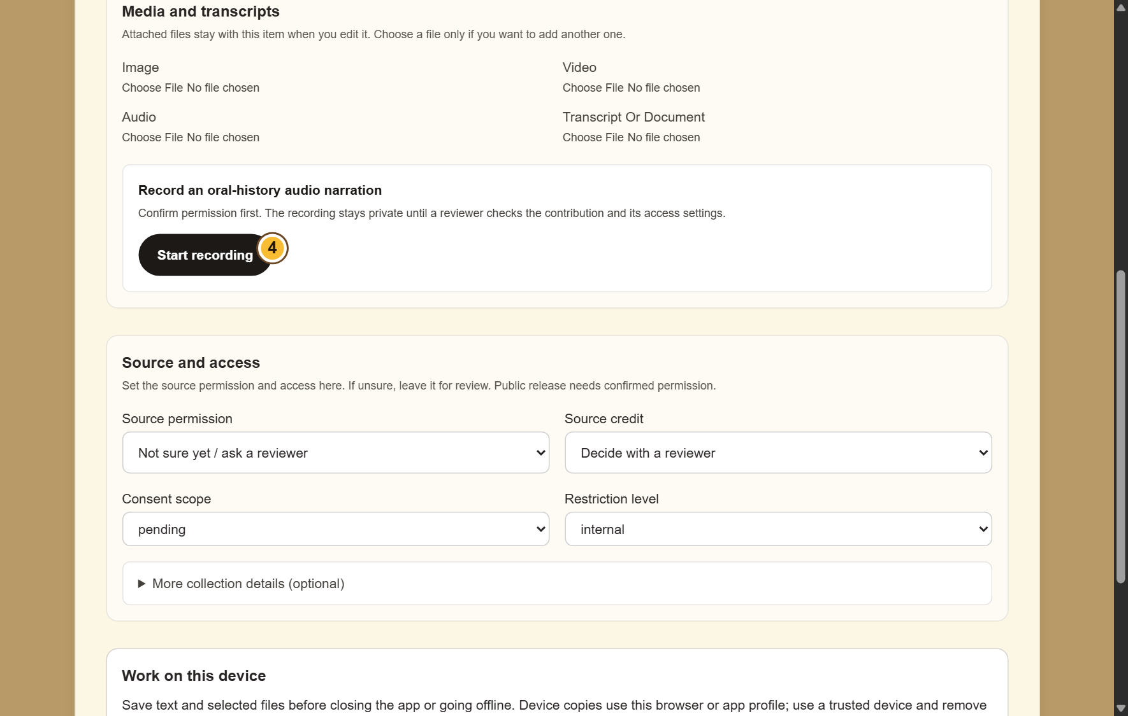
SELF-STUDY / COMMON STEPS
Add pictures, audio or documents
1
Find Media and transcripts. Choose a file
under the matching type.
2
For an oral history, confirm permission
before choosing Start recording. Stop when
finished.
3
Check that the correct files are selected.
Keep the app open while an upload is in
progress.
If microphone access is refused, allow it in your device settings or attach
an existing recording.
CURRENT INTERFACE • PRACTICE DETAILS
CHECK: The selected files stay with the contribution when it is saved successfully.
LUO HERITAGE / COMMON STEPS
Contents
13 / 138
Notes:
Add pictures, audio or documents
1. Find Media and transcripts. Choose a file under the matching type.
2. For an oral history, confirm permission before choosing Start recording. Stop when finished.
3. Check that the correct files are selected. Keep the app open while an upload is in progress.
Expected result: The selected files stay with the contribution when it is saved successfully.
Important: If microphone access is refused, allow it in your device settings or attach an existing recording.
Screenshot: current application interface rendered with sample details. No live action is demonstrated.

Slide 14
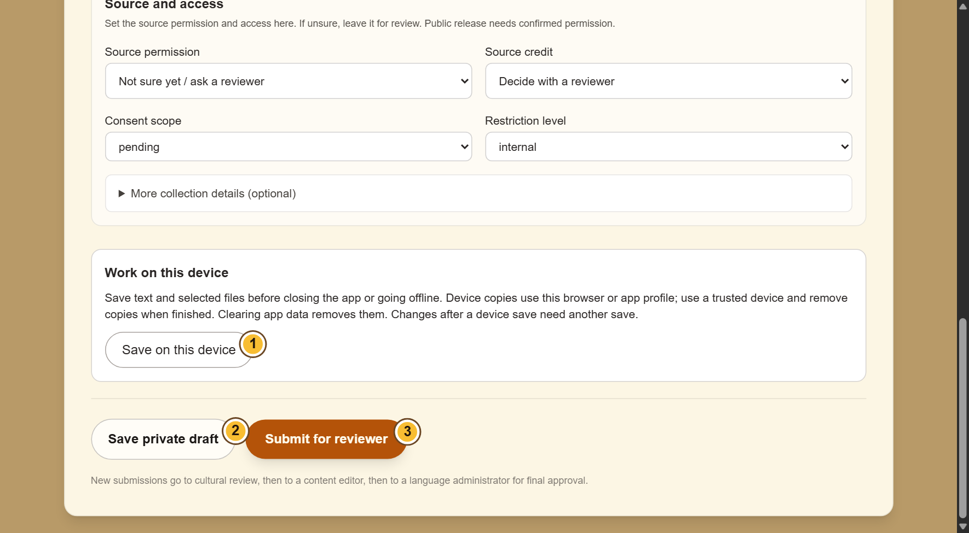
SELF-STUDY / COMMON STEPS
Understand the three save choices
1
Save on this device keeps a local copy,
including selected files. It does not submit
your work.
2
Save private draft saves an online draft for
your account. You need a connection.
3
Submit for reviewer sends the contribution
for checking. Wait for confirmation before
leaving.
Clearing browser or app data can remove local drafts. Save again after
making changes.
CURRENT INTERFACE • PRACTICE DETAILS
CHECK: You know whether the work is on this device, saved online, or sent for review.
LUO HERITAGE / COMMON STEPS
Contents
14 / 138
Notes:
Understand the three save choices
1. Save on this device keeps a local copy, including selected files. It does not submit your work.
2. Save private draft saves an online draft for your account. You need a connection.
3. Submit for reviewer sends the contribution for checking. Wait for confirmation before leaving.
Expected result: You know whether the work is on this device, saved online, or sent for review.
Important: Clearing browser or app data can remove local drafts. Save again after making changes.
Screenshot: current application interface rendered with sample details. No live action is demonstrated.

Slide 15
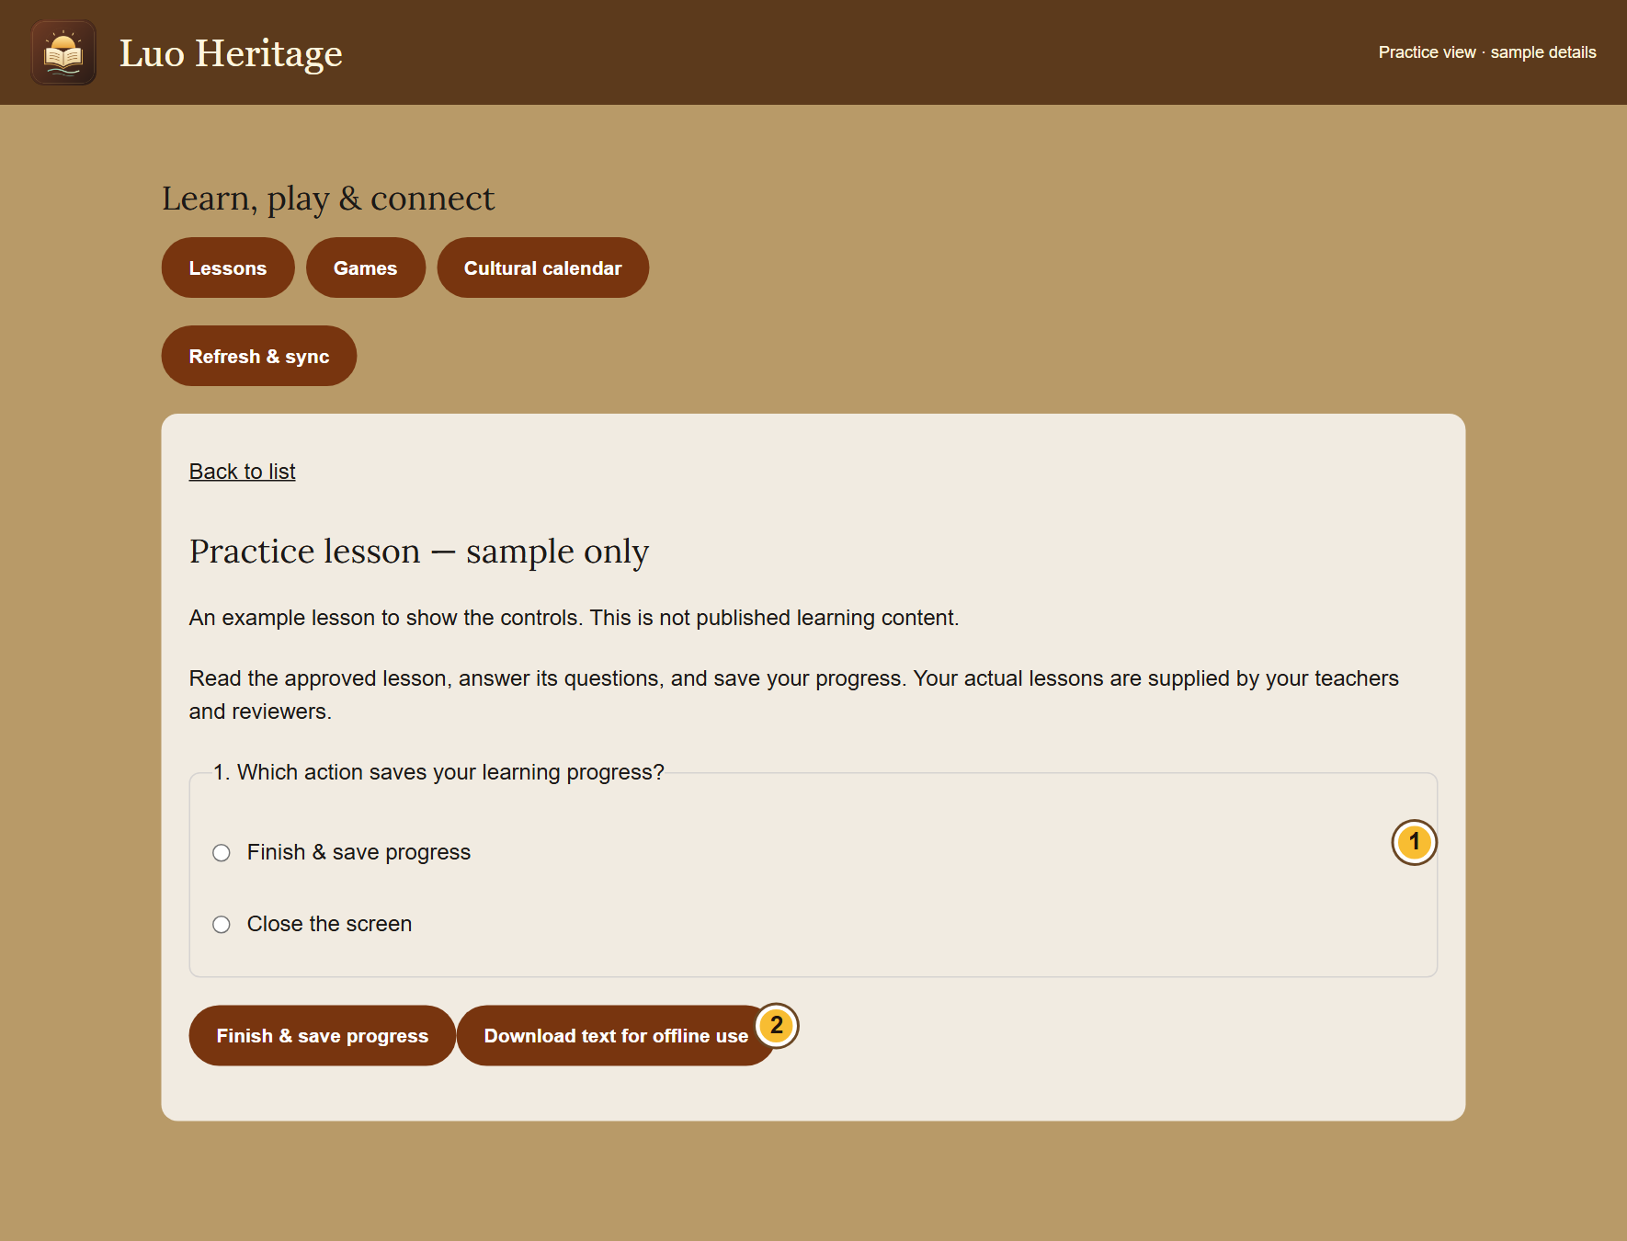
SELF-STUDY / COMMON STEPS
Open a lesson and keep your progress
1
Choose Lessons, games & calendar. Open
a published lesson.
2
Read the lesson and answer its questions.
Choose Finish & save progress.
3
Read the result and feedback. Sign in with
the same account on another device to
keep your learning together.
A score helps you learn; it does not replace a teacher’s review.
CURRENT INTERFACE • PRACTICE DETAILS
CHECK: You see a saved result or a message saying the attempt is waiting to go online.
LUO HERITAGE / COMMON STEPS
Contents
15 / 138
Notes:
Open a lesson and keep your progress
1. Choose Lessons, games & calendar. Open a published lesson.
2. Read the lesson and answer its questions. Choose Finish & save progress.
3. Read the result and feedback. Sign in with the same account on another device to keep your learning together.
Expected result: You see a saved result or a message saying the attempt is waiting to go online.
Important: A score helps you learn; it does not replace a teacher’s review.
Screenshot: current application interface rendered with sample details. No live action is demonstrated.

Slide 16
SELF-STUDY / COMMON STEPS
Prepare to study without internet
1
While connected, open a lesson that allows
downloads. Choose Download text for
offline use.
2
Keep using the same browser or app
profile. Downloaded text can be read
without internet for up to seven days.
3
Reconnect and choose Refresh & sync.
Keep the app open until waiting attempts
have been saved online.
These downloads contain text, not the audio or video files. Some lessons
cannot be downloaded.
CURRENT INTERFACE • PRACTICE DETAILS
CHECK: Permitted lesson text is available offline and saved attempts can synchronize later.
LUO HERITAGE / COMMON STEPS
Contents
16 / 138
Notes:
Prepare to study without internet
1. While connected, open a lesson that allows downloads. Choose Download text for offline use.
2. Keep using the same browser or app profile. Downloaded text can be read without internet for up to seven days.
3. Reconnect and choose Refresh & sync. Keep the app open until waiting attempts have been saved online.
Expected result: Permitted lesson text is available offline and saved attempts can synchronize later.
Important: These downloads contain text, not the audio or video files. Some lessons cannot be downloaded.
Screenshot: current application interface rendered with sample details. No live action is demonstrated.

Slide 17
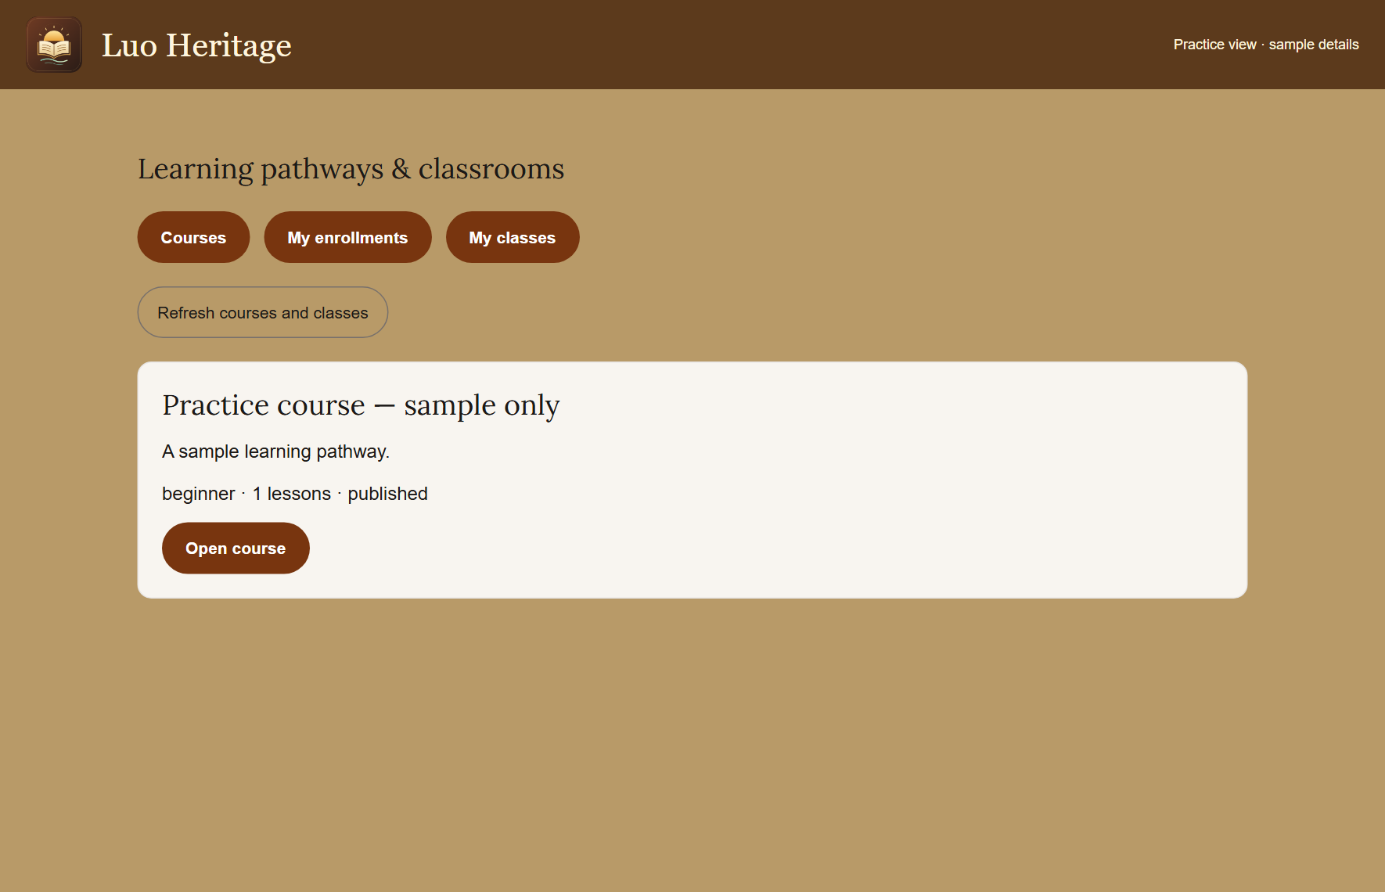
SELF-STUDY / COMMON STEPS
Join a learning course
1
Open Learning pathways & courses.
Choose a published course and read its
description.
2
Open the course and enroll using the
button shown. Start with the available
lesson.
3
Use My enrollments to return later. If
lessons are locked, complete the earlier
lesson and required score first.
If no courses are available, ask your teacher which published course to
use.
CURRENT INTERFACE • PRACTICE DETAILS
CHECK: The course appears among your enrollments and shows your lesson progress.
LUO HERITAGE / COMMON STEPS
Contents
17 / 138
Notes:
Join a learning course
1. Open Learning pathways & courses. Choose a published course and read its description.
2. Open the course and enroll using the button shown. Start with the available lesson.
3. Use My enrollments to return later. If lessons are locked, complete the earlier lesson and required score first.
Expected result: The course appears among your enrollments and shows your lesson progress.
Important: If no courses are available, ask your teacher which published course to use.
Screenshot: current application interface rendered with sample details. No live action is demonstrated.

Slide 18
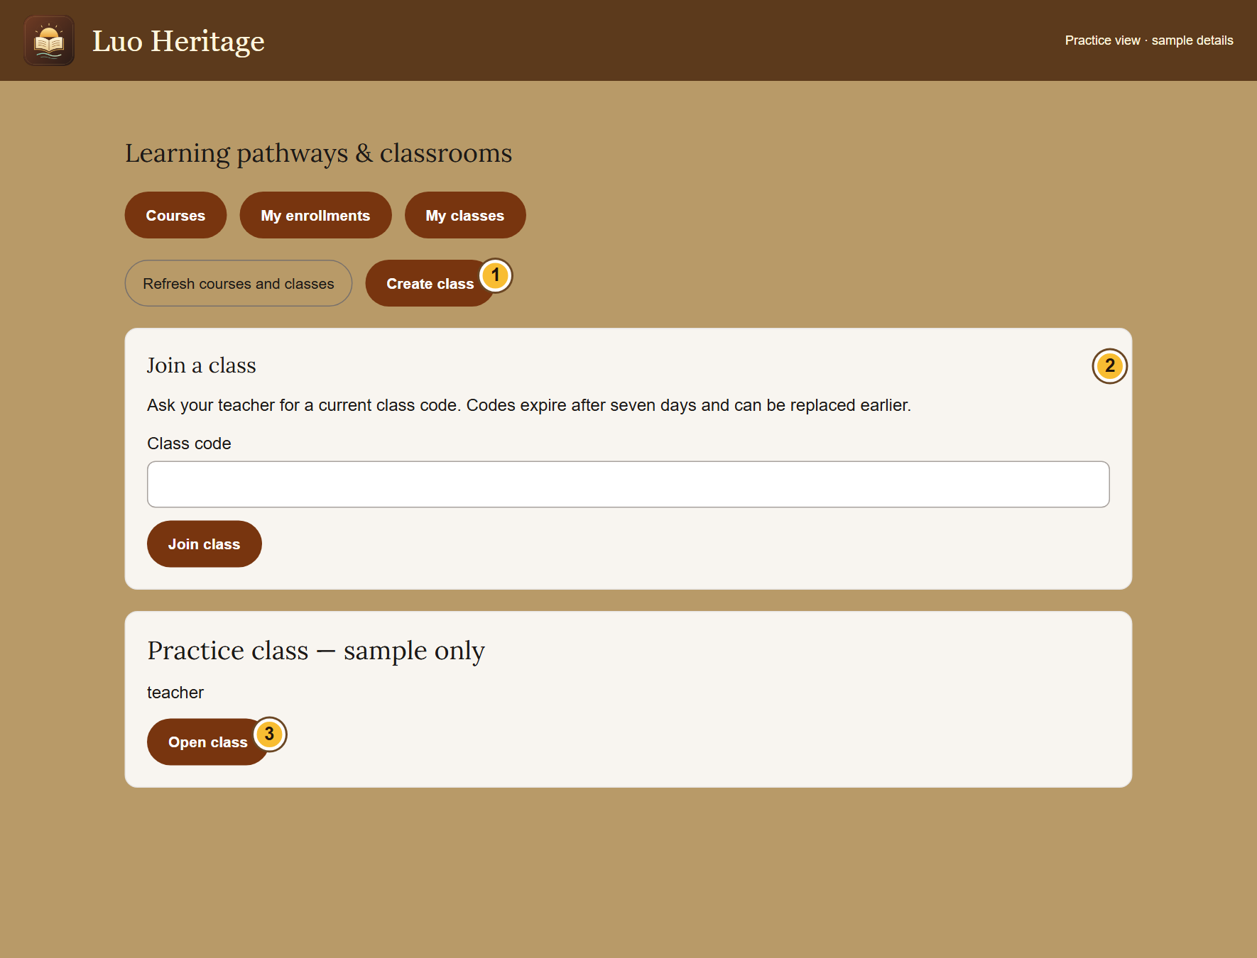
SELF-STUDY / COMMON STEPS
Join a class with your teacher’s code
1
Sign in. Open Teaching & my classes and
choose My classes.
2
Ask your teacher for a current code. Enter
it under Join a class, then choose Join
class.
3
Open the class and read its assignments.
Use your own account for all submissions.
Class codes expire after seven days and may be replaced earlier. Ask for
a new code if needed.
CURRENT INTERFACE • PRACTICE DETAILS
CHECK: Your class appears in My classes.
LUO HERITAGE / COMMON STEPS
Contents
18 / 138
Notes:
Join a class with your teacher’s code
1. Sign in. Open Teaching & my classes and choose My classes.
2. Ask your teacher for a current code. Enter it under Join a class, then choose Join class.
3. Open the class and read its assignments. Use your own account for all submissions.
Expected result: Your class appears in My classes.
Important: Class codes expire after seven days and may be replaced earlier. Ask for a new code if needed.
Screenshot: current application interface rendered with sample details. No live action is demonstrated.

Slide 19
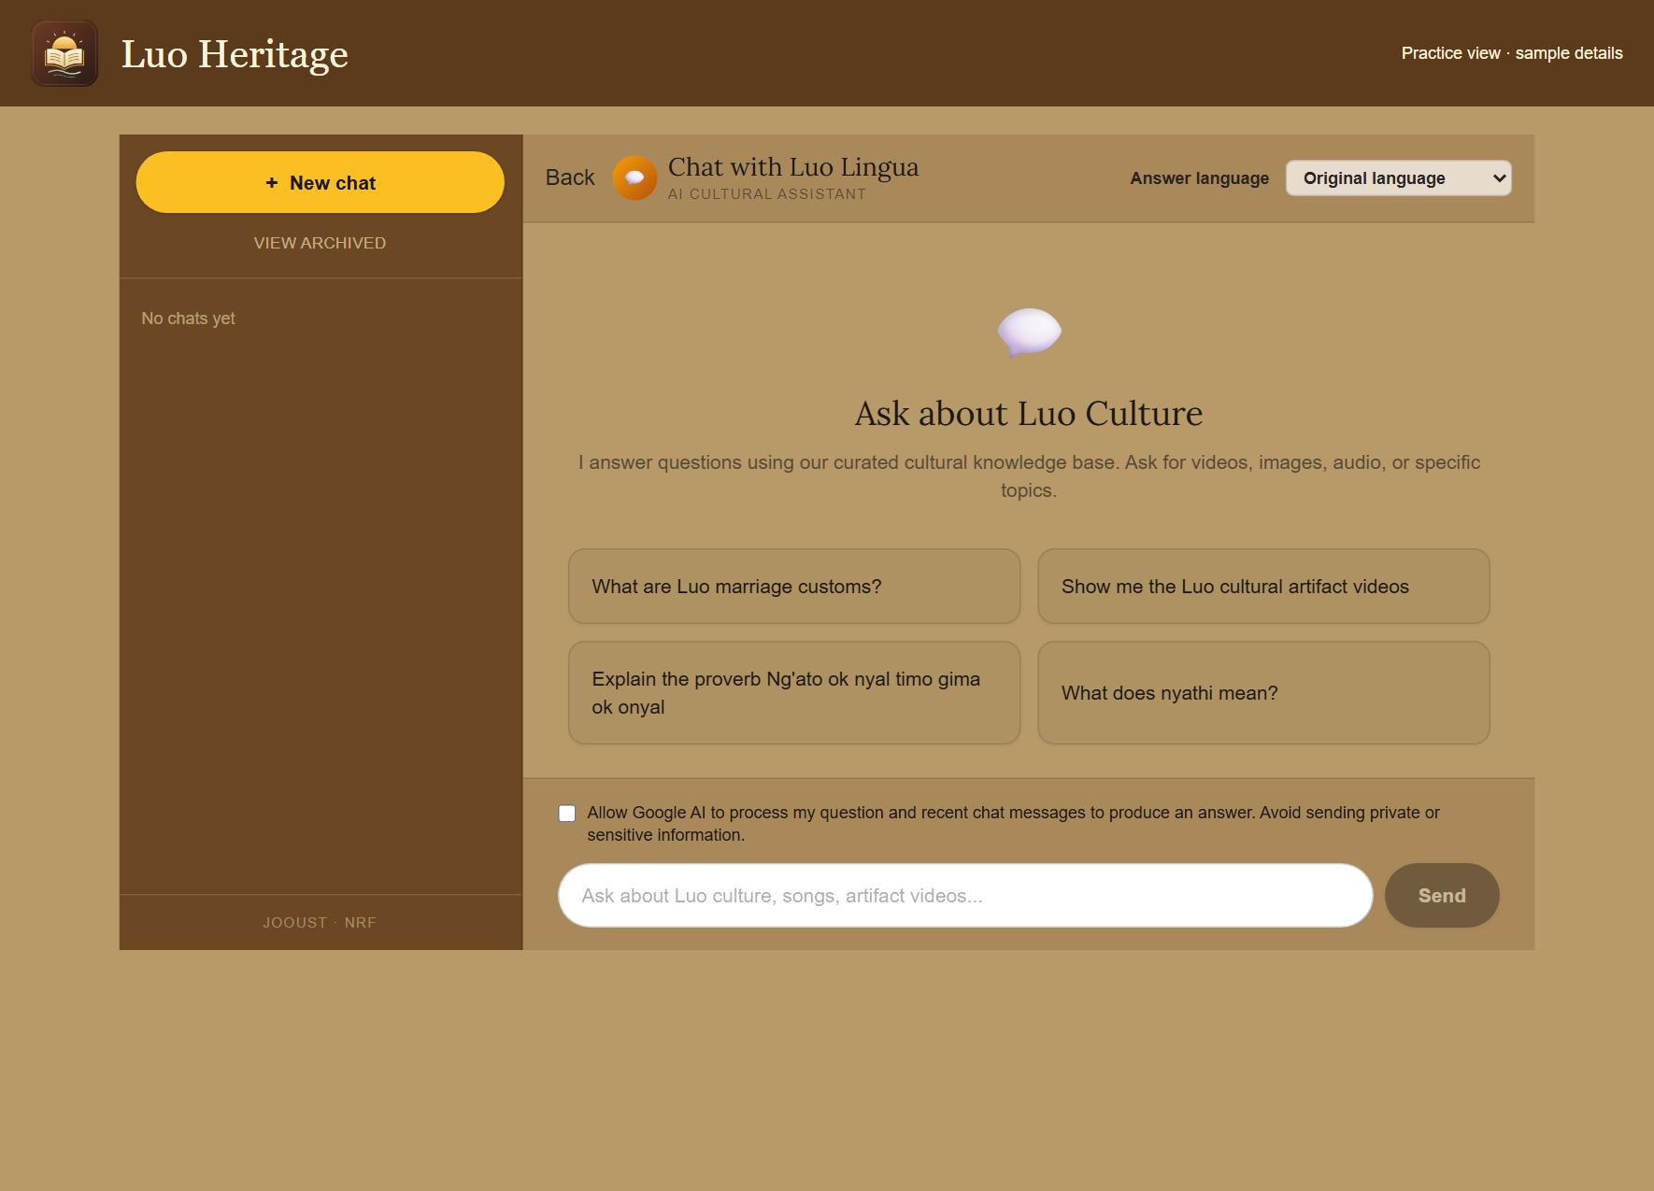
SELF-STUDY / COMMON STEPS
Ask the AI chatbot a clear question
1
Open Chat or Chatbot. Choose your
answer language and read the processing
permission notice.
2
If you agree, allow AI processing. Ask one
clear question and wait for the response.
3
Open any sources provided. Ask a
follow-up question if you need a simpler
explanation.
AI can make mistakes. Do not enter private interviews, passwords or
learners’ personal information.
CURRENT INTERFACE • PRACTICE DETAILS
CHECK: You can read an answer and inspect any linked sources.
LUO HERITAGE / COMMON STEPS
Contents
19 / 138
Notes:
Ask the AI chatbot a clear question
1. Open Chat or Chatbot. Choose your answer language and read the processing permission notice.
2. If you agree, allow AI processing. Ask one clear question and wait for the response.
3. Open any sources provided. Ask a follow-up question if you need a simpler explanation.
Expected result: You can read an answer and inspect any linked sources.
Important: AI can make mistakes. Do not enter private interviews, passwords or learners’ personal information.
Screenshot: current application interface rendered with sample details. No live action is demonstrated.

Slide 20
SELF-STUDY / COMMUNITY MEMBERS
Community members
1
You will be able to find cultural material, ask questions and submit your own contribution.
2
Read the common steps on slides 4–19 when you need them. Then follow the tasks in this
section.
3
Use only the duties and language assigned to your own account. Choose Contents at the
bottom of a slide to return to the role list.
Find material
→
Read or listen
→
Save or contribute
CHECK: Read a step, try it, and check the result before moving on.
LUO HERITAGE / COMMUNITY MEMBERS
Contents
20 / 138
Notes:
Community members
1. You will be able to find cultural material, ask questions and submit your own contribution.
2. Read the common steps on slides 4–19 when you need them. Then follow the tasks in this section.
3. Use only the duties and language assigned to your own account. Choose Contents at the bottom of a slide to return to the role list.
Expected result: Read a step, try it, and check the result before moving on.

Slide 21
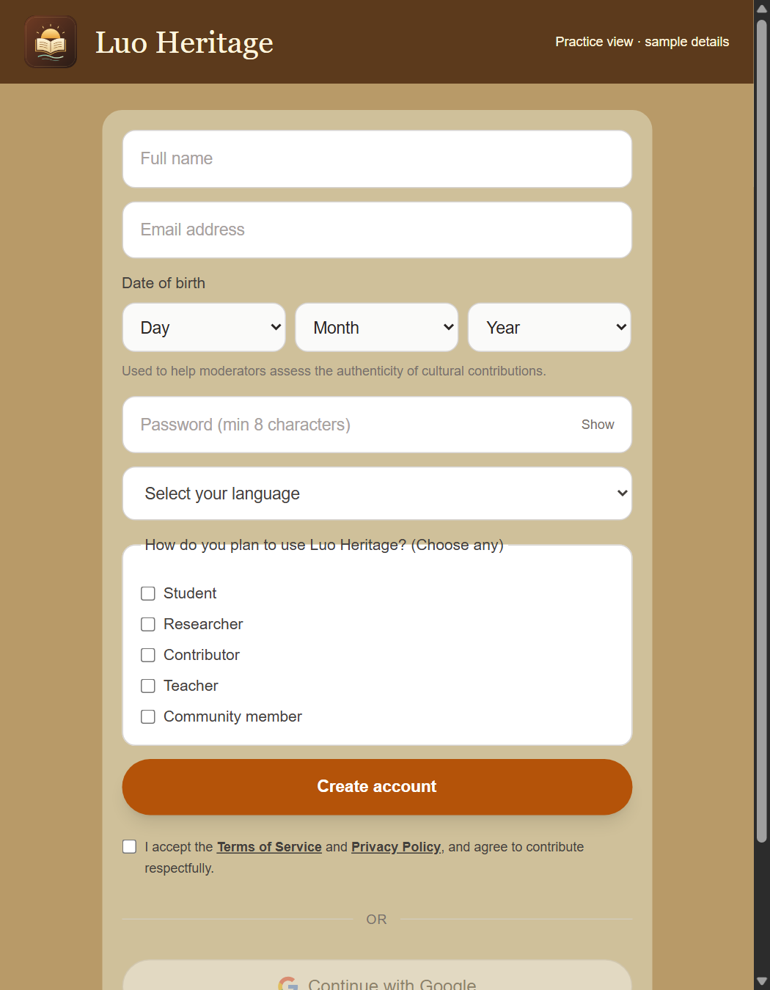
SELF-STUDY / COMMUNITY MEMBERS
Create a community account
1
Choose Create new account from the sign-in screen. Enter your
name, email and date of birth.
2
Choose your language and interests. Read and accept the
Terms and Privacy Policy.
3
Set your password and submit. If approval is required, wait for
confirmation before signing in.
You can choose Google registration if offered, then complete any requested profile information.
CURRENT INTERFACE • PRACTICE DETAILS
CHECK: Your account is created or clearly marked as awaiting approval.
LUO HERITAGE / COMMUNITY MEMBERS
Contents
21 / 138
Notes:
Create a community account
1. Choose Create new account from the sign-in screen. Enter your name, email and date of birth.
2. Choose your language and interests. Read and accept the Terms and Privacy Policy.
3. Set your password and submit. If approval is required, wait for confirmation before signing in.
Expected result: Your account is created or clearly marked as awaiting approval.
Important: You can choose Google registration if offered, then complete any requested profile information.
Screenshot: current application interface rendered with sample details. No live action is demonstrated.

Slide 22
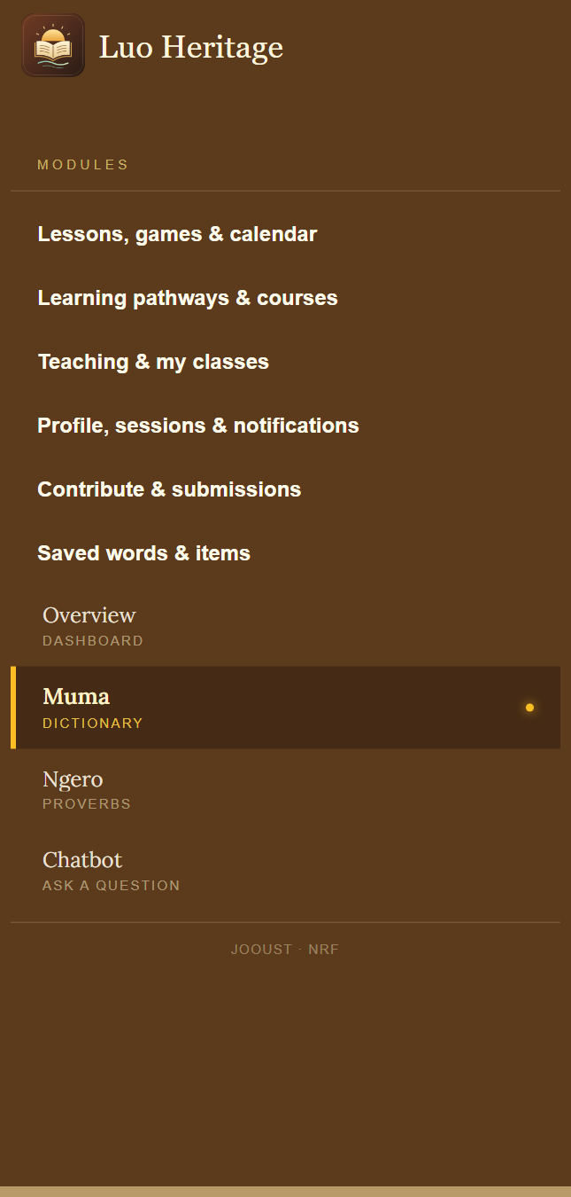
SELF-STUDY / COMMUNITY MEMBERS
Find your way around
1
Open the menu on the left. On a phone, use the menu button
first.
2
Choose a collection such as Muma, Ngero or stories. The
smaller label explains its content.
3
Use the same menu for lessons, courses, saved items,
contributions and your account.
CURRENT INTERFACE • PRACTICE DETAILS
CHECK: You can return to a collection or personal screen without starting again.
LUO HERITAGE / COMMUNITY MEMBERS
Contents
22 / 138
Notes:
Find your way around
1. Open the menu on the left. On a phone, use the menu button first.
2. Choose a collection such as Muma, Ngero or stories. The smaller label explains its content.
3. Use the same menu for lessons, courses, saved items, contributions and your account.
Expected result: You can return to a collection or personal screen without starting again.
Screenshot: current application interface rendered with sample details. No live action is demonstrated.

Slide 23
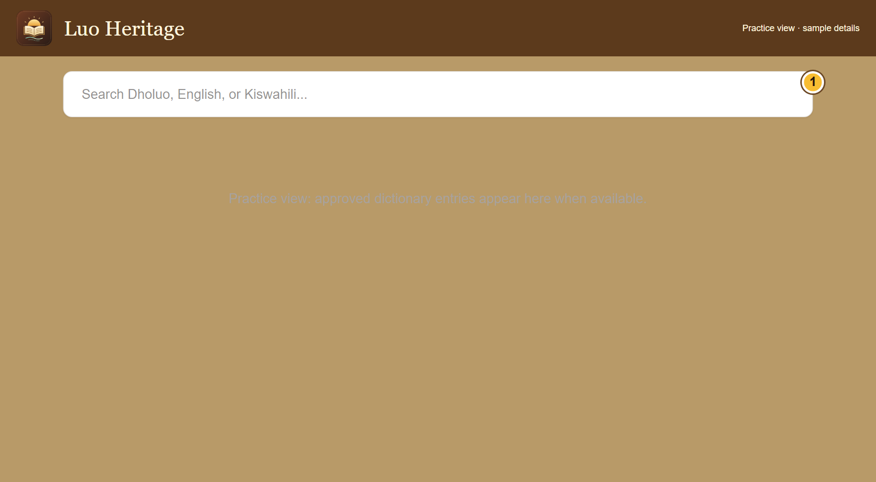
SELF-STUDY / COMMUNITY MEMBERS
Find a word in the public dictionary
1
On the public website, open the dictionary
page and find its search box.
2
Enter a Dholuo word or an English or
Kiswahili meaning. Wait for the results,
then read the relevant entry.
3
If there is no result, check spelling or try
another word. A missing published entry is
not proof that the word does not exist.
The shared app’s Muma screen uses collection filters; it may not show
this website search box.
CURRENT INTERFACE • PRACTICE DETAILS
CHECK: You can use the dictionary search where it is offered.
LUO HERITAGE / COMMUNITY MEMBERS
Contents
23 / 138
Notes:
Find a word in the public dictionary
1. On the public website, open the dictionary page and find its search box.
2. Enter a Dholuo word or an English or Kiswahili meaning. Wait for the results, then read the relevant entry.
3. If there is no result, check spelling or try another word. A missing published entry is not proof that the word does not exist.
Expected result: You can use the dictionary search where it is offered.
Important: The shared app’s Muma screen uses collection filters; it may not show this website search box.
Screenshot: current application interface rendered with sample details. No live action is demonstrated.

Slide 24
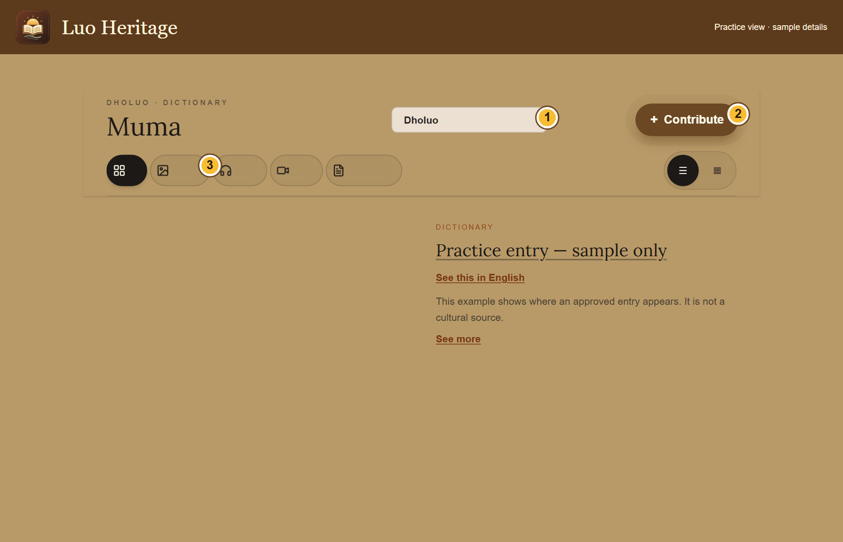
SELF-STUDY / COMMUNITY MEMBERS
Read, listen and change the view
1
Open an entry or choose the grid button,
then select its card.
2
Use See description or See this in English
when offered. Audio and video use their
own play controls.
3
Use All if a filter shows no results. Save
item is available in signed-in views that
offer it.
An unavailable English description does not mean the original entry is
missing.
CURRENT INTERFACE • PRACTICE DETAILS
CHECK: You can read the entry and use the media that has actually been published.
LUO HERITAGE / COMMUNITY MEMBERS
Contents
24 / 138
Notes:
Read, listen and change the view
1. Open an entry or choose the grid button, then select its card.
2. Use See description or See this in English when offered. Audio and video use their own play controls.
3. Use All if a filter shows no results. Save item is available in signed-in views that offer it.
Expected result: You can read the entry and use the media that has actually been published.
Important: An unavailable English description does not mean the original entry is missing.
Screenshot: current application interface rendered with sample details. No live action is demonstrated.

Slide 25
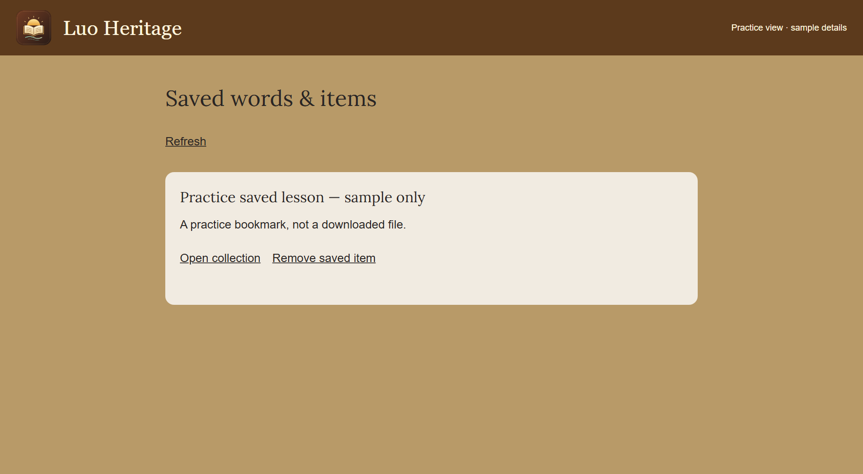
SELF-STUDY / COMMUNITY MEMBERS
Return to saved words and items
1
Sign in and choose Save item on an entry
or lesson where that button is available.
2
Open Saved words & items from the menu.
Choose Open collection to return to its
source.
3
Choose Remove saved item when you no
longer need the bookmark.
Saving a bookmark does not download a file for offline use.
CURRENT INTERFACE • PRACTICE DETAILS
CHECK: Your saved list helps you find material again on the same account.
LUO HERITAGE / COMMUNITY MEMBERS
Contents
25 / 138
Notes:
Return to saved words and items
1. Sign in and choose Save item on an entry or lesson where that button is available.
2. Open Saved words & items from the menu. Choose Open collection to return to its source.
3. Choose Remove saved item when you no longer need the bookmark.
Expected result: Your saved list helps you find material again on the same account.
Important: Saving a bookmark does not download a file for offline use.
Screenshot: current application interface rendered with sample details. No live action is demonstrated.

Slide 26
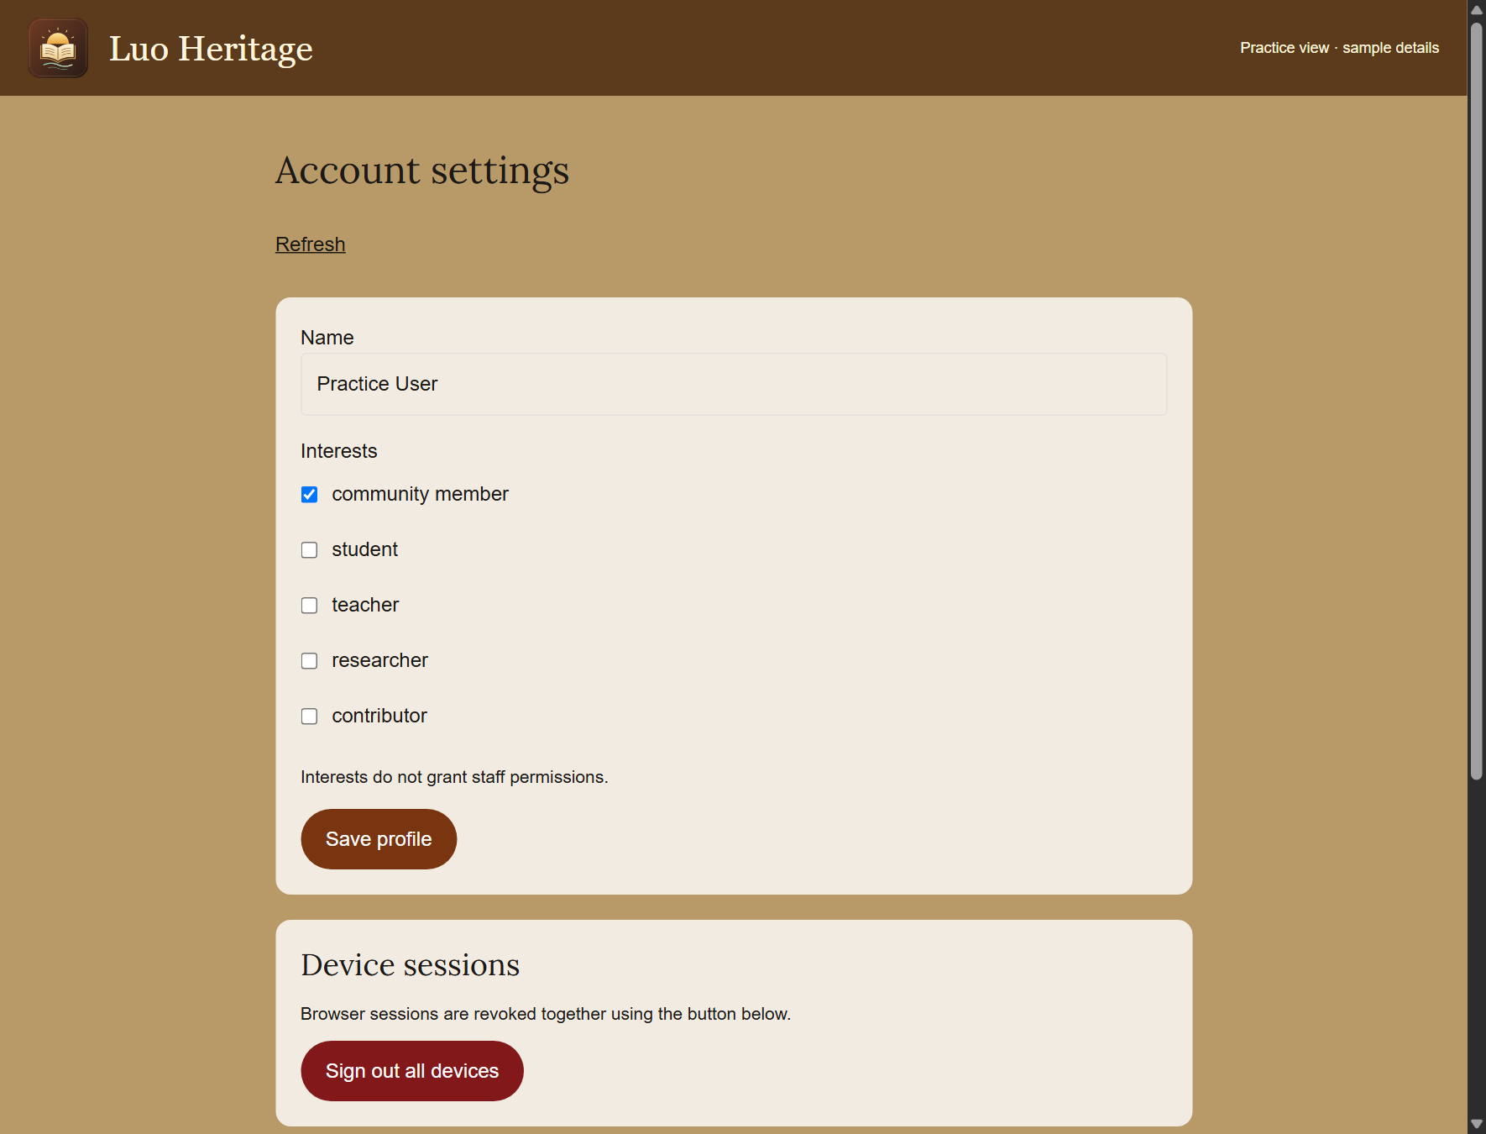
SELF-STUDY / COMMUNITY MEMBERS
Update your profile and read notices
1
Open Profile, sessions & notifications from
the menu.
2
Change your name or interests and choose
Save profile. Interests describe you; they
do not grant staff duties.
3
Read your notifications and use Mark read
when offered. Check Device sessions if
you need to end an old app sign-in.
Sign out all devices ends your current sign-in too. Sign in again
afterwards if you use it.
CURRENT INTERFACE • PRACTICE DETAILS
CHECK: Your profile changes are saved and notices are easy to find.
LUO HERITAGE / COMMUNITY MEMBERS
Contents
26 / 138
Notes:
Update your profile and read notices
1. Open Profile, sessions & notifications from the menu.
2. Change your name or interests and choose Save profile. Interests describe you; they do not grant staff duties.
3. Read your notifications and use Mark read when offered. Check Device sessions if you need to end an old app sign-in.
Expected result: Your profile changes are saved and notices are easy to find.
Important: Sign out all devices ends your current sign-in too. Sign in again afterwards if you use it.
Screenshot: current application interface rendered with sample details. No live action is demonstrated.

Slide 27
SELF-STUDY / COMMUNITY MEMBERS
Verify your email address
1
Open account verification and recovery
from your account settings.
2
Choose Verify email under Action, enter
your own account email and choose Send
email.
3
Open the newest email link within 30
minutes and choose Confirm. Use a new
link if the earlier one has expired.
The screenshot shows the same form set to Reset password. Change
Action to Verify email for this task.
CURRENT INTERFACE • PRACTICE DETAILS
CHECK: The confirmation verifies the address for the intended account.
LUO HERITAGE / COMMUNITY MEMBERS
Contents
27 / 138
Notes:
Verify your email address
1. Open account verification and recovery from your account settings.
2. Choose Verify email under Action, enter your own account email and choose Send email.
3. Open the newest email link within 30 minutes and choose Confirm. Use a new link if the earlier one has expired.
Expected result: The confirmation verifies the address for the intended account.
Important: The screenshot shows the same form set to Reset password. Change Action to Verify email for this task.
Screenshot: current application interface rendered with sample details. No live action is demonstrated.

Slide 28
SELF-STUDY / COMMUNITY MEMBERS
If you decide to delete your account
1
Read the warning first. Deletion removes
your sign-in, profile, saved chats and
personal progress.
2
In account recovery, choose Delete
account. Request the email link only if you
intend to continue.
3
Open the link and read the confirmation
before choosing Confirm. Required
cultural-source and review records can be
retained.
This is optional, not a practice task. Active class teachers and the Master
Super Admin may need to resolve their responsibilities first.
CURRENT INTERFACE • PRACTICE DETAILS
CHECK: You understand the consequences before requesting deletion.
LUO HERITAGE / COMMUNITY MEMBERS
Contents
28 / 138
Notes:
If you decide to delete your account
1. Read the warning first. Deletion removes your sign-in, profile, saved chats and personal progress.
2. In account recovery, choose Delete account. Request the email link only if you intend to continue.
3. Open the link and read the confirmation before choosing Confirm. Required cultural-source and review records can be retained.
Expected result: You understand the consequences before requesting deletion.
Important: This is optional, not a practice task. Active class teachers and the Master Super Admin may need to resolve their responsibilities first.
Screenshot: current application interface rendered with sample details. No live action is demonstrated.

Slide 29
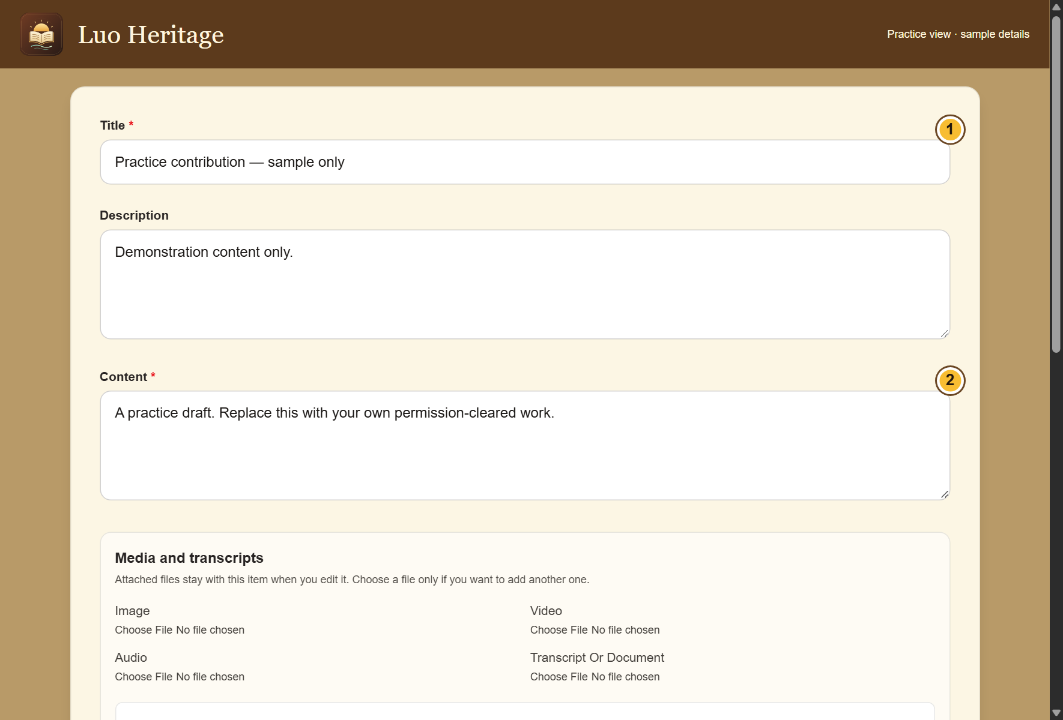
SELF-STUDY / COMMUNITY MEMBERS
Start your own contribution
1
Choose Contribute & submissions or the
Contribute button inside a collection.
2
Select the collection and choose New
private draft. Enter a short title and the
requested details.
3
Use your own material or material you
have permission to share. Mark uncertain
facts for review.
CURRENT INTERFACE • PRACTICE DETAILS
CHECK: A contribution form contains your draft; it is not published.
LUO HERITAGE / COMMUNITY MEMBERS
Contents
29 / 138
Notes:
Start your own contribution
1. Choose Contribute & submissions or the Contribute button inside a collection.
2. Select the collection and choose New private draft. Enter a short title and the requested details.
3. Use your own material or material you have permission to share. Mark uncertain facts for review.
Expected result: A contribution form contains your draft; it is not published.
Screenshot: current application interface rendered with sample details. No live action is demonstrated.

Slide 30
SELF-STUDY / COMMUNITY MEMBERS
What the permission labels mean
1
Source permission: has the source agreed
to the proposed use? Choose Not sure yet
when you do not know.
2
Consent scope: what use was agreed?
Public excerpt means an approved public
part; research only and teaching have
different limits.
3
Restriction level: who may see it? Internal
and restricted are not public. Sacred
material needs the collection owner’s
special care.
If the permission record is unclear, keep the item private and ask the
responsible reviewer.
CURRENT INTERFACE • PRACTICE DETAILS
CHECK: You understand the labels before you change them.
LUO HERITAGE / COMMUNITY MEMBERS
Contents
30 / 138
Notes:
What the permission labels mean
1. Source permission: has the source agreed to the proposed use? Choose Not sure yet when you do not know.
2. Consent scope: what use was agreed? Public excerpt means an approved public part; research only and teaching have different limits.
3. Restriction level: who may see it? Internal and restricted are not public. Sacred material needs the collection owner’s special care.
Expected result: You understand the labels before you change them.
Important: If the permission record is unclear, keep the item private and ask the responsible reviewer.
Screenshot: current application interface rendered with sample details. No live action is demonstrated.

Slide 31
SELF-STUDY / COMMUNITY MEMBERS
Check what happened to your submission
1
Open Contribute & submissions, then find
My online submissions.
2
Read the status. If asked to make changes,
choose Edit draft or requested revision.
3
Read the reviewer’s request, make the
correction, and submit again when ready.
If an item is locked for review, ask the reviewer to return it rather than
creating a duplicate.
CURRENT INTERFACE • PRACTICE DETAILS
CHECK: You can tell the difference between a draft, an item under review and published material.
LUO HERITAGE / COMMUNITY MEMBERS
Contents
31 / 138
Notes:
Check what happened to your submission
1. Open Contribute & submissions, then find My online submissions.
2. Read the status. If asked to make changes, choose Edit draft or requested revision.
3. Read the reviewer’s request, make the correction, and submit again when ready.
Expected result: You can tell the difference between a draft, an item under review and published material.
Important: If an item is locked for review, ask the reviewer to return it rather than creating a duplicate.
Screenshot: current application interface rendered with sample details. No live action is demonstrated.

Slide 32
SELF-STUDY / COMMUNITY MEMBERS
Check your skills before working alone
1
Find one collection and change its content filter.
2
Open a lesson or ask a simple AI question, then check any source.
3
Prepare a private practice draft and identify the option that sends it for review.
Try
→
Check
→
Ask if unsure
Use only approved practice material. Do not publish, delete accounts or change live settings just to practise.
CHECK: You are ready for routine work when you can complete these steps without help.
LUO HERITAGE / COMMUNITY MEMBERS
Contents
32 / 138
Notes:
Check your skills before working alone
1. Find one collection and change its content filter.
2. Open a lesson or ask a simple AI question, then check any source.
3. Prepare a private practice draft and identify the option that sends it for review.
Expected result: You are ready for routine work when you can complete these steps without help.
Important: Use only approved practice material. Do not publish, delete accounts or change live settings just to practise.

Slide 33
SELF-STUDY / STUDENTS AND LEARNERS
Students and learners
1
You will be able to enroll, join a class, study and find your feedback.
2
Read the common steps on slides 4–19 when you need them. Then follow the tasks in this
section.
3
Use only the duties and language assigned to your own account. Choose Contents at the
bottom of a slide to return to the role list.
Join a course
→
Complete work
→
Read feedback
CHECK: Read a step, try it, and check the result before moving on.
LUO HERITAGE / STUDENTS AND LEARNERS
Contents
33 / 138
Notes:
Students and learners
1. You will be able to enroll, join a class, study and find your feedback.
2. Read the common steps on slides 4–19 when you need them. Then follow the tasks in this section.
3. Use only the duties and language assigned to your own account. Choose Contents at the bottom of a slide to return to the role list.
Expected result: Read a step, try it, and check the result before moving on.

Slide 34
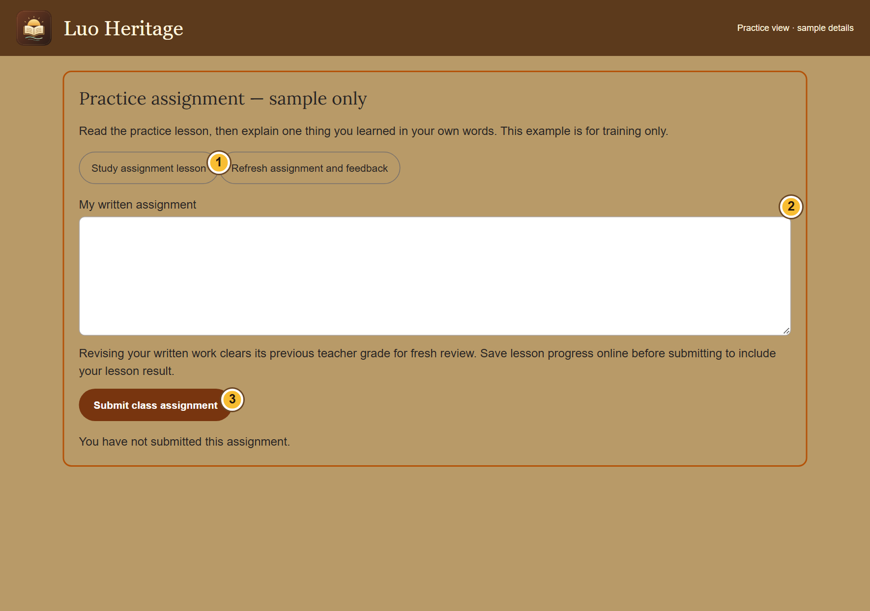
SELF-STUDY / STUDENTS AND LEARNERS
Complete a class assignment
1
Open your class, then choose Open
assignment. Read the instructions and due
date.
2
Choose Study assignment lesson and
complete the lesson. Return to the
assignment when ready.
3
Enter the work requested and use the
submission button shown. Wait for a saved
confirmation.
If the assignment is closed or the lesson unavailable, contact your
teacher; do not submit to a different class.
CURRENT INTERFACE • PRACTICE DETAILS
CHECK: Your assignment shows your submission rather than an unsaved answer.
LUO HERITAGE / STUDENTS AND LEARNERS
Contents
34 / 138
Notes:
Complete a class assignment
1. Open your class, then choose Open assignment. Read the instructions and due date.
2. Choose Study assignment lesson and complete the lesson. Return to the assignment when ready.
3. Enter the work requested and use the submission button shown. Wait for a saved confirmation.
Expected result: Your assignment shows your submission rather than an unsaved answer.
Important: If the assignment is closed or the lesson unavailable, contact your teacher; do not submit to a different class.
Screenshot: current application interface rendered with sample details. No live action is demonstrated.

Slide 35
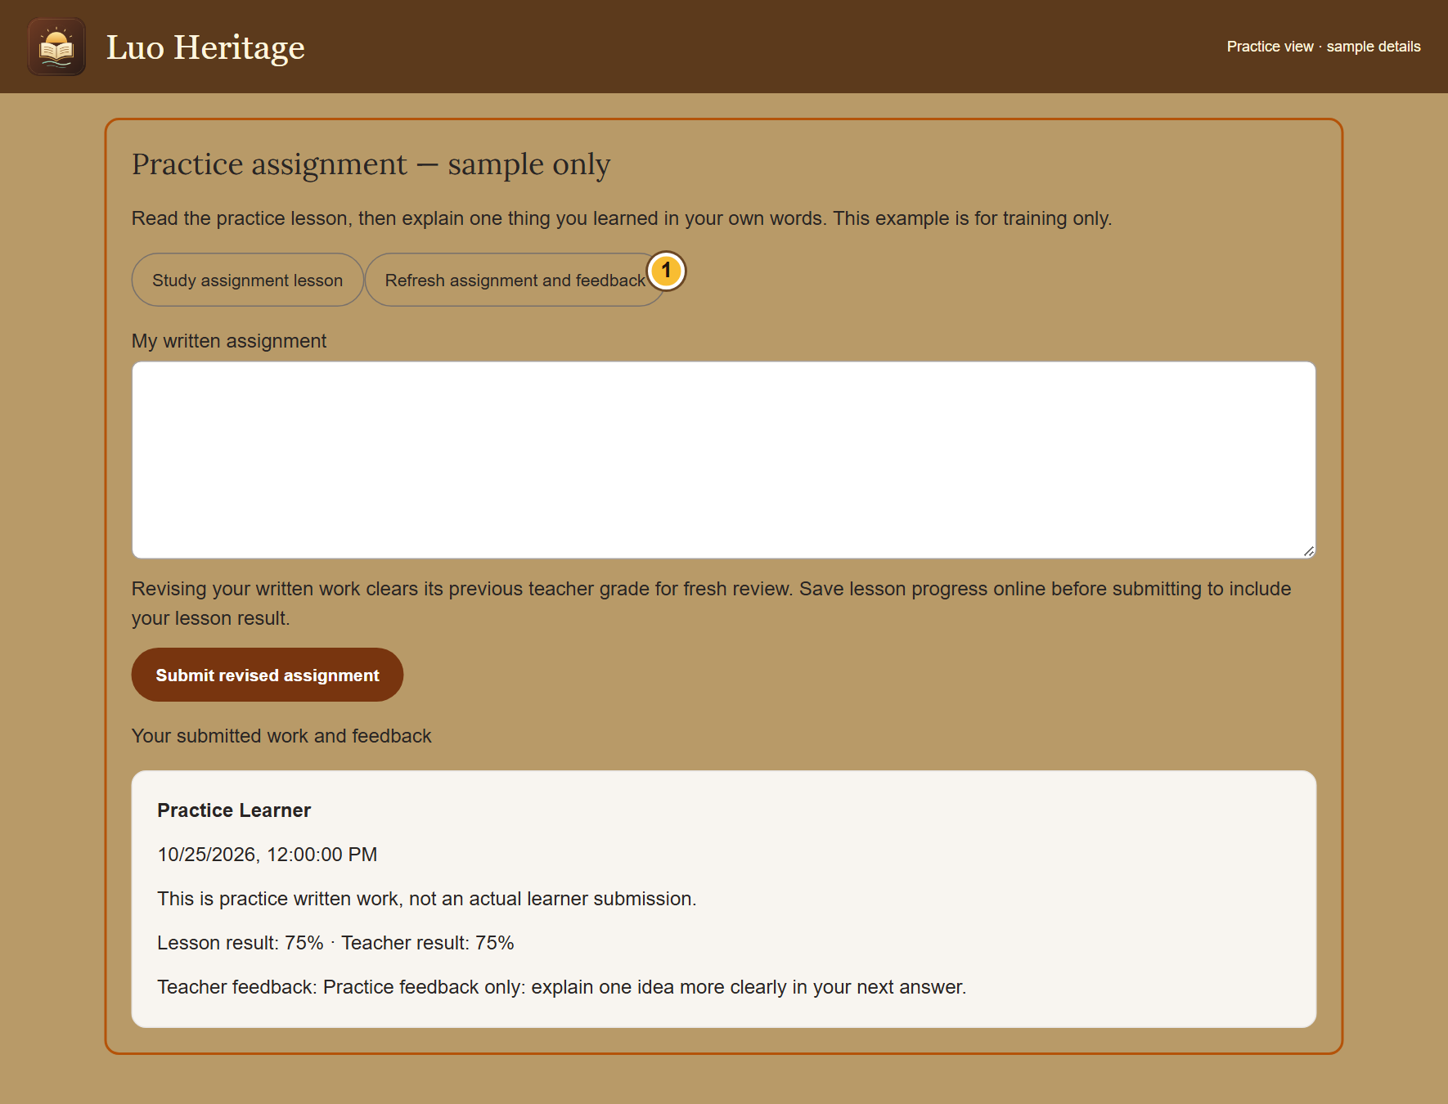
SELF-STUDY / STUDENTS AND LEARNERS
Read feedback and try again
1
Open the same class assignment after
your teacher reviews it.
2
Choose Refresh assignment and feedback.
Read the score and the teacher’s
comments.
3
If a new submission is requested and
allowed, correct your work and submit it
again.
Sending revised written work clears its previous teacher grade so the
teacher can review it again.
CURRENT INTERFACE • PRACTICE DETAILS
CHECK: You know what to improve and which result belongs to you.
LUO HERITAGE / STUDENTS AND LEARNERS
Contents
35 / 138
Notes:
Read feedback and try again
1. Open the same class assignment after your teacher reviews it.
2. Choose Refresh assignment and feedback. Read the score and the teacher’s comments.
3. If a new submission is requested and allowed, correct your work and submit it again.
Expected result: You know what to improve and which result belongs to you.
Important: Sending revised written work clears its previous teacher grade so the teacher can review it again.
Screenshot: current application interface rendered with sample details. No live action is demonstrated.

Slide 36
SELF-STUDY / STUDENTS AND LEARNERS
Keep your own learning record
1
Use the same account on your phone and
computer.
2
Before changing devices, reconnect and
use Refresh & sync for waiting attempts.
3
Do not leave a class just to change
devices: leaving can delete your work in
that class.
Tell your teacher if you accidentally created two accounts.
CURRENT INTERFACE • PRACTICE DETAILS
CHECK: Your work stays linked to the intended account.
LUO HERITAGE / STUDENTS AND LEARNERS
Contents
36 / 138
Notes:
Keep your own learning record
1. Use the same account on your phone and computer.
2. Before changing devices, reconnect and use Refresh & sync for waiting attempts.
3. Do not leave a class just to change devices: leaving can delete your work in that class.
Expected result: Your work stays linked to the intended account.
Important: Tell your teacher if you accidentally created two accounts.
Screenshot: current application interface rendered with sample details. No live action is demonstrated.

Slide 37
SELF-STUDY / STUDENTS AND LEARNERS
Check your skills before working alone
1
Enroll in the course your teacher names and open its first available lesson.
2
Join your class with a current code and find the assignment instructions.
3
Save one practice result and show where you would read teacher feedback.
Try
→
Check
→
Ask if unsure
Use only approved practice material. Do not publish, delete accounts or change live settings just to practise.
CHECK: You are ready for routine work when you can complete these steps without help.
LUO HERITAGE / STUDENTS AND LEARNERS
Contents
37 / 138
Notes:
Check your skills before working alone
1. Enroll in the course your teacher names and open its first available lesson.
2. Join your class with a current code and find the assignment instructions.
3. Save one practice result and show where you would read teacher feedback.
Expected result: You are ready for routine work when you can complete these steps without help.
Important: Use only approved practice material. Do not publish, delete accounts or change live settings just to practise.

Slide 38
SELF-STUDY / TEACHERS AND LECTURERS
Teachers and lecturers
1
You will be able to run a class and help students find their work and feedback.
2
Read the common steps on slides 4–19 when you need them. Then follow the tasks in this
section.
3
Use only the duties and language assigned to your own account. Choose Contents at the
bottom of a slide to return to the role list.
Create a class
→
Set assignments
→
Review learning
CHECK: Read a step, try it, and check the result before moving on.
LUO HERITAGE / TEACHERS AND LECTURERS
Contents
38 / 138
Notes:
Teachers and lecturers
1. You will be able to run a class and help students find their work and feedback.
2. Read the common steps on slides 4–19 when you need them. Then follow the tasks in this section.
3. Use only the duties and language assigned to your own account. Choose Contents at the bottom of a slide to return to the role list.
Expected result: Read a step, try it, and check the result before moving on.

Slide 39
SELF-STUDY / TEACHERS AND LECTURERS
Check that you have teaching access
1
Sign in with your own account. Open
Teaching & my classes.
2
Look for Create class or an existing class
where your role is teacher.
3
If these are missing, ask the language
administrator to assign teaching access.
Selecting teacher as an interest does not
grant it.
CURRENT INTERFACE • PRACTICE DETAILS
CHECK: You know whether you can teach a class or are viewing as a learner.
LUO HERITAGE / TEACHERS AND LECTURERS
Contents
39 / 138
Notes:
Check that you have teaching access
1. Sign in with your own account. Open Teaching & my classes.
2. Look for Create class or an existing class where your role is teacher.
3. If these are missing, ask the language administrator to assign teaching access. Selecting teacher as an interest does not grant it.
Expected result: You know whether you can teach a class or are viewing as a learner.
Screenshot: current application interface rendered with sample details. No live action is demonstrated.

Slide 40
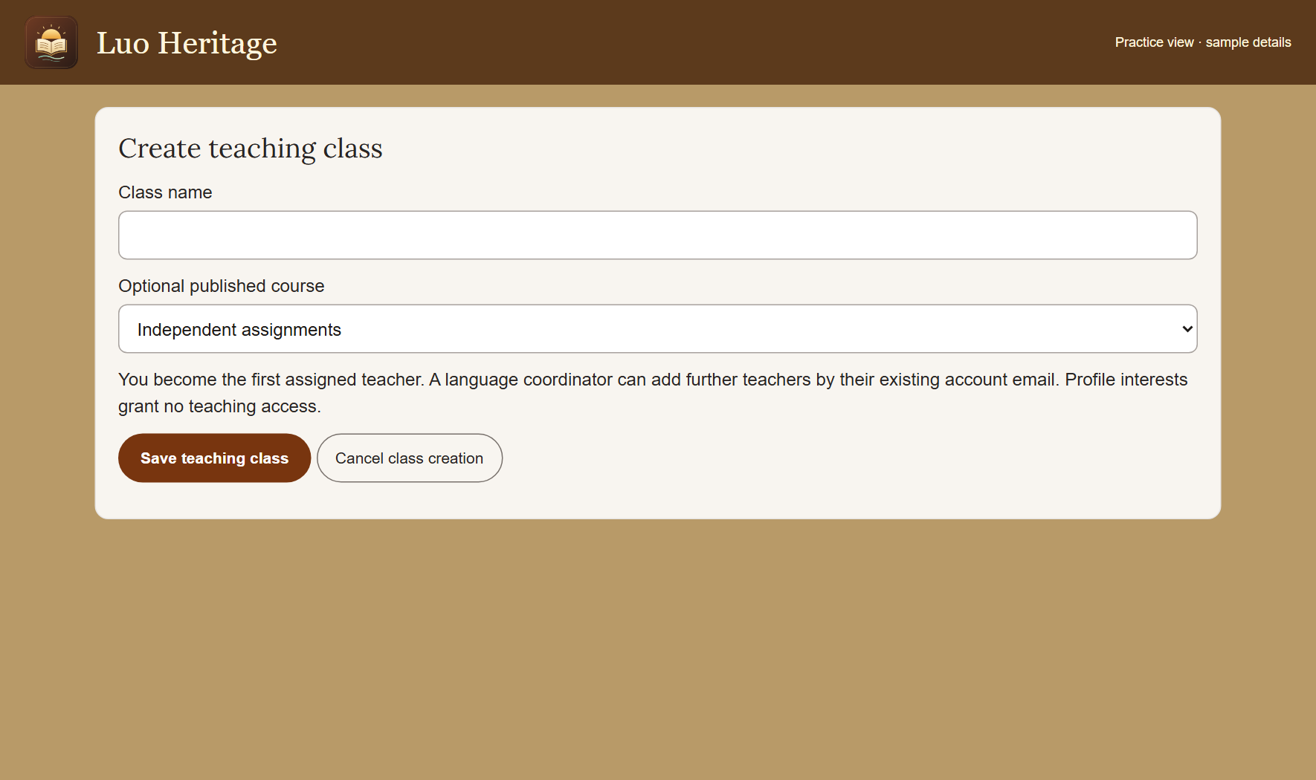
SELF-STUDY / TEACHERS AND LECTURERS
Create a teaching class
1
Open My classes and choose Create class.
2
Enter the class title and requested details.
Select a published course if the class
needs one.
3
Choose Save teaching class. Keep the
new class join code private until you invite
learners.
Teaching a class does not automatically let you publish cultural content
or courses.
CURRENT INTERFACE • PRACTICE DETAILS
CHECK: The class opens and you can see its invitation controls.
LUO HERITAGE / TEACHERS AND LECTURERS
Contents
40 / 138
Notes:
Create a teaching class
1. Open My classes and choose Create class.
2. Enter the class title and requested details. Select a published course if the class needs one.
3. Choose Save teaching class. Keep the new class join code private until you invite learners.
Expected result: The class opens and you can see its invitation controls.
Important: Teaching a class does not automatically let you publish cultural content or courses.
Screenshot: current application interface rendered with sample details. No live action is demonstrated.

Slide 41
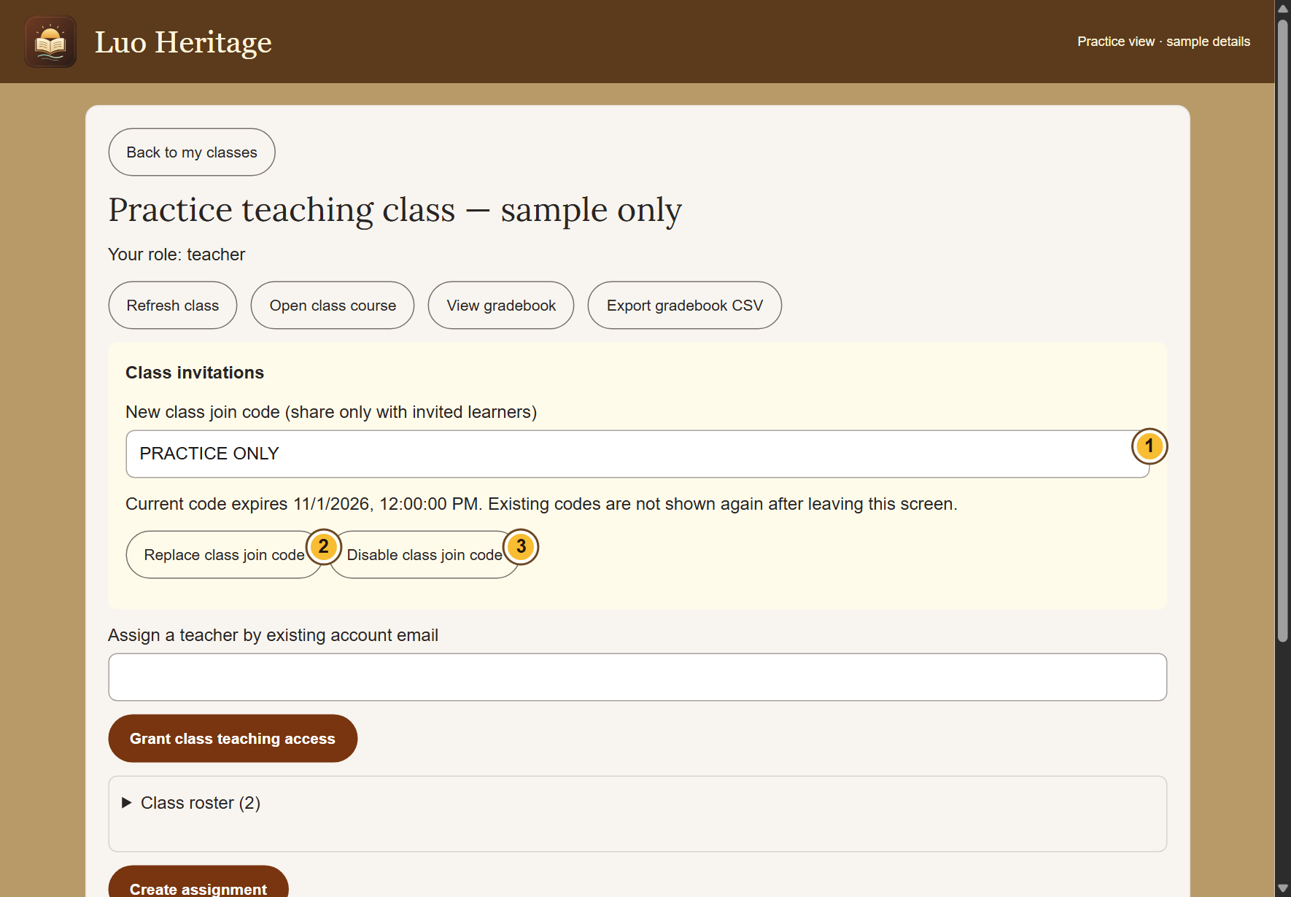
SELF-STUDY / TEACHERS AND LECTURERS
Invite your learners safely
1
Open the class and find Class invitations.
Share its current join code with the
intended learners.
2
Ask learners to sign in and use Join a
class. Check the member list afterwards.
3
If a code is shared too widely, choose
Replace class join code or Disable class
join code.
Codes expire after seven days. A replacement invalidates the previous
code.
CURRENT INTERFACE • PRACTICE DETAILS
CHECK: The correct learners are listed in the class.
LUO HERITAGE / TEACHERS AND LECTURERS
Contents
41 / 138
Notes:
Invite your learners safely
1. Open the class and find Class invitations. Share its current join code with the intended learners.
2. Ask learners to sign in and use Join a class. Check the member list afterwards.
3. If a code is shared too widely, choose Replace class join code or Disable class join code.
Expected result: The correct learners are listed in the class.
Important: Codes expire after seven days. A replacement invalidates the previous code.
Screenshot: current application interface rendered with sample details. No live action is demonstrated.

Slide 42
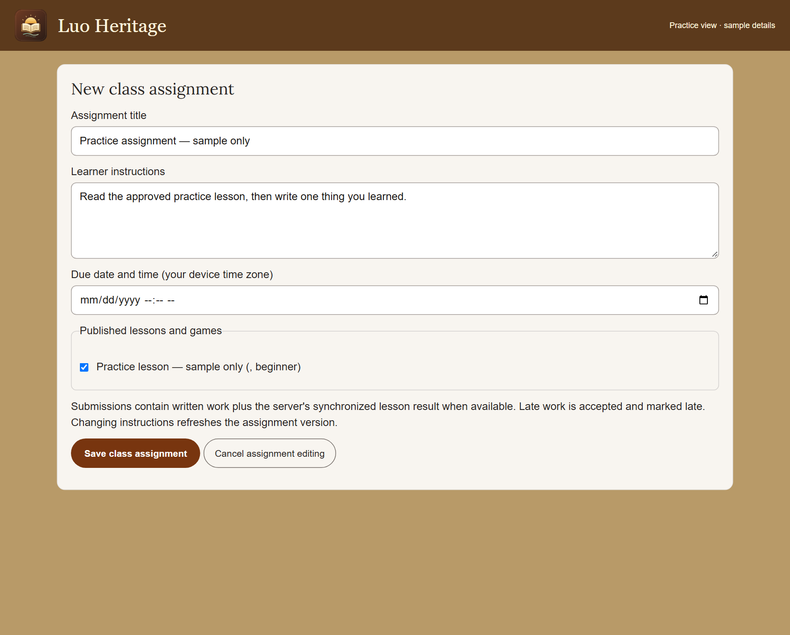
SELF-STUDY / TEACHERS AND LECTURERS
Set a useful assignment
1
Open the class and choose Create
assignment.
2
Choose an available published lesson.
Write a clear title, instructions and due
date.
3
Choose Save class assignment. Open it
again to check exactly what learners will
see.
Use a lesson in the correct language. If a lesson is withdrawn, choose an
approved replacement.
CURRENT INTERFACE • PRACTICE DETAILS
CHECK: The assignment is listed for members of this class.
LUO HERITAGE / TEACHERS AND LECTURERS
Contents
42 / 138
Notes:
Set a useful assignment
1. Open the class and choose Create assignment.
2. Choose an available published lesson. Write a clear title, instructions and due date.
3. Choose Save class assignment. Open it again to check exactly what learners will see.
Expected result: The assignment is listed for members of this class.
Important: Use a lesson in the correct language. If a lesson is withdrawn, choose an approved replacement.
Screenshot: current application interface rendered with sample details. No live action is demonstrated.

Slide 43
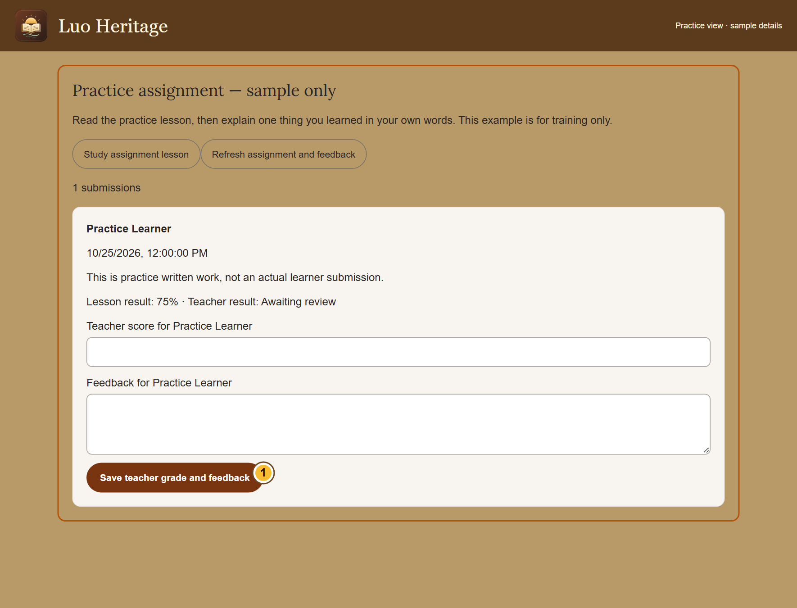
SELF-STUDY / TEACHERS AND LECTURERS
Review a learner’s submission
1
Open the class assignment and choose the
learner’s submission.
2
Read their work, enter the score and write
feedback that explains one clear next step.
3
Choose Save teacher grade and feedback.
Ask for another submission when
correction is needed.
Check the learner’s name before saving. Do not discuss individual results
in public chats.
CURRENT INTERFACE • PRACTICE DETAILS
CHECK: The learner can refresh the assignment to see the saved grade and feedback.
LUO HERITAGE / TEACHERS AND LECTURERS
Contents
43 / 138
Notes:
Review a learner’s submission
1. Open the class assignment and choose the learner’s submission.
2. Read their work, enter the score and write feedback that explains one clear next step.
3. Choose Save teacher grade and feedback. Ask for another submission when correction is needed.
Expected result: The learner can refresh the assignment to see the saved grade and feedback.
Important: Check the learner’s name before saving. Do not discuss individual results in public chats.
Screenshot: current application interface rendered with sample details. No live action is demonstrated.

Slide 44
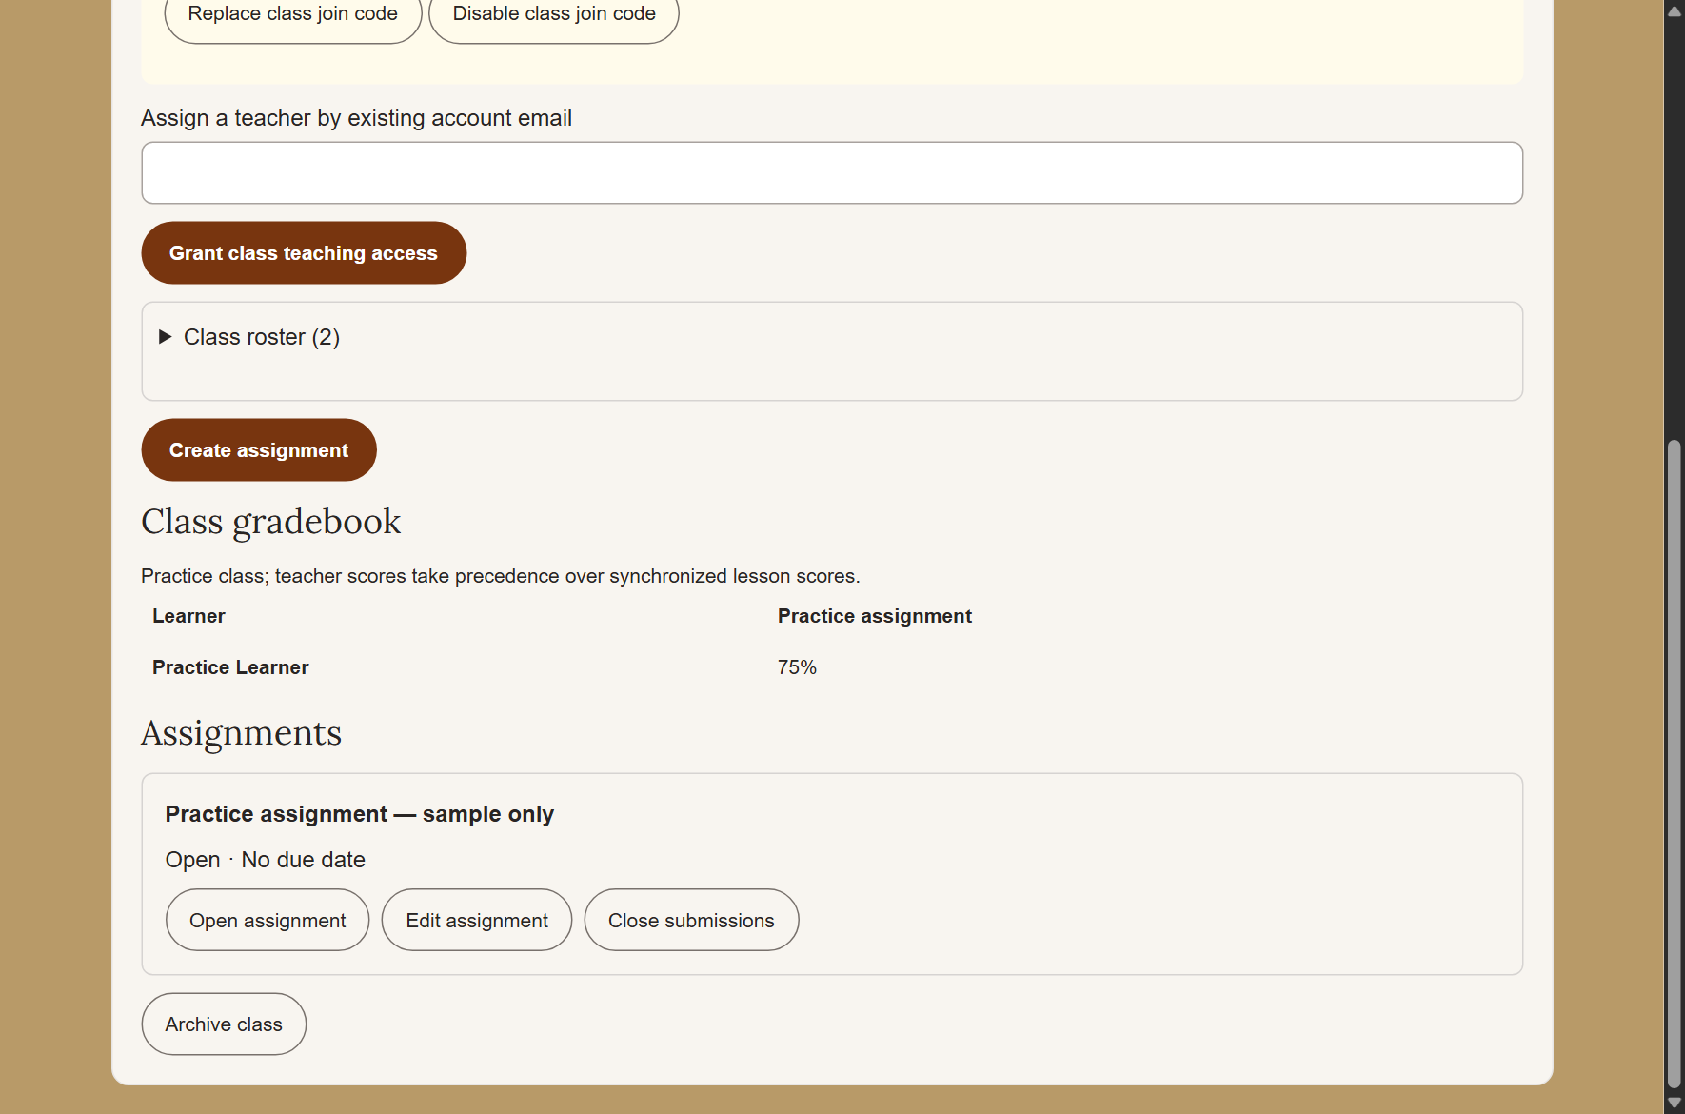
SELF-STUDY / TEACHERS AND LECTURERS
See the class gradebook
1
Open the class and choose View
gradebook.
2
Read the assignment columns and learner
rows. A teacher’s grade takes priority over
a synchronized lesson score.
3
Use Export gradebook CSV only if you are
allowed to keep a spreadsheet copy. Store
it privately.
A downloaded gradebook contains personal information. Do not share it
as a public attachment.
CURRENT INTERFACE • PRACTICE DETAILS
CHECK: You can identify submitted, ungraded and completed work.
LUO HERITAGE / TEACHERS AND LECTURERS
Contents
44 / 138
Notes:
See the class gradebook
1. Open the class and choose View gradebook.
2. Read the assignment columns and learner rows. A teacher’s grade takes priority over a synchronized lesson score.
3. Use Export gradebook CSV only if you are allowed to keep a spreadsheet copy. Store it privately.
Expected result: You can identify submitted, ungraded and completed work.
Important: A downloaded gradebook contains personal information. Do not share it as a public attachment.
Screenshot: current application interface rendered with sample details. No live action is demonstrated.

Slide 45
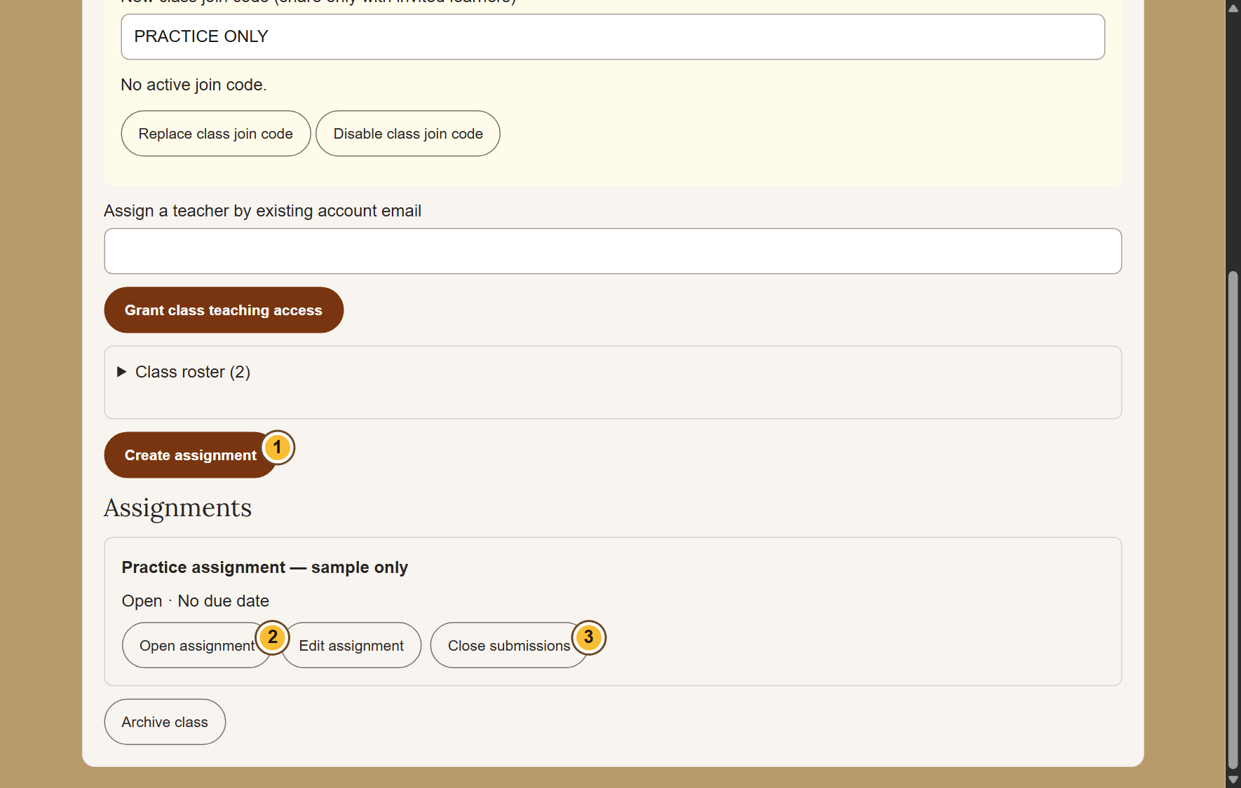
SELF-STUDY / TEACHERS AND LECTURERS
Manage changes without losing work
1
Use Edit assignment before closing
submissions. Read any warning when
changing instructions.
2
Choose Close submissions when no more
work should be accepted.
3
Remove a class member only after
checking the consequences: that action
can remove their class submissions.
CURRENT INTERFACE • PRACTICE DETAILS
CHECK: Class membership and assignment availability match your intention.
LUO HERITAGE / TEACHERS AND LECTURERS
Contents
45 / 138
Notes:
Manage changes without losing work
1. Use Edit assignment before closing submissions. Read any warning when changing instructions.
2. Choose Close submissions when no more work should be accepted.
3. Remove a class member only after checking the consequences: that action can remove their class submissions.
Expected result: Class membership and assignment availability match your intention.
Screenshot: current application interface rendered with sample details. No live action is demonstrated.

Slide 46
SELF-STUDY / TEACHERS AND LECTURERS
Share teaching responsibility
1
Open the class and find Assign a teacher
by existing account email.
2
Check the colleague’s exact account email
and grant teaching access only if you have
permission.
3
Confirm their role in the member list. Keep
at least one teacher in each active class.
A class teacher is different from a system administrator.
CURRENT INTERFACE • PRACTICE DETAILS
CHECK: The intended colleague has teaching access to this class.
LUO HERITAGE / TEACHERS AND LECTURERS
Contents
46 / 138
Notes:
Share teaching responsibility
1. Open the class and find Assign a teacher by existing account email.
2. Check the colleague’s exact account email and grant teaching access only if you have permission.
3. Confirm their role in the member list. Keep at least one teacher in each active class.
Expected result: The intended colleague has teaching access to this class.
Important: A class teacher is different from a system administrator.
Screenshot: current application interface rendered with sample details. No live action is demonstrated.

Slide 47
SELF-STUDY / TEACHERS AND LECTURERS
Finish a term or close a class
1
Save any permitted reports before closing
the class.
2
Choose Archive class only when teaching,
invitations and submissions should end.
Read the confirmation.
3
Explain to learners that archived classes
remain readable to existing members,
while new activity is closed.
Do not leave or remove the last teacher from an active class.
CURRENT INTERFACE • PRACTICE DETAILS
CHECK: The class is archived rather than accidentally deleted.
LUO HERITAGE / TEACHERS AND LECTURERS
Contents
47 / 138
Notes:
Finish a term or close a class
1. Save any permitted reports before closing the class.
2. Choose Archive class only when teaching, invitations and submissions should end. Read the confirmation.
3. Explain to learners that archived classes remain readable to existing members, while new activity is closed.
Expected result: The class is archived rather than accidentally deleted.
Important: Do not leave or remove the last teacher from an active class.
Screenshot: current application interface rendered with sample details. No live action is demonstrated.

Slide 48
SELF-STUDY / TEACHERS AND LECTURERS
Check your skills before working alone
1
Open a practice class and explain how a student joins it.
2
Identify Create assignment, the feedback area and View gradebook.
3
Explain the difference between closing submissions, archiving a class and removing a learner.
Try
→
Check
→
Ask if unsure
Use only approved practice material. Do not publish, delete accounts or change live settings just to practise.
CHECK: You are ready for routine work when you can complete these steps without help.
LUO HERITAGE / TEACHERS AND LECTURERS
Contents
48 / 138
Notes:
Check your skills before working alone
1. Open a practice class and explain how a student joins it.
2. Identify Create assignment, the feedback area and View gradebook.
3. Explain the difference between closing submissions, archiving a class and removing a learner.
Expected result: You are ready for routine work when you can complete these steps without help.
Important: Use only approved practice material. Do not publish, delete accounts or change live settings just to practise.

Slide 49
SELF-STUDY / UPLOADERS
Uploaders
1
You will be able to add the right material, record permission and follow its review status.
2
Read the common steps on slides 4–19 when you need them. Then follow the tasks in this
section.
3
Use only the duties and language assigned to your own account. Choose Contents at the
bottom of a slide to return to the role list.
Prepare draft
→
Check permission
→
Submit for review
CHECK: Read a step, try it, and check the result before moving on.
LUO HERITAGE / UPLOADERS
Contents
49 / 138
Notes:
Uploaders
1. You will be able to add the right material, record permission and follow its review status.
2. Read the common steps on slides 4–19 when you need them. Then follow the tasks in this section.
3. Use only the duties and language assigned to your own account. Choose Contents at the bottom of a slide to return to the role list.
Expected result: Read a step, try it, and check the result before moving on.

Slide 50
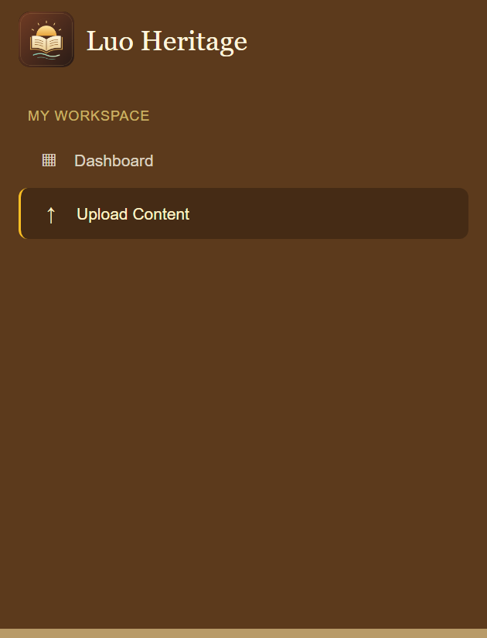
SELF-STUDY / UPLOADERS
Open your uploading workspace
1
Sign in using the account supplied to you. Open the admin
dashboard.
2
Choose Upload Content. Work only in the language assigned to
you.
3
If no collection can be created, check your assigned language
with the administrator.
Uploaders normally see Dashboard and Upload Content. Other duties require a separate assignment.
CURRENT INTERFACE • PRACTICE DETAILS
CHECK: Your content list opens for the languages you are allowed to upload.
LUO HERITAGE / UPLOADERS
Contents
50 / 138
Notes:
Open your uploading workspace
1. Sign in using the account supplied to you. Open the admin dashboard.
2. Choose Upload Content. Work only in the language assigned to you.
3. If no collection can be created, check your assigned language with the administrator.
Expected result: Your content list opens for the languages you are allowed to upload.
Important: Uploaders normally see Dashboard and Upload Content. Other duties require a separate assignment.
Screenshot: current application interface rendered with sample details. No live action is demonstrated.

Slide 51
SELF-STUDY / UPLOADERS
Prepare before you upload
1
Check the collection, language, title and file
names before starting.
2
Confirm who supplied the material and
what permission was given. Keep evidence
through the organisation’s approved
process.
3
Use a draft when a meaning, translation or
permission is uncertain. Do not guess.
CURRENT INTERFACE • PRACTICE DETAILS
CHECK: You have the information needed for a useful draft.
LUO HERITAGE / UPLOADERS
Contents
51 / 138
Notes:
Prepare before you upload
1. Check the collection, language, title and file names before starting.
2. Confirm who supplied the material and what permission was given. Keep evidence through the organisation’s approved process.
3. Use a draft when a meaning, translation or permission is uncertain. Do not guess.
Expected result: You have the information needed for a useful draft.
Screenshot: current application interface rendered with sample details. No live action is demonstrated.

Slide 52
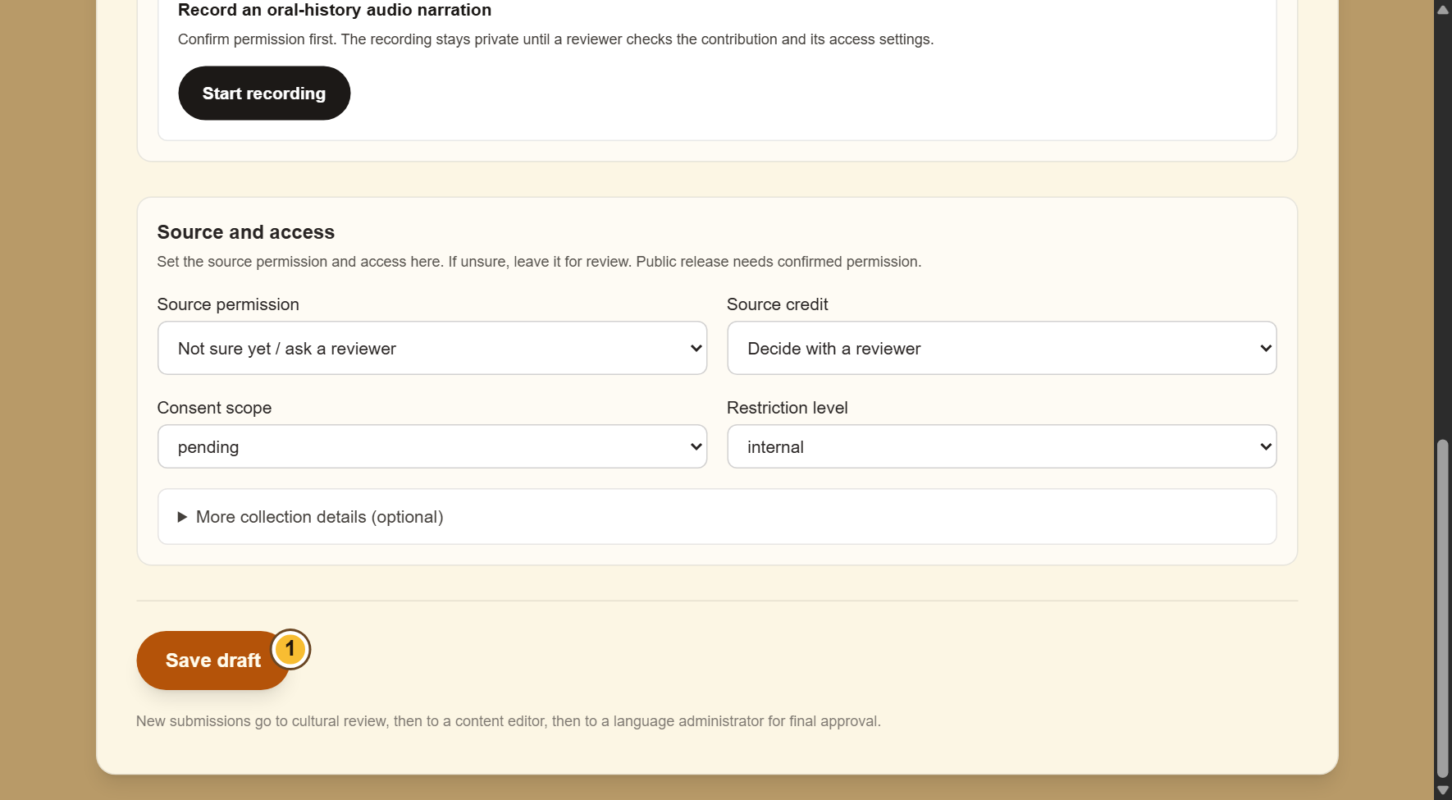
SELF-STUDY / UPLOADERS
Enter the contribution details
1
Open the appropriate new-content form
from Upload Content.
2
Enter the title and all required collection
fields. Read the text again for missing
words.
3
Add a clear description and choose Save
draft. An admin upload is a draft until
submitted for review.
Admin forms use Save draft or Save changes. Community forms use
Save private draft and Submit for reviewer.
CURRENT INTERFACE • PRACTICE DETAILS
CHECK: The online draft appears in your content list.
LUO HERITAGE / UPLOADERS
Contents
52 / 138
Notes:
Enter the contribution details
1. Open the appropriate new-content form from Upload Content.
2. Enter the title and all required collection fields. Read the text again for missing words.
3. Add a clear description and choose Save draft. An admin upload is a draft until submitted for review.
Expected result: The online draft appears in your content list.
Important: Admin forms use Save draft or Save changes. Community forms use Save private draft and Submit for reviewer.
Screenshot: current application interface rendered with sample details. No live action is demonstrated.

Slide 53
SELF-STUDY / UPLOADERS
What the permission labels mean
1
Source permission: has the source agreed
to the proposed use? Choose Not sure yet
when you do not know.
2
Consent scope: what use was agreed?
Public excerpt means an approved public
part; research only and teaching have
different limits.
3
Restriction level: who may see it? Internal
and restricted are not public. Sacred
material needs the collection owner’s
special care.
If the permission record is unclear, keep the item private and ask the
responsible reviewer.
CURRENT INTERFACE • PRACTICE DETAILS
CHECK: You understand the labels before you change them.
LUO HERITAGE / UPLOADERS
Contents
53 / 138
Notes:
What the permission labels mean
1. Source permission: has the source agreed to the proposed use? Choose Not sure yet when you do not know.
2. Consent scope: what use was agreed? Public excerpt means an approved public part; research only and teaching have different limits.
3. Restriction level: who may see it? Internal and restricted are not public. Sacred material needs the collection owner’s special care.
Expected result: You understand the labels before you change them.
Important: If the permission record is unclear, keep the item private and ask the responsible reviewer.
Screenshot: current application interface rendered with sample details. No live action is demonstrated.

Slide 54
SELF-STUDY / UPLOADERS
Add collection details when required
1
Open the extra source or collection details
section.
2
Record the known collection date, source
reference, location and collector. Leave
unknown details for review.
3
Do not put personal phone numbers,
sacred site coordinates or private
participant details in a public description.
CURRENT INTERFACE • PRACTICE DETAILS
CHECK: Reviewers can understand where the material came from without exposing private details.
LUO HERITAGE / UPLOADERS
Contents
54 / 138
Notes:
Add collection details when required
1. Open the extra source or collection details section.
2. Record the known collection date, source reference, location and collector. Leave unknown details for review.
3. Do not put personal phone numbers, sacred site coordinates or private participant details in a public description.
Expected result: Reviewers can understand where the material came from without exposing private details.
Screenshot: current application interface rendered with sample details. No live action is demonstrated.

Slide 55
SELF-STUDY / UPLOADERS
Know where your draft is saved
1
In Upload Content, Save draft or Save
changes saves the item online. Wait for
confirmation and check the list.
2
The community Contribute & submissions
form also offers device copies. That is a
separate route from the admin upload form.
3
A device copy is never submitted
automatically. To send an admin draft, use
Send to cultural review in the online list.
Keep the original file until the online item and its attachments have been
checked.
CURRENT INTERFACE • PRACTICE DETAILS
CHECK: You know which copy is saved and which action sends it for review.
LUO HERITAGE / UPLOADERS
Contents
55 / 138
Notes:
Know where your draft is saved
1. In Upload Content, Save draft or Save changes saves the item online. Wait for confirmation and check the list.
2. The community Contribute & submissions form also offers device copies. That is a separate route from the admin upload form.
3. A device copy is never submitted automatically. To send an admin draft, use Send to cultural review in the online list.
Expected result: You know which copy is saved and which action sends it for review.
Important: Keep the original file until the online item and its attachments have been checked.
Screenshot: current application interface rendered with sample details. No live action is demonstrated.

Slide 56
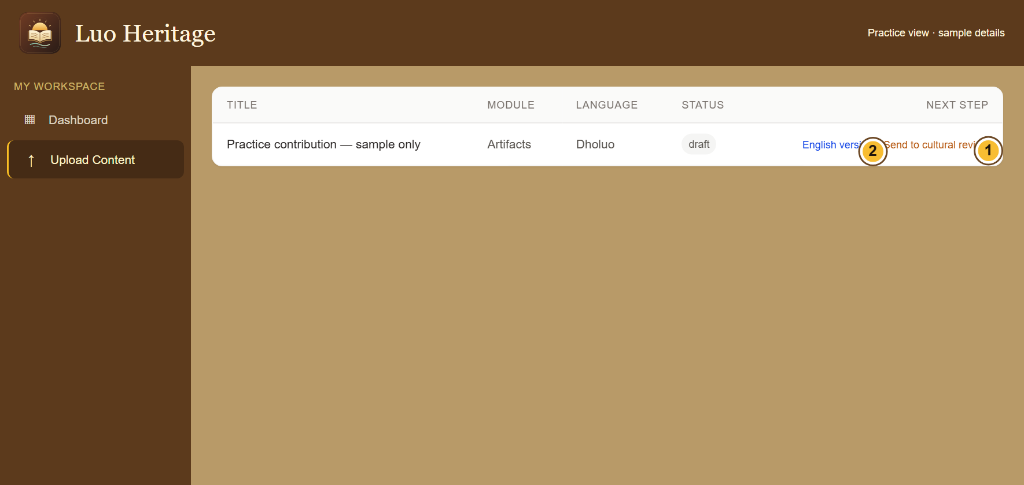
SELF-STUDY / UPLOADERS
Send the online draft for cultural review
1
Return to Upload Content and find the
saved draft.
2
Choose Send to cultural review beside the
intended item. Send it only once.
3
Refresh the list and check its status. You
cannot publish an item using only the
uploader role.
The English version link opens a separate translation. Complete it where
required before review.
CURRENT INTERFACE • PRACTICE DETAILS
CHECK: The draft is marked as submitted or under review.
LUO HERITAGE / UPLOADERS
Contents
56 / 138
Notes:
Send the online draft for cultural review
1. Return to Upload Content and find the saved draft.
2. Choose Send to cultural review beside the intended item. Send it only once.
3. Refresh the list and check its status. You cannot publish an item using only the uploader role.
Expected result: The draft is marked as submitted or under review.
Important: The English version link opens a separate translation. Complete it where required before review.
Screenshot: current application interface rendered with sample details. No live action is demonstrated.

Slide 57
SELF-STUDY / UPLOADERS
Respond to a correction request
1
Find the returned item and read the
reviewer’s notes.
2
Open the editable draft, make only the
necessary corrections and save.
3
Submit the corrected item again or follow
the editor’s handover. Tell the reviewer
what changed.
Editors use Editor Queue. Uploaders use the editable items available in
Upload Content.
CURRENT INTERFACE • PRACTICE DETAILS
CHECK: The corrected version is ready for another independent check.
LUO HERITAGE / UPLOADERS
Contents
57 / 138
Notes:
Respond to a correction request
1. Find the returned item and read the reviewer’s notes.
2. Open the editable draft, make only the necessary corrections and save.
3. Submit the corrected item again or follow the editor’s handover. Tell the reviewer what changed.
Expected result: The corrected version is ready for another independent check.
Important: Editors use Editor Queue. Uploaders use the editable items available in Upload Content.
Screenshot: current application interface rendered with sample details. No live action is demonstrated.

Slide 58
SELF-STUDY / UPLOADERS
Check files before you finish
1
Reopen the saved item and inspect every
attached file.
2
If an upload failed, reconnect and check
whether the text or file was already saved
before retrying.
3
Keep your original source file until the
organisation confirms it is safely stored.
CURRENT INTERFACE • PRACTICE DETAILS
CHECK: The item has the intended files and no accidental duplicate uploads.
LUO HERITAGE / UPLOADERS
Contents
58 / 138
Notes:
Check files before you finish
1. Reopen the saved item and inspect every attached file.
2. If an upload failed, reconnect and check whether the text or file was already saved before retrying.
3. Keep your original source file until the organisation confirms it is safely stored.
Expected result: The item has the intended files and no accidental duplicate uploads.
Screenshot: current application interface rendered with sample details. No live action is demonstrated.

Slide 59
SELF-STUDY / UPLOADERS
Check your skills before working alone
1
Locate your assigned collection and create a private practice draft.
2
Explain the permission setting you would choose when permission is uncertain.
3
Show where you would submit the draft, and explain why you cannot publish it yourself.
Try
→
Check
→
Ask if unsure
Use only approved practice material. Do not publish, delete accounts or change live settings just to practise.
CHECK: You are ready for routine work when you can complete these steps without help.
LUO HERITAGE / UPLOADERS
Contents
59 / 138
Notes:
Check your skills before working alone
1. Locate your assigned collection and create a private practice draft.
2. Explain the permission setting you would choose when permission is uncertain.
3. Show where you would submit the draft, and explain why you cannot publish it yourself.
Expected result: You are ready for routine work when you can complete these steps without help.
Important: Use only approved practice material. Do not publish, delete accounts or change live settings just to practise.

Slide 60
SELF-STUDY / CULTURAL REVIEWERS
Cultural reviewers
1
You will be able to make a clear, independent cultural review decision.
2
Read the common steps on slides 4–19 when you need them. Then follow the tasks in this
section.
3
Use only the duties and language assigned to your own account. Choose Contents at the
bottom of a slide to return to the role list.
Read source
→
Check accuracy
→
Record decision
CHECK: Read a step, try it, and check the result before moving on.
LUO HERITAGE / CULTURAL REVIEWERS
Contents
60 / 138
Notes:
Cultural reviewers
1. You will be able to make a clear, independent cultural review decision.
2. Read the common steps on slides 4–19 when you need them. Then follow the tasks in this section.
3. Use only the duties and language assigned to your own account. Choose Contents at the bottom of a slide to return to the role list.
Expected result: Read a step, try it, and check the result before moving on.

Slide 61
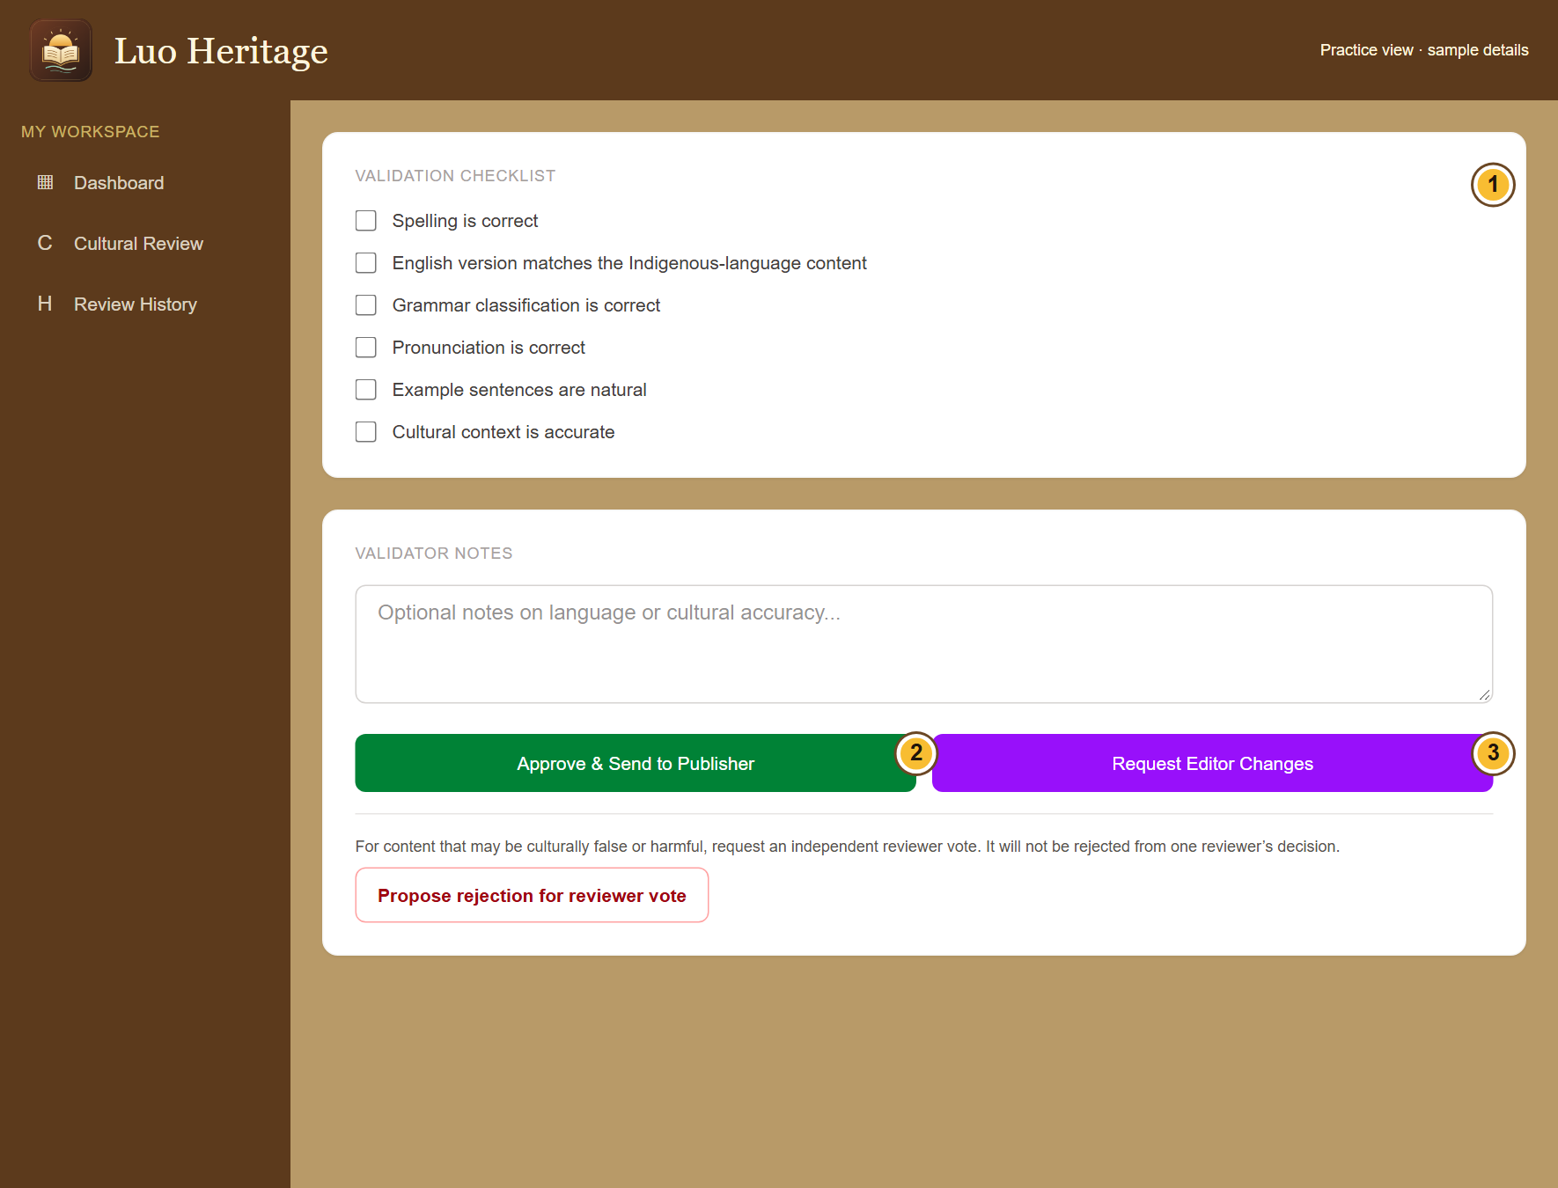
SELF-STUDY / CULTURAL REVIEWERS
Open the right review item
1
Choose Cultural Review in your staff menu.
2
Open a submitted item in your assigned
language. Check that you did not prepare
the material yourself.
3
Read its source, access settings, full text
and attached media before deciding.
An item can change while another reviewer works on it. Refresh if the
system asks you to.
CURRENT INTERFACE • PRACTICE DETAILS
CHECK: You are reviewing the current version of the intended item.
LUO HERITAGE / CULTURAL REVIEWERS
Contents
61 / 138
Notes:
Open the right review item
1. Choose Cultural Review in your staff menu.
2. Open a submitted item in your assigned language. Check that you did not prepare the material yourself.
3. Read its source, access settings, full text and attached media before deciding.
Expected result: You are reviewing the current version of the intended item.
Important: An item can change while another reviewer works on it. Refresh if the system asks you to.
Screenshot: current application interface rendered with sample details. No live action is demonstrated.

Slide 62
SELF-STUDY / CULTURAL REVIEWERS
Complete the cultural checks
1
Open Cultural Review and choose the
item. Read its text, source details and
attached files.
2
Check spelling, translation, grammar,
pronunciation, examples and cultural
context. Tick only what you have checked.
3
Add useful notes. If the item is correct,
choose Approve & Send to Publisher.
If you cannot check a recording or meaning, ask for help rather than
ticking the box.
CURRENT INTERFACE • PRACTICE DETAILS
CHECK: The item moves to the publisher queue after a successful cultural review.
LUO HERITAGE / CULTURAL REVIEWERS
Contents
62 / 138
Notes:
Complete the cultural checks
1. Open Cultural Review and choose the item. Read its text, source details and attached files.
2. Check spelling, translation, grammar, pronunciation, examples and cultural context. Tick only what you have checked.
3. Add useful notes. If the item is correct, choose Approve & Send to Publisher.
Expected result: The item moves to the publisher queue after a successful cultural review.
Important: If you cannot check a recording or meaning, ask for help rather than ticking the box.
Screenshot: current application interface rendered with sample details. No live action is demonstrated.

Slide 63
SELF-STUDY / CULTURAL REVIEWERS
What the permission labels mean
1
Source permission: has the source agreed
to the proposed use? Choose Not sure yet
when you do not know.
2
Consent scope: what use was agreed?
Public excerpt means an approved public
part; research only and teaching have
different limits.
3
Restriction level: who may see it? Internal
and restricted are not public. Sacred
material needs the collection owner’s
special care.
If the permission record is unclear, keep the item private and ask the
responsible reviewer.
CURRENT INTERFACE • PRACTICE DETAILS
CHECK: You understand the labels before you change them.
LUO HERITAGE / CULTURAL REVIEWERS
Contents
63 / 138
Notes:
What the permission labels mean
1. Source permission: has the source agreed to the proposed use? Choose Not sure yet when you do not know.
2. Consent scope: what use was agreed? Public excerpt means an approved public part; research only and teaching have different limits.
3. Restriction level: who may see it? Internal and restricted are not public. Sacred material needs the collection owner’s special care.
Expected result: You understand the labels before you change them.
Important: If the permission record is unclear, keep the item private and ask the responsible reviewer.
Screenshot: current application interface rendered with sample details. No live action is demonstrated.

Slide 64
SELF-STUDY / CULTURAL REVIEWERS
Request an editor’s correction
1
Describe the problem in the notes: say
where it is, why it matters and what needs
checking.
2
Choose Request Editor Changes when a
correction is needed.
3
The editor fixes the draft and sends it back
to cultural review. Check the corrected
version again.
Write useful comments such as “Check the meaning in paragraph two,”
rather than “Wrong.”
CURRENT INTERFACE • PRACTICE DETAILS
CHECK: The editor receives a clear change request; the item is not published.
LUO HERITAGE / CULTURAL REVIEWERS
Contents
64 / 138
Notes:
Request an editor’s correction
1. Describe the problem in the notes: say where it is, why it matters and what needs checking.
2. Choose Request Editor Changes when a correction is needed.
3. The editor fixes the draft and sends it back to cultural review. Check the corrected version again.
Expected result: The editor receives a clear change request; the item is not published.
Important: Write useful comments such as “Check the meaning in paragraph two,” rather than “Wrong.”
Screenshot: current application interface rendered with sample details. No live action is demonstrated.

Slide 65
SELF-STUDY / CULTURAL REVIEWERS
Raise a serious cultural concern
1
If material may be culturally false or
harmful, explain your concern in the notes.
2
Choose Propose rejection for reviewer
vote. This asks other assigned reviewers to
check it.
3
Do not treat your proposal as a completed
rejection. Wait for the required independent
votes.
For a serious privacy problem, also contact the responsible administrator
promptly.
CURRENT INTERFACE • PRACTICE DETAILS
CHECK: The concern goes to an independent review vote.
LUO HERITAGE / CULTURAL REVIEWERS
Contents
65 / 138
Notes:
Raise a serious cultural concern
1. If material may be culturally false or harmful, explain your concern in the notes.
2. Choose Propose rejection for reviewer vote. This asks other assigned reviewers to check it.
3. Do not treat your proposal as a completed rejection. Wait for the required independent votes.
Expected result: The concern goes to an independent review vote.
Important: For a serious privacy problem, also contact the responsible administrator promptly.
Screenshot: current application interface rendered with sample details. No live action is demonstrated.

Slide 66
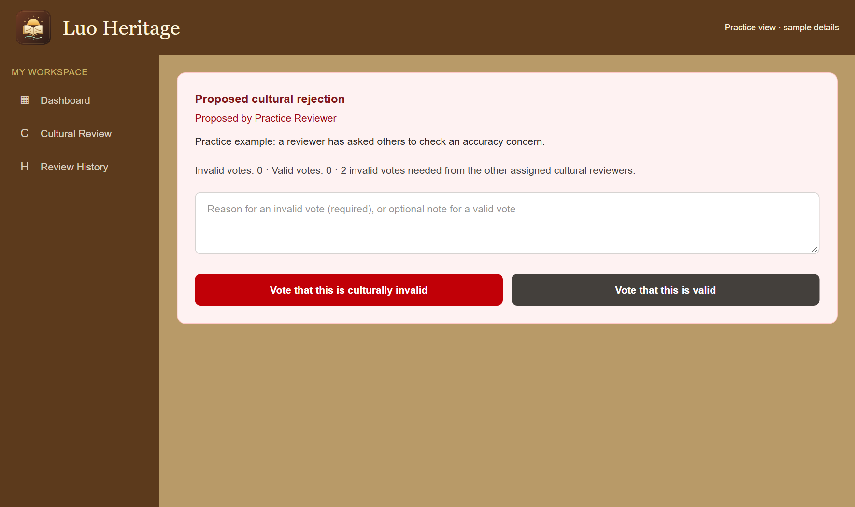
SELF-STUDY / CULTURAL REVIEWERS
Vote on another reviewer’s proposal
1
Open the proposed cultural rejection. Read
the reason and the original source.
2
If you are eligible, choose whether the item
is culturally valid or invalid. Give a clear
reason for an invalid vote.
3
Check the confirmation and vote count.
You cannot vote on your own proposal or
vote twice.
CURRENT INTERFACE • PRACTICE DETAILS
CHECK: Your independent vote is recorded. The system applies the required threshold.
LUO HERITAGE / CULTURAL REVIEWERS
Contents
66 / 138
Notes:
Vote on another reviewer’s proposal
1. Open the proposed cultural rejection. Read the reason and the original source.
2. If you are eligible, choose whether the item is culturally valid or invalid. Give a clear reason for an invalid vote.
3. Check the confirmation and vote count. You cannot vote on your own proposal or vote twice.
Expected result: Your independent vote is recorded. The system applies the required threshold.
Screenshot: current application interface rendered with sample details. No live action is demonstrated.

Slide 67
SELF-STUDY / CULTURAL REVIEWERS
Keep a useful review history
1
Open Review History to find your recorded
actions.
2
Use the item’s title and review notes when
explaining a decision to an editor or
coordinator.
3
If an error is found later, report it with the
item reference rather than editing history or
concealing the earlier decision.
CURRENT INTERFACE • PRACTICE DETAILS
CHECK: Other staff can understand how the decision was reached.
LUO HERITAGE / CULTURAL REVIEWERS
Contents
67 / 138
Notes:
Keep a useful review history
1. Open Review History to find your recorded actions.
2. Use the item’s title and review notes when explaining a decision to an editor or coordinator.
3. If an error is found later, report it with the item reference rather than editing history or concealing the earlier decision.
Expected result: Other staff can understand how the decision was reached.
Screenshot: current application interface rendered with sample details. No live action is demonstrated.

Slide 68
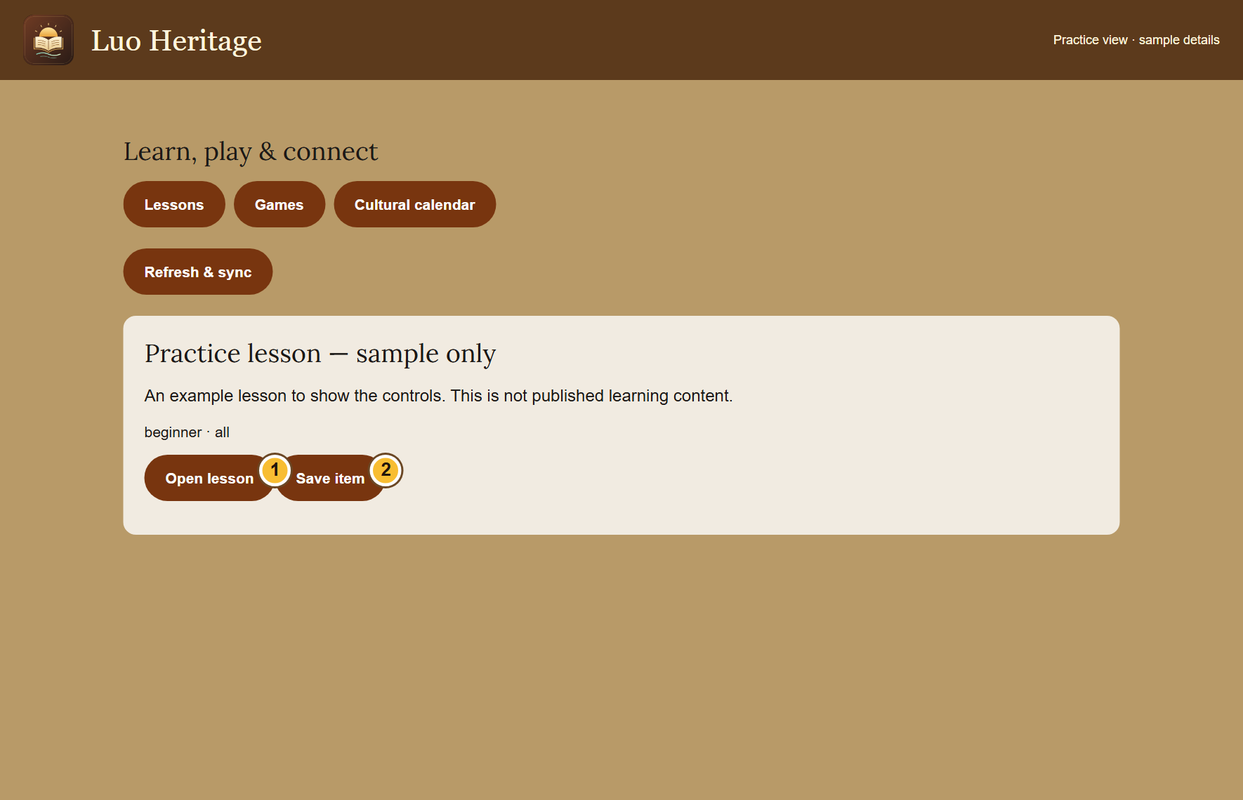
SELF-STUDY / CULTURAL REVIEWERS
Review learning material with the same care
1
Open Lessons, games & calendar if your
role offers the content workspace.
2
Read a submitted lesson, its questions,
answers, source and audience. Use the
review action only if independently
assigned.
3
A course review is separate from reviewing
its individual lessons. Ask the coordinator if
the action is not available.
A role that can review material does not automatically let its author
approve their own work.
CURRENT INTERFACE • PRACTICE DETAILS
CHECK: Learning material receives the appropriate independent checks.
LUO HERITAGE / CULTURAL REVIEWERS
Contents
68 / 138
Notes:
Review learning material with the same care
1. Open Lessons, games & calendar if your role offers the content workspace.
2. Read a submitted lesson, its questions, answers, source and audience. Use the review action only if independently assigned.
3. A course review is separate from reviewing its individual lessons. Ask the coordinator if the action is not available.
Expected result: Learning material receives the appropriate independent checks.
Important: A role that can review material does not automatically let its author approve their own work.
Screenshot: current application interface rendered with sample details. No live action is demonstrated.

Slide 69
SELF-STUDY / CULTURAL REVIEWERS
Check your skills before working alone
1
Explain one checklist item using an approved practice contribution.
2
Describe how to request an editor change and how the item returns to you.
3
Explain why a proposed rejection needs independent votes.
Try
→
Check
→
Ask if unsure
Use only approved practice material. Do not publish, delete accounts or change live settings just to practise.
CHECK: You are ready for routine work when you can complete these steps without help.
LUO HERITAGE / CULTURAL REVIEWERS
Contents
69 / 138
Notes:
Check your skills before working alone
1. Explain one checklist item using an approved practice contribution.
2. Describe how to request an editor change and how the item returns to you.
3. Explain why a proposed rejection needs independent votes.
Expected result: You are ready for routine work when you can complete these steps without help.
Important: Use only approved practice material. Do not publish, delete accounts or change live settings just to practise.

Slide 70
SELF-STUDY / CONTENT EDITORS
Content editors
1
You will be able to correct content without bypassing the review process.
2
Read the common steps on slides 4–19 when you need them. Then follow the tasks in this
section.
3
Use only the duties and language assigned to your own account. Choose Contents at the
bottom of a slide to return to the role list.
Read feedback
→
Correct draft
→
Return for review
CHECK: Read a step, try it, and check the result before moving on.
LUO HERITAGE / CONTENT EDITORS
Contents
70 / 138
Notes:
Content editors
1. You will be able to correct content without bypassing the review process.
2. Read the common steps on slides 4–19 when you need them. Then follow the tasks in this section.
3. Use only the duties and language assigned to your own account. Choose Contents at the bottom of a slide to return to the role list.
Expected result: Read a step, try it, and check the result before moving on.

Slide 71
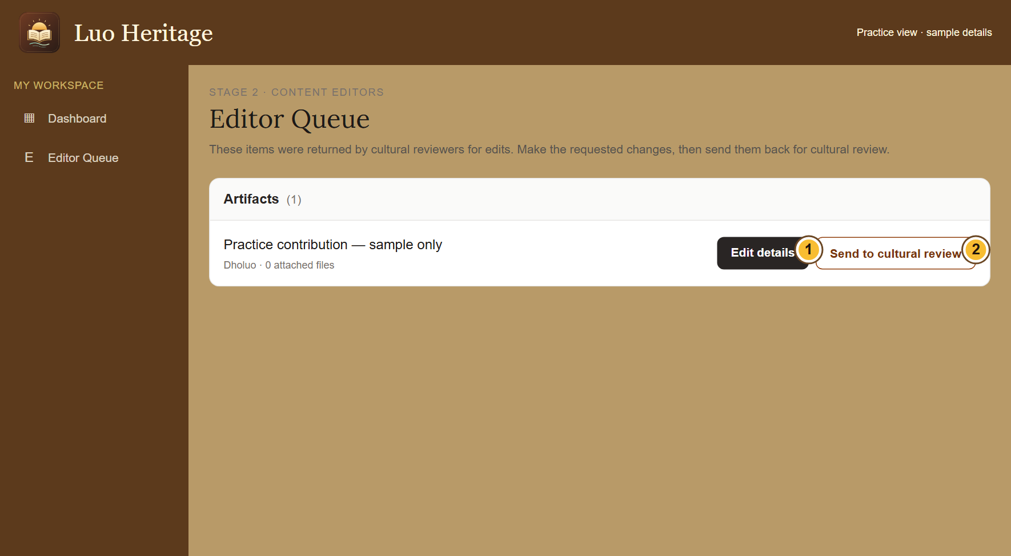
SELF-STUDY / CONTENT EDITORS
Correct an item returned by a reviewer
1
Open Editor Queue. Find the item and
choose Edit details.
2
Read the requested changes. Correct the
text or files, then save your changes.
3
Return to the queue and choose Send to
cultural review. The reviewer must check
the corrected version.
Saving an edit does not publish it. Keep the source’s meaning and credit.
CURRENT INTERFACE • PRACTICE DETAILS
CHECK: The corrected item returns to cultural review.
LUO HERITAGE / CONTENT EDITORS
Contents
71 / 138
Notes:
Correct an item returned by a reviewer
1. Open Editor Queue. Find the item and choose Edit details.
2. Read the requested changes. Correct the text or files, then save your changes.
3. Return to the queue and choose Send to cultural review. The reviewer must check the corrected version.
Expected result: The corrected item returns to cultural review.
Important: Saving an edit does not publish it. Keep the source’s meaning and credit.
Screenshot: current application interface rendered with sample details. No live action is demonstrated.

Slide 72
SELF-STUDY / CONTENT EDITORS
Make a careful edit
1
Read the reviewer’s request before
changing the draft. Keep the original
meaning.
2
Correct spelling, formatting, descriptions
and the requested collection details. Do not
invent missing translations.
3
Save changes, reopen the item and check
that the corrected version is shown.
For a disputed meaning, ask a cultural reviewer rather than silently
replacing it.
CURRENT INTERFACE • PRACTICE DETAILS
CHECK: The saved draft reflects the requested correction.
LUO HERITAGE / CONTENT EDITORS
Contents
72 / 138
Notes:
Make a careful edit
1. Read the reviewer’s request before changing the draft. Keep the original meaning.
2. Correct spelling, formatting, descriptions and the requested collection details. Do not invent missing translations.
3. Save changes, reopen the item and check that the corrected version is shown.
Expected result: The saved draft reflects the requested correction.
Important: For a disputed meaning, ask a cultural reviewer rather than silently replacing it.
Screenshot: current application interface rendered with sample details. No live action is demonstrated.

Slide 73
SELF-STUDY / CONTENT EDITORS
What the permission labels mean
1
Source permission: has the source agreed
to the proposed use? Choose Not sure yet
when you do not know.
2
Consent scope: what use was agreed?
Public excerpt means an approved public
part; research only and teaching have
different limits.
3
Restriction level: who may see it? Internal
and restricted are not public. Sacred
material needs the collection owner’s
special care.
If the permission record is unclear, keep the item private and ask the
responsible reviewer.
CURRENT INTERFACE • PRACTICE DETAILS
CHECK: You understand the labels before you change them.
LUO HERITAGE / CONTENT EDITORS
Contents
73 / 138
Notes:
What the permission labels mean
1. Source permission: has the source agreed to the proposed use? Choose Not sure yet when you do not know.
2. Consent scope: what use was agreed? Public excerpt means an approved public part; research only and teaching have different limits.
3. Restriction level: who may see it? Internal and restricted are not public. Sacred material needs the collection owner’s special care.
Expected result: You understand the labels before you change them.
Important: If the permission record is unclear, keep the item private and ask the responsible reviewer.
Screenshot: current application interface rendered with sample details. No live action is demonstrated.

Slide 74
SELF-STUDY / CONTENT EDITORS
Return the item to the reviewer
1
Go back to Editor Queue after saving your
changes.
2
Choose Send to cultural review beside the
intended item.
3
Read the success message. The item
should leave the editable queue when the
handover succeeds.
If the item has already moved, refresh instead of sending a stale copy.
CURRENT INTERFACE • PRACTICE DETAILS
CHECK: The current corrected version is ready for cultural review.
LUO HERITAGE / CONTENT EDITORS
Contents
74 / 138
Notes:
Return the item to the reviewer
1. Go back to Editor Queue after saving your changes.
2. Choose Send to cultural review beside the intended item.
3. Read the success message. The item should leave the editable queue when the handover succeeds.
Expected result: The current corrected version is ready for cultural review.
Important: If the item has already moved, refresh instead of sending a stale copy.
Screenshot: current application interface rendered with sample details. No live action is demonstrated.

Slide 75
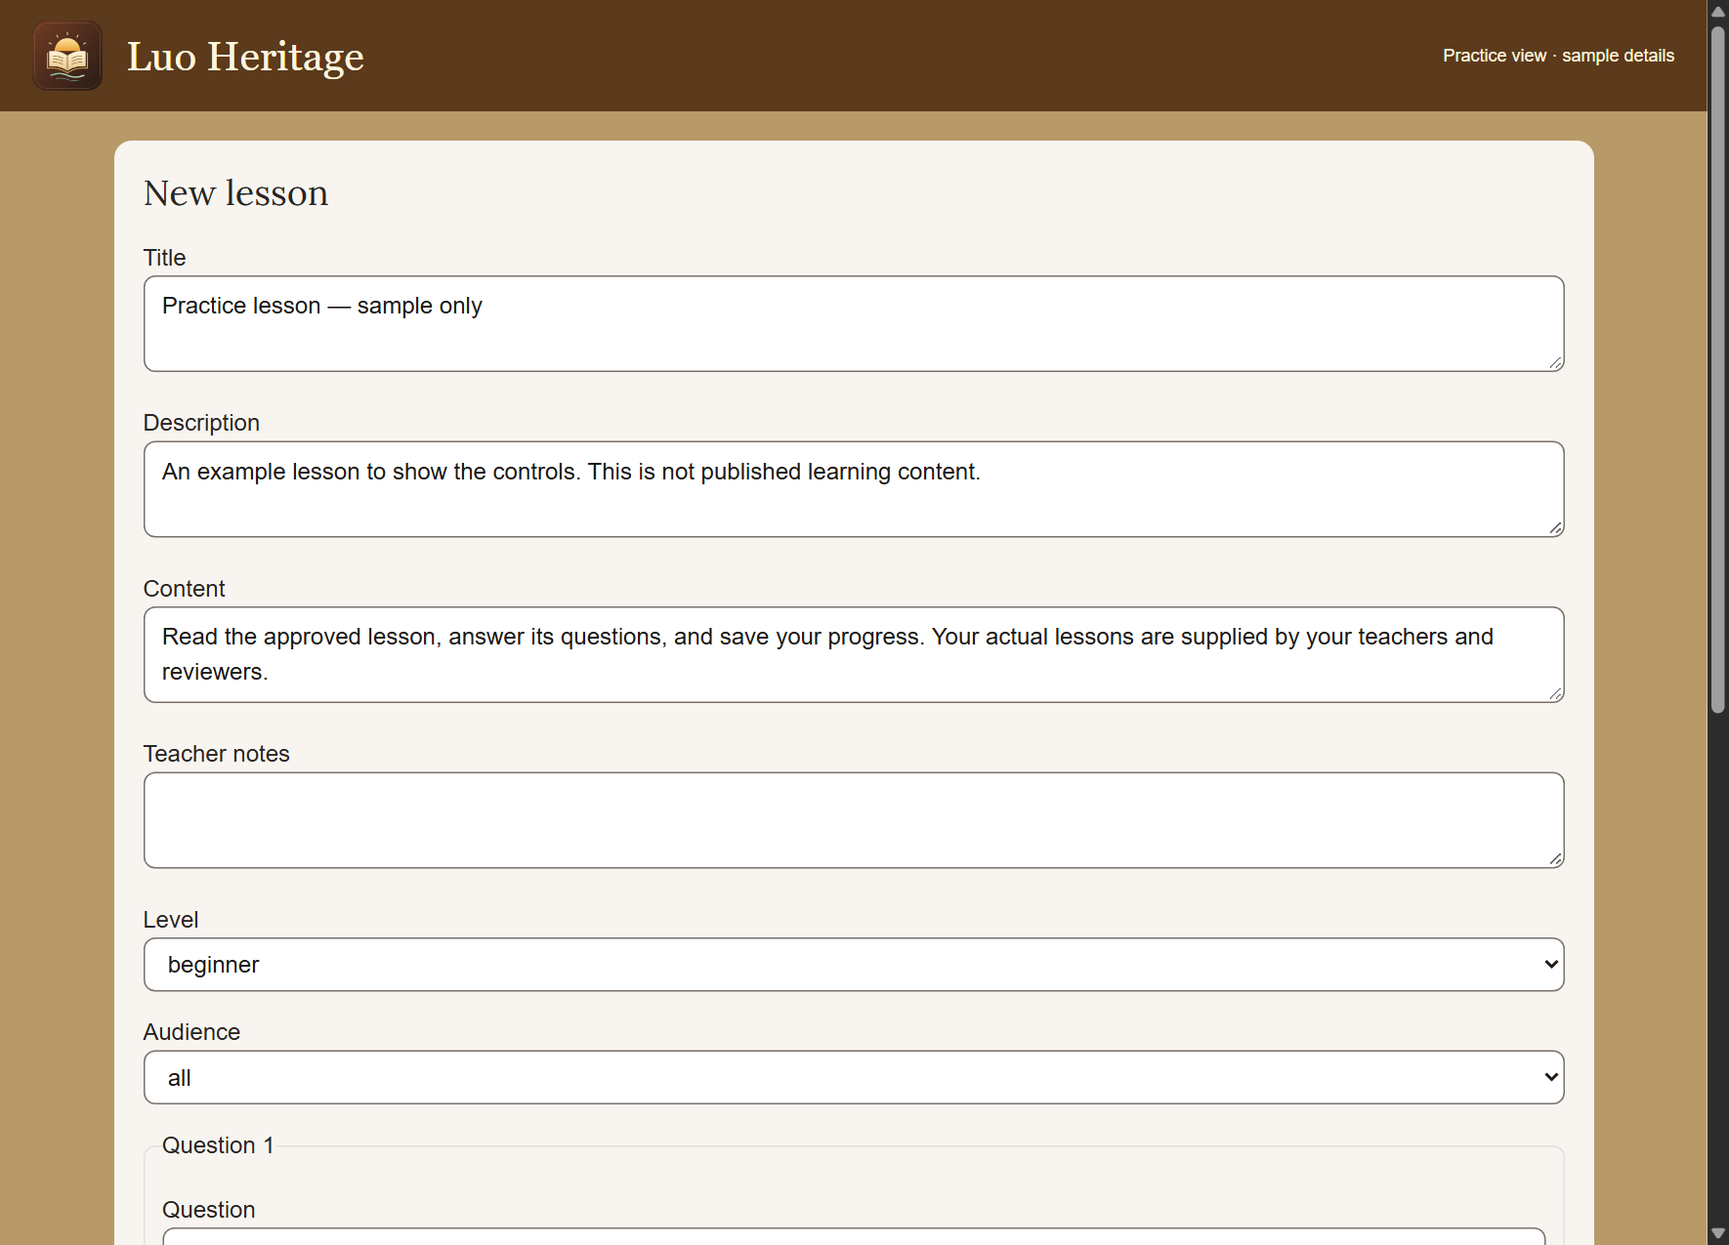
SELF-STUDY / CONTENT EDITORS
Prepare a lesson or game draft
1
Open Lessons, games & calendar and use
Content workspace when offered.
2
Choose Create content. Write the title,
content, level and audience; add checked
questions and answers.
3
Save the private draft and submit for
independent review. Do not approve your
own resource.
A written question game is different from a live multiplayer game.
CURRENT INTERFACE • PRACTICE DETAILS
CHECK: The resource is a draft or submitted item, not automatically public.
LUO HERITAGE / CONTENT EDITORS
Contents
75 / 138
Notes:
Prepare a lesson or game draft
1. Open Lessons, games & calendar and use Content workspace when offered.
2. Choose Create content. Write the title, content, level and audience; add checked questions and answers.
3. Save the private draft and submit for independent review. Do not approve your own resource.
Expected result: The resource is a draft or submitted item, not automatically public.
Important: A written question game is different from a live multiplayer game.
Screenshot: current application interface rendered with sample details. No live action is demonstrated.

Slide 76
SELF-STUDY / CONTENT EDITORS
Build a course from approved lessons
1
Open Learning pathways & courses and
enable Course staff workspace.
2
Choose Create course. Use published
lessons from the same language, place
them in order and set required scores.
3
Save course draft, open it and submit it for
independent course review.
Changing a published course requires another review before publication.
CURRENT INTERFACE • PRACTICE DETAILS
CHECK: The course draft links the intended approved lessons.
LUO HERITAGE / CONTENT EDITORS
Contents
76 / 138
Notes:
Build a course from approved lessons
1. Open Learning pathways & courses and enable Course staff workspace.
2. Choose Create course. Use published lessons from the same language, place them in order and set required scores.
3. Save course draft, open it and submit it for independent course review.
Expected result: The course draft links the intended approved lessons.
Important: Changing a published course requires another review before publication.
Screenshot: current application interface rendered with sample details. No live action is demonstrated.

Slide 77
SELF-STUDY / CONTENT EDITORS
Avoid duplicate or unfinished corrections
1
If saving fails, keep the draft open and
check the connection.
2
Reopen or refresh only after preserving
unsaved text in a trusted place. Check the
current item version.
3
If another person has already changed the
item, read their changes before trying
again.
CURRENT INTERFACE • PRACTICE DETAILS
CHECK: You update the intended current version and avoid overwriting another person’s work.
LUO HERITAGE / CONTENT EDITORS
Contents
77 / 138
Notes:
Avoid duplicate or unfinished corrections
1. If saving fails, keep the draft open and check the connection.
2. Reopen or refresh only after preserving unsaved text in a trusted place. Check the current item version.
3. If another person has already changed the item, read their changes before trying again.
Expected result: You update the intended current version and avoid overwriting another person’s work.
Screenshot: current application interface rendered with sample details. No live action is demonstrated.

Slide 78
SELF-STUDY / CONTENT EDITORS
Check your skills before working alone
1
Find a practice correction and identify the requested change.
2
Save a corrected draft and locate Send to cultural review.
3
Explain why editing, cultural review and publication are separate actions.
Try
→
Check
→
Ask if unsure
Use only approved practice material. Do not publish, delete accounts or change live settings just to practise.
CHECK: You are ready for routine work when you can complete these steps without help.
LUO HERITAGE / CONTENT EDITORS
Contents
78 / 138
Notes:
Check your skills before working alone
1. Find a practice correction and identify the requested change.
2. Save a corrected draft and locate Send to cultural review.
3. Explain why editing, cultural review and publication are separate actions.
Expected result: You are ready for routine work when you can complete these steps without help.
Important: Use only approved practice material. Do not publish, delete accounts or change live settings just to practise.

Slide 79
SELF-STUDY / PUBLISHERS
Publishers
1
You will be able to check a reviewed item and distinguish public release from internal
approval.
2
Read the common steps on slides 4–19 when you need them. Then follow the tasks in this
section.
3
Use only the duties and language assigned to your own account. Choose Contents at the
bottom of a slide to return to the role list.
Check review
→
Check permission
→
Release correctly
CHECK: Read a step, try it, and check the result before moving on.
LUO HERITAGE / PUBLISHERS
Contents
79 / 138
Notes:
Publishers
1. You will be able to check a reviewed item and distinguish public release from internal approval.
2. Read the common steps on slides 4–19 when you need them. Then follow the tasks in this section.
3. Use only the duties and language assigned to your own account. Choose Contents at the bottom of a slide to return to the role list.
Expected result: Read a step, try it, and check the result before moving on.

Slide 80
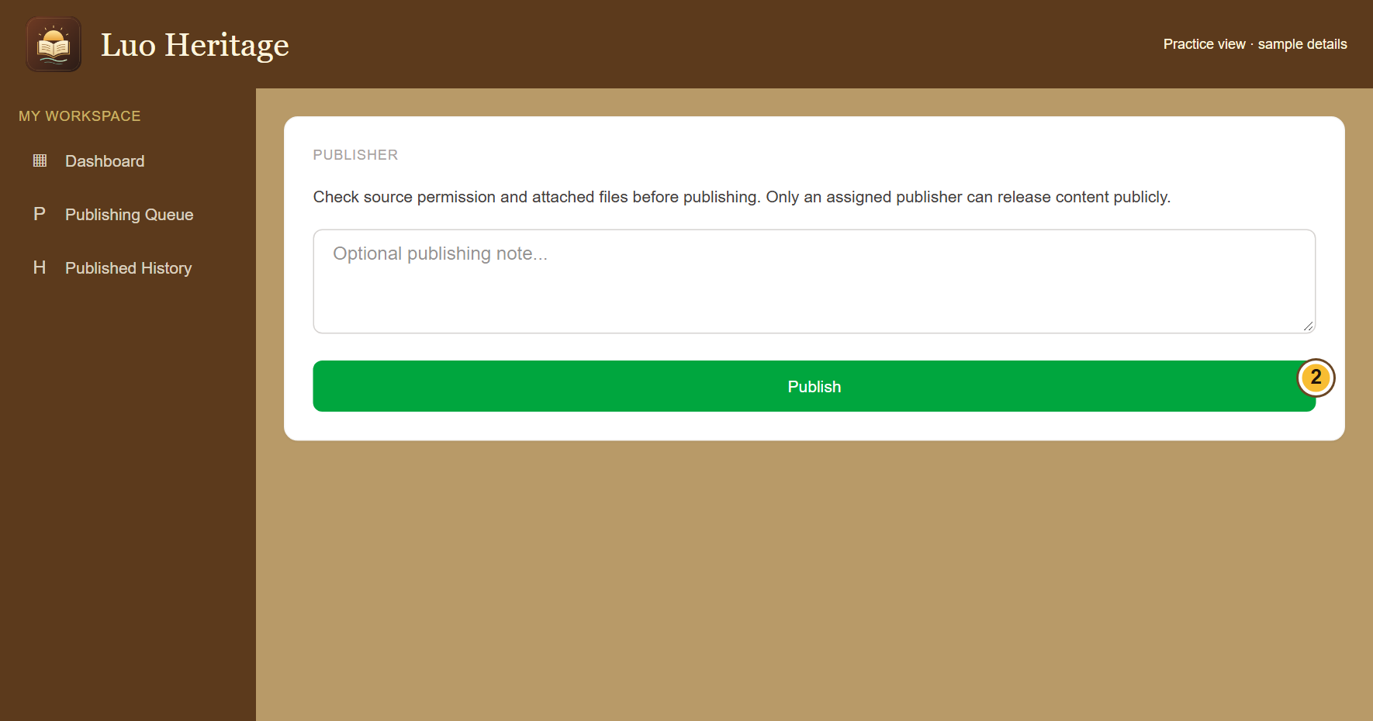
SELF-STUDY / PUBLISHERS
Check carefully before choosing Publish
1
Open Publishing Queue and read the
culturally reviewed item.
2
Check the text, attached files, source
permission and public access settings. Add
a note if needed.
3
Choose Publish only when the item is
ready. Read the confirmation: an internal
approval can remain private.
A Publish button is not permission to release sacred, restricted or
research-only material.
CURRENT INTERFACE • PRACTICE DETAILS
CHECK: Eligible public material becomes available to readers; internal material remains protected.
LUO HERITAGE / PUBLISHERS
Contents
80 / 138
Notes:
Check carefully before choosing Publish
1. Open Publishing Queue and read the culturally reviewed item.
2. Check the text, attached files, source permission and public access settings. Add a note if needed.
3. Choose Publish only when the item is ready. Read the confirmation: an internal approval can remain private.
Expected result: Eligible public material becomes available to readers; internal material remains protected.
Important: A Publish button is not permission to release sacred, restricted or research-only material.
Screenshot: current application interface rendered with sample details. No live action is demonstrated.

Slide 81
SELF-STUDY / PUBLISHERS
What the permission labels mean
1
Source permission: has the source agreed
to the proposed use? Choose Not sure yet
when you do not know.
2
Consent scope: what use was agreed?
Public excerpt means an approved public
part; research only and teaching have
different limits.
3
Restriction level: who may see it? Internal
and restricted are not public. Sacred
material needs the collection owner’s
special care.
If the permission record is unclear, keep the item private and ask the
responsible reviewer.
CURRENT INTERFACE • PRACTICE DETAILS
CHECK: You understand the labels before you change them.
LUO HERITAGE / PUBLISHERS
Contents
81 / 138
Notes:
What the permission labels mean
1. Source permission: has the source agreed to the proposed use? Choose Not sure yet when you do not know.
2. Consent scope: what use was agreed? Public excerpt means an approved public part; research only and teaching have different limits.
3. Restriction level: who may see it? Internal and restricted are not public. Sacred material needs the collection owner’s special care.
Expected result: You understand the labels before you change them.
Important: If the permission record is unclear, keep the item private and ask the responsible reviewer.
Screenshot: current application interface rendered with sample details. No live action is demonstrated.

Slide 82
SELF-STUDY / PUBLISHERS
Use a final pre-publication check
1
Confirm the title, language and current
version are correct and the cultural review
is complete.
2
Open the files and read descriptions,
translations and source credit. Check that
public sharing is actually permitted.
3
If anything is unclear, stop and contact the
reviewer or language administrator before
publishing.
CURRENT INTERFACE • PRACTICE DETAILS
CHECK: The release decision is based on the complete item and its permission evidence.
LUO HERITAGE / PUBLISHERS
Contents
82 / 138
Notes:
Use a final pre-publication check
1. Confirm the title, language and current version are correct and the cultural review is complete.
2. Open the files and read descriptions, translations and source credit. Check that public sharing is actually permitted.
3. If anything is unclear, stop and contact the reviewer or language administrator before publishing.
Expected result: The release decision is based on the complete item and its permission evidence.
Screenshot: current application interface rendered with sample details. No live action is demonstrated.

Slide 83
SELF-STUDY / PUBLISHERS
Understand the confirmation message
1
After choosing Publish, read the full
success message.
2
Public release means eligible readers can
see the item. Internal curation means it
remains private.
3
Do not change consent or access merely to
make an internally approved item appear in
the public library.
CURRENT INTERFACE • PRACTICE DETAILS
CHECK: You know whether the item was publicly released or privately curated.
LUO HERITAGE / PUBLISHERS
Contents
83 / 138
Notes:
Understand the confirmation message
1. After choosing Publish, read the full success message.
2. Public release means eligible readers can see the item. Internal curation means it remains private.
3. Do not change consent or access merely to make an internally approved item appear in the public library.
Expected result: You know whether the item was publicly released or privately curated.
Screenshot: current application interface rendered with sample details. No live action is demonstrated.

Slide 84
SELF-STUDY / PUBLISHERS
Check the reader’s view
1
Open the public library, preferably in a
separate signed-out browser window.
2
Choose the correct collection and content
type. Find the released item and try its
files.
3
If it is missing, confirm the release
message, language, permission and
selected filter before escalating.
Do not test private content by sharing a staff-only link with a member of
the public.
CURRENT INTERFACE • PRACTICE DETAILS
CHECK: The intended public item is readable and its files are usable.
LUO HERITAGE / PUBLISHERS
Contents
84 / 138
Notes:
Check the reader’s view
1. Open the public library, preferably in a separate signed-out browser window.
2. Choose the correct collection and content type. Find the released item and try its files.
3. If it is missing, confirm the release message, language, permission and selected filter before escalating.
Expected result: The intended public item is readable and its files are usable.
Important: Do not test private content by sharing a staff-only link with a member of the public.
Screenshot: current application interface rendered with sample details. No live action is demonstrated.

Slide 85
SELF-STUDY / PUBLISHERS
Keep the publication record
1
Open Published History to find earlier
releases.
2
Record any concern with the item’s title
and reference, and notify the language
administrator.
3
If an urgent rights or privacy issue is found,
request the approved withdrawal process.
Do not assume a saved edit removes a
public item.
CURRENT INTERFACE • PRACTICE DETAILS
CHECK: Publication decisions and later concerns can be traced.
LUO HERITAGE / PUBLISHERS
Contents
85 / 138
Notes:
Keep the publication record
1. Open Published History to find earlier releases.
2. Record any concern with the item’s title and reference, and notify the language administrator.
3. If an urgent rights or privacy issue is found, request the approved withdrawal process. Do not assume a saved edit removes a public item.
Expected result: Publication decisions and later concerns can be traced.
Screenshot: current application interface rendered with sample details. No live action is demonstrated.

Slide 86
SELF-STUDY / PUBLISHERS
Publish lessons and courses separately
1
In the learning content workspace, inspect
validated resources and use publish only
when permitted.
2
For a course, open its staff view and
choose Publish course after independent
review.
3
Confirm that both the course and its linked
lessons are available to the intended
learners.
You cannot independently approve a resource you authored yourself.
CURRENT INTERFACE • PRACTICE DETAILS
CHECK: Learners see a usable course with available lessons.
LUO HERITAGE / PUBLISHERS
Contents
86 / 138
Notes:
Publish lessons and courses separately
1. In the learning content workspace, inspect validated resources and use publish only when permitted.
2. For a course, open its staff view and choose Publish course after independent review.
3. Confirm that both the course and its linked lessons are available to the intended learners.
Expected result: Learners see a usable course with available lessons.
Important: You cannot independently approve a resource you authored yourself.
Screenshot: current application interface rendered with sample details. No live action is demonstrated.

Slide 87
SELF-STUDY / PUBLISHERS
Check your skills before working alone
1
Explain the checks you make before Publish.
2
Distinguish a public release from an internal approval.
3
Find the public collection and explain how you would report an incorrect release.
Try
→
Check
→
Ask if unsure
Use only approved practice material. Do not publish, delete accounts or change live settings just to practise.
CHECK: You are ready for routine work when you can complete these steps without help.
LUO HERITAGE / PUBLISHERS
Contents
87 / 138
Notes:
Check your skills before working alone
1. Explain the checks you make before Publish.
2. Distinguish a public release from an internal approval.
3. Find the public collection and explain how you would report an incorrect release.
Expected result: You are ready for routine work when you can complete these steps without help.
Important: Use only approved practice material. Do not publish, delete accounts or change live settings just to practise.

Slide 88
SELF-STUDY / LANGUAGE ADMINISTRATORS
Language administrators
1
You will be able to manage your language’s work while keeping staff duties clear.
2
Read the common steps on slides 4–19 when you need them. Then follow the tasks in this
section.
3
Use only the duties and language assigned to your own account. Choose Contents at the
bottom of a slide to return to the role list.
Check language
→
Coordinate staff
→
Follow up work
CHECK: Read a step, try it, and check the result before moving on.
LUO HERITAGE / LANGUAGE ADMINISTRATORS
Contents
88 / 138
Notes:
Language administrators
1. You will be able to manage your language’s work while keeping staff duties clear.
2. Read the common steps on slides 4–19 when you need them. Then follow the tasks in this section.
3. Use only the duties and language assigned to your own account. Choose Contents at the bottom of a slide to return to the role list.
Expected result: Read a step, try it, and check the result before moving on.

Slide 89
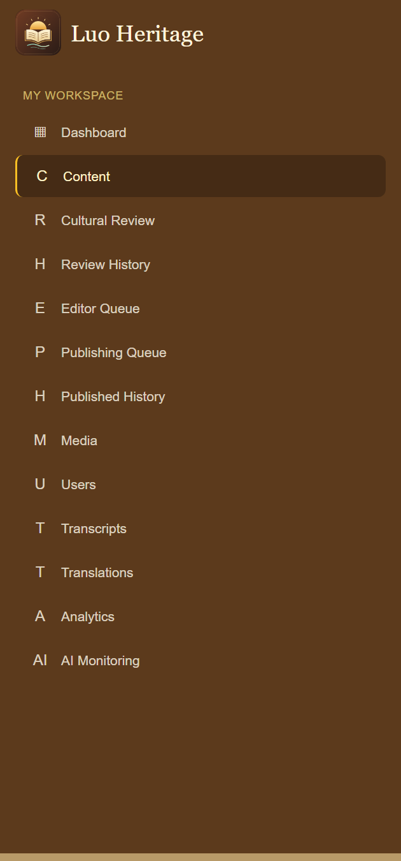
SELF-STUDY / LANGUAGE ADMINISTRATORS
Read your language workspace
1
Open the admin dashboard and confirm the selected language.
2
Use Content, Cultural Review, Editor Queue and Publishing
Queue to find work at each stage.
3
Use Media, Users and Transcripts only for the material and
people in your permitted scope.
CURRENT INTERFACE • PRACTICE DETAILS
CHECK: You can direct a question to the right screen and staff member.
LUO HERITAGE / LANGUAGE ADMINISTRATORS
Contents
89 / 138
Notes:
Read your language workspace
1. Open the admin dashboard and confirm the selected language.
2. Use Content, Cultural Review, Editor Queue and Publishing Queue to find work at each stage.
3. Use Media, Users and Transcripts only for the material and people in your permitted scope.
Expected result: You can direct a question to the right screen and staff member.
Screenshot: current application interface rendered with sample details. No live action is demonstrated.

Slide 90
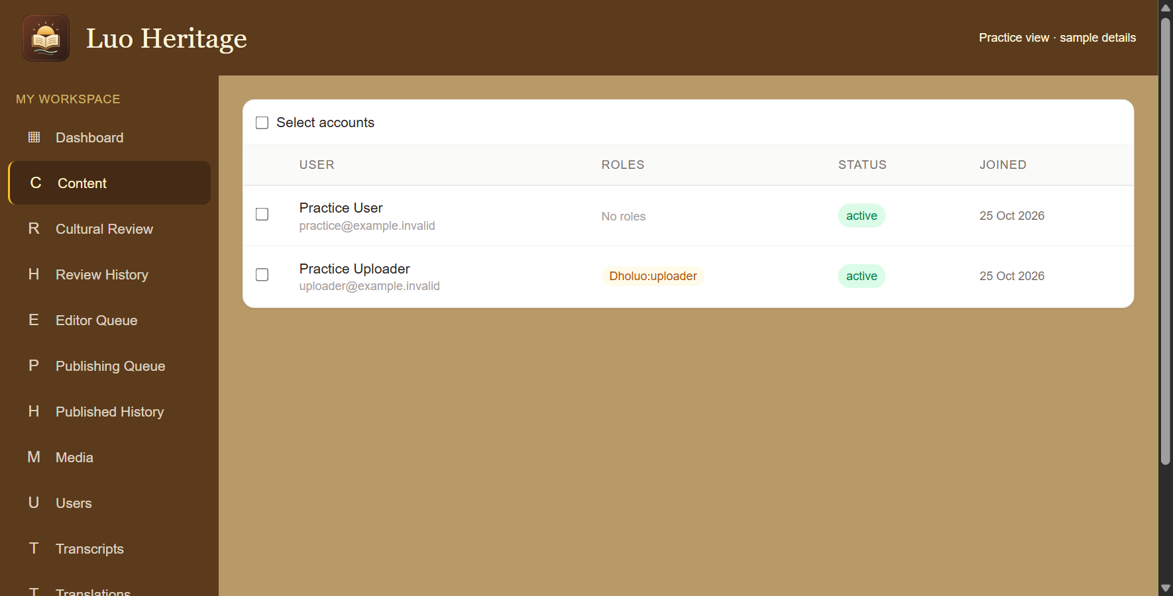
SELF-STUDY / LANGUAGE ADMINISTRATORS
Help users without changing the wrong account
1
Open Users. Find the person by their own
name and email.
2
Open their details and check their
language and current access before
changing anything.
3
Use only the changes allowed by your role.
Read every confirmation before
suspending or activating accounts.
Do not select every account to solve a problem affecting one person.
CURRENT INTERFACE • PRACTICE DETAILS
CHECK: The intended account has the correct status and access.
LUO HERITAGE / LANGUAGE ADMINISTRATORS
Contents
90 / 138
Notes:
Help users without changing the wrong account
1. Open Users. Find the person by their own name and email.
2. Open their details and check their language and current access before changing anything.
3. Use only the changes allowed by your role. Read every confirmation before suspending or activating accounts.
Expected result: The intended account has the correct status and access.
Important: Do not select every account to solve a problem affecting one person.
Screenshot: current application interface rendered with sample details. No live action is demonstrated.

Slide 91
SELF-STUDY / LANGUAGE ADMINISTRATORS
Give a person only the access they need
1
Open the person’s account details and
verify their email.
2
Use the role controls available to you for
your language. If staff creation is not
offered, ask a Super Admin.
3
Confirm the assignment in the person’s
access list and ask them to sign in again if
the menu has not refreshed.
Language access does not allow you to grant Super Admin ownership.
CURRENT INTERFACE • PRACTICE DETAILS
CHECK: The right person can do their assigned task in the intended language.
LUO HERITAGE / LANGUAGE ADMINISTRATORS
Contents
91 / 138
Notes:
Give a person only the access they need
1. Open the person’s account details and verify their email.
2. Use the role controls available to you for your language. If staff creation is not offered, ask a Super Admin.
3. Confirm the assignment in the person’s access list and ask them to sign in again if the menu has not refreshed.
Expected result: The right person can do their assigned task in the intended language.
Important: Language access does not allow you to grant Super Admin ownership.
Screenshot: current application interface rendered with sample details. No live action is demonstrated.

Slide 92
SELF-STUDY / LANGUAGE ADMINISTRATORS
Coordinate a review without skipping stages
1
Check the oldest waiting items and who is
assigned to each stage.
2
Ask the uploader to complete missing
source details, the reviewer to check
accuracy, or the editor to make requested
changes.
3
Keep independent review: broad access
does not make it appropriate to approve
your own submission.
CURRENT INTERFACE • PRACTICE DETAILS
CHECK: Work moves through the intended people and checks.
LUO HERITAGE / LANGUAGE ADMINISTRATORS
Contents
92 / 138
Notes:
Coordinate a review without skipping stages
1. Check the oldest waiting items and who is assigned to each stage.
2. Ask the uploader to complete missing source details, the reviewer to check accuracy, or the editor to make requested changes.
3. Keep independent review: broad access does not make it appropriate to approve your own submission.
Expected result: Work moves through the intended people and checks.
Screenshot: current application interface rendered with sample details. No live action is demonstrated.

Slide 93
SELF-STUDY / LANGUAGE ADMINISTRATORS
Complete the cultural checks
1
Open Cultural Review and choose the
item. Read its text, source details and
attached files.
2
Check spelling, translation, grammar,
pronunciation, examples and cultural
context. Tick only what you have checked.
3
Add useful notes. If the item is correct,
choose Approve & Send to Publisher.
If you cannot check a recording or meaning, ask for help rather than
ticking the box.
CURRENT INTERFACE • PRACTICE DETAILS
CHECK: The item moves to the publisher queue after a successful cultural review.
LUO HERITAGE / LANGUAGE ADMINISTRATORS
Contents
93 / 138
Notes:
Complete the cultural checks
1. Open Cultural Review and choose the item. Read its text, source details and attached files.
2. Check spelling, translation, grammar, pronunciation, examples and cultural context. Tick only what you have checked.
3. Add useful notes. If the item is correct, choose Approve & Send to Publisher.
Expected result: The item moves to the publisher queue after a successful cultural review.
Important: If you cannot check a recording or meaning, ask for help rather than ticking the box.
Screenshot: current application interface rendered with sample details. No live action is demonstrated.

Slide 94
SELF-STUDY / LANGUAGE ADMINISTRATORS
Correct an item returned by a reviewer
1
Open Editor Queue. Find the item and
choose Edit details.
2
Read the requested changes. Correct the
text or files, then save your changes.
3
Return to the queue and choose Send to
cultural review. The reviewer must check
the corrected version.
Saving an edit does not publish it. Keep the source’s meaning and credit.
CURRENT INTERFACE • PRACTICE DETAILS
CHECK: The corrected item returns to cultural review.
LUO HERITAGE / LANGUAGE ADMINISTRATORS
Contents
94 / 138
Notes:
Correct an item returned by a reviewer
1. Open Editor Queue. Find the item and choose Edit details.
2. Read the requested changes. Correct the text or files, then save your changes.
3. Return to the queue and choose Send to cultural review. The reviewer must check the corrected version.
Expected result: The corrected item returns to cultural review.
Important: Saving an edit does not publish it. Keep the source’s meaning and credit.
Screenshot: current application interface rendered with sample details. No live action is demonstrated.

Slide 95
SELF-STUDY / LANGUAGE ADMINISTRATORS
Check carefully before choosing Publish
1
Open Publishing Queue and read the
culturally reviewed item.
2
Check the text, attached files, source
permission and public access settings. Add
a note if needed.
3
Choose Publish only when the item is
ready. Read the confirmation: an internal
approval can remain private.
A Publish button is not permission to release sacred, restricted or
research-only material.
CURRENT INTERFACE • PRACTICE DETAILS
CHECK: Eligible public material becomes available to readers; internal material remains protected.
LUO HERITAGE / LANGUAGE ADMINISTRATORS
Contents
95 / 138
Notes:
Check carefully before choosing Publish
1. Open Publishing Queue and read the culturally reviewed item.
2. Check the text, attached files, source permission and public access settings. Add a note if needed.
3. Choose Publish only when the item is ready. Read the confirmation: an internal approval can remain private.
Expected result: Eligible public material becomes available to readers; internal material remains protected.
Important: A Publish button is not permission to release sacred, restricted or research-only material.
Screenshot: current application interface rendered with sample details. No live action is demonstrated.

Slide 96
SELF-STUDY / LANGUAGE ADMINISTRATORS
Check media and translation quality
1
Open Media and the relevant content item.
Check files, labels and access settings.
2
Use Translations to review the language
labels and available translations. Missing
text needs a checked translation.
3
Ask the responsible content editor or
reviewer to correct inaccurate material.
CURRENT INTERFACE • PRACTICE DETAILS
CHECK: The collection is usable in the intended language without misleading labels.
LUO HERITAGE / LANGUAGE ADMINISTRATORS
Contents
96 / 138
Notes:
Check media and translation quality
1. Open Media and the relevant content item. Check files, labels and access settings.
2. Use Translations to review the language labels and available translations. Missing text needs a checked translation.
3. Ask the responsible content editor or reviewer to correct inaccurate material.
Expected result: The collection is usable in the intended language without misleading labels.
Screenshot: current application interface rendered with sample details. No live action is demonstrated.

Slide 97
SELF-STUDY / LANGUAGE ADMINISTRATORS
Handle teaching access and learning content
1
Confirm that a teacher has been given
actual teaching access; an interest on their
profile is not enough.
2
Check that lessons and courses are
published only after independent review.
3
Ask teachers to handle class membership,
assignments and gradebooks within their
classes.
CURRENT INTERFACE • PRACTICE DETAILS
CHECK: Teachers can use the right classes and learners can open approved lessons.
LUO HERITAGE / LANGUAGE ADMINISTRATORS
Contents
97 / 138
Notes:
Handle teaching access and learning content
1. Confirm that a teacher has been given actual teaching access; an interest on their profile is not enough.
2. Check that lessons and courses are published only after independent review.
3. Ask teachers to handle class membership, assignments and gradebooks within their classes.
Expected result: Teachers can use the right classes and learners can open approved lessons.
Screenshot: current application interface rendered with sample details. No live action is demonstrated.

Slide 98
SELF-STUDY / LANGUAGE ADMINISTRATORS
Read activity and AI reports carefully
1
Open Analytics for the activity recorded by the system.
2
Use AI Monitoring to review recorded questions, feedback and
concerns within your allowed access.
3
Treat low counts as a reason to investigate usage, not as proof
of a technical fault. Escalate private-data or accuracy concerns.
CURRENT INTERFACE • PRACTICE DETAILS
CHECK: You can explain recorded activity without inventing missing results.
LUO HERITAGE / LANGUAGE ADMINISTRATORS
Contents
98 / 138
Notes:
Read activity and AI reports carefully
1. Open Analytics for the activity recorded by the system.
2. Use AI Monitoring to review recorded questions, feedback and concerns within your allowed access.
3. Treat low counts as a reason to investigate usage, not as proof of a technical fault. Escalate private-data or accuracy concerns.
Expected result: You can explain recorded activity without inventing missing results.
Screenshot: current application interface rendered with sample details. No live action is demonstrated.

Slide 99
SELF-STUDY / LANGUAGE ADMINISTRATORS
Handle a permission or privacy complaint
1
Note the affected item and what the person
says is wrong. Avoid copying the private
content into your report.
2
Notify the responsible institutional owner
and arrange the permitted restriction or
withdrawal action.
3
Check that the final public view matches
the decision and retain the review record.
Do not resolve a complaint by silently removing source evidence or
review history.
CURRENT INTERFACE • PRACTICE DETAILS
CHECK: A concern has an owner and a documented response.
LUO HERITAGE / LANGUAGE ADMINISTRATORS
Contents
99 / 138
Notes:
Handle a permission or privacy complaint
1. Note the affected item and what the person says is wrong. Avoid copying the private content into your report.
2. Notify the responsible institutional owner and arrange the permitted restriction or withdrawal action.
3. Check that the final public view matches the decision and retain the review record.
Expected result: A concern has an owner and a documented response.
Important: Do not resolve a complaint by silently removing source evidence or review history.
Screenshot: current application interface rendered with sample details. No live action is demonstrated.

Slide 100
SELF-STUDY / LANGUAGE ADMINISTRATORS
Check your skills before working alone
1
Name the person responsible for each stage of a contribution.
2
Check a practice account’s language and duties without granting extra power.
3
Explain how you would handle a missing teacher button or a privacy complaint.
Try
→
Check
→
Ask if unsure
Use only approved practice material. Do not publish, delete accounts or change live settings just to practise.
CHECK: You are ready for routine work when you can complete these steps without help.
LUO HERITAGE / LANGUAGE ADMINISTRATORS
Contents
100 / 138
Notes:
Check your skills before working alone
1. Name the person responsible for each stage of a contribution.
2. Check a practice account’s language and duties without granting extra power.
3. Explain how you would handle a missing teacher button or a privacy complaint.
Expected result: You are ready for routine work when you can complete these steps without help.
Important: Use only approved practice material. Do not publish, delete accounts or change live settings just to practise.

Slide 101
SELF-STUDY / SUPER ADMINS
Super Admins
1
You will be able to coordinate access and monitor work without confusing oversight with
editorial permission.
2
Read the common steps on slides 4–19 when you need them. Then follow the tasks in this
section.
3
Use only the duties and language assigned to your own account. Choose Contents at the
bottom of a slide to return to the role list.
Oversee languages
→
Support staff
→
Check activity
CHECK: Read a step, try it, and check the result before moving on.
LUO HERITAGE / SUPER ADMINS
Contents
101 / 138
Notes:
Super Admins
1. You will be able to coordinate access and monitor work without confusing oversight with editorial permission.
2. Read the common steps on slides 4–19 when you need them. Then follow the tasks in this section.
3. Use only the duties and language assigned to your own account. Choose Contents at the bottom of a slide to return to the role list.
Expected result: Read a step, try it, and check the result before moving on.

Slide 102
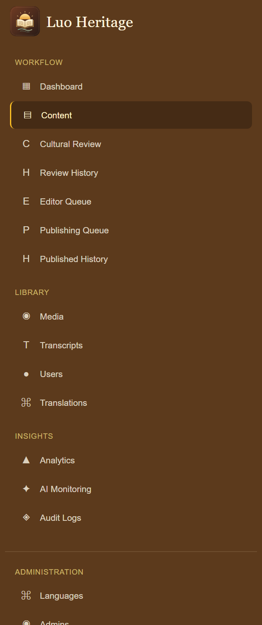
SELF-STUDY / SUPER ADMINS
Understand your wider menu
1
Use Workflow and Library to inspect content, people and
collections.
2
Use Insights to see Analytics, AI Monitoring and Audit Logs.
3
Administration contains Languages, Admins, Backup and
System. Visibility does not mean every action is allowed.
CURRENT INTERFACE • PRACTICE DETAILS
CHECK: You can find the right area without assuming that every visible button is yours to use.
LUO HERITAGE / SUPER ADMINS
Contents
102 / 138
Notes:
Understand your wider menu
1. Use Workflow and Library to inspect content, people and collections.
2. Use Insights to see Analytics, AI Monitoring and Audit Logs.
3. Administration contains Languages, Admins, Backup and System. Visibility does not mean every action is allowed.
Expected result: You can find the right area without assuming that every visible button is yours to use.
Screenshot: current application interface rendered with sample details. No live action is demonstrated.

Slide 103
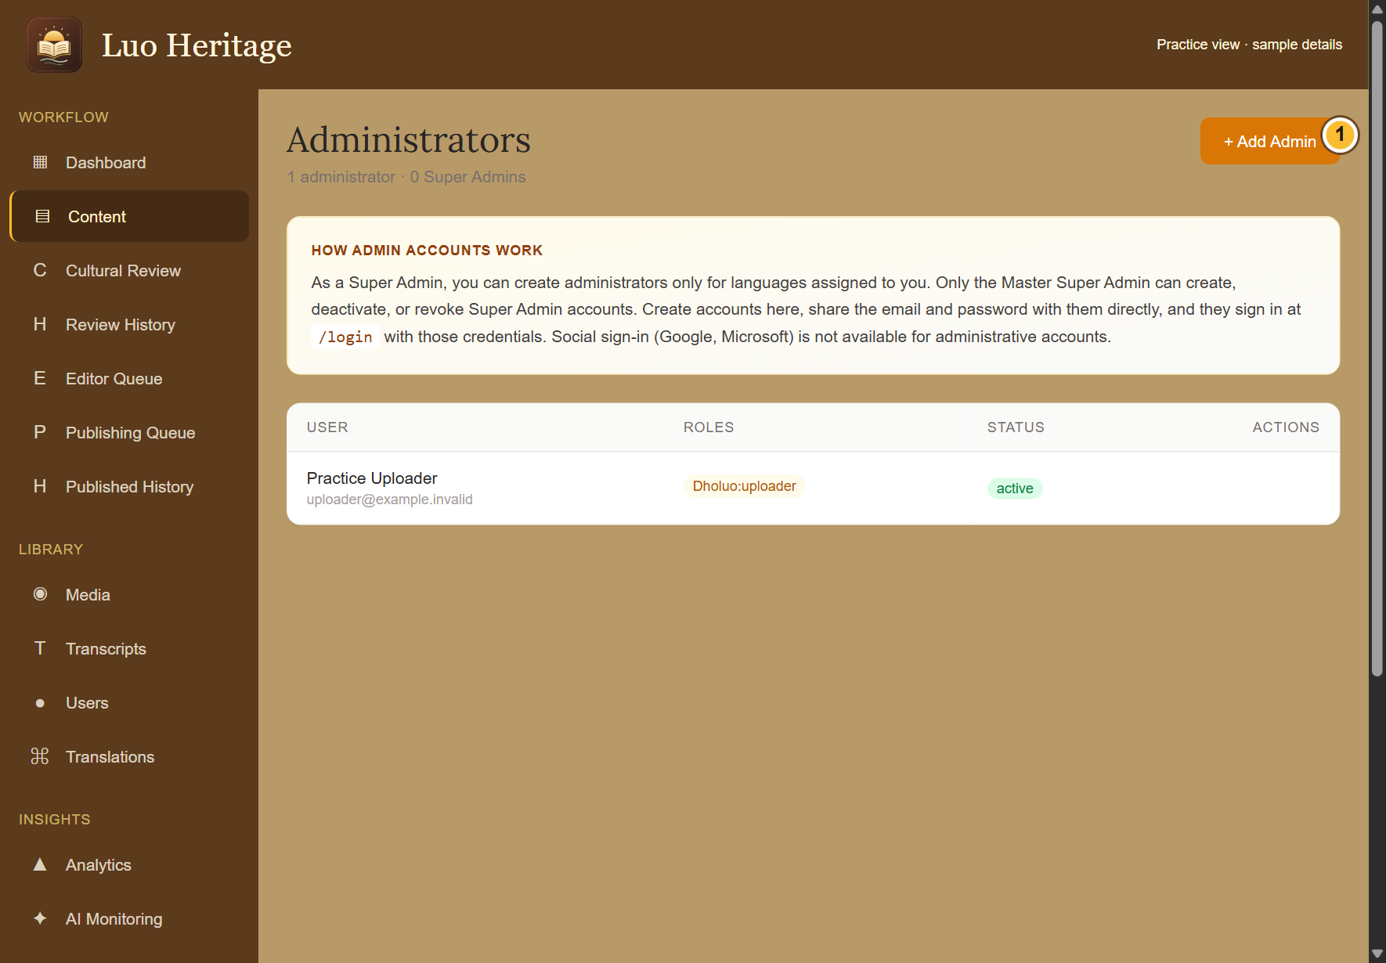
SELF-STUDY / SUPER ADMINS
Know the limits of Super Admin access
1
You oversee the languages assigned to
you and may create permitted staff within
that scope.
2
Editing, cultural review, uploading and
publishing still require their assigned
language duties.
3
Only the Master Super Admin can create or
remove Super Admin authority. Database
backups are also reserved for that owner.
CURRENT INTERFACE • PRACTICE DETAILS
CHECK: You know when to act and when to refer the request to the Master Super Admin.
LUO HERITAGE / SUPER ADMINS
Contents
103 / 138
Notes:
Know the limits of Super Admin access
1. You oversee the languages assigned to you and may create permitted staff within that scope.
2. Editing, cultural review, uploading and publishing still require their assigned language duties.
3. Only the Master Super Admin can create or remove Super Admin authority. Database backups are also reserved for that owner.
Expected result: You know when to act and when to refer the request to the Master Super Admin.
Screenshot: current application interface rendered with sample details. No live action is demonstrated.

Slide 104
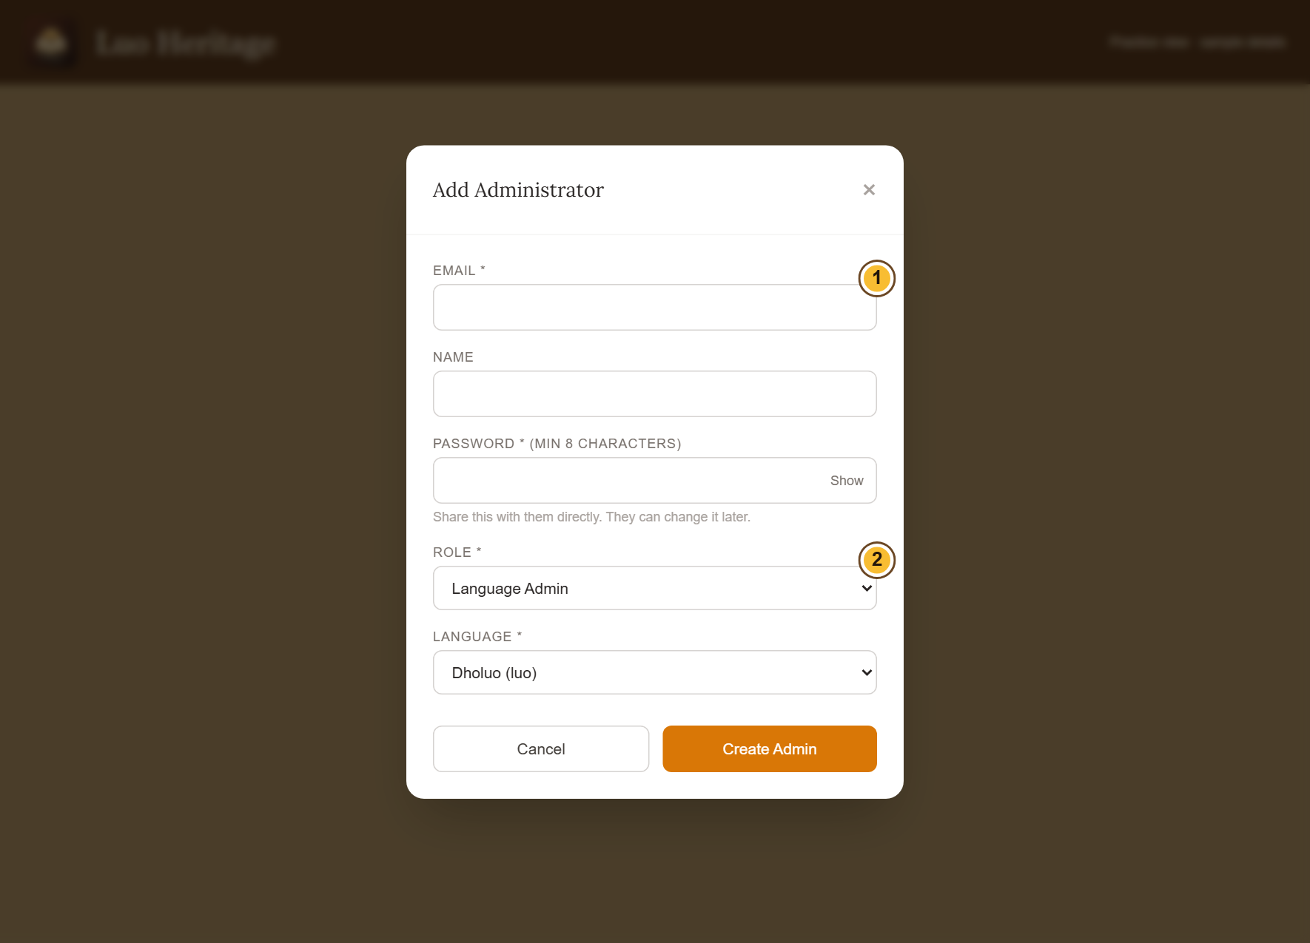
SELF-STUDY / SUPER ADMINS
Create a staff account for the right person
1
Open Admins, then choose + Add Admin.
Confirm the person’s email and name.
2
Choose only the role and language the
person needs. Set a strong temporary
password.
3
Save the account. Share access details
privately with that person and ask them to
set their own password.
Only the Master Super Admin can create or remove Super Admin
authority.
CURRENT INTERFACE • PRACTICE DETAILS
CHECK: The staff member appears in Administrators with the intended role and language.
LUO HERITAGE / SUPER ADMINS
Contents
104 / 138
Notes:
Create a staff account for the right person
1. Open Admins, then choose + Add Admin. Confirm the person’s email and name.
2. Choose only the role and language the person needs. Set a strong temporary password.
3. Save the account. Share access details privately with that person and ask them to set their own password.
Expected result: The staff member appears in Administrators with the intended role and language.
Important: Only the Master Super Admin can create or remove Super Admin authority.
Screenshot: current application interface rendered with sample details. No live action is demonstrated.

Slide 105
SELF-STUDY / SUPER ADMINS
Help users without changing the wrong account
1
Open Users. Find the person by their own
name and email.
2
Open their details and check their
language and current access before
changing anything.
3
Use only the changes allowed by your role.
Read every confirmation before
suspending or activating accounts.
Do not select every account to solve a problem affecting one person.
CURRENT INTERFACE • PRACTICE DETAILS
CHECK: The intended account has the correct status and access.
LUO HERITAGE / SUPER ADMINS
Contents
105 / 138
Notes:
Help users without changing the wrong account
1. Open Users. Find the person by their own name and email.
2. Open their details and check their language and current access before changing anything.
3. Use only the changes allowed by your role. Read every confirmation before suspending or activating accounts.
Expected result: The intended account has the correct status and access.
Important: Do not select every account to solve a problem affecting one person.
Screenshot: current application interface rendered with sample details. No live action is demonstrated.

Slide 106
SELF-STUDY / SUPER ADMINS
Check staff assignments regularly
1
Open Admins and verify each person’s
email, status, language and duty.
2
If a person changes duties, update access
through the permitted controls; do not
share another account.
3
Read every revoke or deactivate
confirmation. Revoking staff duties is
different from deleting the person’s
account.
CURRENT INTERFACE • PRACTICE DETAILS
CHECK: Staff have the access needed for current work and no unnecessary authority.
LUO HERITAGE / SUPER ADMINS
Contents
106 / 138
Notes:
Check staff assignments regularly
1. Open Admins and verify each person’s email, status, language and duty.
2. If a person changes duties, update access through the permitted controls; do not share another account.
3. Read every revoke or deactivate confirmation. Revoking staff duties is different from deleting the person’s account.
Expected result: Staff have the access needed for current work and no unnecessary authority.
Screenshot: current application interface rendered with sample details. No live action is demonstrated.

Slide 107
SELF-STUDY / SUPER ADMINS
Help a user regain access
1
Confirm which email and language they
should be using. Do not ask for their
password.
2
Guide them to Forgotten password? and
the newest email link. Check whether the
account is active.
3
If password emails are not being delivered,
ask the authorised system owner to check
Email settings and the test result.
CURRENT INTERFACE • PRACTICE DETAILS
CHECK: The user receives the right recovery instructions without exposing their credentials.
LUO HERITAGE / SUPER ADMINS
Contents
107 / 138
Notes:
Help a user regain access
1. Confirm which email and language they should be using. Do not ask for their password.
2. Guide them to Forgotten password? and the newest email link. Check whether the account is active.
3. If password emails are not being delivered, ask the authorised system owner to check Email settings and the test result.
Expected result: The user receives the right recovery instructions without exposing their credentials.
Screenshot: current application interface rendered with sample details. No live action is demonstrated.

Slide 108
SELF-STUDY / SUPER ADMINS
Review activity and recorded decisions
1
Use Analytics and AI Monitoring to inspect recorded activity and
feedback.
2
Use Audit Logs to see who changed a record or setting and
when.
3
Investigate unexpected changes with the responsible staff
member. Do not alter evidence to hide a mistake.
CURRENT INTERFACE • PRACTICE DETAILS
CHECK: You can follow a concern to the relevant person and recorded action.
LUO HERITAGE / SUPER ADMINS
Contents
108 / 138
Notes:
Review activity and recorded decisions
1. Use Analytics and AI Monitoring to inspect recorded activity and feedback.
2. Use Audit Logs to see who changed a record or setting and when.
3. Investigate unexpected changes with the responsible staff member. Do not alter evidence to hide a mistake.
Expected result: You can follow a concern to the relevant person and recorded action.
Screenshot: current application interface rendered with sample details. No live action is demonstrated.

Slide 109
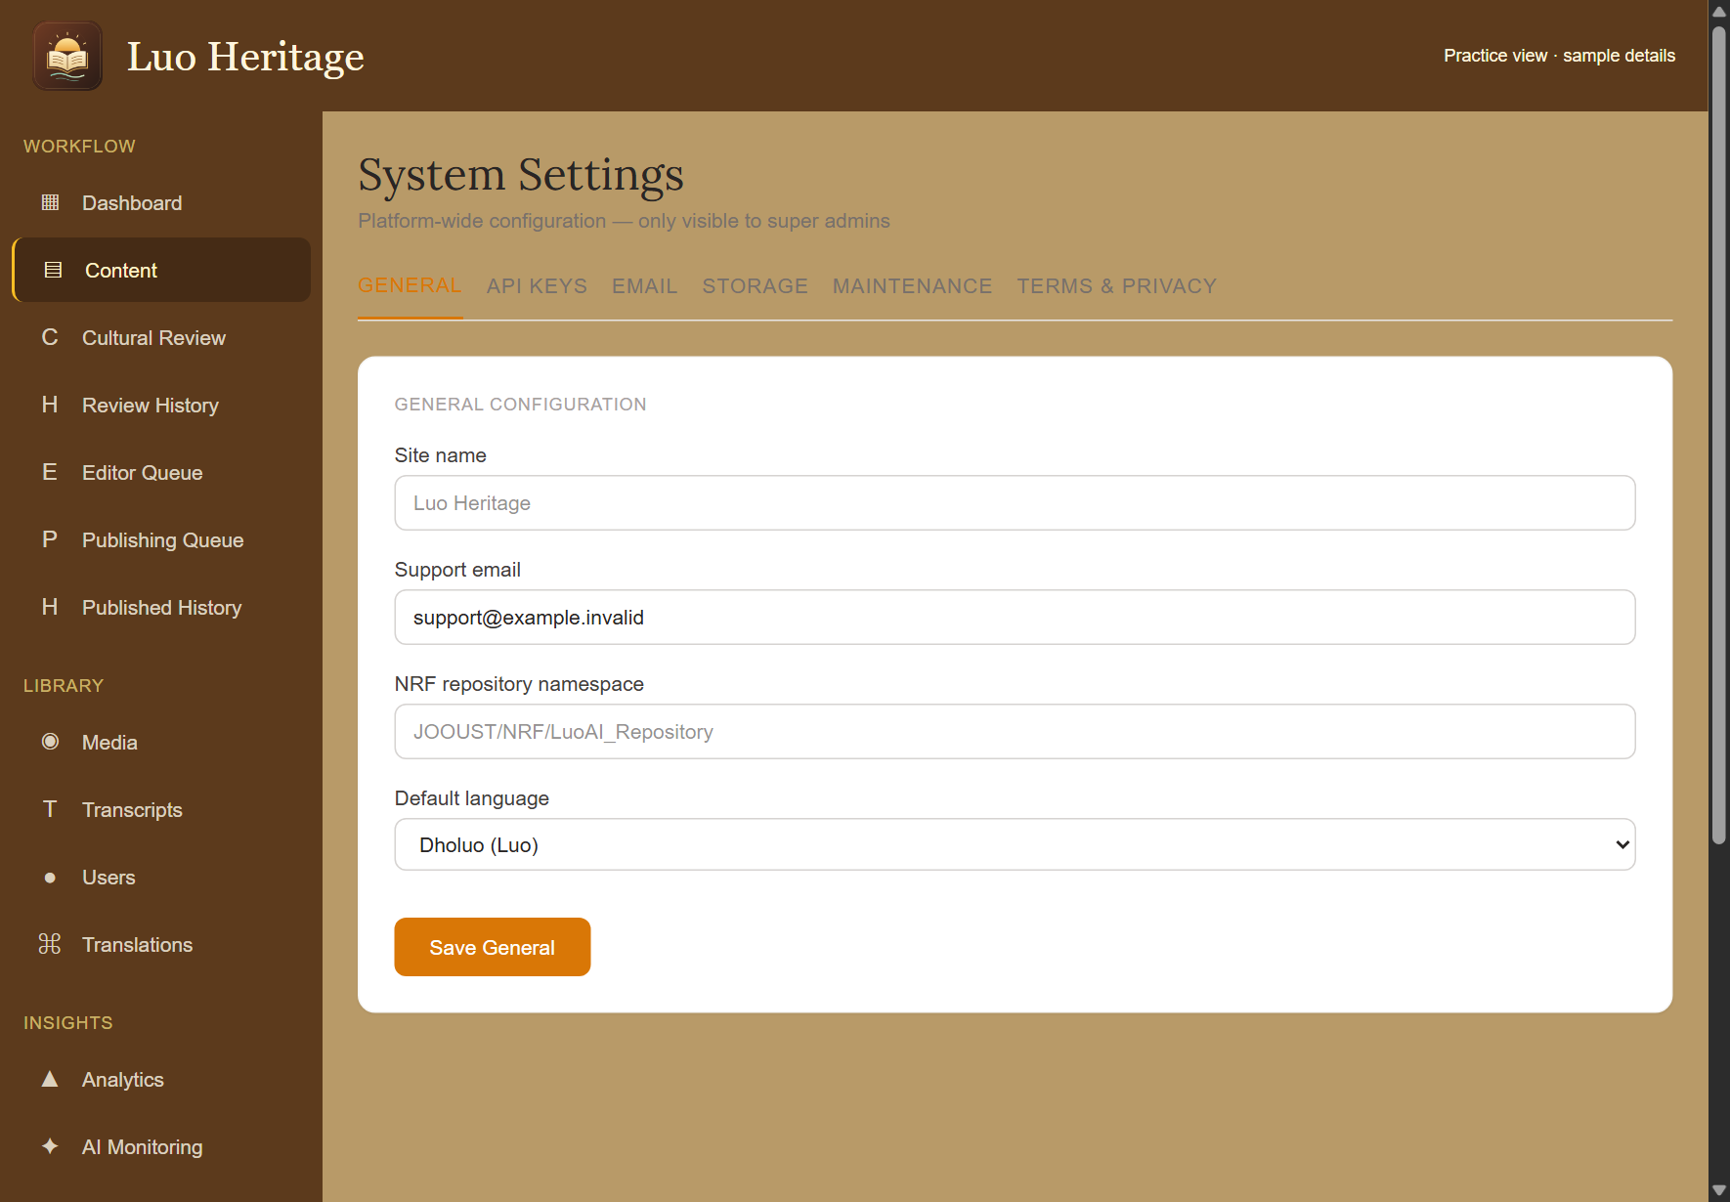
SELF-STUDY / SUPER ADMINS
Use System settings carefully
1
Open System and read the selected tab
before changing anything.
2
Change only a setting you understand and
are authorised to manage. Save the
intended group of settings.
3
Check the result afterwards. For service
keys, backup, legal ownership or an
unavailable control, contact the Master
Super Admin.
Do not include secret service keys in screenshots, slides, email or
support messages.
CURRENT INTERFACE • PRACTICE DETAILS
CHECK: A deliberate saved change has the intended effect.
LUO HERITAGE / SUPER ADMINS
Contents
109 / 138
Notes:
Use System settings carefully
1. Open System and read the selected tab before changing anything.
2. Change only a setting you understand and are authorised to manage. Save the intended group of settings.
3. Check the result afterwards. For service keys, backup, legal ownership or an unavailable control, contact the Master Super Admin.
Expected result: A deliberate saved change has the intended effect.
Important: Do not include secret service keys in screenshots, slides, email or support messages.
Screenshot: current application interface rendered with sample details. No live action is demonstrated.

Slide 110
SELF-STUDY / SUPER ADMINS
Coordinate content and learning concerns
1
Route incomplete uploads to uploaders,
corrections to editors and cultural concerns
to reviewers.
2
Ask the assigned publisher to check
release readiness. Do not bypass the
independent checks.
3
For class work, involve the teacher. Keep
learner results and research material
private.
CURRENT INTERFACE • PRACTICE DETAILS
CHECK: The right person handles the issue without excessive access.
LUO HERITAGE / SUPER ADMINS
Contents
110 / 138
Notes:
Coordinate content and learning concerns
1. Route incomplete uploads to uploaders, corrections to editors and cultural concerns to reviewers.
2. Ask the assigned publisher to check release readiness. Do not bypass the independent checks.
3. For class work, involve the teacher. Keep learner results and research material private.
Expected result: The right person handles the issue without excessive access.
Screenshot: current application interface rendered with sample details. No live action is demonstrated.

Slide 111
SELF-STUDY / SUPER ADMINS
Check your skills before working alone
1
Explain the difference between a Super Admin and the Master Super Admin.
2
Create no live accounts during practice; instead identify the correct role and language in the
form.
3
Find the recovery, monitoring and escalation paths for a reported problem.
Try
→
Check
→
Ask if unsure
Use only approved practice material. Do not publish, delete accounts or change live settings just to practise.
CHECK: You are ready for routine work when you can complete these steps without help.
LUO HERITAGE / SUPER ADMINS
Contents
111 / 138
Notes:
Check your skills before working alone
1. Explain the difference between a Super Admin and the Master Super Admin.
2. Create no live accounts during practice; instead identify the correct role and language in the form.
3. Find the recovery, monitoring and escalation paths for a reported problem.
Expected result: You are ready for routine work when you can complete these steps without help.
Important: Use only approved practice material. Do not publish, delete accounts or change live settings just to practise.

Slide 112
SELF-STUDY / MASTER SUPER ADMIN
Master Super Admin
1
You will be able to oversee high-impact actions, delegate responsibly and keep the platform’s
records safe.
2
Read the common steps on slides 4–19 when you need them. Then follow the tasks in this
section.
3
Use only the duties and language assigned to your own account. Choose Contents at the
bottom of a slide to return to the role list.
Protect ownership
→
Assign access
→
Keep records safe
CHECK: Read a step, try it, and check the result before moving on.
LUO HERITAGE / MASTER SUPER ADMIN
Contents
112 / 138
Notes:
Master Super Admin
1. You will be able to oversee high-impact actions, delegate responsibly and keep the platform’s records safe.
2. Read the common steps on slides 4–19 when you need them. Then follow the tasks in this section.
3. Use only the duties and language assigned to your own account. Choose Contents at the bottom of a slide to return to the role list.
Expected result: Read a step, try it, and check the result before moving on.

Slide 113
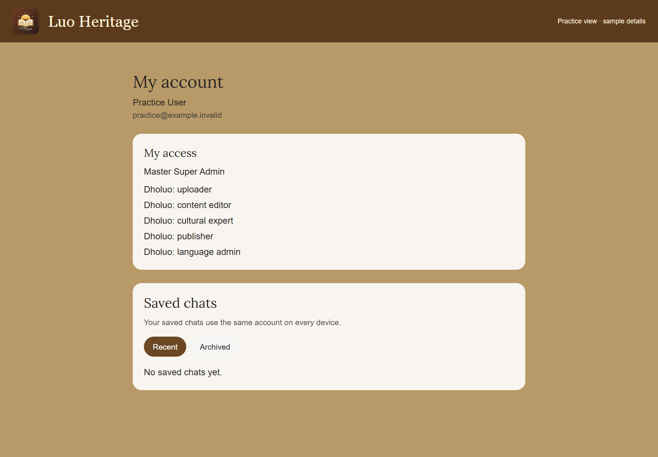
SELF-STUDY / MASTER SUPER ADMIN
Your role carries overall responsibility
1
Use your own protected account. Confirm
My access shows Master Super Admin.
2
Keep the organisation’s ownership, support
arrangements and recovery contact
current.
3
Delegate ordinary work to named staff;
broad access is not a reason to bypass
independent review.
Check My access on your own account; the screenshot uses a labelled
practice account.
CURRENT INTERFACE • PRACTICE DETAILS
CHECK: You know which responsibilities must remain with the institutional owner.
LUO HERITAGE / MASTER SUPER ADMIN
Contents
113 / 138
Notes:
Your role carries overall responsibility
1. Use your own protected account. Confirm My access shows Master Super Admin.
2. Keep the organisation’s ownership, support arrangements and recovery contact current.
3. Delegate ordinary work to named staff; broad access is not a reason to bypass independent review.
Expected result: You know which responsibilities must remain with the institutional owner.
Important: Check My access on your own account; the screenshot uses a labelled practice account.
Screenshot: current application interface rendered with sample details. No live action is demonstrated.

Slide 114
SELF-STUDY / MASTER SUPER ADMIN
Create or change Super Admin authority
1
Open Admins, then + Add Admin to
prepare a new staff account.
2
Select Super Admin only for a trusted
person with an agreed responsibility.
Assign the languages they oversee.
3
Check the saved account carefully. Read
the consequences before revoking or
deactivating a Super Admin.
Never create a shared administrator account for a team.
CURRENT INTERFACE • PRACTICE DETAILS
CHECK: Only the intended person receives the intended authority.
LUO HERITAGE / MASTER SUPER ADMIN
Contents
114 / 138
Notes:
Create or change Super Admin authority
1. Open Admins, then + Add Admin to prepare a new staff account.
2. Select Super Admin only for a trusted person with an agreed responsibility. Assign the languages they oversee.
3. Check the saved account carefully. Read the consequences before revoking or deactivating a Super Admin.
Expected result: Only the intended person receives the intended authority.
Important: Never create a shared administrator account for a team.
Screenshot: current application interface rendered with sample details. No live action is demonstrated.

Slide 115
SELF-STUDY / MASTER SUPER ADMIN
Create a staff account for the right person
1
Open Admins, then choose + Add Admin.
Confirm the person’s email and name.
2
Choose only the role and language the
person needs. Set a strong temporary
password.
3
Save the account. Share access details
privately with that person and ask them to
set their own password.
Only the Master Super Admin can create or remove Super Admin
authority.
CURRENT INTERFACE • PRACTICE DETAILS
CHECK: The staff member appears in Administrators with the intended role and language.
LUO HERITAGE / MASTER SUPER ADMIN
Contents
115 / 138
Notes:
Create a staff account for the right person
1. Open Admins, then choose + Add Admin. Confirm the person’s email and name.
2. Choose only the role and language the person needs. Set a strong temporary password.
3. Save the account. Share access details privately with that person and ask them to set their own password.
Expected result: The staff member appears in Administrators with the intended role and language.
Important: Only the Master Super Admin can create or remove Super Admin authority.
Screenshot: current application interface rendered with sample details. No live action is demonstrated.

Slide 116
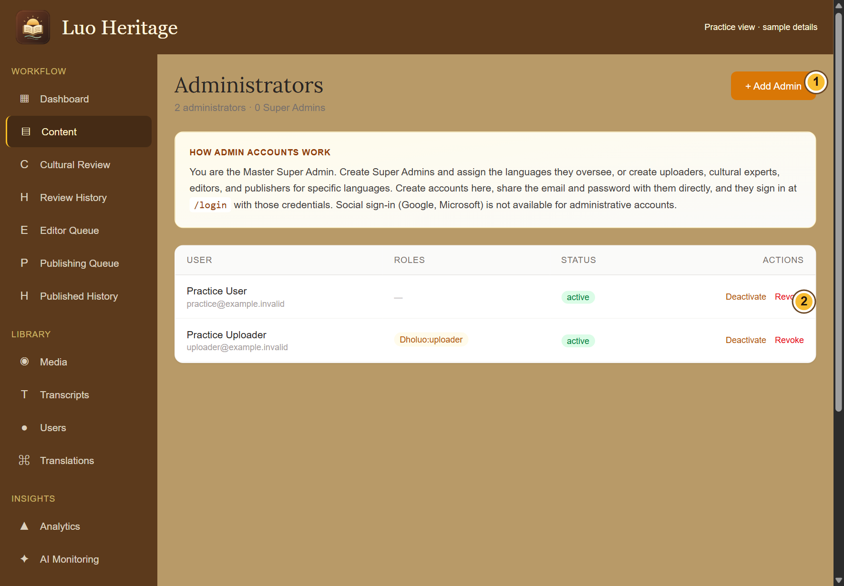
SELF-STUDY / MASTER SUPER ADMIN
Maintain your staff list
1
Open Administrators and review each
name, email, language and role.
2
Remove unneeded authority through the
permitted controls after confirming
ownership of ongoing work.
3
Keep cultural reviewers, editors and
publishers distinct wherever possible.
Record the reason for important access
changes.
CURRENT INTERFACE • PRACTICE DETAILS
CHECK: Current staff responsibilities are clear and former staff cannot retain unwanted access.
LUO HERITAGE / MASTER SUPER ADMIN
Contents
116 / 138
Notes:
Maintain your staff list
1. Open Administrators and review each name, email, language and role.
2. Remove unneeded authority through the permitted controls after confirming ownership of ongoing work.
3. Keep cultural reviewers, editors and publishers distinct wherever possible. Record the reason for important access changes.
Expected result: Current staff responsibilities are clear and former staff cannot retain unwanted access.
Screenshot: current application interface rendered with sample details. No live action is demonstrated.

Slide 117
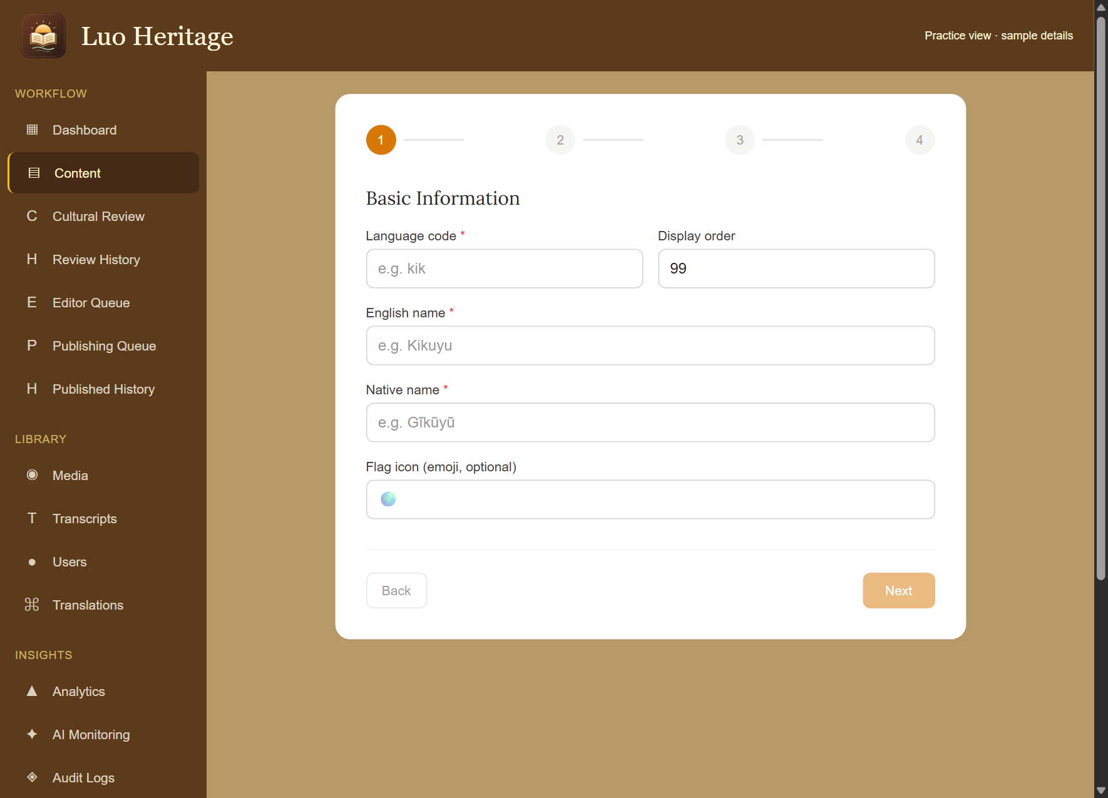
SELF-STUDY / MASTER SUPER ADMIN
Add a language deliberately
1
Open Languages and choose + Add
Language.
2
Follow the numbered language setup:
enter the code, name and local name, then
check the module and administrator
choices.
3
Review the summary before saving.
Creating a language does not create
reviewed translations or public cultural
content.
CURRENT INTERFACE • PRACTICE DETAILS
CHECK: The intended language exists with its configuration ready for checked content.
LUO HERITAGE / MASTER SUPER ADMIN
Contents
117 / 138
Notes:
Add a language deliberately
1. Open Languages and choose + Add Language.
2. Follow the numbered language setup: enter the code, name and local name, then check the module and administrator choices.
3. Review the summary before saving. Creating a language does not create reviewed translations or public cultural content.
Expected result: The intended language exists with its configuration ready for checked content.
Screenshot: current application interface rendered with sample details. No live action is demonstrated.

Slide 118
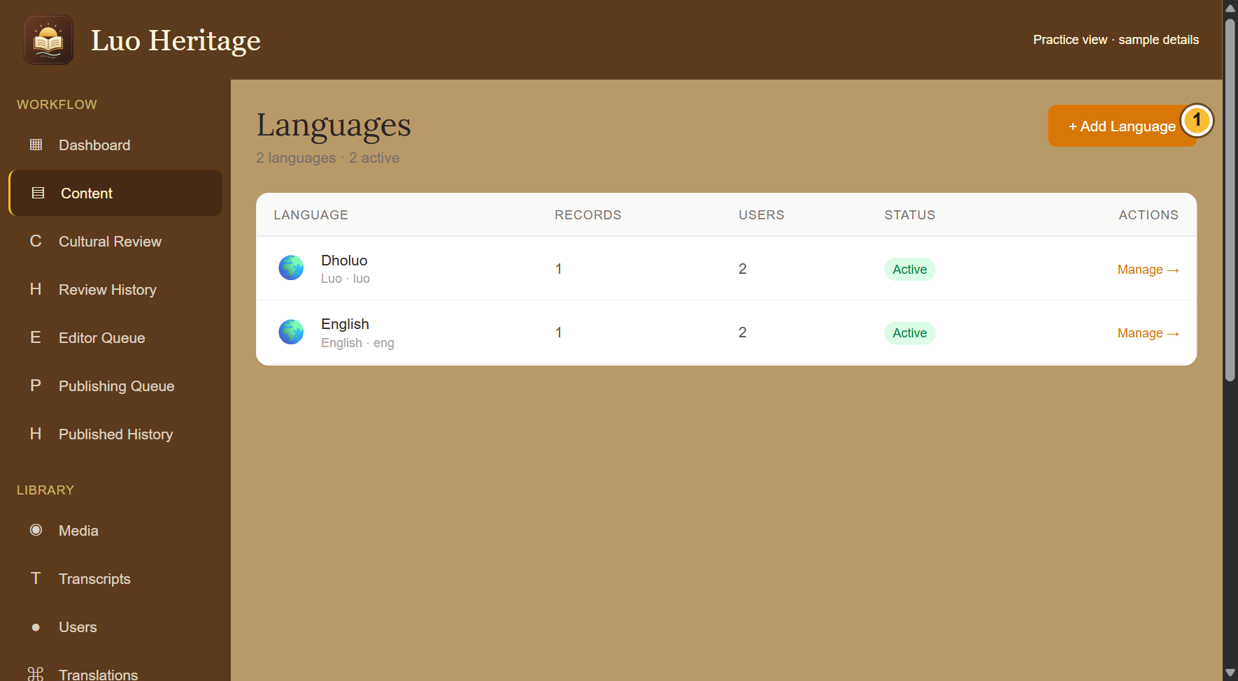
SELF-STUDY / MASTER SUPER ADMIN
Review a language before activation
1
Open Languages and select the language.
2
Check its labels, assigned staff and
collections. Confirm that any public content
is reviewed and permitted.
3
Use the available activation controls only
when the organisation agrees it is ready.
CURRENT INTERFACE • PRACTICE DETAILS
CHECK: The public language selection reflects your deliberate decision.
LUO HERITAGE / MASTER SUPER ADMIN
Contents
118 / 138
Notes:
Review a language before activation
1. Open Languages and select the language.
2. Check its labels, assigned staff and collections. Confirm that any public content is reviewed and permitted.
3. Use the available activation controls only when the organisation agrees it is ready.
Expected result: The public language selection reflects your deliberate decision.
Screenshot: current application interface rendered with sample details. No live action is demonstrated.

Slide 119
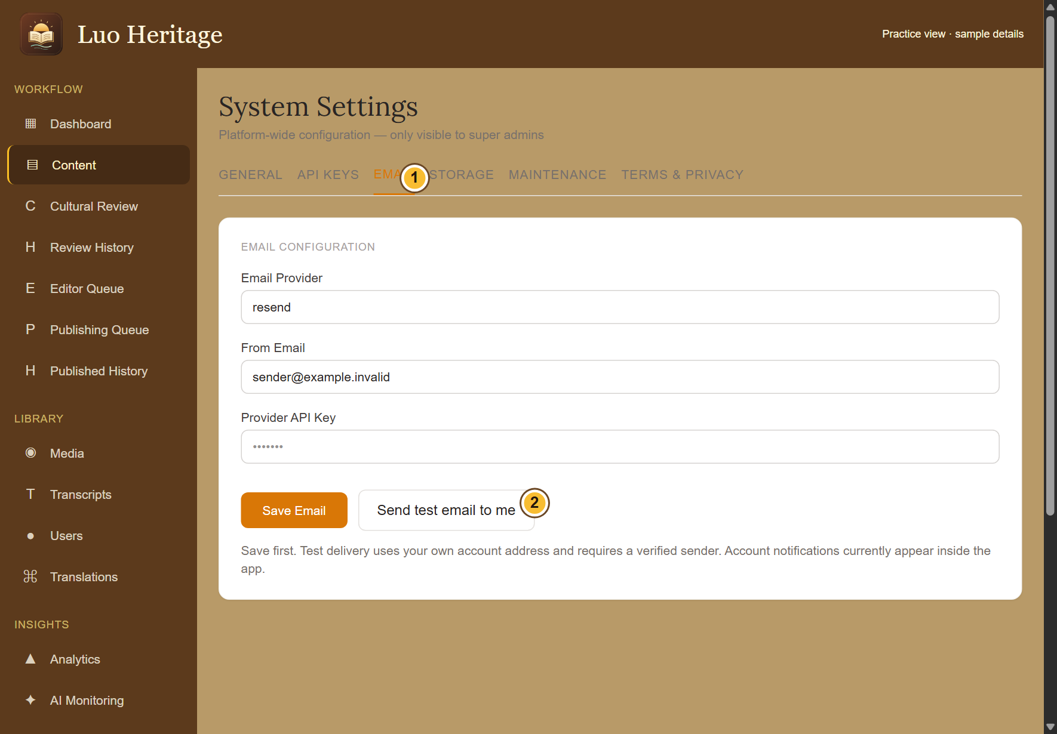
SELF-STUDY / MASTER SUPER ADMIN
Check account email settings
1
Open System, then Email. Confirm the
approved provider, verified sender address
and private service key.
2
Save the email settings. Choose Send test
email to send to your own signed-in
account.
3
Check both the screen result and your
inbox. A provider accepting a message is
not proof it reached the inbox.
Keep keys secret. Password reset cannot send email while provider
credentials or sender approval are missing.
CURRENT INTERFACE • PRACTICE DETAILS
CHECK: You have evidence that the account email path is configured and can be tested.
LUO HERITAGE / MASTER SUPER ADMIN
Contents
119 / 138
Notes:
Check account email settings
1. Open System, then Email. Confirm the approved provider, verified sender address and private service key.
2. Save the email settings. Choose Send test email to send to your own signed-in account.
3. Check both the screen result and your inbox. A provider accepting a message is not proof it reached the inbox.
Expected result: You have evidence that the account email path is configured and can be tested.
Important: Keep keys secret. Password reset cannot send email while provider credentials or sender approval are missing.
Screenshot: current application interface rendered with sample details. No live action is demonstrated.

Slide 120
SELF-STUDY / MASTER SUPER ADMIN
Help with a failed password reset
1
Confirm Email settings and the test result
before asking the user to retry.
2
Ask the user to request a fresh link, check
spam and use the newest link within 30
minutes.
3
Keep the user’s reset link and new
password private. Record the problem
without including either.
CURRENT INTERFACE • PRACTICE DETAILS
CHECK: The user can follow a safe recovery path once email delivery is available.
LUO HERITAGE / MASTER SUPER ADMIN
Contents
120 / 138
Notes:
Help with a failed password reset
1. Confirm Email settings and the test result before asking the user to retry.
2. Ask the user to request a fresh link, check spam and use the newest link within 30 minutes.
3. Keep the user’s reset link and new password private. Record the problem without including either.
Expected result: The user can follow a safe recovery path once email delivery is available.
Screenshot: current application interface rendered with sample details. No live action is demonstrated.

Slide 121
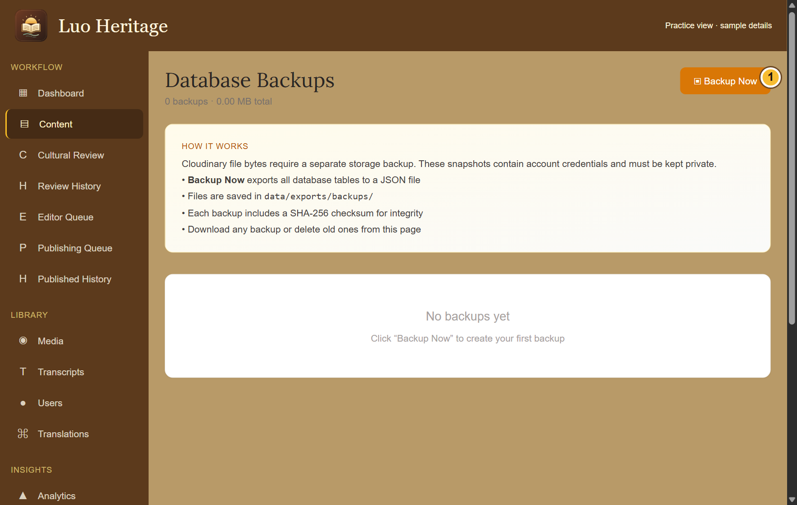
SELF-STUDY / MASTER SUPER ADMIN
Make and protect a database backup
1
Open Backup and choose Backup Now
when a backup is authorised.
2
Wait for confirmation, then check the new
file in the list. Store any downloaded copy
in the organisation’s protected location.
3
Ask the technical maintainer to verify
recovery. A database backup does not
contain the actual picture, audio or video
files.
Backup files contain sensitive account data. Never attach them to a
public message or training exercise.
CURRENT INTERFACE • PRACTICE DETAILS
CHECK: A protected database snapshot is recorded; separate media backup and recovery checks are arranged.
LUO HERITAGE / MASTER SUPER ADMIN
Contents
121 / 138
Notes:
Make and protect a database backup
1. Open Backup and choose Backup Now when a backup is authorised.
2. Wait for confirmation, then check the new file in the list. Store any downloaded copy in the organisation’s protected location.
3. Ask the technical maintainer to verify recovery. A database backup does not contain the actual picture, audio or video files.
Expected result: A protected database snapshot is recorded; separate media backup and recovery checks are arranged.
Important: Backup files contain sensitive account data. Never attach them to a public message or training exercise.
Screenshot: current application interface rendered with sample details. No live action is demonstrated.

Slide 122
SELF-STUDY / MASTER SUPER ADMIN
Check public terms and support information
1
Open System and review the General
settings and Terms & Privacy tab.
2
Replace draft organisation details with the
verified operator and support information
before publishing those texts.
3
Have the responsible institution approve
the wording. Check the public pages after
saving.
Do not publish a legal draft containing bracketed placeholders or
unapproved promises.
CURRENT INTERFACE • PRACTICE DETAILS
CHECK: Readers can find the correct organisation and support information.
LUO HERITAGE / MASTER SUPER ADMIN
Contents
122 / 138
Notes:
Check public terms and support information
1. Open System and review the General settings and Terms & Privacy tab.
2. Replace draft organisation details with the verified operator and support information before publishing those texts.
3. Have the responsible institution approve the wording. Check the public pages after saving.
Expected result: Readers can find the correct organisation and support information.
Important: Do not publish a legal draft containing bracketed placeholders or unapproved promises.
Screenshot: current application interface rendered with sample details. No live action is demonstrated.

Slide 123
SELF-STUDY / MASTER SUPER ADMIN
Treat AI settings and feedback responsibly
1
Use API Keys and AI Monitoring only for
the services and records you are permitted
to manage.
2
Keep service credentials private. Test
ordinary questions without submitting
restricted interviews or personal
information.
3
Investigate wrong answers using their
sources and feedback. Do not describe
untested language or image models as
reliable.
CURRENT INTERFACE • PRACTICE DETAILS
CHECK: AI support is used with clear source and privacy checks.
LUO HERITAGE / MASTER SUPER ADMIN
Contents
123 / 138
Notes:
Treat AI settings and feedback responsibly
1. Use API Keys and AI Monitoring only for the services and records you are permitted to manage.
2. Keep service credentials private. Test ordinary questions without submitting restricted interviews or personal information.
3. Investigate wrong answers using their sources and feedback. Do not describe untested language or image models as reliable.
Expected result: AI support is used with clear source and privacy checks.
Screenshot: current application interface rendered with sample details. No live action is demonstrated.

Slide 124
SELF-STUDY / MASTER SUPER ADMIN
Use maintenance and ownership controls carefully
1
Before enabling maintenance, tell the
affected staff and agree when access will
return.
2
Read each control and confirmation.
Confirm the public view afterwards.
3
Do not delete the Master Super Admin
account to transfer responsibility. Arrange
the approved institutional ownership
process first.
CURRENT INTERFACE • PRACTICE DETAILS
CHECK: High-impact changes have an owner, a reason and a checked result.
LUO HERITAGE / MASTER SUPER ADMIN
Contents
124 / 138
Notes:
Use maintenance and ownership controls carefully
1. Before enabling maintenance, tell the affected staff and agree when access will return.
2. Read each control and confirmation. Confirm the public view afterwards.
3. Do not delete the Master Super Admin account to transfer responsibility. Arrange the approved institutional ownership process first.
Expected result: High-impact changes have an owner, a reason and a checked result.
Screenshot: current application interface rendered with sample details. No live action is demonstrated.

Slide 125
SELF-STUDY / MASTER SUPER ADMIN
Prepare an orderly handover
1
Give each person their own account, role guide and approved
website address.
2
Keep private service details, backup locations and recovery
contacts in a restricted handover record.
3
Record which service and device checks have actually passed.
Treat physical-server migration and store release as separate
planned work.
CURRENT INTERFACE • PRACTICE DETAILS
CHECK: The next responsible person can operate the system without sharing passwords or guessing what was tested.
LUO HERITAGE / MASTER SUPER ADMIN
Contents
125 / 138
Notes:
Prepare an orderly handover
1. Give each person their own account, role guide and approved website address.
2. Keep private service details, backup locations and recovery contacts in a restricted handover record.
3. Record which service and device checks have actually passed. Treat physical-server migration and store release as separate planned work.
Expected result: The next responsible person can operate the system without sharing passwords or guessing what was tested.
Screenshot: current application interface rendered with sample details. No live action is demonstrated.

Slide 126
SELF-STUDY / MASTER SUPER ADMIN
Check your skills before working alone
1
Identify which duties you may delegate and which require Master Super Admin authority.
2
Explain how to check account email delivery without sharing a key or reset link.
3
Explain what the database backup includes, what it excludes, and how you would request a
recovery check.
Try
→
Check
→
Ask if unsure
Use only approved practice material. Do not publish, delete accounts or change live settings just to practise.
CHECK: You are ready for routine work when you can complete these steps without help.
LUO HERITAGE / MASTER SUPER ADMIN
Contents
126 / 138
Notes:
Check your skills before working alone
1. Identify which duties you may delegate and which require Master Super Admin authority.
2. Explain how to check account email delivery without sharing a key or reset link.
3. Explain what the database backup includes, what it excludes, and how you would request a recovery check.
Expected result: You are ready for routine work when you can complete these steps without help.
Important: Use only approved practice material. Do not publish, delete accounts or change live settings just to practise.

Slide 127
SELF-STUDY / RESEARCHERS AND INSTITUTIONAL READERS
Researchers and institutional readers
1
You will be able to distinguish public reading from authorised research access and request
help safely.
2
Read the common steps on slides 4–19 when you need them. Then follow the tasks in this
section.
3
Use only the duties and language assigned to your own account. Choose Contents at the
bottom of a slide to return to the role list.
Confirm access
→
Read sources
→
Respect conditions
CHECK: Read a step, try it, and check the result before moving on.
LUO HERITAGE / RESEARCHERS AND INSTITUTIONAL READERS
Contents
127 / 138
Notes:
Researchers and institutional readers
1. You will be able to distinguish public reading from authorised research access and request help safely.
2. Read the common steps on slides 4–19 when you need them. Then follow the tasks in this section.
3. Use only the duties and language assigned to your own account. Choose Contents at the bottom of a slide to return to the role list.
Expected result: Read a step, try it, and check the result before moving on.

Slide 128
SELF-STUDY / RESEARCHERS AND INSTITUTIONAL READERS
Understand your access before you begin
1
A researcher interest describes your
purpose. It does not unlock private
interviews or staff screens.
2
Start with the public library and approved
sources available to ordinary accounts.
3
For internal research material, contact the
person responsible for the collection. Use
only the access they formally assign.
Your assigned role and language determine which records you may
open.
CURRENT INTERFACE • PRACTICE DETAILS
CHECK: You know which material you may use without borrowing another person’s account.
LUO HERITAGE / RESEARCHERS AND INSTITUTIONAL READERS
Contents
128 / 138
Notes:
Understand your access before you begin
1. A researcher interest describes your purpose. It does not unlock private interviews or staff screens.
2. Start with the public library and approved sources available to ordinary accounts.
3. For internal research material, contact the person responsible for the collection. Use only the access they formally assign.
Expected result: You know which material you may use without borrowing another person’s account.
Important: Your assigned role and language determine which records you may open.
Screenshot: current application interface rendered with sample details. No live action is demonstrated.

Slide 129
SELF-STUDY / RESEARCHERS AND INSTITUTIONAL READERS
Find a word in the public dictionary
1
On the public website, open the dictionary
page and find its search box.
2
Enter a Dholuo word or an English or
Kiswahili meaning. Wait for the results,
then read the relevant entry.
3
If there is no result, check spelling or try
another word. A missing published entry is
not proof that the word does not exist.
The shared app’s Muma screen uses collection filters; it may not show
this website search box.
CURRENT INTERFACE • PRACTICE DETAILS
CHECK: You can use the dictionary search where it is offered.
LUO HERITAGE / RESEARCHERS AND INSTITUTIONAL READERS
Contents
129 / 138
Notes:
Find a word in the public dictionary
1. On the public website, open the dictionary page and find its search box.
2. Enter a Dholuo word or an English or Kiswahili meaning. Wait for the results, then read the relevant entry.
3. If there is no result, check spelling or try another word. A missing published entry is not proof that the word does not exist.
Expected result: You can use the dictionary search where it is offered.
Important: The shared app’s Muma screen uses collection filters; it may not show this website search box.
Screenshot: current application interface rendered with sample details. No live action is demonstrated.

Slide 130
SELF-STUDY / RESEARCHERS AND INSTITUTIONAL READERS
Use a source, not only an AI answer
1
Open the approved entry and read its
description, language and source credit.
2
For an AI answer, open the cited platform
entries and compare the answer with them.
3
Record the source title and permitted
reference details for your research notes.
Follow the organisation’s citation and reuse
rules.
CURRENT INTERFACE • PRACTICE DETAILS
CHECK: Your notes refer to actual approved material rather than an uncited generated answer.
LUO HERITAGE / RESEARCHERS AND INSTITUTIONAL READERS
Contents
130 / 138
Notes:
Use a source, not only an AI answer
1. Open the approved entry and read its description, language and source credit.
2. For an AI answer, open the cited platform entries and compare the answer with them.
3. Record the source title and permitted reference details for your research notes. Follow the organisation’s citation and reuse rules.
Expected result: Your notes refer to actual approved material rather than an uncited generated answer.
Screenshot: current application interface rendered with sample details. No live action is demonstrated.

Slide 131
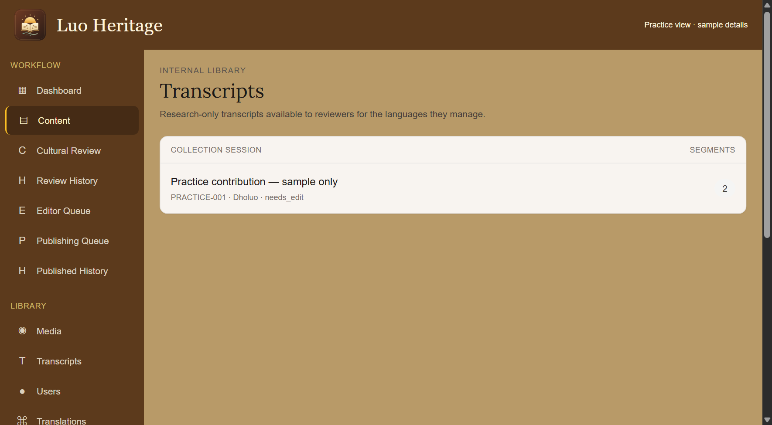
SELF-STUDY / RESEARCHERS AND INSTITUTIONAL READERS
Request private research access properly
1
Describe your research purpose, the
collection needed and who will use it.
2
Ask the person responsible for the
collection what permission, consent and
access conditions apply.
3
Wait for approval. Do not treat a visible
title, an imported file or a colleague’s copy
as permission to reuse it.
Research-only, teaching and public sharing are different permissions.
CURRENT INTERFACE • PRACTICE DETAILS
CHECK: The access request can be considered by the responsible person.
LUO HERITAGE / RESEARCHERS AND INSTITUTIONAL READERS
Contents
131 / 138
Notes:
Request private research access properly
1. Describe your research purpose, the collection needed and who will use it.
2. Ask the person responsible for the collection what permission, consent and access conditions apply.
3. Wait for approval. Do not treat a visible title, an imported file or a colleague’s copy as permission to reuse it.
Expected result: The access request can be considered by the responsible person.
Important: Research-only, teaching and public sharing are different permissions.
Screenshot: current application interface rendered with sample details. No live action is demonstrated.

Slide 132
SELF-STUDY / RESEARCHERS AND INSTITUTIONAL READERS
For authorised reviewers: open transcripts
1
This step applies only if you have
separately been assigned a role that can
read the internal transcript library.
2
Open Transcripts from the staff menu.
Choose the permitted session in your
assigned language.
3
Check the session reference and read only
the material allowed by your approval.
If Transcripts is missing or access is refused, ask the custodian. Do not
try another user’s login.
CURRENT INTERFACE • PRACTICE DETAILS
CHECK: An authorised reader reaches the correct internal session.
LUO HERITAGE / RESEARCHERS AND INSTITUTIONAL READERS
Contents
132 / 138
Notes:
For authorised reviewers: open transcripts
1. This step applies only if you have separately been assigned a role that can read the internal transcript library.
2. Open Transcripts from the staff menu. Choose the permitted session in your assigned language.
3. Check the session reference and read only the material allowed by your approval.
Expected result: An authorised reader reaches the correct internal session.
Important: If Transcripts is missing or access is refused, ask the custodian. Do not try another user’s login.
Screenshot: current application interface rendered with sample details. No live action is demonstrated.

Slide 133
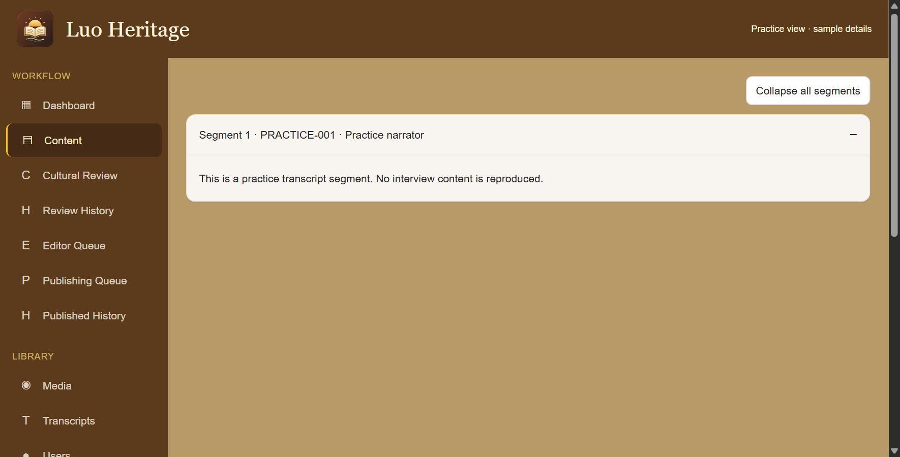
SELF-STUDY / RESEARCHERS AND INSTITUTIONAL READERS
Read transcript sections carefully
1
Open the permitted session and choose a
segment, or Expand all segments.
2
Keep the source reference with your notes.
An AI summary is not a replacement for the
original text.
3
Do not translate, publish, export or submit
internal text to an external AI service
without the required permission.
CURRENT INTERFACE • PRACTICE DETAILS
CHECK: Your work retains its connection to the permitted original source.
LUO HERITAGE / RESEARCHERS AND INSTITUTIONAL READERS
Contents
133 / 138
Notes:
Read transcript sections carefully
1. Open the permitted session and choose a segment, or Expand all segments.
2. Keep the source reference with your notes. An AI summary is not a replacement for the original text.
3. Do not translate, publish, export or submit internal text to an external AI service without the required permission.
Expected result: Your work retains its connection to the permitted original source.
Screenshot: current application interface rendered with sample details. No live action is demonstrated.

Slide 134
SELF-STUDY / RESEARCHERS AND INSTITUTIONAL READERS
What the permission labels mean
1
Source permission: has the source agreed
to the proposed use? Choose Not sure yet
when you do not know.
2
Consent scope: what use was agreed?
Public excerpt means an approved public
part; research only and teaching have
different limits.
3
Restriction level: who may see it? Internal
and restricted are not public. Sacred
material needs the collection owner’s
special care.
If the permission record is unclear, keep the item private and ask the
responsible reviewer.
CURRENT INTERFACE • PRACTICE DETAILS
CHECK: You understand the labels before you change them.
LUO HERITAGE / RESEARCHERS AND INSTITUTIONAL READERS
Contents
134 / 138
Notes:
What the permission labels mean
1. Source permission: has the source agreed to the proposed use? Choose Not sure yet when you do not know.
2. Consent scope: what use was agreed? Public excerpt means an approved public part; research only and teaching have different limits.
3. Restriction level: who may see it? Internal and restricted are not public. Sacred material needs the collection owner’s special care.
Expected result: You understand the labels before you change them.
Important: If the permission record is unclear, keep the item private and ask the responsible reviewer.
Screenshot: current application interface rendered with sample details. No live action is demonstrated.

Slide 135
SELF-STUDY / RESEARCHERS AND INSTITUTIONAL READERS
Request an export rather than assuming permission
1
Tell the collection owner exactly which
records and fields are needed and why.
2
Ask for the approved export and any
citation, storage, sharing or deletion
conditions.
3
Check the files and permission record
together. Keep participant identities and
sensitive locations protected.
An administrator’s technical ability to export is not the same as
permission for your study.
CURRENT INTERFACE • PRACTICE DETAILS
CHECK: Any research copy has a documented purpose and agreed conditions.
LUO HERITAGE / RESEARCHERS AND INSTITUTIONAL READERS
Contents
135 / 138
Notes:
Request an export rather than assuming permission
1. Tell the collection owner exactly which records and fields are needed and why.
2. Ask for the approved export and any citation, storage, sharing or deletion conditions.
3. Check the files and permission record together. Keep participant identities and sensitive locations protected.
Expected result: Any research copy has a documented purpose and agreed conditions.
Important: An administrator’s technical ability to export is not the same as permission for your study.
Screenshot: current application interface rendered with sample details. No live action is demonstrated.

Slide 136
SELF-STUDY / RESEARCHERS AND INSTITUTIONAL READERS
Report a source or consent concern
1
Note the item title and reference, and
describe the concern without copying
restricted text.
2
Contact the person responsible for the
collection or the administrator who granted
your access.
3
Pause any disputed reuse until the
responsible person confirms what is
permitted.
CURRENT INTERFACE • PRACTICE DETAILS
CHECK: The rights concern is handled without spreading the disputed material.
LUO HERITAGE / RESEARCHERS AND INSTITUTIONAL READERS
Contents
136 / 138
Notes:
Report a source or consent concern
1. Note the item title and reference, and describe the concern without copying restricted text.
2. Contact the person responsible for the collection or the administrator who granted your access.
3. Pause any disputed reuse until the responsible person confirms what is permitted.
Expected result: The rights concern is handled without spreading the disputed material.
Screenshot: current application interface rendered with sample details. No live action is demonstrated.

Slide 137
SELF-STUDY / RESEARCHERS AND INSTITUTIONAL READERS
Check your skills before working alone
1
Find a public source and explain how you would cite it.
2
Explain why the researcher interest does not grant internal access.
3
Describe how you would request a transcript or dataset export and check its reuse conditions.
Try
→
Check
→
Ask if unsure
Use only approved practice material. Do not publish, delete accounts or change live settings just to practise.
CHECK: You are ready for routine work when you can complete these steps without help.
LUO HERITAGE / RESEARCHERS AND INSTITUTIONAL READERS
Contents
137 / 138
Notes:
Check your skills before working alone
1. Find a public source and explain how you would cite it.
2. Explain why the researcher interest does not grant internal access.
3. Describe how you would request a transcript or dataset export and check its reuse conditions.
Expected result: You are ready for routine work when you can complete these steps without help.
Important: Use only approved practice material. Do not publish, delete accounts or change live settings just to practise.

Slide 138
SELF-STUDY / HELP AND NEXT STEPS
Finish confidently and ask for help
1
Keep this one file. Return to Contents whenever you need another task or role.
2
If a screen is empty, access is refused or a service is unavailable, read the message and
contact the person who manages your account.
3
Give support the screen name, button and message. Never send your password, a reset link
or private research material.
Read the message
→
Check your access
→
Ask for help
CHECK: Use your own account and follow the conditions attached to every source.
LUO HERITAGE / HELP AND NEXT STEPS
Contents
138 / 138
Notes:
Finish confidently and ask for help
1. Keep this one file. Return to Contents whenever you need another task or role.
2. If a screen is empty, access is refused or a service is unavailable, read the message and contact the person who manages your account.
3. Give support the screen name, button and message. Never send your password, a reset link or private research material.
Expected result: Use your own account and follow the conditions attached to every source.

