Slide 1

LUO HERITAGE / SELF-STUDY SLIDES
LANGUAGE • CULTURE • LIVING MEMORY
Choose your training guide
Self-study slide library • eleven roles
Open the guide that matches the work you have actually been assigned.
READ • TRY • CHECK
25 October 2026 | Edition 1.0
Notes:
Self-study guide. Screenshots show actual interface components rendered with clearly labelled sample data, not a production acceptance demonstration. No real account or cultural record was changed to make these slides.

Slide 2
SELF-STUDY / CHOOSE YOUR TRAINING GUIDE
Welcome to your self-study slide library
1
Each role has a PowerPoint slide deck and a matching PDF. Open the PDF for easy reading;
use PowerPoint for presenting or editing.
2
Read one task, try it on your own account, then check the result described on the slide.
3
Use the guide for your assigned duty. If you have several duties, read each relevant guide.
Choose a role
→
Read the steps
→
Try and check
CHECK: No classroom trainer is needed to follow the guides.
LUO HERITAGE / CHOOSE YOUR TRAINING GUIDE
Contents
02 / 09
Notes:
Welcome to your self-study slide library
1. Each role has a PowerPoint slide deck and a matching PDF. Open the PDF for easy reading; use PowerPoint for presenting or editing.
2. Read one task, try it on your own account, then check the result described on the slide.
3. Use the guide for your assigned duty. If you have several duties, read each relevant guide.
Expected result: No classroom trainer is needed to follow the guides.

Slide 3
SELF-STUDY / CHOOSE YOUR TRAINING GUIDE
Start with your everyday work
1
Community members: browsing, accounts, contributions and AI chat.
2
Students: courses, classes, assignments and progress.
3
Teachers and lecturers: class setup, assignments, feedback and gradebooks.
CHECK: Open guide 01, 02 or 03.
LUO HERITAGE / CHOOSE YOUR TRAINING GUIDE
Contents
03 / 09
Notes:
Start with your everyday work
1. Community members: browsing, accounts, contributions and AI chat.
2. Students: courses, classes, assignments and progress.
3. Teachers and lecturers: class setup, assignments, feedback and gradebooks.
Expected result: Open guide 01, 02 or 03.

Slide 4
SELF-STUDY / CHOOSE YOUR TRAINING GUIDE
If you prepare or review content
1
Uploaders: draft, attach files, record permission and submit.
2
Cultural reviewers: check accuracy, request corrections and vote independently.
3
Content editors: correct returned work. Publishers: check the final release.
04 Upload
→
05 Review
→
06 Edit
→
07 Publish
CHECK: Open the guide matching your assigned content duty.
LUO HERITAGE / CHOOSE YOUR TRAINING GUIDE
Contents
04 / 09
Notes:
If you prepare or review content
1. Uploaders: draft, attach files, record permission and submit.
2. Cultural reviewers: check accuracy, request corrections and vote independently.
3. Content editors: correct returned work. Publishers: check the final release.
Expected result: Open the guide matching your assigned content duty.

Slide 5
SELF-STUDY / CHOOSE YOUR TRAINING GUIDE
If you manage the platform
1
Language administrators: coordinate people and content in an assigned language.
2
Super Admins: oversee assigned languages and staff, within their authority.
3
Master Super Admin: institutional ownership, Super Admin authority and protected system
operations.
CHECK: Open guide 08, 09 or 10. A wider menu does not grant every action.
LUO HERITAGE / CHOOSE YOUR TRAINING GUIDE
Contents
05 / 09
Notes:
If you manage the platform
1. Language administrators: coordinate people and content in an assigned language.
2. Super Admins: oversee assigned languages and staff, within their authority.
3. Master Super Admin: institutional ownership, Super Admin authority and protected system operations.
Expected result: Open guide 08, 09 or 10. A wider menu does not grant every action.

Slide 6
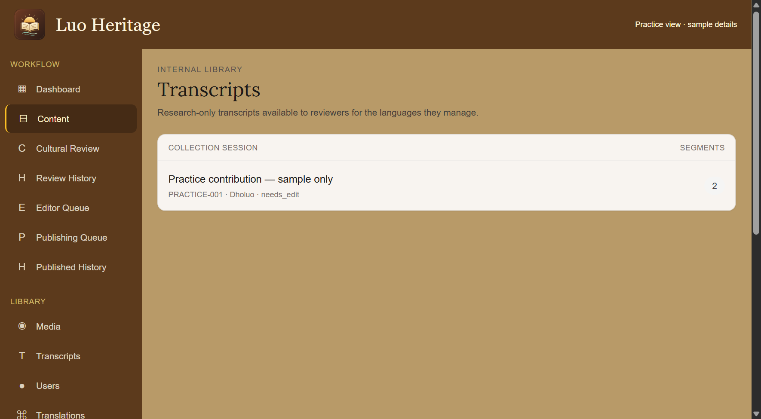
SELF-STUDY / CHOOSE YOUR TRAINING GUIDE
If you use the system for research
1
Open guide 11 for public sources,
internal-access requests and transcript
guidance.
2
A researcher interest on your profile is not
permission to read private interviews.
3
Ask the institutional custodian before
exporting or reusing restricted material.
CURRENT INTERFACE • PRACTICE DETAILS
CHECK: Research follows the source’s access and reuse conditions.
LUO HERITAGE / CHOOSE YOUR TRAINING GUIDE
Contents
06 / 09
Notes:
If you use the system for research
1. Open guide 11 for public sources, internal-access requests and transcript guidance.
2. A researcher interest on your profile is not permission to read private interviews.
3. Ask the institutional custodian before exporting or reusing restricted material.
Expected result: Research follows the source’s access and reuse conditions.
Screenshot: current application interface rendered with sample details. No live action is demonstrated.

Slide 7
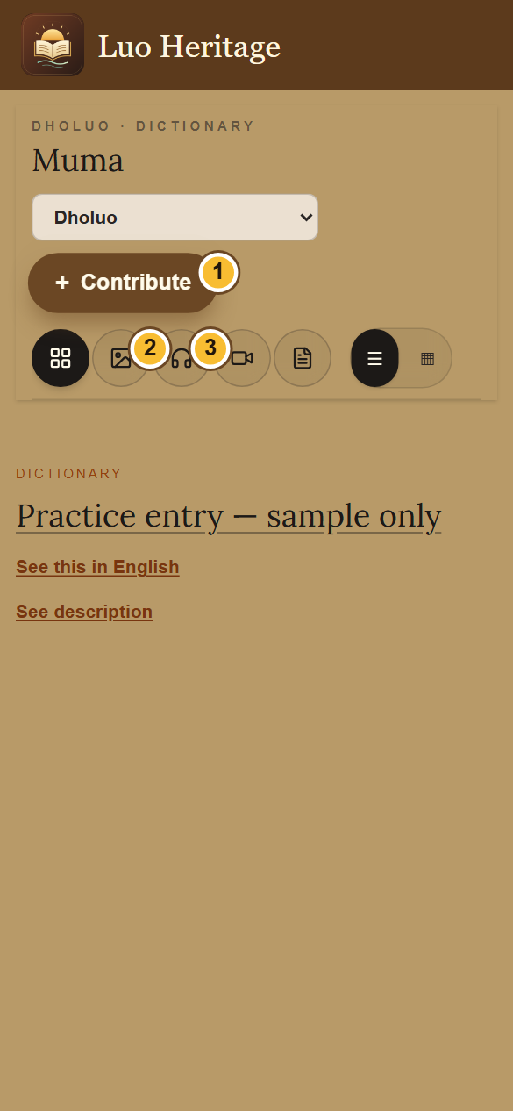
SELF-STUDY / CHOOSE YOUR TRAINING GUIDE
About the screenshots
1
Screens are captured from the current application components
using sample names and practice records.
2
They are illustrations of the interface, not evidence that an email
was delivered, a record was published or a live account was
created.
3
Your menu and records depend on your assigned access. Phone
and computer layouts may place controls differently.
CURRENT INTERFACE • PRACTICE DETAILS
CHECK: You can recognise controls without mistaking practice details for real cultural evidence.
LUO HERITAGE / CHOOSE YOUR TRAINING GUIDE
Contents
07 / 09
Notes:
About the screenshots
1. Screens are captured from the current application components using sample names and practice records.
2. They are illustrations of the interface, not evidence that an email was delivered, a record was published or a live account was created.
3. Your menu and records depend on your assigned access. Phone and computer layouts may place controls differently.
Expected result: You can recognise controls without mistaking practice details for real cultural evidence.
Screenshot: current application interface rendered with sample details. No live action is demonstrated.

Slide 8
SELF-STUDY / CHOOSE YOUR TRAINING GUIDE
Share the right files
1
Send a person their own role’s PDF or PowerPoint. PDF copies keep the layout consistent.
2
The role decks contain their own account and recovery instructions, so they can be read
independently.
3
Keep the editable sources for future updates. Review the screenshots again when the
application changes.
CHECK: Distribute the guides as slides, not as a long technical manual.
LUO HERITAGE / CHOOSE YOUR TRAINING GUIDE
Contents
08 / 09
Notes:
Share the right files
1. Send a person their own role’s PDF or PowerPoint. PDF copies keep the layout consistent.
2. The role decks contain their own account and recovery instructions, so they can be read independently.
3. Keep the editable sources for future updates. Review the screenshots again when the application changes.
Expected result: Distribute the guides as slides, not as a long technical manual.

Slide 9

SELF-STUDY / CHOOSE YOUR TRAINING GUIDE
Need help while studying?
1
For a missing button, check your assigned role and language
with your account administrator.
2
For a failed action, note the screen, button, time and exact
message. Never send your password.
3
Practise high-impact tasks only in an approved practice
environment. Do not publish or delete real data to test a guide.
CURRENT INTERFACE • PRACTICE DETAILS
CHECK: Your administrator can help with a clear description of the problem.
LUO HERITAGE / CHOOSE YOUR TRAINING GUIDE
Contents
09 / 09
Notes:
Need help while studying?
1. For a missing button, check your assigned role and language with your account administrator.
2. For a failed action, note the screen, button, time and exact message. Never send your password.
3. Practise high-impact tasks only in an approved practice environment. Do not publish or delete real data to test a guide.
Expected result: Your administrator can help with a clear description of the problem.
Screenshot: current application interface rendered with sample details. No live action is demonstrated.

