Slide 1

LUO HERITAGE / SELF-STUDY SLIDES
LANGUAGE • CULTURE • LIVING MEMORY
Community members
Read, learn, contribute and manage your account
You will be able to find cultural material, ask questions and submit your own contribution.
READ • TRY • CHECK
25 October 2026 | Edition 1.0
Notes:
Self-study guide. Screenshots show actual interface components rendered with clearly labelled sample data, not a production acceptance demonstration. No real account or cultural record was changed to make these slides.

Slide 2
SELF-STUDY / COMMUNITY MEMBERS
Start here: learn at your own pace
1
Read a slide, try its action, then check the result. Tap means click. Gold circles mark important
controls in the screenshots.
2
Use your own account. Your organisation supplies the correct website address and any staff
access.
3
Screenshots show the current interface with practice details. Actual names, content and
menus may differ.
Read the step
→
Try it yourself
→
Check the result
If your menu looks different, first check My access. Do not ask someone to lend you their account.
CHECK: You will be able to find cultural material, ask questions and submit your own contribution.
LUO HERITAGE / COMMUNITY MEMBERS
Contents
02 / 29
Notes:
Start here: learn at your own pace
1. Read a slide, try its action, then check the result. Tap means click. Gold circles mark important controls in the screenshots.
2. Use your own account. Your organisation supplies the correct website address and any staff access.
3. Screenshots show the current interface with practice details. Actual names, content and menus may differ.
Expected result: You will be able to find cultural material, ask questions and submit your own contribution.
Important: If your menu looks different, first check My access. Do not ask someone to lend you their account.

Slide 3
SELF-STUDY / COMMUNITY MEMBERS
What this guide covers
1
Create and recover an account; understand the menu.
2
Read collections, save items, learn and ask questions.
3
Prepare a private contribution and send it for review.
CHECK: Use the slide numbers to return to a task. The PDF has page bookmarks; PowerPoint has a contents view.
LUO HERITAGE / COMMUNITY MEMBERS
Contents
03 / 29
Notes:
What this guide covers
1. Create and recover an account; understand the menu.
2. Read collections, save items, learn and ask questions.
3. Prepare a private contribution and send it for review.
Expected result: Use the slide numbers to return to a task. The PDF has page bookmarks; PowerPoint has a contents view.

Slide 4

SELF-STUDY / COMMUNITY MEMBERS
Sign in to your own account
1
Open the Luo Heritage address supplied by your organisation.
Choose Sign in or Log in.
2
Enter your email and password, then choose Log in. Check your
spelling if it fails.
3
Community members may also use Google. Staff should use the
account supplied by their administrator.
Never share your password. Use only an address you trust.
CURRENT INTERFACE • PRACTICE DETAILS
CHECK: Your account or dashboard opens.
LUO HERITAGE / COMMUNITY MEMBERS
Contents
04 / 29
Notes:
Sign in to your own account
1. Open the Luo Heritage address supplied by your organisation. Choose Sign in or Log in.
2. Enter your email and password, then choose Log in. Check your spelling if it fails.
3. Community members may also use Google. Staff should use the account supplied by their administrator.
Expected result: Your account or dashboard opens.
Important: Never share your password. Use only an address you trust.
Screenshot: current application interface rendered with sample details. No live action is demonstrated.

Slide 5

SELF-STUDY / COMMUNITY MEMBERS
Forgot your password?
1
On the sign-in screen, choose Forgotten
password? Select Reset password.
2
Enter your account email. Choose Send
email, then check your inbox and spam
folder.
3
Open the newest reset link within 30
minutes. A link can be used only once.
If no email arrives, contact the person who manages your account. Do
not keep requesting links.
CURRENT INTERFACE • PRACTICE DETAILS
CHECK: An account email arrives if the address is eligible and the email service is available.
LUO HERITAGE / COMMUNITY MEMBERS
Contents
05 / 29
Notes:
Forgot your password?
1. On the sign-in screen, choose Forgotten password? Select Reset password.
2. Enter your account email. Choose Send email, then check your inbox and spam folder.
3. Open the newest reset link within 30 minutes. A link can be used only once.
Expected result: An account email arrives if the address is eligible and the email service is available.
Important: If no email arrives, contact the person who manages your account. Do not keep requesting links.
Screenshot: current application interface rendered with sample details. No live action is demonstrated.

Slide 6

SELF-STUDY / COMMUNITY MEMBERS
Choose a new password
1
Open the password reset link from your
own inbox.
2
Enter a new password of at least 12
characters. A short phrase with several
words is easier to remember.
3
Choose Confirm. Return to sign in and use
the new password on each device.
Do not forward the reset link. If it has expired, request a new one.
CURRENT INTERFACE • PRACTICE DETAILS
CHECK: The password changes and old sign-ins are ended.
LUO HERITAGE / COMMUNITY MEMBERS
Contents
06 / 29
Notes:
Choose a new password
1. Open the password reset link from your own inbox.
2. Enter a new password of at least 12 characters. A short phrase with several words is easier to remember.
3. Choose Confirm. Return to sign in and use the new password on each device.
Expected result: The password changes and old sign-ins are ended.
Important: Do not forward the reset link. If it has expired, request a new one.
Screenshot: current application interface rendered with sample details. No live action is demonstrated.

Slide 7
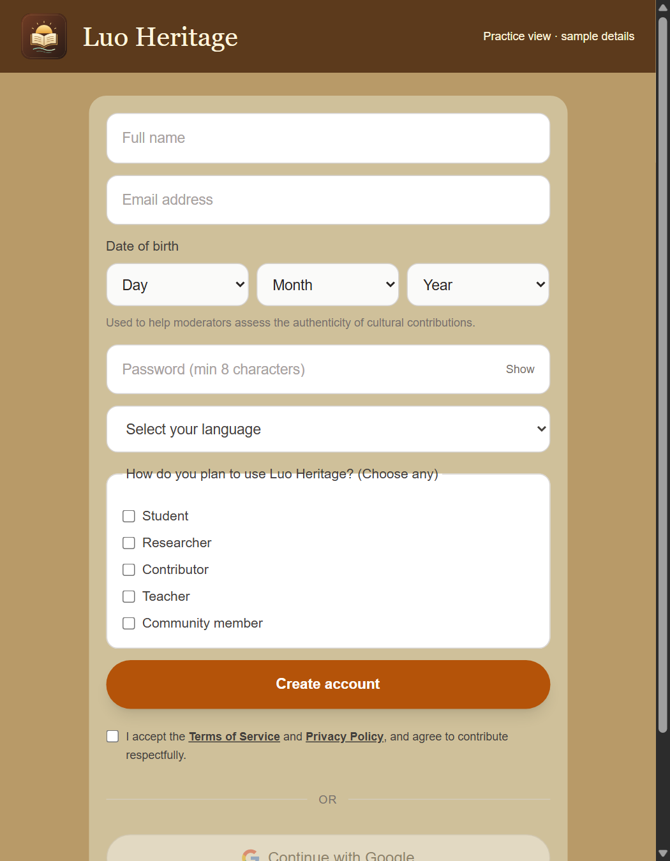
SELF-STUDY / COMMUNITY MEMBERS
Create a community account
1
Choose Create new account from the sign-in screen. Enter your
name, email and date of birth.
2
Choose your language and interests. Read and accept the
Terms and Privacy Policy.
3
Set your password and submit. If approval is required, wait for
confirmation before signing in.
You can choose Google registration if offered, then complete any requested profile information.
CURRENT INTERFACE • PRACTICE DETAILS
CHECK: Your account is created or clearly marked as awaiting approval.
LUO HERITAGE / COMMUNITY MEMBERS
Contents
07 / 29
Notes:
Create a community account
1. Choose Create new account from the sign-in screen. Enter your name, email and date of birth.
2. Choose your language and interests. Read and accept the Terms and Privacy Policy.
3. Set your password and submit. If approval is required, wait for confirmation before signing in.
Expected result: Your account is created or clearly marked as awaiting approval.
Important: You can choose Google registration if offered, then complete any requested profile information.
Screenshot: current application interface rendered with sample details. No live action is demonstrated.

Slide 8
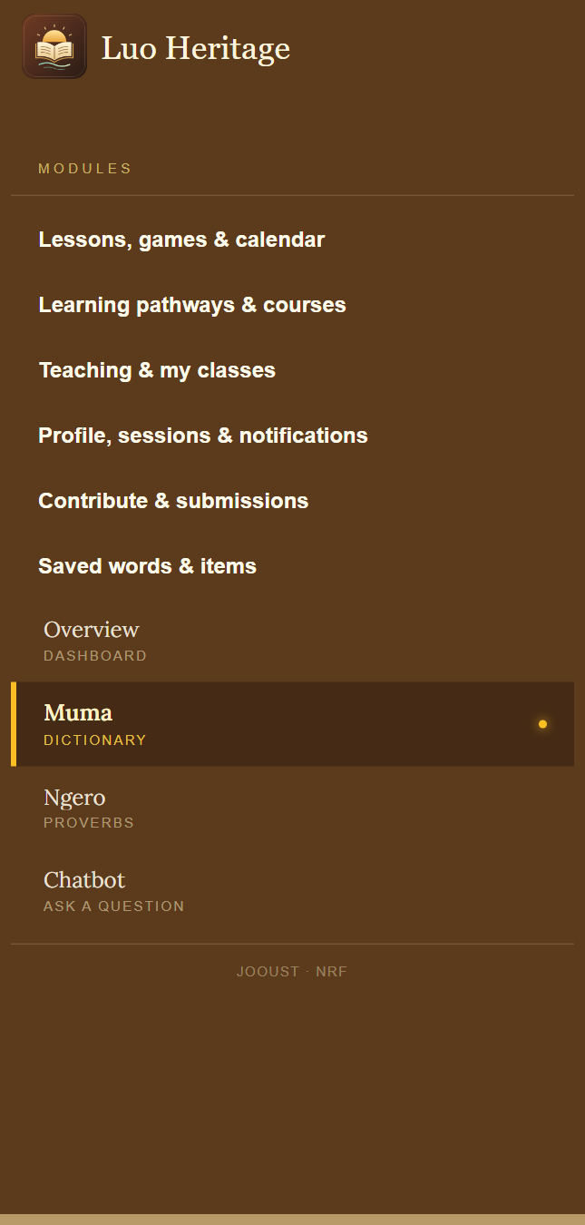
SELF-STUDY / COMMUNITY MEMBERS
Find your way around
1
Open the menu on the left. On a phone, use the menu button
first.
2
Choose a collection such as Muma, Ngero or stories. The
smaller label explains its content.
3
Use the same menu for lessons, courses, saved items,
contributions and your account.
CURRENT INTERFACE • PRACTICE DETAILS
CHECK: You can return to a collection or personal screen without starting again.
LUO HERITAGE / COMMUNITY MEMBERS
Contents
08 / 29
Notes:
Find your way around
1. Open the menu on the left. On a phone, use the menu button first.
2. Choose a collection such as Muma, Ngero or stories. The smaller label explains its content.
3. Use the same menu for lessons, courses, saved items, contributions and your account.
Expected result: You can return to a collection or personal screen without starting again.
Screenshot: current application interface rendered with sample details. No live action is demonstrated.

Slide 9
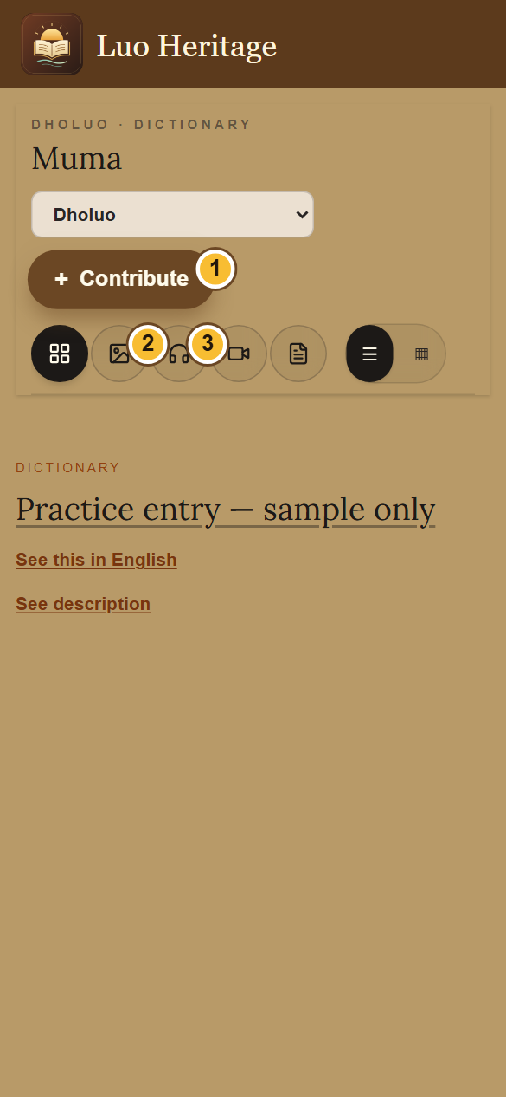
SELF-STUDY / COMMUNITY MEMBERS
Use the library on a phone
1
Open a collection, such as Muma (Dictionary), from the menu.
2
Use the picture, headphones, video or page icon to choose a
type of content. The four-square icon shows all types.
3
Choose the list or grid button to change the view. Scroll the
entries below the controls.
An empty result can mean there are no published entries of that type. Try All.
CURRENT INTERFACE • PRACTICE DETAILS
CHECK: The collection shows entries matching your chosen filter.
LUO HERITAGE / COMMUNITY MEMBERS
Contents
09 / 29
Notes:
Use the library on a phone
1. Open a collection, such as Muma (Dictionary), from the menu.
2. Use the picture, headphones, video or page icon to choose a type of content. The four-square icon shows all types.
3. Choose the list or grid button to change the view. Scroll the entries below the controls.
Expected result: The collection shows entries matching your chosen filter.
Important: An empty result can mean there are no published entries of that type. Try All.
Screenshot: current application interface rendered with sample details. No live action is demonstrated.

Slide 10
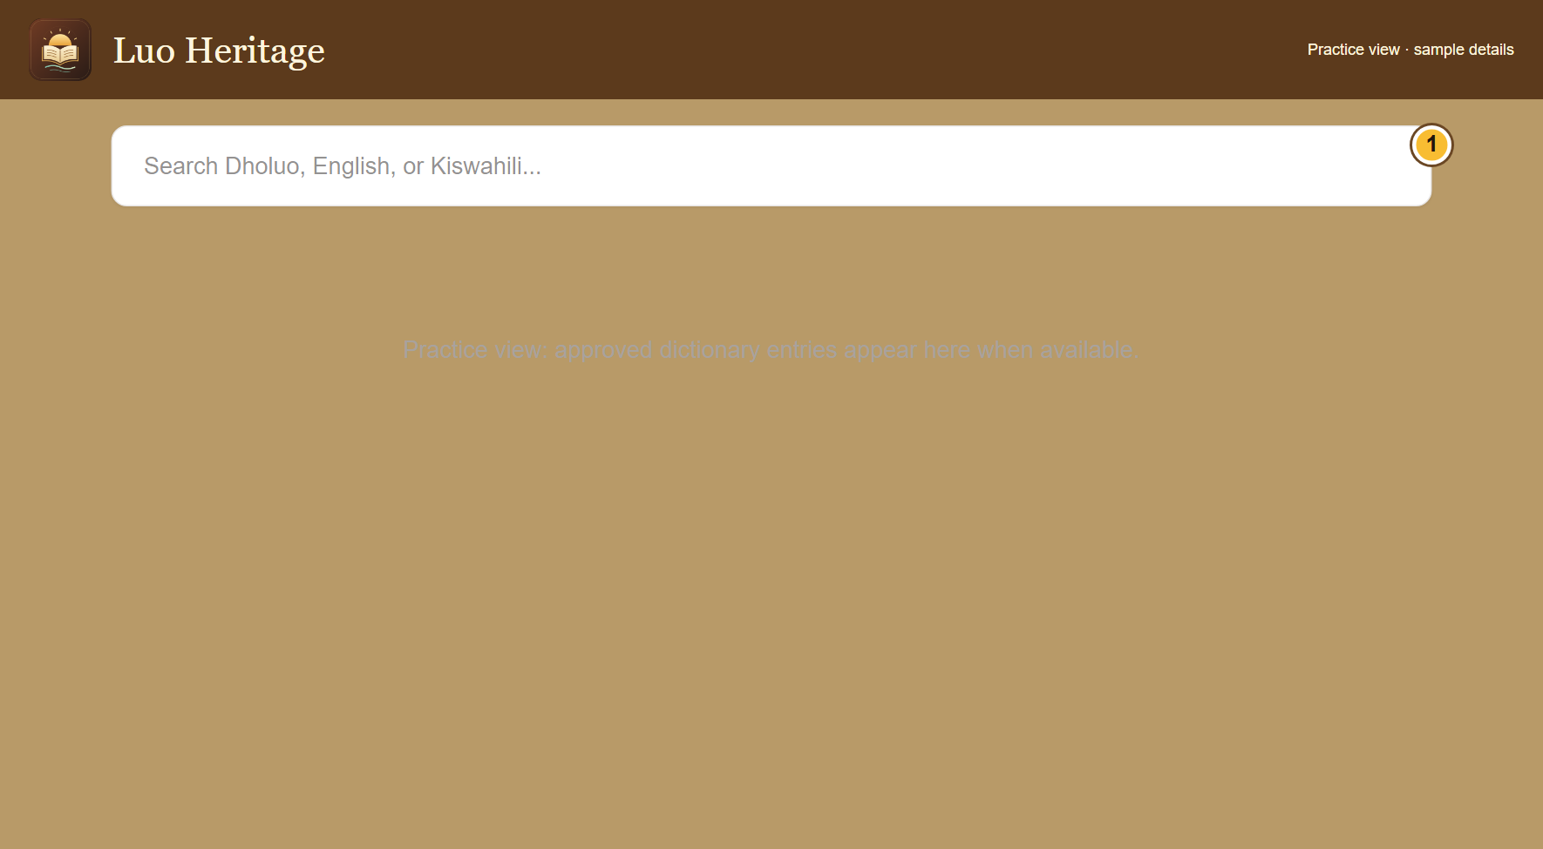
SELF-STUDY / COMMUNITY MEMBERS
Find a word in the public dictionary
1
On the public website, open the dictionary
page and find its search box.
2
Enter a Dholuo word or an English or
Kiswahili meaning. Wait for the results,
then read the relevant entry.
3
If there is no result, check spelling or try
another word. A missing published entry is
not proof that the word does not exist.
The shared app’s Muma screen uses collection filters; it may not show
this website search box.
CURRENT INTERFACE • PRACTICE DETAILS
CHECK: You can use the dictionary search where it is offered.
LUO HERITAGE / COMMUNITY MEMBERS
Contents
10 / 29
Notes:
Find a word in the public dictionary
1. On the public website, open the dictionary page and find its search box.
2. Enter a Dholuo word or an English or Kiswahili meaning. Wait for the results, then read the relevant entry.
3. If there is no result, check spelling or try another word. A missing published entry is not proof that the word does not exist.
Expected result: You can use the dictionary search where it is offered.
Important: The shared app’s Muma screen uses collection filters; it may not show this website search box.
Screenshot: current application interface rendered with sample details. No live action is demonstrated.

Slide 11
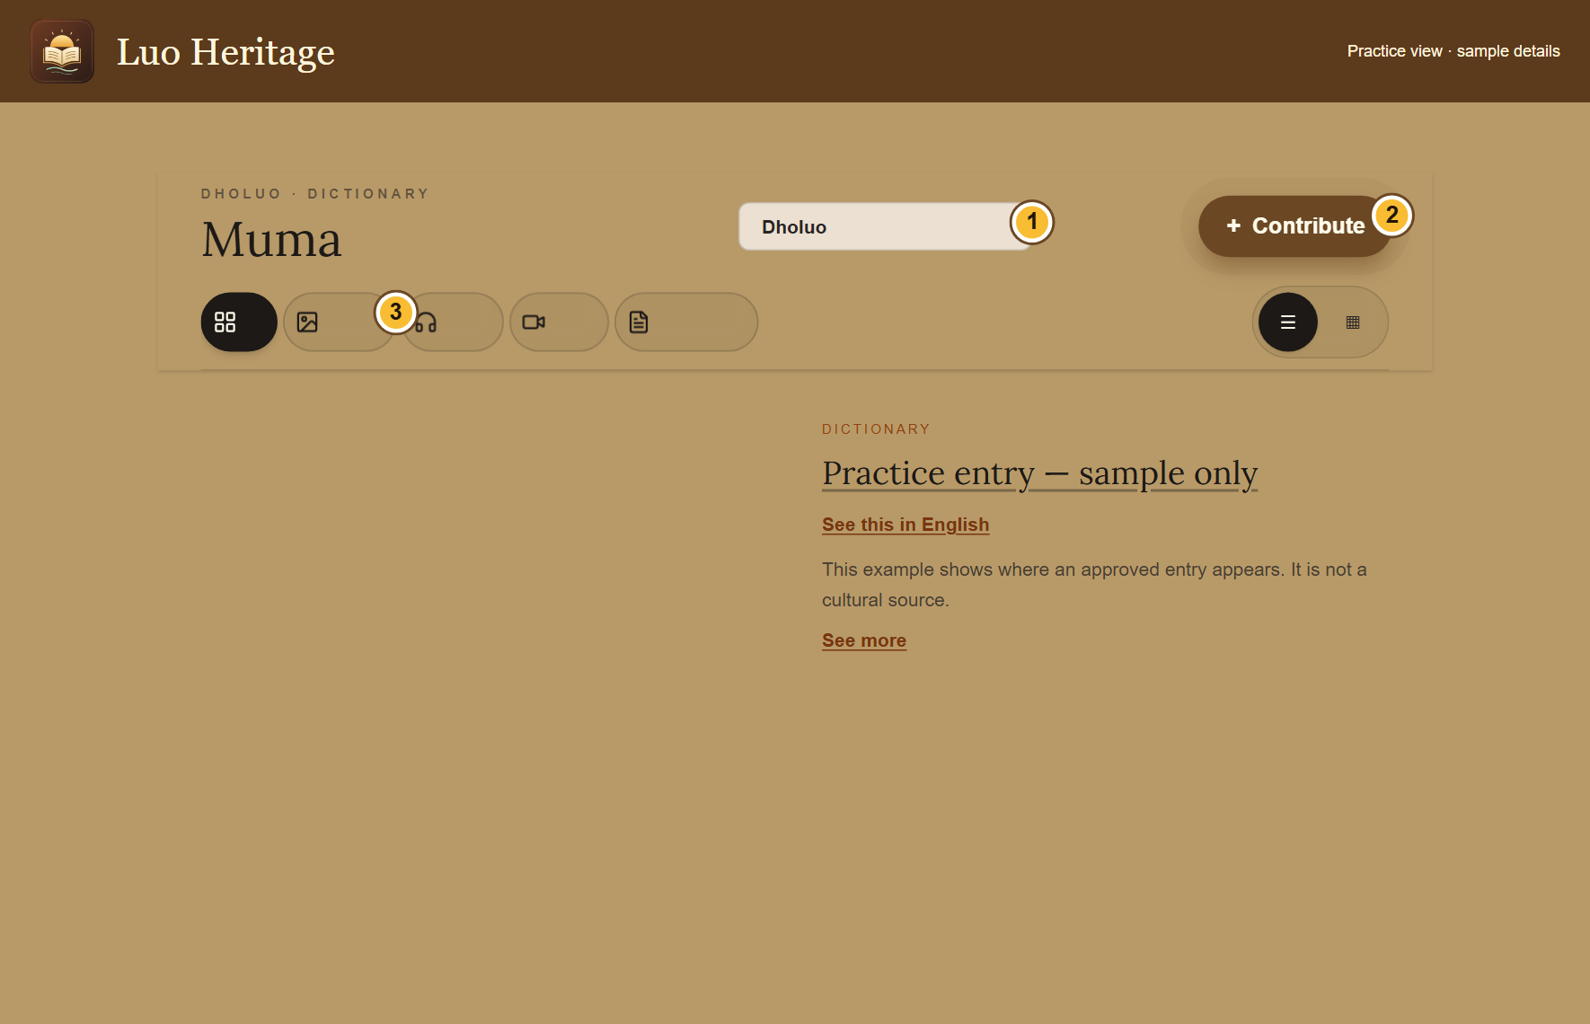
SELF-STUDY / COMMUNITY MEMBERS
Read, listen and change the view
1
Open an entry or choose the grid button,
then select its card.
2
Use See description or See this in English
when offered. Audio and video use their
own play controls.
3
Use All if a filter shows no results. Save
item is available in signed-in views that
offer it.
An unavailable English description does not mean the original entry is
missing.
CURRENT INTERFACE • PRACTICE DETAILS
CHECK: You can read the entry and use the media that has actually been published.
LUO HERITAGE / COMMUNITY MEMBERS
Contents
11 / 29
Notes:
Read, listen and change the view
1. Open an entry or choose the grid button, then select its card.
2. Use See description or See this in English when offered. Audio and video use their own play controls.
3. Use All if a filter shows no results. Save item is available in signed-in views that offer it.
Expected result: You can read the entry and use the media that has actually been published.
Important: An unavailable English description does not mean the original entry is missing.
Screenshot: current application interface rendered with sample details. No live action is demonstrated.

Slide 12
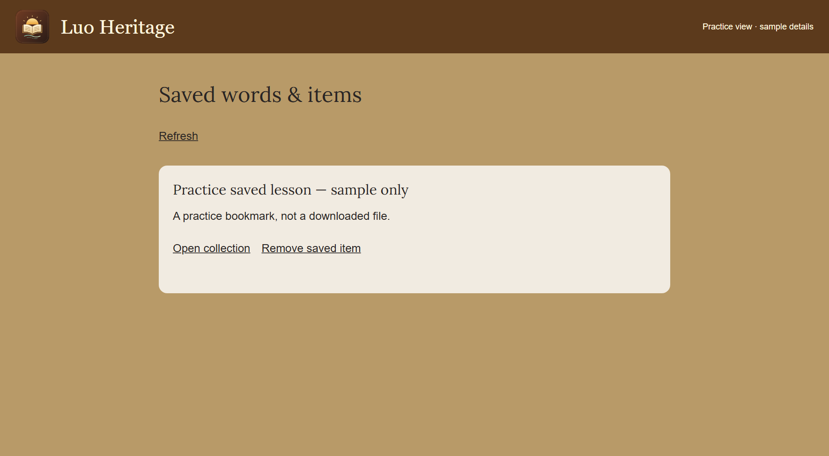
SELF-STUDY / COMMUNITY MEMBERS
Return to saved words and items
1
Sign in and choose Save item on an entry
or lesson where that button is available.
2
Open Saved words & items from the menu.
Choose Open collection to return to its
source.
3
Choose Remove saved item when you no
longer need the bookmark.
Saving a bookmark does not download a file for offline use.
CURRENT INTERFACE • PRACTICE DETAILS
CHECK: Your saved list helps you find material again on the same account.
LUO HERITAGE / COMMUNITY MEMBERS
Contents
12 / 29
Notes:
Return to saved words and items
1. Sign in and choose Save item on an entry or lesson where that button is available.
2. Open Saved words & items from the menu. Choose Open collection to return to its source.
3. Choose Remove saved item when you no longer need the bookmark.
Expected result: Your saved list helps you find material again on the same account.
Important: Saving a bookmark does not download a file for offline use.
Screenshot: current application interface rendered with sample details. No live action is demonstrated.

Slide 13
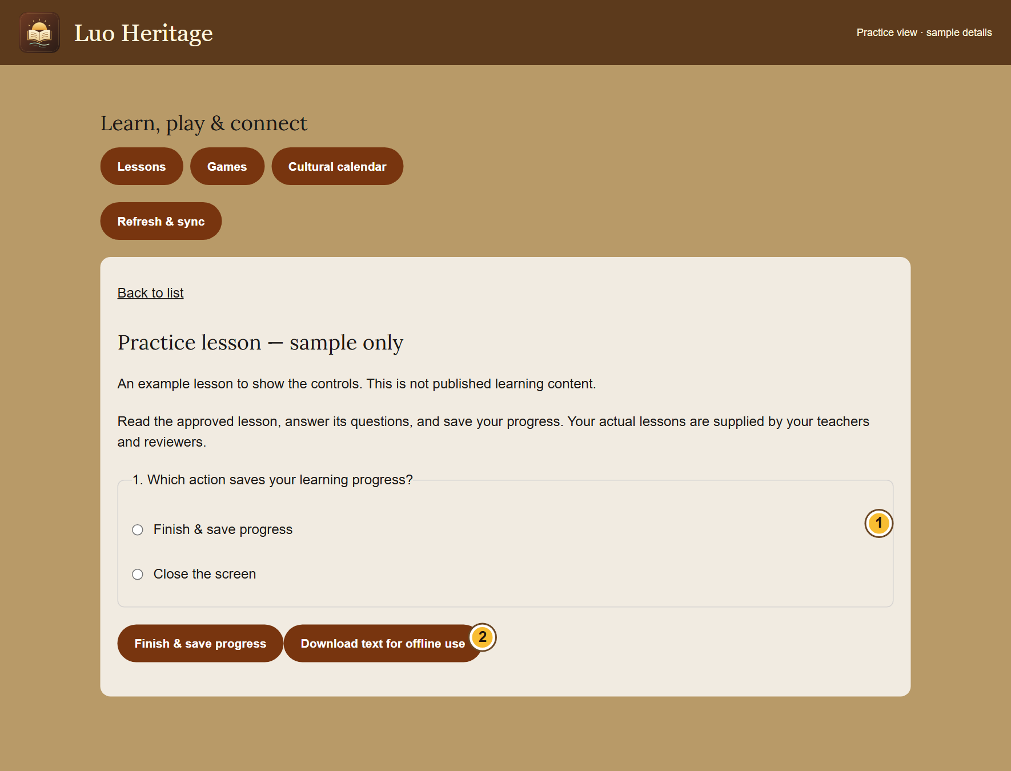
SELF-STUDY / COMMUNITY MEMBERS
Open a lesson and keep your progress
1
Choose Lessons, games & calendar. Open
a published lesson.
2
Read the lesson and answer its questions.
Choose Finish & save progress.
3
Read the result and feedback. Sign in with
the same account on another device to
keep your learning together.
A score helps you learn; it does not replace a teacher’s review.
CURRENT INTERFACE • PRACTICE DETAILS
CHECK: You see a saved result or a message saying the attempt is waiting to go online.
LUO HERITAGE / COMMUNITY MEMBERS
Contents
13 / 29
Notes:
Open a lesson and keep your progress
1. Choose Lessons, games & calendar. Open a published lesson.
2. Read the lesson and answer its questions. Choose Finish & save progress.
3. Read the result and feedback. Sign in with the same account on another device to keep your learning together.
Expected result: You see a saved result or a message saying the attempt is waiting to go online.
Important: A score helps you learn; it does not replace a teacher’s review.
Screenshot: current application interface rendered with sample details. No live action is demonstrated.

Slide 14
SELF-STUDY / COMMUNITY MEMBERS
Prepare to study without internet
1
While connected, open a lesson that allows
downloads. Choose Download text for
offline use.
2
Keep using the same browser or app
profile. Downloaded text can be read
without internet for up to seven days.
3
Reconnect and choose Refresh & sync.
Keep the app open until waiting attempts
have been saved online.
These downloads contain text, not the audio or video files. Some lessons
cannot be downloaded.
CURRENT INTERFACE • PRACTICE DETAILS
CHECK: Permitted lesson text is available offline and saved attempts can synchronize later.
LUO HERITAGE / COMMUNITY MEMBERS
Contents
14 / 29
Notes:
Prepare to study without internet
1. While connected, open a lesson that allows downloads. Choose Download text for offline use.
2. Keep using the same browser or app profile. Downloaded text can be read without internet for up to seven days.
3. Reconnect and choose Refresh & sync. Keep the app open until waiting attempts have been saved online.
Expected result: Permitted lesson text is available offline and saved attempts can synchronize later.
Important: These downloads contain text, not the audio or video files. Some lessons cannot be downloaded.
Screenshot: current application interface rendered with sample details. No live action is demonstrated.

Slide 15
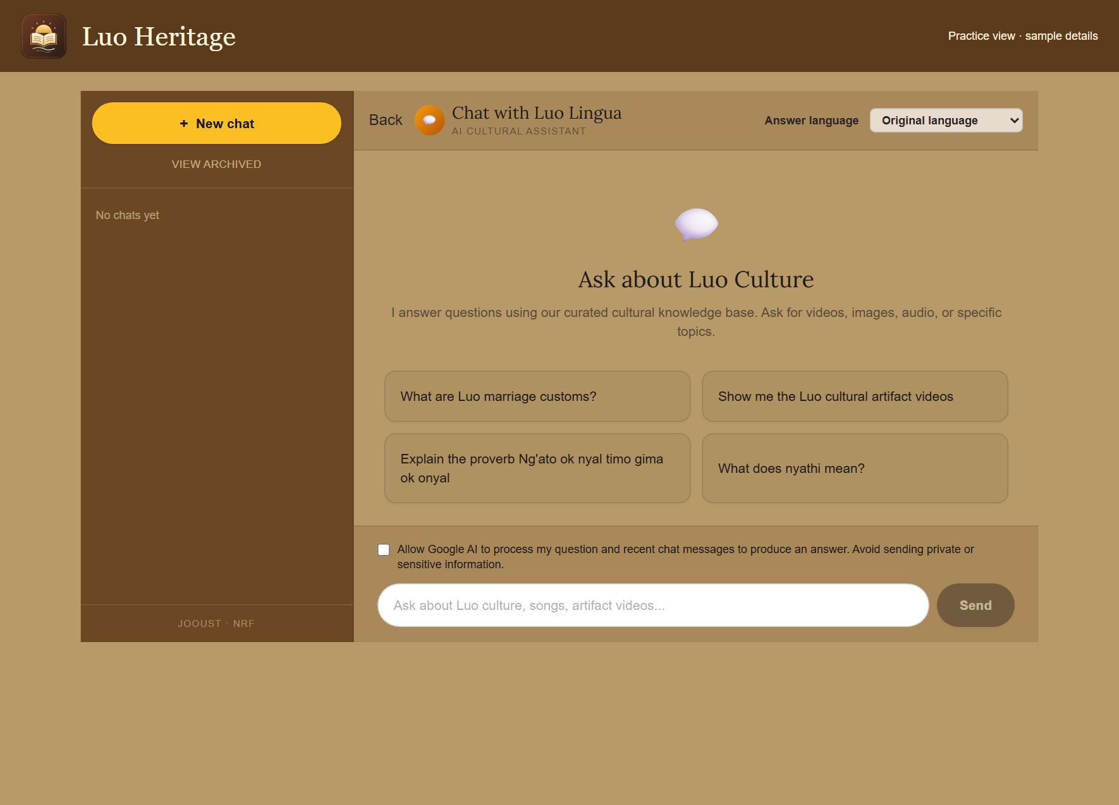
SELF-STUDY / COMMUNITY MEMBERS
Ask the AI chatbot a clear question
1
Open Chat or Chatbot. Choose your
answer language and read the processing
permission notice.
2
If you agree, allow AI processing. Ask one
clear question and wait for the response.
3
Open any sources provided. Ask a
follow-up question if you need a simpler
explanation.
AI can make mistakes. Do not enter private interviews, passwords or
learners’ personal information.
CURRENT INTERFACE • PRACTICE DETAILS
CHECK: You can read an answer and inspect any linked sources.
LUO HERITAGE / COMMUNITY MEMBERS
Contents
15 / 29
Notes:
Ask the AI chatbot a clear question
1. Open Chat or Chatbot. Choose your answer language and read the processing permission notice.
2. If you agree, allow AI processing. Ask one clear question and wait for the response.
3. Open any sources provided. Ask a follow-up question if you need a simpler explanation.
Expected result: You can read an answer and inspect any linked sources.
Important: AI can make mistakes. Do not enter private interviews, passwords or learners’ personal information.
Screenshot: current application interface rendered with sample details. No live action is demonstrated.

Slide 16

SELF-STUDY / COMMUNITY MEMBERS
Find your access and saved chats
1
Open the account menu and choose My
account & saved chats.
2
Read My access to check your assigned
role. Open a chat from Recent or Archived.
3
For your name, sessions or notifications,
open Profile, sessions & notifications from
the menu.
Choosing an interest such as teacher or researcher does not give staff
access.
CURRENT INTERFACE • PRACTICE DETAILS
CHECK: You can find your own account details and earlier conversations.
LUO HERITAGE / COMMUNITY MEMBERS
Contents
16 / 29
Notes:
Find your access and saved chats
1. Open the account menu and choose My account & saved chats.
2. Read My access to check your assigned role. Open a chat from Recent or Archived.
3. For your name, sessions or notifications, open Profile, sessions & notifications from the menu.
Expected result: You can find your own account details and earlier conversations.
Important: Choosing an interest such as teacher or researcher does not give staff access.
Screenshot: current application interface rendered with sample details. No live action is demonstrated.

Slide 17
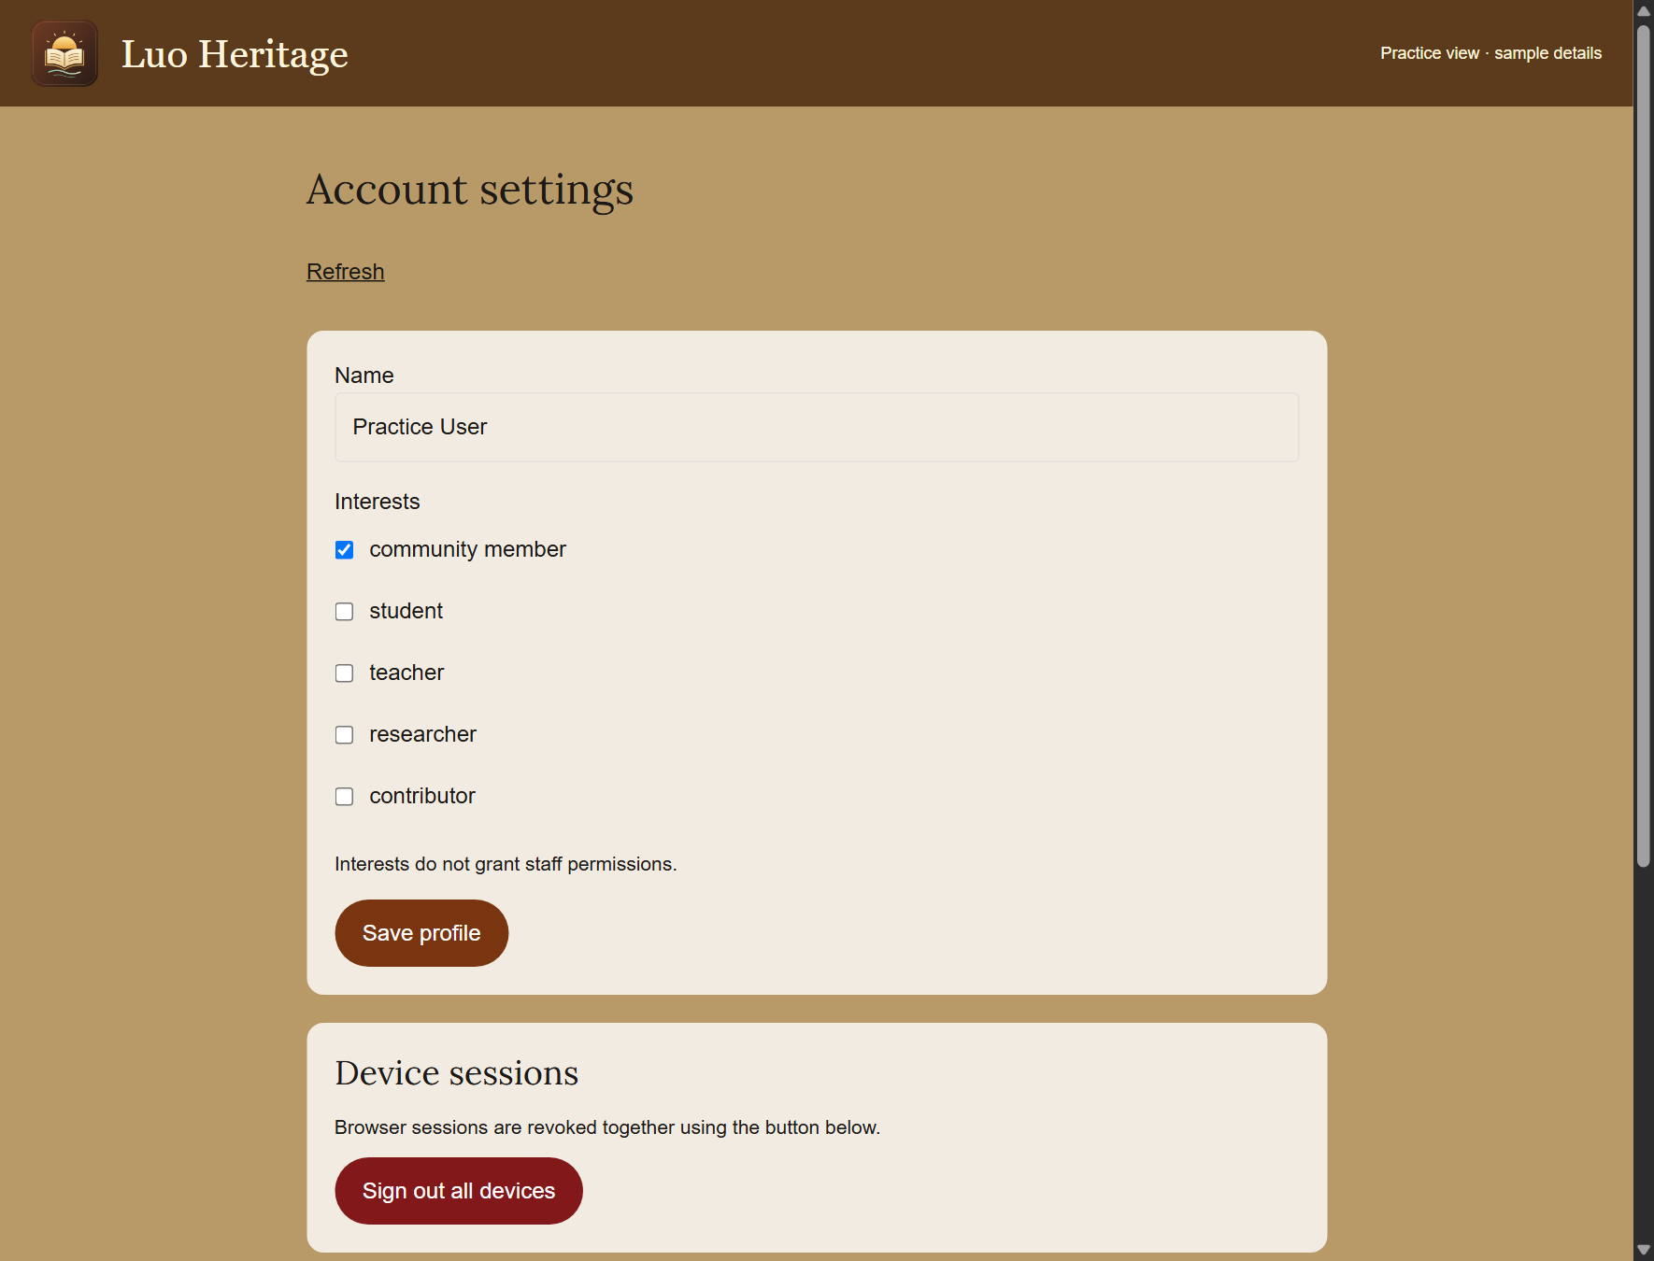
SELF-STUDY / COMMUNITY MEMBERS
Update your profile and read notices
1
Open Profile, sessions & notifications from
the menu.
2
Change your name or interests and choose
Save profile. Interests describe you; they
do not grant staff duties.
3
Read your notifications and use Mark read
when offered. Check Device sessions if
you need to end an old app sign-in.
Sign out all devices ends your current sign-in too. Sign in again
afterwards if you use it.
CURRENT INTERFACE • PRACTICE DETAILS
CHECK: Your profile changes are saved and notices are easy to find.
LUO HERITAGE / COMMUNITY MEMBERS
Contents
17 / 29
Notes:
Update your profile and read notices
1. Open Profile, sessions & notifications from the menu.
2. Change your name or interests and choose Save profile. Interests describe you; they do not grant staff duties.
3. Read your notifications and use Mark read when offered. Check Device sessions if you need to end an old app sign-in.
Expected result: Your profile changes are saved and notices are easy to find.
Important: Sign out all devices ends your current sign-in too. Sign in again afterwards if you use it.
Screenshot: current application interface rendered with sample details. No live action is demonstrated.

Slide 18
SELF-STUDY / COMMUNITY MEMBERS
Verify your email address
1
Open account verification and recovery
from your account settings.
2
Choose Verify email under Action, enter
your own account email and choose Send
email.
3
Open the newest email link within 30
minutes and choose Confirm. Use a new
link if the earlier one has expired.
The screenshot shows the same form set to Reset password. Change
Action to Verify email for this task.
CURRENT INTERFACE • PRACTICE DETAILS
CHECK: The confirmation verifies the address for the intended account.
LUO HERITAGE / COMMUNITY MEMBERS
Contents
18 / 29
Notes:
Verify your email address
1. Open account verification and recovery from your account settings.
2. Choose Verify email under Action, enter your own account email and choose Send email.
3. Open the newest email link within 30 minutes and choose Confirm. Use a new link if the earlier one has expired.
Expected result: The confirmation verifies the address for the intended account.
Important: The screenshot shows the same form set to Reset password. Change Action to Verify email for this task.
Screenshot: current application interface rendered with sample details. No live action is demonstrated.

Slide 19
SELF-STUDY / COMMUNITY MEMBERS
If you decide to delete your account
1
Read the warning first. Deletion removes
your sign-in, profile, saved chats and
personal progress.
2
In account recovery, choose Delete
account. Request the email link only if you
intend to continue.
3
Open the link and read the confirmation
before choosing Confirm. Required
cultural-source and review records can be
retained.
This is optional, not a practice task. Active class teachers and the Master
Super Admin may need to resolve their responsibilities first.
CURRENT INTERFACE • PRACTICE DETAILS
CHECK: You understand the consequences before requesting deletion.
LUO HERITAGE / COMMUNITY MEMBERS
Contents
19 / 29
Notes:
If you decide to delete your account
1. Read the warning first. Deletion removes your sign-in, profile, saved chats and personal progress.
2. In account recovery, choose Delete account. Request the email link only if you intend to continue.
3. Open the link and read the confirmation before choosing Confirm. Required cultural-source and review records can be retained.
Expected result: You understand the consequences before requesting deletion.
Important: This is optional, not a practice task. Active class teachers and the Master Super Admin may need to resolve their responsibilities first.
Screenshot: current application interface rendered with sample details. No live action is demonstrated.

Slide 20
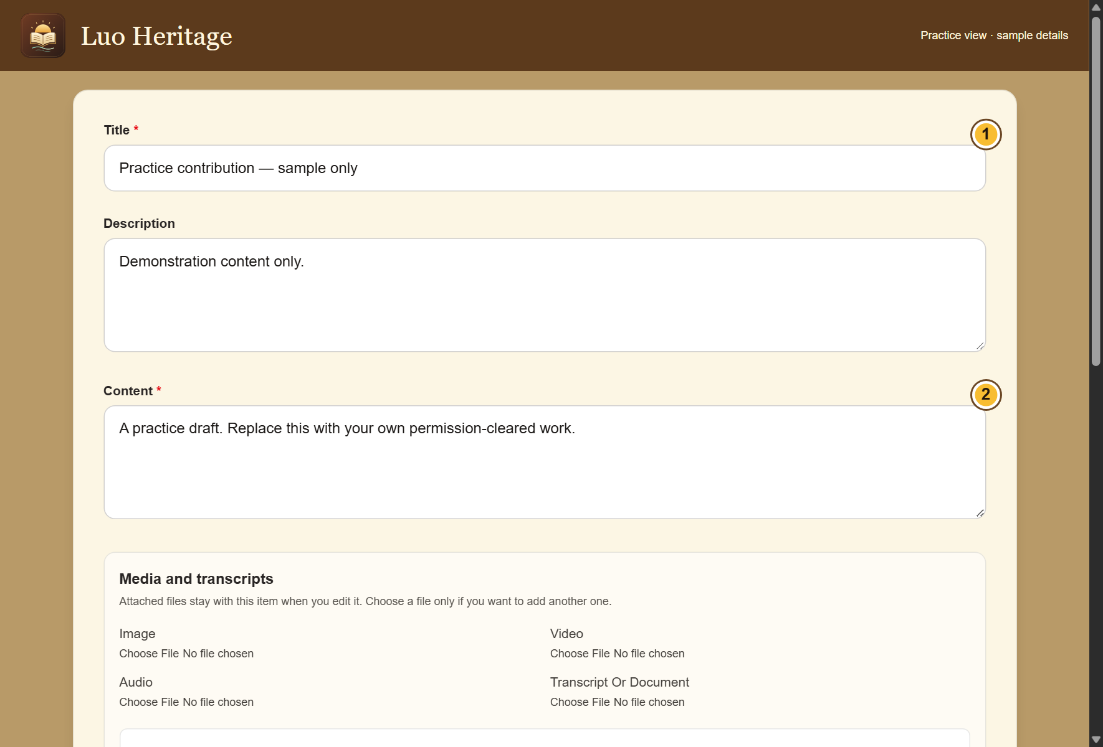
SELF-STUDY / COMMUNITY MEMBERS
Start your own contribution
1
Choose Contribute & submissions or the
Contribute button inside a collection.
2
Select the collection and choose New
private draft. Enter a short title and the
requested details.
3
Use your own material or material you
have permission to share. Mark uncertain
facts for review.
CURRENT INTERFACE • PRACTICE DETAILS
CHECK: A contribution form contains your draft; it is not published.
LUO HERITAGE / COMMUNITY MEMBERS
Contents
20 / 29
Notes:
Start your own contribution
1. Choose Contribute & submissions or the Contribute button inside a collection.
2. Select the collection and choose New private draft. Enter a short title and the requested details.
3. Use your own material or material you have permission to share. Mark uncertain facts for review.
Expected result: A contribution form contains your draft; it is not published.
Screenshot: current application interface rendered with sample details. No live action is demonstrated.

Slide 21
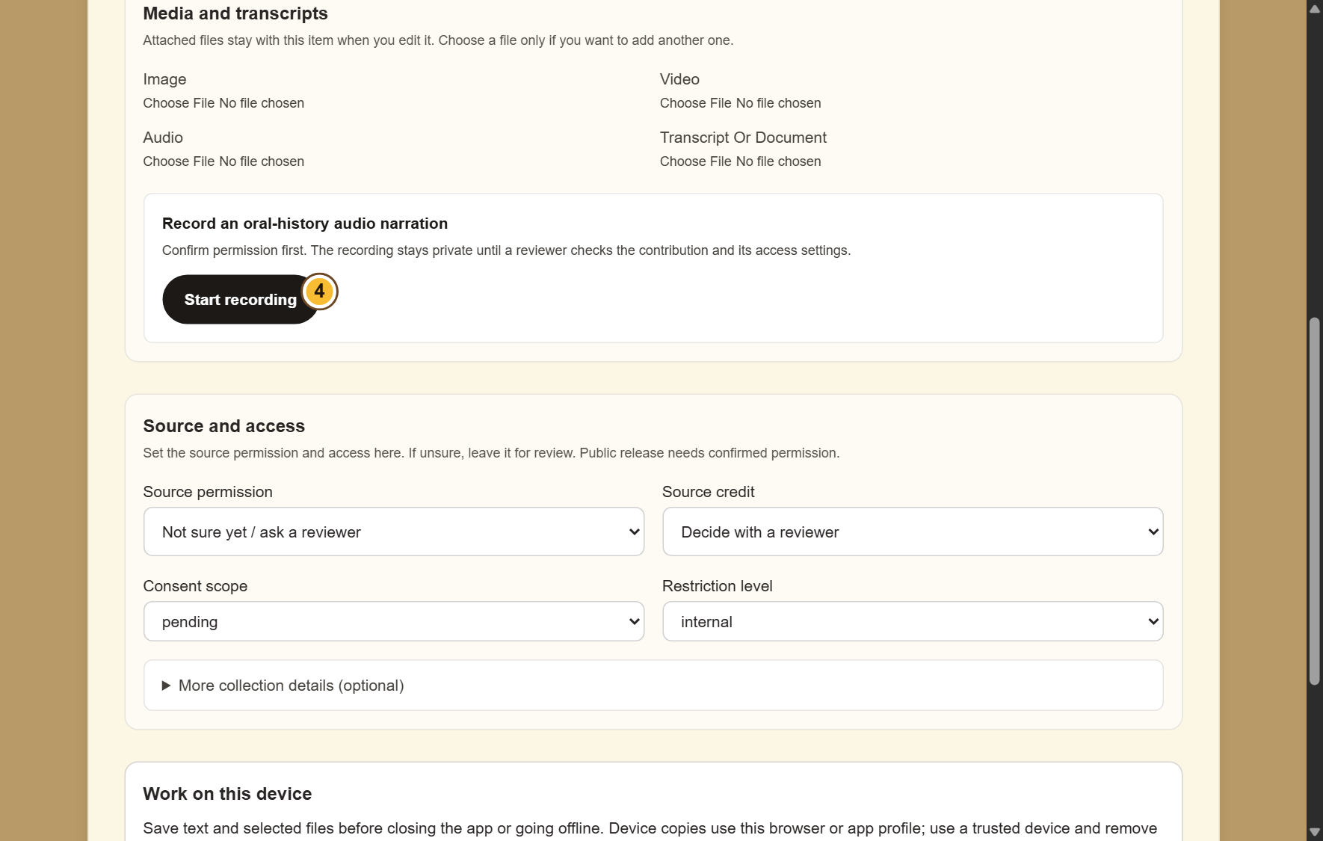
SELF-STUDY / COMMUNITY MEMBERS
Add pictures, audio or documents
1
Find Media and transcripts. Choose a file
under the matching type.
2
For an oral history, confirm permission
before choosing Start recording. Stop when
finished.
3
Check that the correct files are selected.
Keep the app open while an upload is in
progress.
If microphone access is refused, allow it in your device settings or attach
an existing recording.
CURRENT INTERFACE • PRACTICE DETAILS
CHECK: The selected files stay with the contribution when it is saved successfully.
LUO HERITAGE / COMMUNITY MEMBERS
Contents
21 / 29
Notes:
Add pictures, audio or documents
1. Find Media and transcripts. Choose a file under the matching type.
2. For an oral history, confirm permission before choosing Start recording. Stop when finished.
3. Check that the correct files are selected. Keep the app open while an upload is in progress.
Expected result: The selected files stay with the contribution when it is saved successfully.
Important: If microphone access is refused, allow it in your device settings or attach an existing recording.
Screenshot: current application interface rendered with sample details. No live action is demonstrated.

Slide 22

SELF-STUDY / COMMUNITY MEMBERS
Check permission before sharing
1
Under Source and access, choose Source
permission. If unsure, leave Not sure yet /
ask a reviewer.
2
Choose how to credit the source. Use a
person’s name only when they agree.
3
Keep restricted, sacred or research-only
material private. Ask a reviewer before
changing access.
Permission to collect material is not automatically permission to publish it.
CURRENT INTERFACE • PRACTICE DETAILS
CHECK: The draft records who may use the material and how the source should be credited.
LUO HERITAGE / COMMUNITY MEMBERS
Contents
22 / 29
Notes:
Check permission before sharing
1. Under Source and access, choose Source permission. If unsure, leave Not sure yet / ask a reviewer.
2. Choose how to credit the source. Use a person’s name only when they agree.
3. Keep restricted, sacred or research-only material private. Ask a reviewer before changing access.
Expected result: The draft records who may use the material and how the source should be credited.
Important: Permission to collect material is not automatically permission to publish it.
Screenshot: current application interface rendered with sample details. No live action is demonstrated.

Slide 23
SELF-STUDY / COMMUNITY MEMBERS
What the permission labels mean
1
Source permission: has the source agreed
to the proposed use? Choose Not sure yet
when you do not know.
2
Consent scope: what use was agreed?
Public excerpt means an approved public
part; research only and teaching have
different limits.
3
Restriction level: who may see it? Internal
and restricted are not public. Sacred
material needs the collection owner’s
special care.
If the permission record is unclear, keep the item private and ask the
responsible reviewer.
CURRENT INTERFACE • PRACTICE DETAILS
CHECK: You understand the labels before you change them.
LUO HERITAGE / COMMUNITY MEMBERS
Contents
23 / 29
Notes:
What the permission labels mean
1. Source permission: has the source agreed to the proposed use? Choose Not sure yet when you do not know.
2. Consent scope: what use was agreed? Public excerpt means an approved public part; research only and teaching have different limits.
3. Restriction level: who may see it? Internal and restricted are not public. Sacred material needs the collection owner’s special care.
Expected result: You understand the labels before you change them.
Important: If the permission record is unclear, keep the item private and ask the responsible reviewer.
Screenshot: current application interface rendered with sample details. No live action is demonstrated.

Slide 24
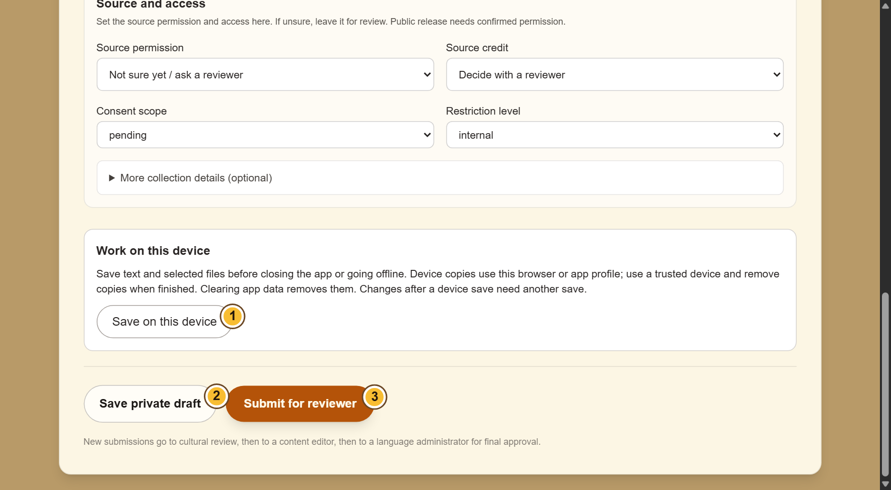
SELF-STUDY / COMMUNITY MEMBERS
Understand the three save choices
1
Save on this device keeps a local copy,
including selected files. It does not submit
your work.
2
Save private draft saves an online draft for
your account. You need a connection.
3
Submit for reviewer sends the contribution
for checking. Wait for confirmation before
leaving.
Clearing browser or app data can remove local drafts. Save again after
making changes.
CURRENT INTERFACE • PRACTICE DETAILS
CHECK: You know whether the work is on this device, saved online, or sent for review.
LUO HERITAGE / COMMUNITY MEMBERS
Contents
24 / 29
Notes:
Understand the three save choices
1. Save on this device keeps a local copy, including selected files. It does not submit your work.
2. Save private draft saves an online draft for your account. You need a connection.
3. Submit for reviewer sends the contribution for checking. Wait for confirmation before leaving.
Expected result: You know whether the work is on this device, saved online, or sent for review.
Important: Clearing browser or app data can remove local drafts. Save again after making changes.
Screenshot: current application interface rendered with sample details. No live action is demonstrated.

Slide 25
SELF-STUDY / COMMUNITY MEMBERS
How a contribution reaches readers
1
The uploader or contributor prepares a draft and submits it.
2
A cultural reviewer checks accuracy. An editor makes requested corrections and returns the
item for review.
3
A publisher checks the final item and permission. Only an approved public release becomes
visible to readers.
Prepare draft
→
Cultural review
→
Publisher check
→
Public release
Different people should perform the independent checks. Do not approve your own work.
CHECK: An item may return for changes. Drafts and private approvals are not public publication.
LUO HERITAGE / COMMUNITY MEMBERS
Contents
25 / 29
Notes:
How a contribution reaches readers
1. The uploader or contributor prepares a draft and submits it.
2. A cultural reviewer checks accuracy. An editor makes requested corrections and returns the item for review.
3. A publisher checks the final item and permission. Only an approved public release becomes visible to readers.
Expected result: An item may return for changes. Drafts and private approvals are not public publication.
Important: Different people should perform the independent checks. Do not approve your own work.

Slide 26
SELF-STUDY / COMMUNITY MEMBERS
Check what happened to your submission
1
Open Contribute & submissions, then find
My online submissions.
2
Read the status. If asked to make changes,
choose Edit draft or requested revision.
3
Read the reviewer’s request, make the
correction, and submit again when ready.
If an item is locked for review, ask the reviewer to return it rather than
creating a duplicate.
CURRENT INTERFACE • PRACTICE DETAILS
CHECK: You can tell the difference between a draft, an item under review and published material.
LUO HERITAGE / COMMUNITY MEMBERS
Contents
26 / 29
Notes:
Check what happened to your submission
1. Open Contribute & submissions, then find My online submissions.
2. Read the status. If asked to make changes, choose Edit draft or requested revision.
3. Read the reviewer’s request, make the correction, and submit again when ready.
Expected result: You can tell the difference between a draft, an item under review and published material.
Important: If an item is locked for review, ask the reviewer to return it rather than creating a duplicate.
Screenshot: current application interface rendered with sample details. No live action is demonstrated.

Slide 27
SELF-STUDY / COMMUNITY MEMBERS
Protect your account and other people
1
Use your own account. Sign out on a
shared computer or phone.
2
Do not copy private interviews, class
results or account lists into public chats or
messages.
3
If a screen shows information you should
not see, stop and tell the account
administrator.
Send support the screen name and error message, never your password
or a reset link.
CURRENT INTERFACE • PRACTICE DETAILS
CHECK: Your work remains linked to the right person and private information stays protected.
LUO HERITAGE / COMMUNITY MEMBERS
Contents
27 / 29
Notes:
Protect your account and other people
1. Use your own account. Sign out on a shared computer or phone.
2. Do not copy private interviews, class results or account lists into public chats or messages.
3. If a screen shows information you should not see, stop and tell the account administrator.
Expected result: Your work remains linked to the right person and private information stays protected.
Important: Send support the screen name and error message, never your password or a reset link.
Screenshot: current application interface rendered with sample details. No live action is demonstrated.

Slide 28
SELF-STUDY / COMMUNITY MEMBERS
When something does not work
1
Check your internet connection. Read the message on screen
before trying again.
2
If your sign-in has expired, sign in again. If a button is missing,
ask which role and language you have.
3
If it still fails, note the time, screen, button and exact message.
Send these to your account administrator.
Before repeating an upload or submission, check whether the first attempt was already saved.
CURRENT INTERFACE • PRACTICE DETAILS
CHECK: You can explain the problem clearly without exposing private information.
LUO HERITAGE / COMMUNITY MEMBERS
Contents
28 / 29
Notes:
When something does not work
1. Check your internet connection. Read the message on screen before trying again.
2. If your sign-in has expired, sign in again. If a button is missing, ask which role and language you have.
3. If it still fails, note the time, screen, button and exact message. Send these to your account administrator.
Expected result: You can explain the problem clearly without exposing private information.
Important: Before repeating an upload or submission, check whether the first attempt was already saved.
Screenshot: current application interface rendered with sample details. No live action is demonstrated.

Slide 29
SELF-STUDY / COMMUNITY MEMBERS
Try it yourself: your readiness check
1
Find one collection and change its content filter.
2
Open a lesson or ask a simple AI question, then check any source.
3
Prepare a private practice draft and identify the option that sends it for review.
Try
→
Check
→
Ask if unsure
Use only approved practice material. Do not publish, delete accounts or change live settings just to practise.
CHECK: You are ready for routine work when you can complete these steps without help.
LUO HERITAGE / COMMUNITY MEMBERS
Contents
29 / 29
Notes:
Try it yourself: your readiness check
1. Find one collection and change its content filter.
2. Open a lesson or ask a simple AI question, then check any source.
3. Prepare a private practice draft and identify the option that sends it for review.
Expected result: You are ready for routine work when you can complete these steps without help.
Important: Use only approved practice material. Do not publish, delete accounts or change live settings just to practise.

