Slide 1

LUO HERITAGE / SELF-STUDY SLIDES
LANGUAGE • CULTURE • LIVING MEMORY
Students and learners
Study lessons, join classes and keep your progress
You will be able to enroll, join a class, study and find your feedback.
READ • TRY • CHECK
25 October 2026 | Edition 1.0
Notes:
Self-study guide. Screenshots show actual interface components rendered with clearly labelled sample data, not a production acceptance demonstration. No real account or cultural record was changed to make these slides.

Slide 2
SELF-STUDY / STUDENTS AND LEARNERS
Start here: learn at your own pace
1
Read a slide, try its action, then check the result. Tap means click. Gold circles mark important
controls in the screenshots.
2
Use your own account. Your organisation supplies the correct website address and any staff
access.
3
Screenshots show the current interface with practice details. Actual names, content and
menus may differ.
Read the step
→
Try it yourself
→
Check the result
If your menu looks different, first check My access. Do not ask someone to lend you their account.
CHECK: You will be able to enroll, join a class, study and find your feedback.
LUO HERITAGE / STUDENTS AND LEARNERS
Contents
02 / 19
Notes:
Start here: learn at your own pace
1. Read a slide, try its action, then check the result. Tap means click. Gold circles mark important controls in the screenshots.
2. Use your own account. Your organisation supplies the correct website address and any staff access.
3. Screenshots show the current interface with practice details. Actual names, content and menus may differ.
Expected result: You will be able to enroll, join a class, study and find your feedback.
Important: If your menu looks different, first check My access. Do not ask someone to lend you their account.

Slide 3
SELF-STUDY / STUDENTS AND LEARNERS
What this guide covers
1
Sign in, recover access and find your learning screens.
2
Study lessons and courses, including downloaded text.
3
Join a class, submit work and read teacher feedback.
CHECK: Use the slide numbers to return to a task. The PDF has page bookmarks; PowerPoint has a contents view.
LUO HERITAGE / STUDENTS AND LEARNERS
Contents
03 / 19
Notes:
What this guide covers
1. Sign in, recover access and find your learning screens.
2. Study lessons and courses, including downloaded text.
3. Join a class, submit work and read teacher feedback.
Expected result: Use the slide numbers to return to a task. The PDF has page bookmarks; PowerPoint has a contents view.

Slide 4

SELF-STUDY / STUDENTS AND LEARNERS
Sign in to your own account
1
Open the Luo Heritage address supplied by your organisation.
Choose Sign in or Log in.
2
Enter your email and password, then choose Log in. Check your
spelling if it fails.
3
Community members may also use Google. Staff should use the
account supplied by their administrator.
Never share your password. Use only an address you trust.
CURRENT INTERFACE • PRACTICE DETAILS
CHECK: Your account or dashboard opens.
LUO HERITAGE / STUDENTS AND LEARNERS
Contents
04 / 19
Notes:
Sign in to your own account
1. Open the Luo Heritage address supplied by your organisation. Choose Sign in or Log in.
2. Enter your email and password, then choose Log in. Check your spelling if it fails.
3. Community members may also use Google. Staff should use the account supplied by their administrator.
Expected result: Your account or dashboard opens.
Important: Never share your password. Use only an address you trust.
Screenshot: current application interface rendered with sample details. No live action is demonstrated.

Slide 5

SELF-STUDY / STUDENTS AND LEARNERS
Forgot your password?
1
On the sign-in screen, choose Forgotten
password? Select Reset password.
2
Enter your account email. Choose Send
email, then check your inbox and spam
folder.
3
Open the newest reset link within 30
minutes. A link can be used only once.
If no email arrives, contact the person who manages your account. Do
not keep requesting links.
CURRENT INTERFACE • PRACTICE DETAILS
CHECK: An account email arrives if the address is eligible and the email service is available.
LUO HERITAGE / STUDENTS AND LEARNERS
Contents
05 / 19
Notes:
Forgot your password?
1. On the sign-in screen, choose Forgotten password? Select Reset password.
2. Enter your account email. Choose Send email, then check your inbox and spam folder.
3. Open the newest reset link within 30 minutes. A link can be used only once.
Expected result: An account email arrives if the address is eligible and the email service is available.
Important: If no email arrives, contact the person who manages your account. Do not keep requesting links.
Screenshot: current application interface rendered with sample details. No live action is demonstrated.

Slide 6

SELF-STUDY / STUDENTS AND LEARNERS
Choose a new password
1
Open the password reset link from your
own inbox.
2
Enter a new password of at least 12
characters. A short phrase with several
words is easier to remember.
3
Choose Confirm. Return to sign in and use
the new password on each device.
Do not forward the reset link. If it has expired, request a new one.
CURRENT INTERFACE • PRACTICE DETAILS
CHECK: The password changes and old sign-ins are ended.
LUO HERITAGE / STUDENTS AND LEARNERS
Contents
06 / 19
Notes:
Choose a new password
1. Open the password reset link from your own inbox.
2. Enter a new password of at least 12 characters. A short phrase with several words is easier to remember.
3. Choose Confirm. Return to sign in and use the new password on each device.
Expected result: The password changes and old sign-ins are ended.
Important: Do not forward the reset link. If it has expired, request a new one.
Screenshot: current application interface rendered with sample details. No live action is demonstrated.

Slide 7
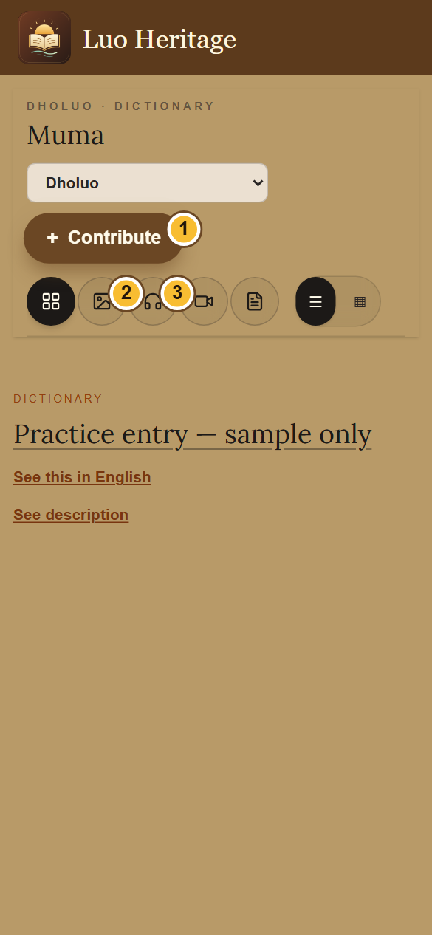
SELF-STUDY / STUDENTS AND LEARNERS
Use the library on a phone
1
Open a collection, such as Muma (Dictionary), from the menu.
2
Use the picture, headphones, video or page icon to choose a
type of content. The four-square icon shows all types.
3
Choose the list or grid button to change the view. Scroll the
entries below the controls.
An empty result can mean there are no published entries of that type. Try All.
CURRENT INTERFACE • PRACTICE DETAILS
CHECK: The collection shows entries matching your chosen filter.
LUO HERITAGE / STUDENTS AND LEARNERS
Contents
07 / 19
Notes:
Use the library on a phone
1. Open a collection, such as Muma (Dictionary), from the menu.
2. Use the picture, headphones, video or page icon to choose a type of content. The four-square icon shows all types.
3. Choose the list or grid button to change the view. Scroll the entries below the controls.
Expected result: The collection shows entries matching your chosen filter.
Important: An empty result can mean there are no published entries of that type. Try All.
Screenshot: current application interface rendered with sample details. No live action is demonstrated.

Slide 8
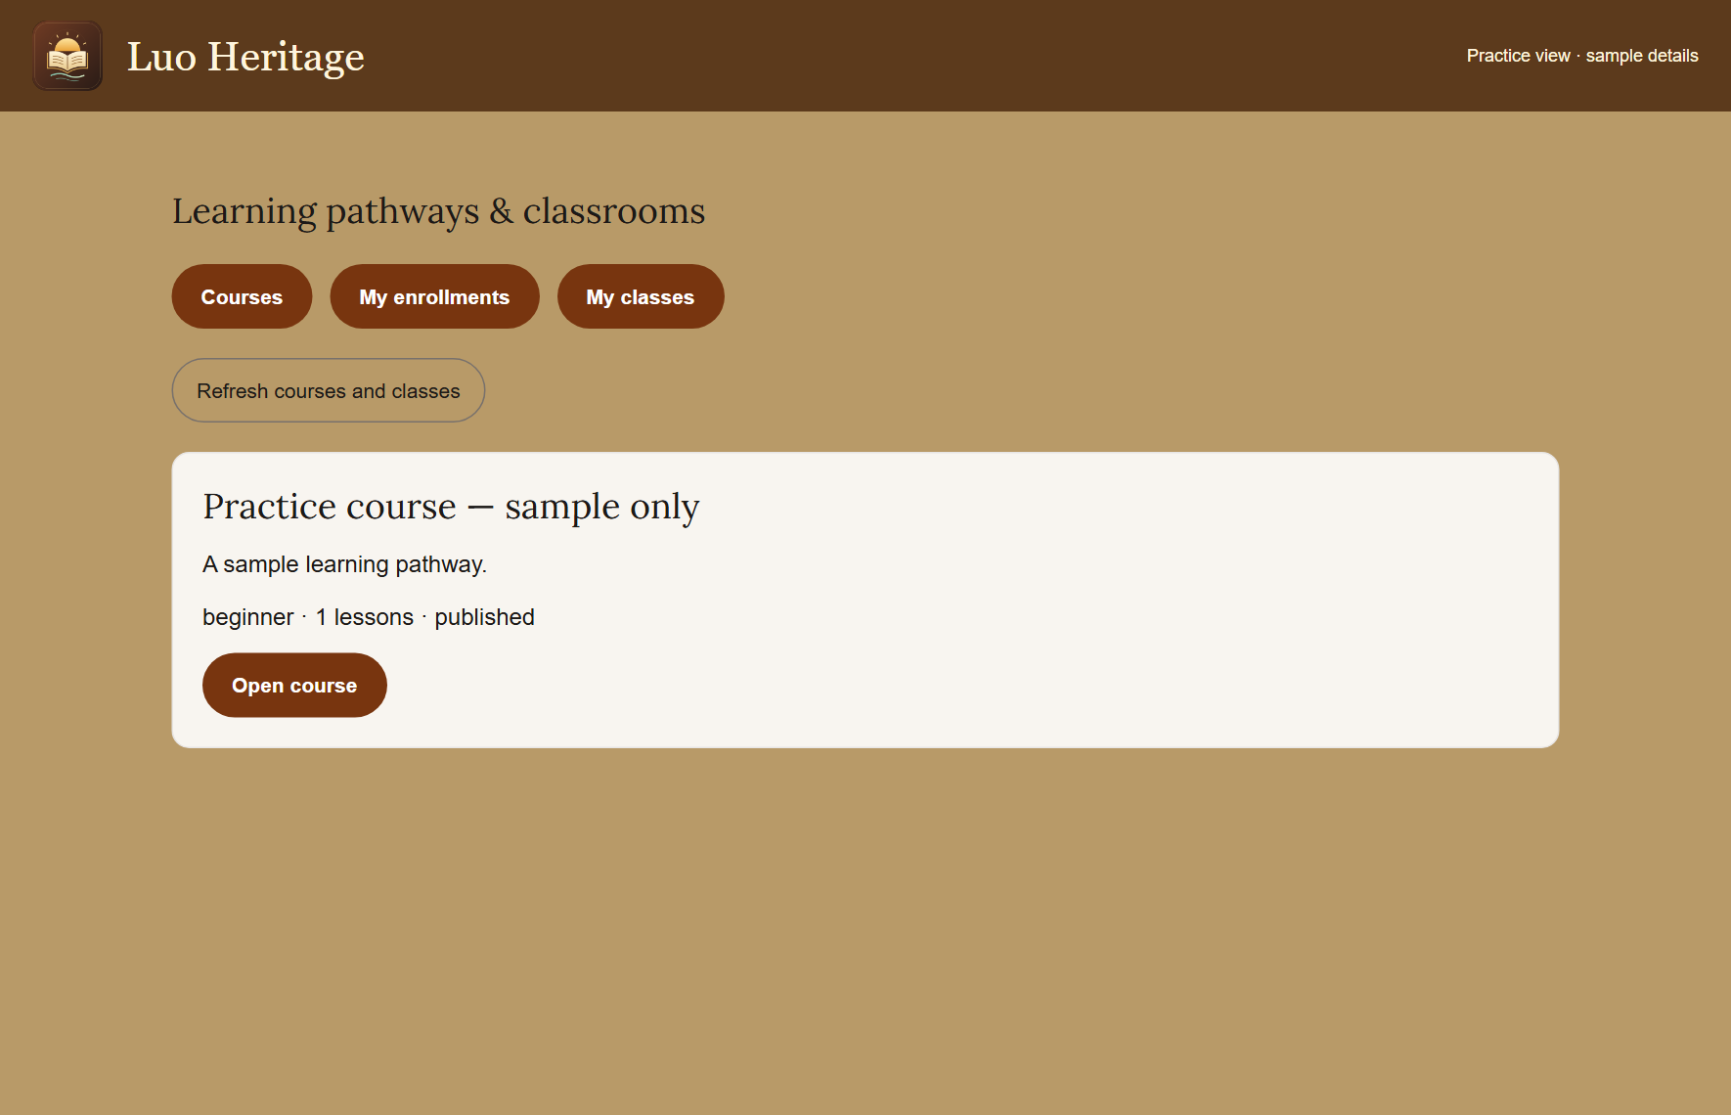
SELF-STUDY / STUDENTS AND LEARNERS
Join a learning course
1
Open Learning pathways & courses.
Choose a published course and read its
description.
2
Open the course and enroll using the
button shown. Start with the available
lesson.
3
Use My enrollments to return later. If
lessons are locked, complete the earlier
lesson and required score first.
If no courses are available, ask your teacher which published course to
use.
CURRENT INTERFACE • PRACTICE DETAILS
CHECK: The course appears among your enrollments and shows your lesson progress.
LUO HERITAGE / STUDENTS AND LEARNERS
Contents
08 / 19
Notes:
Join a learning course
1. Open Learning pathways & courses. Choose a published course and read its description.
2. Open the course and enroll using the button shown. Start with the available lesson.
3. Use My enrollments to return later. If lessons are locked, complete the earlier lesson and required score first.
Expected result: The course appears among your enrollments and shows your lesson progress.
Important: If no courses are available, ask your teacher which published course to use.
Screenshot: current application interface rendered with sample details. No live action is demonstrated.

Slide 9
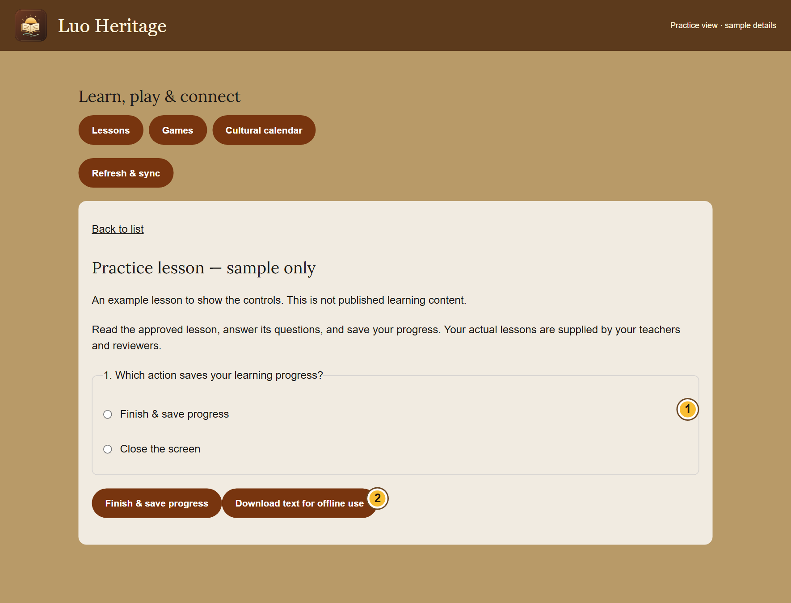
SELF-STUDY / STUDENTS AND LEARNERS
Open a lesson and keep your progress
1
Choose Lessons, games & calendar. Open
a published lesson.
2
Read the lesson and answer its questions.
Choose Finish & save progress.
3
Read the result and feedback. Sign in with
the same account on another device to
keep your learning together.
A score helps you learn; it does not replace a teacher’s review.
CURRENT INTERFACE • PRACTICE DETAILS
CHECK: You see a saved result or a message saying the attempt is waiting to go online.
LUO HERITAGE / STUDENTS AND LEARNERS
Contents
09 / 19
Notes:
Open a lesson and keep your progress
1. Choose Lessons, games & calendar. Open a published lesson.
2. Read the lesson and answer its questions. Choose Finish & save progress.
3. Read the result and feedback. Sign in with the same account on another device to keep your learning together.
Expected result: You see a saved result or a message saying the attempt is waiting to go online.
Important: A score helps you learn; it does not replace a teacher’s review.
Screenshot: current application interface rendered with sample details. No live action is demonstrated.

Slide 10
SELF-STUDY / STUDENTS AND LEARNERS
Prepare to study without internet
1
While connected, open a lesson that allows
downloads. Choose Download text for
offline use.
2
Keep using the same browser or app
profile. Downloaded text can be read
without internet for up to seven days.
3
Reconnect and choose Refresh & sync.
Keep the app open until waiting attempts
have been saved online.
These downloads contain text, not the audio or video files. Some lessons
cannot be downloaded.
CURRENT INTERFACE • PRACTICE DETAILS
CHECK: Permitted lesson text is available offline and saved attempts can synchronize later.
LUO HERITAGE / STUDENTS AND LEARNERS
Contents
10 / 19
Notes:
Prepare to study without internet
1. While connected, open a lesson that allows downloads. Choose Download text for offline use.
2. Keep using the same browser or app profile. Downloaded text can be read without internet for up to seven days.
3. Reconnect and choose Refresh & sync. Keep the app open until waiting attempts have been saved online.
Expected result: Permitted lesson text is available offline and saved attempts can synchronize later.
Important: These downloads contain text, not the audio or video files. Some lessons cannot be downloaded.
Screenshot: current application interface rendered with sample details. No live action is demonstrated.

Slide 11
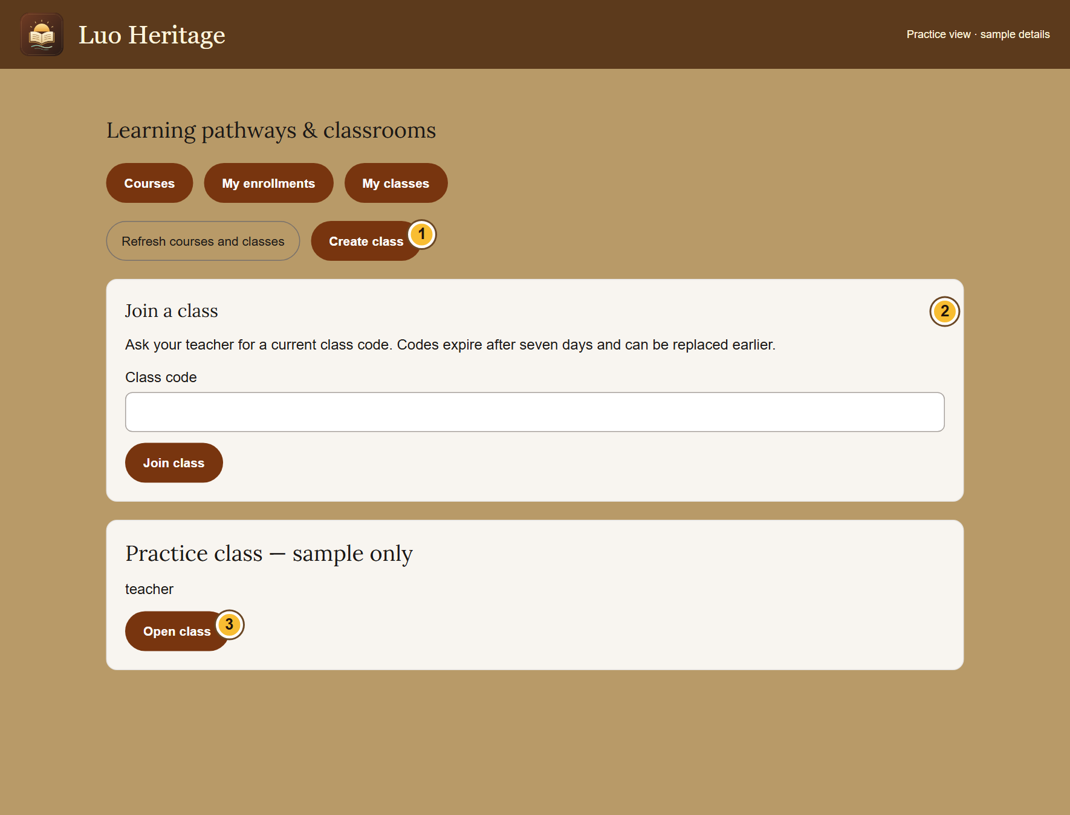
SELF-STUDY / STUDENTS AND LEARNERS
Join a class with your teacher’s code
1
Sign in. Open Teaching & my classes and
choose My classes.
2
Ask your teacher for a current code. Enter
it under Join a class, then choose Join
class.
3
Open the class and read its assignments.
Use your own account for all submissions.
Class codes expire after seven days and may be replaced earlier. Ask for
a new code if needed.
CURRENT INTERFACE • PRACTICE DETAILS
CHECK: Your class appears in My classes.
LUO HERITAGE / STUDENTS AND LEARNERS
Contents
11 / 19
Notes:
Join a class with your teacher’s code
1. Sign in. Open Teaching & my classes and choose My classes.
2. Ask your teacher for a current code. Enter it under Join a class, then choose Join class.
3. Open the class and read its assignments. Use your own account for all submissions.
Expected result: Your class appears in My classes.
Important: Class codes expire after seven days and may be replaced earlier. Ask for a new code if needed.
Screenshot: current application interface rendered with sample details. No live action is demonstrated.

Slide 12
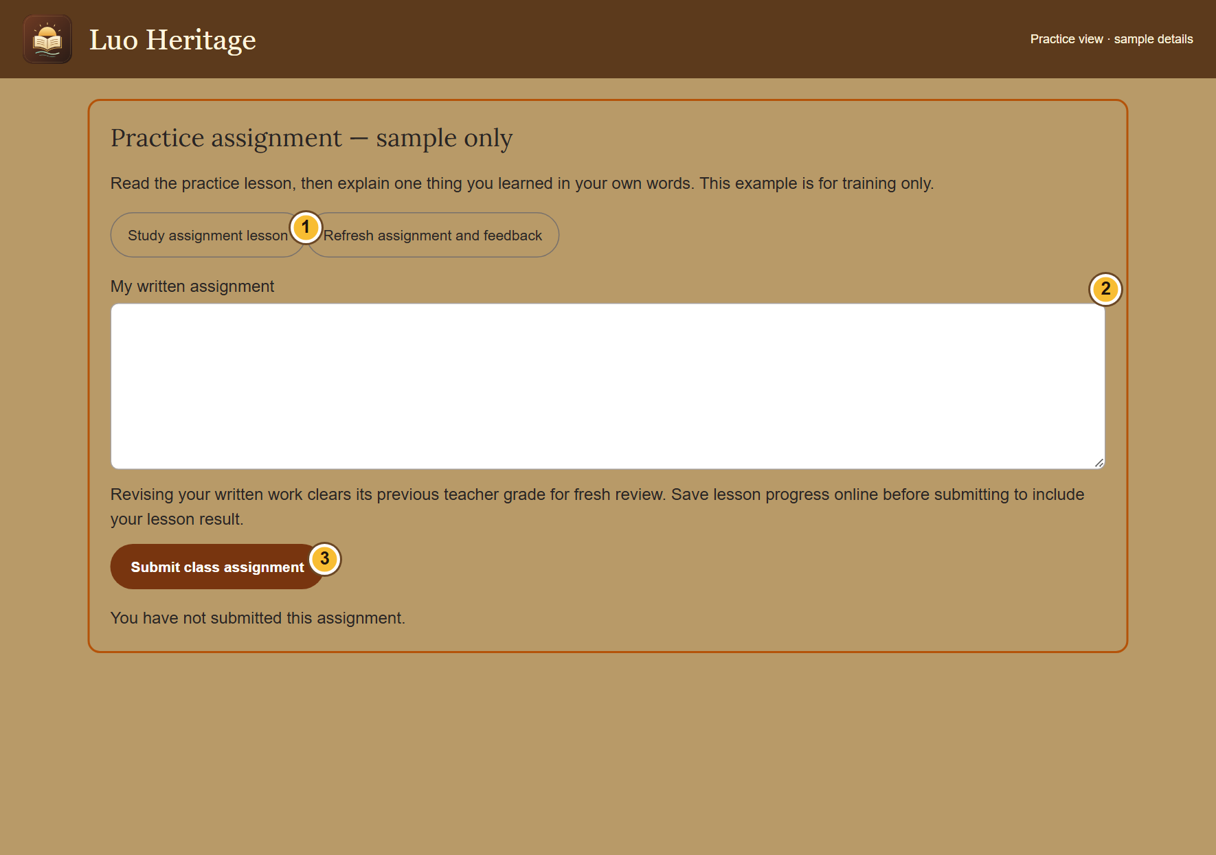
SELF-STUDY / STUDENTS AND LEARNERS
Complete a class assignment
1
Open your class, then choose Open
assignment. Read the instructions and due
date.
2
Choose Study assignment lesson and
complete the lesson. Return to the
assignment when ready.
3
Enter the work requested and use the
submission button shown. Wait for a saved
confirmation.
If the assignment is closed or the lesson unavailable, contact your
teacher; do not submit to a different class.
CURRENT INTERFACE • PRACTICE DETAILS
CHECK: Your assignment shows your submission rather than an unsaved answer.
LUO HERITAGE / STUDENTS AND LEARNERS
Contents
12 / 19
Notes:
Complete a class assignment
1. Open your class, then choose Open assignment. Read the instructions and due date.
2. Choose Study assignment lesson and complete the lesson. Return to the assignment when ready.
3. Enter the work requested and use the submission button shown. Wait for a saved confirmation.
Expected result: Your assignment shows your submission rather than an unsaved answer.
Important: If the assignment is closed or the lesson unavailable, contact your teacher; do not submit to a different class.
Screenshot: current application interface rendered with sample details. No live action is demonstrated.

Slide 13
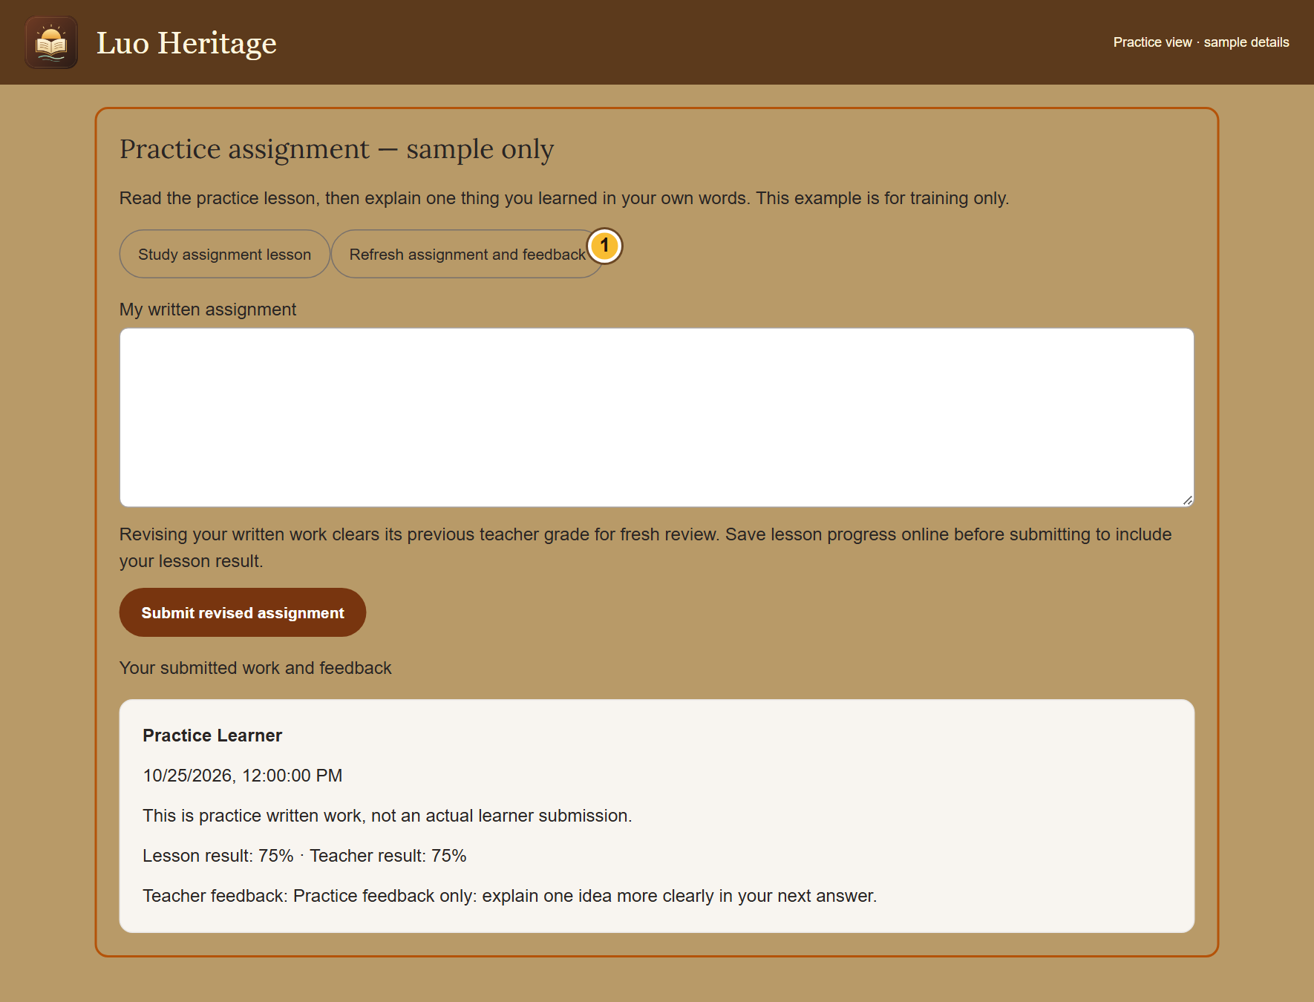
SELF-STUDY / STUDENTS AND LEARNERS
Read feedback and try again
1
Open the same class assignment after
your teacher reviews it.
2
Choose Refresh assignment and feedback.
Read the score and the teacher’s
comments.
3
If a new submission is requested and
allowed, correct your work and submit it
again.
Sending revised written work clears its previous teacher grade so the
teacher can review it again.
CURRENT INTERFACE • PRACTICE DETAILS
CHECK: You know what to improve and which result belongs to you.
LUO HERITAGE / STUDENTS AND LEARNERS
Contents
13 / 19
Notes:
Read feedback and try again
1. Open the same class assignment after your teacher reviews it.
2. Choose Refresh assignment and feedback. Read the score and the teacher’s comments.
3. If a new submission is requested and allowed, correct your work and submit it again.
Expected result: You know what to improve and which result belongs to you.
Important: Sending revised written work clears its previous teacher grade so the teacher can review it again.
Screenshot: current application interface rendered with sample details. No live action is demonstrated.

Slide 14
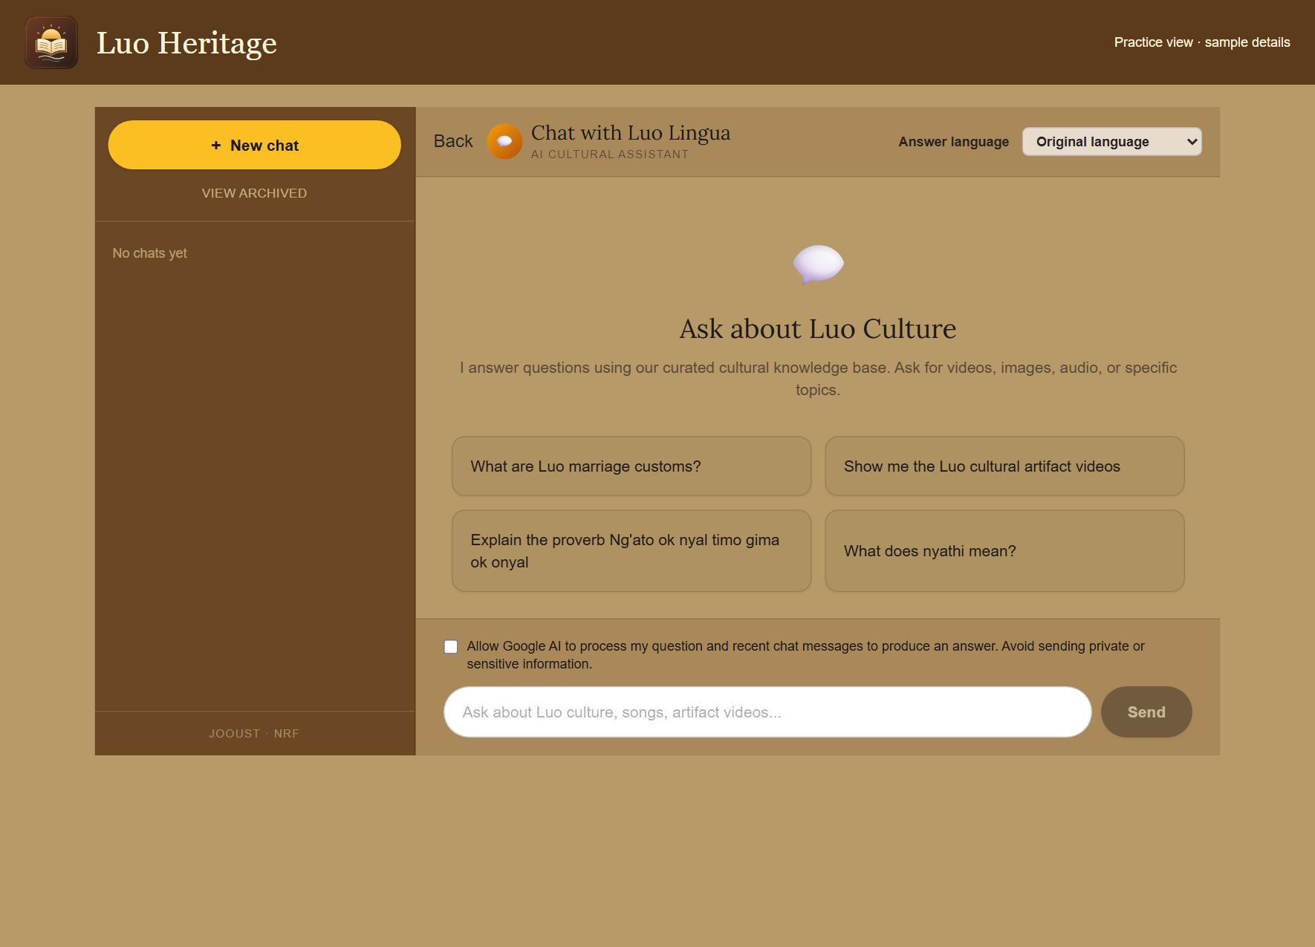
SELF-STUDY / STUDENTS AND LEARNERS
Ask the AI chatbot a clear question
1
Open Chat or Chatbot. Choose your
answer language and read the processing
permission notice.
2
If you agree, allow AI processing. Ask one
clear question and wait for the response.
3
Open any sources provided. Ask a
follow-up question if you need a simpler
explanation.
AI can make mistakes. Do not enter private interviews, passwords or
learners’ personal information.
CURRENT INTERFACE • PRACTICE DETAILS
CHECK: You can read an answer and inspect any linked sources.
LUO HERITAGE / STUDENTS AND LEARNERS
Contents
14 / 19
Notes:
Ask the AI chatbot a clear question
1. Open Chat or Chatbot. Choose your answer language and read the processing permission notice.
2. If you agree, allow AI processing. Ask one clear question and wait for the response.
3. Open any sources provided. Ask a follow-up question if you need a simpler explanation.
Expected result: You can read an answer and inspect any linked sources.
Important: AI can make mistakes. Do not enter private interviews, passwords or learners’ personal information.
Screenshot: current application interface rendered with sample details. No live action is demonstrated.

Slide 15

SELF-STUDY / STUDENTS AND LEARNERS
Find your access and saved chats
1
Open the account menu and choose My
account & saved chats.
2
Read My access to check your assigned
role. Open a chat from Recent or Archived.
3
For your name, sessions or notifications,
open Profile, sessions & notifications from
the menu.
Choosing an interest such as teacher or researcher does not give staff
access.
CURRENT INTERFACE • PRACTICE DETAILS
CHECK: You can find your own account details and earlier conversations.
LUO HERITAGE / STUDENTS AND LEARNERS
Contents
15 / 19
Notes:
Find your access and saved chats
1. Open the account menu and choose My account & saved chats.
2. Read My access to check your assigned role. Open a chat from Recent or Archived.
3. For your name, sessions or notifications, open Profile, sessions & notifications from the menu.
Expected result: You can find your own account details and earlier conversations.
Important: Choosing an interest such as teacher or researcher does not give staff access.
Screenshot: current application interface rendered with sample details. No live action is demonstrated.

Slide 16
SELF-STUDY / STUDENTS AND LEARNERS
Keep your own learning record
1
Use the same account on your phone and
computer.
2
Before changing devices, reconnect and
use Refresh & sync for waiting attempts.
3
Do not leave a class just to change
devices: leaving can delete your work in
that class.
Tell your teacher if you accidentally created two accounts.
CURRENT INTERFACE • PRACTICE DETAILS
CHECK: Your work stays linked to the intended account.
LUO HERITAGE / STUDENTS AND LEARNERS
Contents
16 / 19
Notes:
Keep your own learning record
1. Use the same account on your phone and computer.
2. Before changing devices, reconnect and use Refresh & sync for waiting attempts.
3. Do not leave a class just to change devices: leaving can delete your work in that class.
Expected result: Your work stays linked to the intended account.
Important: Tell your teacher if you accidentally created two accounts.
Screenshot: current application interface rendered with sample details. No live action is demonstrated.

Slide 17
SELF-STUDY / STUDENTS AND LEARNERS
Protect your account and other people
1
Use your own account. Sign out on a
shared computer or phone.
2
Do not copy private interviews, class
results or account lists into public chats or
messages.
3
If a screen shows information you should
not see, stop and tell the account
administrator.
Send support the screen name and error message, never your password
or a reset link.
CURRENT INTERFACE • PRACTICE DETAILS
CHECK: Your work remains linked to the right person and private information stays protected.
LUO HERITAGE / STUDENTS AND LEARNERS
Contents
17 / 19
Notes:
Protect your account and other people
1. Use your own account. Sign out on a shared computer or phone.
2. Do not copy private interviews, class results or account lists into public chats or messages.
3. If a screen shows information you should not see, stop and tell the account administrator.
Expected result: Your work remains linked to the right person and private information stays protected.
Important: Send support the screen name and error message, never your password or a reset link.
Screenshot: current application interface rendered with sample details. No live action is demonstrated.

Slide 18
SELF-STUDY / STUDENTS AND LEARNERS
When something does not work
1
Check your internet connection. Read the message on screen
before trying again.
2
If your sign-in has expired, sign in again. If a button is missing,
ask which role and language you have.
3
If it still fails, note the time, screen, button and exact message.
Send these to your account administrator.
Before repeating an upload or submission, check whether the first attempt was already saved.
CURRENT INTERFACE • PRACTICE DETAILS
CHECK: You can explain the problem clearly without exposing private information.
LUO HERITAGE / STUDENTS AND LEARNERS
Contents
18 / 19
Notes:
When something does not work
1. Check your internet connection. Read the message on screen before trying again.
2. If your sign-in has expired, sign in again. If a button is missing, ask which role and language you have.
3. If it still fails, note the time, screen, button and exact message. Send these to your account administrator.
Expected result: You can explain the problem clearly without exposing private information.
Important: Before repeating an upload or submission, check whether the first attempt was already saved.
Screenshot: current application interface rendered with sample details. No live action is demonstrated.

Slide 19
SELF-STUDY / STUDENTS AND LEARNERS
Try it yourself: your readiness check
1
Enroll in the course your teacher names and open its first available lesson.
2
Join your class with a current code and find the assignment instructions.
3
Save one practice result and show where you would read teacher feedback.
Try
→
Check
→
Ask if unsure
Use only approved practice material. Do not publish, delete accounts or change live settings just to practise.
CHECK: You are ready for routine work when you can complete these steps without help.
LUO HERITAGE / STUDENTS AND LEARNERS
Contents
19 / 19
Notes:
Try it yourself: your readiness check
1. Enroll in the course your teacher names and open its first available lesson.
2. Join your class with a current code and find the assignment instructions.
3. Save one practice result and show where you would read teacher feedback.
Expected result: You are ready for routine work when you can complete these steps without help.
Important: Use only approved practice material. Do not publish, delete accounts or change live settings just to practise.

