Slide 1

LUO HERITAGE / SELF-STUDY SLIDES
LANGUAGE • CULTURE • LIVING MEMORY
Teachers and lecturers
Guide classes, set assignments and review learning
You will be able to run a class and help students find their work and feedback.
READ • TRY • CHECK
25 October 2026 | Edition 1.0
Notes:
Self-study guide. Screenshots show actual interface components rendered with clearly labelled sample data, not a production acceptance demonstration. No real account or cultural record was changed to make these slides.

Slide 2
SELF-STUDY / TEACHERS AND LECTURERS
Start here: learn at your own pace
1
Read a slide, try its action, then check the result. Tap means click. Gold circles mark important
controls in the screenshots.
2
Use your own account. Your organisation supplies the correct website address and any staff
access.
3
Screenshots show the current interface with practice details. Actual names, content and
menus may differ.
Read the step
→
Try it yourself
→
Check the result
If your menu looks different, first check My access. Do not ask someone to lend you their account.
CHECK: You will be able to run a class and help students find their work and feedback.
LUO HERITAGE / TEACHERS AND LECTURERS
Contents
02 / 22
Notes:
Start here: learn at your own pace
1. Read a slide, try its action, then check the result. Tap means click. Gold circles mark important controls in the screenshots.
2. Use your own account. Your organisation supplies the correct website address and any staff access.
3. Screenshots show the current interface with practice details. Actual names, content and menus may differ.
Expected result: You will be able to run a class and help students find their work and feedback.
Important: If your menu looks different, first check My access. Do not ask someone to lend you their account.

Slide 3
SELF-STUDY / TEACHERS AND LECTURERS
What this guide covers
1
Get teaching access and create or open a class.
2
Invite learners, set assignments and review submissions.
3
Keep class results private and close a class responsibly.
CHECK: Use the slide numbers to return to a task. The PDF has page bookmarks; PowerPoint has a contents view.
LUO HERITAGE / TEACHERS AND LECTURERS
Contents
03 / 22
Notes:
What this guide covers
1. Get teaching access and create or open a class.
2. Invite learners, set assignments and review submissions.
3. Keep class results private and close a class responsibly.
Expected result: Use the slide numbers to return to a task. The PDF has page bookmarks; PowerPoint has a contents view.

Slide 4

SELF-STUDY / TEACHERS AND LECTURERS
Sign in to your own account
1
Open the Luo Heritage address supplied by your organisation.
Choose Sign in or Log in.
2
Enter your email and password, then choose Log in. Check your
spelling if it fails.
3
Community members may also use Google. Staff should use the
account supplied by their administrator.
Never share your password. Use only an address you trust.
CURRENT INTERFACE • PRACTICE DETAILS
CHECK: Your account or dashboard opens.
LUO HERITAGE / TEACHERS AND LECTURERS
Contents
04 / 22
Notes:
Sign in to your own account
1. Open the Luo Heritage address supplied by your organisation. Choose Sign in or Log in.
2. Enter your email and password, then choose Log in. Check your spelling if it fails.
3. Community members may also use Google. Staff should use the account supplied by their administrator.
Expected result: Your account or dashboard opens.
Important: Never share your password. Use only an address you trust.
Screenshot: current application interface rendered with sample details. No live action is demonstrated.

Slide 5

SELF-STUDY / TEACHERS AND LECTURERS
Forgot your password?
1
On the sign-in screen, choose Forgotten
password? Select Reset password.
2
Enter your account email. Choose Send
email, then check your inbox and spam
folder.
3
Open the newest reset link within 30
minutes. A link can be used only once.
If no email arrives, contact the person who manages your account. Do
not keep requesting links.
CURRENT INTERFACE • PRACTICE DETAILS
CHECK: An account email arrives if the address is eligible and the email service is available.
LUO HERITAGE / TEACHERS AND LECTURERS
Contents
05 / 22
Notes:
Forgot your password?
1. On the sign-in screen, choose Forgotten password? Select Reset password.
2. Enter your account email. Choose Send email, then check your inbox and spam folder.
3. Open the newest reset link within 30 minutes. A link can be used only once.
Expected result: An account email arrives if the address is eligible and the email service is available.
Important: If no email arrives, contact the person who manages your account. Do not keep requesting links.
Screenshot: current application interface rendered with sample details. No live action is demonstrated.

Slide 6

SELF-STUDY / TEACHERS AND LECTURERS
Choose a new password
1
Open the password reset link from your
own inbox.
2
Enter a new password of at least 12
characters. A short phrase with several
words is easier to remember.
3
Choose Confirm. Return to sign in and use
the new password on each device.
Do not forward the reset link. If it has expired, request a new one.
CURRENT INTERFACE • PRACTICE DETAILS
CHECK: The password changes and old sign-ins are ended.
LUO HERITAGE / TEACHERS AND LECTURERS
Contents
06 / 22
Notes:
Choose a new password
1. Open the password reset link from your own inbox.
2. Enter a new password of at least 12 characters. A short phrase with several words is easier to remember.
3. Choose Confirm. Return to sign in and use the new password on each device.
Expected result: The password changes and old sign-ins are ended.
Important: Do not forward the reset link. If it has expired, request a new one.
Screenshot: current application interface rendered with sample details. No live action is demonstrated.

Slide 7
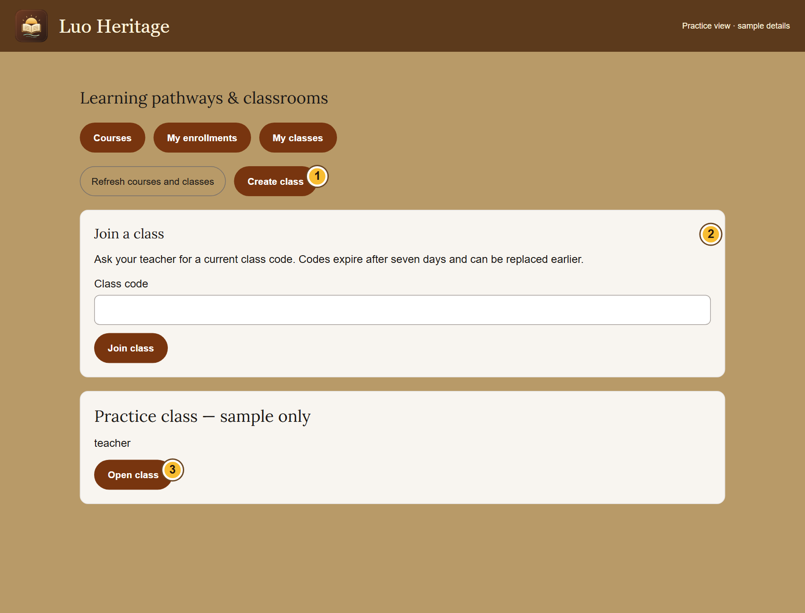
SELF-STUDY / TEACHERS AND LECTURERS
Check that you have teaching access
1
Sign in with your own account. Open
Teaching & my classes.
2
Look for Create class or an existing class
where your role is teacher.
3
If these are missing, ask the language
administrator to assign teaching access.
Selecting teacher as an interest does not
grant it.
CURRENT INTERFACE • PRACTICE DETAILS
CHECK: You know whether you can teach a class or are viewing as a learner.
LUO HERITAGE / TEACHERS AND LECTURERS
Contents
07 / 22
Notes:
Check that you have teaching access
1. Sign in with your own account. Open Teaching & my classes.
2. Look for Create class or an existing class where your role is teacher.
3. If these are missing, ask the language administrator to assign teaching access. Selecting teacher as an interest does not grant it.
Expected result: You know whether you can teach a class or are viewing as a learner.
Screenshot: current application interface rendered with sample details. No live action is demonstrated.

Slide 8
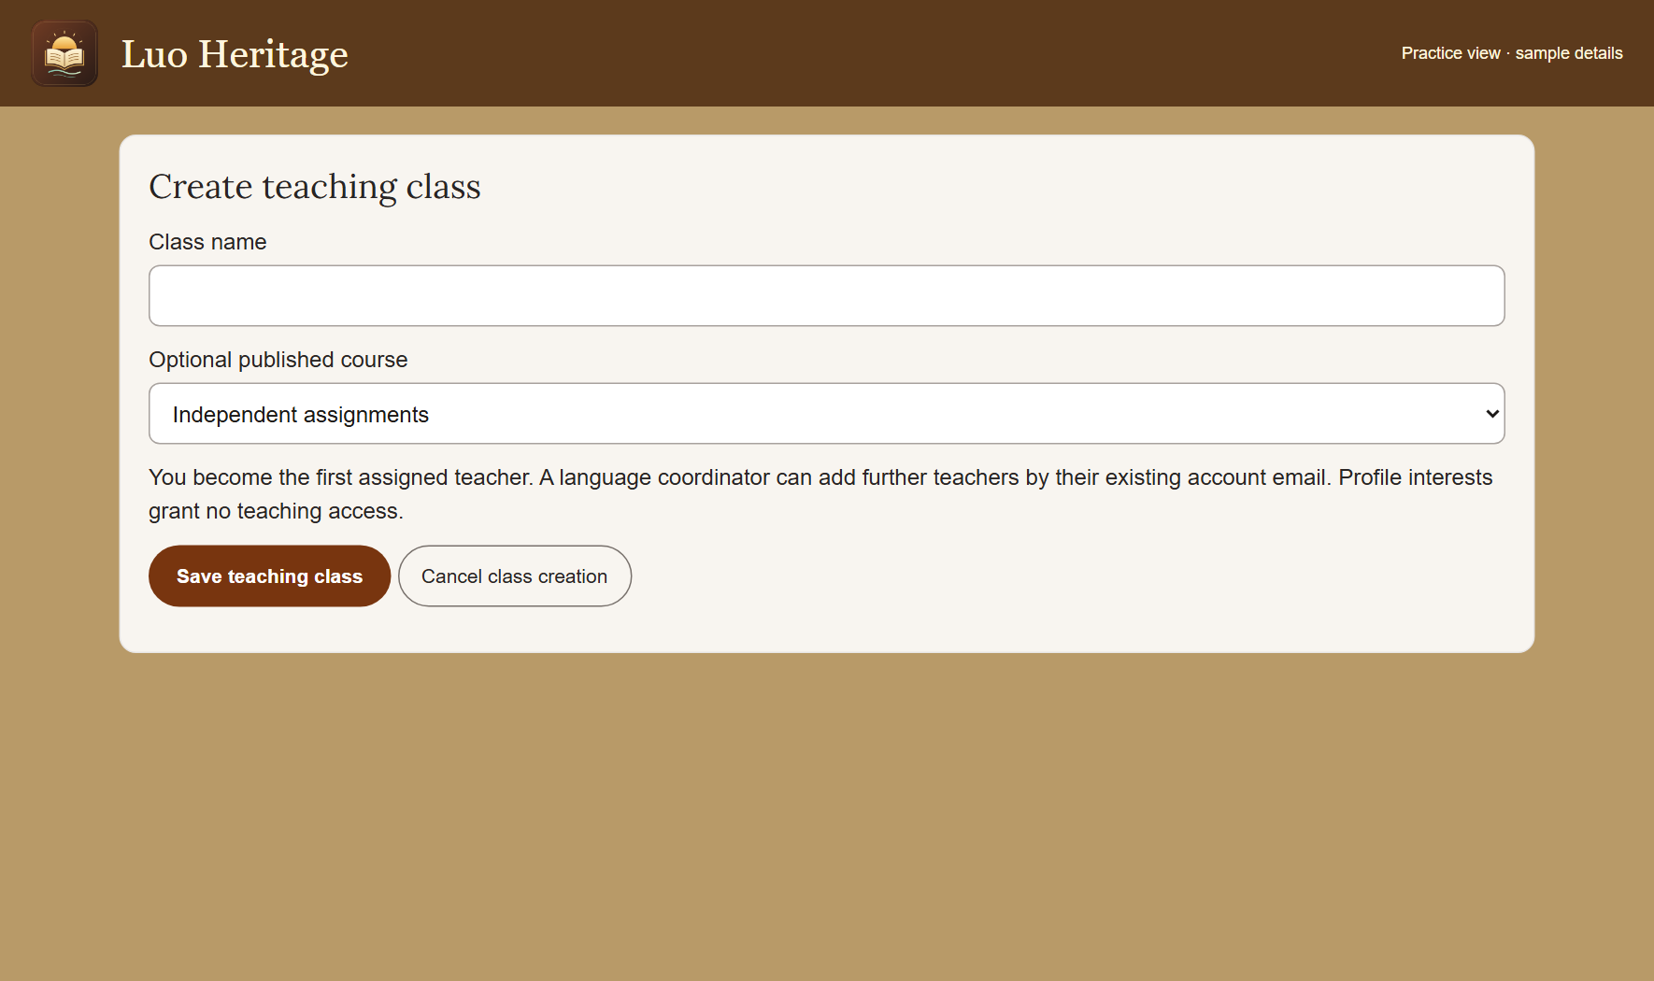
SELF-STUDY / TEACHERS AND LECTURERS
Create a teaching class
1
Open My classes and choose Create class.
2
Enter the class title and requested details.
Select a published course if the class
needs one.
3
Choose Save teaching class. Keep the
new class join code private until you invite
learners.
Teaching a class does not automatically let you publish cultural content
or courses.
CURRENT INTERFACE • PRACTICE DETAILS
CHECK: The class opens and you can see its invitation controls.
LUO HERITAGE / TEACHERS AND LECTURERS
Contents
08 / 22
Notes:
Create a teaching class
1. Open My classes and choose Create class.
2. Enter the class title and requested details. Select a published course if the class needs one.
3. Choose Save teaching class. Keep the new class join code private until you invite learners.
Expected result: The class opens and you can see its invitation controls.
Important: Teaching a class does not automatically let you publish cultural content or courses.
Screenshot: current application interface rendered with sample details. No live action is demonstrated.

Slide 9
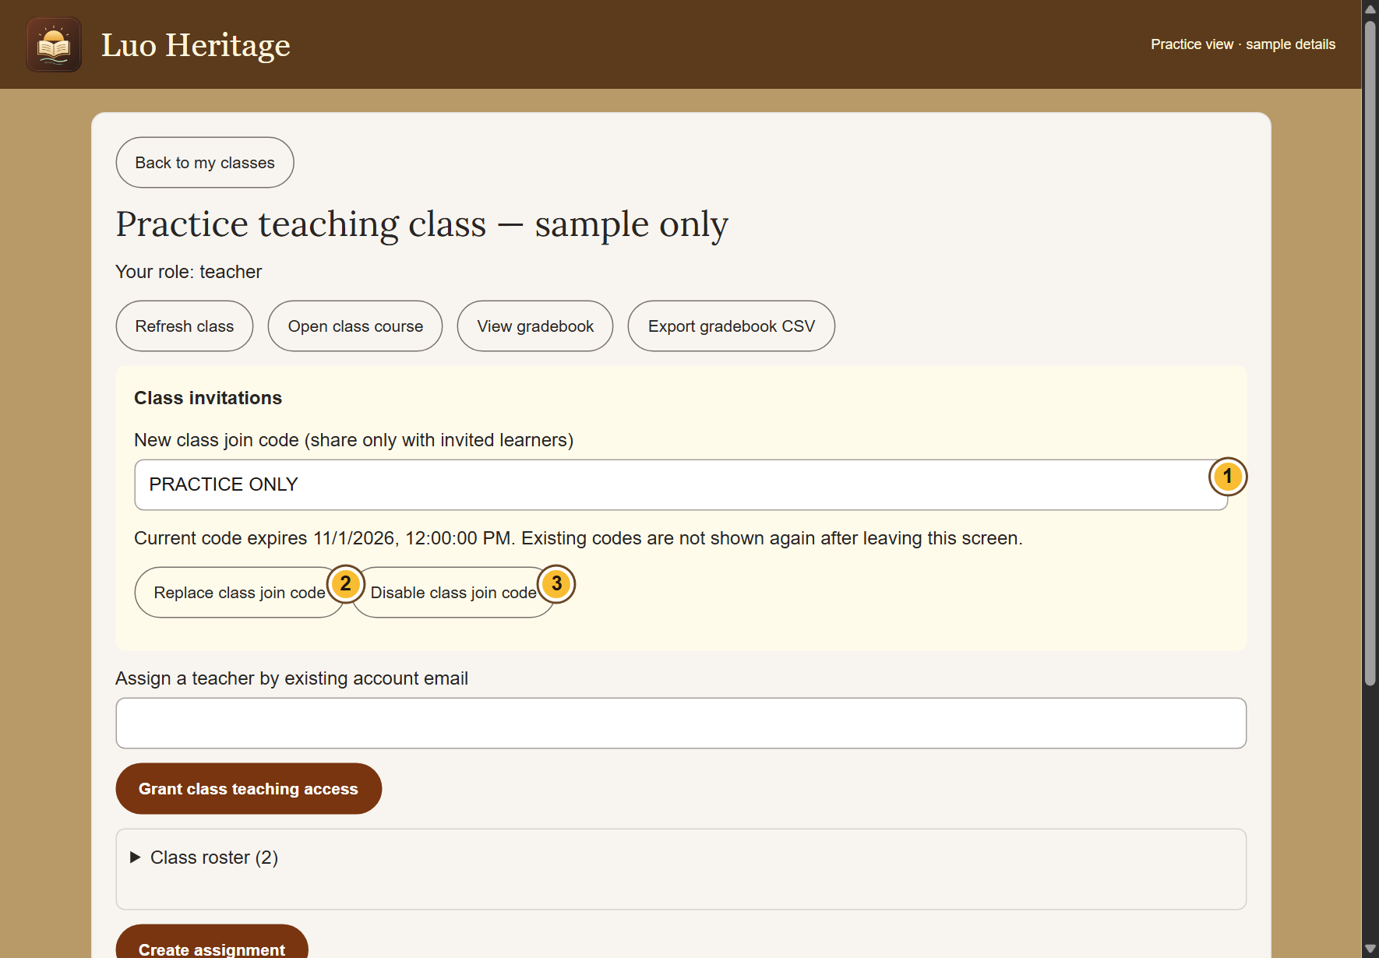
SELF-STUDY / TEACHERS AND LECTURERS
Invite your learners safely
1
Open the class and find Class invitations.
Share its current join code with the
intended learners.
2
Ask learners to sign in and use Join a
class. Check the member list afterwards.
3
If a code is shared too widely, choose
Replace class join code or Disable class
join code.
Codes expire after seven days. A replacement invalidates the previous
code.
CURRENT INTERFACE • PRACTICE DETAILS
CHECK: The correct learners are listed in the class.
LUO HERITAGE / TEACHERS AND LECTURERS
Contents
09 / 22
Notes:
Invite your learners safely
1. Open the class and find Class invitations. Share its current join code with the intended learners.
2. Ask learners to sign in and use Join a class. Check the member list afterwards.
3. If a code is shared too widely, choose Replace class join code or Disable class join code.
Expected result: The correct learners are listed in the class.
Important: Codes expire after seven days. A replacement invalidates the previous code.
Screenshot: current application interface rendered with sample details. No live action is demonstrated.

Slide 10
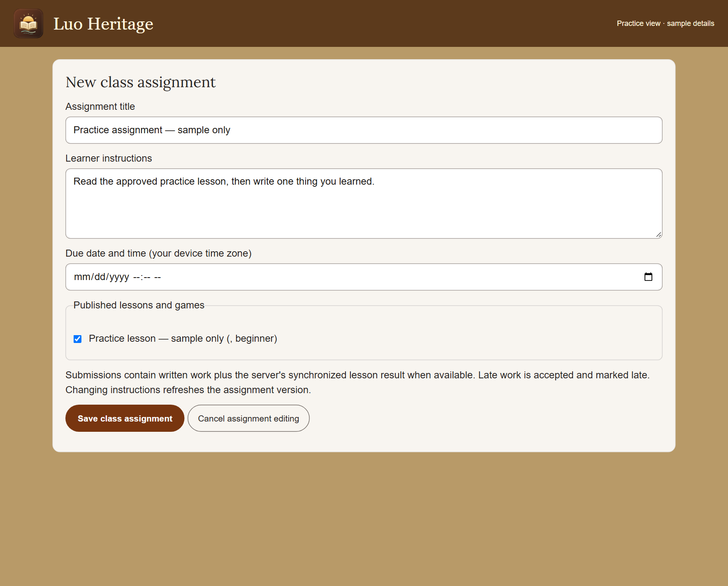
SELF-STUDY / TEACHERS AND LECTURERS
Set a useful assignment
1
Open the class and choose Create
assignment.
2
Choose an available published lesson.
Write a clear title, instructions and due
date.
3
Choose Save class assignment. Open it
again to check exactly what learners will
see.
Use a lesson in the correct language. If a lesson is withdrawn, choose an
approved replacement.
CURRENT INTERFACE • PRACTICE DETAILS
CHECK: The assignment is listed for members of this class.
LUO HERITAGE / TEACHERS AND LECTURERS
Contents
10 / 22
Notes:
Set a useful assignment
1. Open the class and choose Create assignment.
2. Choose an available published lesson. Write a clear title, instructions and due date.
3. Choose Save class assignment. Open it again to check exactly what learners will see.
Expected result: The assignment is listed for members of this class.
Important: Use a lesson in the correct language. If a lesson is withdrawn, choose an approved replacement.
Screenshot: current application interface rendered with sample details. No live action is demonstrated.

Slide 11
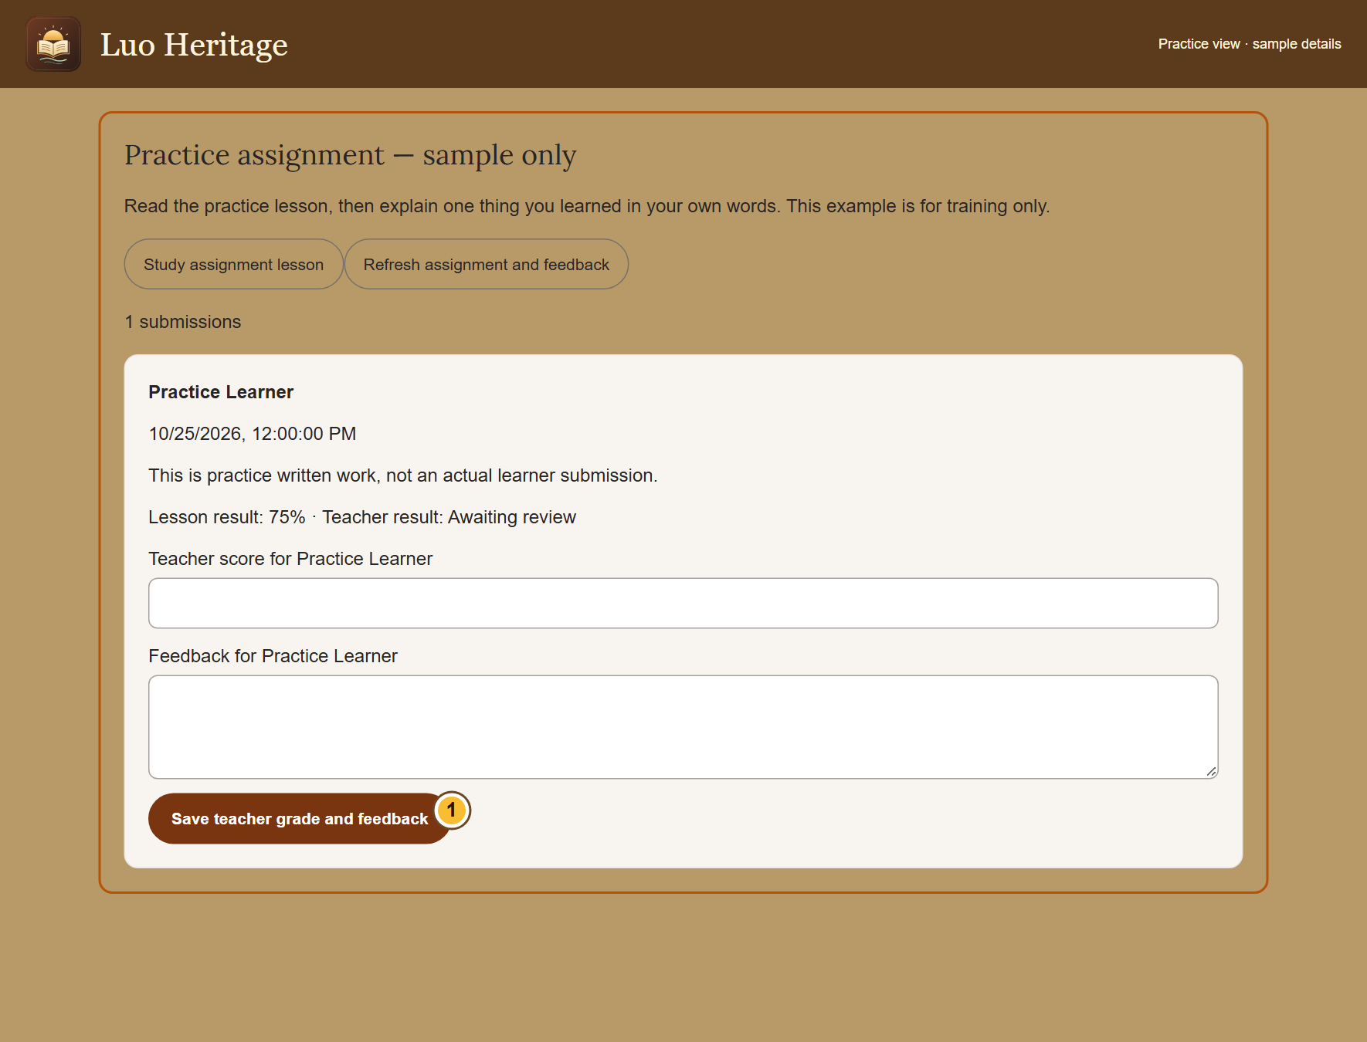
SELF-STUDY / TEACHERS AND LECTURERS
Review a learner’s submission
1
Open the class assignment and choose the
learner’s submission.
2
Read their work, enter the score and write
feedback that explains one clear next step.
3
Choose Save teacher grade and feedback.
Ask for another submission when
correction is needed.
Check the learner’s name before saving. Do not discuss individual results
in public chats.
CURRENT INTERFACE • PRACTICE DETAILS
CHECK: The learner can refresh the assignment to see the saved grade and feedback.
LUO HERITAGE / TEACHERS AND LECTURERS
Contents
11 / 22
Notes:
Review a learner’s submission
1. Open the class assignment and choose the learner’s submission.
2. Read their work, enter the score and write feedback that explains one clear next step.
3. Choose Save teacher grade and feedback. Ask for another submission when correction is needed.
Expected result: The learner can refresh the assignment to see the saved grade and feedback.
Important: Check the learner’s name before saving. Do not discuss individual results in public chats.
Screenshot: current application interface rendered with sample details. No live action is demonstrated.

Slide 12
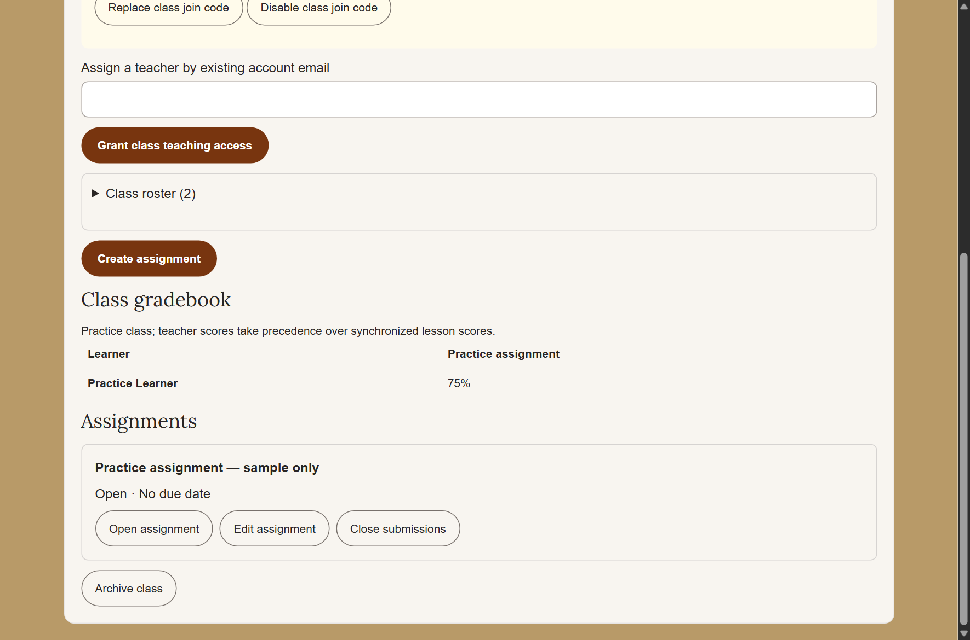
SELF-STUDY / TEACHERS AND LECTURERS
See the class gradebook
1
Open the class and choose View
gradebook.
2
Read the assignment columns and learner
rows. A teacher’s grade takes priority over
a synchronized lesson score.
3
Use Export gradebook CSV only if you are
allowed to keep a spreadsheet copy. Store
it privately.
A downloaded gradebook contains personal information. Do not share it
as a public attachment.
CURRENT INTERFACE • PRACTICE DETAILS
CHECK: You can identify submitted, ungraded and completed work.
LUO HERITAGE / TEACHERS AND LECTURERS
Contents
12 / 22
Notes:
See the class gradebook
1. Open the class and choose View gradebook.
2. Read the assignment columns and learner rows. A teacher’s grade takes priority over a synchronized lesson score.
3. Use Export gradebook CSV only if you are allowed to keep a spreadsheet copy. Store it privately.
Expected result: You can identify submitted, ungraded and completed work.
Important: A downloaded gradebook contains personal information. Do not share it as a public attachment.
Screenshot: current application interface rendered with sample details. No live action is demonstrated.

Slide 13
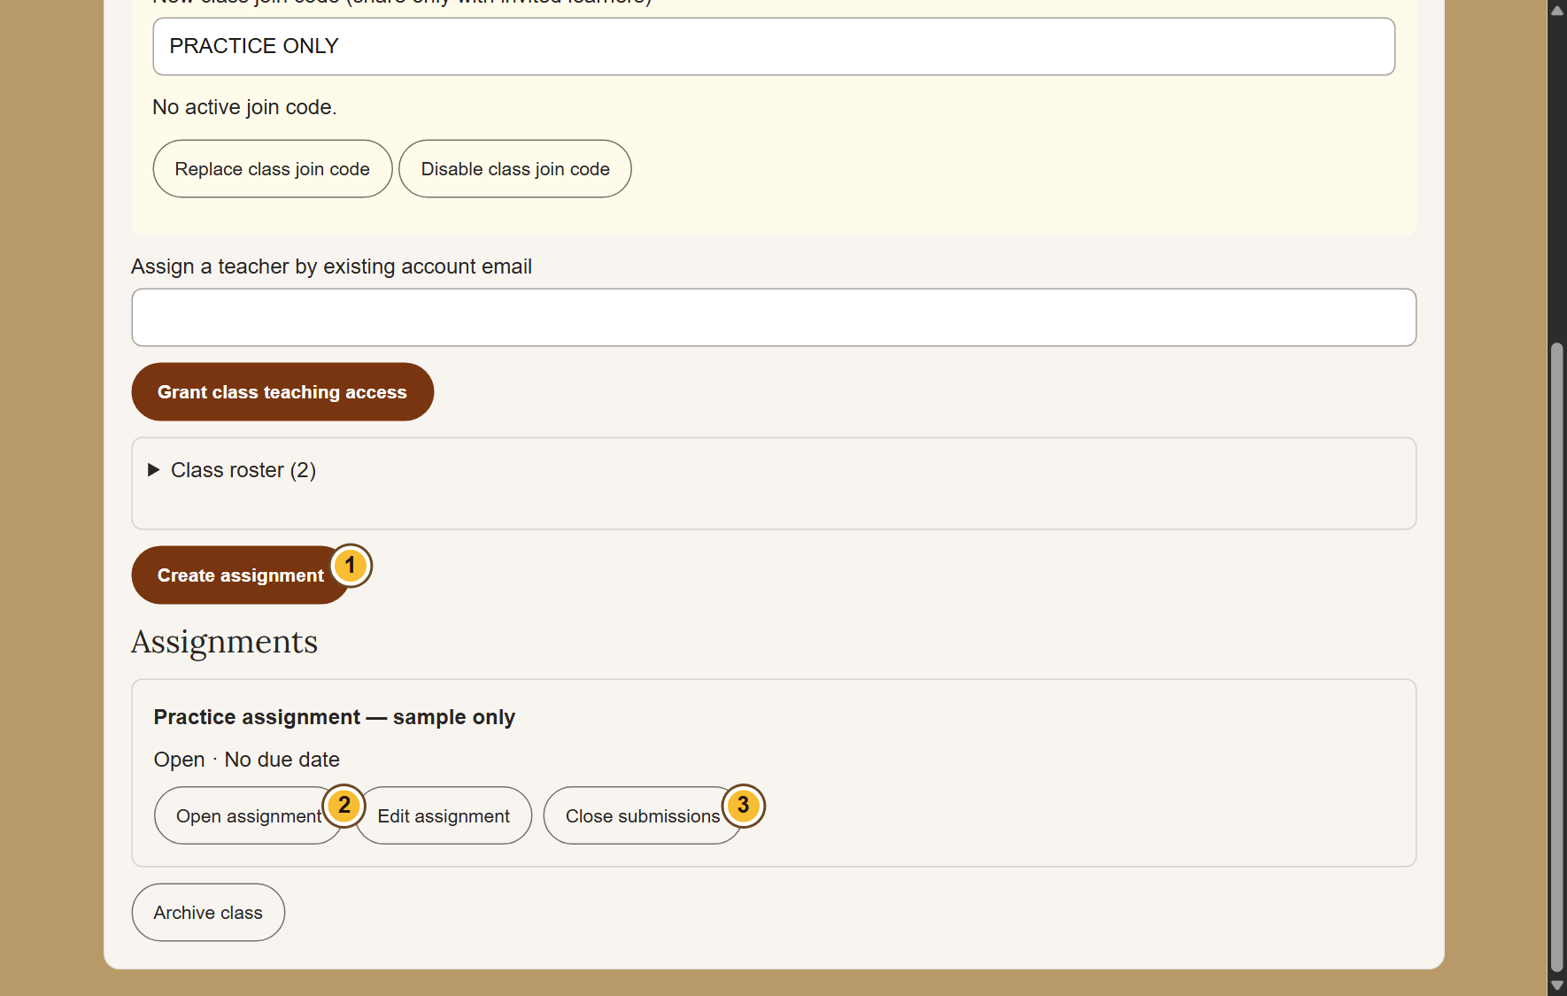
SELF-STUDY / TEACHERS AND LECTURERS
Manage changes without losing work
1
Use Edit assignment before closing
submissions. Read any warning when
changing instructions.
2
Choose Close submissions when no more
work should be accepted.
3
Remove a class member only after
checking the consequences: that action
can remove their class submissions.
CURRENT INTERFACE • PRACTICE DETAILS
CHECK: Class membership and assignment availability match your intention.
LUO HERITAGE / TEACHERS AND LECTURERS
Contents
13 / 22
Notes:
Manage changes without losing work
1. Use Edit assignment before closing submissions. Read any warning when changing instructions.
2. Choose Close submissions when no more work should be accepted.
3. Remove a class member only after checking the consequences: that action can remove their class submissions.
Expected result: Class membership and assignment availability match your intention.
Screenshot: current application interface rendered with sample details. No live action is demonstrated.

Slide 14
SELF-STUDY / TEACHERS AND LECTURERS
Share teaching responsibility
1
Open the class and find Assign a teacher
by existing account email.
2
Check the colleague’s exact account email
and grant teaching access only if you have
permission.
3
Confirm their role in the member list. Keep
at least one teacher in each active class.
A class teacher is different from a system administrator.
CURRENT INTERFACE • PRACTICE DETAILS
CHECK: The intended colleague has teaching access to this class.
LUO HERITAGE / TEACHERS AND LECTURERS
Contents
14 / 22
Notes:
Share teaching responsibility
1. Open the class and find Assign a teacher by existing account email.
2. Check the colleague’s exact account email and grant teaching access only if you have permission.
3. Confirm their role in the member list. Keep at least one teacher in each active class.
Expected result: The intended colleague has teaching access to this class.
Important: A class teacher is different from a system administrator.
Screenshot: current application interface rendered with sample details. No live action is demonstrated.

Slide 15
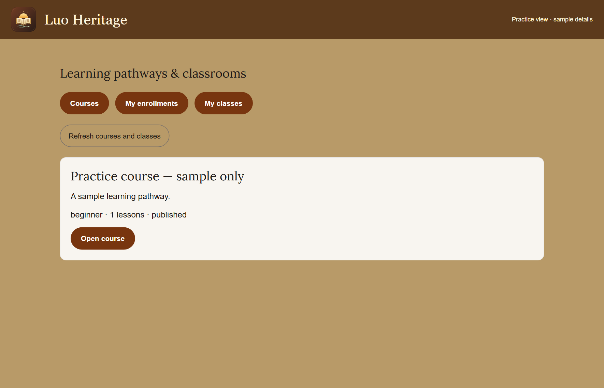
SELF-STUDY / TEACHERS AND LECTURERS
Join a learning course
1
Open Learning pathways & courses.
Choose a published course and read its
description.
2
Open the course and enroll using the
button shown. Start with the available
lesson.
3
Use My enrollments to return later. If
lessons are locked, complete the earlier
lesson and required score first.
If no courses are available, ask your teacher which published course to
use.
CURRENT INTERFACE • PRACTICE DETAILS
CHECK: The course appears among your enrollments and shows your lesson progress.
LUO HERITAGE / TEACHERS AND LECTURERS
Contents
15 / 22
Notes:
Join a learning course
1. Open Learning pathways & courses. Choose a published course and read its description.
2. Open the course and enroll using the button shown. Start with the available lesson.
3. Use My enrollments to return later. If lessons are locked, complete the earlier lesson and required score first.
Expected result: The course appears among your enrollments and shows your lesson progress.
Important: If no courses are available, ask your teacher which published course to use.
Screenshot: current application interface rendered with sample details. No live action is demonstrated.

Slide 16
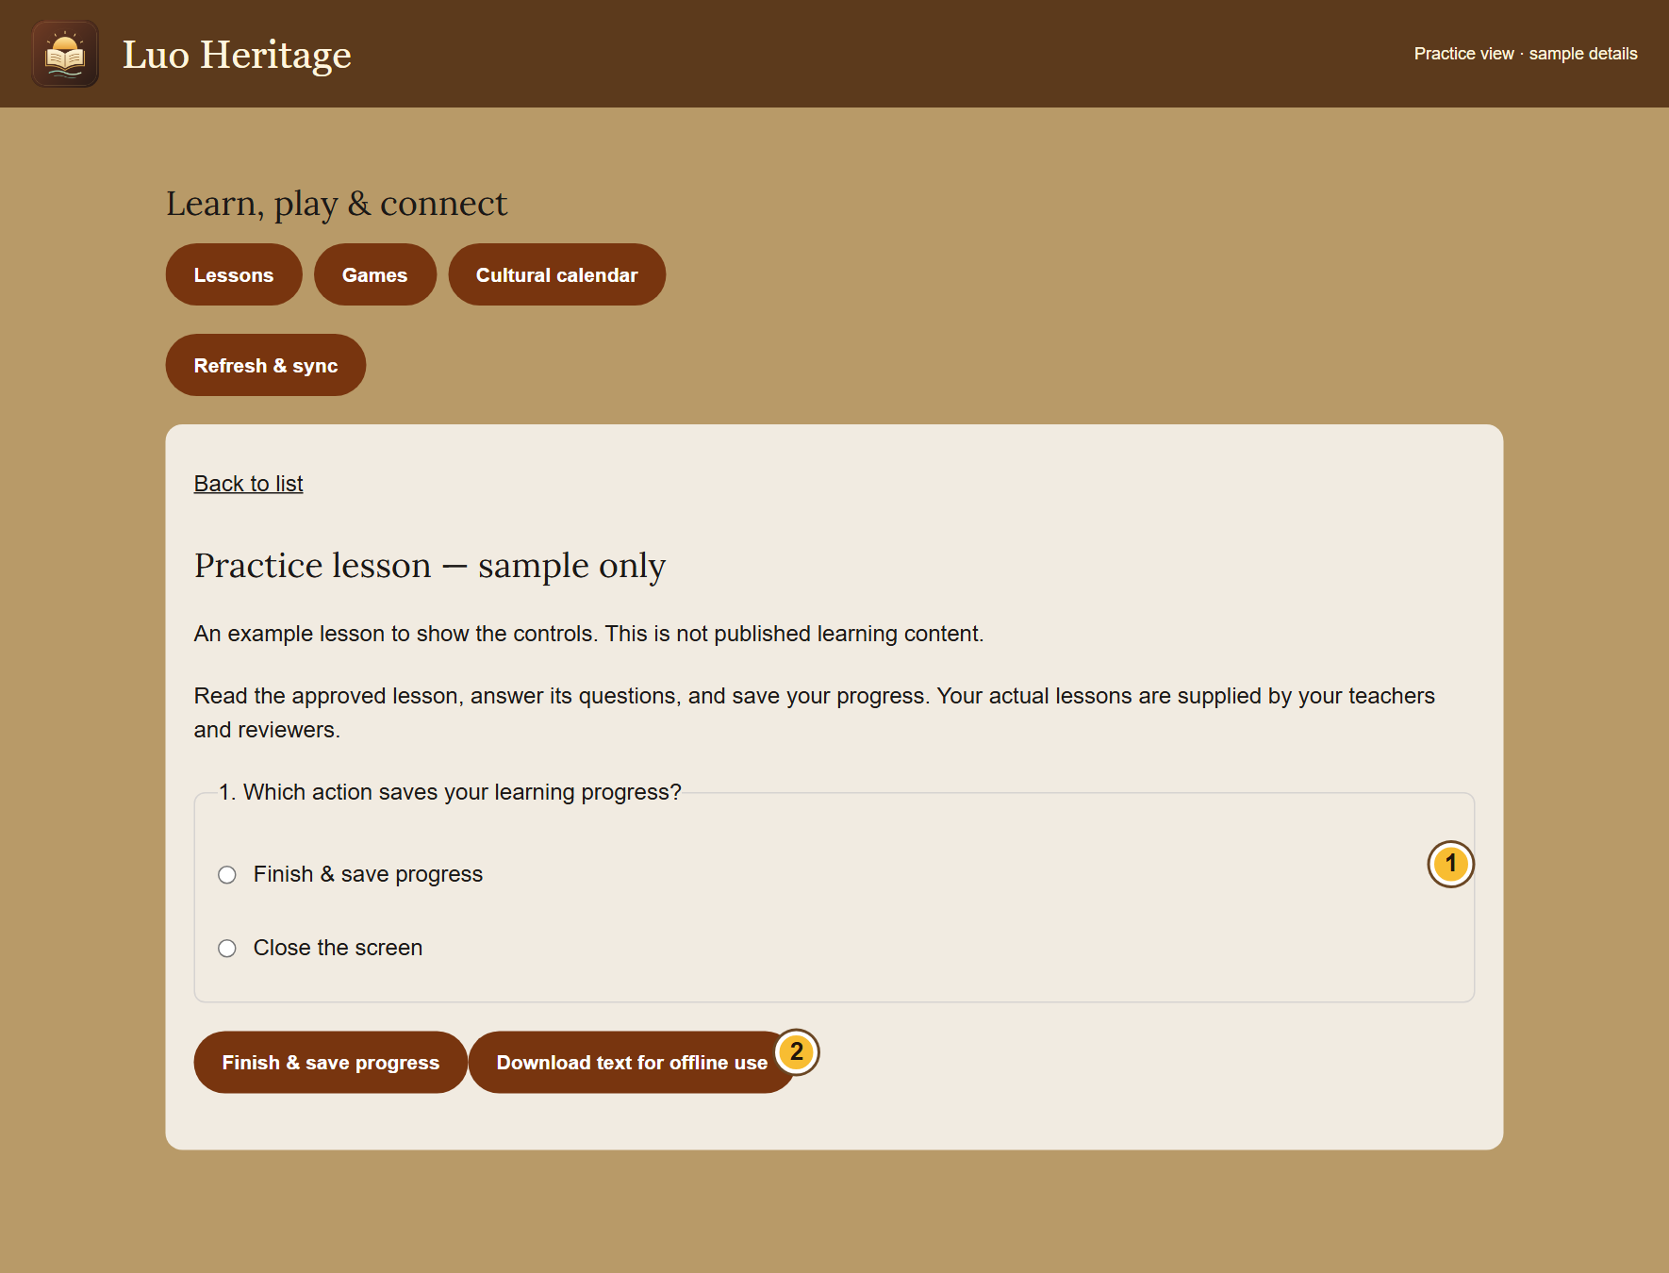
SELF-STUDY / TEACHERS AND LECTURERS
Open a lesson and keep your progress
1
Choose Lessons, games & calendar. Open
a published lesson.
2
Read the lesson and answer its questions.
Choose Finish & save progress.
3
Read the result and feedback. Sign in with
the same account on another device to
keep your learning together.
A score helps you learn; it does not replace a teacher’s review.
CURRENT INTERFACE • PRACTICE DETAILS
CHECK: You see a saved result or a message saying the attempt is waiting to go online.
LUO HERITAGE / TEACHERS AND LECTURERS
Contents
16 / 22
Notes:
Open a lesson and keep your progress
1. Choose Lessons, games & calendar. Open a published lesson.
2. Read the lesson and answer its questions. Choose Finish & save progress.
3. Read the result and feedback. Sign in with the same account on another device to keep your learning together.
Expected result: You see a saved result or a message saying the attempt is waiting to go online.
Important: A score helps you learn; it does not replace a teacher’s review.
Screenshot: current application interface rendered with sample details. No live action is demonstrated.

Slide 17
SELF-STUDY / TEACHERS AND LECTURERS
Prepare to study without internet
1
While connected, open a lesson that allows
downloads. Choose Download text for
offline use.
2
Keep using the same browser or app
profile. Downloaded text can be read
without internet for up to seven days.
3
Reconnect and choose Refresh & sync.
Keep the app open until waiting attempts
have been saved online.
These downloads contain text, not the audio or video files. Some lessons
cannot be downloaded.
CURRENT INTERFACE • PRACTICE DETAILS
CHECK: Permitted lesson text is available offline and saved attempts can synchronize later.
LUO HERITAGE / TEACHERS AND LECTURERS
Contents
17 / 22
Notes:
Prepare to study without internet
1. While connected, open a lesson that allows downloads. Choose Download text for offline use.
2. Keep using the same browser or app profile. Downloaded text can be read without internet for up to seven days.
3. Reconnect and choose Refresh & sync. Keep the app open until waiting attempts have been saved online.
Expected result: Permitted lesson text is available offline and saved attempts can synchronize later.
Important: These downloads contain text, not the audio or video files. Some lessons cannot be downloaded.
Screenshot: current application interface rendered with sample details. No live action is demonstrated.

Slide 18
SELF-STUDY / TEACHERS AND LECTURERS
Finish a term or close a class
1
Save any permitted reports before closing
the class.
2
Choose Archive class only when teaching,
invitations and submissions should end.
Read the confirmation.
3
Explain to learners that archived classes
remain readable to existing members,
while new activity is closed.
Do not leave or remove the last teacher from an active class.
CURRENT INTERFACE • PRACTICE DETAILS
CHECK: The class is archived rather than accidentally deleted.
LUO HERITAGE / TEACHERS AND LECTURERS
Contents
18 / 22
Notes:
Finish a term or close a class
1. Save any permitted reports before closing the class.
2. Choose Archive class only when teaching, invitations and submissions should end. Read the confirmation.
3. Explain to learners that archived classes remain readable to existing members, while new activity is closed.
Expected result: The class is archived rather than accidentally deleted.
Important: Do not leave or remove the last teacher from an active class.
Screenshot: current application interface rendered with sample details. No live action is demonstrated.

Slide 19
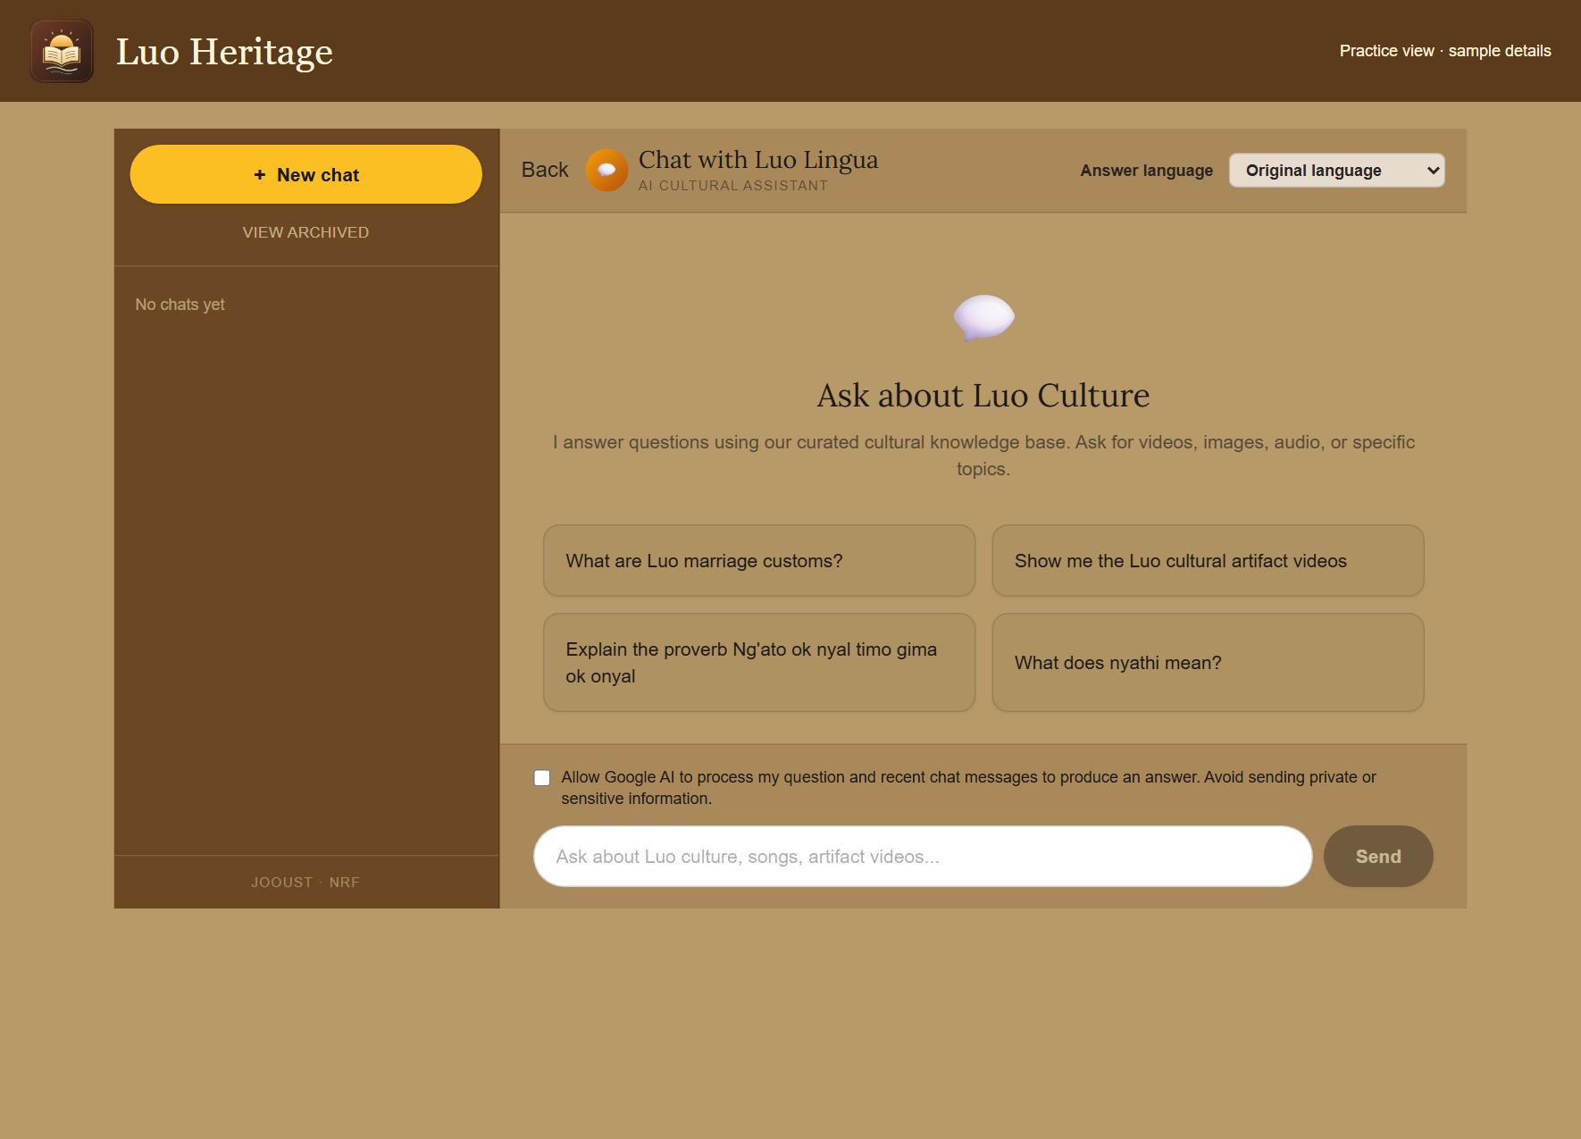
SELF-STUDY / TEACHERS AND LECTURERS
Ask the AI chatbot a clear question
1
Open Chat or Chatbot. Choose your
answer language and read the processing
permission notice.
2
If you agree, allow AI processing. Ask one
clear question and wait for the response.
3
Open any sources provided. Ask a
follow-up question if you need a simpler
explanation.
AI can make mistakes. Do not enter private interviews, passwords or
learners’ personal information.
CURRENT INTERFACE • PRACTICE DETAILS
CHECK: You can read an answer and inspect any linked sources.
LUO HERITAGE / TEACHERS AND LECTURERS
Contents
19 / 22
Notes:
Ask the AI chatbot a clear question
1. Open Chat or Chatbot. Choose your answer language and read the processing permission notice.
2. If you agree, allow AI processing. Ask one clear question and wait for the response.
3. Open any sources provided. Ask a follow-up question if you need a simpler explanation.
Expected result: You can read an answer and inspect any linked sources.
Important: AI can make mistakes. Do not enter private interviews, passwords or learners’ personal information.
Screenshot: current application interface rendered with sample details. No live action is demonstrated.

Slide 20

SELF-STUDY / TEACHERS AND LECTURERS
Protect your account and other people
1
Use your own account. Sign out on a
shared computer or phone.
2
Do not copy private interviews, class
results or account lists into public chats or
messages.
3
If a screen shows information you should
not see, stop and tell the account
administrator.
Send support the screen name and error message, never your password
or a reset link.
CURRENT INTERFACE • PRACTICE DETAILS
CHECK: Your work remains linked to the right person and private information stays protected.
LUO HERITAGE / TEACHERS AND LECTURERS
Contents
20 / 22
Notes:
Protect your account and other people
1. Use your own account. Sign out on a shared computer or phone.
2. Do not copy private interviews, class results or account lists into public chats or messages.
3. If a screen shows information you should not see, stop and tell the account administrator.
Expected result: Your work remains linked to the right person and private information stays protected.
Important: Send support the screen name and error message, never your password or a reset link.
Screenshot: current application interface rendered with sample details. No live action is demonstrated.

Slide 21
SELF-STUDY / TEACHERS AND LECTURERS
When something does not work
1
Check your internet connection. Read the message on screen
before trying again.
2
If your sign-in has expired, sign in again. If a button is missing,
ask which role and language you have.
3
If it still fails, note the time, screen, button and exact message.
Send these to your account administrator.
Before repeating an upload or submission, check whether the first attempt was already saved.
CURRENT INTERFACE • PRACTICE DETAILS
CHECK: You can explain the problem clearly without exposing private information.
LUO HERITAGE / TEACHERS AND LECTURERS
Contents
21 / 22
Notes:
When something does not work
1. Check your internet connection. Read the message on screen before trying again.
2. If your sign-in has expired, sign in again. If a button is missing, ask which role and language you have.
3. If it still fails, note the time, screen, button and exact message. Send these to your account administrator.
Expected result: You can explain the problem clearly without exposing private information.
Important: Before repeating an upload or submission, check whether the first attempt was already saved.
Screenshot: current application interface rendered with sample details. No live action is demonstrated.

Slide 22
SELF-STUDY / TEACHERS AND LECTURERS
Try it yourself: your readiness check
1
Open a practice class and explain how a student joins it.
2
Identify Create assignment, the feedback area and View gradebook.
3
Explain the difference between closing submissions, archiving a class and removing a learner.
Try
→
Check
→
Ask if unsure
Use only approved practice material. Do not publish, delete accounts or change live settings just to practise.
CHECK: You are ready for routine work when you can complete these steps without help.
LUO HERITAGE / TEACHERS AND LECTURERS
Contents
22 / 22
Notes:
Try it yourself: your readiness check
1. Open a practice class and explain how a student joins it.
2. Identify Create assignment, the feedback area and View gradebook.
3. Explain the difference between closing submissions, archiving a class and removing a learner.
Expected result: You are ready for routine work when you can complete these steps without help.
Important: Use only approved practice material. Do not publish, delete accounts or change live settings just to practise.

