Slide 1

LUO HERITAGE / SELF-STUDY SLIDES
LANGUAGE • CULTURE • LIVING MEMORY
Content editors
Make clear corrections and return work for review
You will be able to correct content without bypassing the review process.
READ • TRY • CHECK
25 October 2026 | Edition 1.0
Notes:
Self-study guide. Screenshots show actual interface components rendered with clearly labelled sample data, not a production acceptance demonstration. No real account or cultural record was changed to make these slides.

Slide 2
SELF-STUDY / CONTENT EDITORS
Start here: learn at your own pace
1
Read a slide, try its action, then check the result. Tap means click. Gold circles mark important
controls in the screenshots.
2
Use your own account. Your organisation supplies the correct website address and any staff
access.
3
Screenshots show the current interface with practice details. Actual names, content and
menus may differ.
Read the step
→
Try it yourself
→
Check the result
If your menu looks different, first check My access. Do not ask someone to lend you their account.
CHECK: You will be able to correct content without bypassing the review process.
LUO HERITAGE / CONTENT EDITORS
Contents
02 / 19
Notes:
Start here: learn at your own pace
1. Read a slide, try its action, then check the result. Tap means click. Gold circles mark important controls in the screenshots.
2. Use your own account. Your organisation supplies the correct website address and any staff access.
3. Screenshots show the current interface with practice details. Actual names, content and menus may differ.
Expected result: You will be able to correct content without bypassing the review process.
Important: If your menu looks different, first check My access. Do not ask someone to lend you their account.

Slide 3
SELF-STUDY / CONTENT EDITORS
What this guide covers
1
Find returned items in Editor Queue.
2
Correct text, translations and files while protecting the source.
3
Save the changed version and return it for cultural review.
CHECK: Use the slide numbers to return to a task. The PDF has page bookmarks; PowerPoint has a contents view.
LUO HERITAGE / CONTENT EDITORS
Contents
03 / 19
Notes:
What this guide covers
1. Find returned items in Editor Queue.
2. Correct text, translations and files while protecting the source.
3. Save the changed version and return it for cultural review.
Expected result: Use the slide numbers to return to a task. The PDF has page bookmarks; PowerPoint has a contents view.

Slide 4

SELF-STUDY / CONTENT EDITORS
Sign in to your own account
1
Open the Luo Heritage address supplied by your organisation.
Choose Sign in or Log in.
2
Enter your email and password, then choose Log in. Check your
spelling if it fails.
3
Community members may also use Google. Staff should use the
account supplied by their administrator.
Never share your password. Use only an address you trust.
CURRENT INTERFACE • PRACTICE DETAILS
CHECK: Your account or dashboard opens.
LUO HERITAGE / CONTENT EDITORS
Contents
04 / 19
Notes:
Sign in to your own account
1. Open the Luo Heritage address supplied by your organisation. Choose Sign in or Log in.
2. Enter your email and password, then choose Log in. Check your spelling if it fails.
3. Community members may also use Google. Staff should use the account supplied by their administrator.
Expected result: Your account or dashboard opens.
Important: Never share your password. Use only an address you trust.
Screenshot: current application interface rendered with sample details. No live action is demonstrated.

Slide 5

SELF-STUDY / CONTENT EDITORS
Forgot your password?
1
On the sign-in screen, choose Forgotten
password? Select Reset password.
2
Enter your account email. Choose Send
email, then check your inbox and spam
folder.
3
Open the newest reset link within 30
minutes. A link can be used only once.
If no email arrives, contact the person who manages your account. Do
not keep requesting links.
CURRENT INTERFACE • PRACTICE DETAILS
CHECK: An account email arrives if the address is eligible and the email service is available.
LUO HERITAGE / CONTENT EDITORS
Contents
05 / 19
Notes:
Forgot your password?
1. On the sign-in screen, choose Forgotten password? Select Reset password.
2. Enter your account email. Choose Send email, then check your inbox and spam folder.
3. Open the newest reset link within 30 minutes. A link can be used only once.
Expected result: An account email arrives if the address is eligible and the email service is available.
Important: If no email arrives, contact the person who manages your account. Do not keep requesting links.
Screenshot: current application interface rendered with sample details. No live action is demonstrated.

Slide 6

SELF-STUDY / CONTENT EDITORS
Choose a new password
1
Open the password reset link from your
own inbox.
2
Enter a new password of at least 12
characters. A short phrase with several
words is easier to remember.
3
Choose Confirm. Return to sign in and use
the new password on each device.
Do not forward the reset link. If it has expired, request a new one.
CURRENT INTERFACE • PRACTICE DETAILS
CHECK: The password changes and old sign-ins are ended.
LUO HERITAGE / CONTENT EDITORS
Contents
06 / 19
Notes:
Choose a new password
1. Open the password reset link from your own inbox.
2. Enter a new password of at least 12 characters. A short phrase with several words is easier to remember.
3. Choose Confirm. Return to sign in and use the new password on each device.
Expected result: The password changes and old sign-ins are ended.
Important: Do not forward the reset link. If it has expired, request a new one.
Screenshot: current application interface rendered with sample details. No live action is demonstrated.

Slide 7
SELF-STUDY / CONTENT EDITORS
How a contribution reaches readers
1
The uploader or contributor prepares a draft and submits it.
2
A cultural reviewer checks accuracy. An editor makes requested corrections and returns the
item for review.
3
A publisher checks the final item and permission. Only an approved public release becomes
visible to readers.
Prepare draft
→
Cultural review
→
Publisher check
→
Public release
Different people should perform the independent checks. Do not approve your own work.
CHECK: An item may return for changes. Drafts and private approvals are not public publication.
LUO HERITAGE / CONTENT EDITORS
Contents
07 / 19
Notes:
How a contribution reaches readers
1. The uploader or contributor prepares a draft and submits it.
2. A cultural reviewer checks accuracy. An editor makes requested corrections and returns the item for review.
3. A publisher checks the final item and permission. Only an approved public release becomes visible to readers.
Expected result: An item may return for changes. Drafts and private approvals are not public publication.
Important: Different people should perform the independent checks. Do not approve your own work.

Slide 8
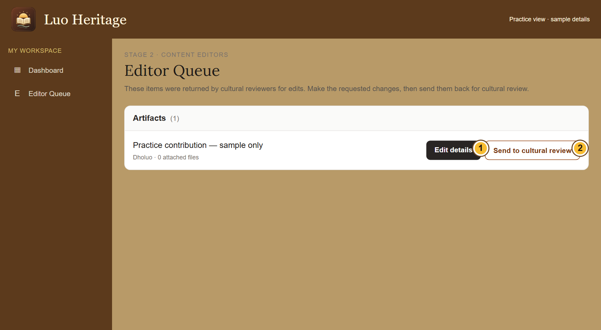
SELF-STUDY / CONTENT EDITORS
Correct an item returned by a reviewer
1
Open Editor Queue. Find the item and
choose Edit details.
2
Read the requested changes. Correct the
text or files, then save your changes.
3
Return to the queue and choose Send to
cultural review. The reviewer must check
the corrected version.
Saving an edit does not publish it. Keep the source’s meaning and credit.
CURRENT INTERFACE • PRACTICE DETAILS
CHECK: The corrected item returns to cultural review.
LUO HERITAGE / CONTENT EDITORS
Contents
08 / 19
Notes:
Correct an item returned by a reviewer
1. Open Editor Queue. Find the item and choose Edit details.
2. Read the requested changes. Correct the text or files, then save your changes.
3. Return to the queue and choose Send to cultural review. The reviewer must check the corrected version.
Expected result: The corrected item returns to cultural review.
Important: Saving an edit does not publish it. Keep the source’s meaning and credit.
Screenshot: current application interface rendered with sample details. No live action is demonstrated.

Slide 9
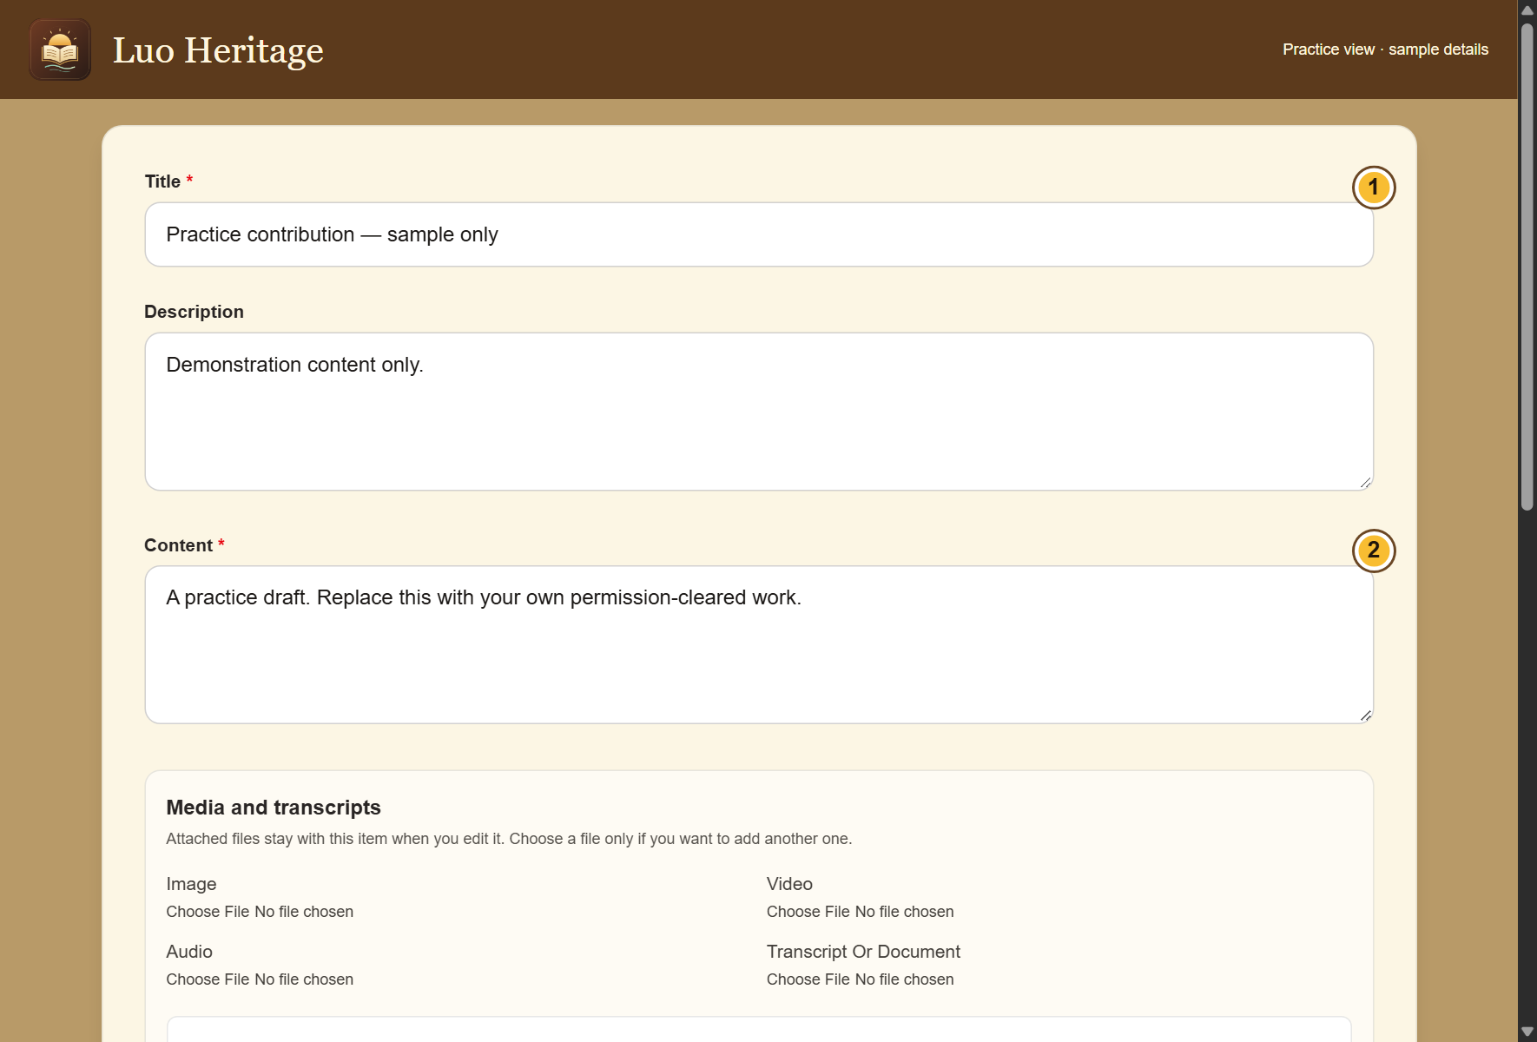
SELF-STUDY / CONTENT EDITORS
Make a careful edit
1
Read the reviewer’s request before
changing the draft. Keep the original
meaning.
2
Correct spelling, formatting, descriptions
and the requested collection details. Do not
invent missing translations.
3
Save changes, reopen the item and check
that the corrected version is shown.
For a disputed meaning, ask a cultural reviewer rather than silently
replacing it.
CURRENT INTERFACE • PRACTICE DETAILS
CHECK: The saved draft reflects the requested correction.
LUO HERITAGE / CONTENT EDITORS
Contents
09 / 19
Notes:
Make a careful edit
1. Read the reviewer’s request before changing the draft. Keep the original meaning.
2. Correct spelling, formatting, descriptions and the requested collection details. Do not invent missing translations.
3. Save changes, reopen the item and check that the corrected version is shown.
Expected result: The saved draft reflects the requested correction.
Important: For a disputed meaning, ask a cultural reviewer rather than silently replacing it.
Screenshot: current application interface rendered with sample details. No live action is demonstrated.

Slide 10
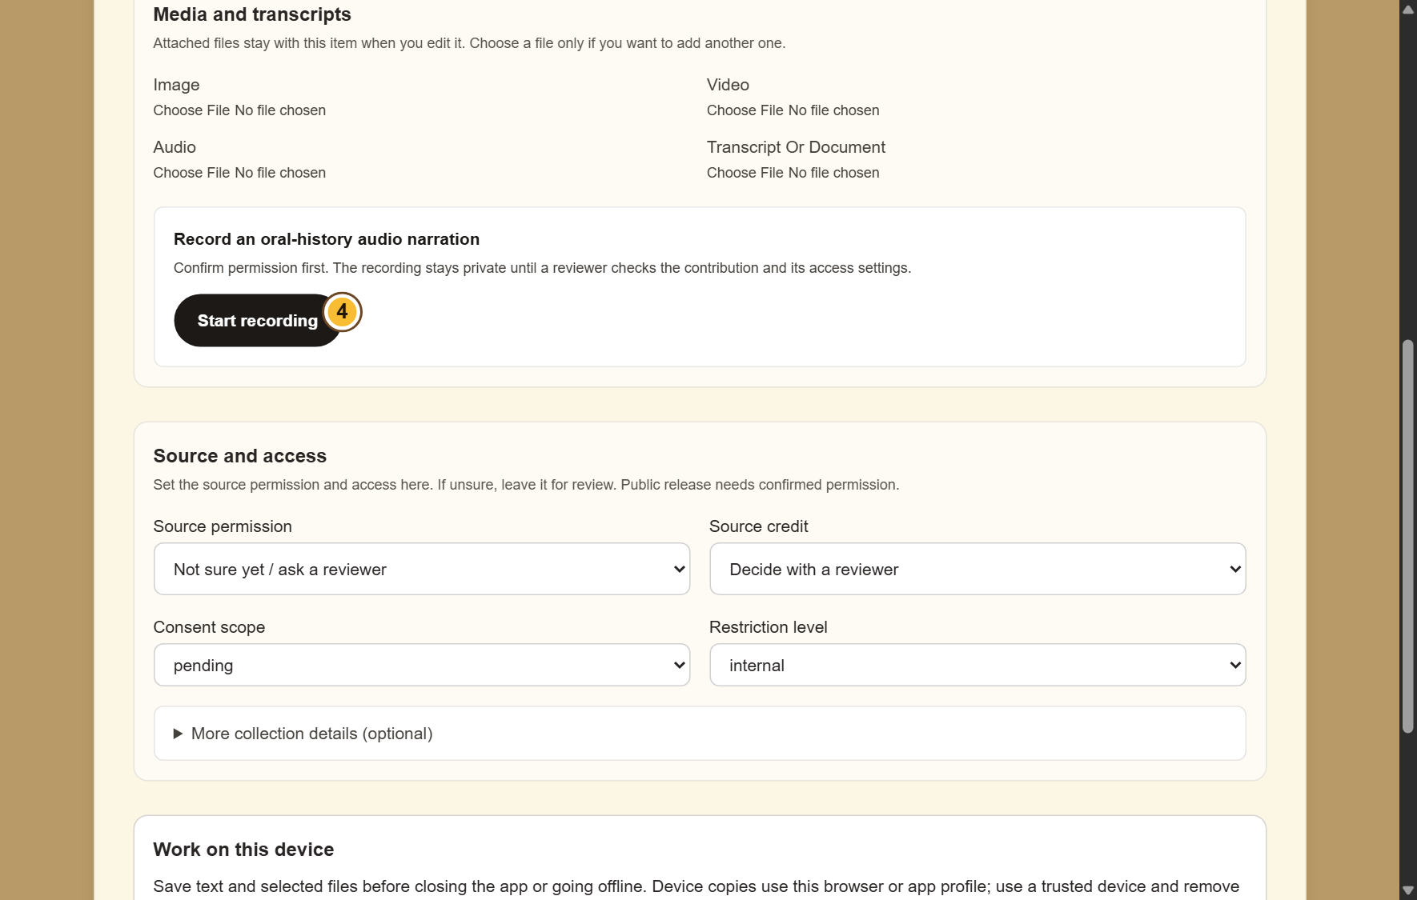
SELF-STUDY / CONTENT EDITORS
Add pictures, audio or documents
1
Find Media and transcripts. Choose a file
under the matching type.
2
For an oral history, confirm permission
before choosing Start recording. Stop when
finished.
3
Check that the correct files are selected.
Keep the app open while an upload is in
progress.
If microphone access is refused, allow it in your device settings or attach
an existing recording.
CURRENT INTERFACE • PRACTICE DETAILS
CHECK: The selected files stay with the contribution when it is saved successfully.
LUO HERITAGE / CONTENT EDITORS
Contents
10 / 19
Notes:
Add pictures, audio or documents
1. Find Media and transcripts. Choose a file under the matching type.
2. For an oral history, confirm permission before choosing Start recording. Stop when finished.
3. Check that the correct files are selected. Keep the app open while an upload is in progress.
Expected result: The selected files stay with the contribution when it is saved successfully.
Important: If microphone access is refused, allow it in your device settings or attach an existing recording.
Screenshot: current application interface rendered with sample details. No live action is demonstrated.

Slide 11

SELF-STUDY / CONTENT EDITORS
Check permission before sharing
1
Under Source and access, choose Source
permission. If unsure, leave Not sure yet /
ask a reviewer.
2
Choose how to credit the source. Use a
person’s name only when they agree.
3
Keep restricted, sacred or research-only
material private. Ask a reviewer before
changing access.
Permission to collect material is not automatically permission to publish it.
CURRENT INTERFACE • PRACTICE DETAILS
CHECK: The draft records who may use the material and how the source should be credited.
LUO HERITAGE / CONTENT EDITORS
Contents
11 / 19
Notes:
Check permission before sharing
1. Under Source and access, choose Source permission. If unsure, leave Not sure yet / ask a reviewer.
2. Choose how to credit the source. Use a person’s name only when they agree.
3. Keep restricted, sacred or research-only material private. Ask a reviewer before changing access.
Expected result: The draft records who may use the material and how the source should be credited.
Important: Permission to collect material is not automatically permission to publish it.
Screenshot: current application interface rendered with sample details. No live action is demonstrated.

Slide 12
SELF-STUDY / CONTENT EDITORS
What the permission labels mean
1
Source permission: has the source agreed
to the proposed use? Choose Not sure yet
when you do not know.
2
Consent scope: what use was agreed?
Public excerpt means an approved public
part; research only and teaching have
different limits.
3
Restriction level: who may see it? Internal
and restricted are not public. Sacred
material needs the collection owner’s
special care.
If the permission record is unclear, keep the item private and ask the
responsible reviewer.
CURRENT INTERFACE • PRACTICE DETAILS
CHECK: You understand the labels before you change them.
LUO HERITAGE / CONTENT EDITORS
Contents
12 / 19
Notes:
What the permission labels mean
1. Source permission: has the source agreed to the proposed use? Choose Not sure yet when you do not know.
2. Consent scope: what use was agreed? Public excerpt means an approved public part; research only and teaching have different limits.
3. Restriction level: who may see it? Internal and restricted are not public. Sacred material needs the collection owner’s special care.
Expected result: You understand the labels before you change them.
Important: If the permission record is unclear, keep the item private and ask the responsible reviewer.
Screenshot: current application interface rendered with sample details. No live action is demonstrated.

Slide 13
SELF-STUDY / CONTENT EDITORS
Return the item to the reviewer
1
Go back to Editor Queue after saving your
changes.
2
Choose Send to cultural review beside the
intended item.
3
Read the success message. The item
should leave the editable queue when the
handover succeeds.
If the item has already moved, refresh instead of sending a stale copy.
CURRENT INTERFACE • PRACTICE DETAILS
CHECK: The current corrected version is ready for cultural review.
LUO HERITAGE / CONTENT EDITORS
Contents
13 / 19
Notes:
Return the item to the reviewer
1. Go back to Editor Queue after saving your changes.
2. Choose Send to cultural review beside the intended item.
3. Read the success message. The item should leave the editable queue when the handover succeeds.
Expected result: The current corrected version is ready for cultural review.
Important: If the item has already moved, refresh instead of sending a stale copy.
Screenshot: current application interface rendered with sample details. No live action is demonstrated.

Slide 14
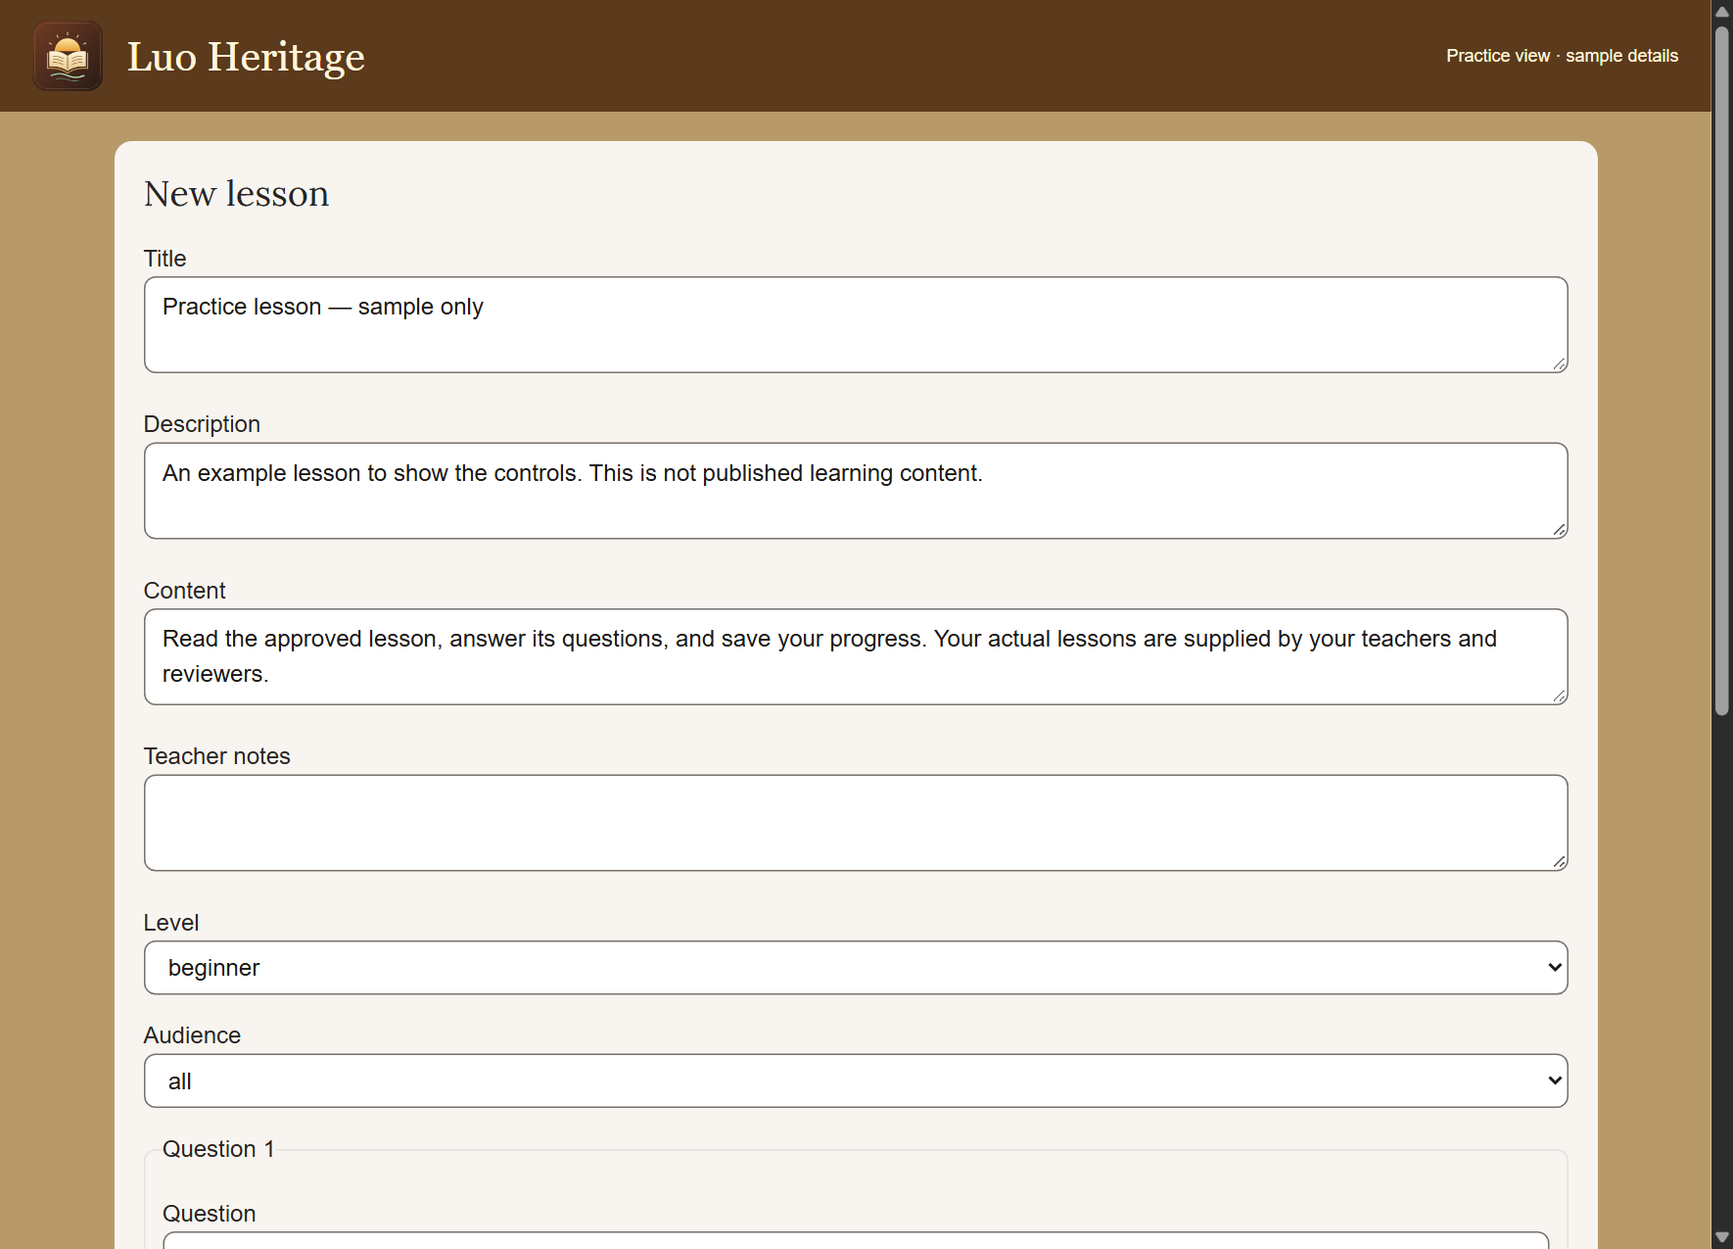
SELF-STUDY / CONTENT EDITORS
Prepare a lesson or game draft
1
Open Lessons, games & calendar and use
Content workspace when offered.
2
Choose Create content. Write the title,
content, level and audience; add checked
questions and answers.
3
Save the private draft and submit for
independent review. Do not approve your
own resource.
A written question game is different from a live multiplayer game.
CURRENT INTERFACE • PRACTICE DETAILS
CHECK: The resource is a draft or submitted item, not automatically public.
LUO HERITAGE / CONTENT EDITORS
Contents
14 / 19
Notes:
Prepare a lesson or game draft
1. Open Lessons, games & calendar and use Content workspace when offered.
2. Choose Create content. Write the title, content, level and audience; add checked questions and answers.
3. Save the private draft and submit for independent review. Do not approve your own resource.
Expected result: The resource is a draft or submitted item, not automatically public.
Important: A written question game is different from a live multiplayer game.
Screenshot: current application interface rendered with sample details. No live action is demonstrated.

Slide 15
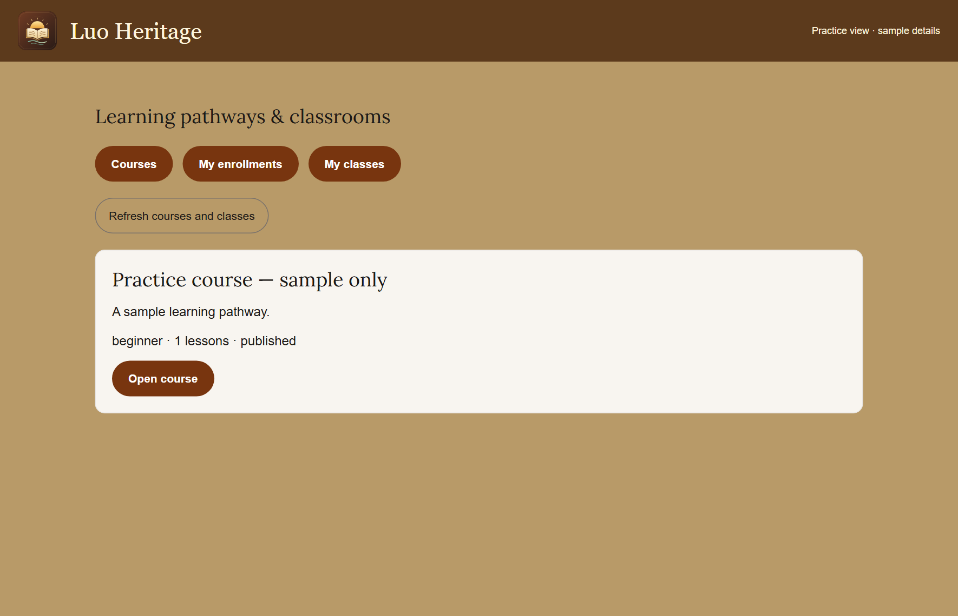
SELF-STUDY / CONTENT EDITORS
Build a course from approved lessons
1
Open Learning pathways & courses and
enable Course staff workspace.
2
Choose Create course. Use published
lessons from the same language, place
them in order and set required scores.
3
Save course draft, open it and submit it for
independent course review.
Changing a published course requires another review before publication.
CURRENT INTERFACE • PRACTICE DETAILS
CHECK: The course draft links the intended approved lessons.
LUO HERITAGE / CONTENT EDITORS
Contents
15 / 19
Notes:
Build a course from approved lessons
1. Open Learning pathways & courses and enable Course staff workspace.
2. Choose Create course. Use published lessons from the same language, place them in order and set required scores.
3. Save course draft, open it and submit it for independent course review.
Expected result: The course draft links the intended approved lessons.
Important: Changing a published course requires another review before publication.
Screenshot: current application interface rendered with sample details. No live action is demonstrated.

Slide 16
SELF-STUDY / CONTENT EDITORS
Avoid duplicate or unfinished corrections
1
If saving fails, keep the draft open and
check the connection.
2
Reopen or refresh only after preserving
unsaved text in a trusted place. Check the
current item version.
3
If another person has already changed the
item, read their changes before trying
again.
CURRENT INTERFACE • PRACTICE DETAILS
CHECK: You update the intended current version and avoid overwriting another person’s work.
LUO HERITAGE / CONTENT EDITORS
Contents
16 / 19
Notes:
Avoid duplicate or unfinished corrections
1. If saving fails, keep the draft open and check the connection.
2. Reopen or refresh only after preserving unsaved text in a trusted place. Check the current item version.
3. If another person has already changed the item, read their changes before trying again.
Expected result: You update the intended current version and avoid overwriting another person’s work.
Screenshot: current application interface rendered with sample details. No live action is demonstrated.

Slide 17

SELF-STUDY / CONTENT EDITORS
Protect your account and other people
1
Use your own account. Sign out on a
shared computer or phone.
2
Do not copy private interviews, class
results or account lists into public chats or
messages.
3
If a screen shows information you should
not see, stop and tell the account
administrator.
Send support the screen name and error message, never your password
or a reset link.
CURRENT INTERFACE • PRACTICE DETAILS
CHECK: Your work remains linked to the right person and private information stays protected.
LUO HERITAGE / CONTENT EDITORS
Contents
17 / 19
Notes:
Protect your account and other people
1. Use your own account. Sign out on a shared computer or phone.
2. Do not copy private interviews, class results or account lists into public chats or messages.
3. If a screen shows information you should not see, stop and tell the account administrator.
Expected result: Your work remains linked to the right person and private information stays protected.
Important: Send support the screen name and error message, never your password or a reset link.
Screenshot: current application interface rendered with sample details. No live action is demonstrated.

Slide 18
SELF-STUDY / CONTENT EDITORS
When something does not work
1
Check your internet connection. Read the message on screen
before trying again.
2
If your sign-in has expired, sign in again. If a button is missing,
ask which role and language you have.
3
If it still fails, note the time, screen, button and exact message.
Send these to your account administrator.
Before repeating an upload or submission, check whether the first attempt was already saved.
CURRENT INTERFACE • PRACTICE DETAILS
CHECK: You can explain the problem clearly without exposing private information.
LUO HERITAGE / CONTENT EDITORS
Contents
18 / 19
Notes:
When something does not work
1. Check your internet connection. Read the message on screen before trying again.
2. If your sign-in has expired, sign in again. If a button is missing, ask which role and language you have.
3. If it still fails, note the time, screen, button and exact message. Send these to your account administrator.
Expected result: You can explain the problem clearly without exposing private information.
Important: Before repeating an upload or submission, check whether the first attempt was already saved.
Screenshot: current application interface rendered with sample details. No live action is demonstrated.

Slide 19
SELF-STUDY / CONTENT EDITORS
Try it yourself: your readiness check
1
Find a practice correction and identify the requested change.
2
Save a corrected draft and locate Send to cultural review.
3
Explain why editing, cultural review and publication are separate actions.
Try
→
Check
→
Ask if unsure
Use only approved practice material. Do not publish, delete accounts or change live settings just to practise.
CHECK: You are ready for routine work when you can complete these steps without help.
LUO HERITAGE / CONTENT EDITORS
Contents
19 / 19
Notes:
Try it yourself: your readiness check
1. Find a practice correction and identify the requested change.
2. Save a corrected draft and locate Send to cultural review.
3. Explain why editing, cultural review and publication are separate actions.
Expected result: You are ready for routine work when you can complete these steps without help.
Important: Use only approved practice material. Do not publish, delete accounts or change live settings just to practise.

