Slide 1

LUO HERITAGE / SELF-STUDY SLIDES
LANGUAGE • CULTURE • LIVING MEMORY
Publishers
Make the final release decision responsibly
You will be able to check a reviewed item and distinguish public release from internal
approval.
READ • TRY • CHECK
25 October 2026 | Edition 1.0
Notes:
Self-study guide. Screenshots show actual interface components rendered with clearly labelled sample data, not a production acceptance demonstration. No real account or cultural record was changed to make these slides.

Slide 2
SELF-STUDY / PUBLISHERS
Start here: learn at your own pace
1
Read a slide, try its action, then check the result. Tap means click. Gold circles mark important
controls in the screenshots.
2
Use your own account. Your organisation supplies the correct website address and any staff
access.
3
Screenshots show the current interface with practice details. Actual names, content and
menus may differ.
Read the step
→
Try it yourself
→
Check the result
If your menu looks different, first check My access. Do not ask someone to lend you their account.
CHECK: You will be able to check a reviewed item and distinguish public release from internal approval.
LUO HERITAGE / PUBLISHERS
Contents
02 / 18
Notes:
Start here: learn at your own pace
1. Read a slide, try its action, then check the result. Tap means click. Gold circles mark important controls in the screenshots.
2. Use your own account. Your organisation supplies the correct website address and any staff access.
3. Screenshots show the current interface with practice details. Actual names, content and menus may differ.
Expected result: You will be able to check a reviewed item and distinguish public release from internal approval.
Important: If your menu looks different, first check My access. Do not ask someone to lend you their account.

Slide 3
SELF-STUDY / PUBLISHERS
What this guide covers
1
Find culturally reviewed items in Publishing Queue.
2
Check source permission, access and media before release.
3
Publish eligible material and verify what readers can see.
CHECK: Use the slide numbers to return to a task. The PDF has page bookmarks; PowerPoint has a contents view.
LUO HERITAGE / PUBLISHERS
Contents
03 / 18
Notes:
What this guide covers
1. Find culturally reviewed items in Publishing Queue.
2. Check source permission, access and media before release.
3. Publish eligible material and verify what readers can see.
Expected result: Use the slide numbers to return to a task. The PDF has page bookmarks; PowerPoint has a contents view.

Slide 4

SELF-STUDY / PUBLISHERS
Sign in to your own account
1
Open the Luo Heritage address supplied by your organisation.
Choose Sign in or Log in.
2
Enter your email and password, then choose Log in. Check your
spelling if it fails.
3
Community members may also use Google. Staff should use the
account supplied by their administrator.
Never share your password. Use only an address you trust.
CURRENT INTERFACE • PRACTICE DETAILS
CHECK: Your account or dashboard opens.
LUO HERITAGE / PUBLISHERS
Contents
04 / 18
Notes:
Sign in to your own account
1. Open the Luo Heritage address supplied by your organisation. Choose Sign in or Log in.
2. Enter your email and password, then choose Log in. Check your spelling if it fails.
3. Community members may also use Google. Staff should use the account supplied by their administrator.
Expected result: Your account or dashboard opens.
Important: Never share your password. Use only an address you trust.
Screenshot: current application interface rendered with sample details. No live action is demonstrated.

Slide 5

SELF-STUDY / PUBLISHERS
Forgot your password?
1
On the sign-in screen, choose Forgotten
password? Select Reset password.
2
Enter your account email. Choose Send
email, then check your inbox and spam
folder.
3
Open the newest reset link within 30
minutes. A link can be used only once.
If no email arrives, contact the person who manages your account. Do
not keep requesting links.
CURRENT INTERFACE • PRACTICE DETAILS
CHECK: An account email arrives if the address is eligible and the email service is available.
LUO HERITAGE / PUBLISHERS
Contents
05 / 18
Notes:
Forgot your password?
1. On the sign-in screen, choose Forgotten password? Select Reset password.
2. Enter your account email. Choose Send email, then check your inbox and spam folder.
3. Open the newest reset link within 30 minutes. A link can be used only once.
Expected result: An account email arrives if the address is eligible and the email service is available.
Important: If no email arrives, contact the person who manages your account. Do not keep requesting links.
Screenshot: current application interface rendered with sample details. No live action is demonstrated.

Slide 6

SELF-STUDY / PUBLISHERS
Choose a new password
1
Open the password reset link from your
own inbox.
2
Enter a new password of at least 12
characters. A short phrase with several
words is easier to remember.
3
Choose Confirm. Return to sign in and use
the new password on each device.
Do not forward the reset link. If it has expired, request a new one.
CURRENT INTERFACE • PRACTICE DETAILS
CHECK: The password changes and old sign-ins are ended.
LUO HERITAGE / PUBLISHERS
Contents
06 / 18
Notes:
Choose a new password
1. Open the password reset link from your own inbox.
2. Enter a new password of at least 12 characters. A short phrase with several words is easier to remember.
3. Choose Confirm. Return to sign in and use the new password on each device.
Expected result: The password changes and old sign-ins are ended.
Important: Do not forward the reset link. If it has expired, request a new one.
Screenshot: current application interface rendered with sample details. No live action is demonstrated.

Slide 7
SELF-STUDY / PUBLISHERS
How a contribution reaches readers
1
The uploader or contributor prepares a draft and submits it.
2
A cultural reviewer checks accuracy. An editor makes requested corrections and returns the
item for review.
3
A publisher checks the final item and permission. Only an approved public release becomes
visible to readers.
Prepare draft
→
Cultural review
→
Publisher check
→
Public release
Different people should perform the independent checks. Do not approve your own work.
CHECK: An item may return for changes. Drafts and private approvals are not public publication.
LUO HERITAGE / PUBLISHERS
Contents
07 / 18
Notes:
How a contribution reaches readers
1. The uploader or contributor prepares a draft and submits it.
2. A cultural reviewer checks accuracy. An editor makes requested corrections and returns the item for review.
3. A publisher checks the final item and permission. Only an approved public release becomes visible to readers.
Expected result: An item may return for changes. Drafts and private approvals are not public publication.
Important: Different people should perform the independent checks. Do not approve your own work.

Slide 8
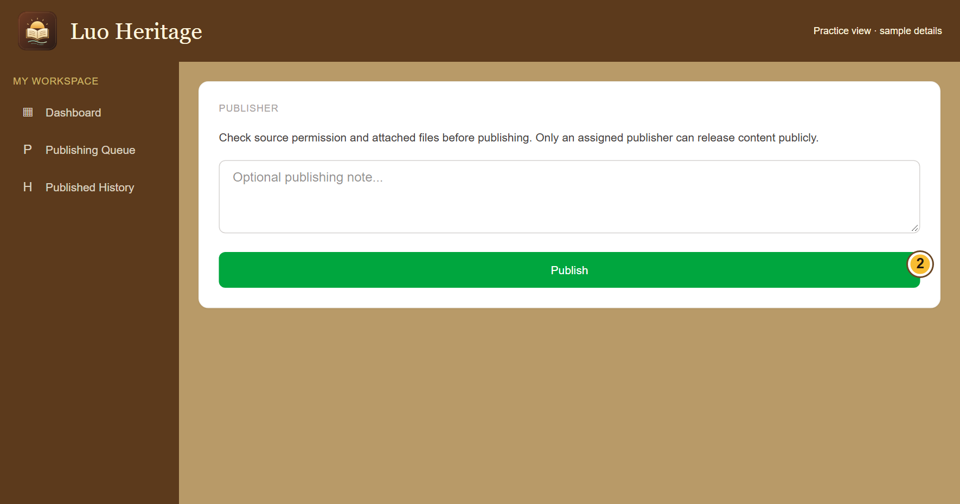
SELF-STUDY / PUBLISHERS
Check carefully before choosing Publish
1
Open Publishing Queue and read the
culturally reviewed item.
2
Check the text, attached files, source
permission and public access settings. Add
a note if needed.
3
Choose Publish only when the item is
ready. Read the confirmation: an internal
approval can remain private.
A Publish button is not permission to release sacred, restricted or
research-only material.
CURRENT INTERFACE • PRACTICE DETAILS
CHECK: Eligible public material becomes available to readers; internal material remains protected.
LUO HERITAGE / PUBLISHERS
Contents
08 / 18
Notes:
Check carefully before choosing Publish
1. Open Publishing Queue and read the culturally reviewed item.
2. Check the text, attached files, source permission and public access settings. Add a note if needed.
3. Choose Publish only when the item is ready. Read the confirmation: an internal approval can remain private.
Expected result: Eligible public material becomes available to readers; internal material remains protected.
Important: A Publish button is not permission to release sacred, restricted or research-only material.
Screenshot: current application interface rendered with sample details. No live action is demonstrated.

Slide 9

SELF-STUDY / PUBLISHERS
Check permission before sharing
1
Under Source and access, choose Source
permission. If unsure, leave Not sure yet /
ask a reviewer.
2
Choose how to credit the source. Use a
person’s name only when they agree.
3
Keep restricted, sacred or research-only
material private. Ask a reviewer before
changing access.
Permission to collect material is not automatically permission to publish it.
CURRENT INTERFACE • PRACTICE DETAILS
CHECK: The draft records who may use the material and how the source should be credited.
LUO HERITAGE / PUBLISHERS
Contents
09 / 18
Notes:
Check permission before sharing
1. Under Source and access, choose Source permission. If unsure, leave Not sure yet / ask a reviewer.
2. Choose how to credit the source. Use a person’s name only when they agree.
3. Keep restricted, sacred or research-only material private. Ask a reviewer before changing access.
Expected result: The draft records who may use the material and how the source should be credited.
Important: Permission to collect material is not automatically permission to publish it.
Screenshot: current application interface rendered with sample details. No live action is demonstrated.

Slide 10
SELF-STUDY / PUBLISHERS
What the permission labels mean
1
Source permission: has the source agreed
to the proposed use? Choose Not sure yet
when you do not know.
2
Consent scope: what use was agreed?
Public excerpt means an approved public
part; research only and teaching have
different limits.
3
Restriction level: who may see it? Internal
and restricted are not public. Sacred
material needs the collection owner’s
special care.
If the permission record is unclear, keep the item private and ask the
responsible reviewer.
CURRENT INTERFACE • PRACTICE DETAILS
CHECK: You understand the labels before you change them.
LUO HERITAGE / PUBLISHERS
Contents
10 / 18
Notes:
What the permission labels mean
1. Source permission: has the source agreed to the proposed use? Choose Not sure yet when you do not know.
2. Consent scope: what use was agreed? Public excerpt means an approved public part; research only and teaching have different limits.
3. Restriction level: who may see it? Internal and restricted are not public. Sacred material needs the collection owner’s special care.
Expected result: You understand the labels before you change them.
Important: If the permission record is unclear, keep the item private and ask the responsible reviewer.
Screenshot: current application interface rendered with sample details. No live action is demonstrated.

Slide 11
SELF-STUDY / PUBLISHERS
Use a final pre-publication check
1
Confirm the title, language and current
version are correct and the cultural review
is complete.
2
Open the files and read descriptions,
translations and source credit. Check that
public sharing is actually permitted.
3
If anything is unclear, stop and contact the
reviewer or language administrator before
publishing.
CURRENT INTERFACE • PRACTICE DETAILS
CHECK: The release decision is based on the complete item and its permission evidence.
LUO HERITAGE / PUBLISHERS
Contents
11 / 18
Notes:
Use a final pre-publication check
1. Confirm the title, language and current version are correct and the cultural review is complete.
2. Open the files and read descriptions, translations and source credit. Check that public sharing is actually permitted.
3. If anything is unclear, stop and contact the reviewer or language administrator before publishing.
Expected result: The release decision is based on the complete item and its permission evidence.
Screenshot: current application interface rendered with sample details. No live action is demonstrated.

Slide 12
SELF-STUDY / PUBLISHERS
Understand the confirmation message
1
After choosing Publish, read the full
success message.
2
Public release means eligible readers can
see the item. Internal curation means it
remains private.
3
Do not change consent or access merely to
make an internally approved item appear in
the public library.
CURRENT INTERFACE • PRACTICE DETAILS
CHECK: You know whether the item was publicly released or privately curated.
LUO HERITAGE / PUBLISHERS
Contents
12 / 18
Notes:
Understand the confirmation message
1. After choosing Publish, read the full success message.
2. Public release means eligible readers can see the item. Internal curation means it remains private.
3. Do not change consent or access merely to make an internally approved item appear in the public library.
Expected result: You know whether the item was publicly released or privately curated.
Screenshot: current application interface rendered with sample details. No live action is demonstrated.

Slide 13
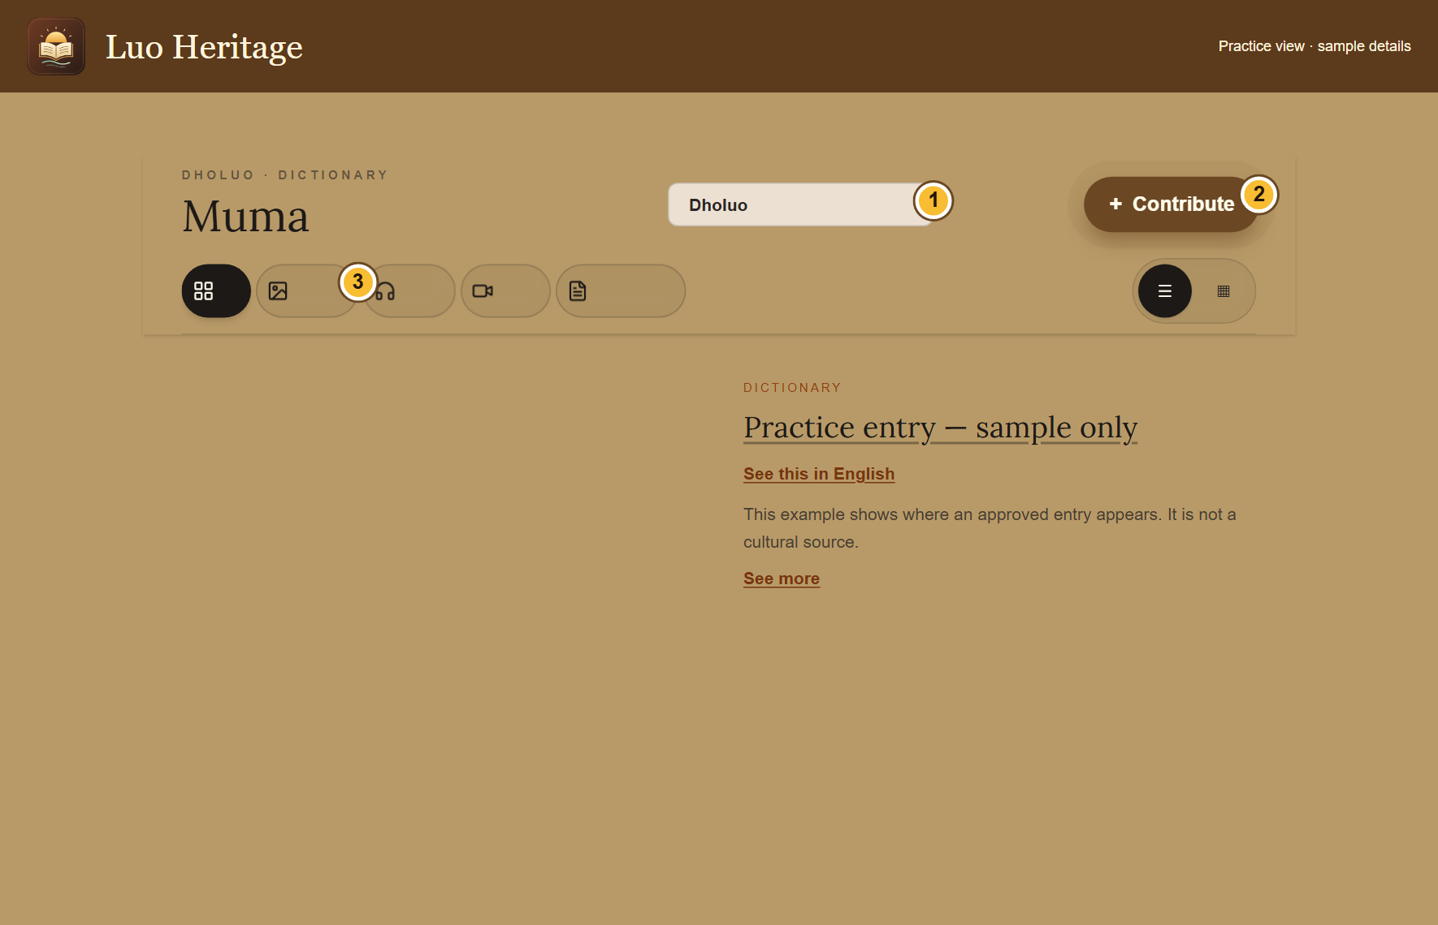
SELF-STUDY / PUBLISHERS
Check the reader’s view
1
Open the public library, preferably in a
separate signed-out browser window.
2
Choose the correct collection and content
type. Find the released item and try its
files.
3
If it is missing, confirm the release
message, language, permission and
selected filter before escalating.
Do not test private content by sharing a staff-only link with a member of
the public.
CURRENT INTERFACE • PRACTICE DETAILS
CHECK: The intended public item is readable and its files are usable.
LUO HERITAGE / PUBLISHERS
Contents
13 / 18
Notes:
Check the reader’s view
1. Open the public library, preferably in a separate signed-out browser window.
2. Choose the correct collection and content type. Find the released item and try its files.
3. If it is missing, confirm the release message, language, permission and selected filter before escalating.
Expected result: The intended public item is readable and its files are usable.
Important: Do not test private content by sharing a staff-only link with a member of the public.
Screenshot: current application interface rendered with sample details. No live action is demonstrated.

Slide 14
SELF-STUDY / PUBLISHERS
Keep the publication record
1
Open Published History to find earlier
releases.
2
Record any concern with the item’s title
and reference, and notify the language
administrator.
3
If an urgent rights or privacy issue is found,
request the approved withdrawal process.
Do not assume a saved edit removes a
public item.
CURRENT INTERFACE • PRACTICE DETAILS
CHECK: Publication decisions and later concerns can be traced.
LUO HERITAGE / PUBLISHERS
Contents
14 / 18
Notes:
Keep the publication record
1. Open Published History to find earlier releases.
2. Record any concern with the item’s title and reference, and notify the language administrator.
3. If an urgent rights or privacy issue is found, request the approved withdrawal process. Do not assume a saved edit removes a public item.
Expected result: Publication decisions and later concerns can be traced.
Screenshot: current application interface rendered with sample details. No live action is demonstrated.

Slide 15
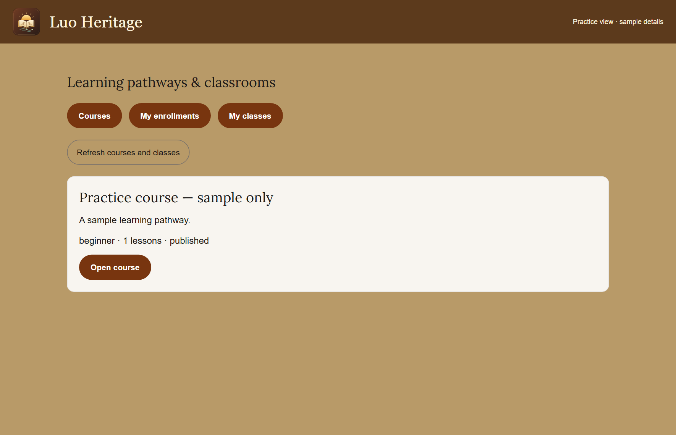
SELF-STUDY / PUBLISHERS
Publish lessons and courses separately
1
In the learning content workspace, inspect
validated resources and use publish only
when permitted.
2
For a course, open its staff view and
choose Publish course after independent
review.
3
Confirm that both the course and its linked
lessons are available to the intended
learners.
You cannot independently approve a resource you authored yourself.
CURRENT INTERFACE • PRACTICE DETAILS
CHECK: Learners see a usable course with available lessons.
LUO HERITAGE / PUBLISHERS
Contents
15 / 18
Notes:
Publish lessons and courses separately
1. In the learning content workspace, inspect validated resources and use publish only when permitted.
2. For a course, open its staff view and choose Publish course after independent review.
3. Confirm that both the course and its linked lessons are available to the intended learners.
Expected result: Learners see a usable course with available lessons.
Important: You cannot independently approve a resource you authored yourself.
Screenshot: current application interface rendered with sample details. No live action is demonstrated.

Slide 16

SELF-STUDY / PUBLISHERS
Protect your account and other people
1
Use your own account. Sign out on a
shared computer or phone.
2
Do not copy private interviews, class
results or account lists into public chats or
messages.
3
If a screen shows information you should
not see, stop and tell the account
administrator.
Send support the screen name and error message, never your password
or a reset link.
CURRENT INTERFACE • PRACTICE DETAILS
CHECK: Your work remains linked to the right person and private information stays protected.
LUO HERITAGE / PUBLISHERS
Contents
16 / 18
Notes:
Protect your account and other people
1. Use your own account. Sign out on a shared computer or phone.
2. Do not copy private interviews, class results or account lists into public chats or messages.
3. If a screen shows information you should not see, stop and tell the account administrator.
Expected result: Your work remains linked to the right person and private information stays protected.
Important: Send support the screen name and error message, never your password or a reset link.
Screenshot: current application interface rendered with sample details. No live action is demonstrated.

Slide 17
SELF-STUDY / PUBLISHERS
When something does not work
1
Check your internet connection. Read the message on screen
before trying again.
2
If your sign-in has expired, sign in again. If a button is missing,
ask which role and language you have.
3
If it still fails, note the time, screen, button and exact message.
Send these to your account administrator.
Before repeating an upload or submission, check whether the first attempt was already saved.
CURRENT INTERFACE • PRACTICE DETAILS
CHECK: You can explain the problem clearly without exposing private information.
LUO HERITAGE / PUBLISHERS
Contents
17 / 18
Notes:
When something does not work
1. Check your internet connection. Read the message on screen before trying again.
2. If your sign-in has expired, sign in again. If a button is missing, ask which role and language you have.
3. If it still fails, note the time, screen, button and exact message. Send these to your account administrator.
Expected result: You can explain the problem clearly without exposing private information.
Important: Before repeating an upload or submission, check whether the first attempt was already saved.
Screenshot: current application interface rendered with sample details. No live action is demonstrated.

Slide 18
SELF-STUDY / PUBLISHERS
Try it yourself: your readiness check
1
Explain the checks you make before Publish.
2
Distinguish a public release from an internal approval.
3
Find the public collection and explain how you would report an incorrect release.
Try
→
Check
→
Ask if unsure
Use only approved practice material. Do not publish, delete accounts or change live settings just to practise.
CHECK: You are ready for routine work when you can complete these steps without help.
LUO HERITAGE / PUBLISHERS
Contents
18 / 18
Notes:
Try it yourself: your readiness check
1. Explain the checks you make before Publish.
2. Distinguish a public release from an internal approval.
3. Find the public collection and explain how you would report an incorrect release.
Expected result: You are ready for routine work when you can complete these steps without help.
Important: Use only approved practice material. Do not publish, delete accounts or change live settings just to practise.

