Slide 1

LUO HERITAGE / SELF-STUDY SLIDES
LANGUAGE • CULTURE • LIVING MEMORY
Master Super Admin
Own platform access and protect the institutional system
You will be able to oversee high-impact actions, delegate responsibly and keep the platform’s
records safe.
READ • TRY • CHECK
25 October 2026 | Edition 1.0
Notes:
Self-study guide. Screenshots show actual interface components rendered with clearly labelled sample data, not a production acceptance demonstration. No real account or cultural record was changed to make these slides.

Slide 2
SELF-STUDY / MASTER SUPER ADMIN
Start here: learn at your own pace
1
Read a slide, try its action, then check the result. Tap means click. Gold circles mark important
controls in the screenshots.
2
Use your own account. Your organisation supplies the correct website address and any staff
access.
3
Screenshots show the current interface with practice details. Actual names, content and
menus may differ.
Read the step
→
Try it yourself
→
Check the result
If your menu looks different, first check My access. Do not ask someone to lend you their account.
CHECK: You will be able to oversee high-impact actions, delegate responsibly and keep the platform’s records safe.
LUO HERITAGE / MASTER SUPER ADMIN
Contents
02 / 23
Notes:
Start here: learn at your own pace
1. Read a slide, try its action, then check the result. Tap means click. Gold circles mark important controls in the screenshots.
2. Use your own account. Your organisation supplies the correct website address and any staff access.
3. Screenshots show the current interface with practice details. Actual names, content and menus may differ.
Expected result: You will be able to oversee high-impact actions, delegate responsibly and keep the platform’s records safe.
Important: If your menu looks different, first check My access. Do not ask someone to lend you their account.

Slide 3
SELF-STUDY / MASTER SUPER ADMIN
What this guide covers
1
Manage Super Admin authority, languages and institutional settings.
2
Check account recovery, backups, public terms and service health.
3
Use documented checks before high-impact changes and handover.
CHECK: Use the slide numbers to return to a task. The PDF has page bookmarks; PowerPoint has a contents view.
LUO HERITAGE / MASTER SUPER ADMIN
Contents
03 / 23
Notes:
What this guide covers
1. Manage Super Admin authority, languages and institutional settings.
2. Check account recovery, backups, public terms and service health.
3. Use documented checks before high-impact changes and handover.
Expected result: Use the slide numbers to return to a task. The PDF has page bookmarks; PowerPoint has a contents view.

Slide 4

SELF-STUDY / MASTER SUPER ADMIN
Sign in to your own account
1
Open the Luo Heritage address supplied by your organisation.
Choose Sign in or Log in.
2
Enter your email and password, then choose Log in. Check your
spelling if it fails.
3
Community members may also use Google. Staff should use the
account supplied by their administrator.
Never share your password. Use only an address you trust.
CURRENT INTERFACE • PRACTICE DETAILS
CHECK: Your account or dashboard opens.
LUO HERITAGE / MASTER SUPER ADMIN
Contents
04 / 23
Notes:
Sign in to your own account
1. Open the Luo Heritage address supplied by your organisation. Choose Sign in or Log in.
2. Enter your email and password, then choose Log in. Check your spelling if it fails.
3. Community members may also use Google. Staff should use the account supplied by their administrator.
Expected result: Your account or dashboard opens.
Important: Never share your password. Use only an address you trust.
Screenshot: current application interface rendered with sample details. No live action is demonstrated.

Slide 5

SELF-STUDY / MASTER SUPER ADMIN
Forgot your password?
1
On the sign-in screen, choose Forgotten
password? Select Reset password.
2
Enter your account email. Choose Send
email, then check your inbox and spam
folder.
3
Open the newest reset link within 30
minutes. A link can be used only once.
If no email arrives, contact the person who manages your account. Do
not keep requesting links.
CURRENT INTERFACE • PRACTICE DETAILS
CHECK: An account email arrives if the address is eligible and the email service is available.
LUO HERITAGE / MASTER SUPER ADMIN
Contents
05 / 23
Notes:
Forgot your password?
1. On the sign-in screen, choose Forgotten password? Select Reset password.
2. Enter your account email. Choose Send email, then check your inbox and spam folder.
3. Open the newest reset link within 30 minutes. A link can be used only once.
Expected result: An account email arrives if the address is eligible and the email service is available.
Important: If no email arrives, contact the person who manages your account. Do not keep requesting links.
Screenshot: current application interface rendered with sample details. No live action is demonstrated.

Slide 6

SELF-STUDY / MASTER SUPER ADMIN
Choose a new password
1
Open the password reset link from your
own inbox.
2
Enter a new password of at least 12
characters. A short phrase with several
words is easier to remember.
3
Choose Confirm. Return to sign in and use
the new password on each device.
Do not forward the reset link. If it has expired, request a new one.
CURRENT INTERFACE • PRACTICE DETAILS
CHECK: The password changes and old sign-ins are ended.
LUO HERITAGE / MASTER SUPER ADMIN
Contents
06 / 23
Notes:
Choose a new password
1. Open the password reset link from your own inbox.
2. Enter a new password of at least 12 characters. A short phrase with several words is easier to remember.
3. Choose Confirm. Return to sign in and use the new password on each device.
Expected result: The password changes and old sign-ins are ended.
Important: Do not forward the reset link. If it has expired, request a new one.
Screenshot: current application interface rendered with sample details. No live action is demonstrated.

Slide 7
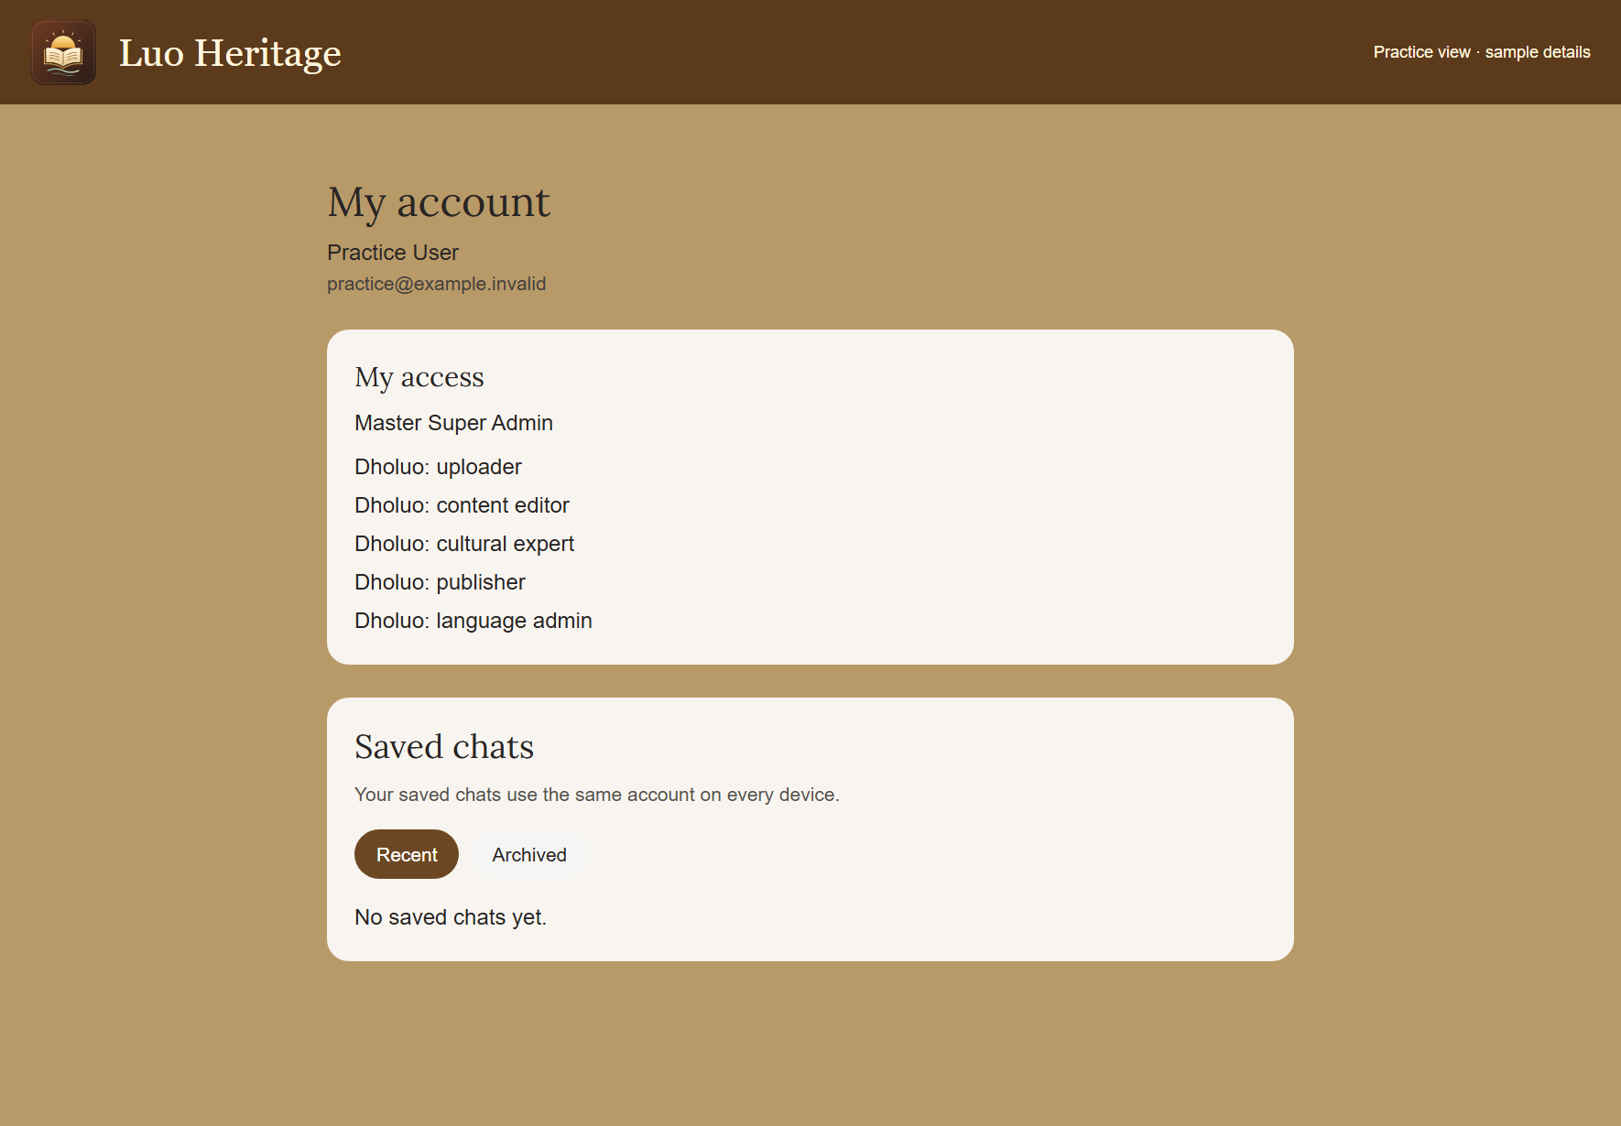
SELF-STUDY / MASTER SUPER ADMIN
Your role carries overall responsibility
1
Use your own protected account. Confirm
My access shows Master Super Admin.
2
Keep the organisation’s ownership, support
arrangements and recovery contact
current.
3
Delegate ordinary work to named staff;
broad access is not a reason to bypass
independent review.
Check My access on your own account; the screenshot uses a labelled
practice account.
CURRENT INTERFACE • PRACTICE DETAILS
CHECK: You know which responsibilities must remain with the institutional owner.
LUO HERITAGE / MASTER SUPER ADMIN
Contents
07 / 23
Notes:
Your role carries overall responsibility
1. Use your own protected account. Confirm My access shows Master Super Admin.
2. Keep the organisation’s ownership, support arrangements and recovery contact current.
3. Delegate ordinary work to named staff; broad access is not a reason to bypass independent review.
Expected result: You know which responsibilities must remain with the institutional owner.
Important: Check My access on your own account; the screenshot uses a labelled practice account.
Screenshot: current application interface rendered with sample details. No live action is demonstrated.

Slide 8
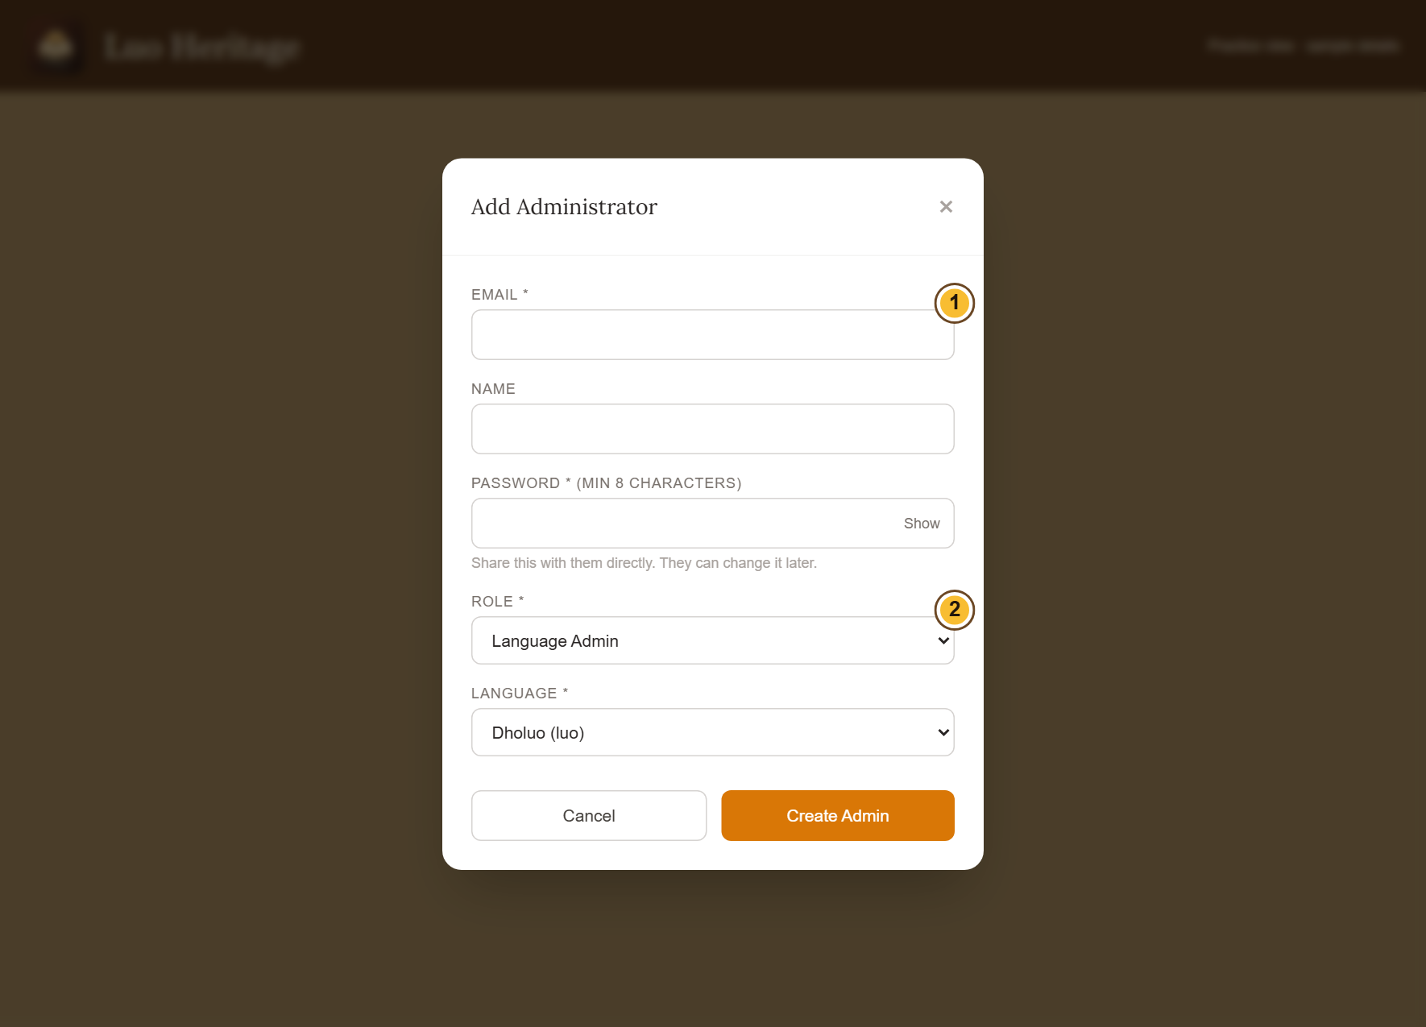
SELF-STUDY / MASTER SUPER ADMIN
Create or change Super Admin authority
1
Open Admins, then + Add Admin to
prepare a new staff account.
2
Select Super Admin only for a trusted
person with an agreed responsibility.
Assign the languages they oversee.
3
Check the saved account carefully. Read
the consequences before revoking or
deactivating a Super Admin.
Never create a shared administrator account for a team.
CURRENT INTERFACE • PRACTICE DETAILS
CHECK: Only the intended person receives the intended authority.
LUO HERITAGE / MASTER SUPER ADMIN
Contents
08 / 23
Notes:
Create or change Super Admin authority
1. Open Admins, then + Add Admin to prepare a new staff account.
2. Select Super Admin only for a trusted person with an agreed responsibility. Assign the languages they oversee.
3. Check the saved account carefully. Read the consequences before revoking or deactivating a Super Admin.
Expected result: Only the intended person receives the intended authority.
Important: Never create a shared administrator account for a team.
Screenshot: current application interface rendered with sample details. No live action is demonstrated.

Slide 9
SELF-STUDY / MASTER SUPER ADMIN
Create a staff account for the right person
1
Open Admins, then choose + Add Admin.
Confirm the person’s email and name.
2
Choose only the role and language the
person needs. Set a strong temporary
password.
3
Save the account. Share access details
privately with that person and ask them to
set their own password.
Only the Master Super Admin can create or remove Super Admin
authority.
CURRENT INTERFACE • PRACTICE DETAILS
CHECK: The staff member appears in Administrators with the intended role and language.
LUO HERITAGE / MASTER SUPER ADMIN
Contents
09 / 23
Notes:
Create a staff account for the right person
1. Open Admins, then choose + Add Admin. Confirm the person’s email and name.
2. Choose only the role and language the person needs. Set a strong temporary password.
3. Save the account. Share access details privately with that person and ask them to set their own password.
Expected result: The staff member appears in Administrators with the intended role and language.
Important: Only the Master Super Admin can create or remove Super Admin authority.
Screenshot: current application interface rendered with sample details. No live action is demonstrated.

Slide 10
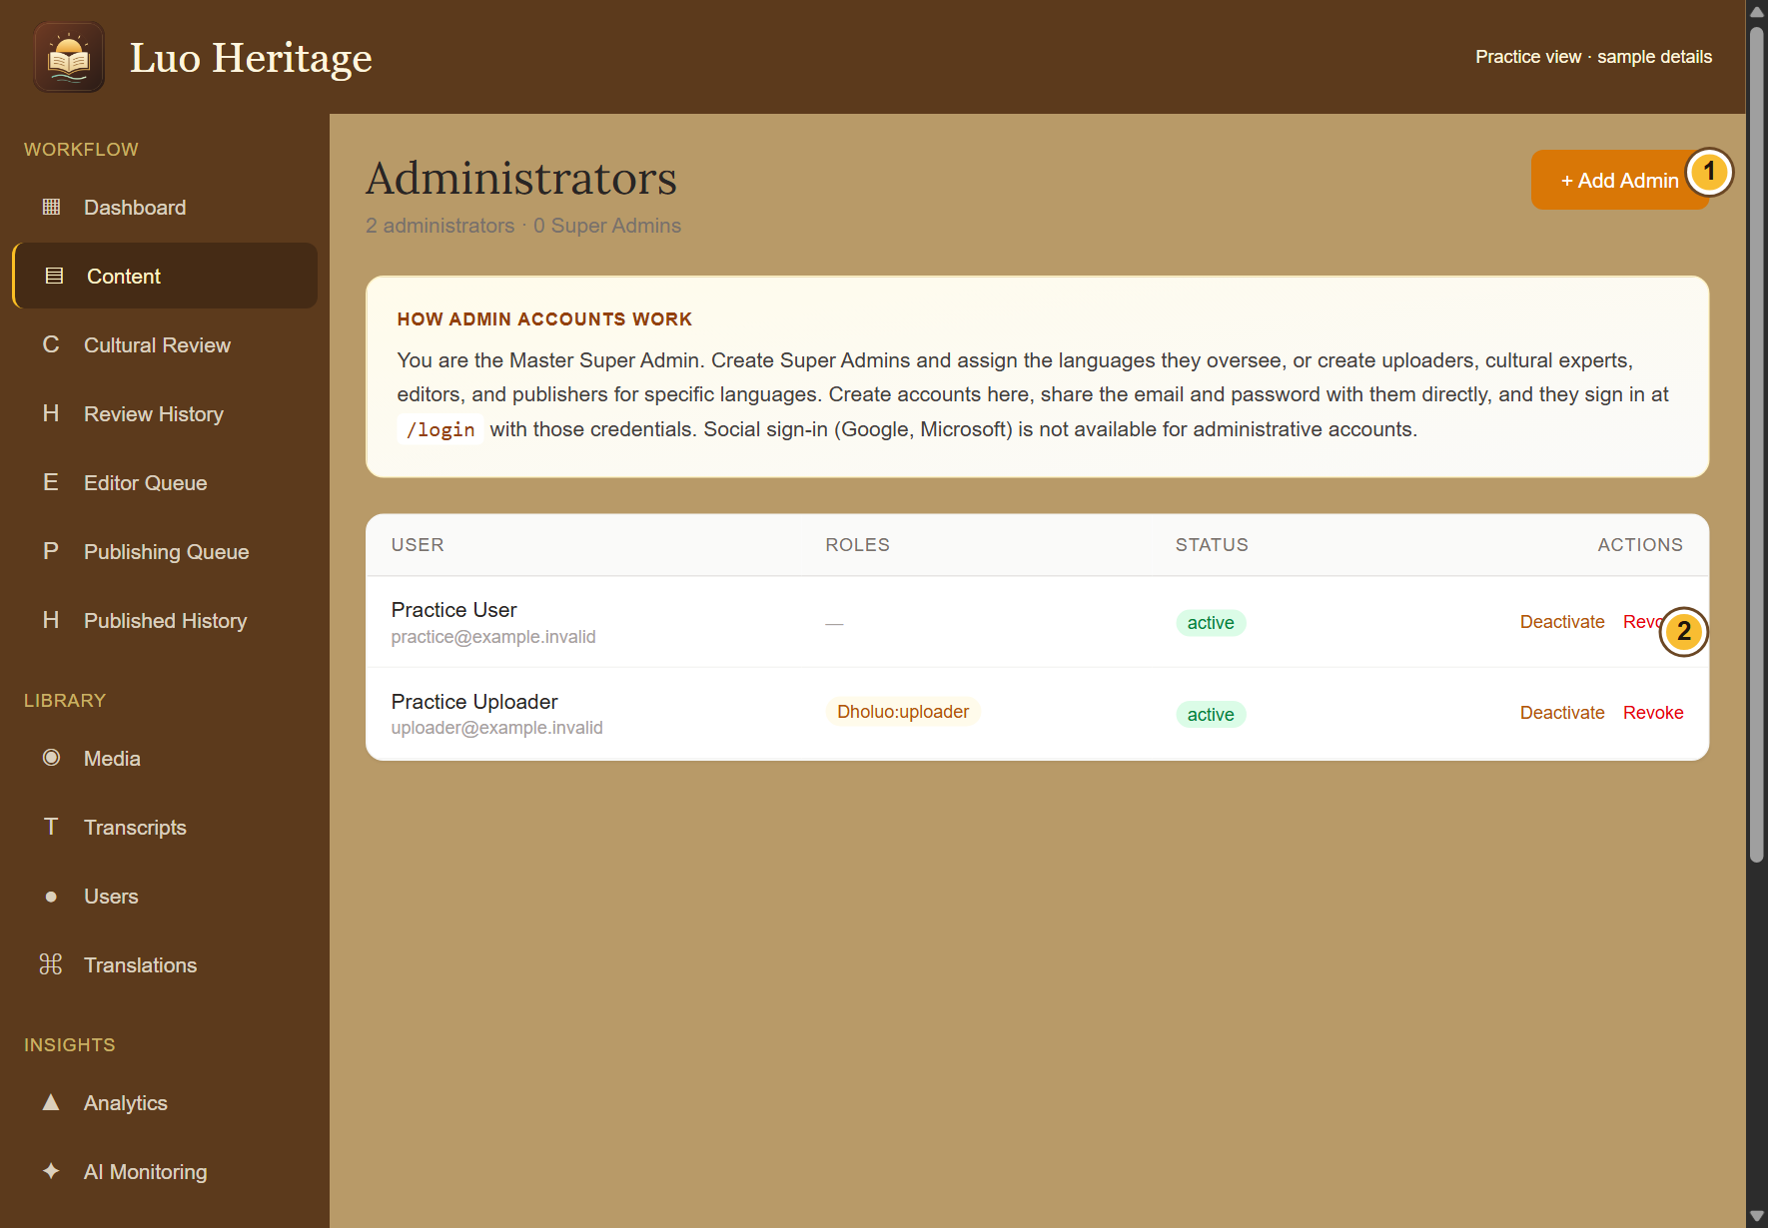
SELF-STUDY / MASTER SUPER ADMIN
Maintain your staff list
1
Open Administrators and review each
name, email, language and role.
2
Remove unneeded authority through the
permitted controls after confirming
ownership of ongoing work.
3
Keep cultural reviewers, editors and
publishers distinct wherever possible.
Record the reason for important access
changes.
CURRENT INTERFACE • PRACTICE DETAILS
CHECK: Current staff responsibilities are clear and former staff cannot retain unwanted access.
LUO HERITAGE / MASTER SUPER ADMIN
Contents
10 / 23
Notes:
Maintain your staff list
1. Open Administrators and review each name, email, language and role.
2. Remove unneeded authority through the permitted controls after confirming ownership of ongoing work.
3. Keep cultural reviewers, editors and publishers distinct wherever possible. Record the reason for important access changes.
Expected result: Current staff responsibilities are clear and former staff cannot retain unwanted access.
Screenshot: current application interface rendered with sample details. No live action is demonstrated.

Slide 11
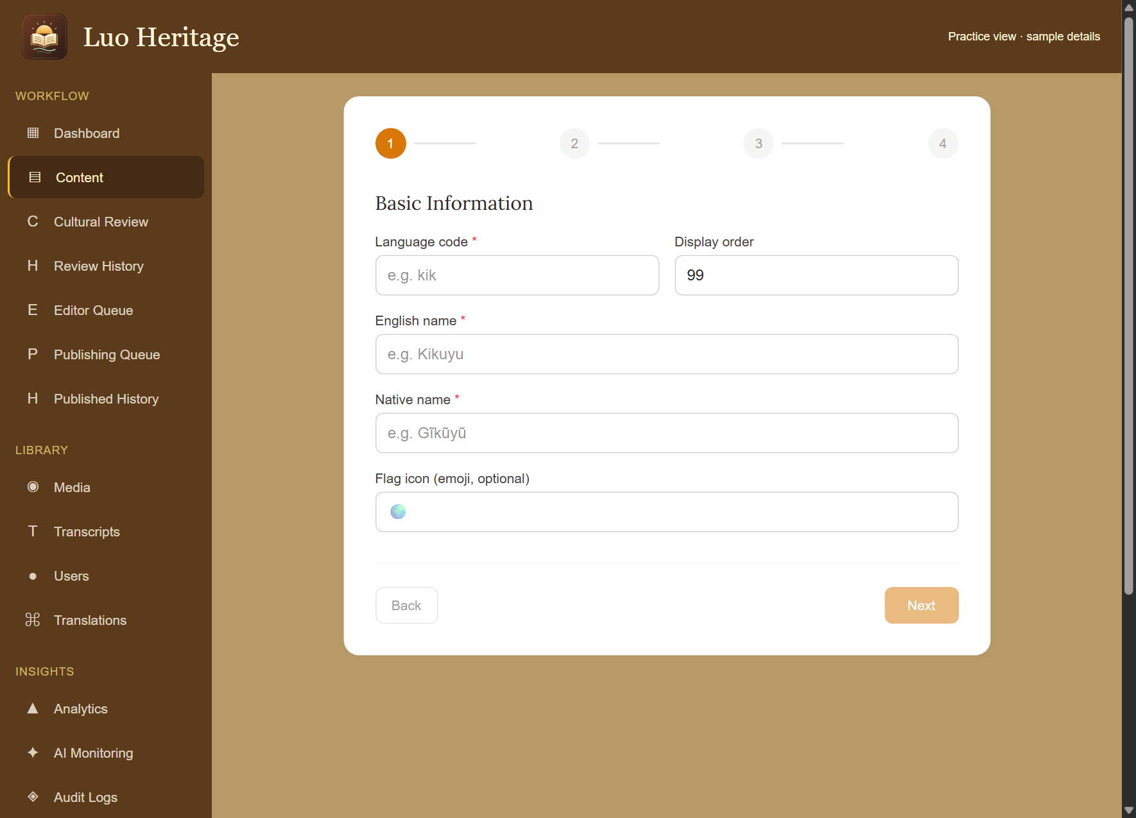
SELF-STUDY / MASTER SUPER ADMIN
Add a language deliberately
1
Open Languages and choose + Add
Language.
2
Follow the numbered language setup:
enter the code, name and local name, then
check the module and administrator
choices.
3
Review the summary before saving.
Creating a language does not create
reviewed translations or public cultural
content.
CURRENT INTERFACE • PRACTICE DETAILS
CHECK: The intended language exists with its configuration ready for checked content.
LUO HERITAGE / MASTER SUPER ADMIN
Contents
11 / 23
Notes:
Add a language deliberately
1. Open Languages and choose + Add Language.
2. Follow the numbered language setup: enter the code, name and local name, then check the module and administrator choices.
3. Review the summary before saving. Creating a language does not create reviewed translations or public cultural content.
Expected result: The intended language exists with its configuration ready for checked content.
Screenshot: current application interface rendered with sample details. No live action is demonstrated.

Slide 12
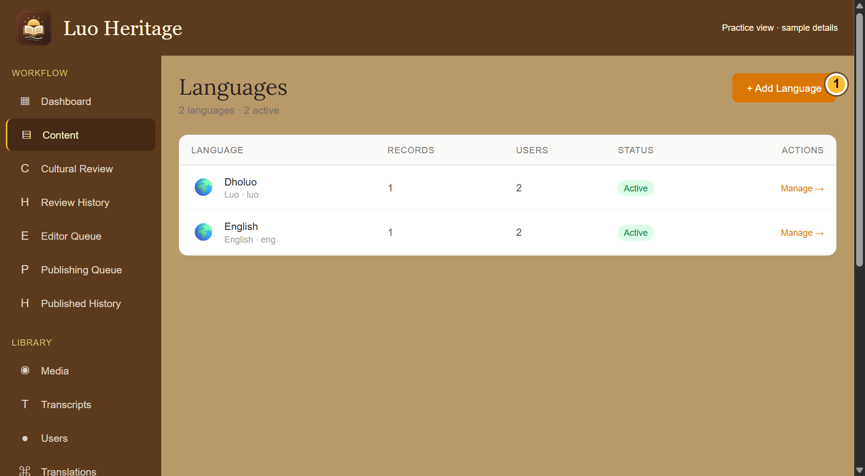
SELF-STUDY / MASTER SUPER ADMIN
Review a language before activation
1
Open Languages and select the language.
2
Check its labels, assigned staff and
collections. Confirm that any public content
is reviewed and permitted.
3
Use the available activation controls only
when the organisation agrees it is ready.
CURRENT INTERFACE • PRACTICE DETAILS
CHECK: The public language selection reflects your deliberate decision.
LUO HERITAGE / MASTER SUPER ADMIN
Contents
12 / 23
Notes:
Review a language before activation
1. Open Languages and select the language.
2. Check its labels, assigned staff and collections. Confirm that any public content is reviewed and permitted.
3. Use the available activation controls only when the organisation agrees it is ready.
Expected result: The public language selection reflects your deliberate decision.
Screenshot: current application interface rendered with sample details. No live action is demonstrated.

Slide 13
SELF-STUDY / MASTER SUPER ADMIN
How a contribution reaches readers
1
The uploader or contributor prepares a draft and submits it.
2
A cultural reviewer checks accuracy. An editor makes requested corrections and returns the
item for review.
3
A publisher checks the final item and permission. Only an approved public release becomes
visible to readers.
Prepare draft
→
Cultural review
→
Publisher check
→
Public release
Different people should perform the independent checks. Do not approve your own work.
CHECK: An item may return for changes. Drafts and private approvals are not public publication.
LUO HERITAGE / MASTER SUPER ADMIN
Contents
13 / 23
Notes:
How a contribution reaches readers
1. The uploader or contributor prepares a draft and submits it.
2. A cultural reviewer checks accuracy. An editor makes requested corrections and returns the item for review.
3. A publisher checks the final item and permission. Only an approved public release becomes visible to readers.
Expected result: An item may return for changes. Drafts and private approvals are not public publication.
Important: Different people should perform the independent checks. Do not approve your own work.

Slide 14
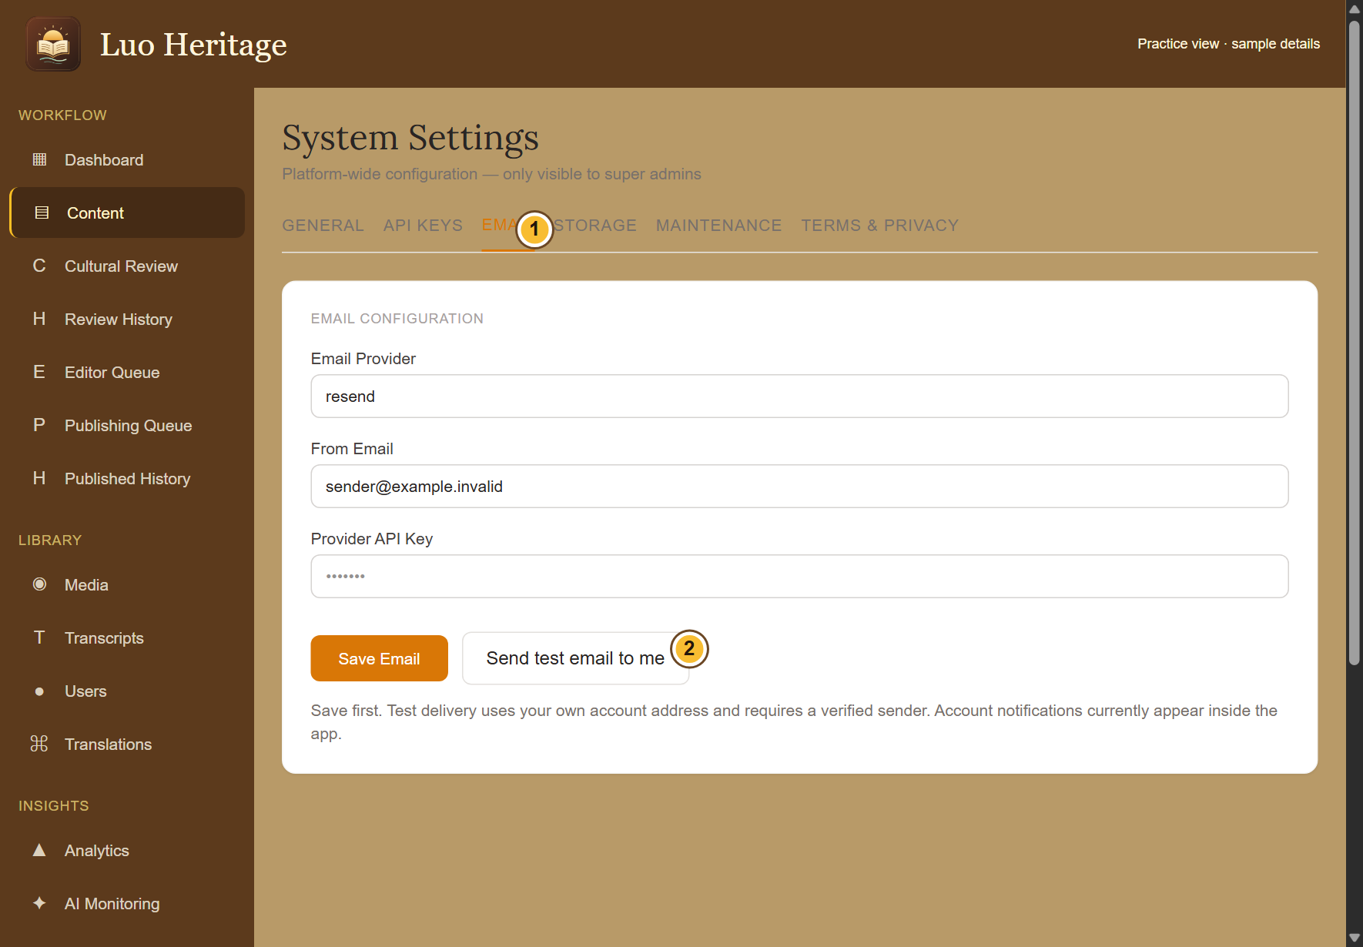
SELF-STUDY / MASTER SUPER ADMIN
Check account email settings
1
Open System, then Email. Confirm the
approved provider, verified sender address
and private service key.
2
Save the email settings. Choose Send test
email to send to your own signed-in
account.
3
Check both the screen result and your
inbox. A provider accepting a message is
not proof it reached the inbox.
Keep keys secret. Password reset cannot send email while provider
credentials or sender approval are missing.
CURRENT INTERFACE • PRACTICE DETAILS
CHECK: You have evidence that the account email path is configured and can be tested.
LUO HERITAGE / MASTER SUPER ADMIN
Contents
14 / 23
Notes:
Check account email settings
1. Open System, then Email. Confirm the approved provider, verified sender address and private service key.
2. Save the email settings. Choose Send test email to send to your own signed-in account.
3. Check both the screen result and your inbox. A provider accepting a message is not proof it reached the inbox.
Expected result: You have evidence that the account email path is configured and can be tested.
Important: Keep keys secret. Password reset cannot send email while provider credentials or sender approval are missing.
Screenshot: current application interface rendered with sample details. No live action is demonstrated.

Slide 15
SELF-STUDY / MASTER SUPER ADMIN
Help with a failed password reset
1
Confirm Email settings and the test result
before asking the user to retry.
2
Ask the user to request a fresh link, check
spam and use the newest link within 30
minutes.
3
Keep the user’s reset link and new
password private. Record the problem
without including either.
CURRENT INTERFACE • PRACTICE DETAILS
CHECK: The user can follow a safe recovery path once email delivery is available.
LUO HERITAGE / MASTER SUPER ADMIN
Contents
15 / 23
Notes:
Help with a failed password reset
1. Confirm Email settings and the test result before asking the user to retry.
2. Ask the user to request a fresh link, check spam and use the newest link within 30 minutes.
3. Keep the user’s reset link and new password private. Record the problem without including either.
Expected result: The user can follow a safe recovery path once email delivery is available.
Screenshot: current application interface rendered with sample details. No live action is demonstrated.

Slide 16
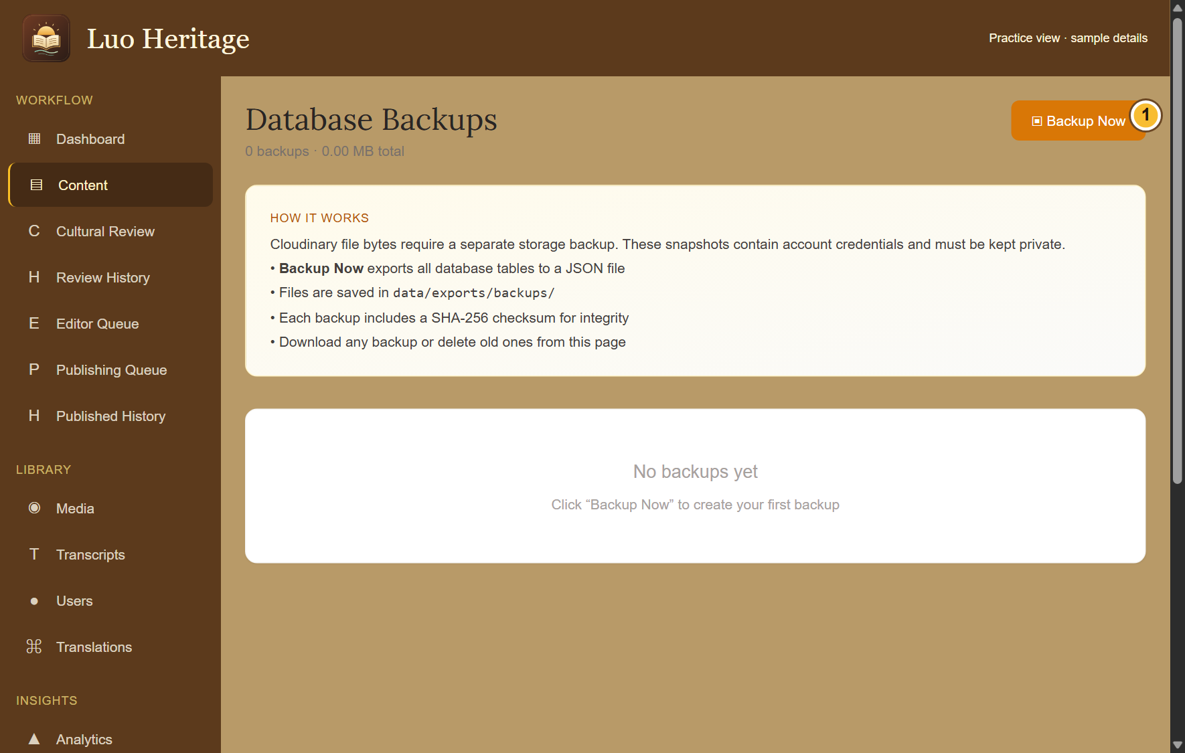
SELF-STUDY / MASTER SUPER ADMIN
Make and protect a database backup
1
Open Backup and choose Backup Now
when a backup is authorised.
2
Wait for confirmation, then check the new
file in the list. Store any downloaded copy
in the organisation’s protected location.
3
Ask the technical maintainer to verify
recovery. A database backup does not
contain the actual picture, audio or video
files.
Backup files contain sensitive account data. Never attach them to a
public message or training exercise.
CURRENT INTERFACE • PRACTICE DETAILS
CHECK: A protected database snapshot is recorded; separate media backup and recovery checks are arranged.
LUO HERITAGE / MASTER SUPER ADMIN
Contents
16 / 23
Notes:
Make and protect a database backup
1. Open Backup and choose Backup Now when a backup is authorised.
2. Wait for confirmation, then check the new file in the list. Store any downloaded copy in the organisation’s protected location.
3. Ask the technical maintainer to verify recovery. A database backup does not contain the actual picture, audio or video files.
Expected result: A protected database snapshot is recorded; separate media backup and recovery checks are arranged.
Important: Backup files contain sensitive account data. Never attach them to a public message or training exercise.
Screenshot: current application interface rendered with sample details. No live action is demonstrated.

Slide 17
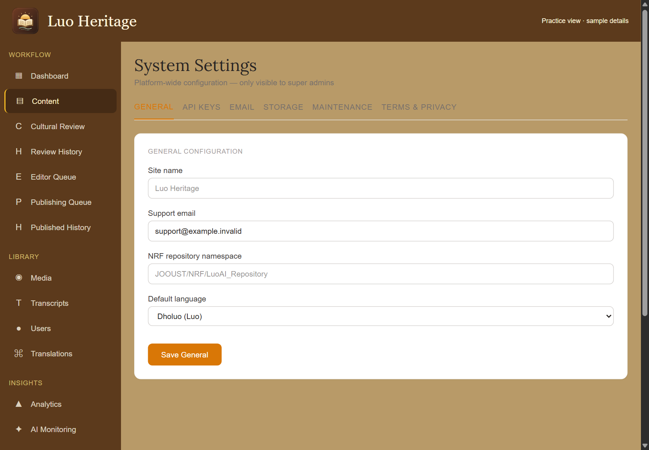
SELF-STUDY / MASTER SUPER ADMIN
Check public terms and support information
1
Open System and review the General
settings and Terms & Privacy tab.
2
Replace draft organisation details with the
verified operator and support information
before publishing those texts.
3
Have the responsible institution approve
the wording. Check the public pages after
saving.
Do not publish a legal draft containing bracketed placeholders or
unapproved promises.
CURRENT INTERFACE • PRACTICE DETAILS
CHECK: Readers can find the correct organisation and support information.
LUO HERITAGE / MASTER SUPER ADMIN
Contents
17 / 23
Notes:
Check public terms and support information
1. Open System and review the General settings and Terms & Privacy tab.
2. Replace draft organisation details with the verified operator and support information before publishing those texts.
3. Have the responsible institution approve the wording. Check the public pages after saving.
Expected result: Readers can find the correct organisation and support information.
Important: Do not publish a legal draft containing bracketed placeholders or unapproved promises.
Screenshot: current application interface rendered with sample details. No live action is demonstrated.

Slide 18
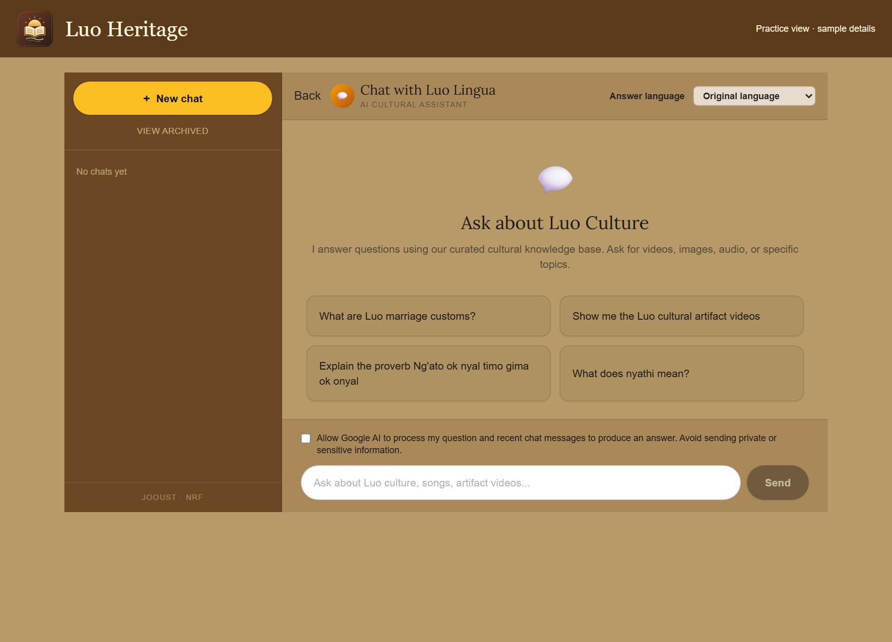
SELF-STUDY / MASTER SUPER ADMIN
Treat AI settings and feedback responsibly
1
Use API Keys and AI Monitoring only for
the services and records you are permitted
to manage.
2
Keep service credentials private. Test
ordinary questions without submitting
restricted interviews or personal
information.
3
Investigate wrong answers using their
sources and feedback. Do not describe
untested language or image models as
reliable.
CURRENT INTERFACE • PRACTICE DETAILS
CHECK: AI support is used with clear source and privacy checks.
LUO HERITAGE / MASTER SUPER ADMIN
Contents
18 / 23
Notes:
Treat AI settings and feedback responsibly
1. Use API Keys and AI Monitoring only for the services and records you are permitted to manage.
2. Keep service credentials private. Test ordinary questions without submitting restricted interviews or personal information.
3. Investigate wrong answers using their sources and feedback. Do not describe untested language or image models as reliable.
Expected result: AI support is used with clear source and privacy checks.
Screenshot: current application interface rendered with sample details. No live action is demonstrated.

Slide 19
SELF-STUDY / MASTER SUPER ADMIN
Use maintenance and ownership controls carefully
1
Before enabling maintenance, tell the
affected staff and agree when access will
return.
2
Read each control and confirmation.
Confirm the public view afterwards.
3
Do not delete the Master Super Admin
account to transfer responsibility. Arrange
the approved institutional ownership
process first.
CURRENT INTERFACE • PRACTICE DETAILS
CHECK: High-impact changes have an owner, a reason and a checked result.
LUO HERITAGE / MASTER SUPER ADMIN
Contents
19 / 23
Notes:
Use maintenance and ownership controls carefully
1. Before enabling maintenance, tell the affected staff and agree when access will return.
2. Read each control and confirmation. Confirm the public view afterwards.
3. Do not delete the Master Super Admin account to transfer responsibility. Arrange the approved institutional ownership process first.
Expected result: High-impact changes have an owner, a reason and a checked result.
Screenshot: current application interface rendered with sample details. No live action is demonstrated.

Slide 20
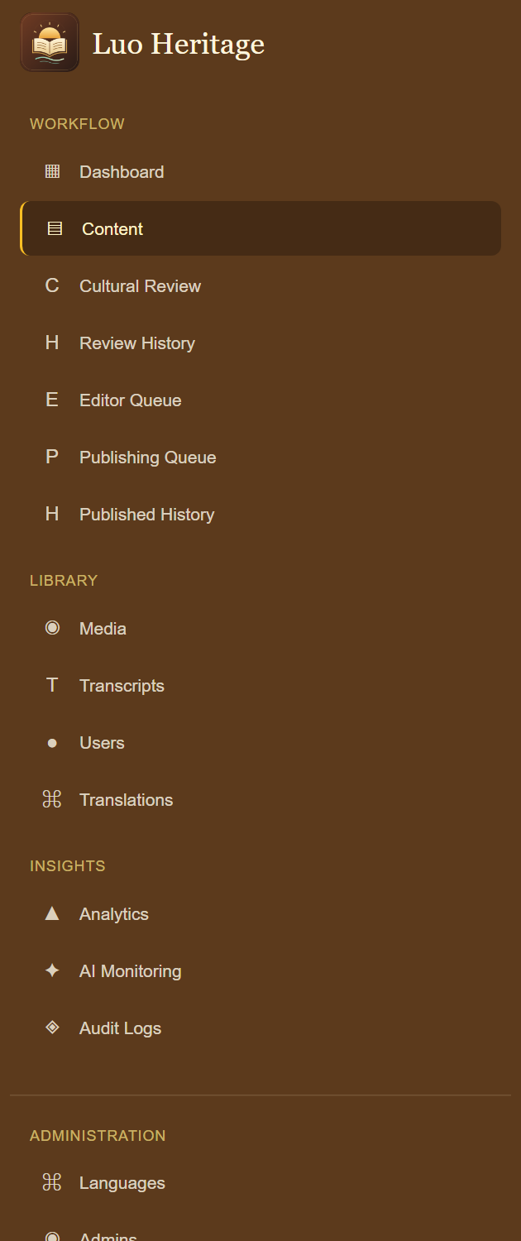
SELF-STUDY / MASTER SUPER ADMIN
Prepare an orderly handover
1
Give each person their own account, role guide and approved
website address.
2
Keep private service details, backup locations and recovery
contacts in a restricted handover record.
3
Record which service and device checks have actually passed.
Treat physical-server migration and store release as separate
planned work.
CURRENT INTERFACE • PRACTICE DETAILS
CHECK: The next responsible person can operate the system without sharing passwords or guessing what was tested.
LUO HERITAGE / MASTER SUPER ADMIN
Contents
20 / 23
Notes:
Prepare an orderly handover
1. Give each person their own account, role guide and approved website address.
2. Keep private service details, backup locations and recovery contacts in a restricted handover record.
3. Record which service and device checks have actually passed. Treat physical-server migration and store release as separate planned work.
Expected result: The next responsible person can operate the system without sharing passwords or guessing what was tested.
Screenshot: current application interface rendered with sample details. No live action is demonstrated.

Slide 21

SELF-STUDY / MASTER SUPER ADMIN
Protect your account and other people
1
Use your own account. Sign out on a
shared computer or phone.
2
Do not copy private interviews, class
results or account lists into public chats or
messages.
3
If a screen shows information you should
not see, stop and tell the account
administrator.
Send support the screen name and error message, never your password
or a reset link.
CURRENT INTERFACE • PRACTICE DETAILS
CHECK: Your work remains linked to the right person and private information stays protected.
LUO HERITAGE / MASTER SUPER ADMIN
Contents
21 / 23
Notes:
Protect your account and other people
1. Use your own account. Sign out on a shared computer or phone.
2. Do not copy private interviews, class results or account lists into public chats or messages.
3. If a screen shows information you should not see, stop and tell the account administrator.
Expected result: Your work remains linked to the right person and private information stays protected.
Important: Send support the screen name and error message, never your password or a reset link.
Screenshot: current application interface rendered with sample details. No live action is demonstrated.

Slide 22
SELF-STUDY / MASTER SUPER ADMIN
When something does not work
1
Check your internet connection. Read the message on screen
before trying again.
2
If your sign-in has expired, sign in again. If a button is missing,
ask which role and language you have.
3
If it still fails, note the time, screen, button and exact message.
Send these to your account administrator.
Before repeating an upload or submission, check whether the first attempt was already saved.
CURRENT INTERFACE • PRACTICE DETAILS
CHECK: You can explain the problem clearly without exposing private information.
LUO HERITAGE / MASTER SUPER ADMIN
Contents
22 / 23
Notes:
When something does not work
1. Check your internet connection. Read the message on screen before trying again.
2. If your sign-in has expired, sign in again. If a button is missing, ask which role and language you have.
3. If it still fails, note the time, screen, button and exact message. Send these to your account administrator.
Expected result: You can explain the problem clearly without exposing private information.
Important: Before repeating an upload or submission, check whether the first attempt was already saved.
Screenshot: current application interface rendered with sample details. No live action is demonstrated.

Slide 23
SELF-STUDY / MASTER SUPER ADMIN
Try it yourself: your readiness check
1
Identify which duties you may delegate and which require Master Super Admin authority.
2
Explain how to check account email delivery without sharing a key or reset link.
3
Explain what the database backup includes, what it excludes, and how you would request a
recovery check.
Try
→
Check
→
Ask if unsure
Use only approved practice material. Do not publish, delete accounts or change live settings just to practise.
CHECK: You are ready for routine work when you can complete these steps without help.
LUO HERITAGE / MASTER SUPER ADMIN
Contents
23 / 23
Notes:
Try it yourself: your readiness check
1. Identify which duties you may delegate and which require Master Super Admin authority.
2. Explain how to check account email delivery without sharing a key or reset link.
3. Explain what the database backup includes, what it excludes, and how you would request a recovery check.
Expected result: You are ready for routine work when you can complete these steps without help.
Important: Use only approved practice material. Do not publish, delete accounts or change live settings just to practise.

