Slide 1


REPLICATION
A guide to SQL Server Replication, how to fix it when it breaks and alternatives to replication.
https://uk.linkedin.com/in/johnmccormackdba
http://johnmccomack.it
John McCormack
13th December 2016
Glasgow, SQL Server Meetup

Slide 2
About me - John McCormack
Database administrator at Monster (since 2012).
I work mostly with SQL Server 2008R2 - 2012. I do some work with MySQL, although mostly on Amazon RDS.
I’ve worked through the various certification exams, ending up as an MCSE: Data Platform.
When it comes to SQL Server, I love automating tasks. If I can automate it, I will automate it. Stripping away the mundane tasks opens up time to learn about the interesting ones.

Slide 3
Replication basics
Purpose of Replication
Replication is a set of technologies for copying and distributing data and database objects from one database to another and then synchronizing between databases to maintain consistency. [1]
Replication Architecture
Replication uses the analogy of the publishing industry for each component in replication.
There are 4 main types of replication:
Snapshot replication
Peer to peer replication
Merge replication
Transactional replication

Slide 4
Replication Architecture
Publisher - The source of the data made available for replication.
Article - A published object to be replicated including tables, stored procedure, views, indexed views and user-defined-function (UDF).
Publication - Articles grouped together into one collection.
Distributor - An instance that manages the transmission from publisher to subscriber. Can be local or remote.
Subscriber - The destination of the publication. Not restricted to SQL Server. Includes Oracle and IBM DB2. [2]
Agent - Agents are required to perform replication related tasks. Usually run as SQL Agent jobs

Slide 5
Types of replication
Snapshot - The simplest type of replication. A snapshot is sent to all subscribers and no further changes are recorded. If a new snapshot is created and pushed out, the full subscriber data is overwritten. (No incremental changes)
Merge - Starts with a snapshot. Multiple subscription may amend their copy of the data and push back to the publisher. These changes are then replicated to the other subscribers. Conflicts may occur and you need to be able to detect and resolve them.
Transactional - starts with a snapshot. Delivers incremental changes to subscriptions in near real time. A log reader agent monitors the transaction log for items marked as for replication and puts these in the distribution database. The distribution agent then sends these changes to the subscriber.
Peer to peer - Is built upon transactional replication but each server acts as both a subscriber and a publisher. When data is changed on one node, the other is updated.

Slide 6
Types of agent [3]
Snapshot Agent
Prepares schema and initial data files
Log Reader Agent
Used with transactional replication. It moves transactions marked for replication from the transaction log on the Publisher to the distribution database.
Distribution Agent
The Distribution Agent is used with snapshot replication and transactional replication. It applies the initial snapshot to the Subscriber and moves transactions held in the distribution database to Subscribers.
Merge Agent
The Merge Agent is used with merge replication. It applies the initial snapshot to the Subscriber and moves and reconciles incremental data changes that occur.

Slide 7
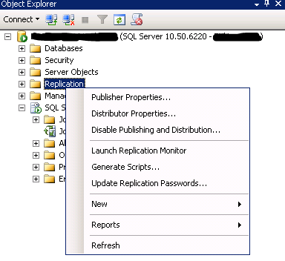
Troubleshooting Replication
Checking for errors
Look for errors here first:
SELECT * FROM distribution..msrepl_errors ORDER BY ID DESC
Replication monitor – “Green is good”
Right click Replication, then Launch Replication Monitor
Tracer tokens
Ideal for confirming everything is fine, but they can take a long time to fail
Comparing row counts

Slide 8
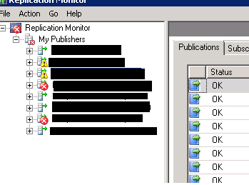
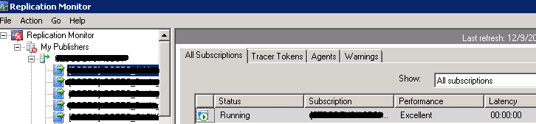
Replication Monitor
Tip: Right click name of publisher and change or disable refresh rate
Green arrow is good
Red X means a failure
Yellow exclamation means warning, possible latency.
Expand publisher for individual publications
Click on publication to show:
All subscriptions
Tracer tokens
Agents
Warnings

Slide 9
Setting up replication
Script is best
It guarantees a consistent set up in all environments
In event of rebuilding replication, it will be the same
GUI is ok at first
If you script out for later use

Slide 10
Alternatives to replication
Alwayson availability groups
Up to 8 secondary databases
Backups and reads can be offloaded to secondaries
Database Mirroring
Marked for deprecation so best to avoid for new implementations
Log Shipping
Continuous or at set windows
Daily restores to secondary server
Depending on size and allowable latency

Slide 11
LINKS
[1] https://msdn.microsoft.com/en-us/library/ms151198.aspx
[2] https://msdn.microsoft.com/en-us/library/ms151195.aspx
[3] https://msdn.microsoft.com/en-us/library/ms152501.aspx
DEMO

