Slide 1
You can run SQL SERVER in AWS?
In this session, I aim to show the different ways of running SQL Server on AWS. I will show the differences between running as a managed service (RDS) and running SQL Server on virtual machines (EC2).
John McCormack | DataGrillen | June 2019

Slide 2
INTRODUCTION
John McCormack
DBA since 2012
MCSE Data Management and Analytics
AWS Certified Cloud Solutions Architect - Associate
Initially focussed on SQL Server, now working with various cloud technologies.
RDS, EMR, ElasticSearch, Athena, S3
Azure SQL DB, IAAS
https://johnmccormack.it
@actualjohn

Slide 3
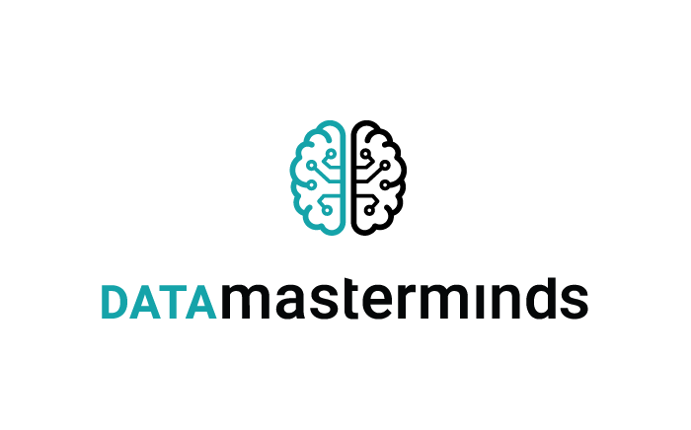










Slide 4
Terminology
AWS – Amazon Web Services (Cloud computing company)
Region – A geographic area comprising of 2 or more AZs
Availability Zone (AZ) – A data centre within a region, providing options for HA/DR
EC2 – VM within AWS (Windows or Linux)
EBS – Block storage in AWS
S3 – Object storage based in AWS (think dropbox)
Bucket – Folder within S3. Name is globally unique
RDS – Relational Database Service. Managed database instances. Various RDBMSs offered including SQL Server, MySQL, Postgressql, Oracle, MariaDB and Aurora.

Slide 5
2 ways to run SQL Server in AWS
EC2
Azure VM
RDS
Managed instance
Less admin, less control
EC2
VM in the cloud
More admin, more control
Control
RDS
Azure Managed Instance
Azure SQL DB
Administration Effort

Slide 6

RDS vs EC2
FEATURE | EC2 | RDS
Use SSMS | ✔ | ✔
Use database as source or target for SSIS | ✔ | ✔
Full control over the instance | ✔
Automated backups |  | ✔
Automated patching |  | ✔
Always On Availability groups | ✔ | (kind of)

Slide 7
RDS vs EC2
FEATURE | EC2 | RDS
AWS-managed Multi AZ deployment |  | ✔
Log Shipping | ✔
Replication | ✔
Database mail | ✔
Bulk Insert | ✔
FILESTREAM | ✔

Slide 8
RDS vs EC2
RDS | EC2
HA/DR | HA/DR
Database backups | Database backups
SQL Server patching | SQL Server patching
Installing SQL Server | Installing SQL Server
OS patching | OS patching
Network | Network
Power | Power
Physical Security | Physical Security
Shared responsibility model
AWS Responsibility
Customer Responsibility

Slide 9
Lets Talk Licensing
Express edition is the only license free edition
License included in instance cost
EC2
You can use developer edition for non prod workloads
RDS
No developer
Enterprise, Standard & Web
BYOL or License included
No software assurance = Dedicated host

Slide 10
BACKUP / RESTORE – RDS
Automated backups
Set your own retention period
Take ad-hoc snapshots
Kept in your S3 bucket until deleted by user
Snapshots can be shared between accounts
Accounts is similar to subscriptions in Azure so sometimes used for restoring prod to dev or test environments
Point in time restores (within 5 minutes)
You can restore to a new RDS instance

Slide 11
BACKUP / RESTORE – EC2
You are responsible for your own backups and restores
Just like on-premises
Backup directly to file system
(EBS)
EBS offers automatic redundancy and encryption
Back up to S3 to save money
(EBS way more expensive than S3)
Directly with 3rd party tools (LiteSpeed / CloudBerry)
Copy from EBS to S3
S3 offers cross-region bucket replication and versioning !
You pay for all versions so look at setting a ‘lifecycle policy’

Slide 12
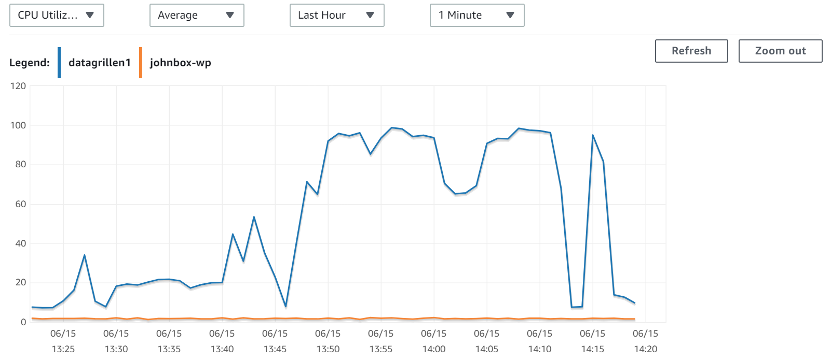
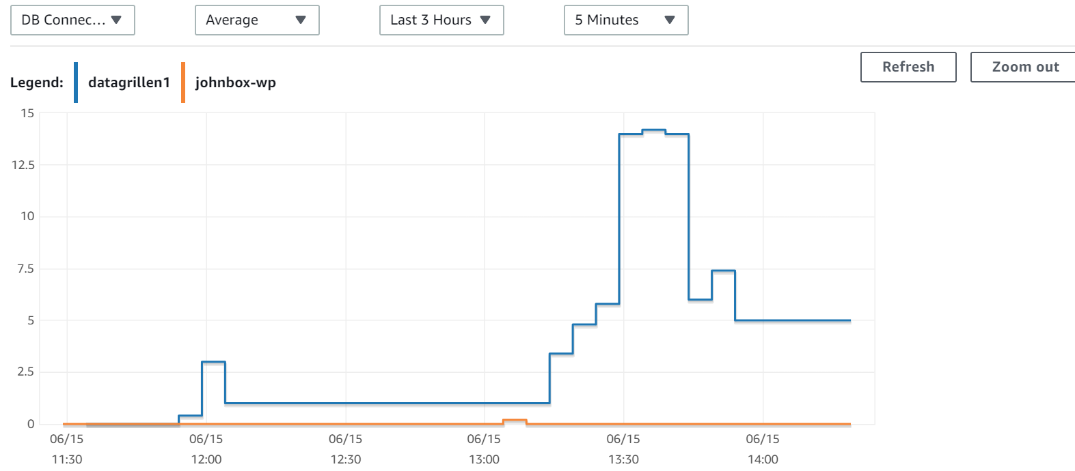
Monitoring
CloudWatch
Near real time info
View multiple instances at once
Trigger alerts
3rd party tools
sp_whoisactive
Sentry One
Grafana

Slide 13
Deep dive into RDS
Versions and Editions
Instance types
Storage types
HA/DR
Security
Encryption
Parameter groups

Slide 14
Deep dive into RDS – Versions/Editions
Express
Web
Standard
Enterprise
2012 – 2017
SQL Server 2008 R2 was removed from options on 1st June 2019.
AWS Warned customers: Upgrade existing instances before June 1, 2019, to avoid automatic upgrade.

Slide 15
Deep dive into RDS – Instance Types
T2
Burstable Performance
Lowest Cost
M4 / M5
General Purpose
M5 Latest Generation
R3 / R4
Memory Optimized
R4 Latest Generation
t2.micro
1 vCPU
1 GiB RAM
m5.xlarge
4 vCPU
16 GiB RAM
r4.xlarge
4 vCPU
30.5 GiB RAM

Slide 16
Deep dive into RDS – Storage
All EDITIONS
Magnetic * | Min: 200 GiB Enterprise/Standard editions, 20 GiB Web/Express Max: 1 TiB all editions
General Purpose (SSD) | Min: 200 GiB Enterprise/Standard editions, 20 GiB Web/Express Max: 16 TiB all editions
Provisioned IOPS (SSD) | Min: 200 GiB Enterprise/Standard editions, 100 GiB Web/Express Max: 16 TiB all editions
* Backwards compatibility only - Before Jan 2017

Slide 17
Deep dive into RDS – HA/DR
Automatic Multi-AZ deployment
Just tell AWS you want to go Multi-AZ
Manual failovers if you want to test
During automatic failover, any fault with original primary is fixed for you
No manual intervention needed.
Technology used is Mirroring or Always On Availability Groups
Automatically chosen depending on version and edition
No readable secondary with AGs
Pick a time to suit your business

Slide 18


Deep dive into RDS – Security
Network Security
VPC
Security Groups
Publicly accessible
Choose your port
Database security
SQL Logins
Master user & others
Active Directory

Slide 19

Deep dive into RDS – Encryption
In-Transit (SSL Support)
You can use SSL to encrypt connections between your apps and RDS instance
You can force all connections to use SSL
Supported in all regions and for all editions
At Rest
Transparent Data Encryption (TDE)
Available in Enterprise Edition
Simply enable encryption at set up for all other editions (except express)

Slide 20
Deep dive into RDS – ParAmEter GRoups
Parameter groups allow you to change settings above and beyond your level of access to the instance.
i.e Something requiring sysadmin or securityadmin role
Examples
Some trace flags e.g. 1204, 4199
Cost threshold for parallelism
Optimize for ad hoc workloads
Changes to parameter groups apply to all instances using the group

Slide 21
CLI & PowerShell
The key to cloud automation is scripting. AWS supports CLI and Powershell to save you from too many clunky manual process.
Examples
aws rds restore-db-instance-from-db-snapshot --db-instance-identifier restored-test-instance --db-snapshot-identifier test-instance-snap
Restore-RDSDBInstanceFromDBSnapshot -DBInstanceIdentifier restored-test-instance -DBSnapshotIdentifier test-instance-snap

Slide 22



PRE Migration PLANNING – MOVING DATA
Snowball / Edge
Direct Connect
S3 Accelerated Transfer
50 / 80 / 100 TB per device
Can use multiple
Transfers in 1 week
Dedicated connection
1Gbps - 10Gbps
CloudFront edge Locations
Distance ∝ improvement
PB Scale
TB / GB Scale
GB / MB Scale

Slide 23
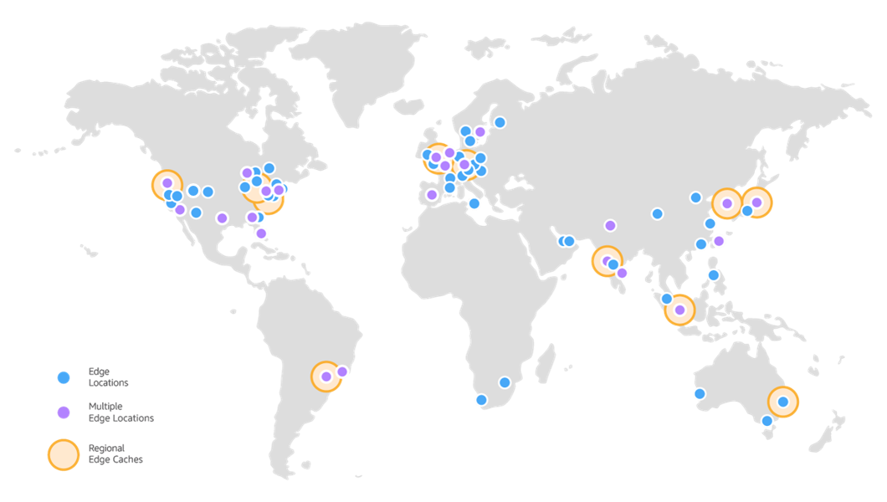
EDGE LOCATIONS
© https://aws.amazon.com/cloudfront/features/#Amazon_CloudFront_Infrastructure

Slide 24
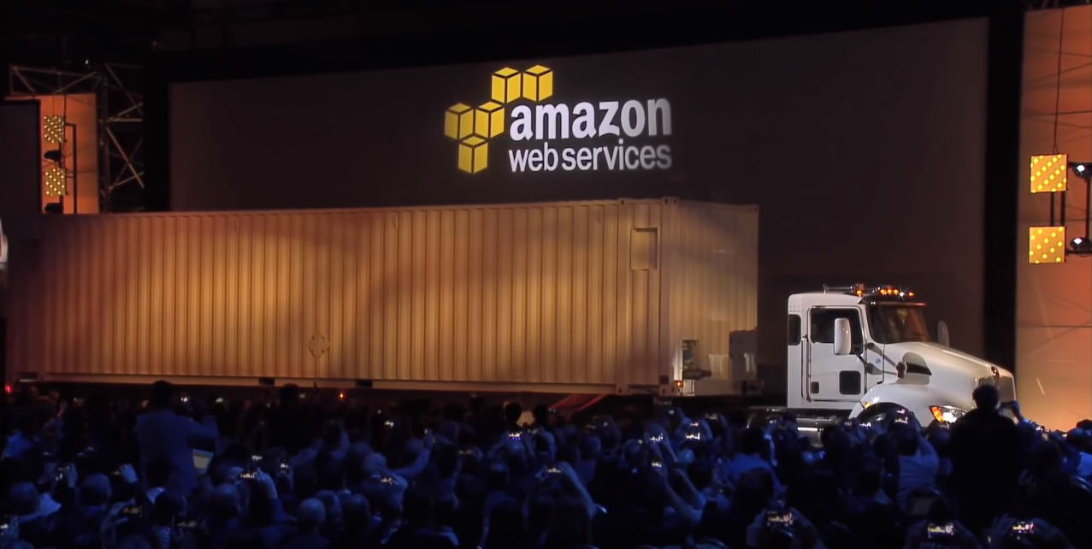
Backups - HAVE YOU SEEN THE SNOWMOBILE
Exabyte Scale

Slide 25
PRE Migration PLANNING
TASK
Create full inventory
Identify features used (What version / edition do we need)
Do you have licenses to take to the cloud?
What are your high availability / disaster recovery requirements
Can you purge unwanted data
What are your team’s capabilities

Slide 26
Migration strategies & tools
Method | EC2 | RDS
Backup / Restore | ✔ | ✔
Database Migration Service and Schema Conversion Tool | ✔ | ✔
Log Shipping | ✔
Transactional Replication | ✔
Snowball | ✔ | ✔

Slide 27

DEMO

Slide 28
Thank you
If you want to find out more, go here:
https://johnmccormack.it/

Slide 29

Session Feedback Day 1 #(not optional!)
http://bit.ly/DataGrillen2019Day1

