Slide 1
The ZERO budget DBA SQL Community has got your back John McCormack | Data Glasgow UG | Feb 2020

Slide 2
The ZERO budget DBA SQL Community has got your back John McCormack | Data Glasgow UG | Feb 2020

Slide 3
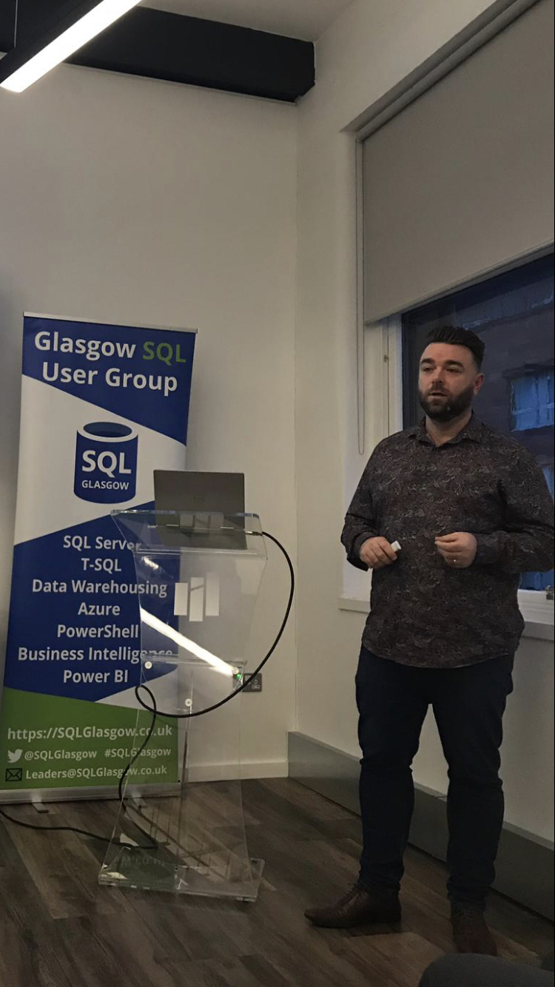
Hello!
John McCormack
https://johnmccormack.it
@actualjohn
https://linkedin.com/in/johnmccormackdba/

Slide 4
Background
Today we are going to talk about some of the best free tools available for managing your SQL Server.
Why would you use free tools?
Your organisation can’t pay or won’t pay for commercial tools
Best in class anyway, no paid for tools are better
Not available elsewhere
Tried and tested (and trusted)
Drawbacks?
Need to know the origin and functionality of code.
Some organisations can be wary of free tools, even established ones
Notes:
Many DBAs work in an environment where the organisation cannot or will not invest money in 3rd party tools.
Furthermore, some free tools are actually best in class so you should be using them anyway.

Slide 5
Which tools
sp_whoisactive
First Responder Kit
StatisticsParser.com
WorkloadTools
Ola Hallengren’s – IndexOptimize & DatabaseBackup
DBATools
DLM Dashboard
Realtime analysis | Troubleshooting | Performance
Automation | productivity
Governance | Controls

Slide 6
DEMOS ARE NOT JUST FOR THE END

Slide 7
sp_whoisactive
Developed by Adam Machanic
What can it do for me
Tell me what is running on my instance right now
Find blockers
Show me query plans
Can be logged to a table for retrospective analysis
Is it safe to run
Completely written in T-SQL so code can be analysed
Been available freely since December 2007
Used by thousands of DBAs worldwide
Adam is highly respected in the SQL Community and is a Data Platform MVP

Slide 8
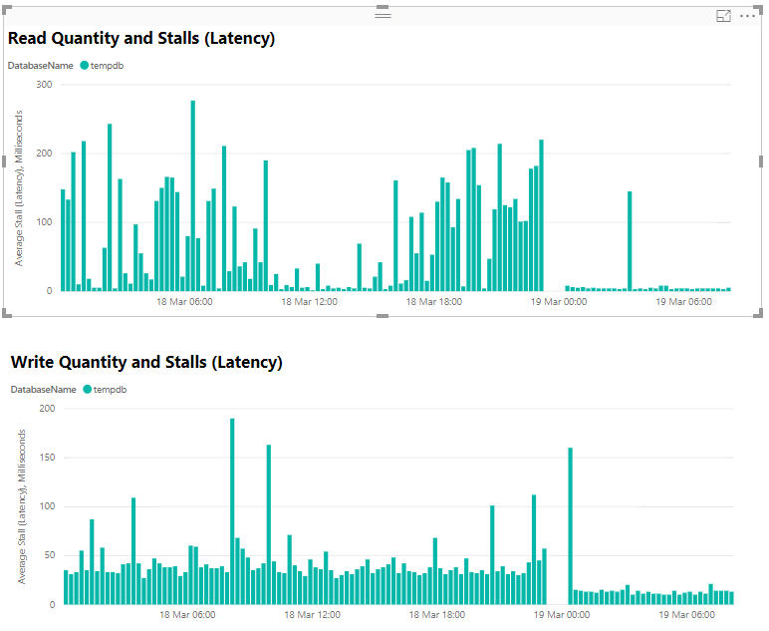
First Responder Kit
Developed by Brent Ozar Unlimited
sp_Blitz – A healthcheck for your SQL Server
sp_Blitzfirst – Shows you what is slow on your SQL Sever right now
sp_Blitzcache – Which queries are using the most resources
sp_Blitzindex – Are you over or under indexed
Free Power BI reports – See key info at a glance

Slide 9
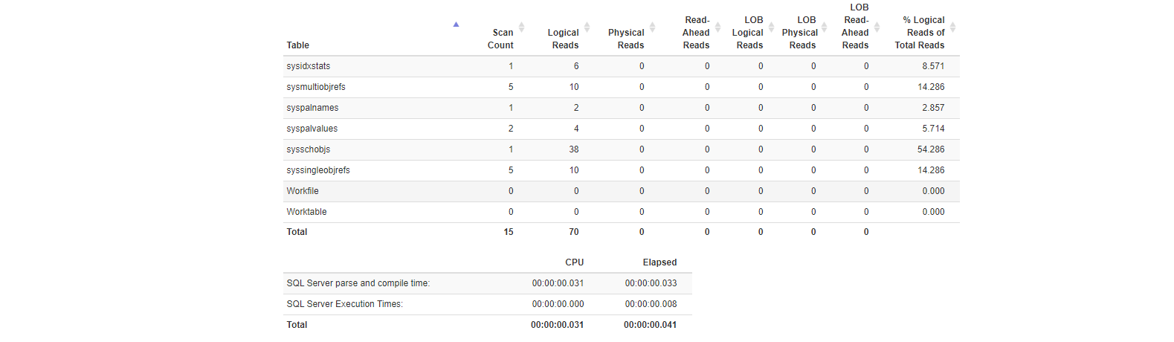
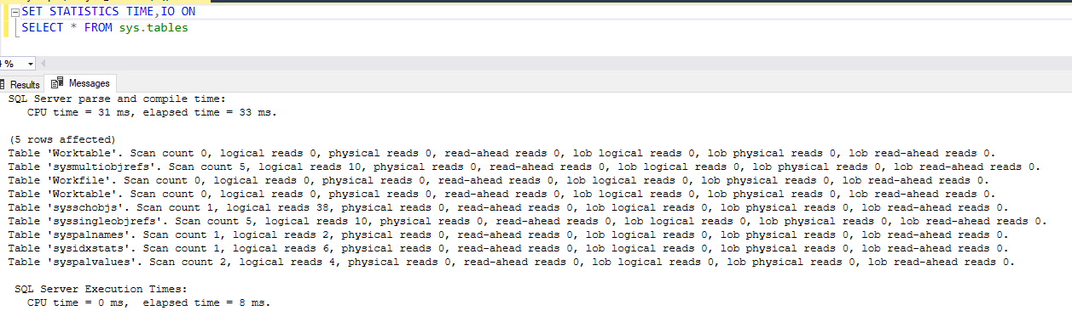
StatisticsParser.com
Developed by Richie Rump
SET STATISTICS TIME, IO ON
Copy/paste output from SSMS into browser window
Tabulates information in easy to read format
Great for measuring improvements during query tuning

Slide 10
Ola Hallengren
MaintenanceSolution.sql
No need to write your own solutions
Highly customizable and flexible
Backup to blob storage
Native backups or 3rd party support
Just download and go
Handy commandlog table
Notes:
MaintenanceSolution.sql
> IndexOptimize
> DatabaseBackup
> DatabaseIntegrityCheck
No need to write your own solutions
Highly customizable and flexible
> Rebuild vs re-organize
> Exemptions
> Minimum page size
> Flexible rebuild vs reorganize % levels
Backup to blob storage
Native backups or 3rd party support
> Quest Litespeed | Redgate SQLBackup Pro | Idera SQL Safe | Dell EMC Domain Boost

Slide 11
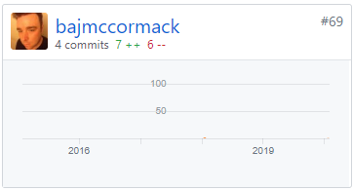
dbatools
Developed by SQLCollaborative team
The simplest way to automate your workloads
Started out as migration scripts by Chrissy LeMaire, now so much more beyond
All code in Github
178 contributors (including me)
500+ commands
Don’t need to be a PowerShell expert
https://dbatools.io/secure/
Digitally signed
Powershell Gallery | Chocolatey
You can compile it yourself
Publically used my Microsoft Employees

Slide 12
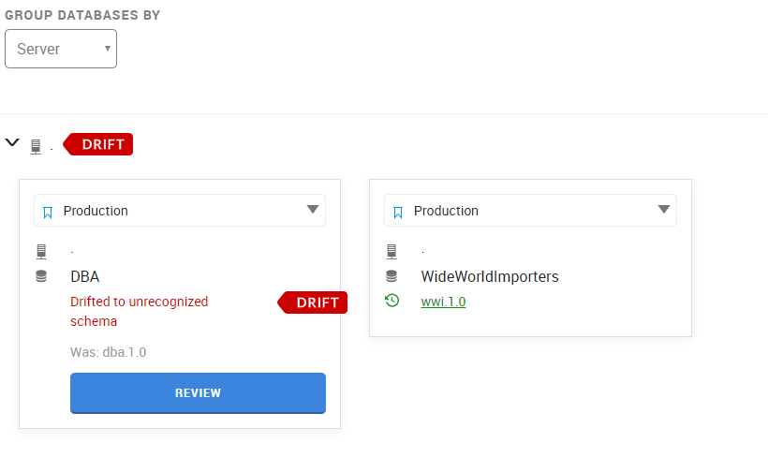
DLM Dashboard
Developed by Redgate (A giant in SQL Server 3rd party software)
Schema tracking tool
> Find out what changed and who changed it
> Download the T-SQL that was executed
> Real time email alerts
Label your releases
Keeps history much longer than default trace

Slide 13
WorkloadTools
Developed by Gianluca Sartori (@SpaghettiDBA)
Capture workloads using XE or Trace
Replay captured workloads
Replay live workloads
Fairly simple to configure using JSON tools
Workload viewer (Graphical tool for analysing/comparing output)
PowerBI dashboard available
Get it here: https://github.com/spaghettidba/WorkloadTools

Slide 14



Thanks!
If you want to find out more
You can find me at
@actualjohn
johnmccormack.it (Slides plus bonus content)
https://linkedin.com/in/johnmccormackdba/

Slide 15
Bonus Content

Slide 16
Further tools worth investigating
Plan Explorer
Open Query Store
SQLWatch.io
Grafana / Telegraf
#sqlhelp
dba.stackexchange.com

Slide 17
Really the end

Slide 18
Credits
Special thanks to all the people who made and released these awesome resources for free:
Presentation template by SlidesCarnival
Photographs by Unsplash

