Slide 1



7 Ways For data teams to save money in Azure
John McCormack
- Working with data since 2012
- Principal DBA @ Monster
- Focussed on SQL Server, AWS & Azure
Socials
https://johnmccormack.it
@actualjohn
https://linkedin.com/in/johnmccormackdba/
Data Scotland’s Scottish Summer | 2021
Notes:
OBS:Default Scene

Slide 2
15 Minute Overview
Managing costs should be everyone’s responsibility
Review your backup retention policy
Right size your Azure SQL DBs, managed instances and SQL VMs
TUNE YOUR QUERIES
Turn non production instances off out of hours
Consider moving to Azure SQL DB serverless
Reserved instances
Delete unused instances
Notes:
OBS:Video in box RHS

Slide 3
Review your backup retention policy
Specific to
SQL Server on VM (IaaS)
SQL Server on premises (Backup to URL)
What’s the problem
Keeping every backup eventually adds up, especially databases with t-log backups – See my example in blog post
What can it do for me
Azure Blob Storage lifecycle management
SQL Server IaaS Agent extension
Azure Backup (SQL Server VMs)
Roll your own solution
Notes:
OBS:Video in circle RHS high

Slide 4
Right size your SQL DBs, MIs and VMs
The cloud is scalable and elastic – buy for now, not for the future
Scale when the time is right
How we used to buy servers (CAPEX)
How we buy cloud resources (OPEX)
Monitor usage
Use built in Azure Monitor and alerts
Usually safe and effective to scale down Ensure the lower tier has the features you need – such as scale out replicas / columnstore indexes
Scale up when the time comes and not before
For IaaS, ensure tempdb is on D drive for best performance and to save space on other storage.
Notes:
OBS:Video in circle RHS low

Slide 5
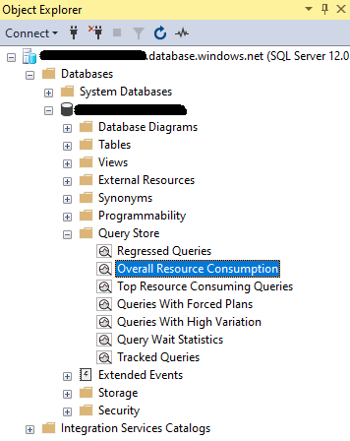
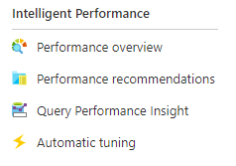
TUNE YOUR QUERIES
Unlike on premises SQL Server, tuning queries can save you money right away
The fewer resources that each query needs, the smaller the instance type needed
Find queries to tune
Azure intelligent performance
Query Store
Open source scripts
Notes:
OBS:Video in circle RHS low

Slide 6
Turn non production instances off out of hours
Turn the cloud off at bedtime
SQL VMs, Synapse SQL Pools
Only pay for what you use (compute)
DEALLOCATE, DEALLOCATE, DEALLOCATE
How to
Azure portal
CLI
PowerShell
Automate it
Used to need to combine Automation Runbooks
Now it can be set in Azure Portal
Notes:
OBS:Video in box RHS

Slide 7
Consider moving to Azure SQL DB Serverless
Don’t pay for compute when you have no queries running
Autopause
1 hr to 7 days
Autoscale
0.5 to 40 vCores
Per second billing
Remember retry logic
Handle error code 40613 in your application
* Not the most cost effective solution with steady utilization
Notes:
OBS:Video in box RHS

Slide 8
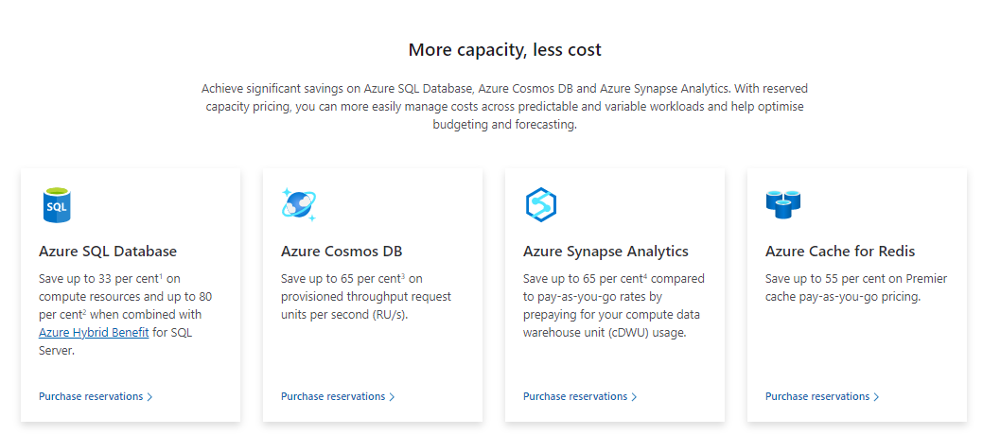
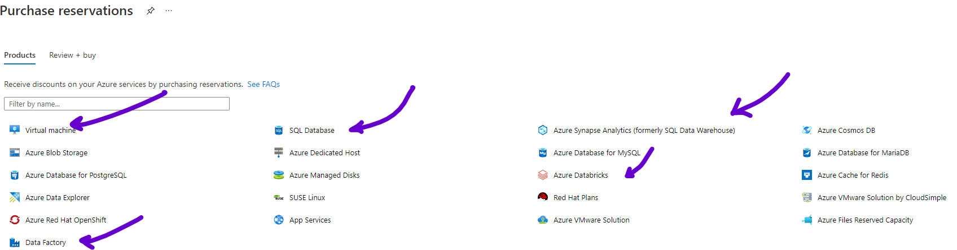
Reserved instances
Save up to 72% on VMs
Save up to 33% on SQL Database
Notes:
OBS:Video in circle RHS high

Slide 9
Delete unused instances
Regularly review your estate for unneeded instances
Challenge people who say they need an instance running
Size / Tier
Time online
Tag all resources with an owner and project tag
Don’t allow untagged resources
Notes:
OBS:Video in circle RHS low

Slide 10
Quick list of other ideas
Elastic Pools
Azure Hybrid Benefit
Cloud Solutions Provider
Purge old and unneeded data
Remove unused indexes (if you are sure)
Notes:
OBS:Video in box RHS

Slide 11



Thanks!
If you want to find out more
You can find me at
@actualjohn
johnmccormack.it
johnmccormackdba
Notes:
OBS:Video in circle RHS low centered

Slide 12
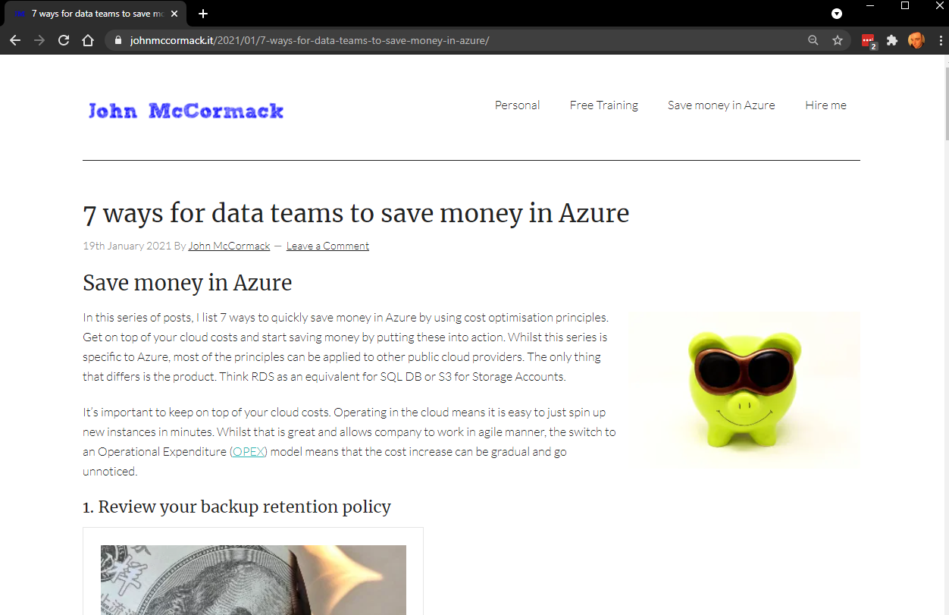
Notes:
OBS:Video in circle RHS low centered

Slide 13
Thanks!
If you want to find out more
You can find me at
@actualjohn
johnmccormack.it
johnmccormackdba
Notes:
**STOP

