Slide 1
UWS Career Talk John McCormack | 23rd March 2022

Slide 2
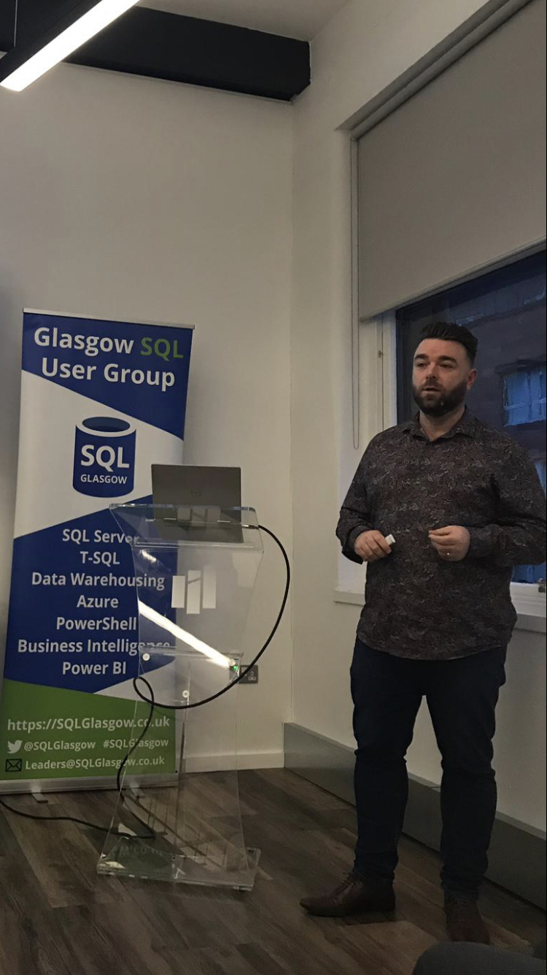

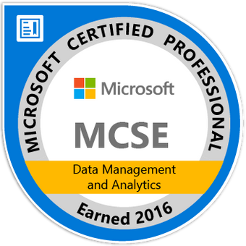

Hello!
John McCormack
Graduated 2012
Principal DBA at Monster.com
Initially focussed on SQL Server, now working with cloud technologies in AWS and Azure
https://johnmccormack.it
@actualjohn
https://linkedin.com/in/johnmccormackdba/

Slide 3
Background
Left school after S5 with 4 mediocre Highers
Worked in banking for around 10 years, then in contact centres
Always the tech guy, good with excel and systems without GUIs
Made some fairly basic websites for friends and even got paid. (Front page, then Dreamweaver)
Wanted to learn properly, so enrolled in Web Dev
As the course went on, I was more interested in DB modules
Graduated 1st class
Notes:
Left school after S5 with 4 mediocre Highers – probably underachieved but that’s how I was at that age
Worked in banking for around 10 years, then in contact centres. I was getting promoted but still pretty dissatisfied with what I was doing and what I was getting paid.
Always the tech guy, good with excel and systems without GUIs.
Made some fairly crude websites for friends and even got paid. (MS FrontPage, then Dreamweaver)
Wanted to learn properly, so enrolled in BSC Web Dev. Little did I know how much programming would be involved, I thought it would be far more design oriented.
As the course went on, I was more interested in DB modules. We had a talk similar to this from someone who outlined lots of different careers paths in the data world.
Graduated 1st Class – It was important to me because I wanted every advantage at interviews.
Put everything into your honours year, try to win medals, prizes and get the highest grades you are capable of.

Slide 4
My Career Path
Graduated summer 2012
October 2012 - Associate DBA (Monster)
December 2014 – DBA (Monster)
January 2019 – Consultant DBA (Nebula Data Solutions)
March 2021 – Principal DBA (Monster)
Notes:
BI Developer – Still a very good entry level role into
Database Developer
Database Administrator
Data Engineer
Data Architect
Cloud Solutions Architect
Entity Framework is very popular with development teams and far less popular with DBAs. It is a great tool for generating CRUD queries and can rapidly improve development time, however it does not handle complex queries very well. The ability to tune or rewrite these will help you stand out.

Slide 5
Data Career paths
BI Developer
Database Developer
Database Administrator
Data Engineer
Data Architect
Cloud Solutions Architect
Remember, good SQL skills will also help to make you a very good web developer.
Notes:
BI Developer – Still a very good entry level role into
Database Developer
Database Administrator
Data Engineer
Data Architect
Cloud Solutions Architect
Entity Framework is very popular with development teams and far less popular with DBAs. It is a great tool for generating CRUD queries and can rapidly improve development time, however it does not handle complex queries very well. The ability to tune or rewrite these will help you stand out.

Slide 6
Learning beyond your degree
Certifications
User Groups
Conferences
Blogs
Follow experts on Twitter and LinkedIn
Books
Online courses such as Pluralsight
Notes:
Learning Beyond the Degree
I did loads of relevant certifications, first in SQL Server, then in AWS then Azure. I saw it a good way of formalizing my on-the-job learning, and it’s something that employers were asking for
User groups – Usually free and good place to meet people
Conferences – Sometimes cost money but good employers may well sponsor you to go. Free ticket and accommodation to speakers usually.
Subscribe to blogs I like

Slide 7
Excelling at work
Listen to experienced colleagues
Find a mentor if you can
Ask for a lot of help at the start, this will reduce over time
Don’t shy away from difficult projects
Share what you learn with the team e.g. Lunch n learn

Slide 8
Raise your public profile (Optional)
Have a complete and searchable LinkedIn Profile
Regularly updated CV on major job board (searchable)
Set up a website or blog in your own name
Try to create regular content
Gain permission from freelance work to showcase them on your site
Share your content on your socials
Submit to speak at user groups and conferences
Try to collaborate on Open Source Projects in GITHUB
Notes:
(Get recruiters to do the hard work for you)

Slide 9



Thanks!
If you want to find out more
You can find me at
@actualjohn
johnmccormack.it
https://linkedin.com/in/johnmccormackdba/

Slide 10
Q and A
If you want to find out more
You can find me at
@actualjohn
johnmccormack.it
https://linkedin.com/in/johnmccormackdba/

Slide 11
Really the end

