Slide 1
AWS Hackathon for Good 2019 Table 16 American Red Cross
By Brendan John, Concorde Habineza, Koushik Chatterjee, Breeona Day, and David Adams

Slide 2
Project Summary
Description:
Help the American Red Cross create a new way for potential volunteers to accept volunteer opportunities
Our solution:
AWS Lex chatbot
Four Question Quiz
Match with top volunteer opportunities
Direct toward applying for the position

Slide 3








Project Architecture
Red Cross API
EC2
Comprehend
DynamoDB
Alexa
Lex
Lambda
SES

Slide 4
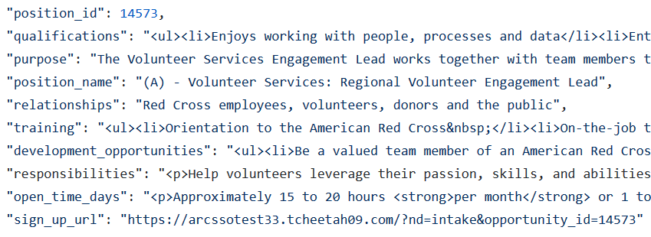
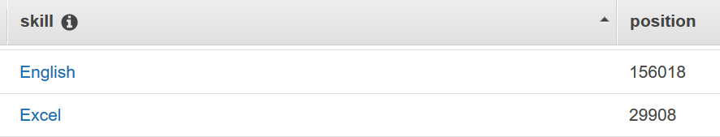
Setting up the Data
Red Cross API
EC2
Comprehend
DynamoDB
AWS Comprehend uses NLP to extract keywords

Slide 5
Chatting with a Chatbot
On a scale of 1-3, rate your feelings toward working with others?
1) Warehouse volunteer 2) Event Registration 3) Speaker
Are you certified to teach CPR?
Do you speak a foreign language?
On a scale of 1-3, how well can you lift heavy objects?
DynamoDB
Requirement:
Red Cross would need to tag position data to match responses
Alexa
Lex
Lambda

Slide 6
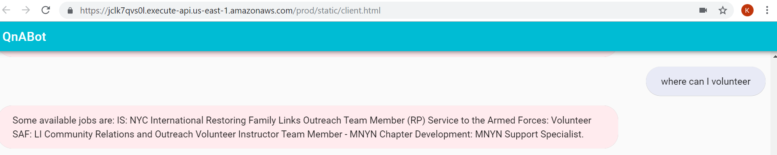
Chatting with a Chatbot

Slide 7
Putting it all together
Red Cross API
EC2
Comprehend
DynamoDB
Alexa
Lex
Lambda
SES

Slide 8
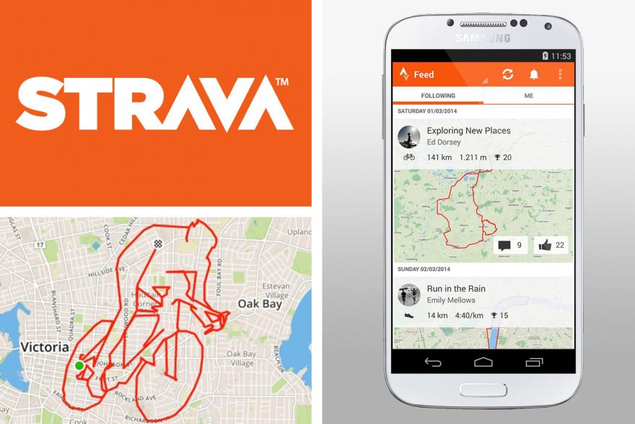
If we had more time to add incentives…
Leaderboard program
Tiered awards
Connect with friends
Pictures
Feedback surveys

Slide 9


If we had more time…
“Tell me more about being a blood donor ambassador” | A variety of compelling facts are shared
“I am running late” | Alexa notifies Red Cross contact
“Tell me something interesting about volunteering” | Alexa explains volunteer leaderboard
“Can I get a reminder for the event?” | Alexa signs you up for Push Notifications
Add additional ways to chat:
Other platforms we won’t name here
Website
Messenger

Slide 10
Special Thank You
American Red Cross team
AWS devs
Amazon Web Services

