Slide 1
Squirrel Feeding Project: Initial Specification
4th November 2019

Slide 2
Objective
Develop a semi-automatic assisted feeding device for neonatal squirrels (also will be useful for other small mammals)
If clinical trails of the above assisted feeding device are successful, develop a fully automated feeding device

Slide 3
Background
When a neonatal squirrel or any small mammal is rescued and raised by humans, it is fed a species-specific and age-specific liquid formula (milk). The manual way of feeding the neonates has the following steps
Take a fresh syringe and remove the needle
Pull-in the required amount of milk into the syringe.
Add a soft rubber nipple to the tip of the syringe
Insert the rubber nipple into the mouth of the animal
Gently, extremely carefully and very slowly keep pressing on the plunger of the syringe so that the rate of delivery of milk matches the rate of consumption by the animal.
Step-5 requires training and practice to execute correctly. It is the most time-consuming part of the procedure. It is also the most dangerous for the animal since any loss of concentration by the caretaker can lead to the animal aspirating milk into its lungs.
Step-5 is apt for automation. Added advantage of automation is that the animals will not imprint on humans, making them more suitable for repatriation into the wild.

Slide 4
Constraints
Automation must not lead to any additional sound being heard by the animal (like motor noise, clicking noise or metal scraping noise etc).
Should be mechanically robust since it will be used in animal setting
Careful consideration to mechanical/electrical faults
Machine *must* turn off

Slide 5
Basic idea
Split the task into two units
Unit1 contains motors and electronics (all the noise making components)
Unit2 contains feeding syringe and bare minimum needed to push the syringe’s plunger
Unit1 is placed far away from the animal and Unit2 is placed next to the animal.
Unit1 and Unit2 are connected by flexible liquid filled tube, so that action from Unit1 is translated to action by Unit2

Slide 6
Basic Idea
Continued in next slide
Liquid filled tube
Syringe1: pushes/pulls liquid into/out of tube
Stepper motor assembly pushes/pulls plunger of syringe1

Slide 7
Basic Idea: continued
Feeding Syringe: Feeding nipple attached here
Continued from previous slide
Liquid filled tube
Syringe2: responds to syringe1’s actions. It’s plunger pushes feeding syringe’s plunger
Feeding Syringe: pushed by syringe2, it delivers milk to the animal

Slide 8
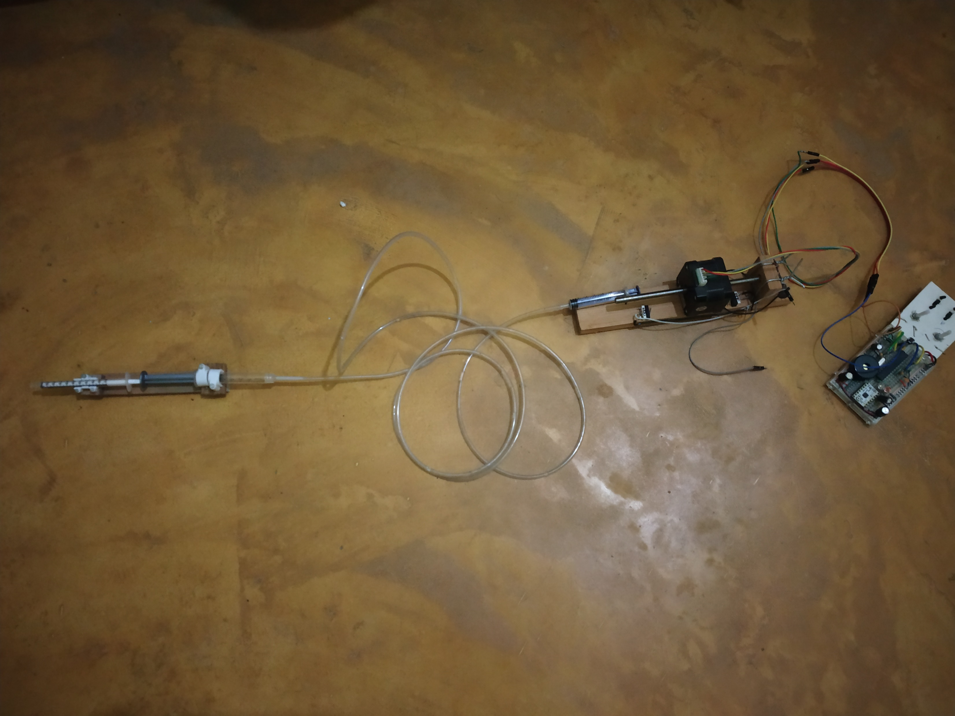
Assembly designed to test out the basic idea
syringe2
Feeding syringe
Syringe1
Controller
Stepper motor
Liquid-filled tube

Slide 9
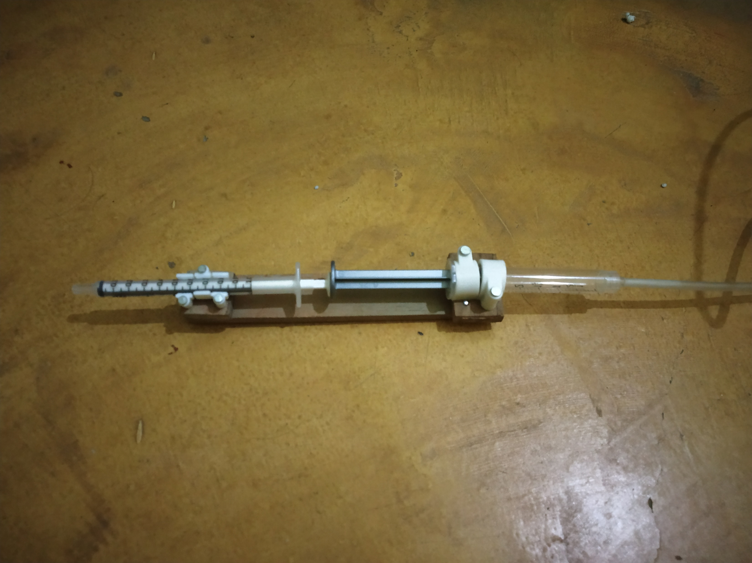
Plunger of Syringe-2 pushing plunger of feeding-syringe
syringe2
Feeding syringe

Slide 10
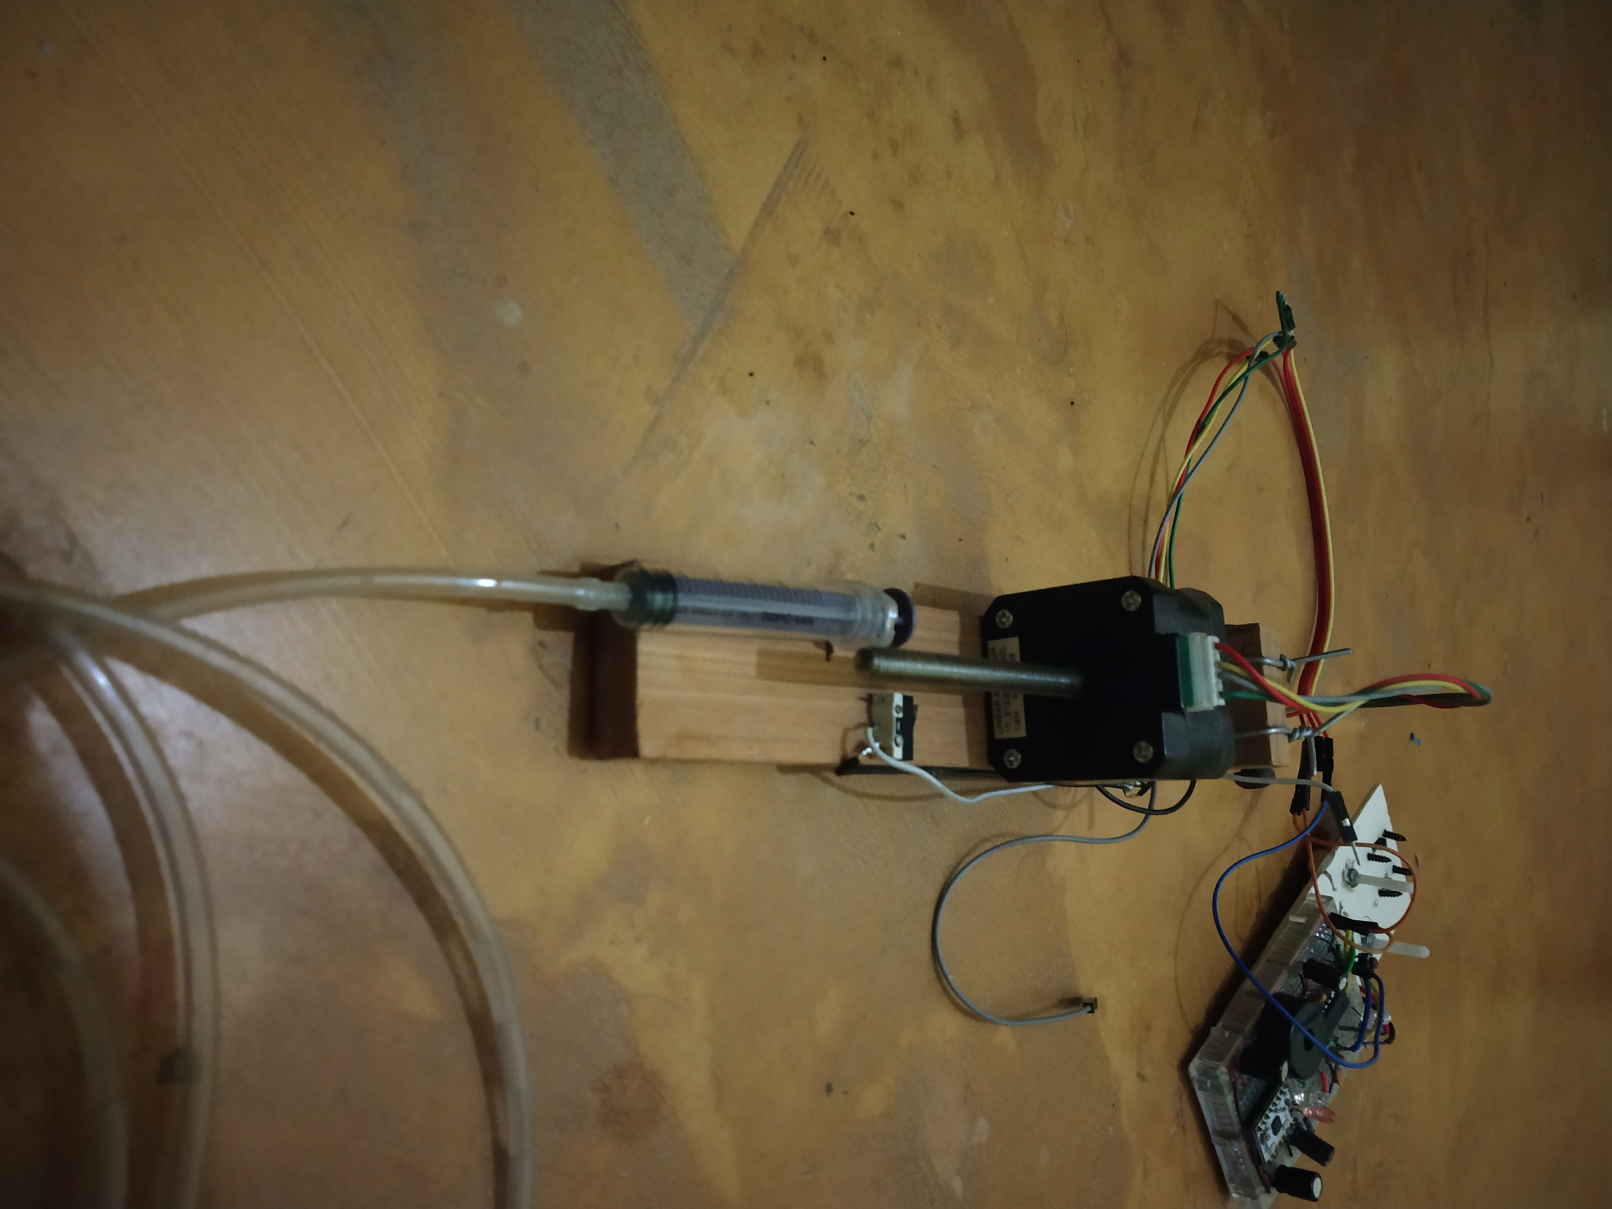
Stepper motor assembly driving Syringe1

Slide 11
New design
Above pictures show a crude design with house-hold components to test out the idea. Very limited testing showed that it could be a workable solution.
That idea needs to be developed into a robust new solution so that animal caretakers can work with it.
The new solution should have 3 feeding-syringes that can feed 3 squirrels simultaneously. This will save significant time and will be added impetus for animal caretakers to try and test the solution.

Slide 12

New design could look like this when it is finished
Sealed box containing all mechanical and electrical components, openable to change batteries
Three water filled tubes
Box with lid, caretaker will insert feeding syringes into slots and close the lid
Box has user controls and display on top
Electrical lines carrying sensor data
Three nipples that come out of box for animals to feed

Slide 13
Battery Pack
Motor Drivers
Motor
Motor
Microcontroller&
User Interface
Motor
Unit1
Edge sensors
Contact sensors
Unit2

Slide 14
User interface can look something like this
One main power On/Off switch
Screen to tell user what is happening
Individual On/Off switch for each motor
One SPST switch to determine direction of motors (forward or reverse)
One SPST switch to determine type of dispensing (Automatic or manual)
Recoil button for manual dispensing of milk
One dialer/knob to set rate of dispensing
One dialer/knob to set volume to be dispensed

