Slide 1
Automated Squirrel Feeding System
-Under the supervision of Prof. Madhav Rao && Mr. Praveen Kalam Sir

Slide 2
System Description
It consists of a capacitive touch sensor for the detection of the squirrel(animal), when any animal approaches the sensor it detects the squirrel and sends the signal to the MCU, then based on the knob inputs for speed and volume, the system starts the stepper motor which allows the syringes to move, make the liquid(milk) dispensed from the outlet. There is an LCD screen to display the speed and volume inputs for each outlet for user reference When the squirrel moves away from the touch sensor it will stop the dispensing. There are switches for individual outlets so the user can change the state of them to forced state(without sensor value) and normal state with sensor values.

Slide 3
Steps to Operate-
First Power On the System.
Adjust the knobs for specific Speeds(in time format) and the Volume(in mL) according to the need.
The entered Speed and Volume are displayed in LCD screen.
Once the entered Volume of liquid is completely displaced it shows (! Mark) in front of respective A and B, also you can see how much liquid dispensed alongside the entered value
For resetting, turn the knob to 0 Volume or any reset volume.
For changing state to forced state pull down the toggle switch and for the normal state to on state of toggle switch.

Slide 4
More About Speeds and Volume Setting
Speeds are in time which shows how much time needed to completely displace the 10mL liquid.
For example, 00m30s means 30seconds required to displace 10mL liquid similarly 10m00s mean 10 minutes to displace 10mL liquid.
Volumes are in mL which shows how much mL of liquid should be displaced(or feeded)
For example, 2 means 2mL of Liquid,9 mean 9mL.

Slide 5
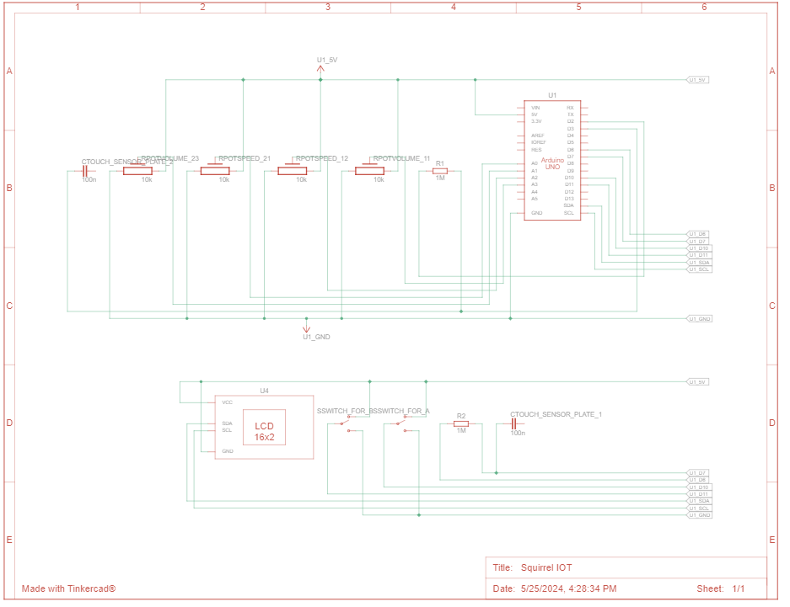
Circuit diagram of the System

Slide 6
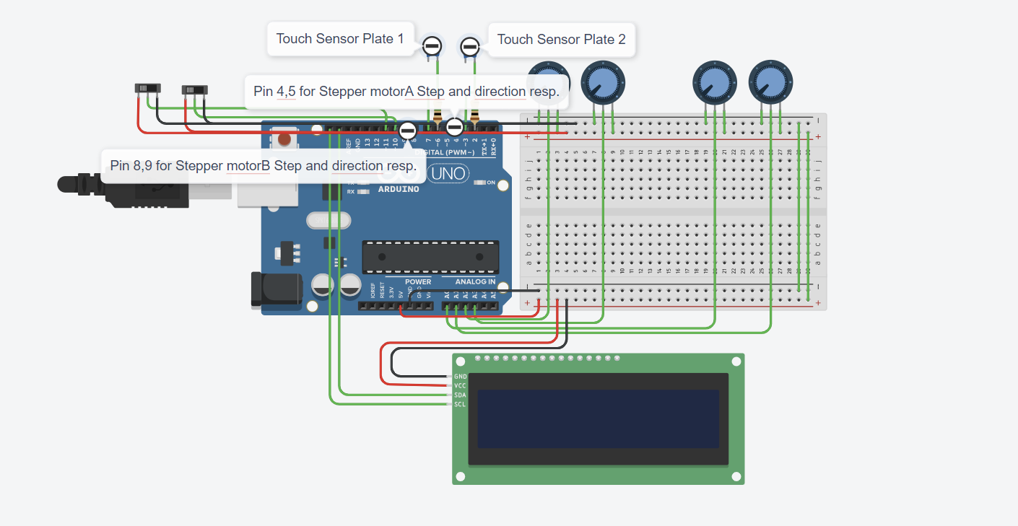
Circuit View with the TinkerCad

Slide 7
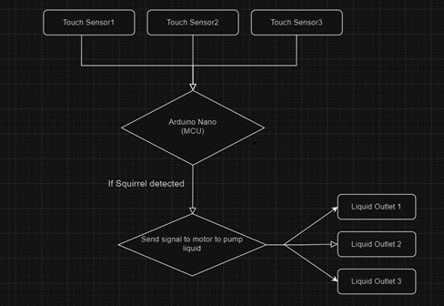
Flow Diagram

Slide 8
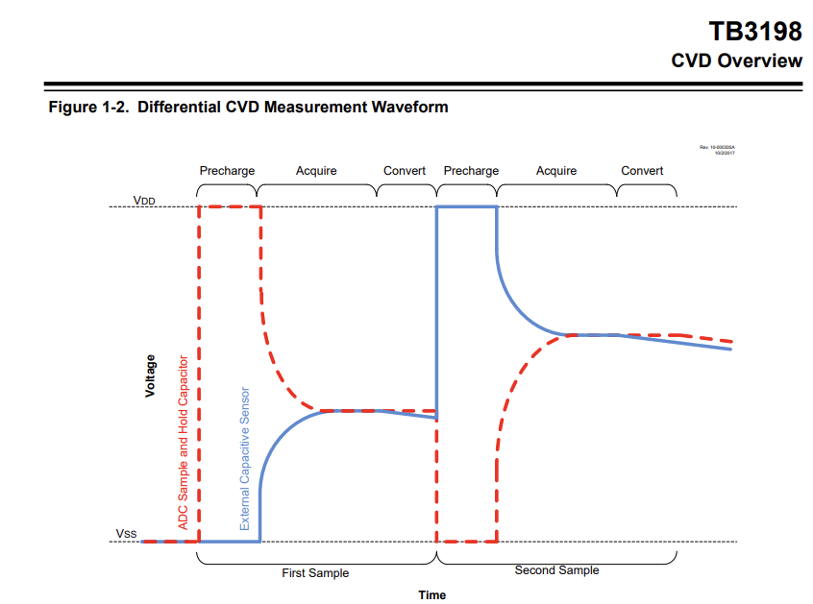
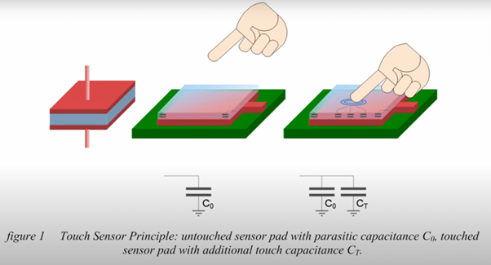
Working Principle of Capacitive Touch Sensor

Slide 9
How Does The Capacitive Sensor Library Works
It uses 2 pins, one send pin, which is set to OUTPUT, and second receive pin, which is set to INPUT, Both the send and receive pins are set low to ensure any previous charge is drained.
The send pin is set to HIGH and receive pin set to LOW.
The time it takes for the receive pin to go HIGH is measured. This time is proportional to the capacitance between the send and receive pins.
τ=R×C
It return the total time it took for receive pin to become HIGH and if the time exceeds the set_timeout value then it gives Error.
A higher capacitance (e.g., when a finger is near the sensor) results in a longer time, hence greater return value.

Slide 10
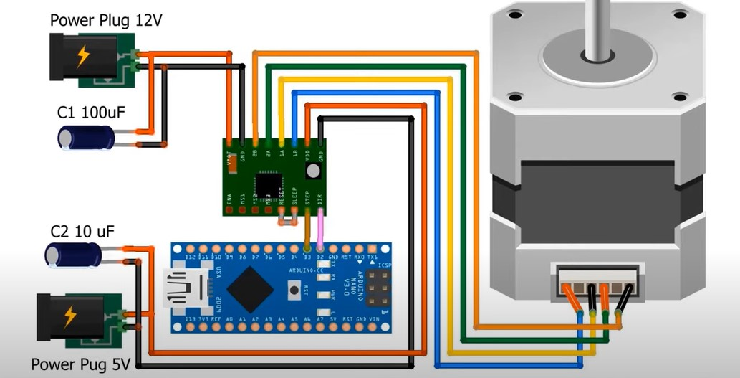
Stepper Motor Connection

Slide 11
Conclusion
The development of the Automated Squirrel Feeding IoT System marks a significant advancement in the care and rehabilitation of neonatal squirrels and small mammals. By automating the feeding process, the system reduces the workload on caregivers while enhancing precision and efficiency. This innovation not only benefits rescued animals but also contributes to the overall welfare and conservation efforts for these species.

Slide 12
Future Prospects
Moving forward, there are several potential avenues for further enhancement and application of the Automated Squirrel Feeding IoT System. Integration with IoT technology could enable remote monitoring and control, allowing caregivers to manage feeding schedules and monitor consumption remotely. Additionally, advancements in sensor technology could facilitate real-time monitoring of the animal's health and nutritional intake, providing valuable insights for caregivers and veterinarians. Moreover, the scalability of the system could be explored to accommodate a wider range of small mammal species, expanding its utility in wildlife rehabilitation and conservation efforts. Overall, the project demonstrates the potential of IoT technology to improve animal care practices and contribute to the welfare of wildlife populations.

Slide 13
References
https://ww1.microchip.com/downloads/aemDocuments/documents/OTH/ApplicationNotes/ApplicationNotes/TB3198_CVD_90003198A.pdf
https://www.arduino.cc/reference/en/libraries/stepper/
https://www.arduino.cc/reference/en/libraries/capacitivesensor/
https://www.tinkercad.com/things/e9BjjWpaCMq-squirrel-iot

