Slide 1


Songs Analysis in
Power BI
Presented by Sameer Bajpai

Slide 2

Problem Statement
This internship project aims to conduct a comprehensive analysis of YouTube songs data using Power BI.
The dataset contains key attributes such as video ID, channel title, title, description, tags, published date,
view count, like count, favorite count, comment count, video duration, video definition, and caption
details. The goal is to utilize Power BI to create insightful visualizations and reports that provide a deeper
understanding of YouTube songs' performance, popularity, and user engagement.

Slide 3

POWER BI
Power BI is a business analytics tool by Microsoft that allows users to visualize and share insights from their data through interactive dashboards and reports, enabling data-driven decision-making and easy integration with various data sources.

Slide 4


Data Cleaning and Preparation
In Power Query, data cleaning and preparation involve steps such as removing duplicates, handling missing values, correcting data types, and transforming data formats. This process ensures that the dataset is accurate, consistent, and ready for analysis.

Slide 5
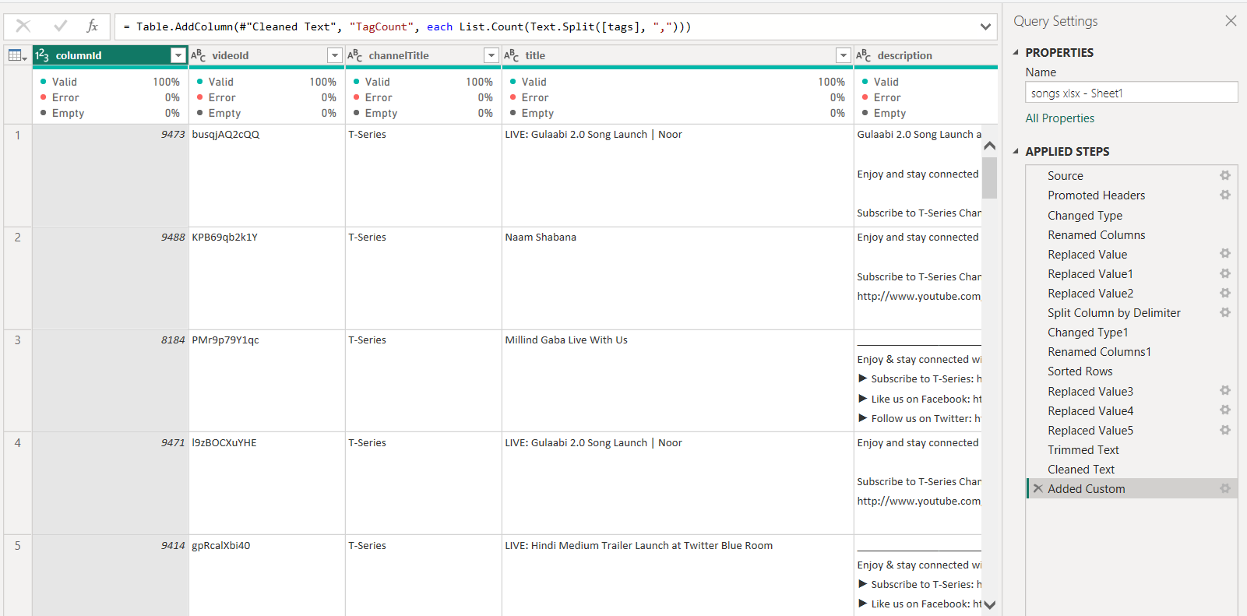
Data Cleaning and Preparation

Slide 6
Exploratory Data Analysis (EDA)
Exploratory Data Analysis (EDA) is a critical step in data analysis that involves visually and statistically examining datasets to summarize their main characteristics. Using tools like histograms, scatter plots, box plots, and correlation matrices, EDA helps identify patterns, trends, and anomalies. It enables analysts to understand the underlying structure of the data, detect outliers, and test underlying assumptions. EDA also provides insights into relationships between variables, guiding the selection of appropriate modeling techniques. By revealing the data's distribution and key features, EDA forms the foundation for more advanced analysis and helps ensure that subsequent steps are based on accurate, well-understood data.

Slide 7
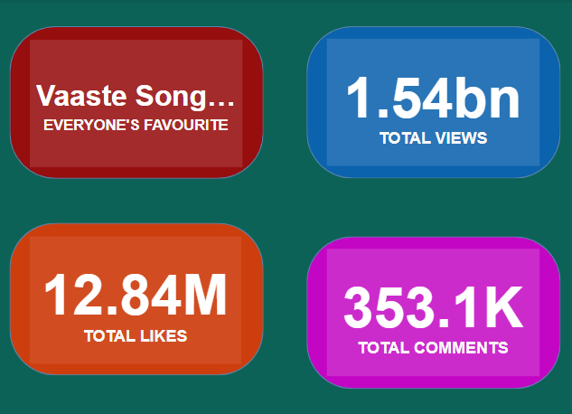
Trends in popularity of YouTube song videos.
A Key Performance Indicator (KPI) is a measurable value that demonstrates how effectively an organization is achieving key business objectives. KPIs are used to evaluate success in reaching targets and making data-driven decisions.
Vaaste Song is the most viewed, liked and commented video. It has 1.54bn Views, 12.84M Likes and 353.1K Comments

Slide 8
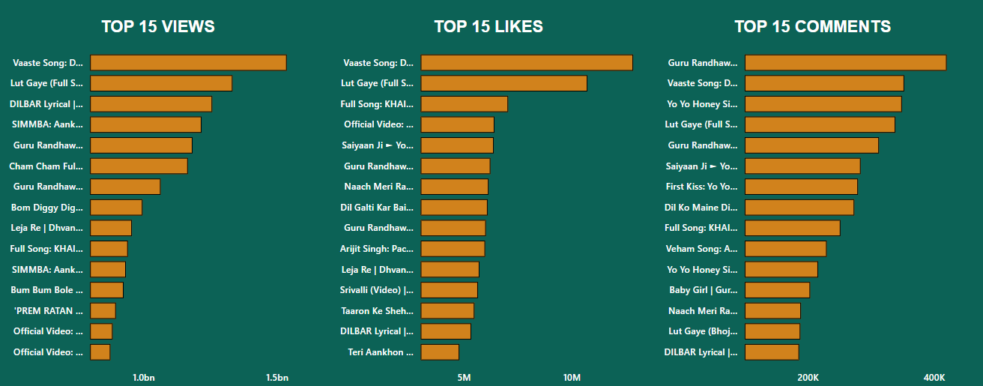
TOP TRENDS

Slide 9
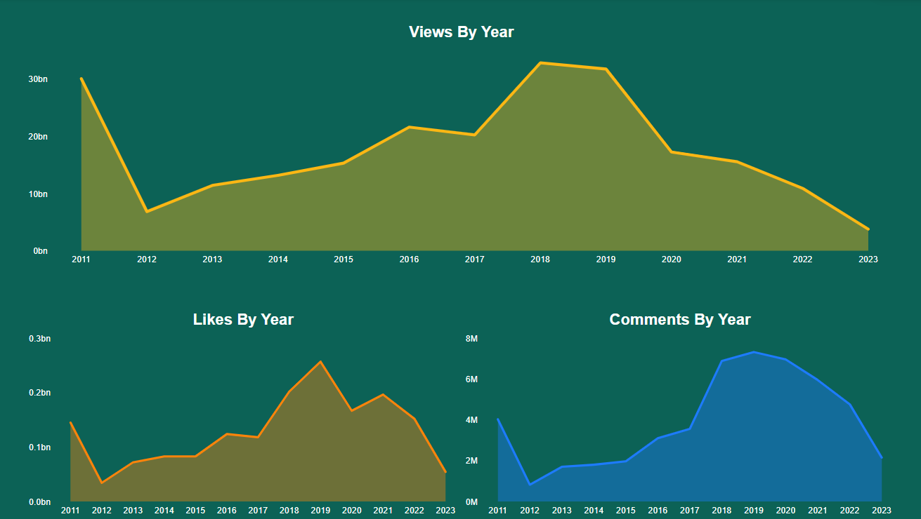
Temporal Trends

Slide 10
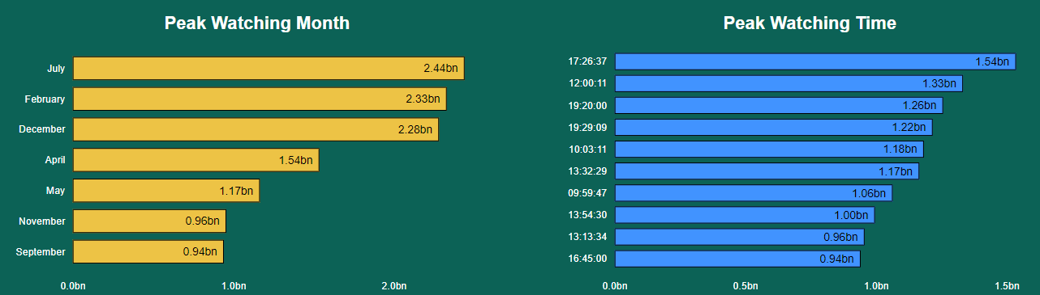
Peak Watching Times
Peak watching time refers to the period when the highest number of viewers are actively watching or engaging with content, such as YouTube songs or videos. This timeframe typically reflects when audience engagement and viewership reach their highest levels during the day or week.

Slide 11
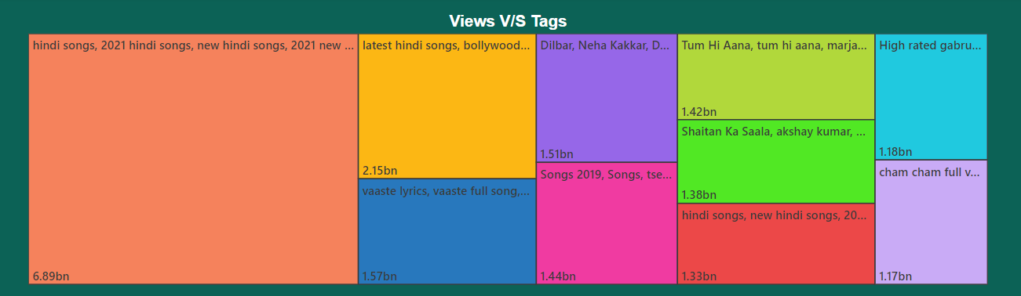
A treemap is a visual representation of hierarchical data using nested rectangles. Each rectangle's size and color can represent different dimensions of the data, such as the proportion within its parent and additional metrics. This visualization is effective for displaying hierarchical structures and comparing categories based on their size.
Most Popular Tags

Slide 12
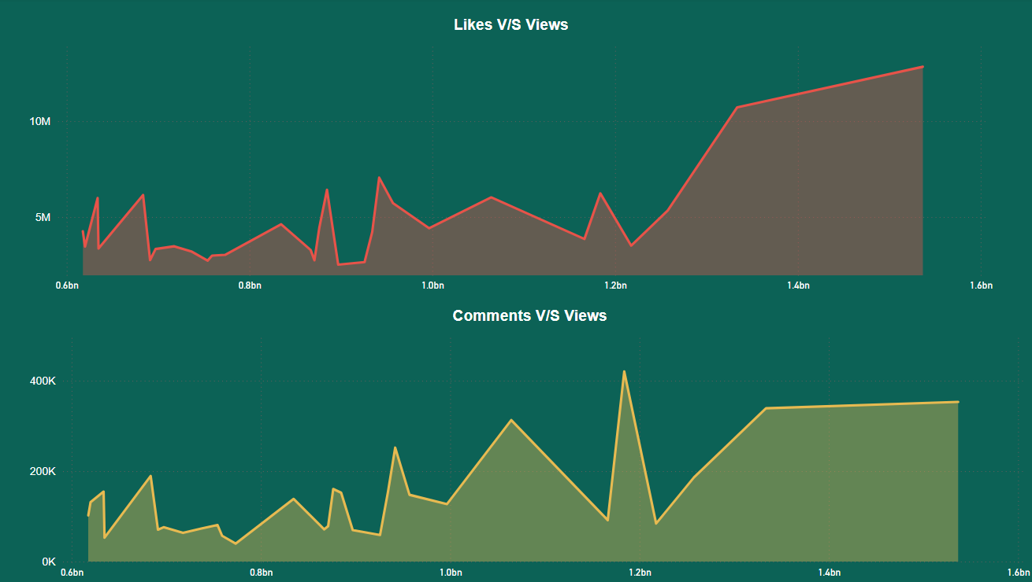
User Engagement

Slide 13
Recommendations
1) Add the most popular tags (from the treemap) for better performance, Also more the tags more the engagement.
2) The Peak Month of viewership is July, followed by February and December. For higher user engagement try to publish the youtube video in these months.
3) Peak Watching Times are around evening (around 7 pm) and in the morning (around 10am). So, content posted during these times may have better chances of performance.

Slide 14

Thank you very much!

