Slide 1
Project 1 – FINANCIAL SENTIMENT ANALYSIS
Group I1 –
1. Anjali Bhoi
2. Tushar Gaikwad
3. Chaittanya Dandekar
4. Deepak Patil
5.Bajrang Govindwad

Slide 2
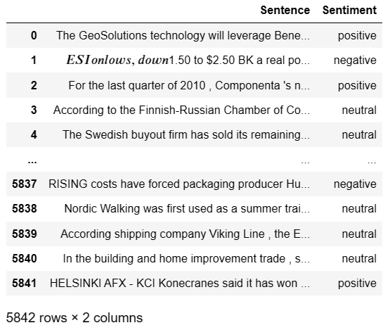
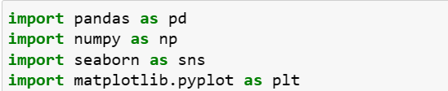
Exploratory Data Analysis (EDA)
Step 1 :
Imported required libraries to import dataset and perform the EDA.
Dataset imported as ‘data’.

Slide 3
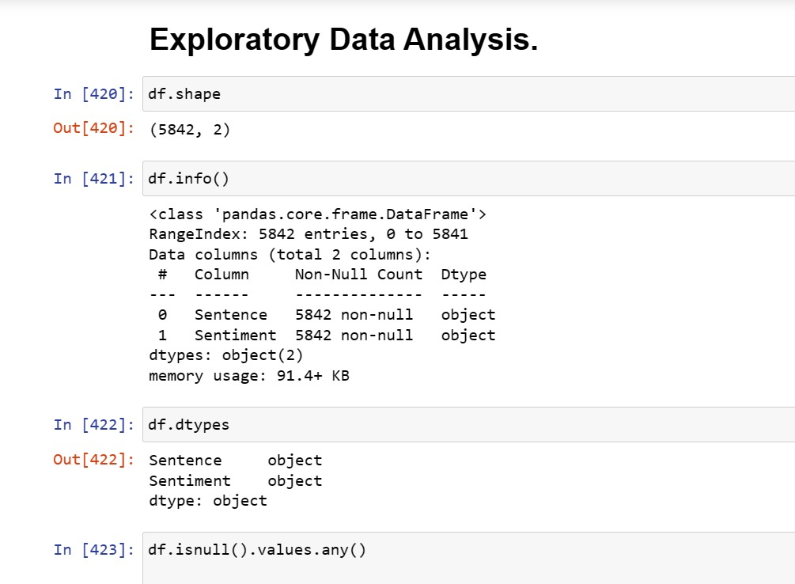
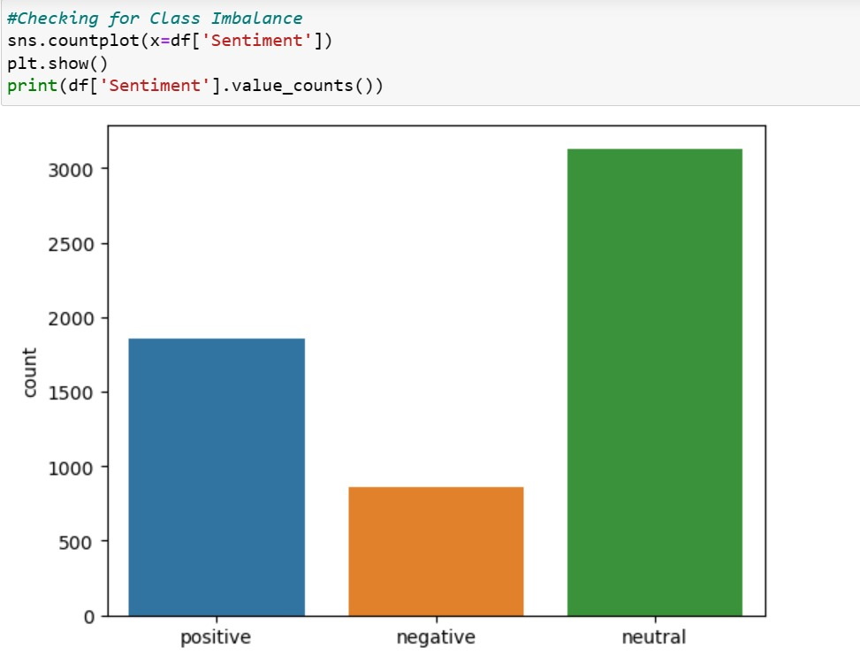
neutral 3130
positive 1852
negative 860
Name: Sentiment, dtype: int64

Slide 4
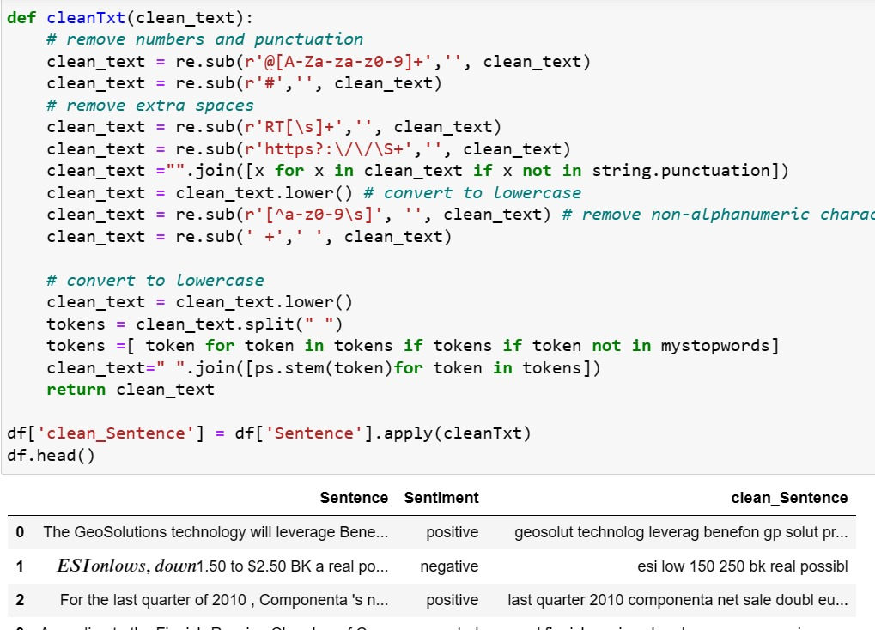
c) Text Cleaning

Slide 5
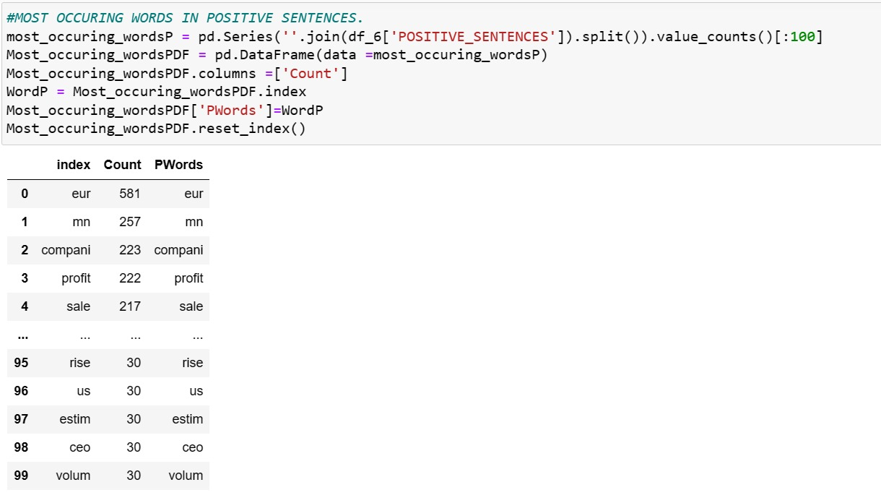
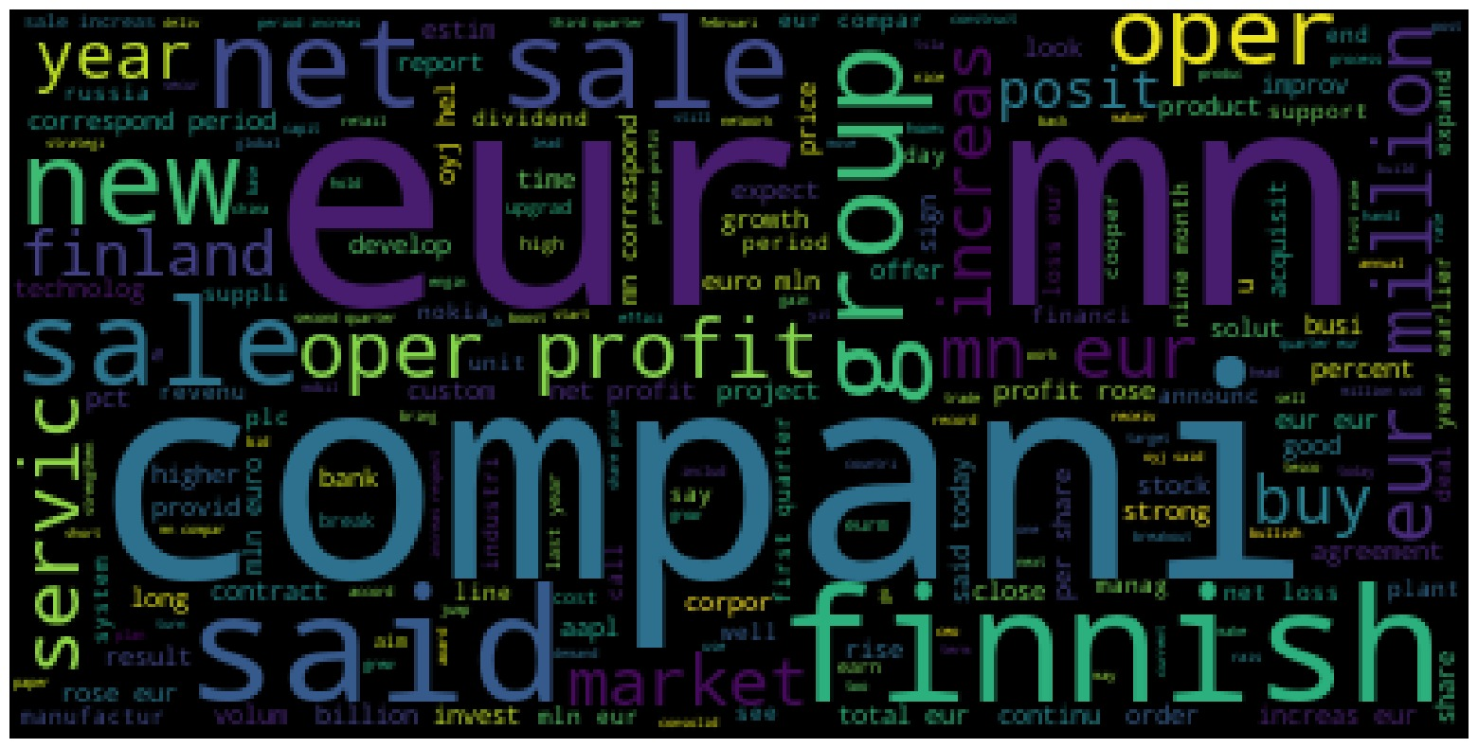
POSITIVE SENTIMENT ANALYSIS

Slide 6
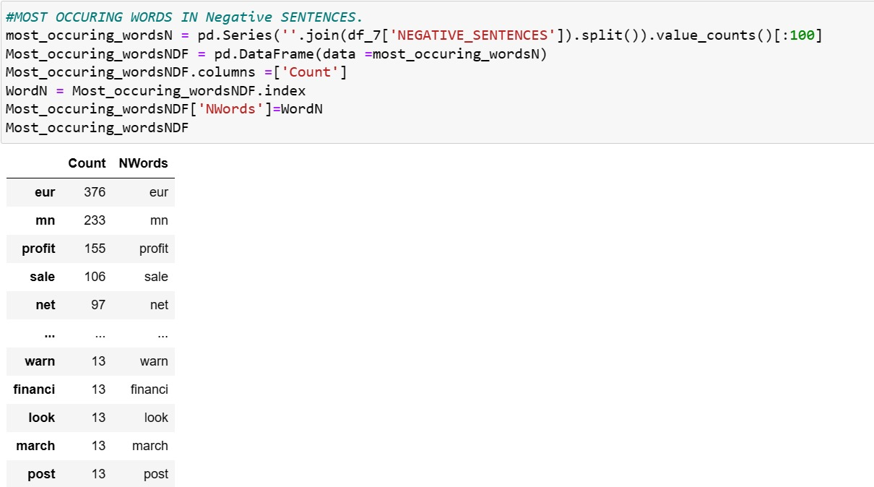
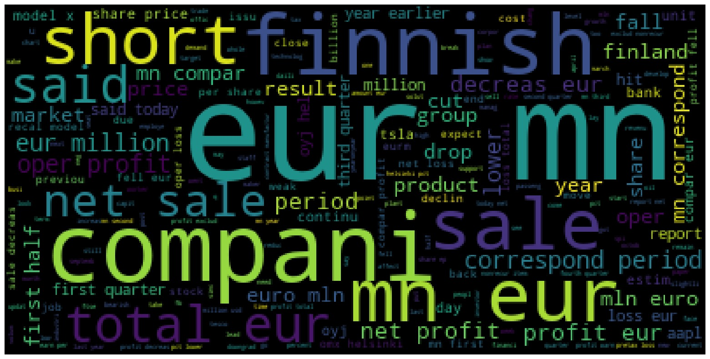
NEGATIVE SENTIMENT ANALYSIS

Slide 7
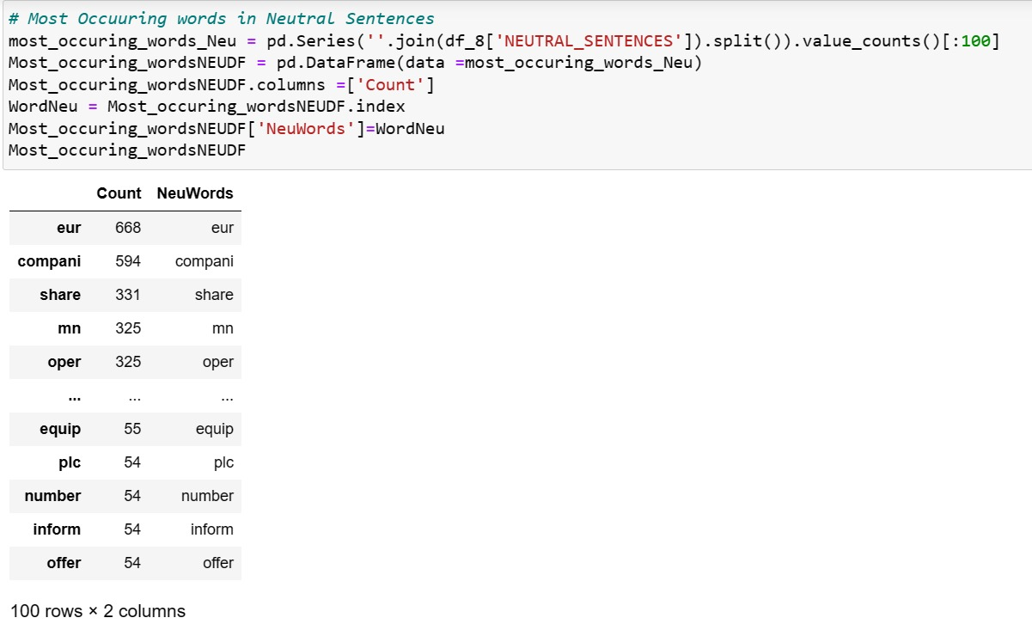
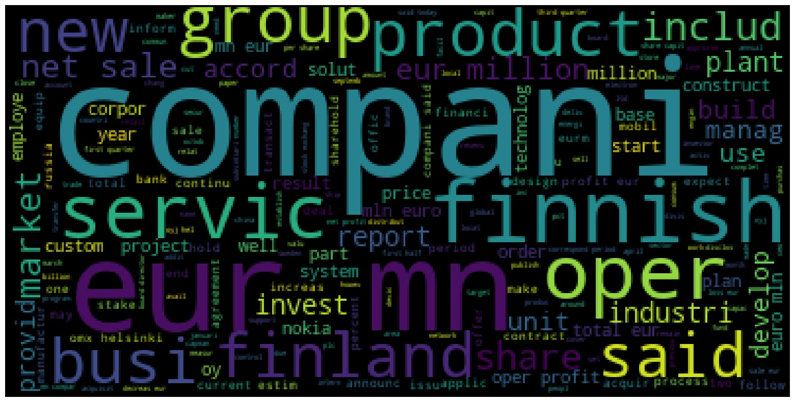
NEUTRAL SENTIMENT ANALYSIS

Slide 8
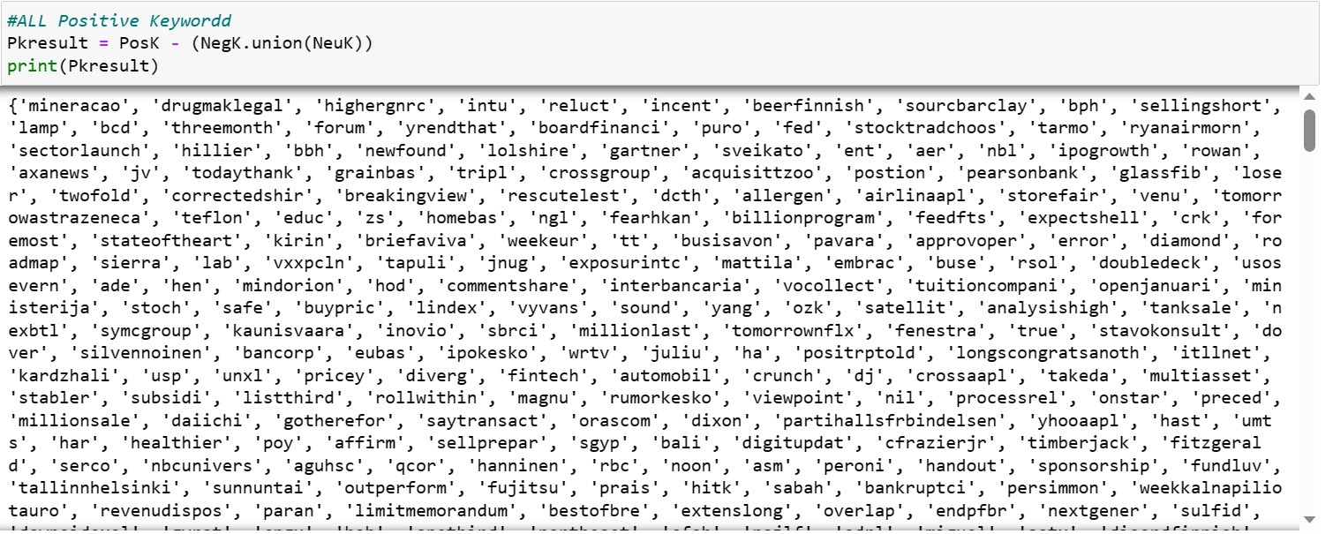
POSITIVE UNIQUE WORDS

Slide 9
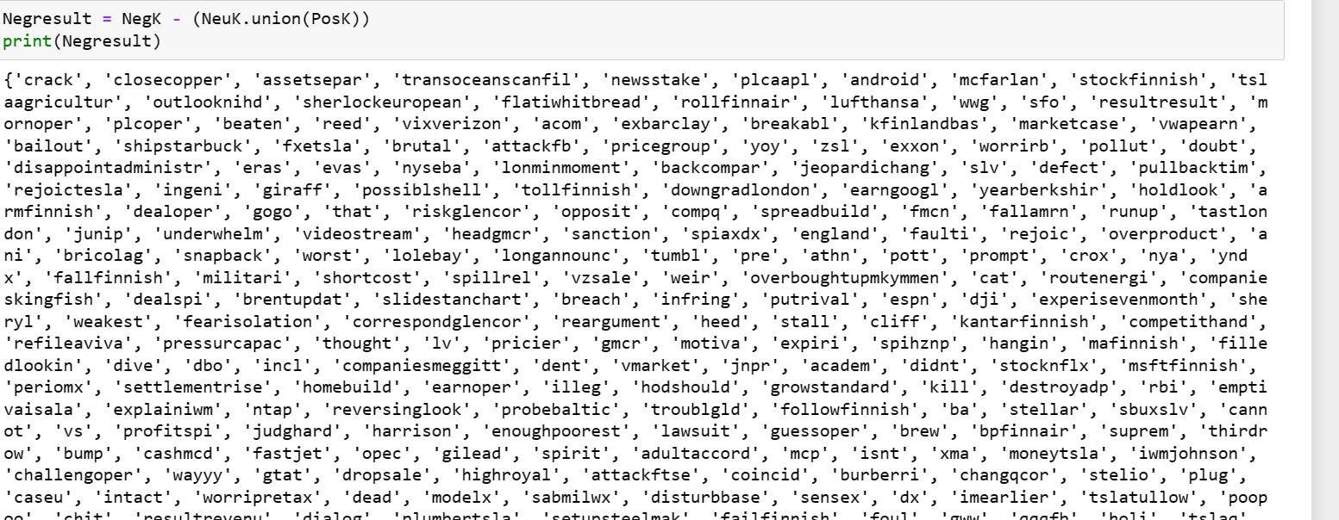
NEGATIVE UNIQUE WORDS

Slide 10
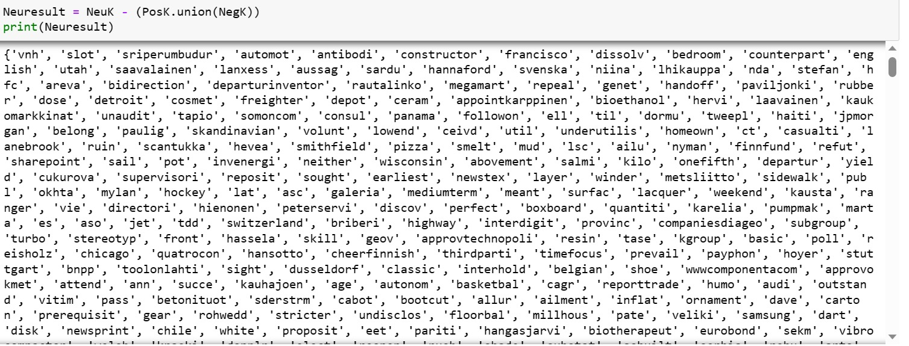
NEUTRAL UNIQUE WORDS

Slide 11
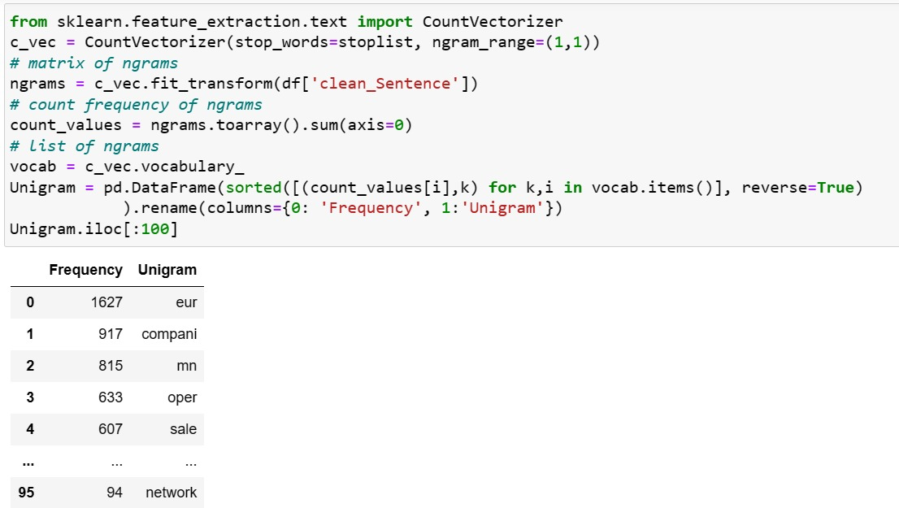
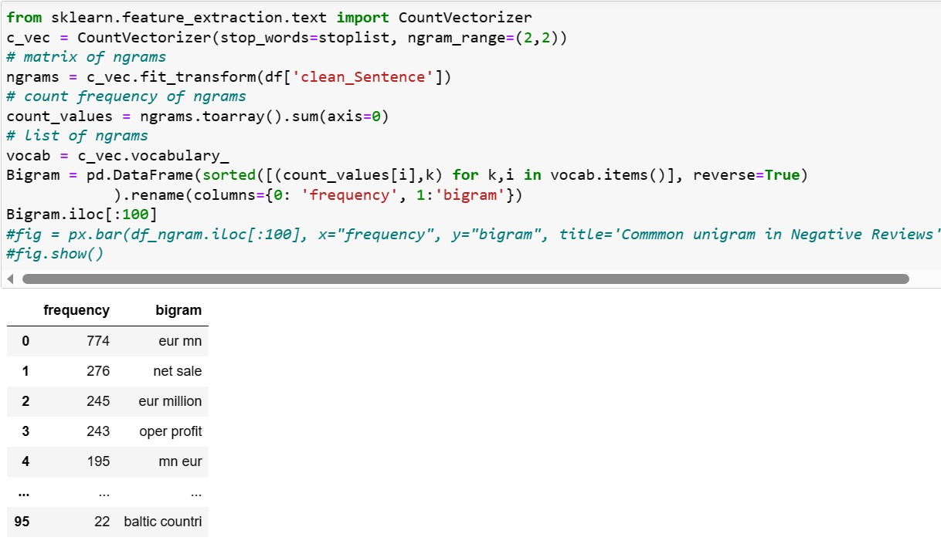
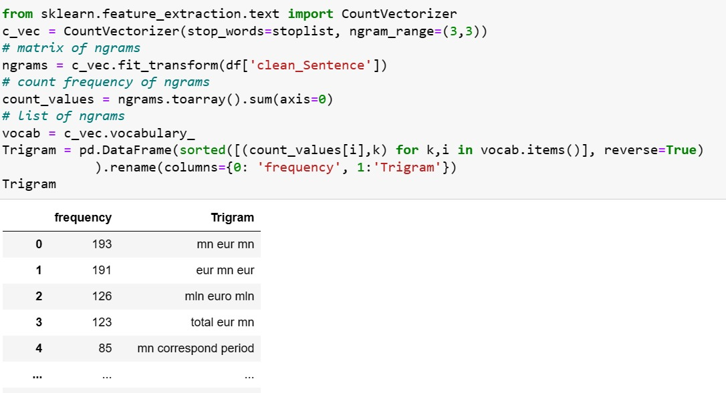
UNIGRAM , BIGRAM & TRIGRAM

Slide 12
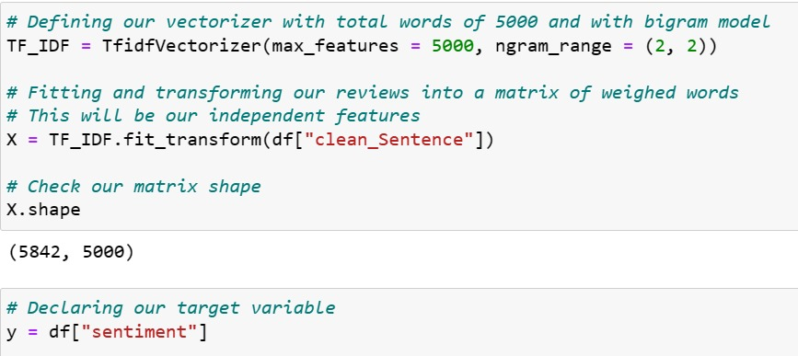
VECTORIZATION USING TF-IDF

Slide 13
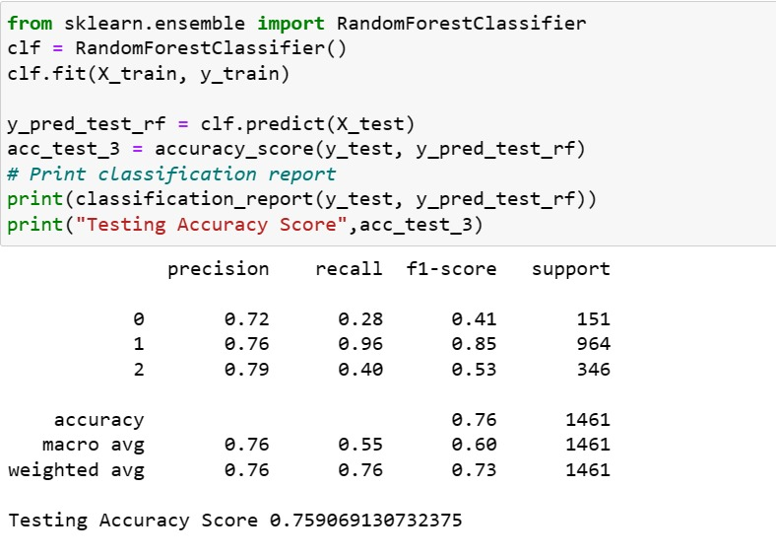
MODEL BUILDING
RANDOM FOREST CLASSIFIER FOR BIGRAM

Slide 14
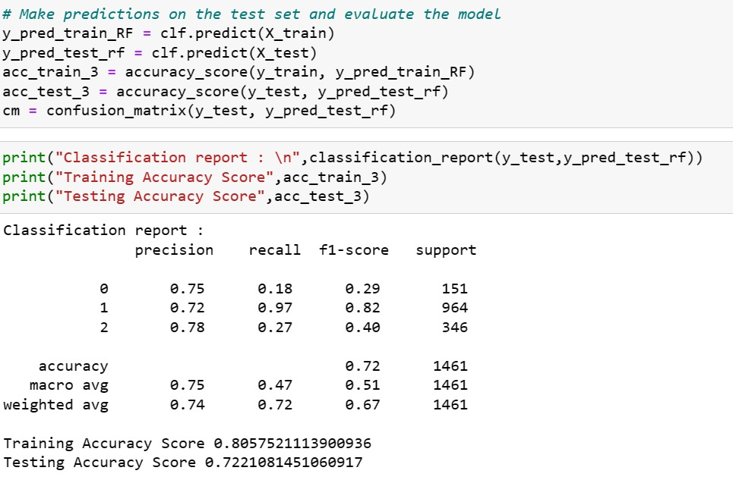
RANDOM FOREST CLASSIFIER FOR TRIGRAM

Slide 15
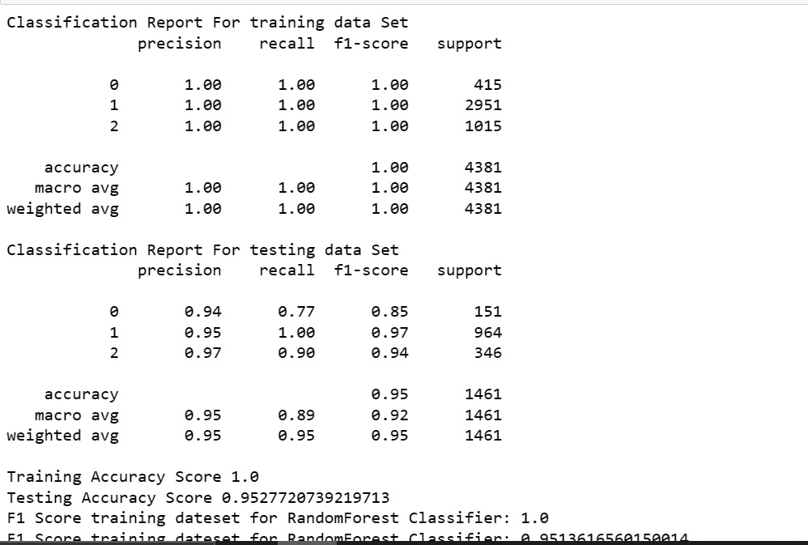
FINAL MODEL
RANDOM FOREST CLASSIFER FOR UNIGRAM

Slide 16
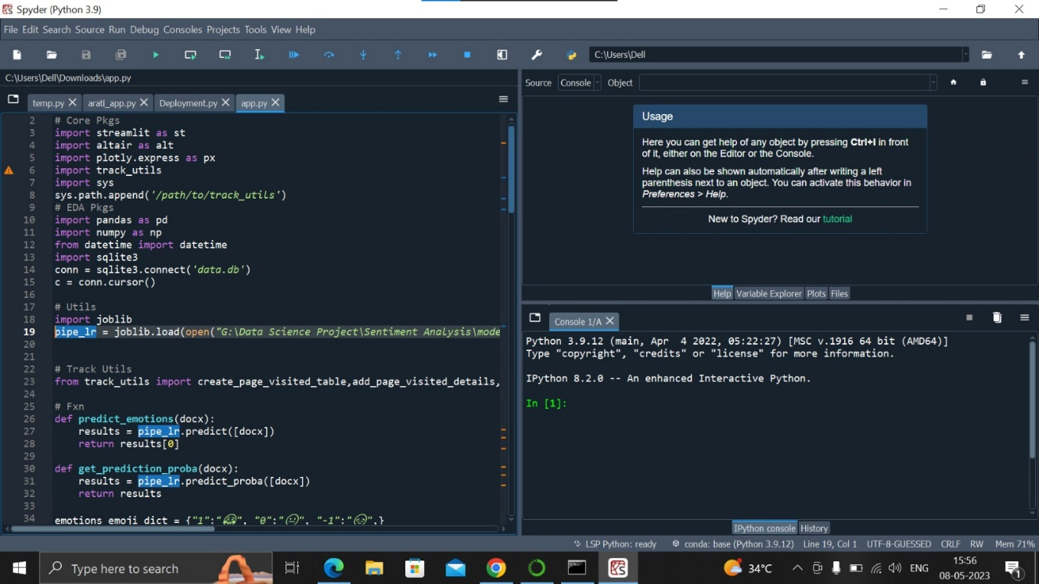
deployment

