Slide 1
Tweet Analyzer including Topic Modelling Sentiment Analysis and Tweet Summarization
Abbhinav Reddie Nomulla — Rahul Sanjay Morishetti — Brooke Dalton
CS-286 Advanced Topics in Computer Science (Topics in NLP)

Slide 2
Models
VADER for sentiment analysis
LDA for topic modelling
BART for summarization

Slide 3
VADER
Valence Aware Dictionary and Sentiment Reasoner
Trained on social media data

Slide 4
LDA
Latent Dirichlet Allocation
A way of automatically discovering topics

Slide 5
BART
Bidirectional autoregressive transformer
Standard encoder-decoder transformer model

Slide 6
Dataset
From twitter
Preprocessing
Use NLP techniques
Remove @ signs, emojis, URLs, and repeat letters

Slide 7
GUI
Contains:
A time span that is selected by the user
5 hottest topics shown
Overall sentiment trend for a certain topic when selected
Sentiment analysis results
Summary

Slide 8
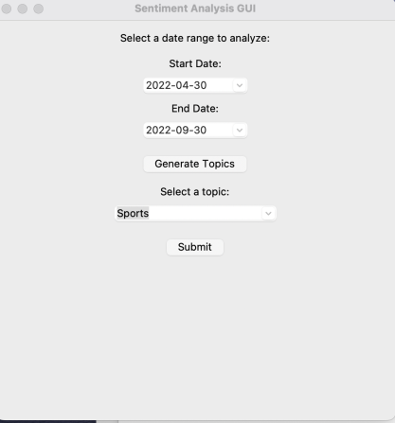
Selecting a Date Range

Slide 9
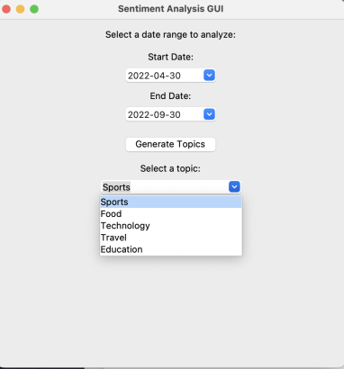
Selecting a Topic

Slide 10
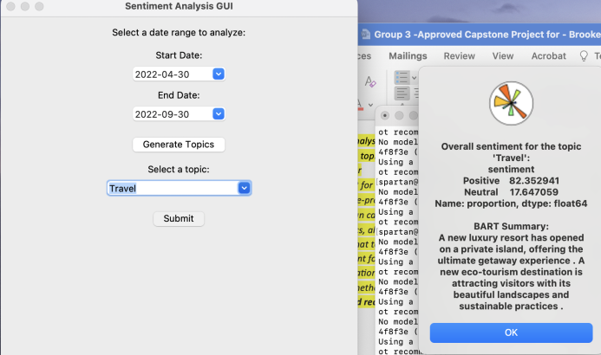
Overall Sentiment and Summary for Specific Topic

Slide 11
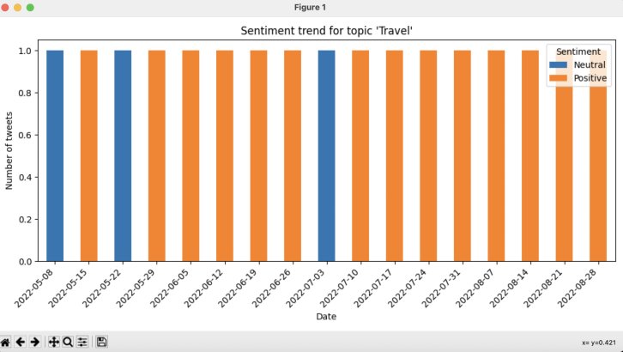
Sentiment Trend

Slide 12
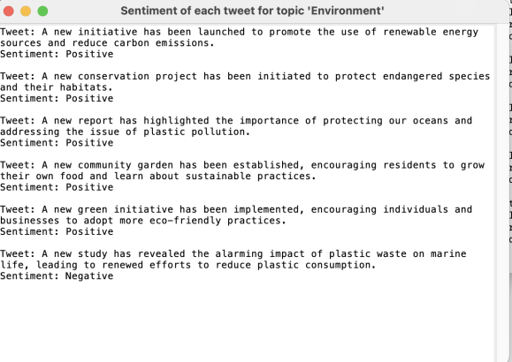
Sentiment of each Tweet

Slide 13
THANK YOU!!

