Slide 1
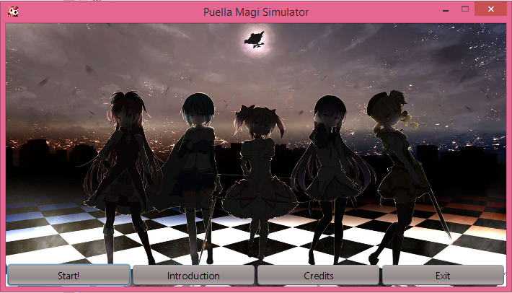
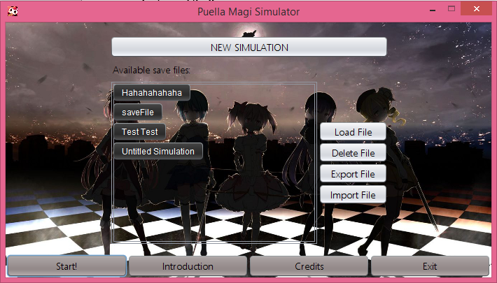
Puella Magi Simulator – User’s Guide
Tony Cui, Jiayin Huang, Sally Hui
Getting Started
Unpack the contents of the zip file into a folder. Then run PuellaMagi.jar.
Features of the Program
Main Menu
Buttons used to switch between parts of the main menu.
Start Simulation Options
Button to create a new simulation.
Users can load, delete, export, or import save files.
Previously saved save files can be viewed and loaded here. A vertical scrollbar automatically appears when needed to expand the space that holds the file names.

Slide 2
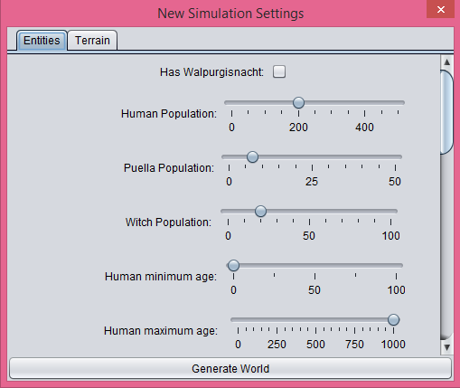
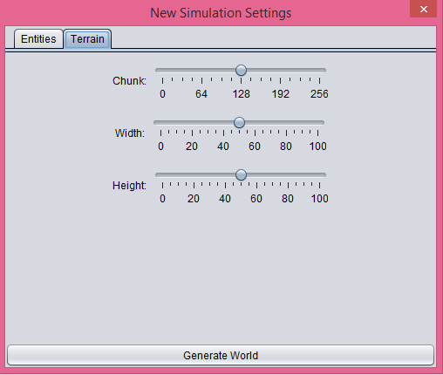
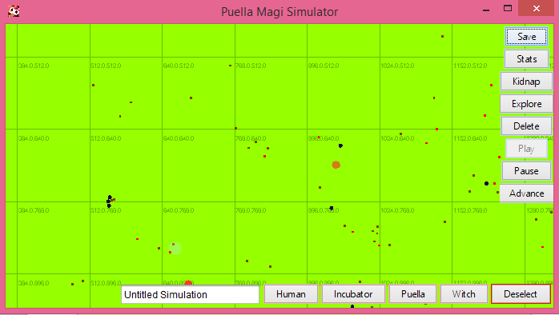
New Simulation Settings
Sliders to manipulate data used to generate a new simulation. The customization options are split into two categories; entities and terrain.
Simulation Screen
Different tools available to: move around the screen, start/stop a timer, save data, delete entities, and move (“kidnap”) entities.
Entities can be dropped into the simulation.
Simulation Settings
The name of the simulation and the save file can be changed using this text field. Press Enter to set the name.

Slide 3
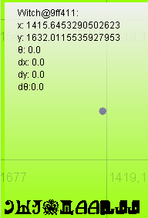
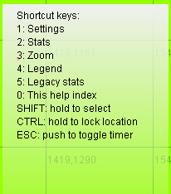

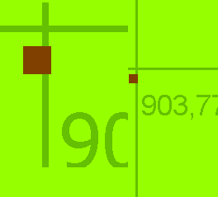
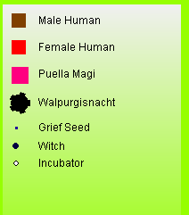
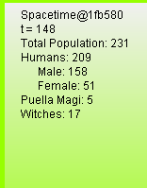
Side Panels
There are six side panels to choose from when playing. The side panel appears in the top left corner of the window, and the state of the panel can be toggled with keyboard shortcuts.
'0' : Lists the hotkeys to all of the other tabs.
'2' : Displays data about a selected Entity.
'1' : Adjusts the frequency of the timer.
'3' : Shows a zoom preview of the area around the cursor.
'4' : Shows a legend for the various colors and shapes on the map.
'5' : Shows data about the entire map in general..
Limitations
Due to the large number of entities being simulated, the program may sometimes crash or lag.
Another limiting factor are the very simple AIs that are controlling the entities. They do not even know how to go around things. Also, the entities themselves look rather plain and simplistic. But that’s good! It’s easier to use imagination that way!

