Slide 1
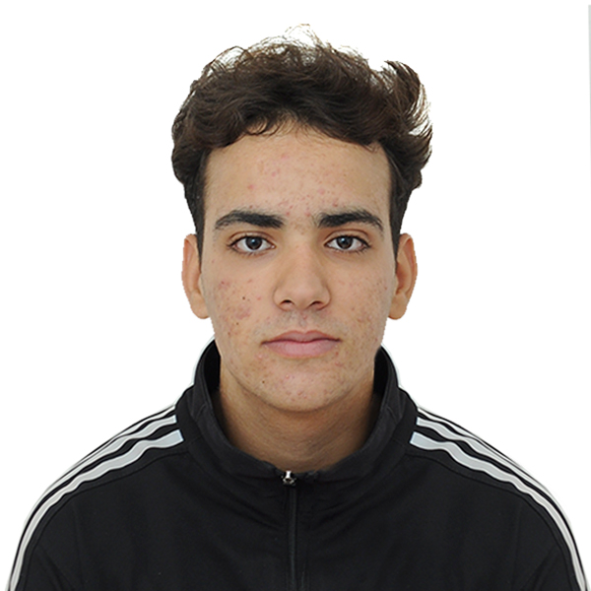
BAKAL ZINE ELABIDDINE
0613786537
bakalzinelabidin1@gmail.com
Beni Mellal
Permis de conduire categorie:B
PROFILE
I obtained my baccalaureate in 2023 in physical science, Now I have my first year in programming(developpment digital. I have a certificate of participation in Enabel
FORMATION
EXPERIENCE
baccalaureate physical sciences
2023\beni mellal
Lycee annour
COMPETENCES
Lngague programation
MS Office
javascript
Montage
Youtube ADS
Html & css
python
LANGUES
Français : : Fluent
Anglais : : Fluent
COMPETENCES
COMPETENCES
Center of interst
CES
Sport activvities : go the gym ,football ,basketball
Content creation:yuotube facebook
Notes:
www.cvexemple.Com

