Slide 1
COMP447 · PROGRESS REPORT
When Does Cheap Consistency Tuning Pay Off?
When is consistency tuning worth it? · The open question we found.
Batuhan Karaman · Kadir Yiğit Özçelik
April 2026

Slide 2
The question
• Diffusion models reach state of the art image quality at the cost of 30 to 100+ neural function evaluations per image.
• Consistency Models compress sampling into 1 or 2 steps, but the upfront tuning is non trivial.
• When is cheap consistency tuning worth paying for, and how should you sample once you've paid?
2 / 10

Slide 3

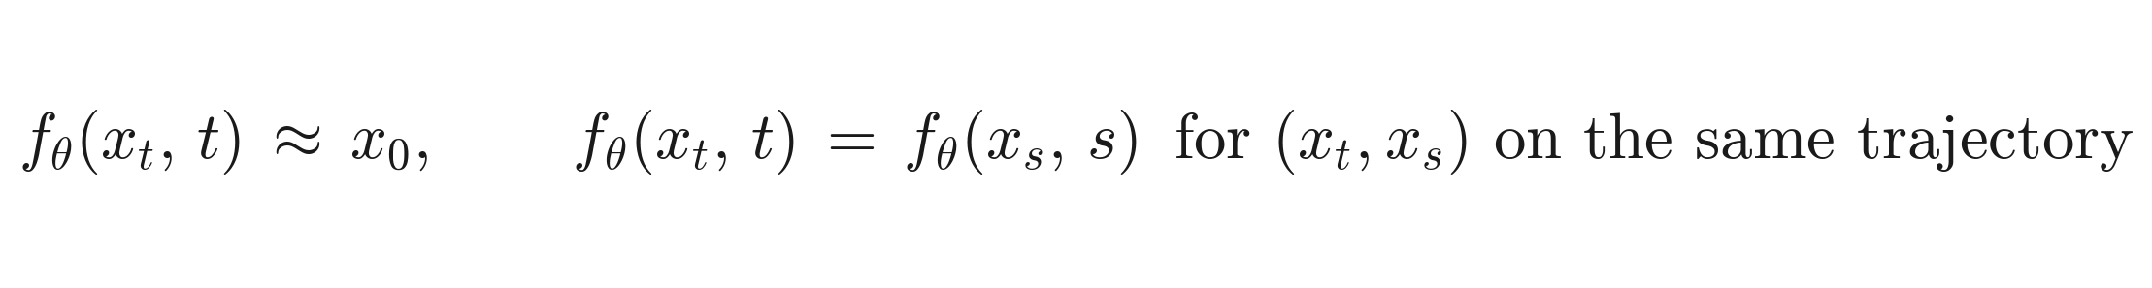
Background
Diffusion: probability flow ODE [Karras+ 2022, EDM]
Consistency model: a learnable flow map [Song+ 2023]
• Diffusion: 2 NFE / step, 18 steps ≈ 35 NFE. · CM: 1 NFE for 1 step, 2 NFE for 2 step.
3 / 10

Slide 4
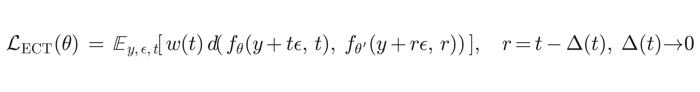
Easy Consistency Tuning · the model we use
Self consistency between infinitesimally close noise levels [Geng+ 2025]
• Initialised from a pretrained EDM checkpoint, no distillation teacher.
• Two step inference uses a single hand picked midpoint at value 0.821, with no derivation in the paper.
• Paper claim: ~1 A100 hour to reach FID 2.11 at 400 k kimg.
4 / 10

Slide 5
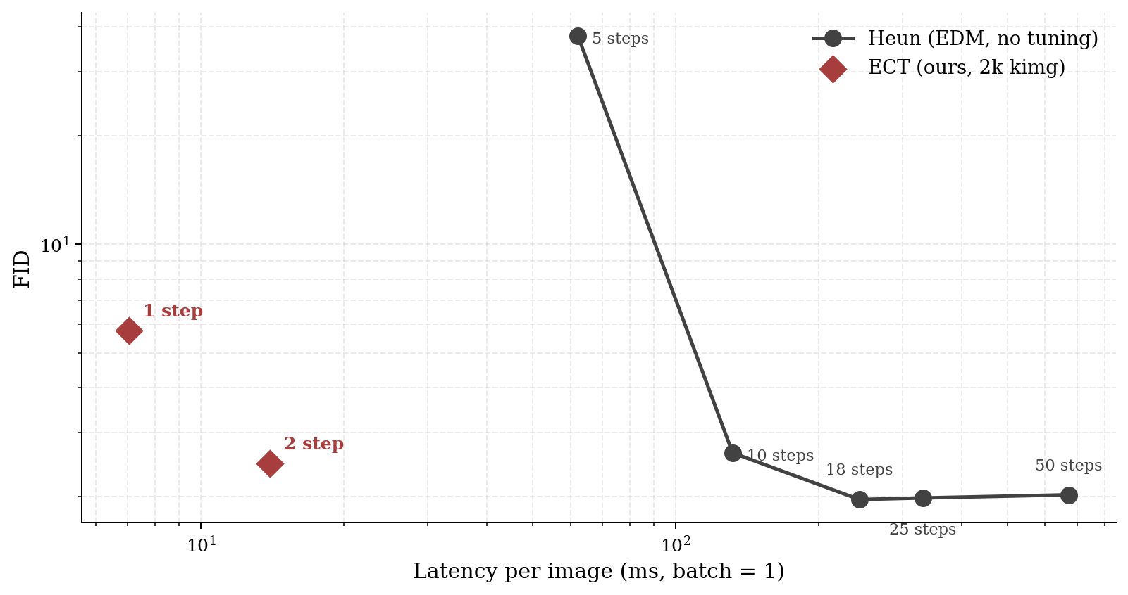
Pareto frontier
EDM CIFAR 10 32×32 · ECT @ 1980 kimg · Heun 5 to 50 steps · NVIDIA G4 Blackwell · batch = 1
• ECT 2 step · FID 2.47 · 14 ms / image → 17× faster than Heun 18.
• On this short tuning budget, ECT Pareto dominates Heun across every operating point.
5 / 10

Slide 6
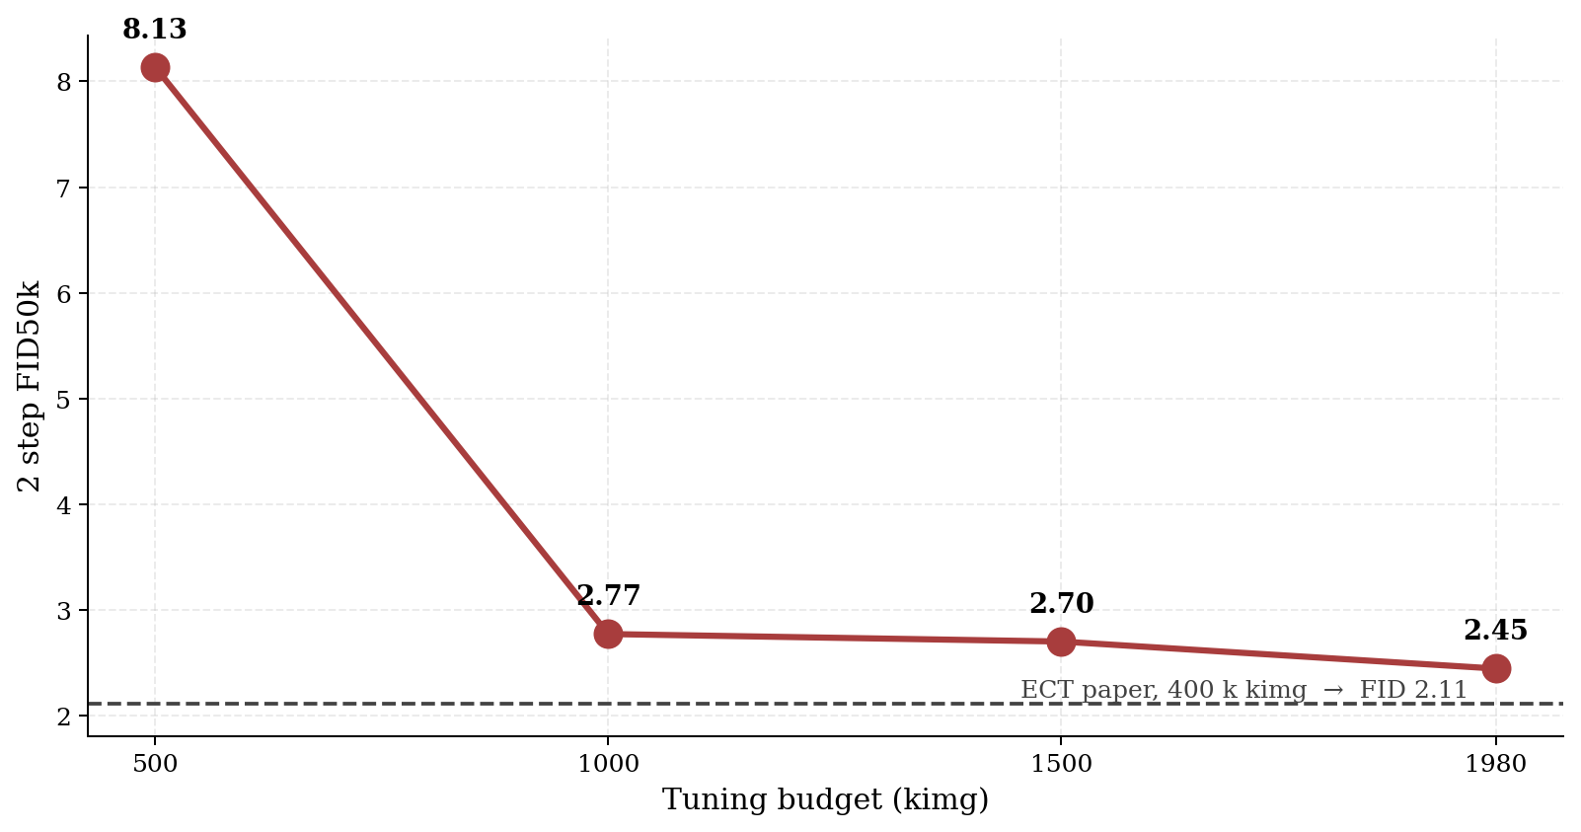
Tuning budget ablation
• 94 % of paper reported quality at 0.5 % of the paper’s training budget.
• Diminishing returns past 1000 kimg → early stopping recipe is realistic.
• Break even vs Heun 18 · N* ≈ 23.5 k images (batch 1) before tuning amortises.
6 / 10

Slide 7
The real open problem
• As we characterised 2 step behaviour across our 4 checkpoints, every result rested on a single hidden parameter: a midpoint at 0.821, fixed across all training stages and step budgets.
“It’s a very good question and I think also an open research problem. I don’t have a manual for it. You can treat it as an optimization problem, maximizing sample quality with respect to these sampling schedules.”
Zhengyang Geng, ECT first author
• No derivation in ECT [Geng+ 2025], sCM [Karras+ 2024], or Multistep CM [Heek+ 2024].
• Heuristic timestep selection exists [TDD, Wang+ 2024], but principled KLUB-based optimization for consistency models does not.
• Align Your Steps [Sabour+ 2024] solves it for diffusion only — we adapt the KL upper bound to the consistency flow map.
7 / 10

Slide 8
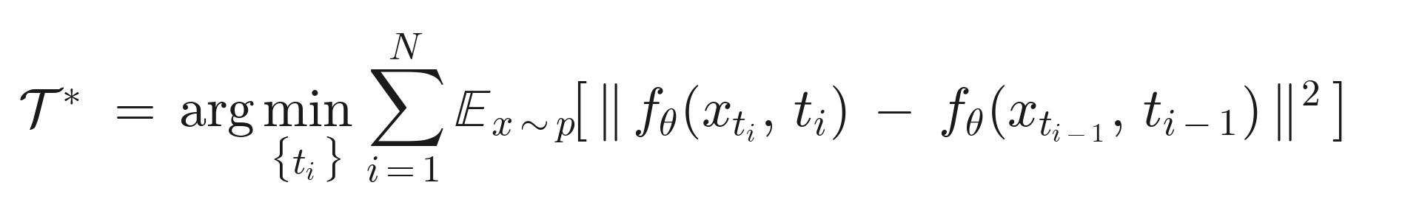
Our method · KLUB CM schedule
Re-derive the Align Your Steps KL upper bound for the consistency function, not the score field.
Inspiration: KL upper bound [Sabour+ 2024] · trajectory awareness [Kim+ 2024, CTM] · adaptive schedules [OSS, 2025]
• Linearise the flow map (not the score) at chosen knots; the KLUB upper bounds the discretisation error.
• Schedule is checkpoint conditioned → drifts with model quality, unlike a fixed magic number.
• Predicted impact: pushes ECT operating points further left on the Pareto frontier; generalises to unseen step budgets without retraining.
8 / 10

Slide 9
Implementation · what we are coding
• KLUB derivation for the CM flow map · rederived for the consistency function, not the score field.
• Schedule optimiser · LBFGS over the schedule knots in PyTorch — gradient based, orders of magnitude cheaper than grid search.
• On policy loss patch in training/loss.py · student's own outputs at the chosen midpoint, motivated by exposure bias work [Agarwal+ 2023, GKD].
• Corrected evaluation pipeline · 1 step and 2 step routed to the right sampler.
training/loss.py · on policy schedule aware term (sketch)
x_mid = f_theta(z * t_max, t_max).detach() # student's own coarse output
t_mid = klub_optimiser(checkpoint=ckpt) # KLUB derived knot
L_on = w(t_mid) * d(
f_theta (x_mid + eps * t_mid, t_mid), # on policy input
f_theta_prime(x_mid + eps * r, r), # EMA target
)
L = L_ECT + lam * L_on # original + on policy
9 / 10

Slide 10
Status & next steps
Done
In flight · Up next
• ECT tuning, 4 checkpoints saved.
• Heun baselines @ 5 to 50 steps.
• Latency profiling, B = 1 and B = 64.
• Corrected evaluation pipeline.
• Midpoint grid sweep across all 4 checkpoints.
• KLUB CM derivation + schedule optimiser.
• On policy schedule aware fine tune (stretch).
• Final report · early June.
Risk · GPU time on Colab; mitigated by small checkpoint footprint and 10k sample screening for the sweep.
10 / 10

