Slide 2
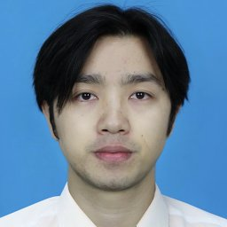
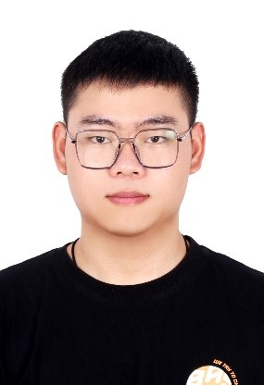


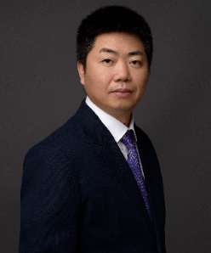
PRIVATE INVESTIGATOR
The Team Behind SQ-GAN
One university, two labs, three academic generations
Wang
Lan
Zhou
Tian
Lv
Academic lineage
Two labs
Zhang Yi (IEEE Fellow, MachineILab 2008)
→ Jiancheng Lv (now Dean, DICALab)
→ Wang, Lan, Tian
MachineILab: neural networks, ML, medical imaging
DICALab: industrial AI, image generation
Includes nuclear-industry applications

Slide 3
PRIVATE INVESTIGATOR
Jian Wang — First Author
His PhD thesis title is the paper's problem statement
PhD student at SCU (2021–present)
All degrees from SCU: BSc 2013, MSc 2017, PhD 2021
Advisor: Prof. Jiancheng Lv
PhD thesis title
“Small-sample image generation via adversarial networks”
小样本图像生成的对抗网络方法
This matches SQ-GAN's problem statement almost word for word.
SQ-GAN is not a side project. It is his thesis.
jianwang.scu@gmail.com | github.com/jianwang-scu | ~87 citations

Slide 4
PRIVATE INVESTIGATOR
Wang's Research Arc
A PhD built on one problem
2020
Abstract painting generation
2021
FusionGAN (abstract paintings)
2022
CR-GAN: craniofacial reconstruction
2024
SLIT: image translation [TNNLS]
2024
MS3D: discriminator fix [ICML, 1st author]
2025
SQ-GAN: style quantization [CVPR, co-1st]
2025
ICCR-Diff: craniofacial + diffusion
painting → faces → translation → limited-data GANs

Slide 5
PRIVATE INVESTIGATOR
Two Papers, One Strategy
Same team, both sides of the same problem
MS3D — ICML 2024
SQ-GAN — CVPR 2025
Wang, Lan, Tian, Lv (no Zhou)
Fixed the discriminator side
RG flow-based gradient regularization
Wang, Lan, Zhou, Tian, Lv (Zhou joins)
Fixed the generator side
Style quantization + codebook + CLIP
Developed in parallel during 2024.
MS3D on arXiv Aug 2024, SQ-GAN submitted to CVPR Nov 2024.

Slide 6
PRIVATE INVESTIGATOR
The Supporting Cast
Xin Lan
Jizhe Zhou
MSc student, co-first, corresponding author
ICML + CVPR co-first as a master's student
Handled reviewer correspondence
Assoc. Prof, tenured 2025
All degrees from Univ. of Macau
CUHK + Yonsei (Korea) experience
"generation & anti-generation"
Yuxin Tian
Jiancheng Lv
PhD student, now at Ant Group
Alibaba DAMO 2022, Ant Group 2024
Focus: continual learning, LLMs
Dean of CS, PI
12,000 citations, h-index 48
Runs both labs

Slide 7
PRIVATE INVESTIGATOR
Jiancheng Lv — Principal Investigator
Full Professor, Dean of CS + Intelligence Science at SCU
PhD from UESTC (2006), advisor: Zhang Yi (IEEE Fellow)
Postdoc at NUS Singapore (2007-08)
Worked at ZTE Corporation before academia
Numbers
~12,000 citations, h-index ~48
375+ publications
Natl Science Fund for Distinguished Young Scholars
2nd Prize, National Natural Science Award (2020)
Notable
Alumni: Dayiheng Liu → Alibaba DAMO, core of Qwen LLM
Co-authored "Subspace Learning of Neural Networks" (CRC Press)

Slide 8
PRIVATE INVESTIGATOR
Why This Problem? Why This Lab?
Lab applications
Funding
Craniofacial reconstruction (CR-GAN)
Dental identification (DHI-GAN)
Boneprint person ID
Nuclear-industry AI
NSFC Major Instruments Grant
Sichuan Province Research Groups Fund
Central Universities Fund
Institutionally funded.
Broader context
China's PIPL (Nov 2021): restricts
biometric/medical data collection
Copyright limits training data
Industrial and medical focus makes limited-data training a daily reality.

Slide 9
PRIVATE INVESTIGATOR
Summary
SQ-GAN is the latest output of Jian Wang's PhD thesis.
His thesis title matches the paper's problem statement word for word.
Two-paper arc: MS3D fixed the discriminator, SQ-GAN fixed the generator.
Systematic strategy, not accidental.
Xin Lan: MSc student with ICML + CVPR in consecutive years.
Jizhe Zhou joined for SQ-GAN, bringing forensics expertise.
The lab's industrial focus (nuclear, medical, forensic) makes
limited-data training a real need, not just a research trend.
Three academic generations, two labs, one sustained program.

