Slide 1


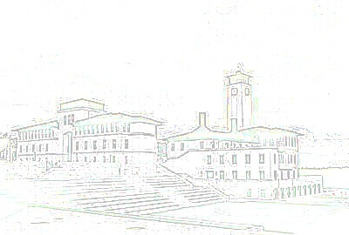

Project Title
Name of student(s)
Advisor: Name of advisor(s)
Department of Computer Engineering
Koç University
Project Description / Objectives
Put your group photo (containing all members) here.
Put your QR Code here (right side of the photo).
State project definition and scope.
State objectives of the project.
Support your statements with visuals.
Put all the text content as bullet items.
Methods
Describe the methods used and challenges that you have encountered.
Support methodology statements with visuals.
Do not add figures from other papers. If you have to, please cite them.
System Design
Describe the system design and main parts of your project.
Support your description with system design figures (e.g. UML, ERD, Algorithms, Flowcharts).
Results
State project achievements and results.
State project deliverables.
State the future works.
System Architecture
Describe the system architecture.
Provide visuals that describe the system components and relations among them.
Acknowledgement
References
Pay Attention to use IEEE format for references: https://ieee-dataport.org/sites/default/files/analysis/27/IEEE%20Citation%20Guidelines.pdf

