Slide 1

FPGA-Based Morse Code Communication System
CE436 – Digital System Design | Complex Engineering Problem (CEP)
Platform: Digilent Nexys A7 (100 MHz FPGA)
Ahmad Mir 2022062
Abubakar Mazhar 2022039
Aqeeb Warriach 2022349

Slide 2
Project Objectives and Scope
Core Functionality
Operational Modes
Design an FPGA-based system to accurately encode decimal digits (0–9) into standard Morse code elements.
Implement support for single-digit transmission utilizing on-board switches and buttons.
Timing Fidelity
Hardware Target
Achieve precise, real-time timing control and sequencing, leveraging the 100 MHz FPGA clock source for maximum accuracy.
Ensure successful synthesis, mapping, and physical implementation on the Digilent Nexys A7 FPGA development board.

Slide 3

Design Methodology: Architecture and Control
FSM-Centric Control
The entire sequencing and timing generation is managed by a central Finite State Machine (FSM).
Decoupled control logic facilitates modular testing and verification.
Deterministic timing is derived from the master 100 MHz clock using counter logic.
Modular RTL Design
Each functional block (Debouncer, FIFO, FSM, Timing) was implemented as a separate, verifiable RTL module.
Used VHDL/Verilog for hardware description, ensuring optimized resource utilization on the A7 FPGA.

Slide 4

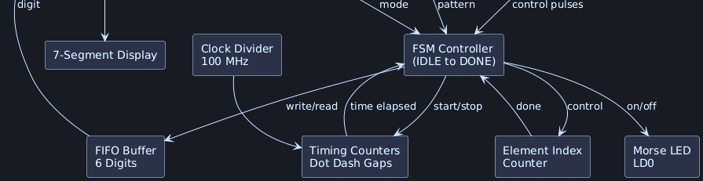
System Architecture: Block Diagram
The system is comprised of six primary modules, ensuring robust input handling, deterministic encoding, and precise output signaling.
Input
Preprocessing
Switches & Buttons
Debounce & FIFO
Core Logic
Output
Morse LUT & FSM
LED & 7-Segment

Slide 5








FSM and Deterministic Timing Control
Finite State Machine (FSM) States
Timing Rules (Unit Time 't' = 0.5s)
IDLE
Awaiting input trigger.
Dot Duration
FETCH_DIGIT
2t (1.0 second)
Retrieving next digit from FIFO.
LOAD_PATTERN
Accessing Morse pattern via LUT.
Dash Duration
6t (3.0 seconds)
SEND_ELEMENT
Active transmission (Dot/Dash).
ELEMENT_GAP
Element Gap
Short pause between elements.
1t (0.5 second)
DIGIT_GAP
Longer pause between digits.
Digit Gap
DONE
4t (2.0 seconds)
Transmission complete.
These rules are strictly based on standard Morse code conventions, with timing scaled for visual clarity.

Slide 6
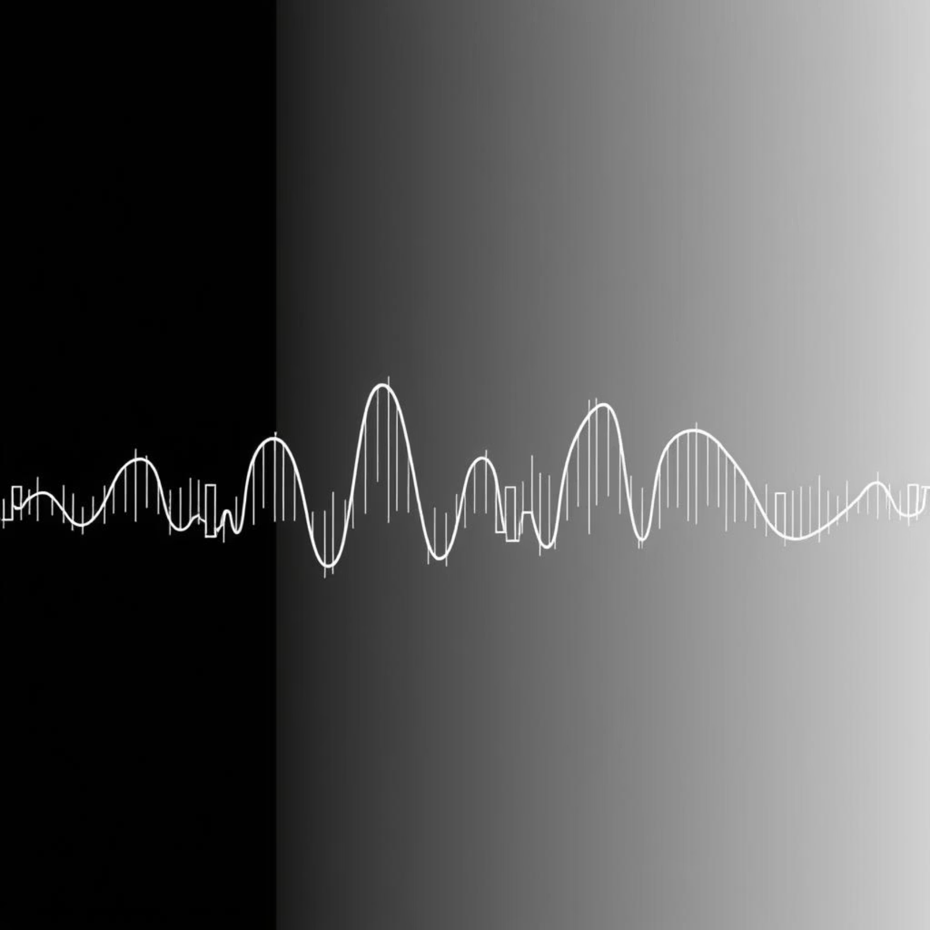
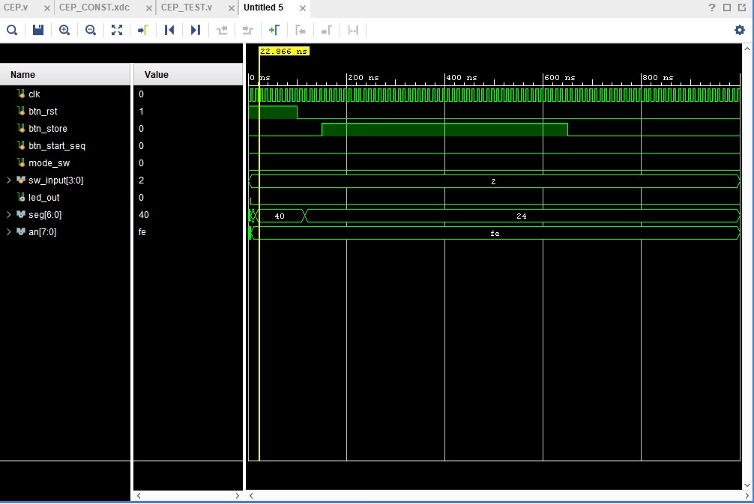

Verification: Simulation Results
Extensive simulation was performed to ensure precise FSM sequencing and accurate timing before hardware synthesis.
Testbench Strategy
Verified single-digit FSM flow, confirming 1:3 ratio for Dot:Dash durations.
Multi-digit verification confirmed FIFO handling and correct sequencing of Digit Gap between transmissions.
Accelerated simulation timing (reduced clock speed) was used to compress waveform visualization.
Simulation Waveforms :
The clock, FSM state transitions,
and LED output signal can be seen
demonstrating the correct timing sequence.

Slide 7
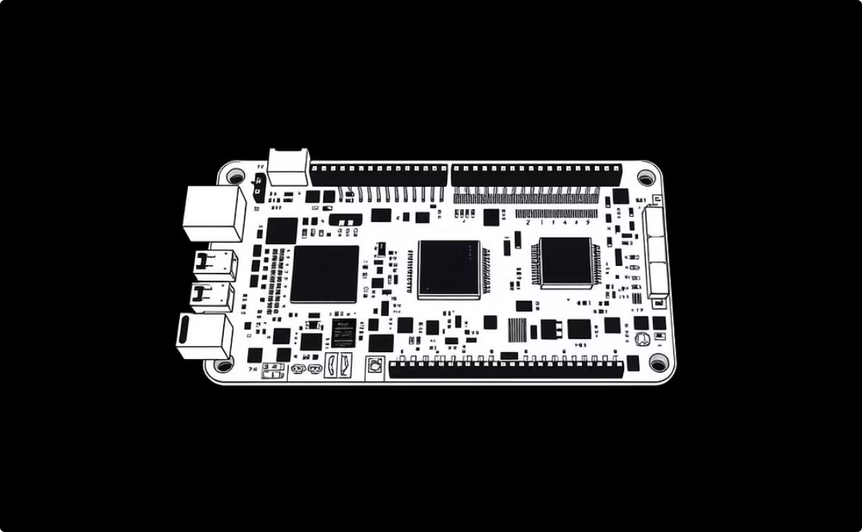
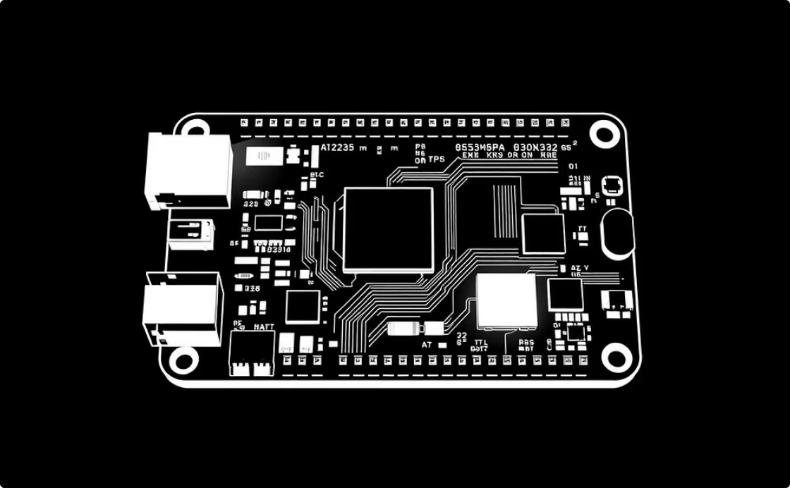
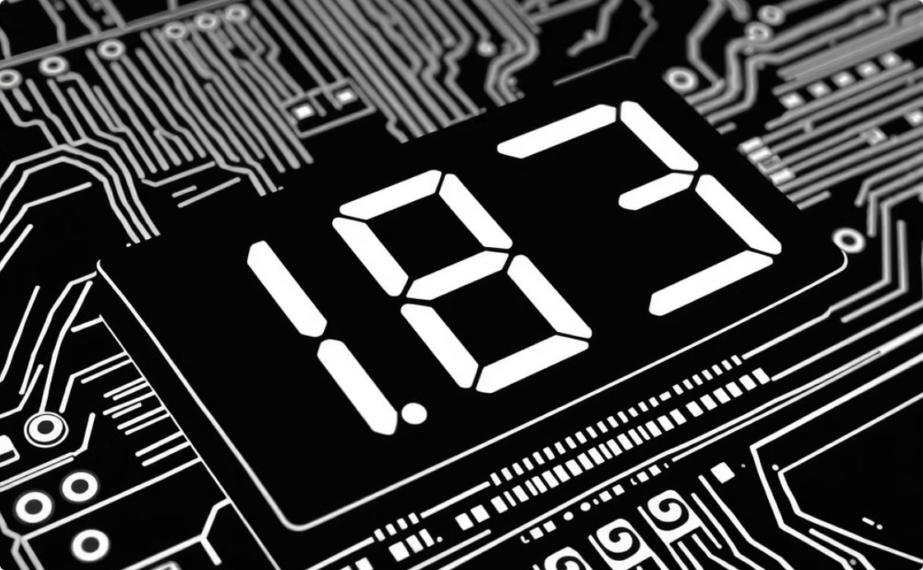
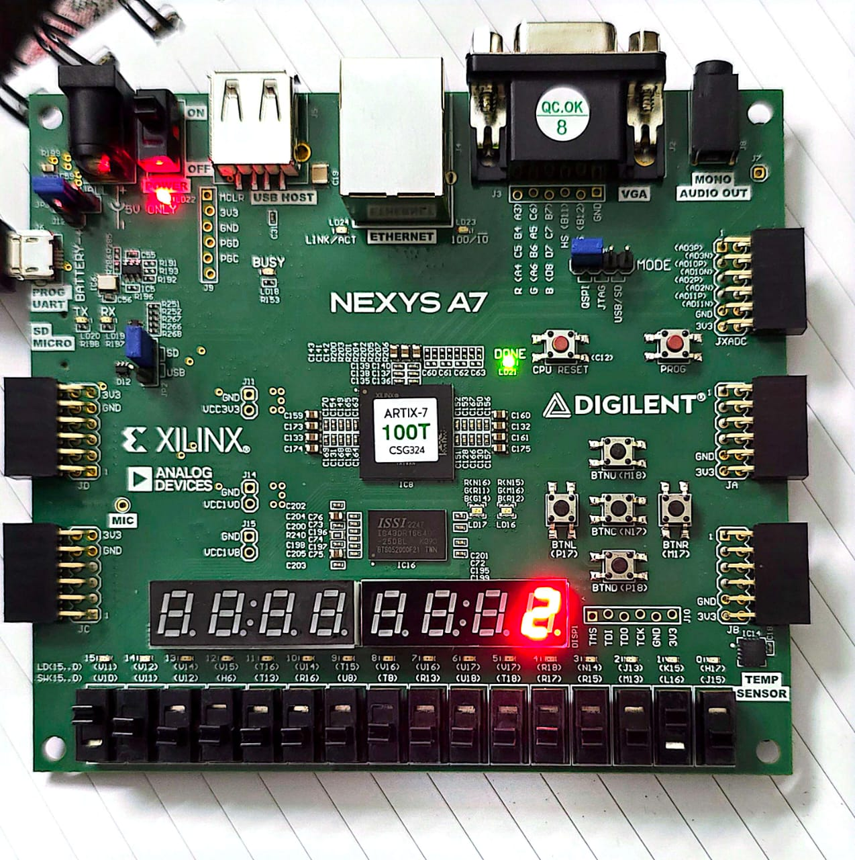
Hardware Implementation and Results
The synthesized design was successfully deployed to the Nexys A7, validating the real-world performance of the system.
Successful Synthesis
Real-Time Operation
Interface Validation
The design met all timing constraints and utilized resources efficiently, confirming RTL quality.
Observed LED output timing confirmed simulation results, demonstrating accurate real-time response to input changes.
Physical input from switches and buttons was robustly handled by the debouncer module.
Explicit Placeholder for FPGA Board Photos
Photos should showcase the Nexys A7 board with visible connections and the output LEDs/7-segment display.

Slide 8
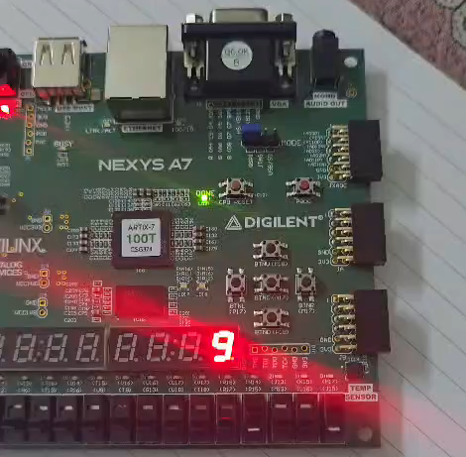
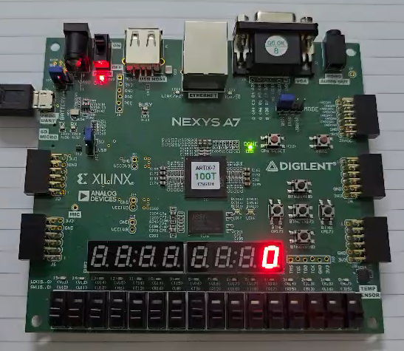

Live FPGA Demonstration
The following demonstration showcases the system's core functionality, highlighting robust input handling and accurate Morse output timing.
Live Demo / Video Placeholder
Test 1: Single Digit
Test 2: Multi-Digit Mode
Entering a digit (e.g., '0') and verifying the 5-dash sequence.
Entering a number (e.g., '42') and observing the correct digit spacing.

Slide 9




Challenges and Engineering Lessons Learned
The project provided critical experience in bridging theoretical digital design with practical hardware constraints.
Precise Timing Control
Asynchronous Inputs
Mastering clock division techniques to derive multi-second timing from a 100 MHz source was the key challenge.
Understanding the necessity of synchronization and debouncing circuits for reliable interaction with physical buttons and switches.
FSM Sequencing
Modular Design Value
Implementing robust state transitions to handle the varying length of Morse patterns and multi-digit sequencing proved complex but rewarding.
Confirmed that well-defined RTL modules significantly simplify verification, integration, and debugging in a large system.

Slide 10

Conclusion and Future Work
We successfully implemented a fully functional, robust, and accurate FPGA-based Morse code encoder, meeting all CEP requirements.
Project Summary
Next Steps: Expanding Capability
Achieved accurate, deterministic timing behavior.
Full Alphabetical Support
Validated design via comprehensive simulation and successful hardware deployment.
Extend the Morse LUT and FSM to include letters (A-Z) and punctuation.
Demonstrated strong alignment with CEP objectives through complex system integration.
Alternative Outputs
Implement Audio tone generation or UART transmission capability.
Wireless Communication
Integrate a transmission module (e.g., XBee) for short-range wireless Morse broadcasting.

