Slide 1
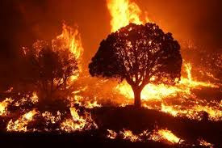
AUTOMATED SATELLITE-BASED
WILDFIRE DETECTION USING DEEP LEARNING

Slide 2
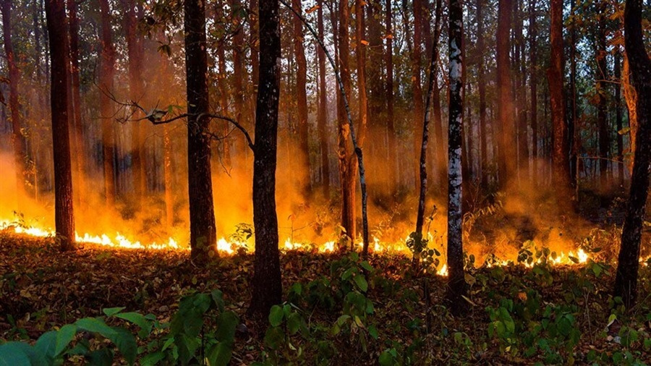
Introduction
2
Climate change has driven a concerning rise in the frequency and severity of wildfires, resulting in irreversible ecological harm and annual economic losses surpassing billions of dollars. Conventional detection approaches—such as ground-based sensors and manual patrols—struggle with scalability and real-time monitoring limitations.
Satellite remote sensing, leveraging platforms like Moderate Resolution Imaging Spectroradiometer (MODIS) and Sentinel-2, provides a promising alternative by delivering high-resolution thermal and optical imagery for fire surveillance. Breakthroughs in deep learning, including convolutional neural networks (CNNs) and image segmentation models, highlight transformative potential for automating wildfire detection systems. Despite progress, critical challenges remain: the scarcity of real-time detection frameworks, underutilized fusion of multimodal data sources, and gaps in adapting models to diverse geographic regions

Slide 3



Objectives
3
Classification and Segmentation
Data Collection
Time Series Model
Use Google Earth Engine (GEE) to access and process satellite data.
Train CNNs (ResNet, EfficientNet) or U-Net for image classification/segmentation.
Develope Time-Series Model For Predicting Fire Spread

Slide 4
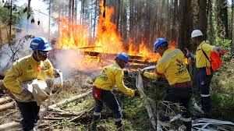
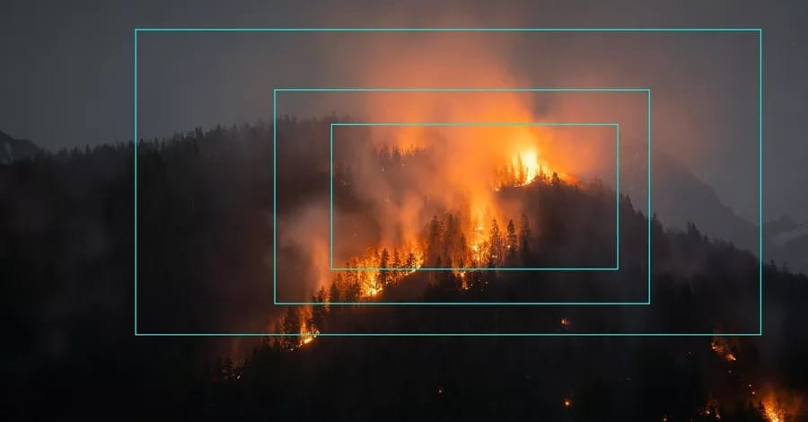
Significance
4
Key Impact
This project bridges critical gaps in wildfire management by enabling early detection and real-time monitoring. The integration of satellite data and deep learning reduces reliance on delayed manual methods, improving emergency response efficiency. The framework’s scalability allows adaptation to other disasters (e.g., floods, hurricanes), offering policymakers and environmental agencies a versatile tool for disaster mitigation.

Slide 5




Methodologies
5
Data Collection
Model Training
The project will focus on the California Wildfire Zone as the Area of Interest (AOI), leveraging a combination of satellite data and labeled datasets for accurate wildfire detection and prediction.
Three distinct models will be made to address different aspects of wildfire detection and prediction, Classification, Segmentation and Time Series Prediction
Model Testing/Evaluation
Preprocessing
Downloaded satelite images will be used for testing.
·Accuracy, Precision, Recall, F1-score to evaluate the classification model.
·Intersection over Union (IoU), Dice coefficient to evaluate the segmentation.
·Root Mean Squared Error (RMSE) to evaluate the time-series prediction.
Raw satellite data will be converted to Geographic Tagged Image File Format (GeoTIFF)/Portable Network Graphic (PNG) format.
·Infrared bands (Shortwave Infrared, Near-Infrared) will be extracted to isolate fire hotspots.
Application of spatial alignment and image augmentation

Slide 6
Future Work
6
The system will be further optimized for scalability and efficiency
Successful
project
A Flask or Streamlit dashboard will be developed to visualize fire locations and trends, offering a user-friendly interface for real-time monitoring.
Automated alerts, fire risk predictions, and enhanced mapping features can also be incorporated.

Slide 7
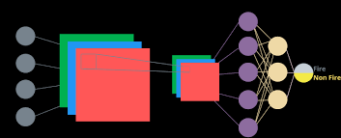
Models
7
CNN
A Convolutional Neural Network (CNN) is a deep learning architecture designed for processing grid-like data, such as images.
Architectures like ResNet and EfficientNet will be use for the classification

Slide 8
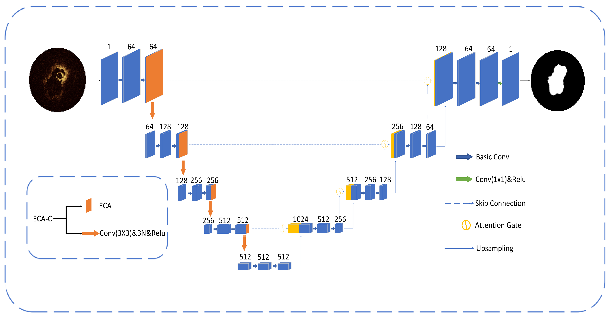
Models
7
U-net
U-Net is a convolutional neural network (CNN) architecture designed for image segmentation tasks, particularly in medical and satellite imaging. It follows a U-shaped structure with a contracting path (encoder) that extracts features and a symmetric expanding path (decoder) that reconstructs spatial information.

Slide 9

Models
7
TimeGPT
TimeGPT is a transformer-based time-series forecasting model designed to handle complex temporal dependencies across various data domains, it leverages self-attention mechanisms to capture long-term dependencies efficiently.

Slide 10
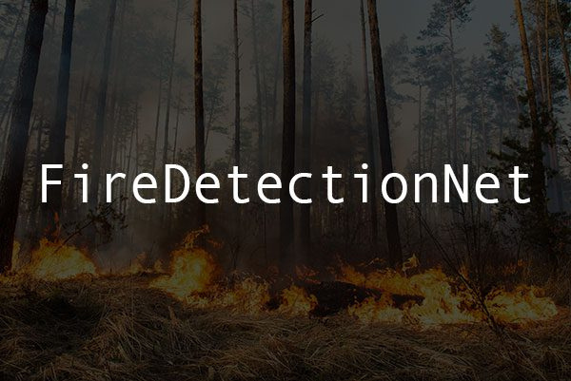
Summary
10
This project proposes a deep learning framework for automated wildfire detection using Moderate Resolution Imaging Spectroradiometer (MODIS) and Sentinel-2 satellite data. By combining CNNs, U-Net, and Transformers, the system aims to achieve high accuracy in fire detection, segmentation, and spread prediction. Outcomes include a real-time monitoring tool and actionable insights for disaster

Slide 11

THANK
YOU

