Slide 1
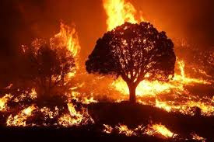
AUTOMATED SATELLITE-BASED
WILDFIRE DETECTION USING DEEP LEARNING
Progress Report on Data Collection, Preprocessing, and Challenges

Slide 2
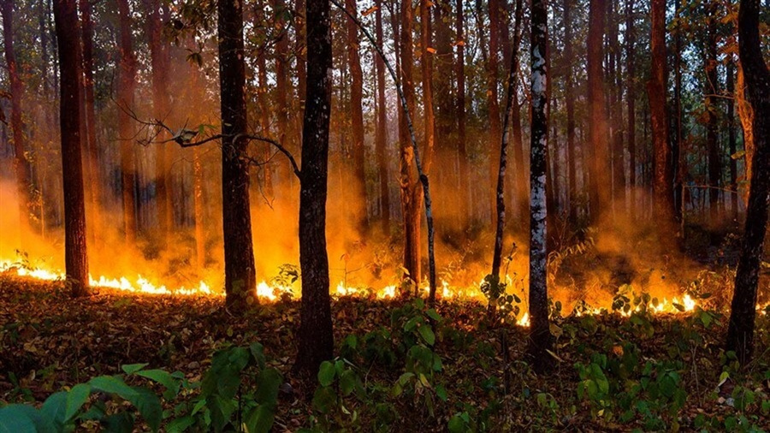
Data Collection
2
For the fire detection, two datasets are being be used
MODIS (Moderate Resolution Imaging Spectroradiometer)
Sentinel2

Slide 3
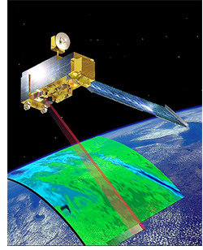
MODIS
4
MODIS is an instrument on NASA's Terra and Aqua satellites, which observe the entire Earth every 1–2 days in 36 spectral bands. Terra passes the equator in the morning, while Aqua crosses in the afternoon. MODIS data help monitor global processes on land, oceans, and the atmosphere, improving climate models and supporting environmental policy decisions.

Slide 4
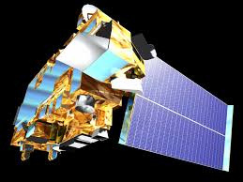
MODIS data
4
For this project, MOD14A1
will be used
Role: Detects thermal anomalies (fire hotspots).
Resolution: 1km (daily data).
Key Band: FireMask (confidence levels 0–9).

Slide 5
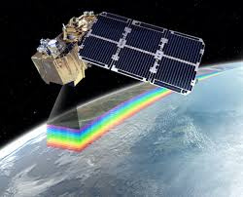
Sentinel 2
4
Sentinel-2 (S2) is a wide-swath, high-resolution, multispectral imaging mission with a global 5-day revisit frequency. The S2 Multispectral Instrument (MSI) samples 13 spectral bands: visible and NIR at 10 meters, red edge and SWIR at 20 meters, and atmospheric bands at 60 meters spatial resolution. It provides data suitable for assessing state and change of vegetation, soil, and water cover.

Slide 6
Sentinel 2 data
4
COPERNICUS/S2_SR_HARMONIZED will be used for the project.
Role: Provides high-resolution (10–20m) optical imagery.
Bands Used:
B4 (Red), B8 (NIR), B12 (SWIR) for fire signatures.
QA60: Legacy cloud masking (for bitwise operations).

Slide 7




Preprocessing Workflow
5
Cloud Masking
Spatial Resampling
Sentinel-2: Mask opaque clouds/cirrus using QA60 (bit 10/11).
MODIS: Directly use FireMask
Resample MODIS (1km) to Sentinel-2 resolution (10m).
Data Export
Temporal Alignment
Export aligned samples as TensorFlow Records to Google Cloud Storage (GCS)
Join MODIS and Sentinel-2 data within ±2-day windows.

Slide 8

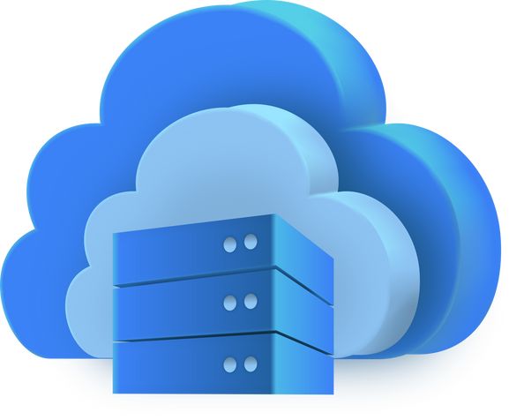

Objectives
3
Integration
Scalability
Cost Efficiency and Real-Time Access
Handle large-scale satellite data (~TB) without local storage.
Seamless pipeline from Google Earth Engine(GEE) → GOogle Cloud Storage (GCS) → TensorFlow.
Stream data directly to training pipelines with Pay-as-you-go model for storage/compute.

Slide 9
Key Challenges
6
Failed Data Export (20-byte TFRecord)
Issues
Debugging Complexity
Limited visibility into Earth Engine’s backend.
Export tasks queue for hours before failing.

Slide 10
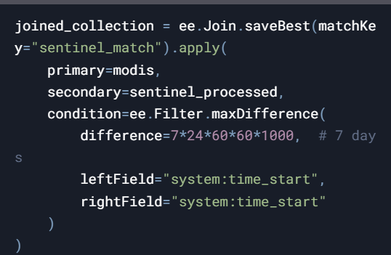
Plan of Action
6
Check MODIS/Sentinel-2 date lists for overlap.
Use saveBest join with a 7-day window.
Debugging Complexity
Limited visibility into Earth Engine’s backend.
Export tasks queue for hours before failing.

Slide 11

THANK
YOU

