Slide 1
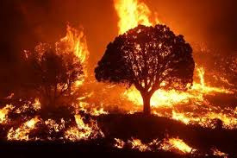
AUTOMATED SATELLITE-BASED
WILDFIRE DETECTION USING DEEP LEARNING
Progress Report on Data Collection, Preprocessing, and Model Developement

Slide 2
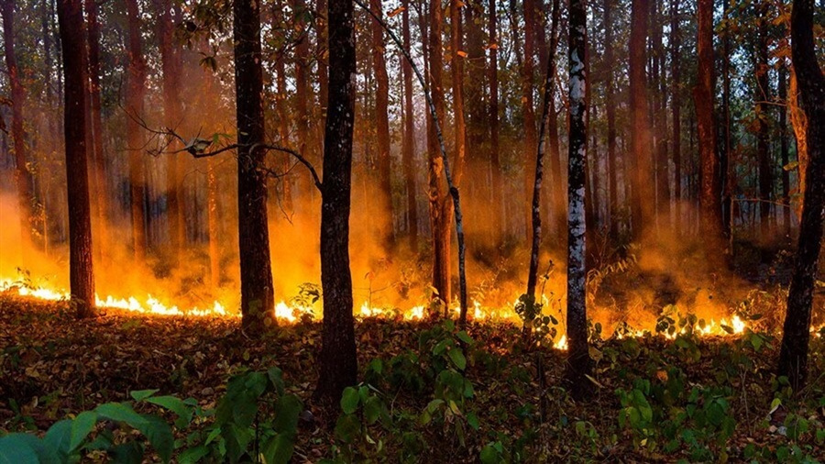
Data Collection
2
Due to previous challenges such as failed exports and debugging complexity, a different approach has been used to collect the data.
Fire Information for Resource Management System (FIRMS) will be used.

Slide 3

FIRMS
4
The Fire Information for Resource Management System (FIRMS) is a platform developed by NASA to provide near real-time active fire data to natural resource managers and the public. Utilizing satellite observations from the Moderate Resolution Imaging Spectroradiometer (MODIS) and the Visible Infrared Imaging Radiometer Suite (VIIRS), FIRMS delivers active fire locations globally within approximately three hours of satellite observation.

Slide 4
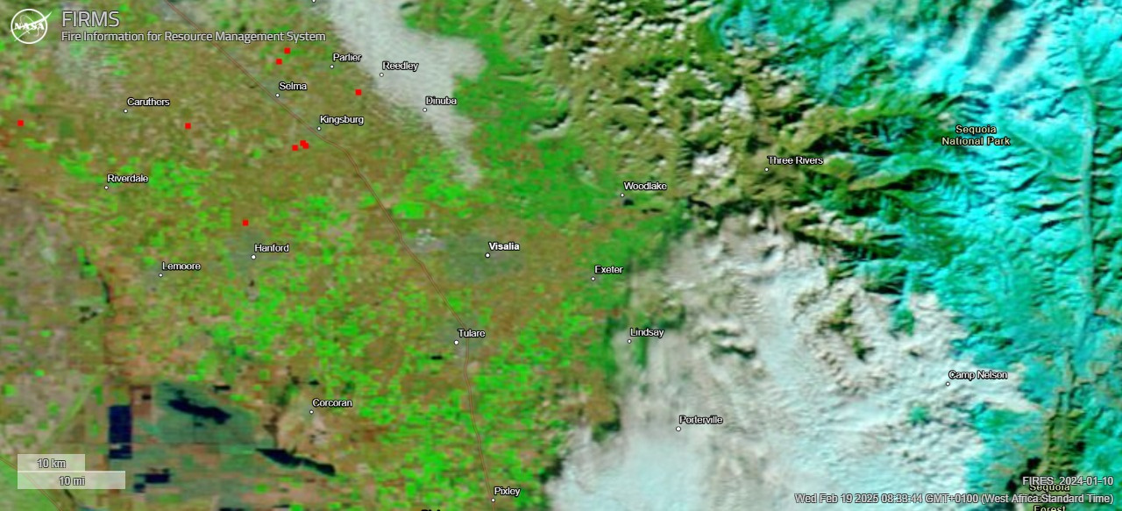
Sample Data
4
Satelitte Data
Data covers California Area
Each red spot represents fire/hotspots picked up by all three FIRMS satelitte
MODIS/Terra is used over as dynamic image to check reflectance of vegetation and burned areas.

Slide 5
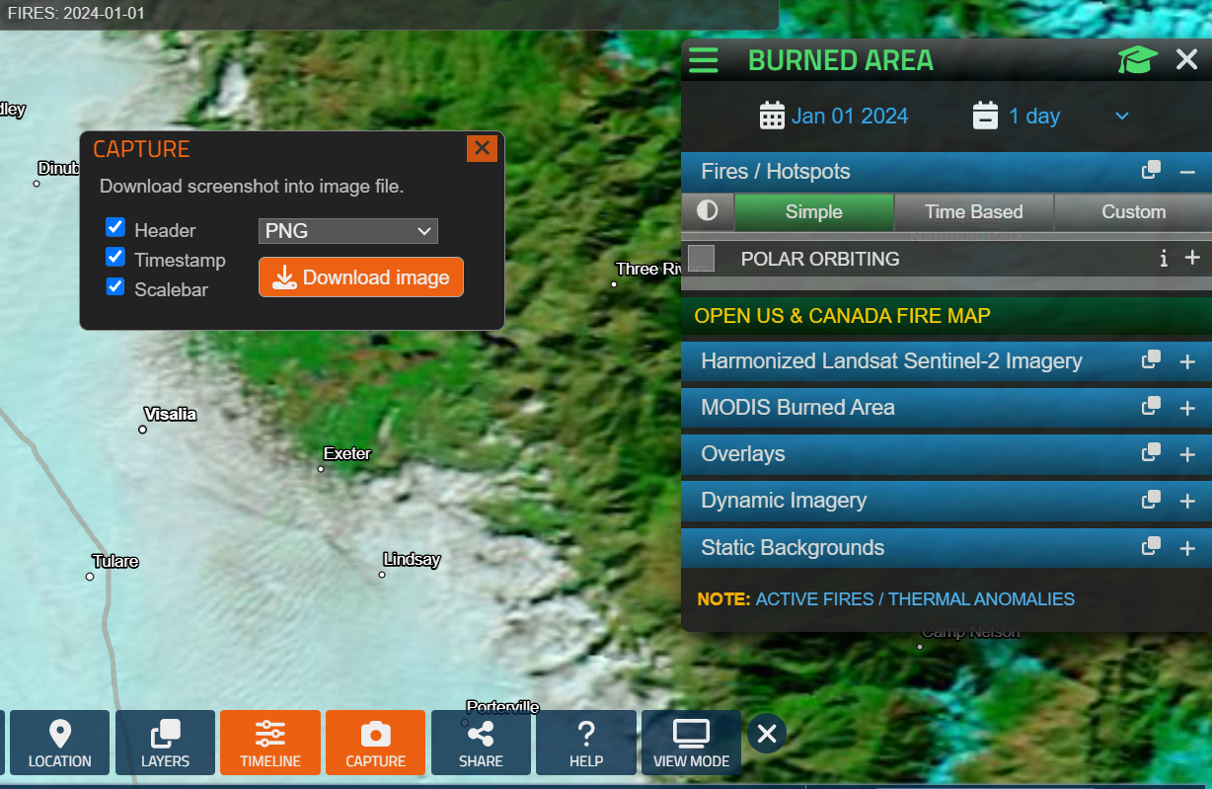
Data Timeline
4
Image captured covers a one day range for a period of 1 year (2024 - 2025).
These images are captured as a PNG file and saved Locally for Model Training.
Folder structure:
data/
├── fire/ # Images with ≥1 hotspot
└── no_fire/ # Images with 0 hotspots

Slide 6
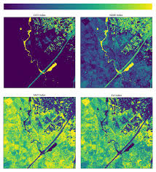
Model Development
4
Segmentation Model (U-Net)
Goal: Pixel-wise fire localization.
Input: Satellite image.
Output: Binary mask (fire regions = 1).
Loss: Dice Loss (handles class imbalance).

Slide 7
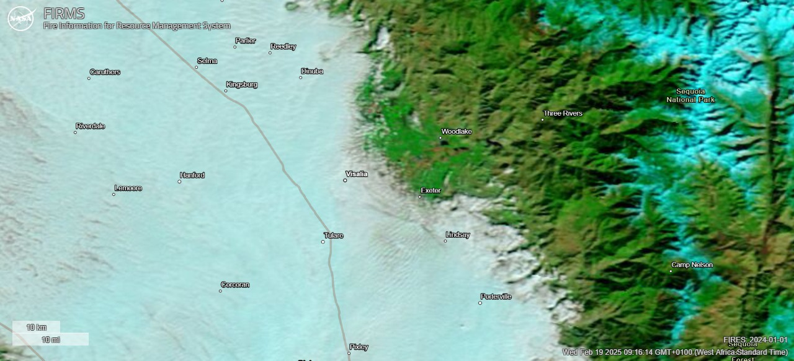
Model Development
4
Classification Model (Fire vs. No-Fire)
Architecture: Transfer learning with EfficientNet (pre-trained on ImageNet).
Input: 256x256x3 PNG images.
Output: Binary label (0/1).
Metrics: Precision, Recall, F1-Score.

Slide 8
Next Steps
6
Model Evaluation and Optimization
Issues
Developement of the forecasting model

Slide 9

THANK
YOU

