Slide 1

Hybrid CNN – LSTM – SVM model for advanced brain tumor classification
Final Review — DL Tumor Classification
Five backbones · leakage audit · frozen external validation · web stress test · explainability
RegNo & Name: 127018005 Akash A
127018017 Harish R
127018045 Pranav S
Guide
M. Rajakumaran /SoC
*
1
Notes:
Read the title. This is our final review of a four-class brain MRI classification project built on the 2026 Springer hybrid CNN + LSTM + SVM paper. Introduce the team, register numbers and guide. One-line framing: we implemented the hybrid model for five backbones, and then tested how far its very high public-dataset accuracy can be trusted — through a leakage audit, frozen external validation, a web stress test and explainability.

Slide 2
Index
Final Project Overview
Motivation
Base Paper & Reported Result
Literature Gaps → Our Response
Problem Statement & Objectives
Roadmap vs Final Status
Final Architecture
Dataset · Preprocessing & Split
Implementation Journey
Phase 1: Baseline & Neural Head
PCA + SVM Comparison
Duplicate / Leakage Audit
Leakage-Aware Evaluation
Phase 2A: 30-Epoch Protocol
Phase 2B: Hyperparameter Sensitivity
Frozen 15-Pipeline Protocol
BDNeuro Audit & Clean Cohort
BDNeuro External Results
Web-40 Stress Test
Cross-Domain Progression
Final Selected Model
Grad-CAM · Final-SVM Occlusion
Streamlit Prototype
Findings · Limitations · Conclusion
References · Backup Slides
*
2
Notes:
Agenda in one breath: motivation and base paper; problem and objectives; the roadmap and what was completed; architecture and data; Phase 1; the leakage audit; Phase 2A and 2B; external validation on BDNeuro and the web stress test; final model; explainability; prototype; findings, limitations and conclusion.

Slide 3
Final Project Overview
What we built — and what we found
Built
• Hybrid CNN → LSTM → Dense128 → Scaler → PCA64 → linear SVM
• 5 independent backbones (VGG16/19, ResNet50/152, EfficientNet-B3)
• Phase 1, 2A (5 runs), 2B (35 runs + 70 downstream evals)
• Leakage audit of 7,023 images
• 15 pipelines frozen + SHA-256 hashed
• BDNeuro external (2,644) + web stress test (40)
• Grad-CAM, final-SVM occlusion, Streamlit prototype
Final representative: ResNet152 Phase 2A (epoch 10)
Evaluation | Accuracy
Internal validation | 98.60%
Internal test* | 98.70%
material_clean test* | 98.869%
BDNeuro full (2,644) | 88.31%
BDNeuro balanced (1,648) | 90.47%
Web-40 stress test | 37.5%
* original split, later shown to contain duplicate leakage
High internal accuracy ≠ robustness to domain shift
*
3
Notes:
This is the whole project on one slide. Left: what was built — five independent hybrid pipelines, all six roadmap phases complete, plus a web stress test beyond the plan. Right: the key numbers for our final representative across progressively harder evaluations. The message to land: internal accuracy is about 99%, structured external about 88%, and heterogeneous web images about 38%. The central finding is that high public-dataset accuracy does not guarantee robust out-of-distribution performance. Likely question: 'So is the model good or bad?' Answer: strong within its training distribution and on a structured external dataset; not robust to severe domain shift.

Slide 4
Introduction & Motivation
• Glioma, meningioma and pituitary tumours are frequent brain tumours; accurate identification supports treatment planning.
• Manual MRI reading is time-consuming, expert-dependent and subject to inter-observer variability.
• Deep learning reports ~98–99% accuracy on public brain-MRI datasets.
• But high accuracy alone does not establish reliability — data leakage, dataset shift and model opacity must be examined.
• Our final project examined all three — and all three changed the interpretation.
Glioma
Meningioma
No Tumour
Pituitary
*
4
Notes:
Clinical context first: these tumour types are common, and MRI reading is expert-dependent and time-consuming. Technical context second: deep models report very high accuracy on public datasets — so the interesting question is how trustworthy that accuracy is. We named three threats at Review-I: data leakage, dataset shift and model opacity. The final project tested all three, and all three turned out to matter.

Slide 5
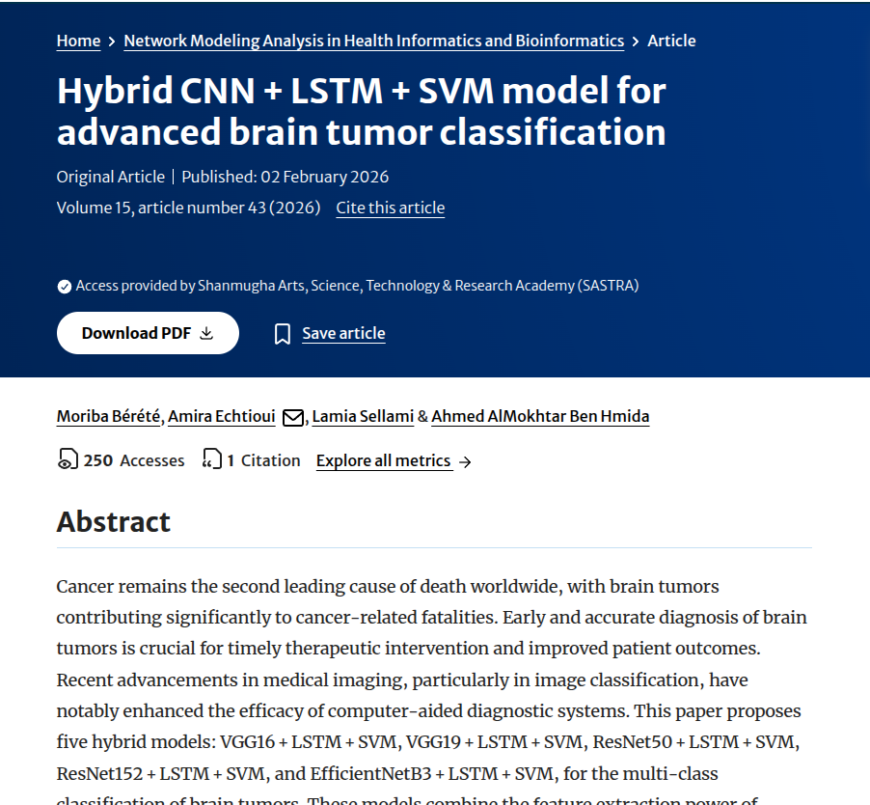
Base Paper
Moriba Bérété, Amira Echtioui, Lamia Sellami & Ahmed AlMokhtar Ben Hmida, “Hybrid CNN+LSTM+SVM model for advanced brain tumor classification”, Network Modeling Analysis in Health Informatics and Bioinformatics, Springer, Volume 15, Article 43, 2026.
DOI: 10.1007/s13721-025-00718-8
Indexed in: Scopus / SCI / SCI-E
Year: 2026
*
5
Notes:
Springer journal, Scopus-indexed, published February 2026 — satisfying the base-paper requirement. It is our methodological anchor. Our implementation is an adapted reconstruction with documented deviations, not an exact replication of every experiment.

Slide 6
Base Paper – Method & Reported Findings
Pretrained CNN backbone
RMSprop results as reported [1, Table 3]
Model (RMSprop) | Accuracy
VGG16 | 94%
VGG19 | 96%
ResNet50 | 99%
ResNet152 | 99%
EfficientNetB3 | 98%
Feature map → sequence
LSTM
BatchNorm → Dropout → Dense
StandardScaler
Protocol (as reported)
5 backbones × 4 optimizers · 30 epochs · batch 32 · LR 1e-4 · dropout 0.3
Not reported: duplicate check · external dataset · implemented XAI
PCA (64)
Linear SVM
*
6
Notes:
Five pipelines, one per backbone, each trained with four optimizers in the paper — twenty configurations. The headline, as reported by the authors, is ResNet152 + LSTM + SVM with RMSprop at 99%. These are the paper's numbers, not ours. Key gaps we noticed: no duplicate check, single dataset, and explainability only mentioned as future work. Viva question: 'Did you reproduce 99%?' — No: our ResNet152 reached 98.40% (Phase 1) and 98.70% (Phase 2A) on the same contaminated split; we explain why later.

Slide 7
Identified Limitations → Our Solution
Limitation identified in literature | Our solution | Phase
High accuracy without duplicate / leakage checks [1] | Cross-split hash + perceptual audit; 3 leakage-aware test policies | 2D ✓
Single-dataset evaluation [1, 9, 12] | 15 frozen pipelines on an overlap-audited external cohort, no tuning | 2C ✓
Early stopping hides convergence | Fixed 30 epochs; best-within-30 and epoch-30 states | 2A ✓
Search-based hyperparameter choice [14] | One-factor study: LR, LSTM size, dropout | 2B ✓
Ensembles / single backbones [11, 13, 15] | Five independent backbones, one protocol | 1, 3 ✓
Grad-CAM cannot explain an SVM [10] | Grad-CAM (neural head) + final-SVM occlusion | 4 ✓
Heatmaps over-read as localization [12] | Rated as coarse contribution maps — no segmentation claim | 4 ✓
(added) Severe domain shift untested | Source-verified web-40 stress test, locked before inference | 2C+ ✓
*
7
Notes:
This closes the literature: each limitation maps to a phase, and every row is now complete. The last row is extra — the web stress test was added beyond the Review-I plan, to test severe domain shift.

Slide 8
Problem Statement & Objectives
To build and rigorously evaluate a hybrid CNN–LSTM–PCA–SVM framework for four-class brain MRI classification, examining backbone choice, training behaviour, data integrity and generalization — as a research framework, not a clinical diagnostic device.
Objective | Where | Status
Reconstruct & adapt the base-paper pipeline (deviations documented) | Ph 1 | ✓ Complete
Compare five backbones under one protocol | Ph 1, 3 | ✓ Complete
Training behaviour & hyperparameter sensitivity | Ph 2A, 2B | ✓ Complete
Verify data integrity; leakage-aware evaluation | Ph 2D | ✓ Complete
Overlap-audited external validation, models frozen | Ph 2C | ✓ Complete
Explainability: Grad-CAM + occlusion | Ph 4 | ✓ Complete
Research & educational prototype | Ph 5 | ✓ Complete
*
8
Notes:
Same problem statement as Review-I — deliberately unchanged. Seven objectives, all met. Emphasize there was never an accuracy target; the aim was a defensible evaluation. Question: 'Why no accuracy target?' Because a target on a leaky public split would reward the wrong thing.

Slide 9
Original Roadmap vs Final Status
PHASE 1 — BASELINE SYSTEM ✓
PHASE 2 — OPTIMISATION & VALIDATION ✓
Brain MRI Dataset
2A 30-Epoch Protocol ✓
2B Hyperparameter Analysis ✓
2C External Validation ✓
Dataset Preparation | Preprocessing
CNN Feature Extractor
2D Data Integrity / Robustness ✓ — leakage audit + 3 test policies
Spatial Feature Sequence
+ Web-40 stress test (beyond plan) ✓
LSTM
PHASE 3 — COMPARATIVE ANALYSIS & FINAL MODEL SELECTION ✓
128-D Deep Features
StandardScaler
PHASE 4 — EXPLAINABILITY (Grad-CAM + occlusion) ✓
PCA (64)
Linear SVM
PHASE 5 — PROTOTYPE APPLICATION ✓
Initial Evaluation + Neural Head
PHASE 6 — FINAL VALIDATION, REPORT & DEMONSTRATION ✓
✓ Completed
Added beyond plan
*
9
Notes:
This is the Review-I master architecture, now with every box complete. Note the order in practice: the data-integrity audit (2D) was run before 2A/2B because it changed how every later number had to be read. The web stress test is extra work beyond the plan.

Slide 10
Final Project Architecture
One independent pipeline per backbone — not an ensemble
Brain MRI
4 classes
Preprocess
RGB · 224×224 · ImageNet norm
Pretrained CNN
VGG16 · VGG19 · ResNet50
ResNet152 · EffNet-B3
Feature map
[B, C, 7, 7]
Spatial → sequence
[B, 49, C]
LSTM (256)
last step [B, 256]
BatchNorm → Dropout 0.3
Dense 128 + ReLU
128-D deep feature
StandardScaler
fit on training only
PCA (64)
fit on training only
Linear SVM (C = 1)
final classifier
Prediction
glioma · meningioma · notumor · pituitary
Neural head (training & comparison): Dense128 → Linear 4 logits · CrossEntropyLoss on raw logits · softmax only at inference. VGG16/19 CNN frozen; ResNet50/152 & EfficientNet-B3 fine-tuned.
*
10
Notes:
Trace the flow. The feature map — 7 by 7 for every backbone at 224 pixels — is flattened into 49 spatial tokens for the LSTM. The LSTM reads spatial positions of one image, not time and not MRI slices. Two branches read the 128-D feature: the neural head, trained with CrossEntropyLoss on raw logits, and the final classifier — StandardScaler, PCA to 64, linear SVM with C equal to 1, all fitted on training features only. VGG backbones are frozen; ResNets and EfficientNet are fine-tuned. Viva questions: 'Why an LSTM on one image?' 'Is softmax used in training?' — No, only at inference. 'Are SVM scores probabilities?' — No: probability=False, we show relative scores.

Slide 11
Dataset, Preprocessing & Split
Class | Training | Testing | Total
Glioma | 1,321 | 300 | 1,621
Meningioma | 1,339 | 306 | 1,645
No tumour | 1,595 | 405 | 2,000
Pituitary | 1,457 | 300 | 1,757
Total | 5,712 | 1,311 | 7,023
Split (seed 42, stratified)
Train 4,569 — fits CNN-LSTM, scaler, PCA, SVM
Validation 1,143 — checkpoint, state & config selection
Test 1,311 — final evaluation only; never used for selection
Every image
RGB conversion · resize 224 × 224 · ImageNet mean/std normalization
Training only (src/data_pipeline_torch.py L65–78)
H-flip p=0.5 · V-flip p=0.5 · ColorJitter(brightness 0.1, contrast 0.2, saturation 0.2, hue 0.1)
Validation / test / features / GUI: deterministic transform
*
11
Notes:
Public Kaggle dataset by Masoud Nickparvar: 7,023 images. We split the supplied Training folder 80/20, stratified, seed 42, and reuse the same saved split for every experiment. The Testing folder is the held-out test set — never used for fitting or selection, and deliberately not evaluated in Phase 2B. Augmentation is verified in source: flips p=0.5 and ColorJitter 0.1/0.2/0.2/0.1 — training only. Caveat to state now: the audit later showed this split is not image-level independent.

Slide 12
Implementation Journey
TensorFlow → PyTorch, then a verified, step-wise build
28 Aug
TensorFlow on RTX 5070 → INVALID_PTX (sm_120); nightly abandoned
→
PyTorch 2.11.0 + cu128 under WSL2; CUDA verified
Late Aug
Seed-42 split saved; RGB · 224 · ImageNet norm; train-only augmentation
Early Sep
Step-wise tests: CNN map → sequence → LSTM → post-LSTM → full model → real batch → training step
Early Sep
First ResNet152 hybrid end-to-end (legacy, superseded)
6–12 Sep
Generic CNNLSTM for 5 backbones; VGG16 collapse (~28% val) → freeze VGG backbones
*
12
Notes:
TensorFlow detected the RTX 5070 GPU but failed on real workloads with INVALID_PTX — Blackwell sm_120 was not supported. A nightly build was tried and abandoned. Lesson: GPU detection is not proof of toolchain compatibility. We moved to PyTorch 2.11 with CUDA 12.8 and built the model in small verified steps before training. The first ResNet152 prototype proved the full hybrid path end to end (around 97.6% test per project notes), then the generic five-backbone framework replaced it. VGG16 collapsed when fully fine-tuned — about 28% validation, which is exactly 'always predict notumor' — so VGG backbones were frozen.

Slide 13
Phase 1 — Baseline Methodology
Backbone | CNN policy | Epochs run / max | Best epoch | PCA variance kept
VGG16 | frozen | 19 / 30 | 16 | 99.18%
VGG19 | frozen | 21 / 30 | 18 | 99.33%
ResNet50 | fine-tuned | 10 / 10 | 7 | 99.45%
ResNet152 | fine-tuned | 10 / 10 | 8 | 99.39%
EfficientNet-B3 | fine-tuned | 9 / 10 | 6 | 99.33%
• RMSprop · LR 1e-4 · batch 8 (drop_last) · LSTM 256 · Dense 128 · dropout 0.3 · seed 42 · CE on raw logits
• Best-validation checkpoint; early stopping patience 3 — unequal budgets (30 vs 10) motivated Phase 2A
• Deterministic 128-D features → StandardScaler → PCA 64 → linear SVM (fit on train only)
*
13
Notes:
Phase 1 trains each backbone with RMSprop at 1e-4, batch 8, seed 42 and keeps the best validation checkpoint with early stopping, patience 3. Be explicit that the epoch budget was not equal: VGG had up to 30 epochs and stopped at 19 and 21; ResNets and EfficientNet had a 10-epoch budget. That unequal horizon is exactly why Phase 2A exists. After training, features are extracted deterministically and the scaler, PCA and SVM are fitted on training features only.

Slide 14
Phase 1 — Neural-Head Results
Before PCA/SVM: the CNN-LSTM's own 4-class head
Backbone | Best epoch | Validation acc | Test acc | Test macro F1
VGG16 | 16 | 94.58% | 93.67% | 93.32%
VGG19 | 18 | 94.58% | 93.14% | 92.72%
ResNet50 | 7 | 97.73% | 97.33% | 97.19%
ResNet152 | 8 | 98.25% | 98.17% | 98.06%
EfficientNet-B3 | 6 | 98.43% | 98.02% | 97.94%
Original 1,311-image test set — later shown to contain duplicate leakage (slide 17).
*
14
Notes:
Each best checkpoint was reloaded and its neural head evaluated deterministically — the test set was never used to select checkpoints. ResNet152 has the highest neural-head test accuracy, with EfficientNet-B3 very close; the gap is a few images and is not a claim of superiority. These are results on the original split.

Slide 15
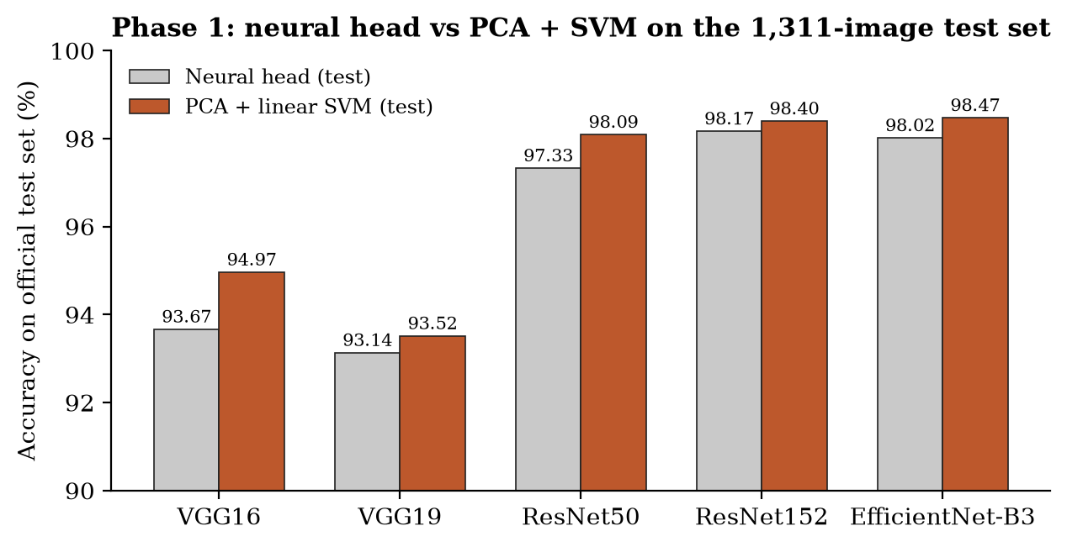
PCA + SVM vs Neural Head
Downstream-classifier comparison (not a PCA-only ablation)
Backbone | Δ test | Δ val
VGG16 | +1.30 pp | +0.35 pp
VGG19 | +0.38 pp | -0.09 pp
ResNet50 | +0.76 pp | -0.17 pp
ResNet152 | +0.23 pp | +0.00 pp
EfficientNet-B3 | +0.46 pp | +0.09 pp
Test ↑ for all 5; validation mixed → no universal PCA claim
*
15
Notes:
Replacing the neural head with scaler, PCA and SVM raised test accuracy for all five backbones, by 0.23 to 1.30 points. EfficientNet-B3 gained 0.46 points. But validation did not improve uniformly — VGG19 and ResNet50 dropped slightly and ResNet152 was unchanged — so we do not claim a universal PCA benefit. Two things change at once, so this is a downstream-classifier comparison, not a PCA ablation.

Slide 16
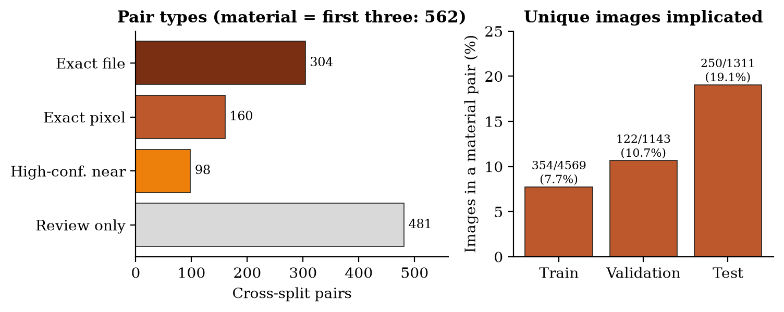
Duplicate / Leakage Audit (Phase 2D)
7,023 images · file SHA-256 · decoded-pixel SHA-256 · pHash/dHash + MAE/correlation
464
exact file / pixel pairs
98
high-confidence near pairs
562
material pairs
250
test images implicated (19%)
Status: MATERIAL_DUPLICATION
Unique images implicated: train 354 · val 122 · test 250
Test by class: gli 0 · men 109 · no 136 · pit 5
Patient-level independence: cannot be established
*
16
Notes:
Before locking, we tested the one assumption everything relied on — that the partitions were independent. The audit returned MATERIAL_DUPLICATION: 464 exact file or pixel cross-split pairs plus 98 high-confidence near-duplicates, 562 material pairs, and 481 more review candidates. 250 of the 1,311 test images — about 19% — have a material counterpart in train or validation. All pairs share the same label, so this is duplication, not label noise. Most overlap already existed between the dataset's own Training and Testing folders. Patient-level independence cannot be established — no patient IDs. Viva: 'Does this invalidate your work?' — It invalidates one interpretation, that ~98% measured independent generalization; the models and numbers remain real.

Slide 17
Leakage-Aware Internal Evaluation
Post-hoc re-scoring of saved models — no retraining, no refitting
Backbone | Original n=1,311 | exact_clean n=1,095 | material_clean n=1,061 | material F1 | conservative n=926
VGG16 | 94.97% | 94.98% | 94.816% | 94.302% | 94.06%
VGG19 | 93.52% | 93.24% | 93.025% | 92.415% | 92.01%
ResNet50 | 98.09% | 98.36% | 98.303% | 98.134% | 98.06%
ResNet152 | 98.40% | 98.45% | 98.398% | 98.315% | 98.16%
EfficientNet-B3 | 98.47% | 98.63% | 98.680% | 98.511% | 98.49%
Supported
Strong Phase 1 scores are not driven solely by duplicated test images (|Δ| < 0.5 pp)
Not supported
material_clean does not repair training contamination · no patient-level independence
*
17
Notes:
Three pre-defined policies remove implicated test images: exact_clean, material_clean — our primary policy — and conservative_clean. Accuracy changed by under half a point and the ranking was preserved: the high scores were not driven solely by duplicated test images. The critical caveat: material_clean removes contaminated test images; it does NOT repair contaminated training or validation. It is a post-hoc subset, not a new independent test set.

Slide 18
Phase 2A — 30-Epoch Standardized Protocol
• Why: early stopping hides convergence and late-epoch drift; Phase 1 budgets were unequal
• All five baselines: RMSprop · LR 1e-4 · LSTM 256 · dropout 0.3 · batch 8 · seed 42
• Exactly 30 / 30 epochs, no early termination
• Saved: best_val_within_30.pth and epoch_30_model.pth
• Both states → Scaler → PCA 64 → SVM: 10 evaluations
• Representative chosen by full-hybrid validation (ties → macro-F1 → best_val_within_30)
Technical note
VGG16, VGG19, ResNet50: best epoch = 30, so both states tie (7 distinct results of 10).
Frozen representative = best_val_within_30 at epoch 30 — not epoch_30_model.pth (files differ by hash).
*
18
Notes:
Early stopping confounds comparison — a model that stops at epoch 9 has never been seen at epoch 25. Phase 2A trains all five baselines for exactly 30 epochs, keeps two checkpoints — best within 30 and epoch 30 — and evaluates both through the full PCA plus SVM path: ten evaluations. Important technical detail: for VGG16, VGG19 and ResNet50 the best epoch was 30 itself, so the two states give identical metrics; the frozen representative is formally best_val_within_30 at epoch 30, not epoch_30_model, even though metrics tie.

Slide 19
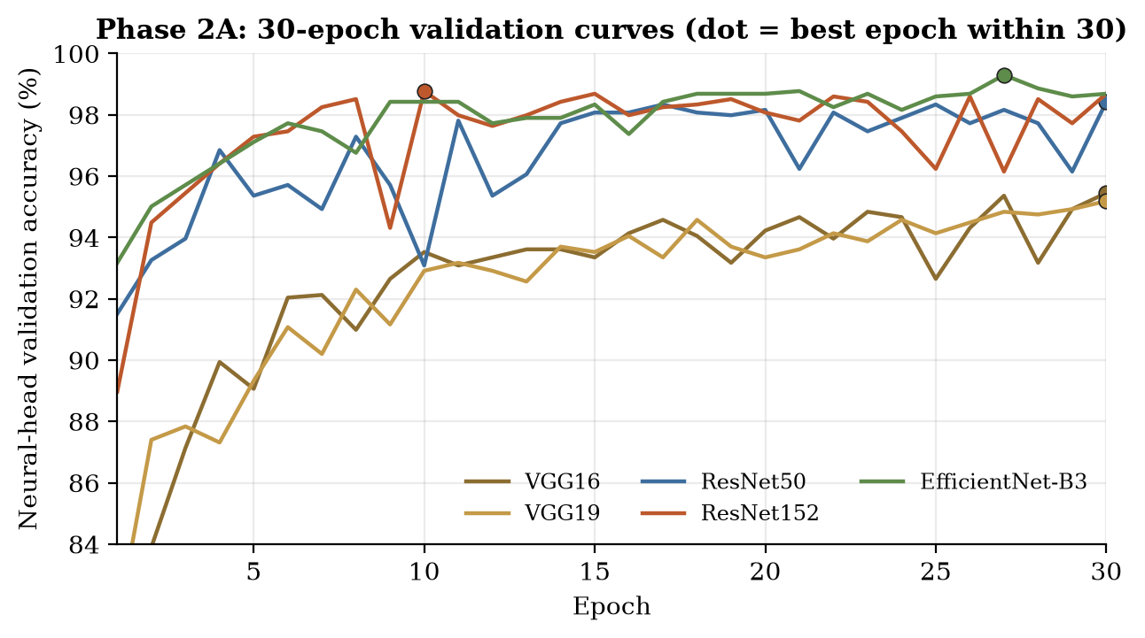
Phase 2A — Results
Backbone | Representative state | SVM val | Test* | mat.-clean*
VGG16 | best_val_within_30 · ep 30 | 95.888% | 96.186% | 95.853%
VGG19 | best_val_within_30 · ep 30 | 95.626% | 95.271% | 95.099%
ResNet50 | best_val_within_30 · ep 30 | 98.688% | 98.932% | 98.963%
ResNet152 | best_val_within_30 · ep 10 | 98.600% | 98.703% | 98.869%
EfficientNet-B3 | best_val_within_30 · ep 27 | 99.300% | 99.314% | 99.246%
• VGG16/19 improved until epoch 30 → Phase 1 early stopping halted them early
• ResNet152 peaked at epoch 10 (98.78% neural val) and stayed close (98.69% at 30)
• * contaminated original split; not used for any selection
*
19
Notes:
EfficientNet-B3 led internally at 99.30%, then ResNet50, ResNet152 at 98.60, and the two VGGs. Every backbone improved over Phase 1. VGGs kept improving to the last epoch; ResNet152 peaked early at epoch 10 and stayed close. Material_clean for ResNet152 Phase 2A was 98.869%. All internal numbers are on the contaminated split and were not used to pick anything externally.

Slide 20
Phase 2B — Hyperparameter Sensitivity Design
Run | LR | LSTM | Dropout
lr_1e-5 | 1e-5 | 256 | 0.3
lr_5e-5 | 5e-5 | 256 | 0.3
lr_5e-4 | 5e-4 | 256 | 0.3
lstm_128 | 1e-4 | 128 | 0.3
lstm_512 | 1e-4 | 512 | 0.3
dropout_0.2 | 1e-4 | 256 | 0.2
dropout_0.5 | 1e-4 | 256 | 0.5
5 × 7 = 35 runs
all 30 / 30 epochs
35 × 2 states = 70 downstream evals
Test set deliberately NOT evaluated
70 states compared → scoring test would make it a tuning set; selection is validation-only
One-factor-at-a-time around the Phase 2A baseline (LR 1e-4 · LSTM 256 · dropout 0.3); every other setting fixed.
*
20
Notes:
One factor at a time around the Phase 2A baseline: three learning rates, two LSTM widths, two dropouts. Five backbones times seven = 35 training runs of 30 epochs; two retained states each = 70 downstream evaluations. Crucially, the test set was not evaluated at all in Phase 2B: we compare 70 states and pick winners, so scoring the test set each time would turn it into a tuning set. Selection is validation-only. Viva: 'Why not grid search?' — attribution: we wanted to know which factor matters, not just a best configuration.

Slide 21
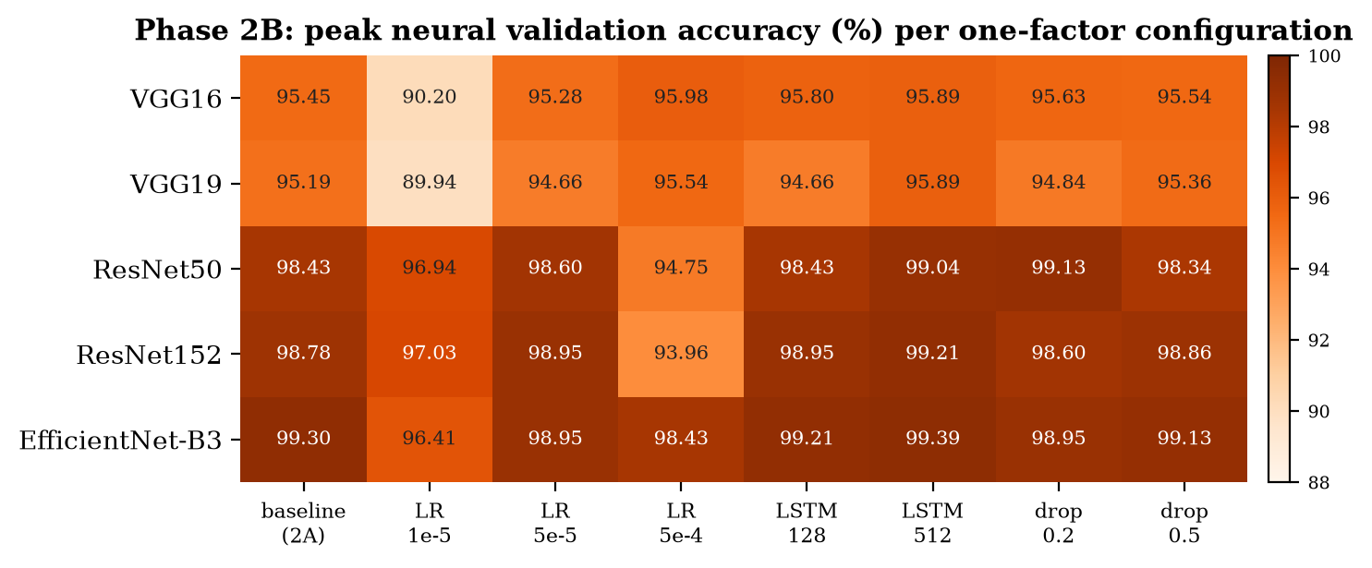
Phase 2B — Findings
Factor | Mean range
Learning rate | 4.62 pp
LSTM width | 0.58 pp
Dropout | 0.42 pp
• Learning rate dominates and is architecture-dependent (frozen VGG ↔ fine-tuned ResNet)
• ResNet50 LR 5e-4: 94.75% at epoch 25 → 90.99% at epoch 30 (−3.76 pp drift)
• Best-neural state vs epoch 30 downstream: 20 better · 8 worse · 7 tied
• Strongest changed configs: VGG16 lr_5e-4 (96.50) · VGG19 dropout_0.5 (95.54) · ResNet50 dropout_0.2 (99.13) · ResNet152 lstm_512 (99.30) · EffNet-B3 lstm_512 (99.39)
*
21
Notes:
Learning rate dominated: mean within-backbone range 4.62 points, against 0.58 for LSTM width and 0.42 for dropout. And it is architecture-dependent: frozen VGGs underfit at 1e-5 and tolerate 5e-4; fine-tuned ResNets are damaged by 5e-4 — ResNet50 dropped 3.76 points from its peak by epoch 30. LSTM512 gave small peak gains everywhere, not stable. Best-neural state beat epoch-30 downstream in 20, lost in 8, tied in 7. One seed, one contaminated validation split: sensitivity findings, not significance.

Slide 22
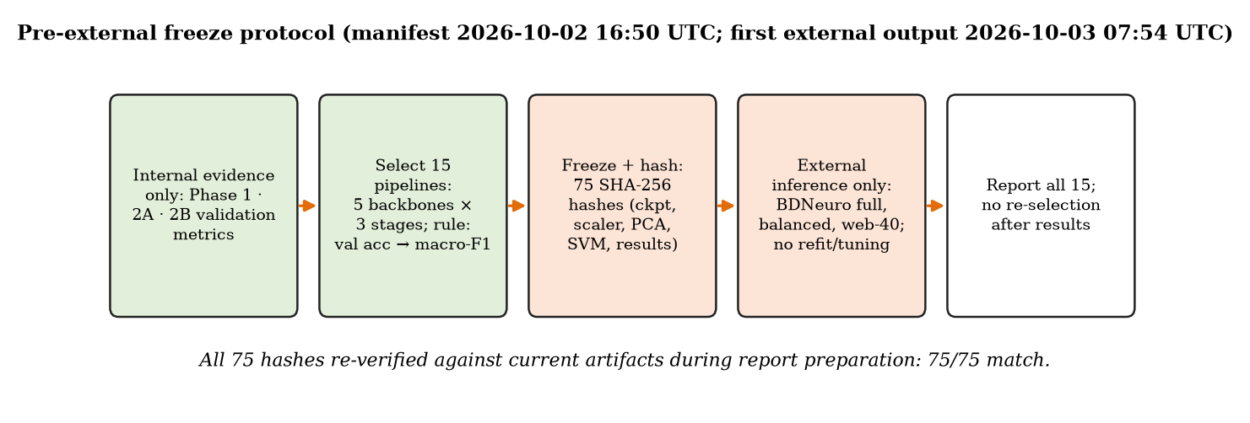
Frozen 15-Pipeline Protocol
Selected on internal validation only — frozen and hashed before any external image
frozen_15_manifest.json · 15 × 5 = 75 SHA-256 hashes · re-verified 75 / 75 match
*
22
Notes:
To prevent external tuning, exactly 15 pipelines — Phase 1, 2A and 2B for each backbone — were selected on internal validation and frozen. The manifest stores 75 SHA-256 hashes: checkpoint, scaler, PCA, SVM and results file for each. It is time-stamped before every external result. While preparing this review we recomputed all 75: all match. So what was externally evaluated is byte-for-byte what was frozen, and nothing was retrained or reselected afterwards.

Slide 23
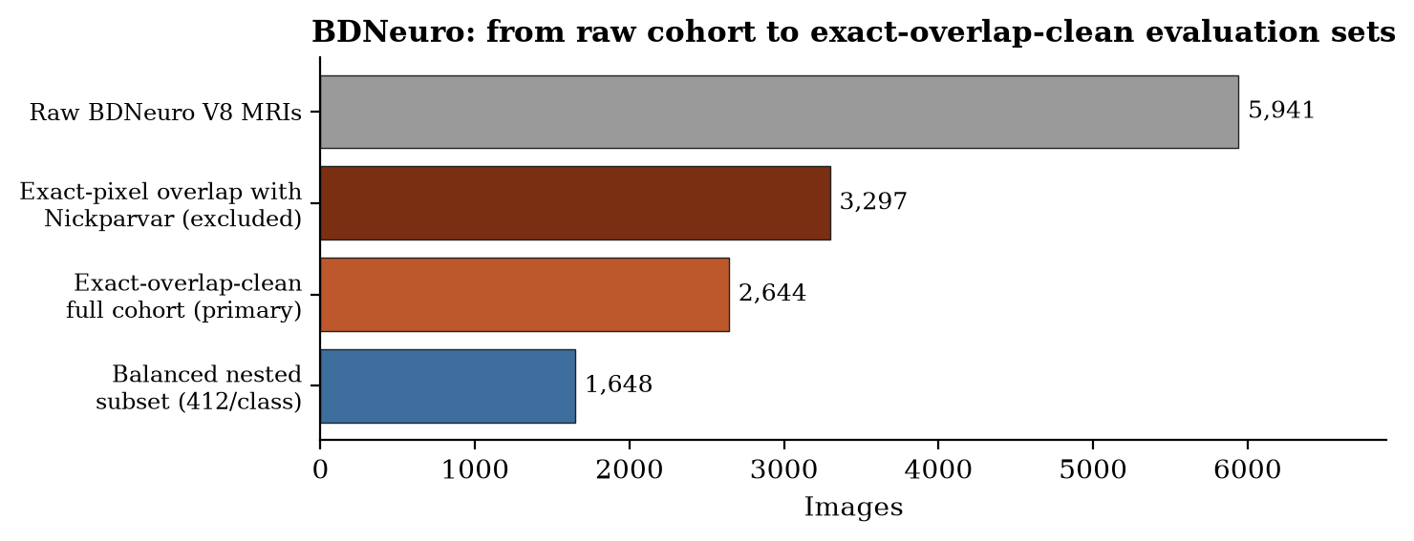
BDNeuro: Overlap Audit & Clean Cohort
Audit (vs 7,023) | Count
Exact file pairs | 3,421
Exact pixel pairs | 3,519
Unique exact-pixel images | 3,297
pHash ≤ 6 pairs | 9,981
pHash ≤ 4 pairs | 6,664
Cohort | Glioma | Mening. | Notumor | Pituit. | Total
Exact-clean (primary) | 1,159 | 472 | 412 | 601 | 2,644
Balanced (nested) | 412 | 412 | 412 | 412 | 1,648
Rule
Exclude exact decoded-pixel matches only
Keep non-identical pHash candidates (screening, not proof)
Raw BDNeuro 5,941 is NOT an independent external set.
*
23
Notes:
BDNeuro-MRI version 8 is a four-class dataset with a different documented source. Before using it we audited it against all 7,023 development images. 3,297 of its 5,941 MRIs — 55% — were pixel-identical to our development images, all with the same label. Documented provenance cannot override pixel identity, so we removed exact decoded-pixel matches only. We did not remove pHash candidates, because MRI anatomy is repetitive and similar hashes do not prove the same scan. That gives the 2,644-image exact-overlap-clean primary cohort, and a nested balanced subset of 412 per class, chosen by SHA-256 ranking without any model output. The balanced subset is not a second independent dataset.

Slide 24
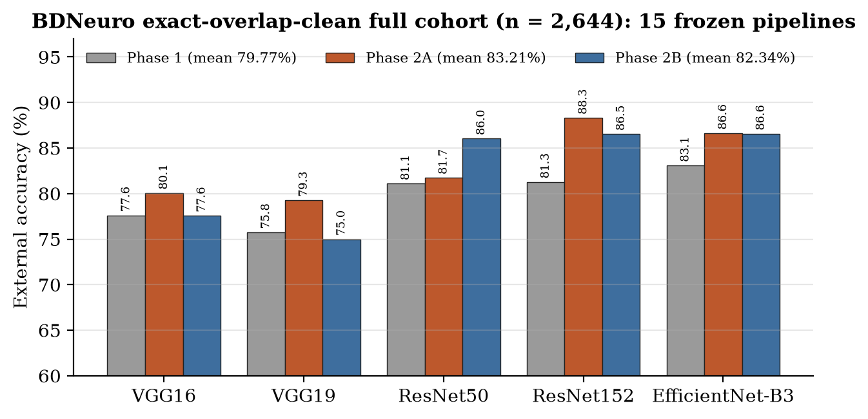
BDNeuro External Results (n = 2,644)
All 15 frozen pipelines — no retraining, refitting or recalibration
Stage | Mean acc
Phase 1 | 79.77%
Phase 2A | 83.21%
Phase 2B | 82.34%
Best: ResNet152 Phase 2A
88.31% · F1 87.85%
gap -10.29 pp
Phase 2A > Phase 2B > Phase 1 on average; Phase 2B gains did not transfer consistently (helped ResNet50, hurt VGG16/19).
*
24
Notes:
Every pipeline lost accuracy versus internal validation — by 10 to 21 points — but kept meaningful accuracy: 75.0 to 88.3%. ResNet152 Phase 2A was best: 88.31% accuracy, macro-F1 87.85%, with the smallest gap, -10.29 pp. Stage means: Phase 1 79.77%, Phase 2A 83.21%, Phase 2B 82.34%. Phase 2B tuning did not transfer consistently — it helped ResNet50 but hurt both VGGs. Higher internal validation did not predict higher external accuracy.

Slide 25
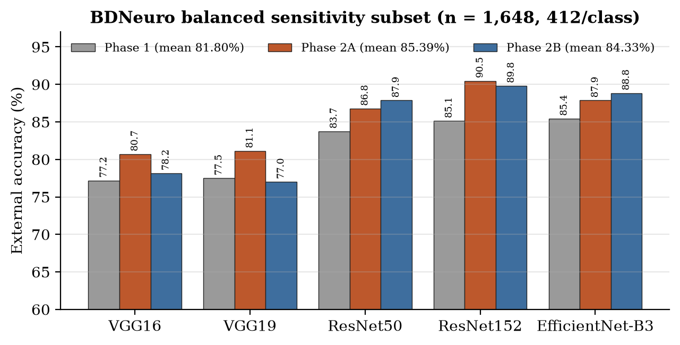
Balanced Sensitivity Subset (n = 1,648)
412 per class · nested inside the 2,644 cohort — not a second dataset
Stage | Mean acc
Phase 1 | 81.80%
Phase 2A | 85.39%
Phase 2B | 84.33%
Best: ResNet152 Phase 2A
90.47% · F1 90.50%
gap -8.13 pp
Balancing raised accuracy in 14 of 15 pipelines (glioma is 43.8% of the natural cohort and below-average recall for most models).
*
25
Notes:
On the balanced subset, accuracy equals mean per-class recall. ResNet152 Phase 2A again led: 90.47% accuracy, F1 90.50%, gap -8.13 pp. Balancing raised accuracy for 14 of 15 pipelines because glioma — weaker for most models — is 44% of the natural cohort. Same ordering of stage means. Emphasize: nested sensitivity analysis, not independent confirmation.

Slide 26
Web-40 Stress Test — Methodology
Source-verified exploratory stress test — not clinical validation
• 40 images: 10 glioma · 10 meningioma · 10 notumor · 10 pituitary
• Diagnosis from the original source page (search engines only for discovery)
• Reject CT, histology, segmentation maps, ambiguous labels
• Audit vs Nickparvar (7,023) + BDNeuro clean (2,644): exact file, exact pixel, pHash
• Locked before inference; 15 frozen pipelines → 600 predictions
NOR_01 — pHash 0 vs Te-no_0227
same slice visually → rejected & replaced BEFORE inference
MEN_02 — pHash 6 vs Tr-me_0633
clearly different scan → retained
Final audit
0 exact overlaps · pHash ≤ 4: 0 · LOCKED_BEFORE_INFERENCE
*
26
Notes:
Our guide asked: what happens with an MRI found on the web? We collected exactly 40 images, 10 per class, from case reports and open-access medical pages — the source page establishes the diagnosis. Before any inference we audited them against Nickparvar and BDNeuro. NOR_01 had pHash distance 0 to a Nickparvar test image — visually the same slice — so it was replaced before inference. MEN_02 at distance 6 was clearly a different scan and kept. Then the cohort was locked: no image may be changed after predictions. The lock record is time-stamped 47 seconds before the comparison output.

Slide 27
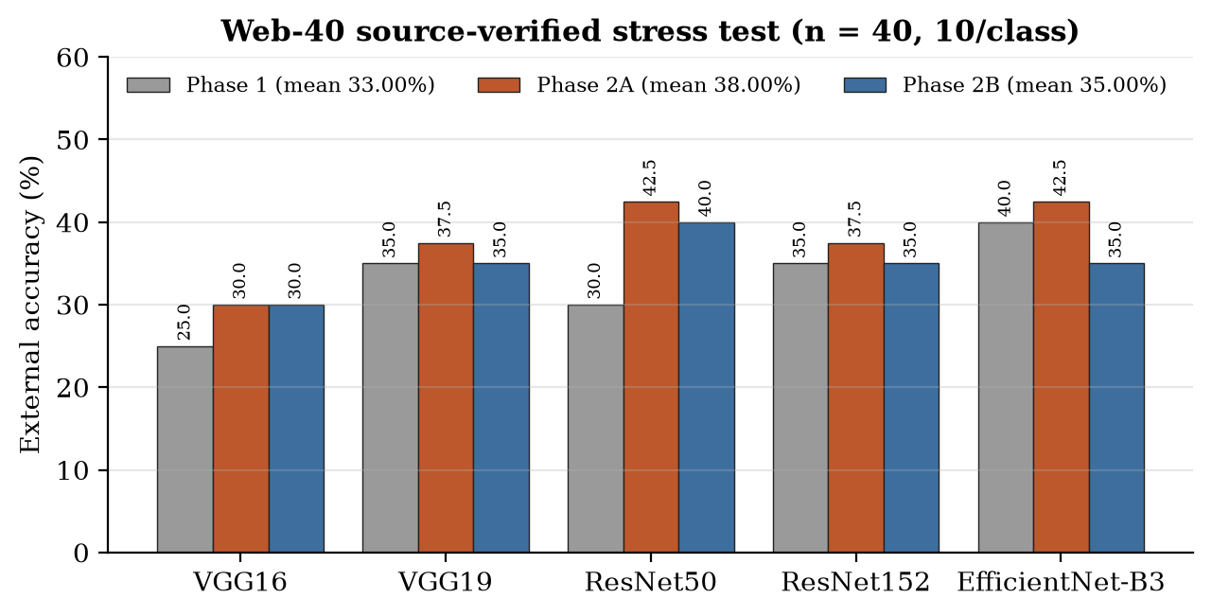
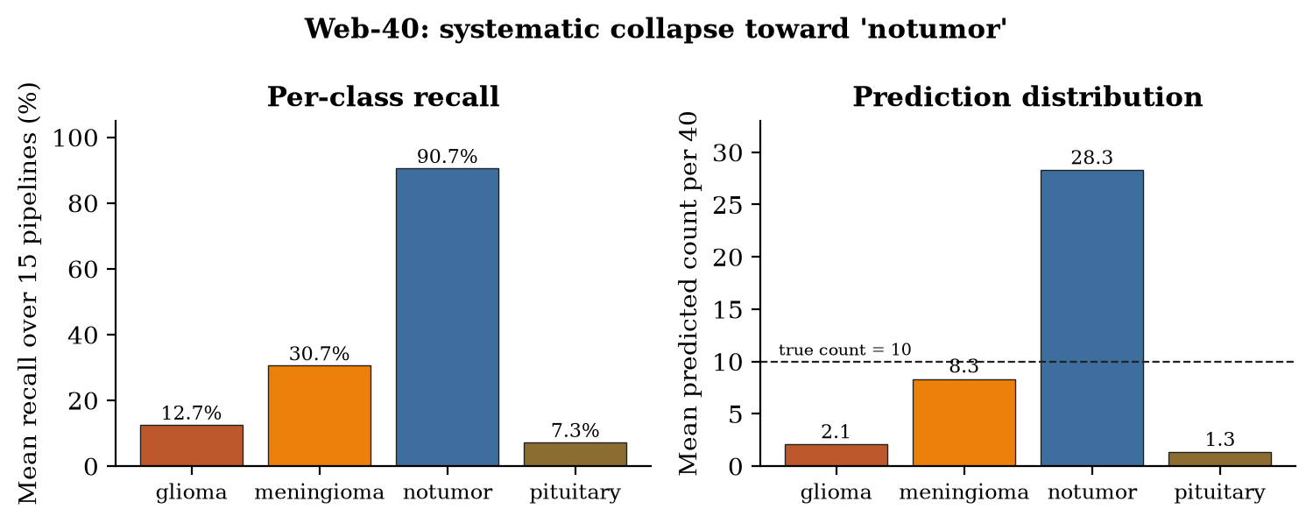
Web-40 Results
Severe domain shift: 25.0–42.5% accuracy and collapse toward notumor
Stage | Mean acc | Mean macro F1
Phase 1 | 33.00% | 26.56%
Phase 2A | 38.00% | 30.56%
Phase 2B | 35.00% | 26.95%
Best 42.5% (17/40): ResNet50 2A, EffNet-B3 2A
EffNet-B3 Phase 1 = 40.0% · 1 image = 2.5 pp
*
27
Notes:
Accuracy fell to 25 to 42.5%. Best: ResNet50 Phase 2A and EfficientNet-B3 Phase 2A at 42.5%, that is 17 of 40. Correction to note: EfficientNet-B3 Phase 1 was 40.0%, not 42.5. One image is 2.5 points, so no fine ranking. The failure is systematic: on average 28 of 40 images were called notumor; glioma recall 12.7%, pituitary 7.3%. Under strong shift the models default to 'no tumour' — false negatives, generally the more serious error in screening. Do not call 42.5% clinical accuracy.

Slide 28
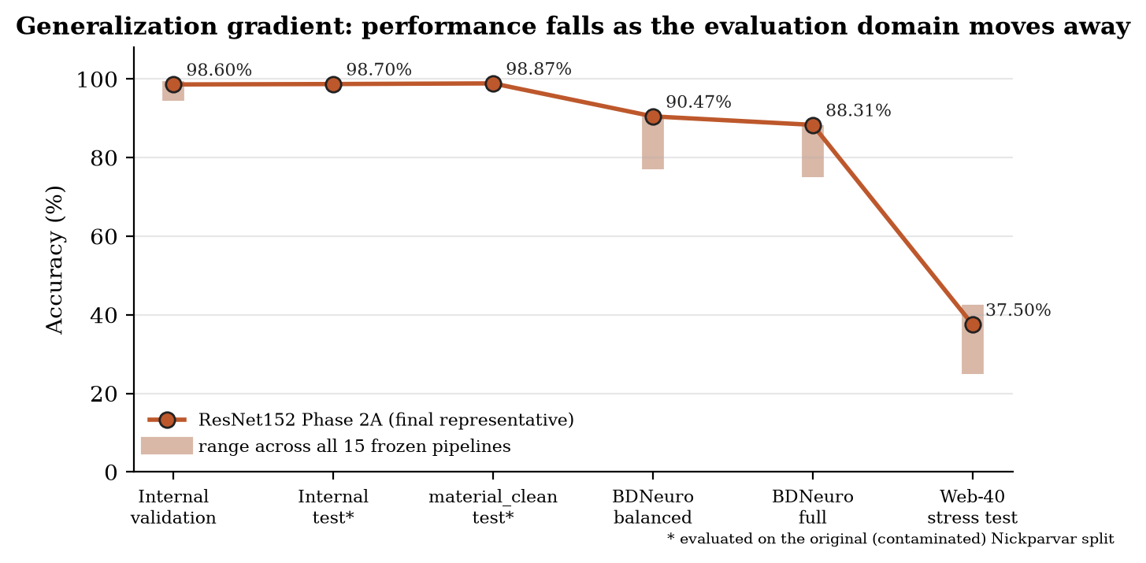
Cross-Domain Performance Progression
Internal → material-clean → BDNeuro → web-40
High public-dataset accuracy does not guarantee robust out-of-distribution performance
*
28
Notes:
This is the central finding. Follow the line for our final representative: about 98.6 to 98.9% internally, 90.5 and 88.3% on BDNeuro, 37.5% on web images. The shaded bars show the same fall across all 15 pipelines — it is not one unlucky model. High public-dataset accuracy does not guarantee robust out-of-distribution performance. Plausible contributors: acquisition and sequence differences, cropping and presentation, source heterogeneity and dependence on training-domain cues — but without metadata we do not claim a single cause.

Slide 29
Final Project Representative
ResNet152 · Phase 2A · best_val_within_30 · epoch 10
Evaluation | Accuracy
Internal validation (full hybrid) | 98.60%
Internal test* | 98.70%
material_clean test* | 98.869%
BDNeuro full (2,644) | 88.31%
BDNeuro balanced (1,648) | 90.47%
Web-40 stress test | 37.5%
Configuration
RMSprop · LR 1e-4 · LSTM 256 · dropout 0.3 · Dense 128
StandardScaler → PCA 64 → linear SVM (C = 1)
Why
15 frozen on internal validation; representative = strongest structured (BDNeuro) evidence + smallest gaps
Web-40 was NOT used for selection (37.5%, below two other pipelines). No model was retrained or altered after external results.
* original contaminated split · not claimed to be universally superior
*
29
Notes:
Configuration: RMSprop, 1e-4, LSTM 256, dropout 0.3, Dense 128, StandardScaler, PCA 64, linear SVM C=1. How it was chosen, two steps: the 15 candidates were frozen on internal validation only; naming one representative was a retrospective synthesis of internal validation and the larger structured BDNeuro evidence — strongest result and smallest gap on both cohorts. The web-40 test was NOT used — on it this model scored 37.5%, below two others. No model was changed after external results. The slide shows a trajectory, not uniform high performance. Honest caveat: because BDNeuro informed the naming, its BDNeuro numbers carry slight selection optimism; the full 15-model tables are the unbiased record.

Slide 30
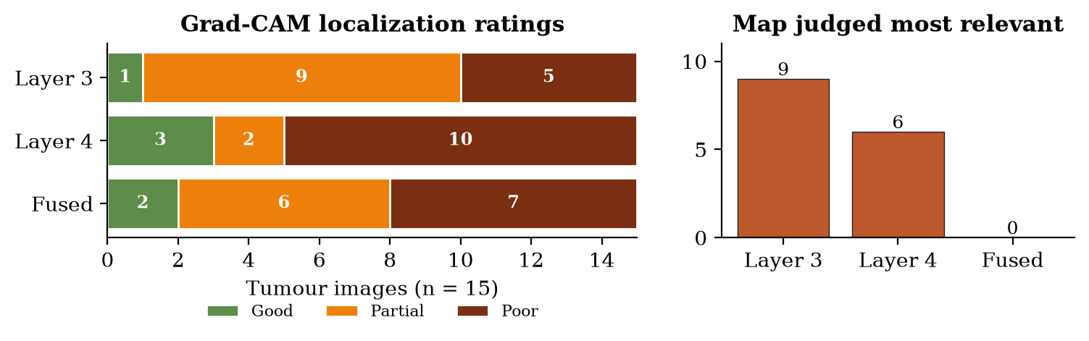
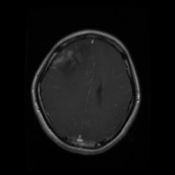
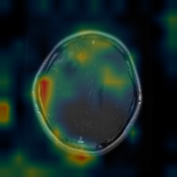
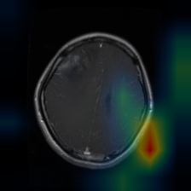
Explainability — Grad-CAM
ResNet152 (Phase 1 model) · seed 42 · 20 images, 5/class · Layer 3, Layer 4, fused
Input (glioma)
Layer 3 · Partial
Layer 4 · Poor
Best map: Layer 3 = 9 · Layer 4 = 6 · Fused = 0
• Neural head & SVM agreed 20/20; both correct 19/20 · shared error Te-pi_0078 (pituitary → glioma)
• Correct predictions often had off-lesion maps (skull margin, borders, extracranial)
• Coarse contribution maps — NOT tumour segmentation · Phase 1 ResNet152 only
*
30
Notes:
Grad-CAM explains the neural head. Protocol frozen before rating. On 15 tumour images: layer 3 rated Good 1, Partial 9, Poor 5; layer 4 Good 3, Partial 2, Poor 10; fused Good 2, Partial 6, Poor 7. Layer 3 was most relevant 9 times, layer 4 6 times, fusion never. Heads agreed on all 20, both correct on 19; the shared error was Te-pi_0078, pituitary predicted glioma. Correct predictions often had off-lesion maps — skull margin, borders. Note: this was the Phase 1 ResNet152, not the final Phase 2A model. Coarse contribution maps, not segmentation.

Slide 31
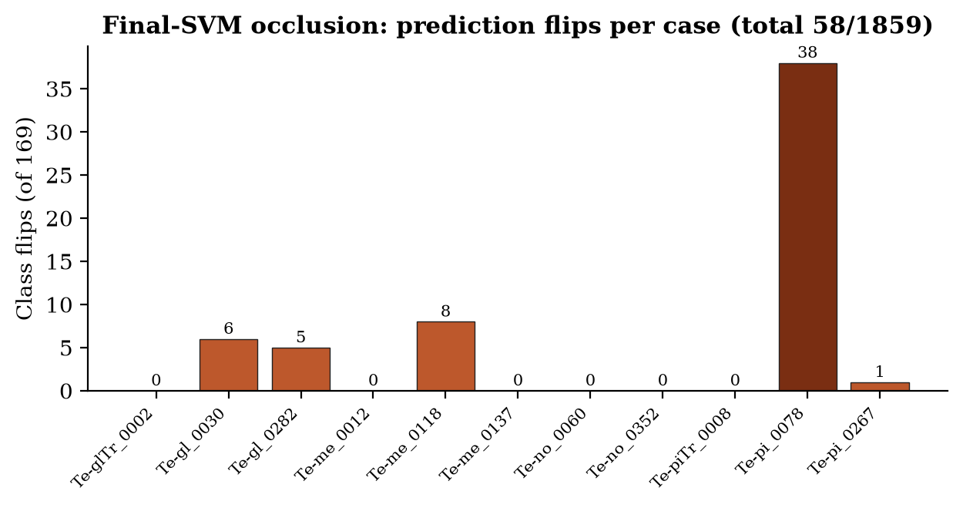
Explainability — Final-SVM Occlusion
11 cases · patch 32×32 · stride 16 · 169 occlusions/image · 1,859 total
Measure | Value
Tumour rating G/P/Poor | 2 / 2 / 5
Grad-CAM better | 4
Occlusion better | 3
Both off-lesion | 2
Flips (pooled) | 58 / 1,859 (3.12%)
• Probes the deployed SVM decision directly — but no more lesion-focused than Grad-CAM
• Correct cases stable (median 0 flips); misclassified Te-pi_0078 fragile (38/169 = 22.5%)
• Per-image normalization: read maps with effect sizes · not segmentation
*
31
Notes:
Grad-CAM cannot pass through the SVM, so occlusion masks one patch at a time and reruns the whole pipeline — CNN, LSTM, scaler, PCA, SVM. 11 cases chosen before results. Tumour localization Good 2, Partial 2, Poor 5. Grad-CAM more relevant in 4, occlusion in 3, both off-lesion in 2. 58 of 1,859 occlusions flipped the class — 3.12% — median 0 per image; the misclassified Te-pi_0078 flipped 38 times, 22.5%. Correct predictions were stable; the error was fragile. Maps are normalized per image, so always read them with effect sizes.

Slide 32
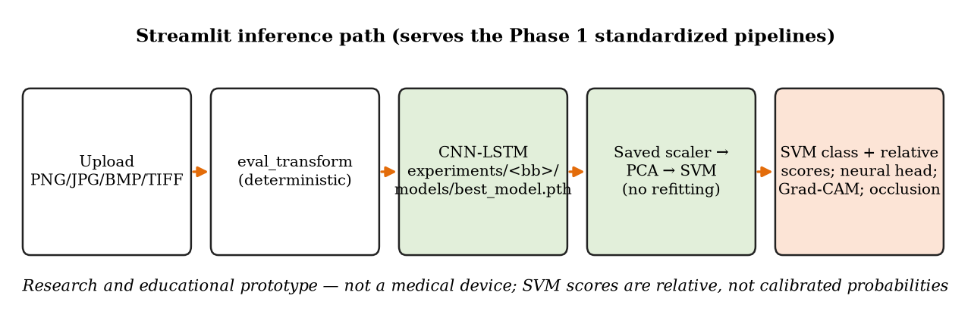
Streamlit Research Prototype
Upload → choose backbone → SVM prediction, neural head, scores, metrics, Grad-CAM, occlusion
• Tabs: Predict MRI · Model performance · Compare models · Methodology
• Saved scaler/PCA/SVM — no refitting on uploads
• Relative scores, not calibrated probabilities · no DICOM
Verified limitation
GUI loads experiments/<backbone>/ → serves Phase 1 pipelines, NOT the final ResNet152 Phase 2A epoch-10 model
*
32
Notes:
Four tabs: Predict MRI, Model performance, Compare models, Methodology. Uploads PNG, JPG, BMP or TIFF — no DICOM. The final answer is the SVM; neural head shown for comparison with an agreement notice; SVM scores are relative, not probabilities. Nothing is refitted on uploads. Important verified clarification: the GUI loads experiments/<backbone>, so it serves the Phase 1 standardized pipelines — it does NOT currently load the final ResNet152 Phase 2A epoch-10 representative. Research and educational prototype only. Demo tip: show a correct test image, then explain why web images can fail.

Slide 33
Major Findings
• Hybrid works internally: 93.5–98.5% (Phase 1 test), up to 99.30% validation (Phase 2A)
• PCA + SVM ↑ test for all 5 backbones; validation mixed → downstream-classifier comparison, no universal claim
• Learning rate dominates sensitivity (4.62 pp vs 0.58 / 0.42); architecture-dependent
• Public split has material duplicate leakage (562 pairs, 250 test images); material_clean stable but post-hoc
• Internal tuning gains did not reliably transfer: Phase 2A > 2B externally on average
• Generalization gradient: ~99% internal → 75–88% BDNeuro → 25–42.5% web, with notumor collapse
• XAI: correct predictions often with off-lesion maps — accuracy ≠ lesion-centred reasoning
*
33
Notes:
Six findings. The hybrid works internally. PCA plus SVM helped test accuracy but not universally. Learning rate dominates and is architecture-dependent. The public split contains material leakage. Internal tuning gains did not transfer. And performance degrades step by step with domain shift, with explanations often off-lesion. The contribution is the layered, auditable evidence — not a headline percentage.

Slide 34
Limitations
• Original split contaminated; internal numbers are historical — material_clean does NOT repair training contamination
• Patient-level independence cannot be established (no patient IDs — Nickparvar, BDNeuro or web)
• Single seed / single split; no CIs — Phase 2B differences are not statistically established
• VGG frozen vs others fine-tuned; Phase 1 budgets unequal; no no-LSTM / no-PCA ablation
• BDNeuro balanced subset is nested in the 2,644 cohort; BDNeuro README licence/citation unfilled
• Web-40: n = 40, 1 image = 2.5 pp; exploratory, not clinical
• XAI: small, single-rater, Phase 1 ResNet152 only · GUI serves Phase 1 pipelines
• Research & educational prototype — no clinical or safety claim
*
34
Notes:
State these plainly; they bound every claim. No patient-level independence anywhere; material_clean does not repair training contamination; one seed; asymmetric VGG policy; BDNeuro balanced is nested, not independent; web is 40 images; XAI small and on the Phase 1 model; GUI serves Phase 1. And no clinical claim of any kind.

Slide 35
Conclusion & Future Work
Conclusion
All roadmap phases (1, 2A, 2B, 2C, 2D, 3, 4, 5, 6) complete, plus a web stress test beyond plan.
Five hybrid pipelines reach ~98% on the public split — but that split leaks, structured external accuracy is 75–88%, and web accuracy falls to 25–42.5%.
High public-dataset accuracy does not guarantee robust out-of-distribution performance.
• Duplicate-group-aware retraining · patient-identified, multi-site data · repeated seeds + CIs
• Ablations (no-LSTM / no-PCA) · MRI-specific normalization & domain adaptation, tested on NEW external data
• Calibration · quantitative XAI with expert masks · GUI → final Phase 2A model · DICOM support
*
35
Notes:
Close with the central sentence. Then future work: duplicate-group-aware retraining, patient-identified multi-site data, repeated seeds, ablations, robustness methods evaluated on new untouched data, calibration, quantitative XAI on the final model, and pointing the GUI at the final representative.

Slide 36
References
[1] Bérété M. et al. (2026), Hybrid CNN+LSTM+SVM model for advanced brain tumor classification, NMAHIB 15, 43. doi:10.1007/s13721-025-00718-8
[2] Simonyan & Zisserman (2015), VGG, ICLR · [3] He et al. (2016), ResNet, CVPR · [4] Tan & Le (2019), EfficientNet, ICML
[5] Hochreiter & Schmidhuber (1997), LSTM, Neural Computation · [6] Cortes & Vapnik (1995), Support-vector networks, Machine Learning
[7] Selvaraju et al. (2020), Grad-CAM, IJCV 128(2) · [8] Zeiler & Fergus (2014), Visualizing CNNs, ECCV
[9] Başarslan (2025), J. Supercomput. 81, 502 · [10] Özbay & Özbay (2023), Iran J. Comput. Sci. 6 · [11] Hosny et al. (2025), Neural Comput. Appl. 37
[12] Musthafa et al. (2024), BMC Med. Imaging 24, 107 · [13] Panigrahi et al. (2025), Discov. Appl. Sci. · [14] Sahoo et al. (2024), IJCIS 17 · [15] Kumar et al. (2021), MTAP 80(9)
Datasets: Nickparvar, Brain Tumor MRI Dataset (Kaggle) · BDNeuro-MRI V8 (README; licence/citation to be completed)
*
36
Notes:
References 1 to 15 are the ones verified for Review-I; dataset sources are in the report. The BDNeuro README leaves licence and citation unfilled — flagged for completion.

Slide 37
Thank you
Questions?
*
37
Notes:
Invite questions. Likely questions: Why an LSTM on one image? (49 spatial positions, not time). Is it an ensemble? (No.) Did you reproduce 99%? (No — ~98.4–98.7% on the same leaky split.) Why trust anything after the leakage finding? (material_clean + frozen external validation.) Why was web performance so low? (severe domain shift; notumor collapse.) Was the final model chosen on web results? (No.) Does the GUI use the final model? (No — Phase 1 pipelines; a small future change.)

Slide 38
Backup — BDNeuro Full (n = 2,644), all 15
Backbone | Stage | Variant | Int. val % | Ext. acc % | Macro F1 % | Gap pp
VGG16 | Phase 1 | early_stopping | 94.93 | 77.61 | 75.50 | -17.32
VGG16 | Phase 2A | lr1e-4_lstm256_dropout0.3 | 95.89 | 80.07 | 78.71 | -15.82
VGG16 | Phase 2B | lr_5e-4 | 96.50 | 77.57 | 76.01 | -18.93
VGG19 | Phase 1 | early_stopping | 94.49 | 75.76 | 74.80 | -18.73
VGG19 | Phase 2A | lr1e-4_lstm256_dropout0.3 | 95.63 | 79.27 | 78.12 | -16.35
VGG19 | Phase 2B | dropout_0.5 | 95.54 | 75.00 | 74.27 | -20.54
ResNet50 | Phase 1 | early_stopping | 97.55 | 81.09 | 79.93 | -16.46
ResNet50 | Phase 2A | lr1e-4_lstm256_dropout0.3 | 98.69 | 81.73 | 81.42 | -16.96
ResNet50 | Phase 2B | dropout_0.2 | 99.13 | 86.04 | 84.83 | -13.08
ResNet152 | Phase 1 | early_stopping | 98.25 | 81.28 | 80.84 | -16.97
ResNet152 | Phase 2A | lr1e-4_lstm256_dropout0.3 | 98.60 | 88.31 | 87.85 | -10.29
ResNet152 | Phase 2B | lstm_512 | 99.30 | 86.54 | 85.67 | -12.76
EfficientNet-B3 | Phase 1 | early_stopping | 98.51 | 83.09 | 81.93 | -15.42
EfficientNet-B3 | Phase 2A | lr1e-4_lstm256_dropout0.3 | 99.30 | 86.65 | 85.12 | -12.65
EfficientNet-B3 | Phase 2B | lstm_512 | 99.39 | 86.57 | 85.53 | -12.81
*
B38
Notes:
Full table for questions. Source: comparison_15_models_bdneuro_full/external_comparison_15.csv.

Slide 39
Backup — BDNeuro Balanced (n = 1,648), all 15
Backbone | Stage | Variant | Int. val % | Ext. acc % | Macro F1 % | Gap pp
VGG16 | Phase 1 | early_stopping | 94.93 | 77.18 | 76.82 | -17.74
VGG16 | Phase 2A | lr1e-4_lstm256_dropout0.3 | 95.89 | 80.70 | 80.62 | -15.18
VGG16 | Phase 2B | lr_5e-4 | 96.50 | 78.16 | 77.88 | -18.35
VGG19 | Phase 1 | early_stopping | 94.49 | 77.49 | 77.64 | -17.00
VGG19 | Phase 2A | lr1e-4_lstm256_dropout0.3 | 95.63 | 81.13 | 81.24 | -14.50
VGG19 | Phase 2B | dropout_0.5 | 95.54 | 77.00 | 77.15 | -18.54
ResNet50 | Phase 1 | early_stopping | 97.55 | 83.74 | 83.80 | -13.81
ResNet50 | Phase 2A | lr1e-4_lstm256_dropout0.3 | 98.69 | 86.77 | 86.90 | -11.92
ResNet50 | Phase 2B | dropout_0.2 | 99.13 | 87.86 | 87.87 | -11.26
ResNet152 | Phase 1 | early_stopping | 98.25 | 85.13 | 85.13 | -13.12
ResNet152 | Phase 2A | lr1e-4_lstm256_dropout0.3 | 98.60 | 90.47 | 90.50 | -8.13
ResNet152 | Phase 2B | lstm_512 | 99.30 | 89.81 | 89.76 | -9.49
EfficientNet-B3 | Phase 1 | early_stopping | 98.51 | 85.44 | 85.60 | -13.08
EfficientNet-B3 | Phase 2A | lr1e-4_lstm256_dropout0.3 | 99.30 | 87.86 | 87.79 | -11.44
EfficientNet-B3 | Phase 2B | lstm_512 | 99.39 | 88.83 | 88.96 | -10.55
*
B39
Notes:
Full table. Source: comparison_15_models_bdneuro_balanced/external_comparison_15.csv. Nested subset, not independent.

Slide 40
Backup — Web-40 (n = 40), all 15
Backbone | Stage | Variant | Int. val % | Ext. acc % | Macro F1 % | Gap pp
VGG16 | Phase 1 | early_stopping | 94.93 | 25.00 | 14.58 | -69.93
VGG16 | Phase 2A | lr1e-4_lstm256_dropout0.3 | 95.89 | 30.00 | 23.23 | -65.89
VGG16 | Phase 2B | lr_5e-4 | 96.50 | 30.00 | 21.59 | -66.50
VGG19 | Phase 1 | early_stopping | 94.49 | 35.00 | 28.89 | -59.49
VGG19 | Phase 2A | lr1e-4_lstm256_dropout0.3 | 95.63 | 37.50 | 27.78 | -58.13
VGG19 | Phase 2B | dropout_0.5 | 95.54 | 35.00 | 25.45 | -60.54
ResNet50 | Phase 1 | early_stopping | 97.55 | 30.00 | 26.49 | -67.55
ResNet50 | Phase 2A | lr1e-4_lstm256_dropout0.3 | 98.69 | 42.50 | 38.18 | -56.19
ResNet50 | Phase 2B | dropout_0.2 | 99.13 | 40.00 | 33.91 | -59.13
ResNet152 | Phase 1 | early_stopping | 98.25 | 35.00 | 28.08 | -63.25
ResNet152 | Phase 2A | lr1e-4_lstm256_dropout0.3 | 98.60 | 37.50 | 31.66 | -61.10
ResNet152 | Phase 2B | lstm_512 | 99.30 | 35.00 | 25.74 | -64.30
EfficientNet-B3 | Phase 1 | early_stopping | 98.51 | 40.00 | 34.78 | -58.51
EfficientNet-B3 | Phase 2A | lr1e-4_lstm256_dropout0.3 | 99.30 | 42.50 | 31.97 | -56.80
EfficientNet-B3 | Phase 2B | lstm_512 | 99.39 | 35.00 | 28.07 | -64.39
*
B40
Notes:
Full table. Source: comparison_15_models_web_stress_40/external_comparison_15.csv. EfficientNet-B3 Phase 1 = 40.0%; 1 image = 2.5 pp.

Slide 41
Backup — Phase 2B Configurations & Selection
Backbone | Config | State | Epoch | SVM val | SVM val F1
VGG16 | lr_5e-4 | best_val_within_30 | 27 | 96.500% | 96.321%
VGG19 | dropout_0.5 | epoch_30 | 30 | 95.538% | 95.382%
ResNet50 | dropout_0.2 | best_val_within_30 | 28 | 99.125% | 99.122%
ResNet152 | lstm_512 | best_val_within_30 | 26 | 99.300% | 99.265%
EfficientNet-B3 | lstm_512 | best_val_within_30 | 29 | 99.388% | 99.377%
Backbone | LR range | LSTM range | Dropout range | LSTM512 − base
VGG16 | 5.77 | 0.44 | 0.17 | +0.44
VGG19 | 5.60 | 1.22 | 0.52 | +0.70
ResNet50 | 3.85 | 0.61 | 0.79 | +0.61
ResNet152 | 4.99 | 0.44 | 0.26 | +0.44
EfficientNet-B3 | 2.89 | 0.17 | 0.35 | +0.09
*
B41
Notes:
Selection rule for Phase 2B representatives: highest full-hybrid validation accuracy among 14 states, ties by macro-F1, then prefer best_val_within_30. Test set not used.

Slide 42
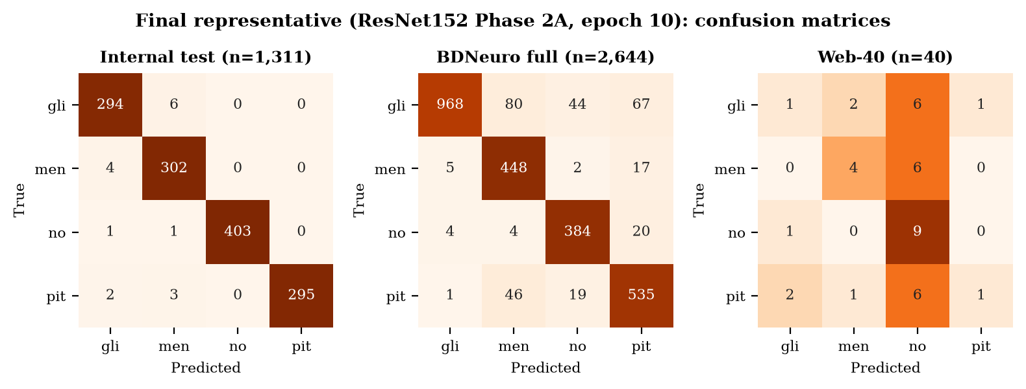
Backup — Final Model Confusion Matrices
ResNet152 Phase 2A (best_val_within_30, epoch 10): internal test · BDNeuro full · web-40. Web column 'no' shows the notumor collapse.
*
B42
Notes:
Rows true, columns predicted. Internal test nearly diagonal; BDNeuro glioma errors spread to meningioma and pituitary; web images collapse into the notumor column.

Slide 43
Backup — Evidence & Artifact References
Result | Repository source
Phase 1 | experiments/<bb>/results/{final,neural_head,training}_results.json
Leakage audit | final_project_docs/duplicate_leakage_audit/duplicate_leakage_audit.json
Leakage policies | final_project_docs/leakage_corrected_evaluation/leakage_corrected_summary.csv
Phase 2A | phase2/experiments_30epoch/<bb>/…; phase2/results/leakage_corrected_30epoch/
Phase 2B | phase2/hyperparameter_dl/<bb>/<run>/…
Freeze | phase2/external_validation/frozen_15_manifest.json (75 hashes, 75/75 verified)
BDNeuro | phase2/external_validation/bdneuro_*/ ; comparison_15_models_bdneuro_{full,balanced}/
Web-40 | web_stress_40_audit/, web_stress_40_locked/, comparison_15_models_web_stress_40/
XAI | gradcam_evaluation/*.csv ; occlusion_evaluation/*.csv
GUI / augmentation | gui/model_registry.py L51–60 ; src/data_pipeline_torch.py L65–78
*
B43
Notes:
Every number in the deck traces to these files; see FINAL_PROJECT_EVIDENCE_MAP.md for field-level mapping.

