Slide 1
COMPILER PRINCIPLES — GROUP PROJECT
Usage of Automatic Construction Tools for Lexer
Building a C-like lexical analyzer with Flex
Group members
Tool
Flex
Bakbergen Amir
202469990559
Bakbergen Alen
202469990562
Huang Liu Diego David
202469990549
fast lexical analyzer generator (lex successor)
Liu Bryan
202469990275

Slide 2
Problem & objectives
What we set out to do
Why automatic construction?
• Build a working lexical analyzer for a C-like subset.
• Use an automatic construction tool — Flex — instead of hand-coding the DFA.
• Recognise keywords, identifiers, integer / float / string / char constants, single-/multi-line comments, and 30+ operator and punctuation symbols.
• Track line and column for every token and report lexical errors with location.
• Validate the scanner on a real-looking C-like test program.
• Specification reads as the language definition.
• Generator produces a deterministic finite automaton.
• Far fewer bugs than a hand-rolled scanner.
• Easy to extend — add a regex, recompile.
Compiler Principles · Automatic Construction Tools for Lexer
2 / 10

Slide 3
What is Flex?
Fast Lexical Analyzer Generator — open-source descendant of AT&T lex.
lexer.l
flex
lex.yy.c
gcc
lexer
specification → generator → C source → compile → binary
What Flex actually generates
• An NFA from each rule's regex, then the equivalent DFA, then a compressed transition table.
• A C function yylex() that walks that table — picking the longest match, breaking ties by rule order.
• Hooks for line tracking (yylineno) and the matched lexeme (yytext, yyleng).
Compiler Principles · Automatic Construction Tools for Lexer
3 / 10

Slide 4
Token categories recognised
KEYWORD
IDENT
INT_CONST
if else while for do return int float char void const struct ...
[A-Za-z_][A-Za-z0-9_]*
[0-9]+
FLT_CONST
STR_CONST
CHR_CONST
[0-9]+.[0-9]+([eE][+-]?[0-9]+)?
"..." with escapes
'.' with escapes
OPERATOR
PUNCT
COMMENT
+ - * / % = < > ! & | ^ ~ == != <= >= && || ++ -- += -= *= /= ->
( ) { } [ ] ; , . : ? #
// line comment /* block comment */
Compiler Principles · Automatic Construction Tools for Lexer
4 / 10

Slide 5
Source code — lexer.l (highlights)
%option noyywrap yylineno
DIGIT [0-9]
LETTER [a-zA-Z_]
ID {LETTER}({LETTER}|{DIGIT})*
INT {DIGIT}+
FLOAT {DIGIT}+"."{DIGIT}+([eE][+-]?{DIGIT}+)?
STRING \"([^\"\\\n]|\\.)*\"
LCOMMENT "//"[^\n]*
BCOMMENT "/*"([^*]|\*+[^*/])*\*+"/"
%%
"if"|"else"|"while"|"for"|"return"|"int"|"float"|... { emit(KEYWORD , yytext); }
"=="|"!="|"<="|">="|"&&"|"||"|"++"|"--"|"+="|"->" { emit(OPERATOR, yytext); }
[+\-*/%=<>!&|^~] { emit(OPERATOR, yytext); }
[(){}\[\];,.:?#] { emit(PUNCT , yytext); }
{FLOAT} { emit(FLT_CONST, yytext); }
{INT} { emit(INT_CONST, yytext); }
{STRING} { emit(STR_CONST, yytext); }
{ID} { emit(IDENT , yytext); }
{LCOMMENT}|{BCOMMENT} { emit(COMMENT , "..."); }
[ \t]+ | \r?\n { /* skip */ }
. { error(yytext); }
%%
Multi-character operators precede single-character ones — Flex's longest-match rule keeps '<=' from being scanned as '<' followed by '='.
Compiler Principles · Automatic Construction Tools for Lexer
5 / 10

Slide 6
Test program — test.c
#include <stdio.h>
// compute factorial of n
int factorial(int n) {
if (n <= 1) return 1;
return n * factorial(n - 1);
}
float average(int a, int b) {
/* multi-line comment */
return (a + b) / 2.0;
}
int main(void) {
int x = 42;
float pi = 3.14159;
char c = 'A';
const char *msg = "Hello, Compiler!";
for (int i = 0; i < 5; i++) x += factorial(i);
if (x >= 100 && pi != 0.0)
printf("%s x=%d\n", msg, x);
return 0;
}
int bad@token = 0; // deliberate error
What this exercises
• preprocessor # and < >
• // and /* … */ comments
• keywords: int float char void const for if return
• identifiers and function calls
• integer + float literals (incl. 2.0, 3.14159)
• char literal 'A' and string literal "…"
• all multi-char ops: <= >= != && ++ +=
• deliberate '@' to test error reporting
Compiler Principles · Automatic Construction Tools for Lexer
6 / 10

Slide 7
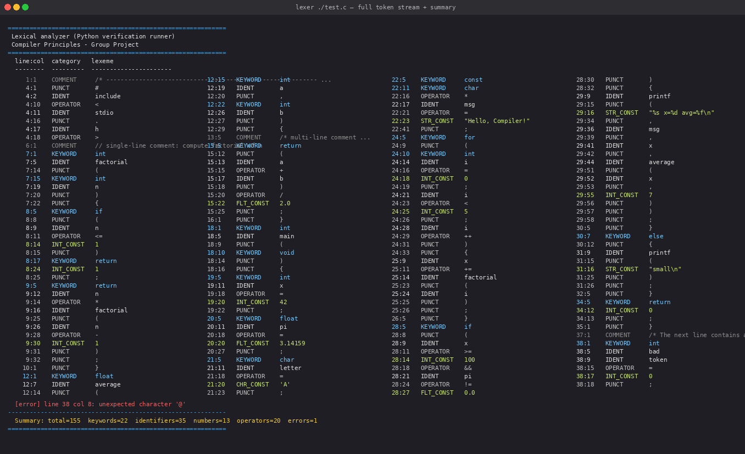
Demo — token stream (first half)
Each row prints line:column category lexeme — exactly as the Flex spec emits. Tokens flow left-to-right across columns.
Compiler Principles · Automatic Construction Tools for Lexer
7 / 10

Slide 8
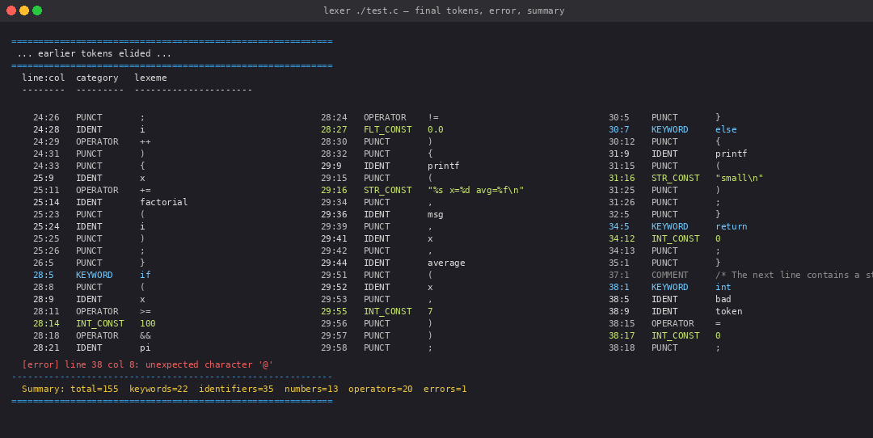
Demo — final tokens, error, and summary
The deliberate '@' is reported with line/column; the scanner recovers and tokenises the rest of the file.
Compiler Principles · Automatic Construction Tools for Lexer
8 / 10

Slide 9
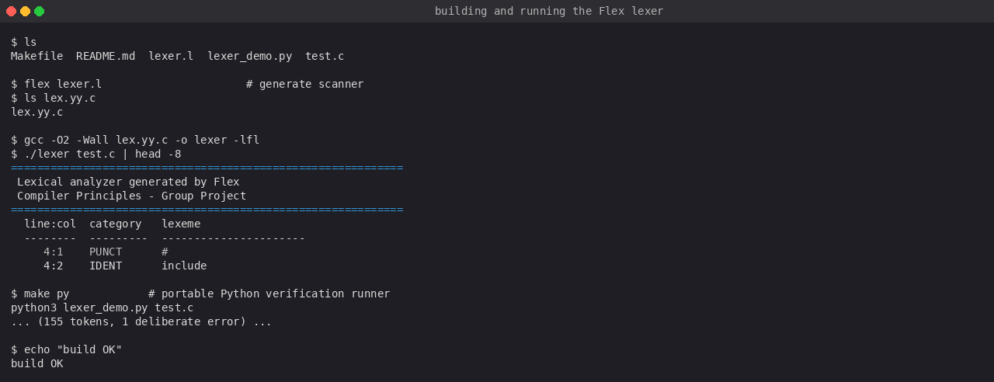
Build, run, and portable verification
How to build
flex lexer.l
gcc lex.yy.c -o lexer -lfl
./lexer test.c
# or just:
make run
Portable runner (Python)
python3 lexer_demo.py test.c
Same regex spec, identical token stream — for graders without a C toolchain.
Compiler Principles · Automatic Construction Tools for Lexer
9 / 10

Slide 10
Results & conclusion
155
22
35
13
20
tokens recognised
keywords
identifiers
numeric literals
operators
+ 1 deliberate lexical error correctly reported at line 38, column 8.
Takeaways
• Flex lets us specify the lexer at the language level (regular expressions) and trust the generator for the DFA.
• Longest-match plus rule ordering correctly disambiguates keywords vs identifiers and multi-char vs single-char operators.
• Line/column tracking and error recovery come essentially for free once the spec is correct.
• The same regex spec ported to Python (lexer_demo.py) produces an identical token stream — a useful regression check.
Thank you · Questions?
Compiler Principles · Automatic Construction Tools for Lexer
10 / 10

