Slide 1
New Relic Mastery
Azure
Notes:
This deck is a template for What The Hack lectures.
It is recommended that Coaches deliver mini-lectures ahead of each Challenge that set context for the challenge and introduce & explain any key technologies.
At a minimum, it is handy to have a slide with the key goals of each challenge to display on the screen when running the hack in-person.

Slide 2
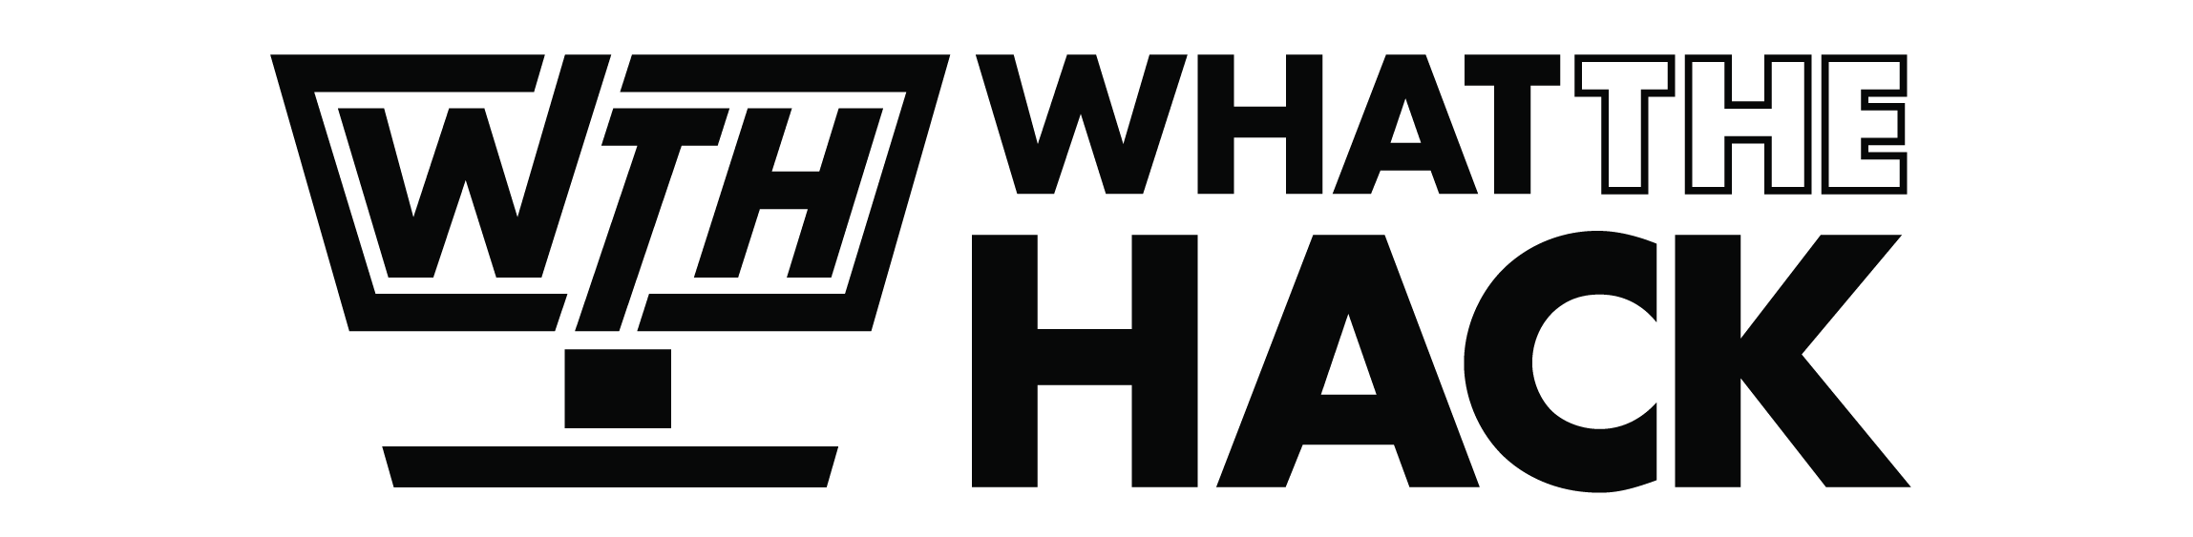
New Relic
Welcome & Intros
<Coach Name>
<Coach Name>
<Coach Title>
<Coach Title>
<Coach Name>
<Coach Name>
<Coach Title>
<Coach Title>
Notes:
Coaches/Presenters for THIS hack/lecture event should be listed on this slide.
Original contributors to the hack content & these slides include:
Please list original contributors to this hack here in the speaker notes and give them credit when delivering this content.
<Original Author 1>
<Original Author 2>
…
<Original Author N>

Slide 3
Challenge Zero
Get your machines ready!
Notes:
Modify this slide and add the pre-reqs specific to your hack here.
Each challenge slide should list the key goals for the challenge.

Slide 4
Challenge 1
Basic Instrumentation and Integration with Azure's New Relic App Service
Notes:
After deploying your initial solution for eShopOnWeb, you want to make sure that the telemetry is collected from the VMs deployed and display the results on a dashboard for visualization and alerting purposes. By default Azure Monitoring collects only host-level metrics - like CPU utilization, disk and network usage - for all virtual machines and virtual machine scale sets without any additional software. For more insight into your virtual machines, you can collect guest-level log and performance data using Azure Monitor Agent.
To accomplish this task, you will need to understand the concept of metrics and logs, how to collect them into Azure Monitor, how to configure different types of alerts, and display results in an Azure Dashboard.
Once you have configured the dashboard, alerts, and diagnostics data to be collected, you will use two tools to simulate a load on the eShopOnWeb resources:
HammerDB - A benchmarking and load testing tool for the world's most popular databases, including SQL Server.
A custom script that produces CPU load on the eShopOnWeb website.

Slide 5
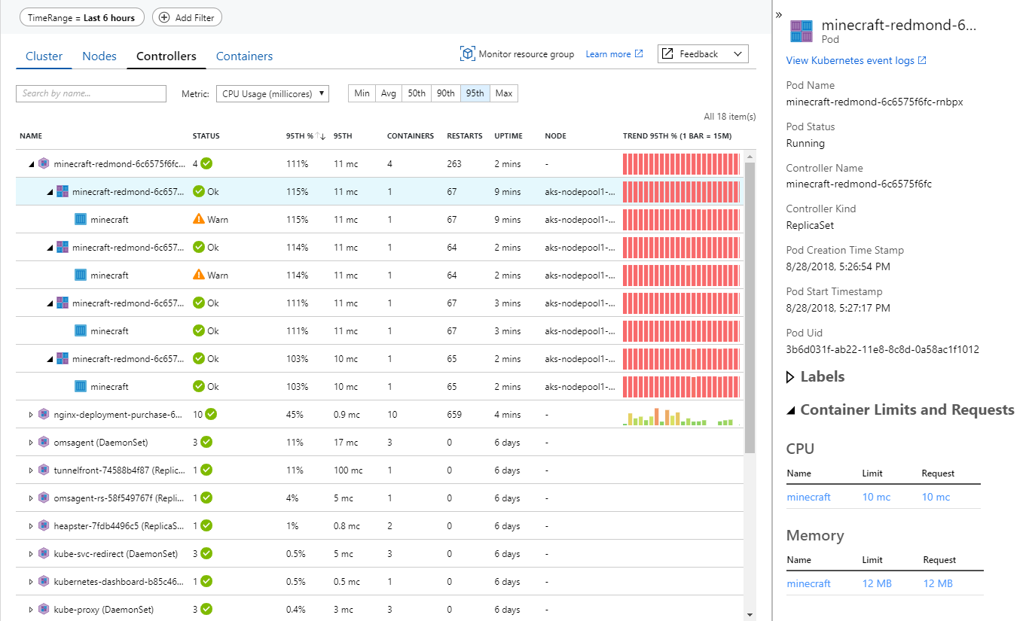
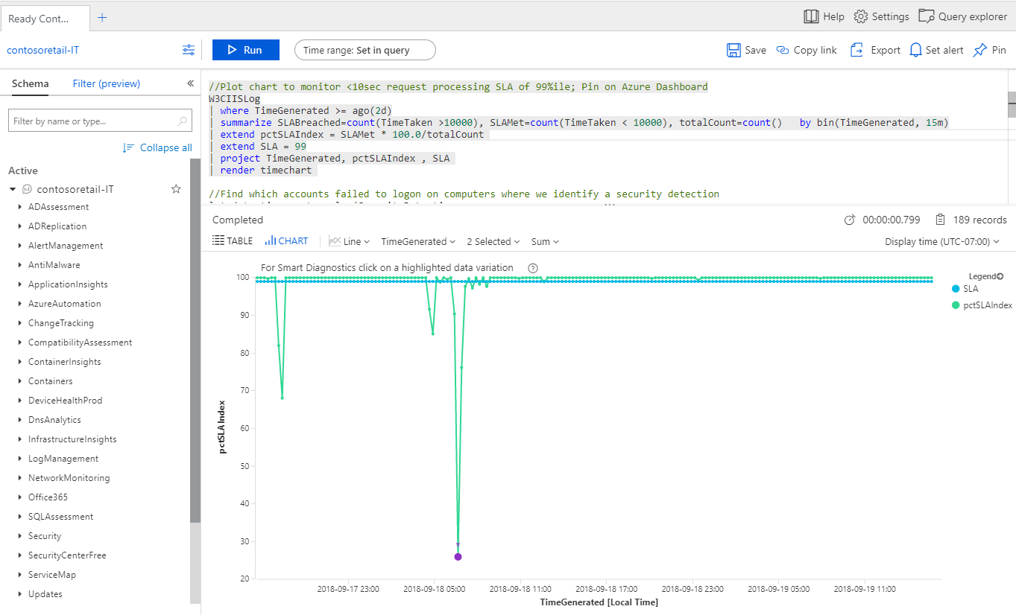
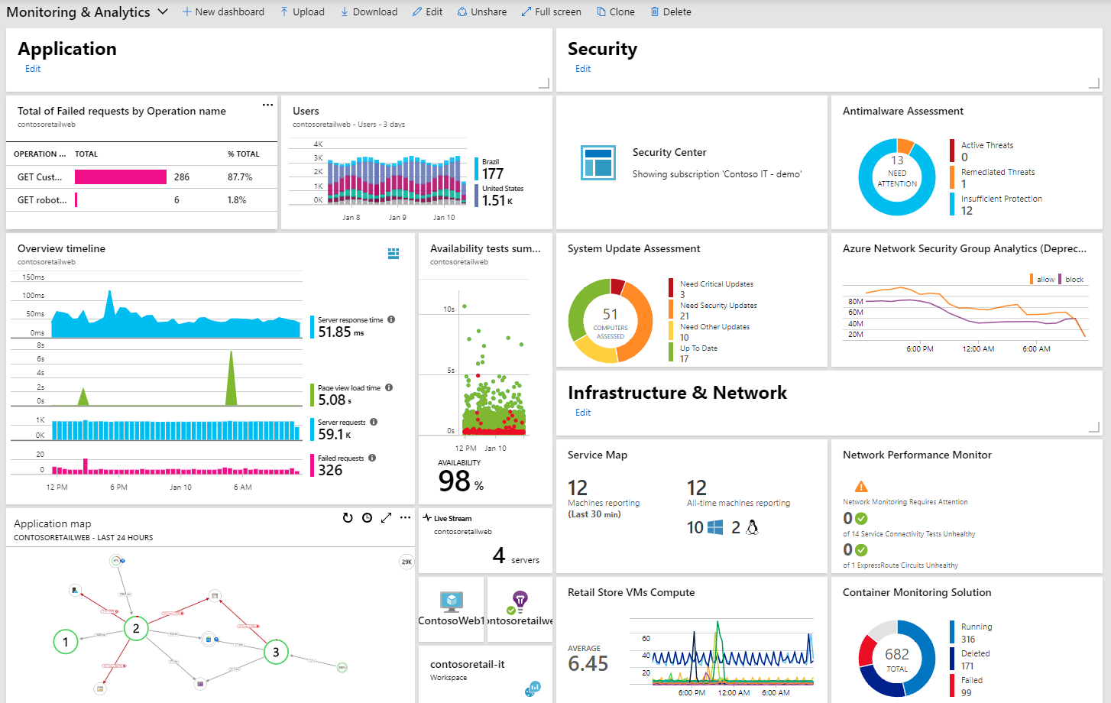
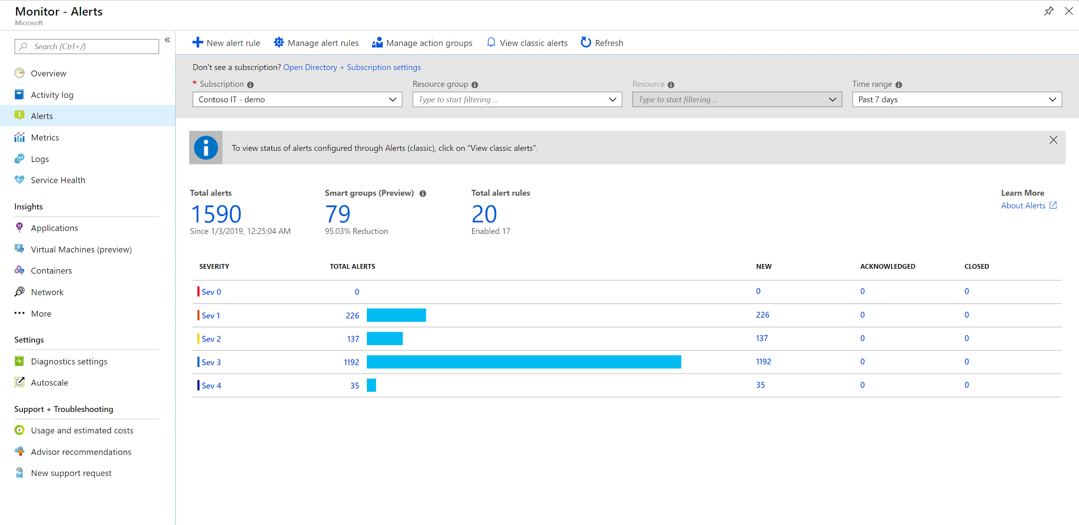
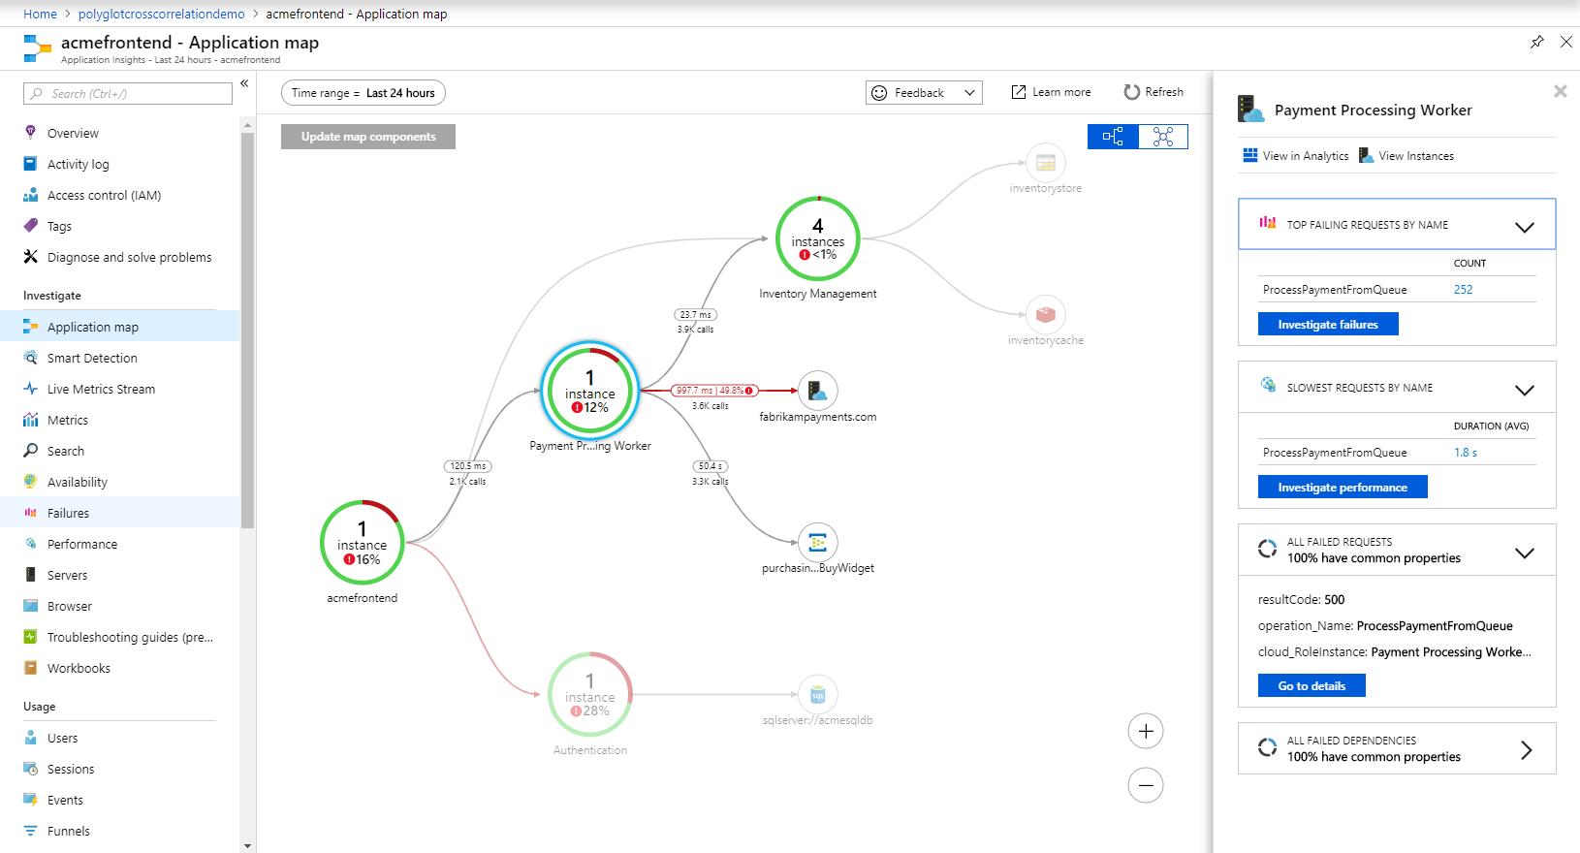
Azure Monitor
Observability Scenarios
Detect & diagnose issues across apps and dependencies with application insights
Correlate issues at infra level with insights for VMs, containers, network, etc.
Operationalize at scale with smart alerts and automated actions
Drill down with log analytics for troubleshooting & deeper diagnostics
Create visualizations with Azure dashboards, workbooks & Grafana
Notes:
Azure Monitor is a comprehensive monitoring solution for collecting, analyzing, and responding to telemetry from your cloud and on-premises environments.

Slide 6
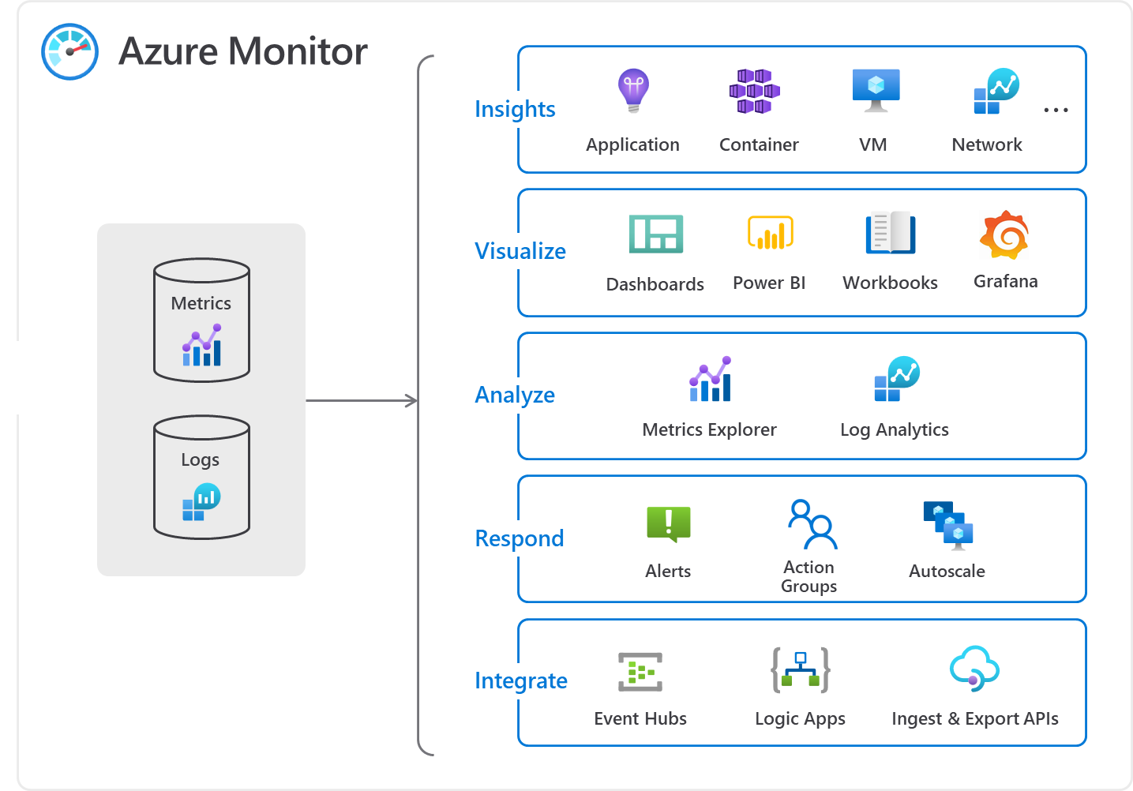
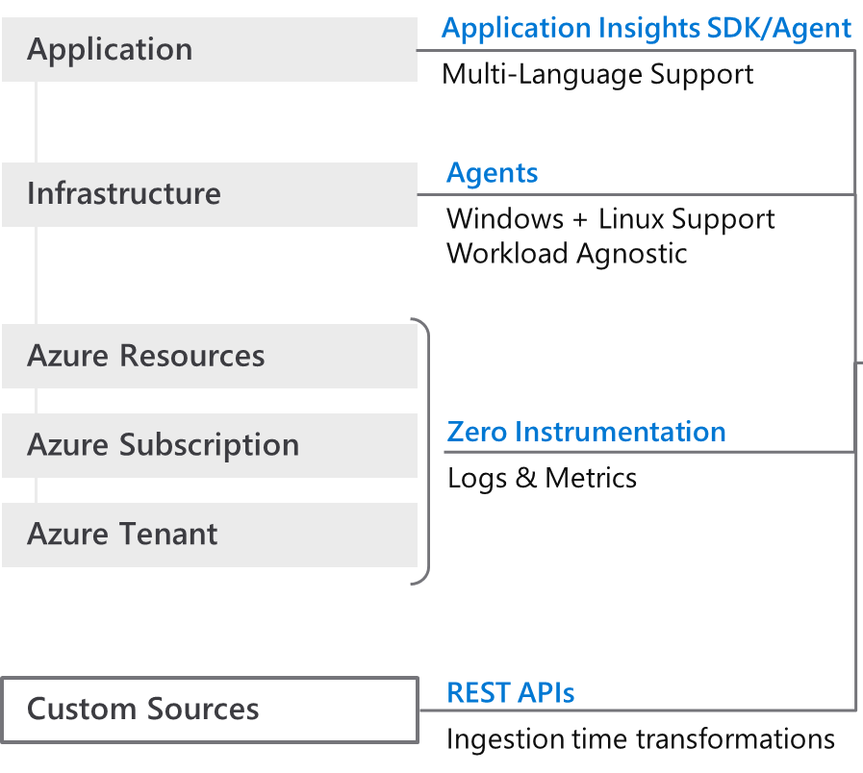

How Azure Monitor works
Notes:
So how does Azure Monitor work.
1) It all starts with collecting telemetry. Azure Monitor can collect data from Application, Network, Infrastructure and you can also ingest your own custom data. All the data is stored in centralized, fully managed logs and metrics stores. So what can you do with all the data:
Typically you start with insights which are end to end experiences we have put together for canonical scenarios or resources such as applications, containers, VMs, network, storage etc. Insights provide guidance and help troubleshoot and root cause issues quickly with a drill down experience.
You may in certain cases, just want to visualize the data. For that we provide Azure dashboards, Power BI integrations and a more native experience called Workbooks.
After visualizing the data, you may form some hypothesis and want to test them out. For that you need access to the raw data stores. For that we provide metrics explorer and a powerful big data platform called Log Analytics that is capable of querying petabytes of data within seconds.
If you want to pro-active and take corrective actions, you can create alerts and runbooks to auto remedy an issue. Or if it’s a capacity issue, you can choose to scale-in or scale-out
Finally, we know that monitoring isn’t done is silos. Azure Monitor provides out of the box integration with popular ITSM and DevOps tools. You can again use APIs, EventHub and Logic Apps to build custom integrations.
Azure Monitor Metrics and Logs
Azure Monitor Logs is a feature of Azure Monitor that collects and organizes log and performance data from monitored resources into Log Analytics workspaces. Azure Monitor Logs is one half of the data platform that supports Azure Monitor. The other is Azure Monitor Metrics, which stores lightweight numeric data in a time-series database. Azure Monitor Metrics can support near real time scenarios, so it's useful for alerting and fast detection of issues. Azure Monitor Metrics can only store numeric data in a particular structure, whereas Azure Monitor Logs can store a variety of data types that have their own structures. You can also perform complex analysis on Azure Monitor Logs data by using KQL queries, which can't be used for analysis of Azure Monitor Metrics data.

Slide 7
Agents in Azure Monitor
Required for VM guest-level telemetry collection
Azure Monitor Agent (AMA): Sends data from Azure VMs and on-prem machines to a Log Analytics workspace or Azure Monitor Metrics for use by features, insights, and other monitoring solutions and services. Azure Monitor Agent replaces all of Azure Monitor's legacy monitoring agents.
Log Analytics Agent (MMA/OMS): Legacy. To be retired 31 August 2024. Sends data from Azure VMs and on-prem machines to a Log Analytics workspace and supports monitoring solutions and services.
Diagnostics extension (WAD/LAD): Legacy. Sends data from Azure VMs to Azure Monitor Metrics (Windows only), Azure Event Hubs, and Azure Storage.
Telegraf agent: Legacy. Sends data to Azure Monitor Metrics (Linux only).
Dependency Agent: Collects data about processes running on the virtual machine and external process dependencies.
Notes:
By default Azure Monitoring collects only host-level metrics - like CPU utilization, disk and network usage - for all virtual machines and virtual machine scale sets without any additional software. For more insight into your virtual machines, you can collect guest-level log and performance data using Azure Monitor Agent.
Azure Monitor Agent (AMA) collects monitoring data from the guest operating system of Azure and hybrid virtual machines and delivers it to Azure Monitor for use by features, insights, and other services, such as Microsoft Sentinel and Microsoft Defender for Cloud. Azure Monitor Agent replaces all of Azure Monitor's legacy monitoring agents.
Azure Monitor Agent
Azure Monitor Agent collects monitoring data from the guest operating system of Azure and hybrid virtual machines and delivers it to Azure Monitor for use by features, insights, and other services. Azure Monitor Agent uses Data collection rules, where you define which data you want each agent to collect and where to send.
Note Azure Monitor Agent (AMA) replaces several legacy monitoring agents, like the Log Analytics Agent (Microsoft Monitoring Agent, MMA, OMS), Diagnostics agent and Telegraf agent. The legacy Log Analytics agent will not be supported after August 2024. For this reason, we will be using only the Azure Monitor Agent (AMA) in this Hackathon, we won't be using any of the legacy agents.

Slide 8




Azure Monitor Agent
Cost reduction
- Targeted data collection
- Data filtering, aggregation
Simplified management
- Multi homing
- Easily onboard -> deploy -> update at scale
- Transparency and control via extensibility
- Seamless management for Azure & hybrid
Security and performance
- Modern auth (MI, AAD)
- Higher EPS
- Efficient resource utilization
Single monitoring agent
- All data sources and data types
- All destinations
- All features in one
Notes:
Cost savings by using data collection rules:
Enables targeted and granular data collection for a machine or subset(s) of machines, as compared to the "all or nothing" approach of legacy agents.
Allows filtering rules and data transformations to reduce the overall data volume being uploaded, thus lowering ingestion and storage costs significantly.
Simpler management including efficient troubleshooting:
Supports data uploads to multiple destinations (multiple Log Analytics workspaces, i.e. multihoming on Windows and Linux) including cross-region and cross-tenant data collection (using Azure LightHouse).
Centralized agent configuration "in the cloud" for enterprise scale throughout the data collection lifecycle, from onboarding to deployment to updates and changes over time.
Any change in configuration is rolled out to all agents automatically, without requiring a client side deployment.
Greater transparency and control of more capabilities and services, such as Microsoft Sentinel, Defender for Cloud, and VM Insights.
Security and Performance
Enhanced security through Managed Identity and Azure Active Directory (Azure AD) tokens (for clients).
Higher event throughput that is 25% better than the legacy Log Analytics (MMA/OMS) agents.
A single agent that serves all data collection needs across supported servers and client devices. A single agent is the goal, although Azure Monitor Agent is currently converging with the Log Analytics agents.

Slide 9
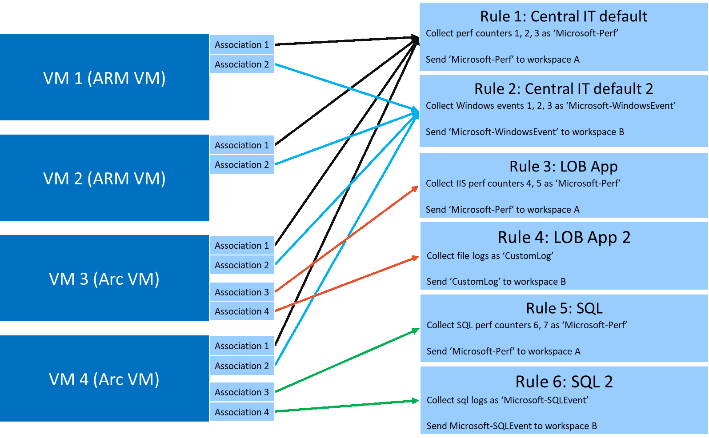
Azure Monitor Agent
Data Collection Rules
Best practices for data collection rule creation and management in Azure Monitor
Notes:
Data Collection Rules (DCRs) determine how to collect and process telemetry sent to Azure. Some data collection rules will be created and managed by Azure Monitor, while you may create others to customize data collection for your particular requirements. This article discusses some best practices that should be applied when creating your own DCRs.
When creating a DCR, there are some aspects that need to be considered such as:
The type of data that will be collected, also known as data source type (performance, events)
The target Virtual Machines to which the DCR will be associated with
The destination of collected data

Slide 10
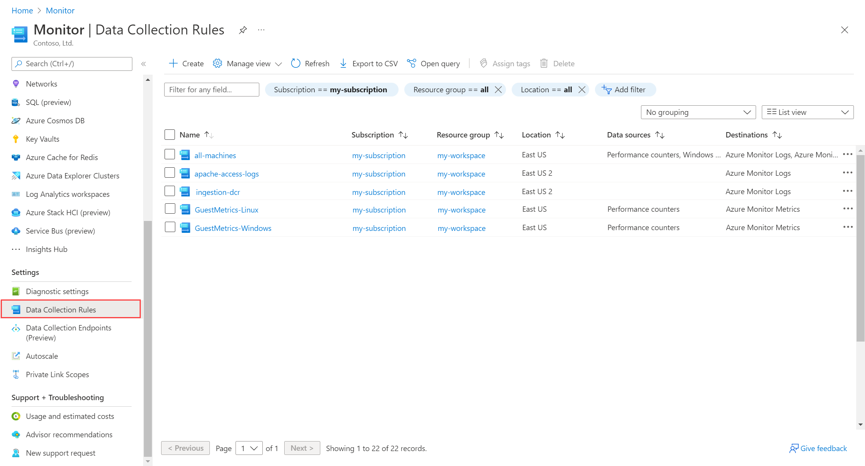
Data Collection Rules
Create via Portal
Notes:
Template for a lecture slide with bullets (if you need them).
Try to NOT use bullet lists in your presentation.
Diagrams, puppy pictures, etc are always better. ☺

Slide 11

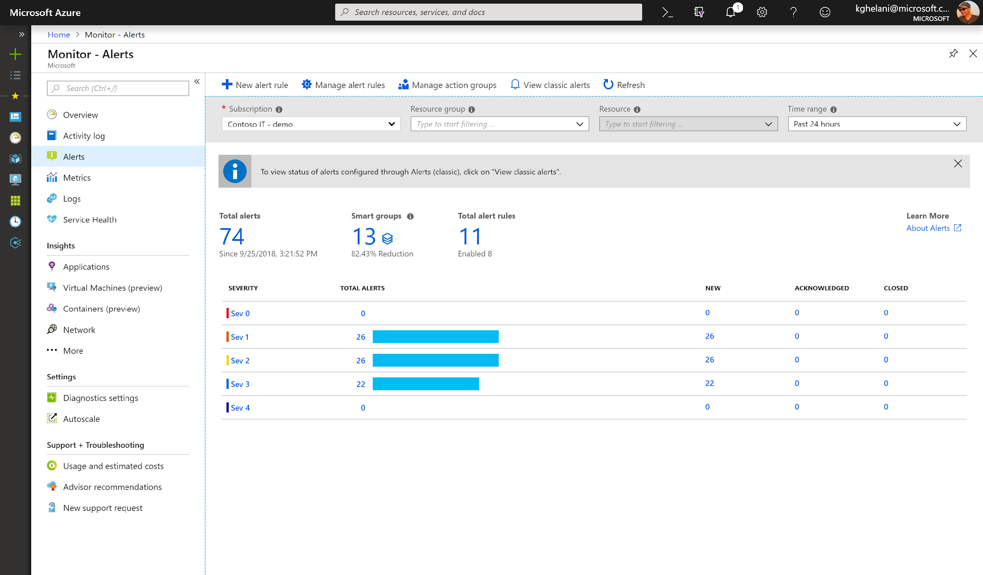
Azure Monitor Alerts
One Alert Mgmt experience
Configure Alerts at Scale Multi-resource alerting
Unified Alert lifecycle Management
Smart grouping to reduce noise
Dynamic threshold base Alerting
Notes:
You can create different types of alerts in Azure Monitor:
A Metric alert rule monitors a resource by evaluating conditions on the resource metrics at regular intervals. Metric alerts are useful when you want to be alerted about data that requires little or no manipulation.
A Log alert rule monitors a resource by using a Log Analytics query to evaluate resource logs at a set frequency. You can use KQL queries to perform advanced logic operations in the condition of the alert rule.
An Activity log alert rule monitors a resource by checking the Activity logs for a new activity log event that matches the defined conditions. For example, you might want to be notified when a production VM is deleted or a Service Health event occurs.

Slide 12
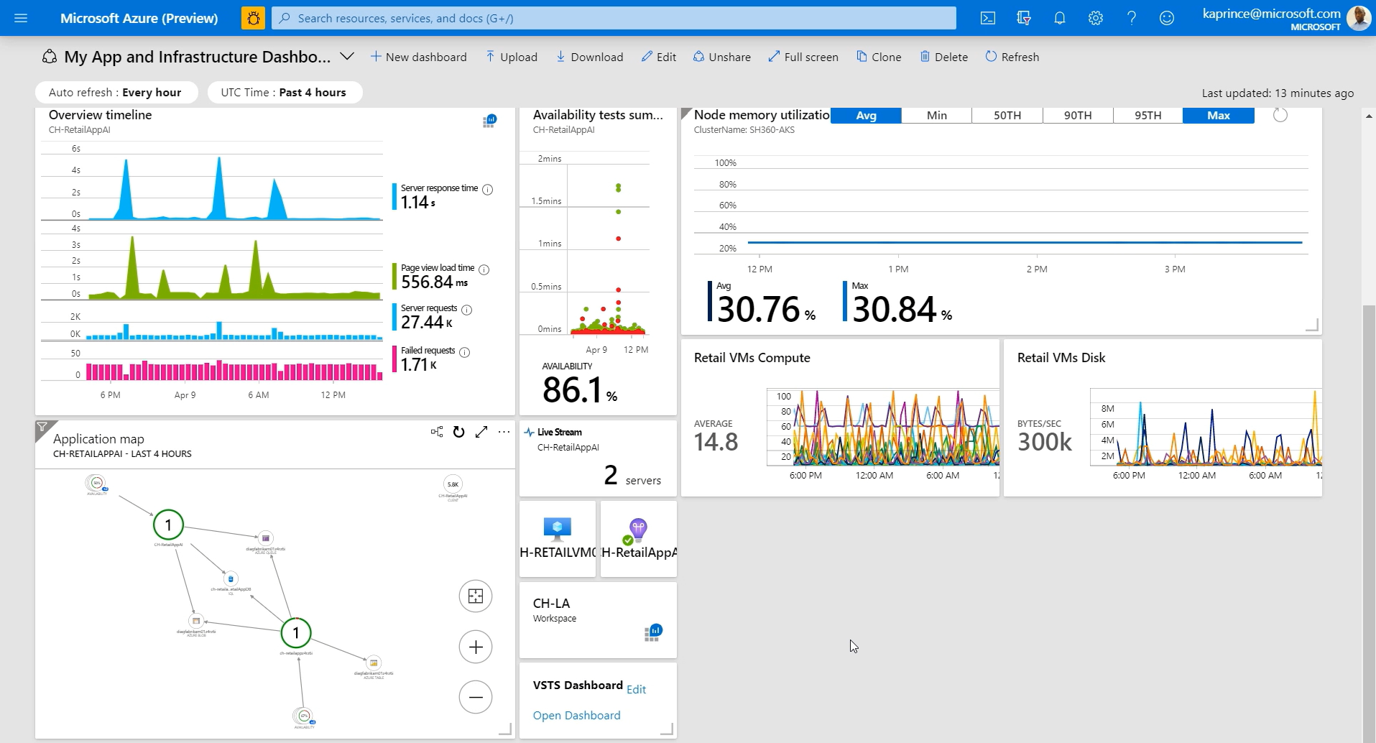
Azure Dashboards
Notes:
Azure dashboards are useful in providing a "single pane of glass" of your Azure infrastructure and services. While a workbook provides richer functionality, a dashboard can combine Azure Monitor data with data from other Azure services.

Slide 13
Challenge #1
Monitoring Basics: Metrics, Logs, Alerts and Dashboards
To accomplish this task, you will need to understand the concept of metrics and logs, how to collect them into Azure Monitor, how to configure different types of alerts, and display results in an Azure Dashboard.
Once you have configured the dashboard, alerts, and diagnostics data to be collected, you will use two tools to simulate a load on the eShopOnWeb resources:
HammerDB - A benchmarking and load testing tool for the world's most popular databases, including SQL Server.
A custom script that produces CPU load on the eShopOnWeb website.
Notes:
For each challenge, list out the key high-level goals.
If there are important specifications, list them here, or remind students to “read the student guide!”

Slide 14
Thank You for Attending!
https://aka.ms/wth
Notes:
Thank students for attending and share the link to the What The Hack website with them.

