Slide 1
What you will learn:
1
You will setup and configure a linux based hardware and software environment.
You will setup and configure a web, application and database environment.
You will gain a deep understanding of what a SQL injection attack is, how it is executed, and most importantly, how to effectively protect against it.
2
3
A SQL injection (SQLi) attack is a type of cyberattack where an attacker exploits a vulnerability in an application's software by inserting malicious SQL (Structured Query Language) code into an input field. This allows the attacker to manipulate or interact with the backend database in unauthorized ways.

Slide 2

Business Impact of a successful SQL injection Attack
“Your Company Name here”was hit by Major Data Breach," "Customer Data Exposed in Massive Attack”
“We lost everything. Trust, reputation...money everything."

Slide 3
Business Impact of a successful SQL injection Attack
1. Stolen Data
SQL injection allows hackers to access and steal sensitive customer information, like email addresses, passwords, and even credit card numbers. This not only affects your customers but could also lead to identity theft, and if they use the data for fraud, it can lead to significant financial losses.
2. Loss of Trust
When customers find out their personal information is exposed or stolen, they’re not going to want to do business with you anymore. This loss of trust can be hard to recover from, and people may avoid your website, causing a drop in sales.
3. Legal and Financial Consequences
Depending on your country or region, there are strict laws that require businesses to protect customer data (like GDPR in Europe). If you fail to do so, you might face huge fines and legal action. Additionally, you could have to pay for credit monitoring or reparations for the affected customers.
4. Damage to Reputation
If news gets out that your site was hacked, it’s not just the customers who will lose trust—it can spread fast through social media, news outlets, and forums. Your reputation could take a huge hit, and even after you fix the vulnerability, people might still remember that you were compromised.
5. Business Disruption
During the time it takes to fix the vulnerability, your site might go down or experience serious issues. This could stop sales, make it hard for customers to access their accounts, and halt any other business operations. All this downtime means lost revenue.
6. Higher Security Costs
After an SQL injection attack, you'll need to invest a lot of time and money into strengthening your website’s security. This includes hiring security experts, upgrading systems, implementing new technologies, and possibly conducting regular audits—all of which add to your operational costs.
7. Lost Competitive Advantage
While you're dealing with the fallout from a hack, your competitors might continue operating smoothly. Customers could leave you for them, and if you lose enough trust, you may fall behind, not just in sales but in brand reputation and market share.

Slide 4
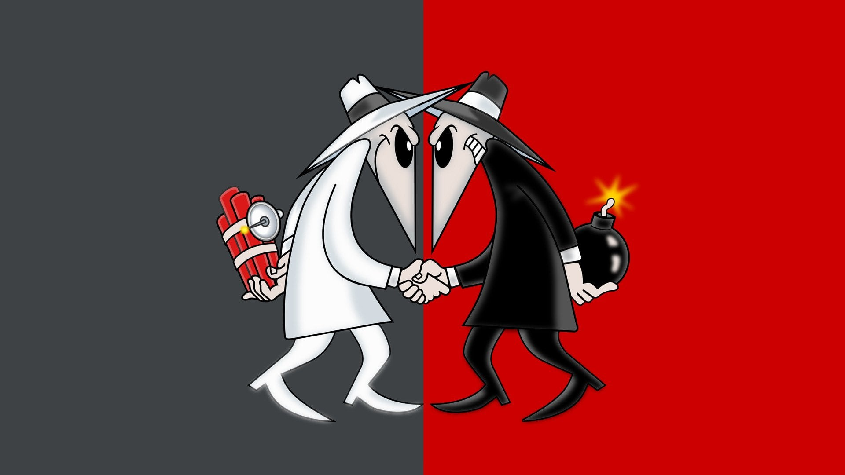
Ethical and Moral questions around Cybersecurity
Ethics A code of behavior that is defined by the group to which an individual belongs
Morals The personal principles upon which an individual bases his or her decisions about what is right and wrong
Ethical hacking is the practice of deliberately testing and probing computer systems, networks, or applications for vulnerabilities with the goal of identifying and fixing security weaknesses, rather than exploiting them for malicious purposes. Ethical hackers, also known as "white hat" hackers, use the same techniques as malicious hackers but do so with the permission of the system owner to improve security.
Unethical hacking is when someone hacks into a computer system, network, or website without permission and for malicious reasons, like stealing information, causing damage, or disrupting services. Unlike ethical hacking, which is done to find and fix security weaknesses with consent, unethical hacking (often called "black hat hacking") is illegal and harmful.

Slide 5
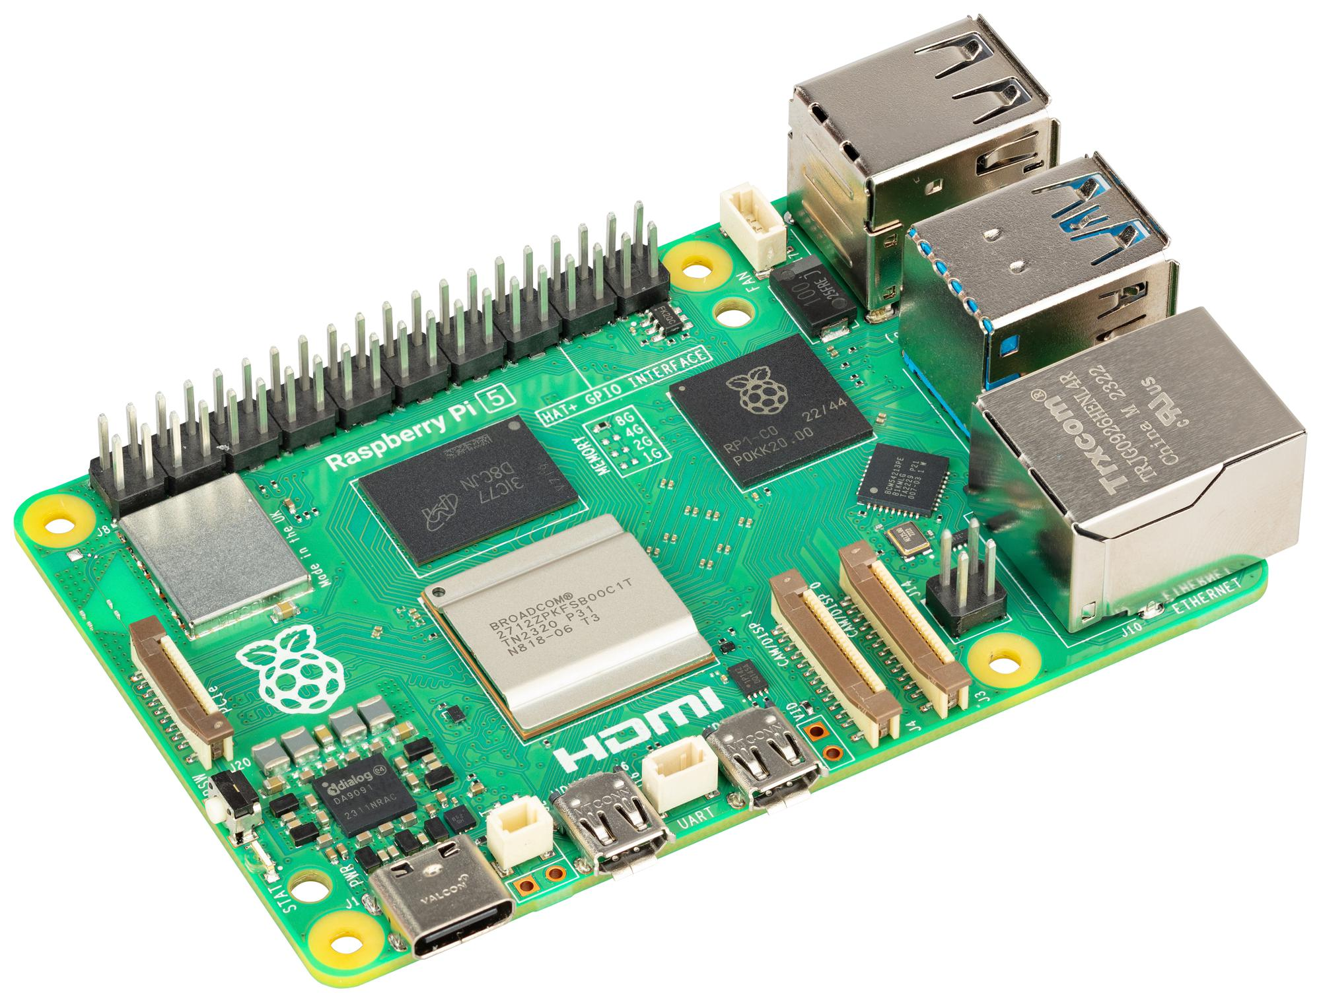

1
Setup and configure the linux based lab environment running on a Raspberry PI
https://www.raspberrypi.com/products/raspberry-pi-5/
Why Raspberry PI? Full computing environment. It’s cheap and if you break it, It’s not my fault.

Slide 6
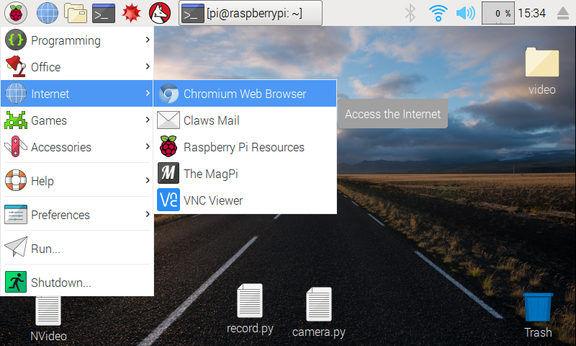
How to setup a Raspberry PI for Noobs
https://www.youtube.com/watch?v=jRKgEXiMtns

Slide 7
Go to https://github.com/bakerjohn/forum/tree/master
Follow the instruction within the Website.readme.txt
website readme.txt

Slide 8
References
https://www.udacity.com/
https://bobby-tables.com/
https://www.raspberrypi.com/products/raspberry-pi-5/
https://www.youtube.com/watch?v=jRKgEXiMtns
https://github.com/bakerjohn/forum/tree/master

