Slide 1
Auto Chasing Turtle
Hirotaka Niisato
Noritsuna Imamura

Slide 2
Agenda
Summary
Part “Hardware”
Need more power supply
Nothing display
Need more more power supply
Part “Software”
Not Bitmap
Calculate the course
Calculate the distance

Slide 3
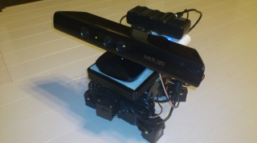
Summary
This product is "Auto Chasing Turtle".
By autonomous control, this robot recognizes people's face and approaches to the detected human.
Rotate and look for the human who becomes a target.
Detect the human with recognizing people's face by using RGB camera of Kinect.
If it can detect the human, it calculates the course which it should follow. And It direction is changed.
Calculate the distance to target by using Z(depth) camera of Kinect.
Walk toward to target.
2-5 are repeated until it becomes a suitable distance. And if losts target, returns to 1.
The scene that it is working in real time can be seen by iPad.

Slide 4
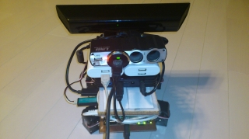
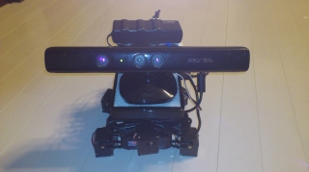





Movie
YouTube
http://www.youtube.com/watch?v=8EgfAk5RBVo
Source Code & detail explanation
http://www.siprop.org/ja/2.0/index.php?product%2FAutoChasingTurtle

Slide 5
complete set parts
Robot
KONDO Animal 01
http://fswg.oesf.biz/
Controllers
For servo
RCB3
For application
Beagleboard-xM
Linaro-Kernel
Android(Embedded Master)
Sensors
RGB camera
Z(Depth) camera
Kinect
Connect to outside
Radio wave
Wi-Fi router
Viewer
iPad
Power supply
12V1A output
10V1A output
5V3A output

Slide 6
OpenFrameworks x Kinect x Android
=
ofxDroidKinect

Slide 7
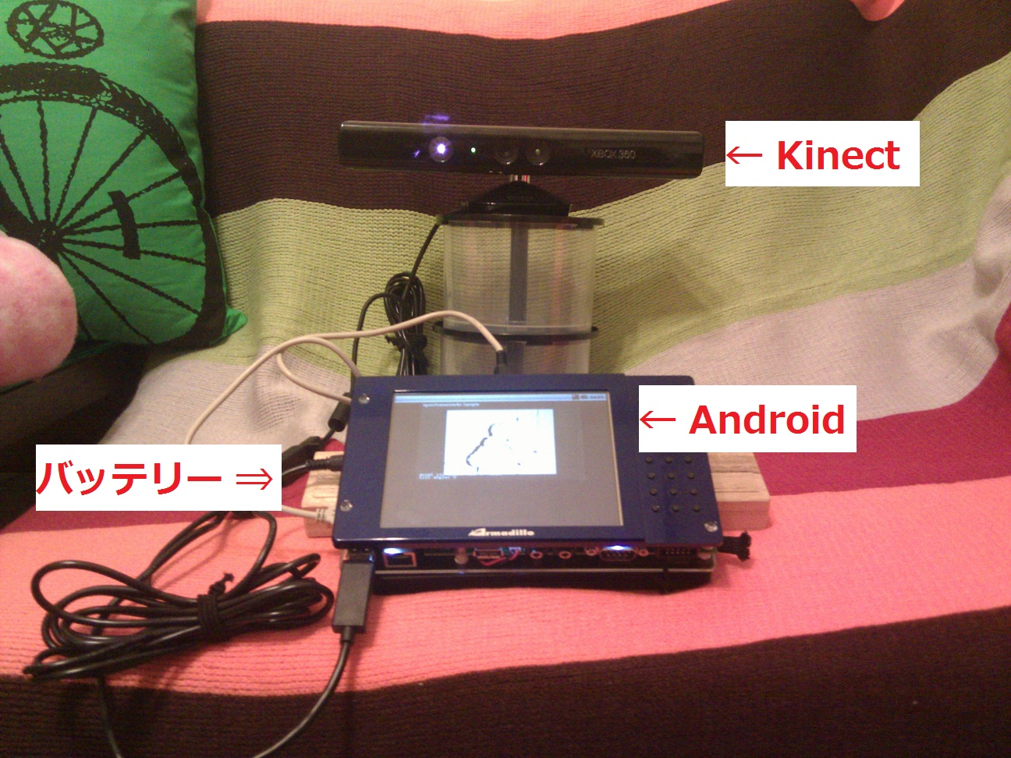
About ofxDroidKinect

Slide 8
About ofxDroidKinect
This is the Android Application Framework which runs on openFrameworks & uses Kinect.
Download
http://www.noritsuna.com/archives/2011/01/openframeworks_kinect_android.html
Using softwares
openFrameworks for Android
It’s the gaming framework. You can make game easier.
http://openframeworks.cc/
Android
Linaro Android
http://git.linaro.org/gitweb?p=people/jstultz/linux.git;a=summary

Slide 9
Part “Hardware”

Slide 10
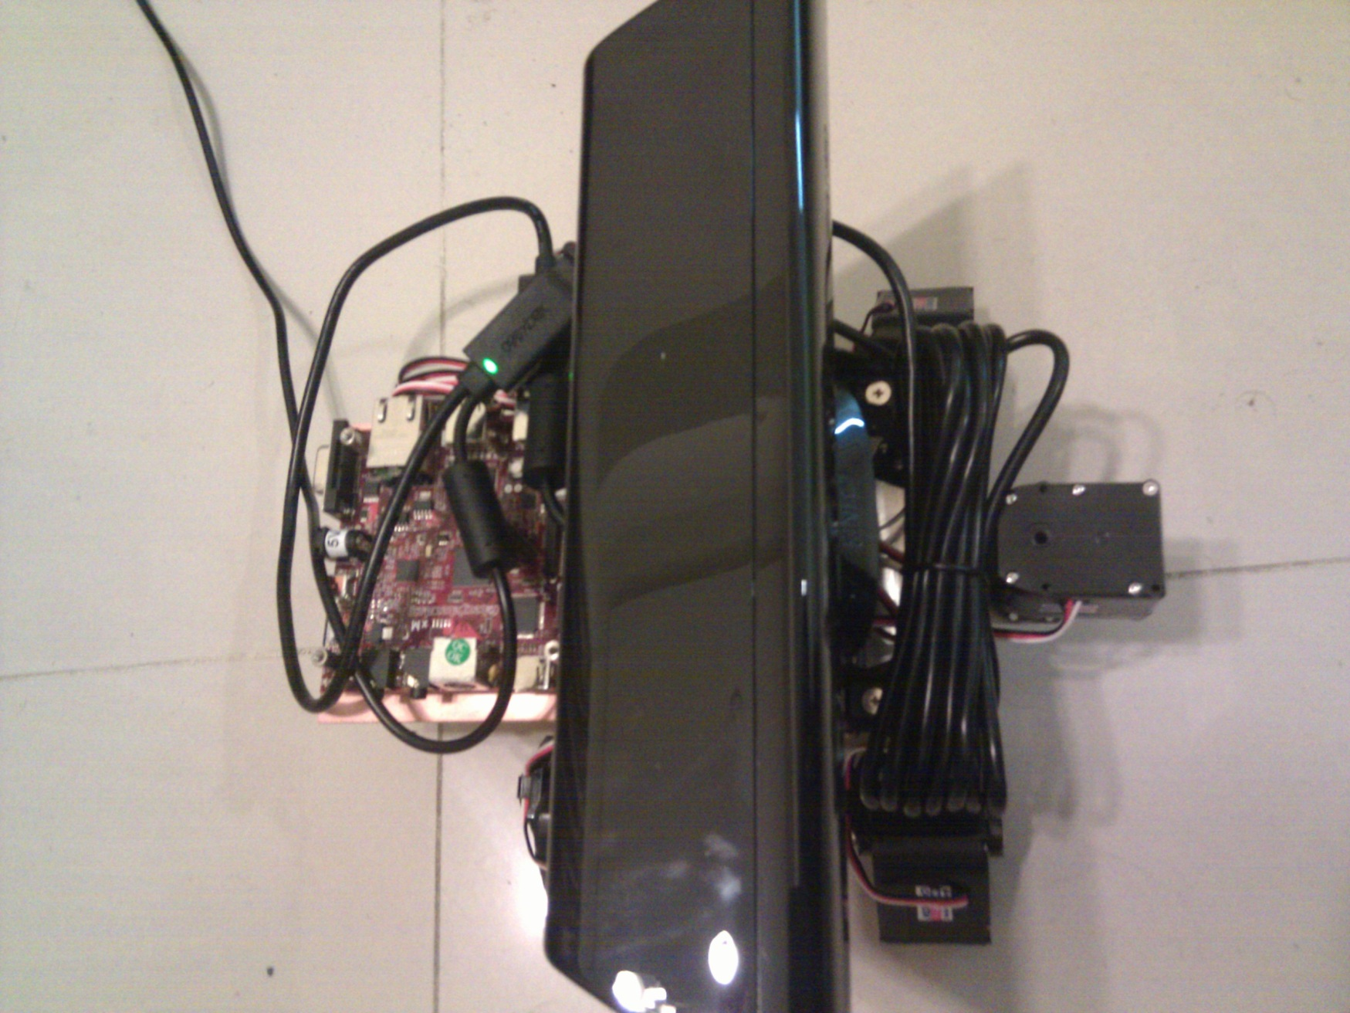
Need more power supply

Slide 11

Need more power supply
Don’t run beagleboard-xM by 5V/1A power supply.
It needs 5V/2A.
Standard USB battery has 5V/1A.
Create power supply by myself
My battery has 12V/2A.
My plan is to create convertor of 12V/2A ⇒ 5V/2A.
Can’t get power IC…
Using car’s cigarette adapter which convert to USB.
12V・24V/2A ⇒ 5V/2A

Slide 12
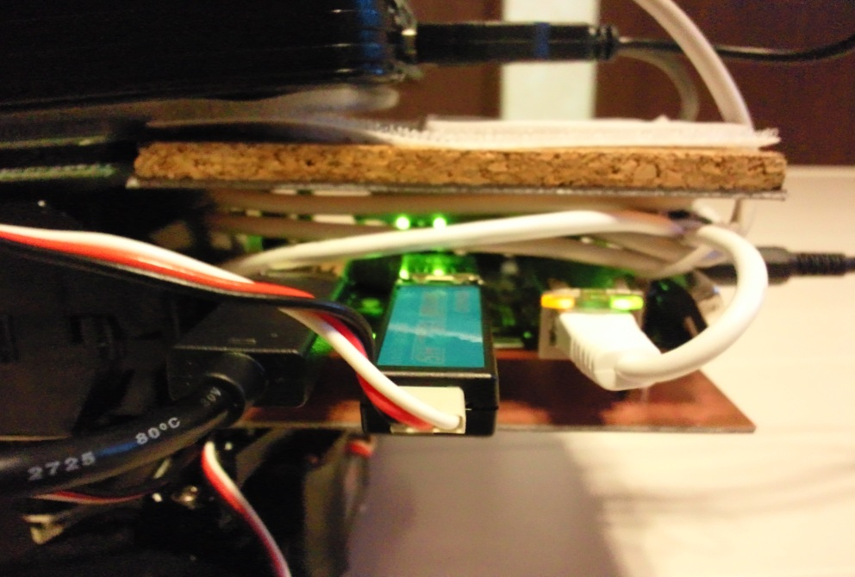
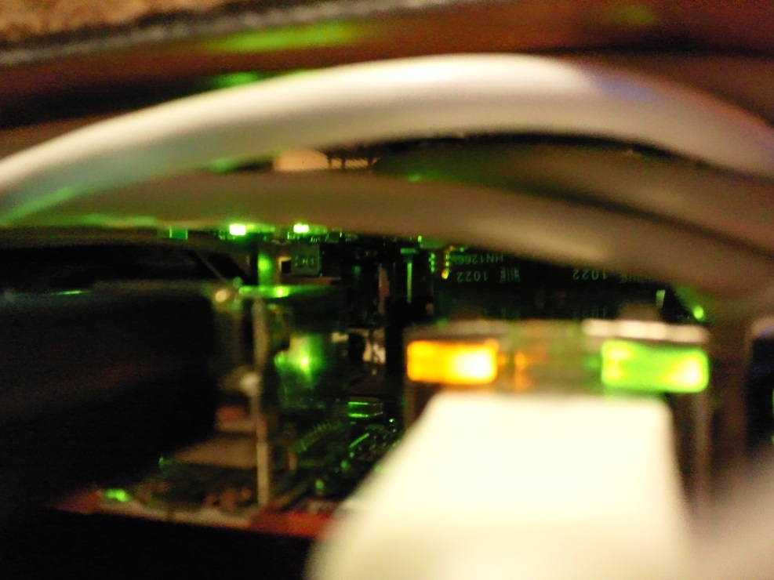
Nothing display
Can’t view camera’s image
Using VNC viewer
It needs Wi-Fi router.
We attached Wi-Fi router on beagleboard-xM.

Slide 13

Need more more power supply
Can’t get IP address from Wi-Fi router
Wi-Fi router needs more “Power supply”.
Wi-Fi router: 1A + beagleboard-xM: 2A = Total: 3A

Slide 14
Part “Software”

Slide 15
Not Bitmap
Standard RGB camera(BITMAP) format
32bit(int)
8bit(A), 8bit(R), 8bit(G), 8bit(B)
Kinect’s RGB camera format by libfreenect
3 int
32bit(R), 32bit(G), 32bit(B)
32bit(int)
8bit
8bit
8bit
8bit
A
R
G
B
32bit(int)
32bit(int)
32bit(int)
R
G
B

Slide 16
Not Bitmap
However ・・・・・・ can’t detect Face.
Must convert format BMP to JPEG…
Bitmap bitmap = Bitmap.createBitmap(w, h, Bitmap.Config.ARGB_8888);
byte[] pixels = OFAndroid.getImgPixels();
if (pixels != null) {
for (int i=0;i<w;i++) {
for (int j=0;j<h;j++){
int index = (j * w + i) * 3;
bitmap.setPixel(i, j,
Color.rgb(pixels[index++],
pixels[index++],
pixels[index]));
}
}
FileOutputStream fos = new FileOutputStream("/screenshot.jpg");
bitmap.compress(Bitmap.CompressFormat.JPEG, 100, fos);
fos.flush(); fos.close();

Slide 17
Calculate the course
Calculate the course which it should follow.
It direction is changed.
FaceDetector detector = new FaceDetector(w, h, faces.length);
int numFaces = detector.findFaces(bitmap, faces);
if (pointX > 0 && pointX < w/4) {
DroidBot.getInstance().turnRight2(); // right position
} else if (pointX >= w/4 && pointX <= 3*w/4) {
; // center position
} else if (pointX > 3*w/4 && pointX <= w) {
DroidBot.getInstance().turnLeft2(); // left position
}

Slide 18

Calculate the course

Slide 19

Calculate the course
Using height.
Change Kinect’s angle.
int angle = 30 - pointY*30/h;
if (angle > 0 && angle <= 30)
OFAndroid.setAngle(angle);

Slide 20
Calculate the distance
Calculate the distance to target by using Z(depth) camera of Kinect.
Range 0~65565
int dist = OFAndroid.getDistance(pointX, pointY);
if (dist < 100) DroidBot.getInstance().walkBack4();
else if (dist >= 100 && dist < 150) DroidBot.getInstance().walkToward4();
else if (dist >= 150 && dist < 200) DroidBot.getInstance().walkToward8();
else if (dist >= 200 && dist < 300) DroidBot.getInstance().walkToward16();
else if (dist >= 300) DroidBot.getInstance().walkToward32();

Slide 21
MAKE:style
Hardware
beagleboard-xM
KONDO Animal
Kinect
Software
ofxDroidKinect
Linaro Kernel
Android(Embedded Master)
Do It Yourself ⇒Do It With Others!

